Slide 1

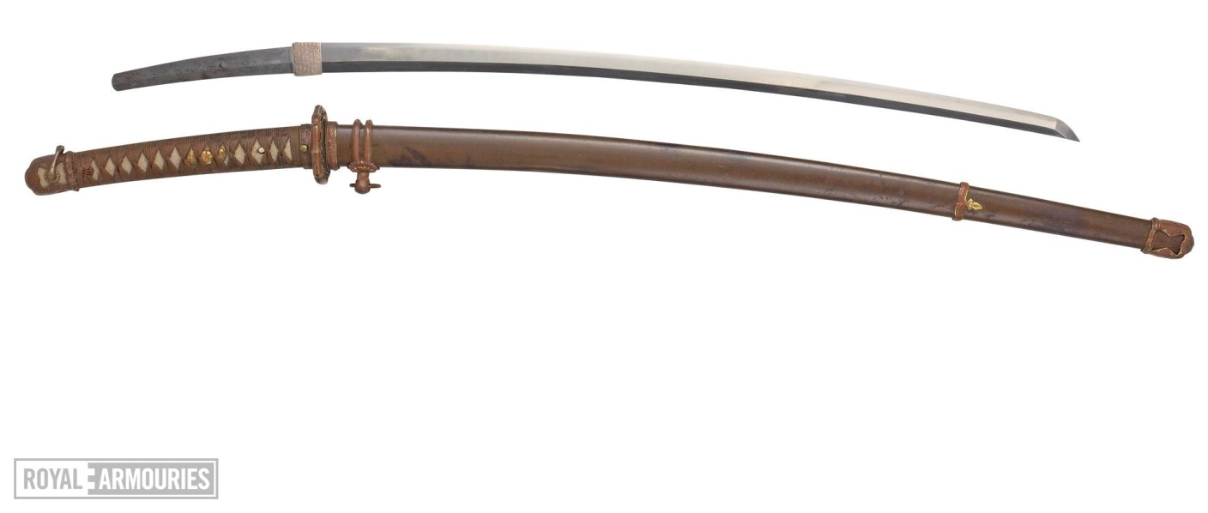
Warm Up
How could this object have affected the design of Japanese buildings?
Hint: Think about the materials!
Notes:
Teacher’s Notes
Display this on the screen/board as students enter the classroom so that they can begin straight away, leaving space for the date and title if they are writing their answer in their books. Click for a hint to appear.
This is a Katana (sword). Japanese, 14th century, with 20th century military mounts.
For more information see: https://collections.royalarmouries.org/object/rac-object-51201.html

Slide 2
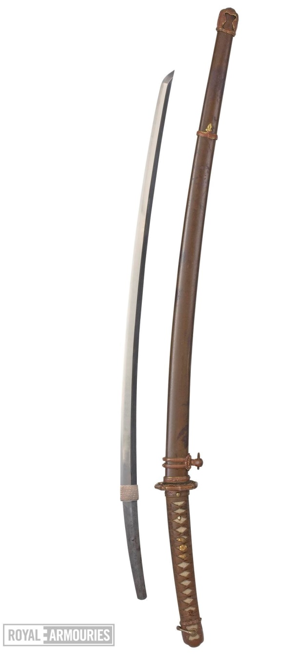
Warm Up
Katana swords contain iron which is a scarce material in Japan. Iron was especially in demand during times of war as it was needed to make weapons.
Iron also rusts quickly in Japan’s humid climate. Carpenters were able to come up with ways to build without using iron.
Notes:
Teacher’s Notes
This is a Katana (sword). Japanese, 14th century, with 20th century military mounts.

Slide 3

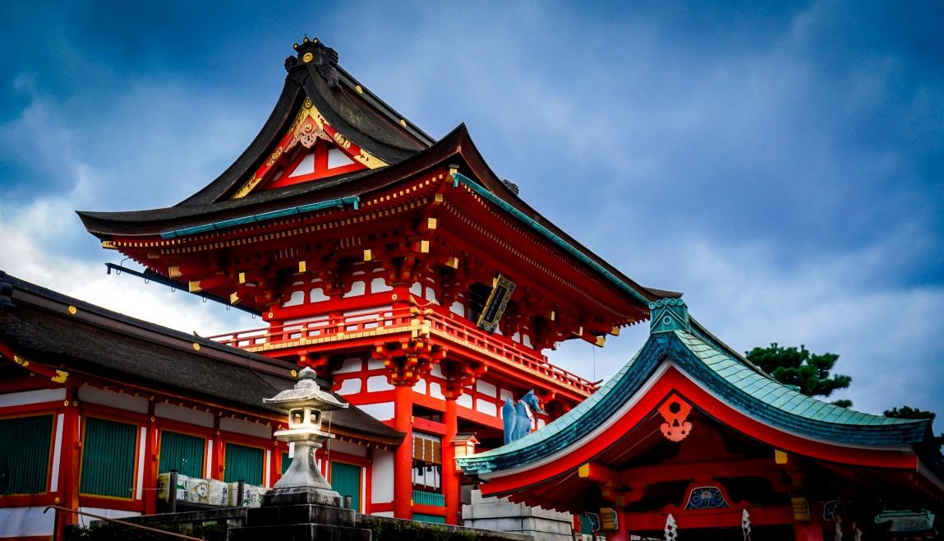
Japanese Buildings
Your Learning Objectives:
Identify building materials and design aspects suitable for earthquake prone areas.
Explain some aspects of earthquake proof design.
Evaluate the effectiveness of an earthquake proof building design.
Notes:
Teacher’s Note
Image shows part of Kiyomizu-dera, a temple in Kyoto.

Slide 4
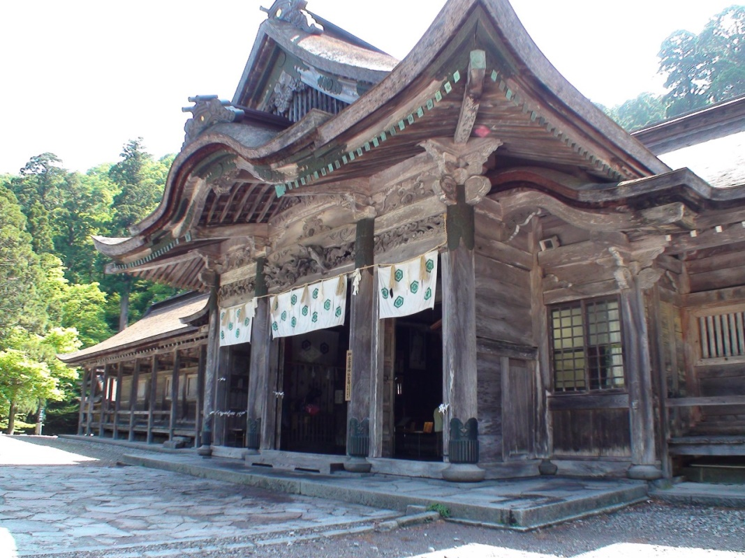
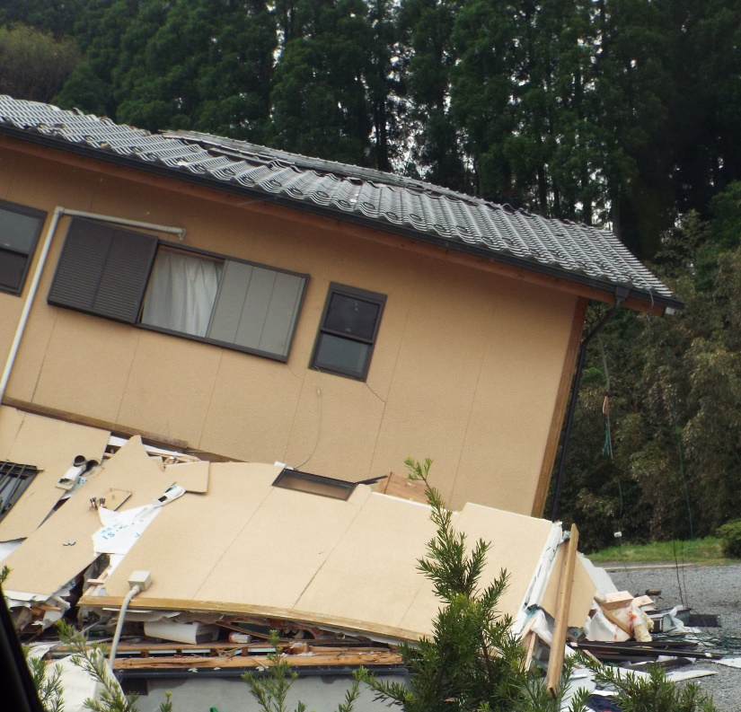
Starter
Ogamiyama Shrine
Modern building
©Tottori Prefecture/©JNTO
Over 1200 years old
So what went wrong here?
Notes:
Teacher’s Note
Students can write down their ideas or share in a discussion.

Slide 5
Starter
Ogamiyama Shrine
Traditional wooden temples are built using a technique called “sashimono”, where screws and nails are replaced with intricate joints with precise grooves called ‘hozo’ cut into them so that they fit together perfectly.
The type of carpenter who work on temples are called ‘miyadaiku’.
©Tottori Prefecture/©JNTO
Over 1200 years old
Notes:
Teacher’s Notes
Show students the following video for an interview with a miyadaiku and examples of wooden joints and construction without nails.
If short on time, a clip of the first thirty seconds will give students an idea.
https://www.youtube.com/watch?v=O-u4T13guko (‘3:32)

Slide 6
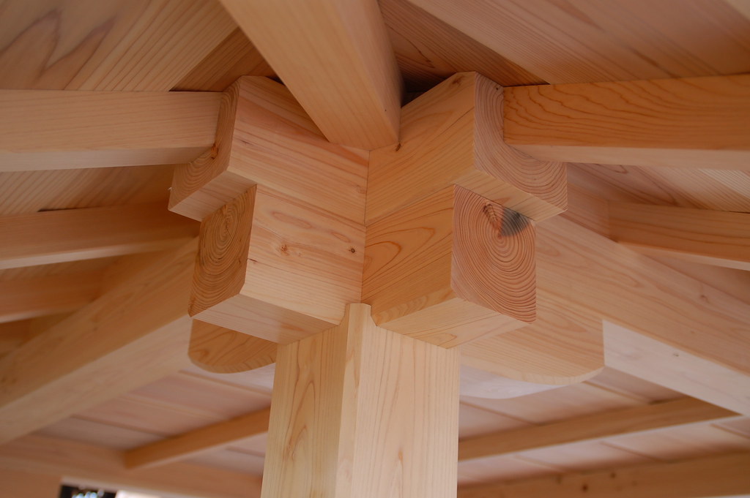
Starter
Here is an example of roof joinery.
Can you see how everything fits together without nails?

Slide 7
Materials and Design
 |  | Advantages | Disadvantages
Materials | Wood | Flexible, sections can be replaced, easy to get (forests). | Can rot and be weakened by woodworm
 | Concrete | Strong, can make any shape easily | Not flexible, can’t bend or twist. Needs to be reinforced with iron.
 | Metal | Flexible, strong | Hard to get, Japan doesn’t have much naturally. Has to be imported so expensive.
Design | Square/ rectangle | Easy to build, doesn’t require a lot of materials | Weak, corner joints collapse easily.
 | Triangle | Easy to build, existing square structures can be strengthened using cross bracing which creates triangles. | Cross bracing requires iron, so can be expensive and requires more materials than squares or circles.
 | Circle/ curve | Very strong, doesn’t require a lot of materials. | Difficult to build.
Notes:
Teacher’s Note
This can be printed to support students with their tasks if needed.
Students are to use this information to help them to fill in task 1 on their worksheet, where they begin making choices for their own earthquake proof buildings.

Slide 8
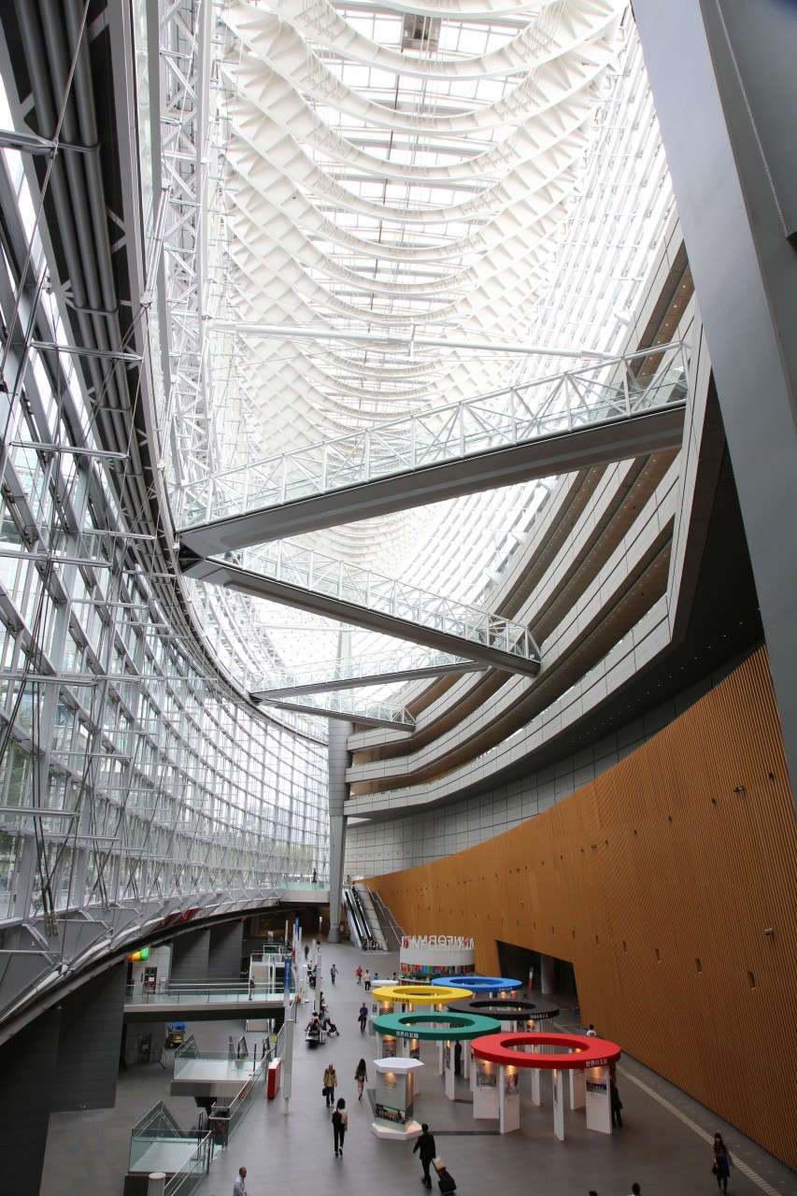
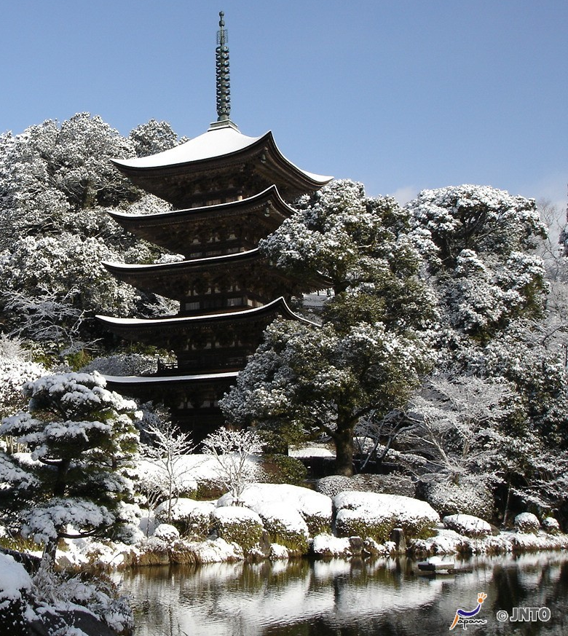
Materials and Design
Tokyo International Forum
Curves and triangles
Rurikoji Temple
Built around a central column
to increase flexibility
©Yasufumi Nishi/©JNTO
Notes:
Teacher’s Notes
This can be printed to support students with their tasks if needed.
Students are to use this information to help them to fill in task 1 on their worksheet, where they begin making choices for their own earthquake proof buildings.

Slide 9
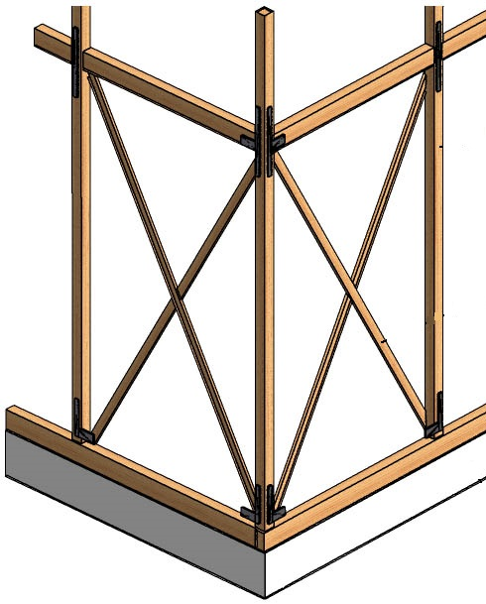
Cross bracing
Cross bracing is usual in earthquake proof structures.
Two diagonal supports placed in an X-shape reinforce the structure.
Cross bracing can be applied to any structure with a rectangular frame - you might see chairs with cross bracing.

Slide 10
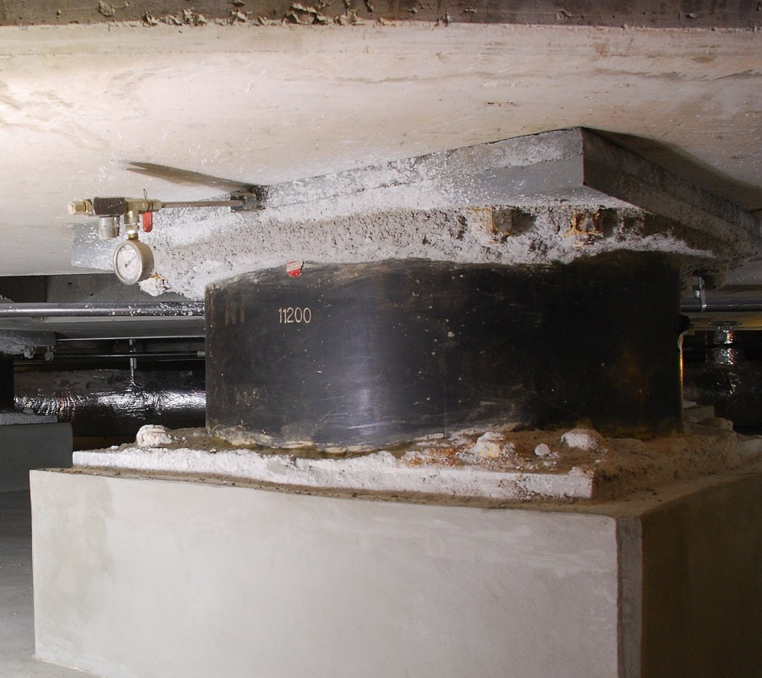
Shock absorbers
Buildings that directly touch the ground will move with the earthquake.
A process called base isolation separates the building from the ground to reduce movement and damage.
The building sits on flexible shock absorbers, for example springs or thick blocks of rubber, so it won’t move as much.

Slide 11
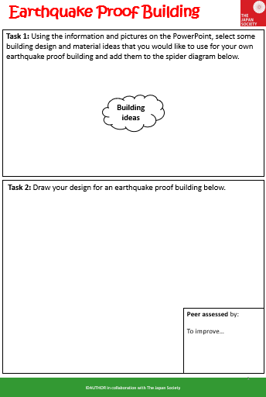
Task 1: Building Design
Task: Use the information and pictures you have seen this lesson to complete task 1 on your worksheet.
On the mind map, write down any design ideas and materials that you think would be good to include in your own earthquake proof building design.
Challenge task: Include notes on the advantages of the ideas you have written down.

Slide 12
Task 2: Design a Building
Task: Design your building!
Produce a clear sketch or diagram to show your own design for an earthquake proof building suitable for Japan. Label it to show the choices you made.
Challenge task: Develop the labels into annotations by explaining your choices.
Notes:
Teacher’s Notes
Alternatively you could do a practical version of this activity. Ask students to use playdoh or marshmallows and pasta to create models of their buildings instead of drawing their designs.

Slide 13
Task 3: Critique
Trainee architects often critique each other’s work as part of their training, so that’s what we’re going to do too!
Swap your work with a partner. Look at their design and consider the following points:
Have they used strong shapes?
Have they used strong materials?
Are the materials flexible?
Give your partner verbal feedback about what they did well and give them one written way to improve their design.

Slide 14
Plenary: Key Terms
Make as many key terms as you can using the letters and letter pairs below.
ur
so
m
b
i
You can use them more than once.
You can find key terms to do with any of our lessons about Japan.
up
no
e
c
su
er
n
t
vo
es
l
h
a
on
re
m
Notes:
Teacher’s Notes
Words that can definitely be made: eruption, resources, climate, habitat, volcano, tsunami.

Slide 15




This resource was authored by Katie Holmberg in collaboration with the Japan Society
The Japan Society
13/14 Cornwall Terrace, London NW1 4QP
Tel: 020 7935 0475
Email: education@japansociety.org.uk
www.japansociety.org.uk
Follow us on:
@japansocietylon
@JapanSocietyLondon

