Slide 1


Warm Up
Manga is the name for comic books and are printed rather than animated. Anime is the name for animated cartoons. Manga are often adapted into anime when they are made into TV series.
How many different
anime and manga
do you know?
Notes:
Teacher’s Note
Display this on the screen/board as students enter the classroom so that they can begin straight away, leaving space for the date and title if they are writing their answer in their books.
Students can discuss or write lists in their books. They may refer to examples including: Studio Ghibli (Spirited Away, My Neighbour Totoro, etc), Attack on Titan, Pokémon, Dragon Ball (manga) and Dragon Ball Z (the anime adaptation), Avatar: the last airbender, Ghost in the Shell.

Slide 2

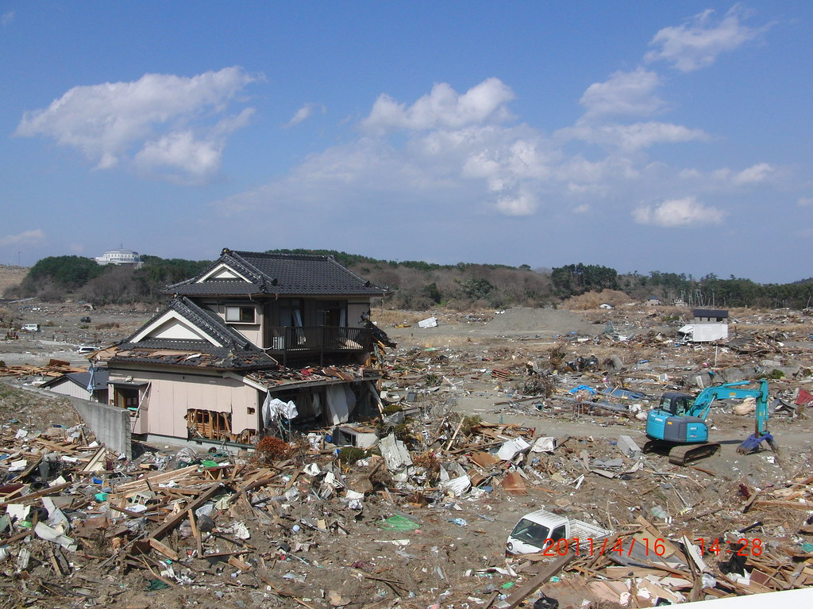
The Tohoku
Earthquake and Tsunami
Your Learning Objectives:
Outline how an earthquake can cause a tsunami.
Illustrate the sequence of events of the Eastern Japan Great Earthquake Disaster.
Describe the effects of the tsunami on the Tohoku region.
Notes:
Teacher’s Notes
Officially disaster is called the Eastern Japan Great Earthquake Disaster, but it is referred to by different names in English.
Students will be focus on the impact of the tsunami in particular, but should be made aware by the end of the lessons that the 2011 disaster in the Tohoku region was a result of the combined impact of the earthquake, tsunami and nuclear disaster.

Slide 3
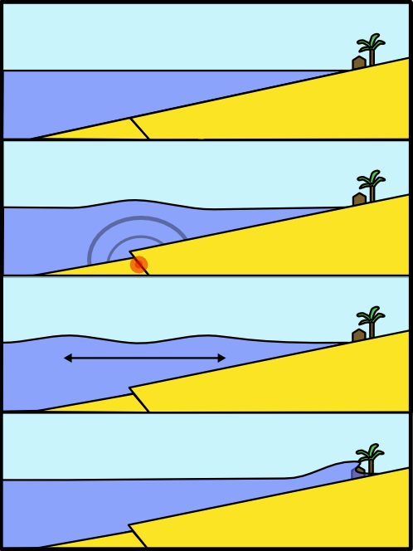
Starter: Tsunami Formation
Task: Use the key terms in the box below to complete the explanation of how tsunamis are formed.
earthquake
When an _ _ _ _ _ _ _ _ _ _ happens under water, the _ _ _ _ _ _ move
_ _ _ _ _ _ _ _. This pushes up the
_ _ _ _ _ above the plate _ _ _ _ _ _ _ _ and causes huge waves to spread
_ _ _ _ _ _ _ _, this is a _ _ _ _ _ _ _.
plates
suddenly
water
boundary
outwards
tsunami
suddenly
tsunami
water
plates
outwards
earthquake
boundary
Notes:
Teacher’s Notes
There is an opportunity for peer or self-assessment after this task.

Slide 4
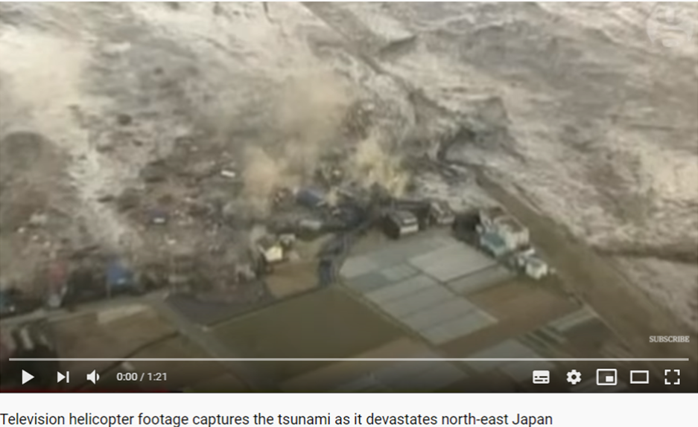
The Tohoku Tsunami
Watch the clip of the Tohoku Tsunami, 2011. Think about the damage that occurred as the water swept over the north-east of Japan.
Notes:
Teacher’s Notes
Click the image to go to the video. ‘1:21 long.
https://www.youtube.com/watch?v=ilwB0GCc_ZM

Slide 5
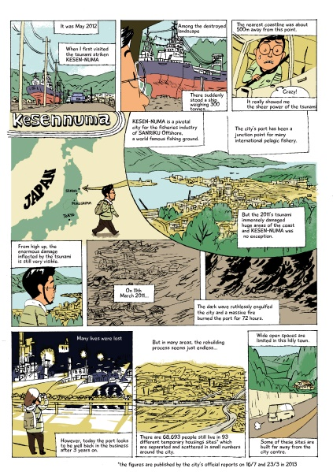
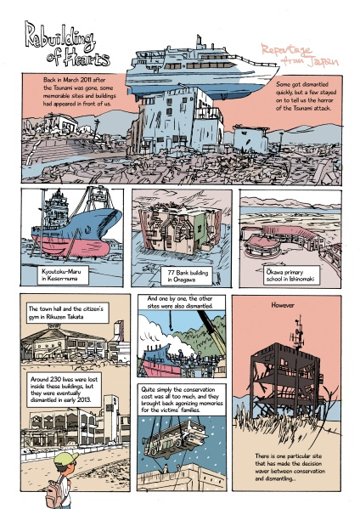
Task 1: Sharing the Story
The Tohoku earthquake and tsunami disaster happened several years ago, but its impact is still felt by many. It’s important that people remember the disaster and learn from it.
Task: Think, Pair, Share
How could manga help to share the story?
Why is it a good medium to use to educate people?
Notes:
Teacher Notes
The students could write down their ideas in a spider diagram. There are suggestions on the following slide.
Fumio Obata’s work is shown on this slide, students will look at it in more detail later in the lesson.

Slide 6
Task 1: Sharing the Story
Clear images and simple text are suitable for any audience.
Text boxes or speech bubbles can include important information.
Task: Think, Pair, Share
How could manga help to share the story?
Why is it a good medium to use to educate people?
Manga
The layout is good for showing events over time clearly.
Graphic details or upsetting images can be avoided in drawings.

Slide 7
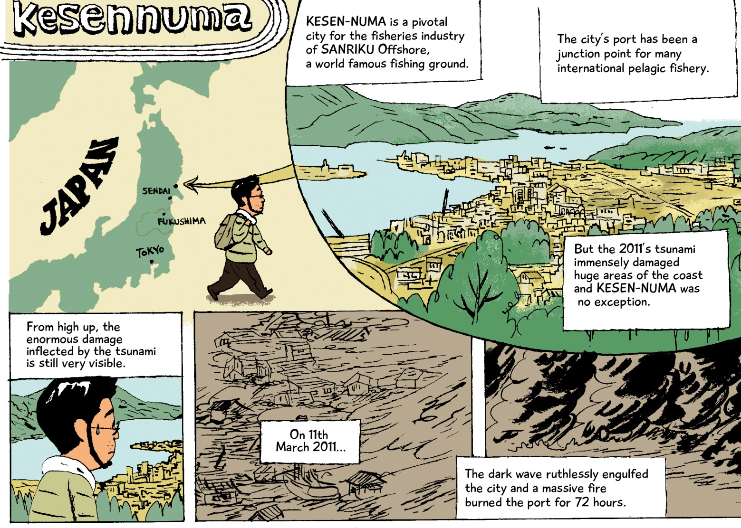
The Tohoku Disaster
Today we’ll be creating our own manga.
This is part of a ‘comic reportage’ on the Tohoku disaster that happened in 2011, drawn by Fumio Obata. In this section he shows some background information and the start of the disaster.
Notes:
Teacher’s Notes
Fumio Obata is a comic book artist, graphic novelist and illustrator from Japan. He lives and works in the UK.
See more of his work: www.fumioobata.co.uk

Slide 8
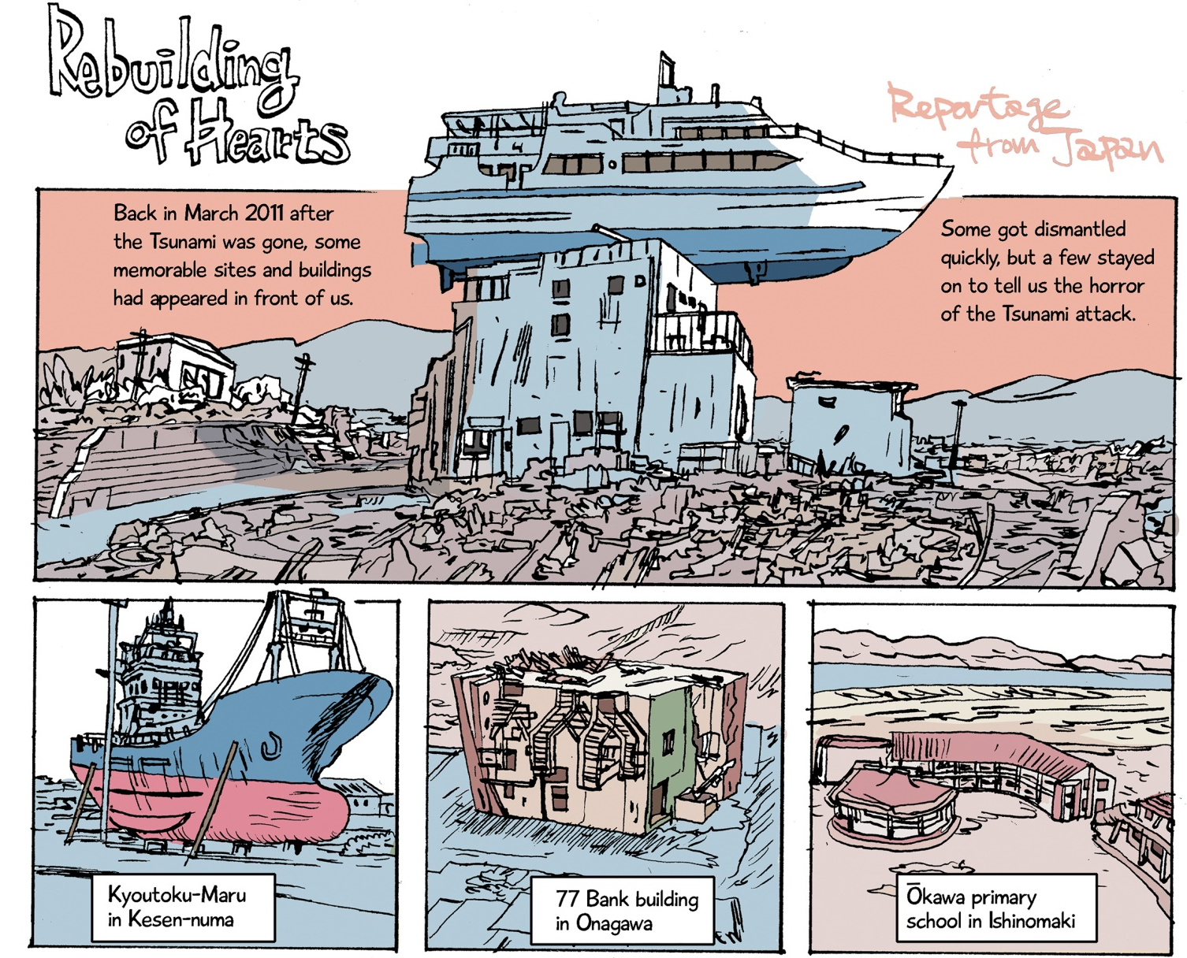
The Tohoku Disaster
Here is how Fumio Obata showed the aftermath and the start of the rebuilding of the area after the tsunami.
Notes:
Teacher’s Notes
There is information about Okawa primary school (shown in the bottom right panel) in the printable timeline.

Slide 9

The Tohoku Disaster
Notice how much detail is in the text on this comic strip; that’s what we want to achieve too.
Make sure you include data in your work.

Slide 10
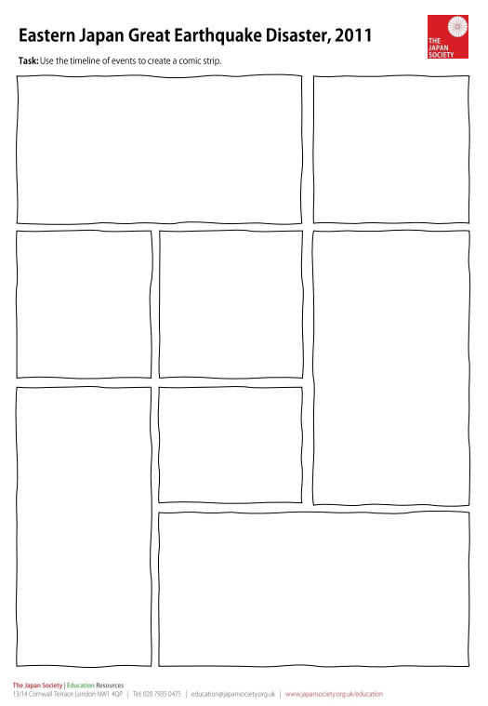
Task 2: Using Manga
Create your own manga to tell the story of the 2011 Tohoku earthquake and tsunami.
Your aim is to educate people about the disaster and what caused it.
Use drawings to show the events and add in text boxes to give more detail.
Try to include specific details and data in the text boxes. Use the timeline to help you.
Notes:
Teacher’s Notes
Students may use the printable manga template (advised if only using one lesson), or design their own, though this would take longer.
There is also a version of the worksheet for LA students which is pre-illustrated for students to add appropriate text.
Alternatively, students could write a blog entry or series of text messages as if they were in Fukushima at the time of the earthquake and tsunami.
If using one lesson students could finish this task as homework. If using two lessons, students may only make a start on this task, depending on how much time you have available. They can continue it in the following lesson.

Slide 11
Tsunami Timeline
Friday 11/03/11 |  | 14:46 – a magnitude 9.0 earthquake occurred off the north east coast of Japan, triggering the start of the tsunami.
 |  | The north east coast was hit by the wave first and they were still being struck by aftershocks of the earthquake. The wave was 10m high when it first hit. It reached up to 10km inland.
 |  | The staff and students at Okawa Elementary School evacuated to the playground at the bottom of a hill. They didn’t realise the wave would be so big. 70 of the 108 students and 9 of the 13 teachers who were there were killed by the tsunami.
 |  | The wave destroyed almost everything in it’s path; cars, boats, people and many buildings which had already been weakened by the earthquake. Broken gas pipes and electricity lines caused huge fires.
 |  | As the water drained back into the sea, it swept people and debris with it. The number of people who died or were never found totalled 18,500.
Notes:
Teacher’s Notes
There is more detail on the pintable version, but this slide gives an outline of the events and would be suitable for LA students.
Students may use the printable manga template (advised if only using one lesson), or design their own, though this would take longer.

Slide 12

Plenary: UK Hazards
Discuss:
What hazards are we at risk from in the UK?

Slide 13




This resource was authored by Katie Holmberg in collaboration with the Japan Society and features illustrations by Fumio Obata.
See more of Fumio’s work: www.fumioobata.co.uk
The Japan Society
13/14 Cornwall Terrace, London NW1 4QP
Tel: 020 7935 0475
Email: education@japansociety.org.uk
www.japansociety.org.uk
Follow us on:
@japansocietylon
@JapanSocietyLondon

