Slide 1

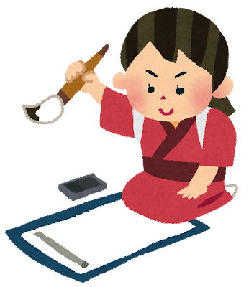
の
カタカナ
書道
ソ
き
エ
Writing in Japanese
た
バ
漢字
あ
書く
ヘ
ひらがな
© The Japan Society
Notes:
Ask students: What do you think the symbols in grey are? Any guesses.
Answer: It's written Japanese – a mix of written alphabet sounds and pictures with meanings (we'll learn more about these)

Slide 2

日本
語
ni
hon
go
This says nihongo, which means 'Japanese'.
What do you notice about the writing which is different to English?
© The Japan Society
Notes:
Click for romaji (ni, hon, go) to appear next to each character.
You can take volunteers on the spot or make into a think, pair, share activity.

Slide 3
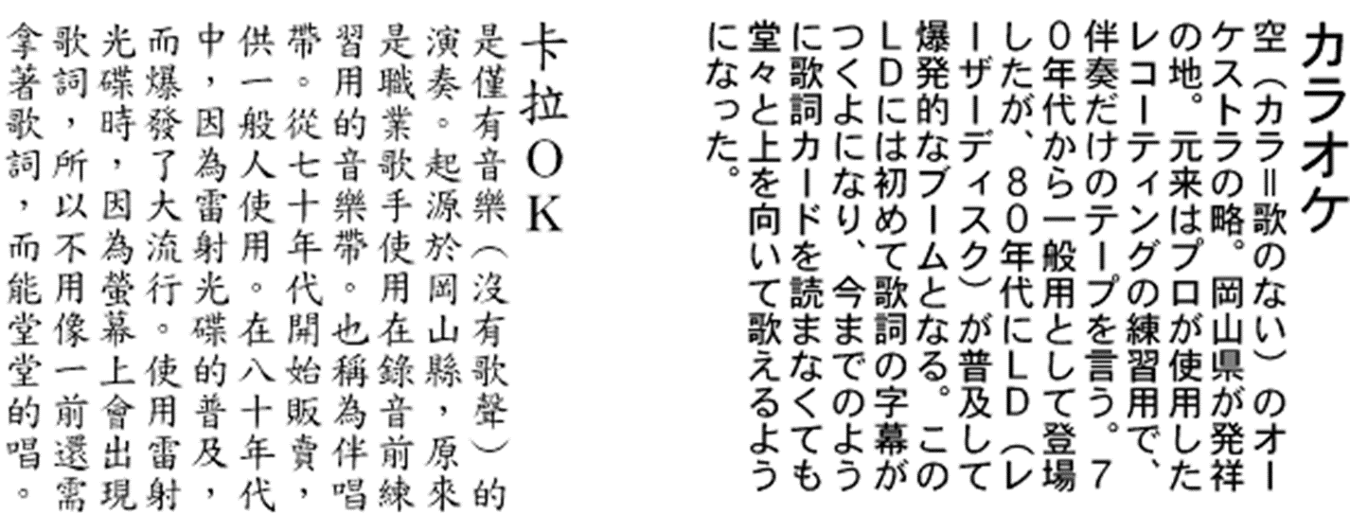

How to read Japanese
Traditionally Japanese is read from top to bottom, and from right to left.
© The Japan Society
Notes:
Here is some Japanese writing.
In Japanese, we traditionally read and write vertically, from top to bottom, and then from left to right.
Can you spot the title (on the left-hand side)?
How is this different to reading English?
How about other languages you know?
Teacher's Note: If you have a Japanese book, show it to students. Point out how it seems to start at the back.

Slide 4
Think Pair Share
What else do you notice about the writing and the characters?
Discuss with your partner.
© The Japan Society
Notes:
Listen to students' answers. Try to draw out that some of the characters look quite different – a few simple lines versus more complex ones, curvy versus angular, can they spot letters or other symbols they recognise? etc.

Slide 5
In Japanese, there are three sets of symbols which are used to write.
These all say nihon, which means Japan.
Kanji
Hiragana
Katakana
にほん
二ホン
日本
© The Japan Society
Notes:
3 different sets of characters are used when we write: Kanji, Hiragana and Katakana.
Japanese school children must learn all 3.

Slide 6
Let’s look at hiragana and katakana first.
They are alphabets. Each one has 46 basic characters which represent a sound.
Hiragana
Katakana
Hiragana is often used to write Japanese words.
For example, konnichiwa (hello):
こんにちは
Katakana is often used to write foreign words and non-Japanese names.
For example,
Tomato: トマト
Emma: エマ
にほん
二ホン
ni
ni
ho
ho
n
n
© The Japan Society

Slide 7
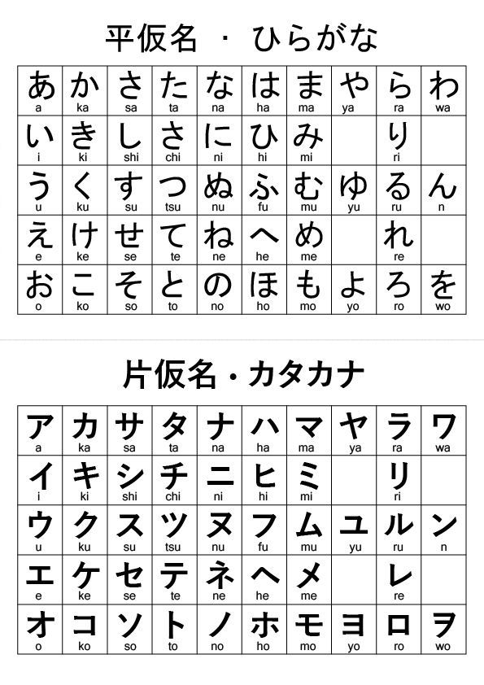
Hiragana
Katakana
© The Japan Society

Slide 8
Kanji
As well as katakana and hiragana, there are kanji.
A kanji symbol is called a character. Each one has a meaning. They can be used in different combinations to make words.
Kanji is originally from China. They were introduced to Japan over 1000 years ago!
Children in primary school will have to learn over 1000 kanji characters!
日本
ni
hon
© The Japan Society

Slide 9
Kanji Examples
花
This character 花 means flower.
火
And this character 火 means fire.
When combined together, they mean firework.
© The Japan Society
Notes:
Firework in Japanese is "Hanabi".

Slide 10
Let's take
a closer look at kanji...
© The Japan Society

Slide 11

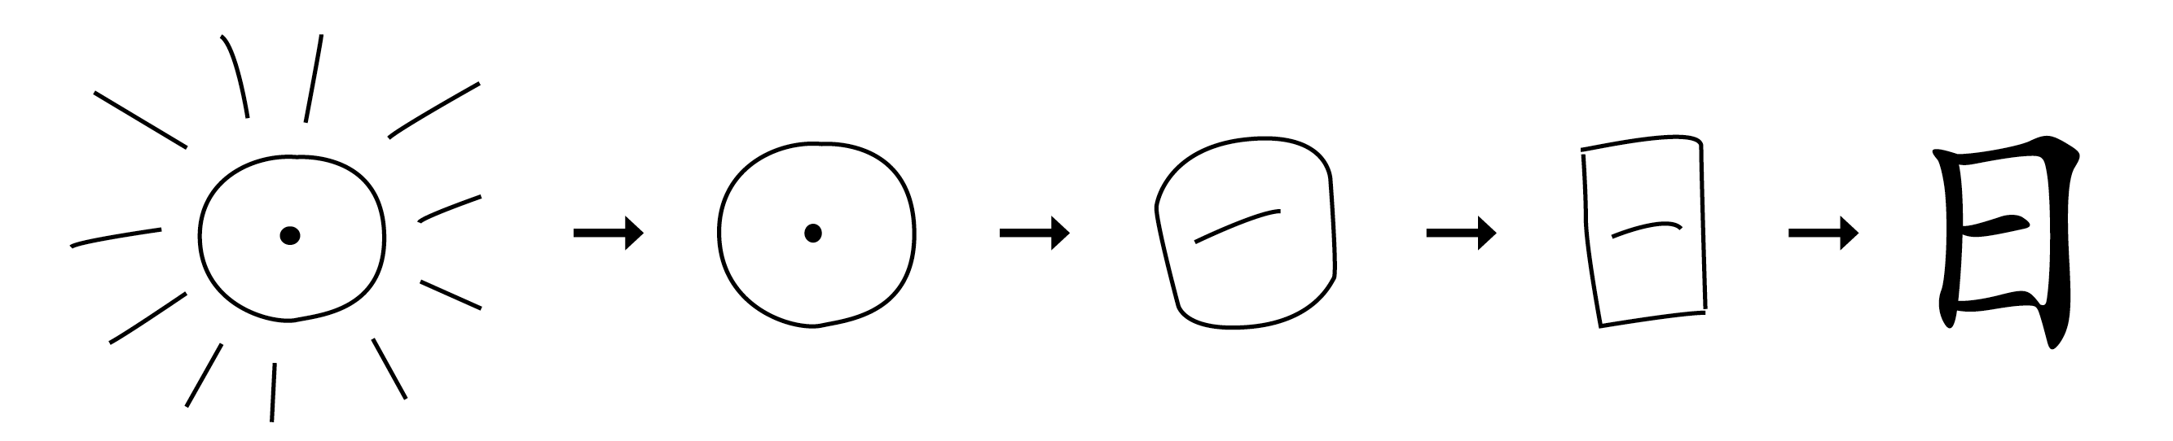
How are kanji formed?
© The Japan Society
Notes:
Teacher’s Note
Many basic kanji characters look like simplified drawings of what they represent. To familiarise students with the concept, this slide and the following show examples of the sun and moon.
More examples are shown on the following slides without the answers so you can turn it into a quiz for students (suggested hints are provided in the notes)

Slide 12

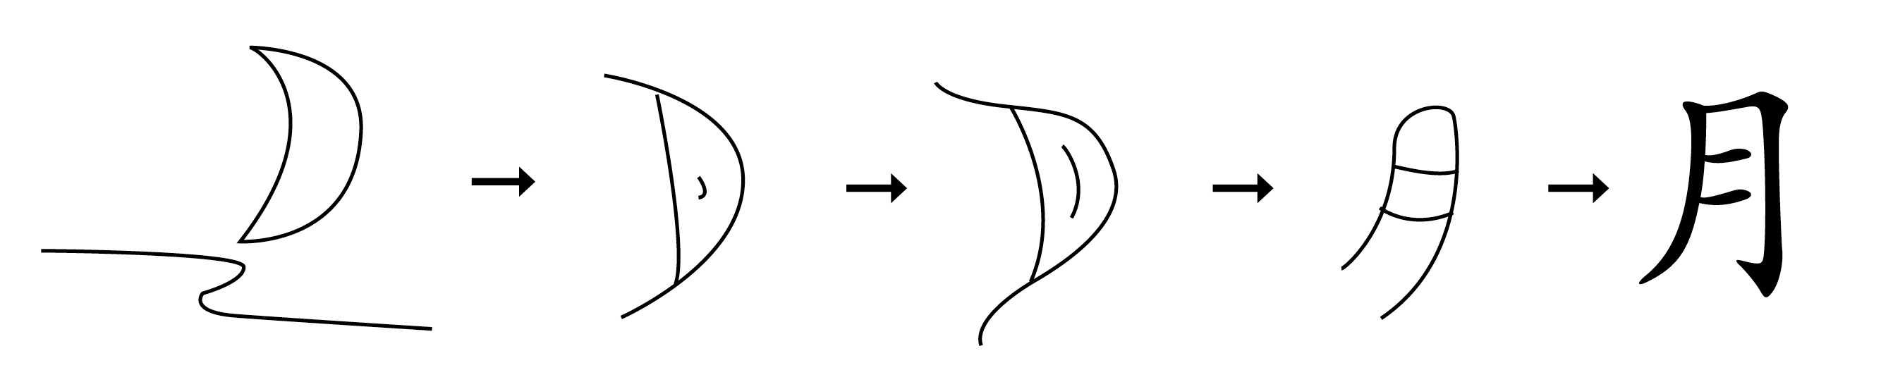
How are kanji formed?
© The Japan Society
Notes:
Teacher’s Note
Many basic kanji characters look like simplified drawings of what they represent. Examples are shown on the following slides to familiarise students with the concept.
Turn it into a quiz and give the hints from the notes section.

Slide 13
Kanji Example 1
山
What could this be? Take a guess!
© The Japan Society
Notes:
Ask students if they have any guesses for what this kanji is.
Hints
Something found in nature
Something tall you can climb
Mount Fuji is one

Slide 14
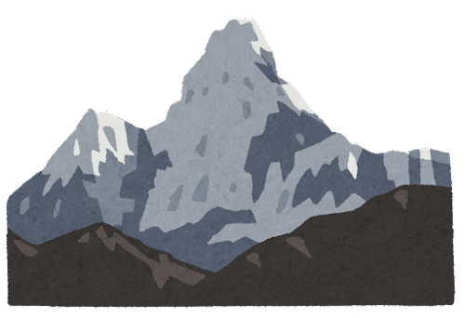
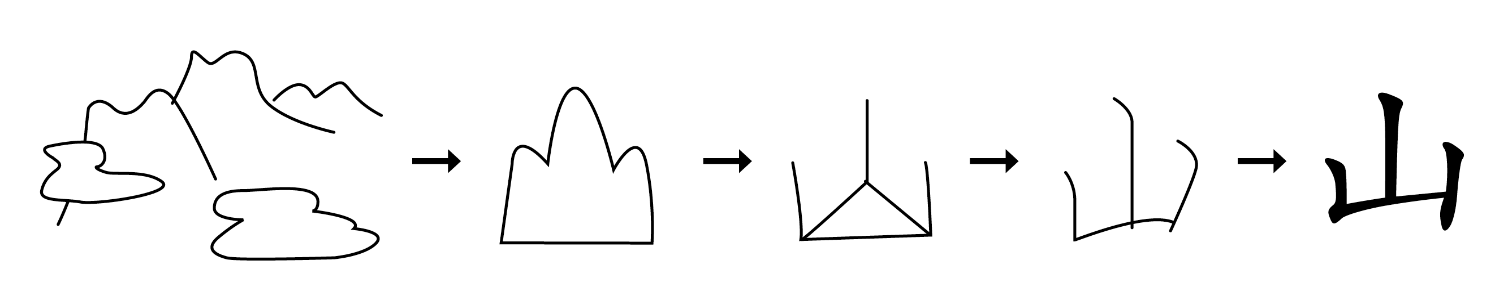
Kanji Example 1
© The Japan Society

Slide 15
Kanji Example 2
川
What could this be? Take a guess!
© The Japan Society
Notes:
Ask students if they have any guesses for what this kanji is.
Hints
Something found in nature
Something that can run (and is wet)
The Thames is a famous one in the UK

Slide 16
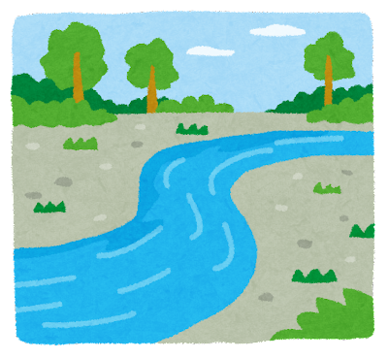
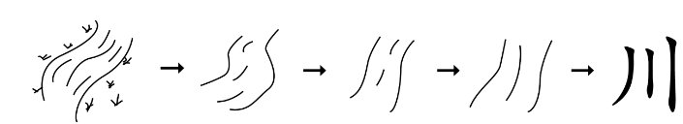
Kanji Example 2
© The Japan Society

Slide 17
Kanji Example 3
目
What could this be? Take a guess!
© The Japan Society
Notes:
Ask students if they have any guesses for what this kanji is.
Hints
There's lots of them in this room
They can be found on faces
You use them to see with

Slide 18

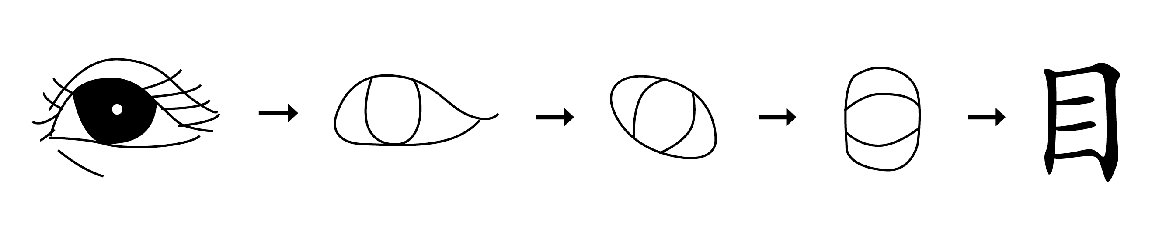
Kanji Example 3
© The Japan Society

Slide 19
Kanji Example 4
木
What could this be? Take a guess!
© The Japan Society
Notes:
Ask students if they have any guesses for what this kanji is.
Hints
They are found in nature
There are lots of different types
They have branches and leaves

Slide 20

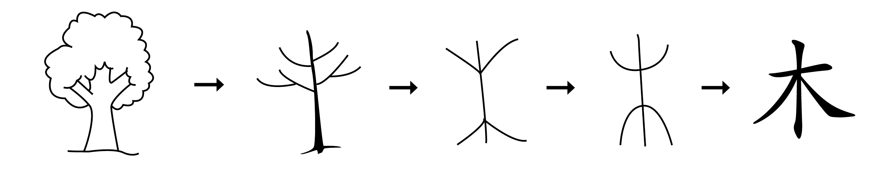
Kanji Example 4
© The Japan Society

Slide 21
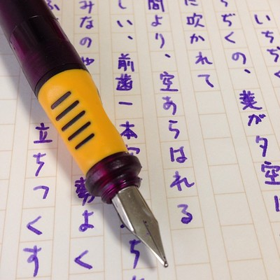
Learning how to write
Children begin learning hiragana and katakana in kindergarten.
They start learning kanji from Year 1.
By the time they finish junior high school, Japanese students will know 2,136 ‘daily use’ kanji which are essential for daily life.
Just like in the UK, Japanese children must practice their handwriting.
Tatsumine Sugiura
© The Japan Society
Notes:
Teacher’s Note
Junior High School is equivalent to the lower secondary school years 7 – 9.
Image: https://www.flickr.com/photos/tatsumine/14363046135

Slide 22

Japanese Calligraphy
Japanese calligraphy is an art form. It's called shodo in Japanese.
Each brushstroke is unique and individual to the artist.
To practice Japanese calligraphy, you need 4 basic pieces of equipment.
Brush
Paper
Ink
Inkstone or inkwell
These are known as the four treasures!
© The Japan Society
Notes:
Teachers Note
Emphasise the different between learning to write neatly (which all children do) and learning calligraphy – which is considered an art form.
All whilst Japanese students will get to try calligraphy at school, but it’s not the standard way of writing.

Slide 23
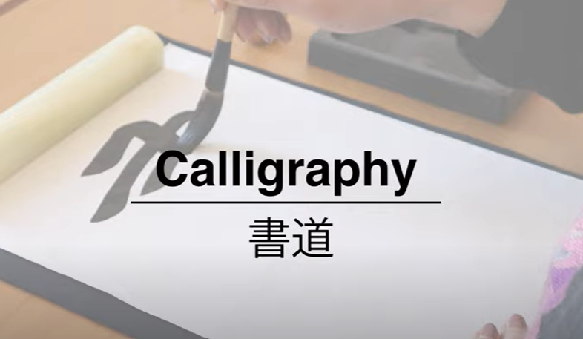
Activity
Watch the video tutorial
and try Calligraphy!
© The Japan Society
Notes:
Due to the large file size, the video is not embedded in the presentation; you will need an internet connection to play it.
Click the links on the slide or here: https://youtu.be/kBRTHcffPp4?si=heaokJe-gwGd7yzM

Slide 24

Extension Activity
Follow the steps to design your own kanji!
Decide what object you will make a kanji for
Make a simple drawing of the object
Decide on some details to remove
Draw it again without those details
Repeat steps 3 and 4 until you are happy with your kanji
emoji designed by OpenMoji, CC BY-SA 4.0
Notes:
These are some suggestions on the following slide if you want to give students a narrower choice for their kanji design.

Slide 25
Extension Activity
Design a kanji for one of the below:
HORSEHORSE
HORSEHORSE
Human
Child
HORSEHORSE
HORSEHORSE
Money
Horse
© The Japan Society
Notes:
These are some suggestions of simple kanji. The actual Japanese kanji for these characters can be found on the next page if you want students to do a comparison.

Slide 26
Extension Activity
Design a kanji for one of the below:
HORSEHORSE
Human
Child
Money
Horse
E
子
馬
人
金
© The Japan Society
Notes:
Students can guess which kanji they think is which.
Click to reveal the answers one by one.

Slide 27





This resource was created by The Japan Society
The Japan Society
13/14 Cornwall Terrace, London NW1 4QP
Tel: 020 7935 0475
Email: education@japansociety.org.uk
www.japansociety.org.uk
Follow us on:
@TheJapanSociety
@TheJapanSociety

