Slide 1


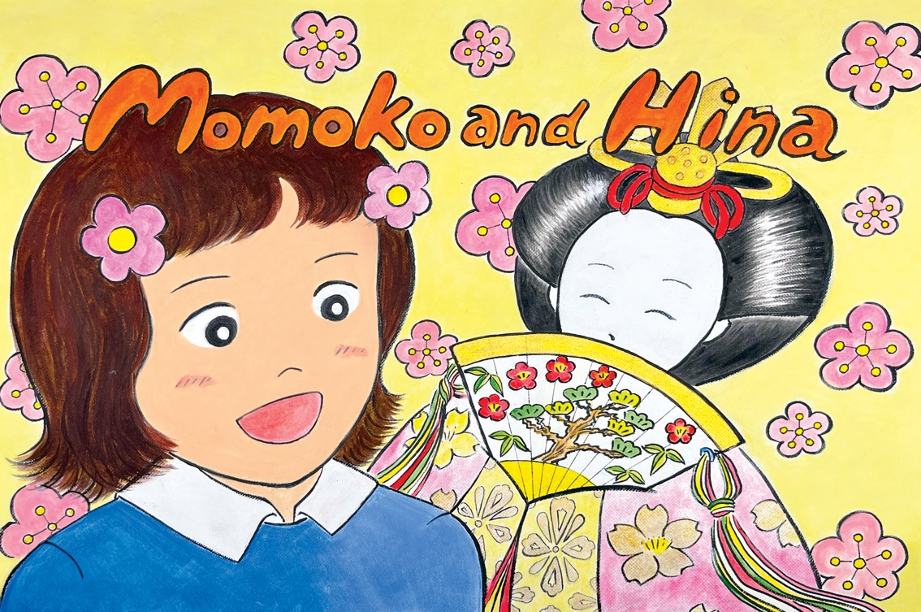

Kamishibai:
Japanese Storytelling
Notes:
Momoko and Hina
1
Pre-text
The Doll Festival (Hina Matsuri in Japanese) takes place every year on March 3 in Japan and celebrates the health and happiness of girls. In the run-up to the festival, families with daughters will usually display ornamental dolls at home and these dolls are often passed down through families. Public displays are also common.
Both the dolls themselves and the displays vary from simple to extremely elaborate, however the tiered stands are usually red and the Emperor and Empress will always be found at the top dressed in costumes from the Heian era (794-1192). Traditionally, it is considered bad luck to leave the dolls out after the festival.
********
The Japanese words in this story are:
Hina: Refers to dolls which are displayed during this festival
Bonbori: A paper lantern
Hishi-mochi: A Japanese sweet associated with the festival. They are diamond-shaped, made from rice and have three layers which are coloured pink, white and green.
Amazake: A sweet traditional Japanese drink made from fermented rice and associated with the festival.

Slide 2
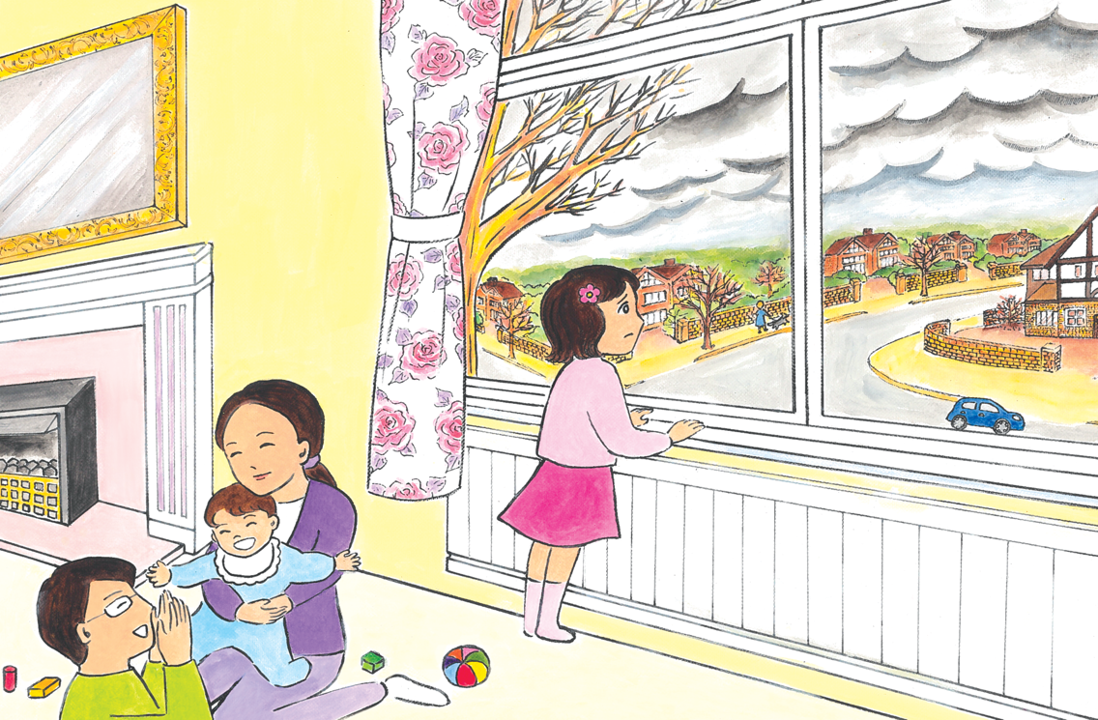
Notes:
2
Momoko hates England. She arrived around a month ago with her family - Mum, Dad and... that. ‘That’ appeared when they were still living in Japan. It’s her new brother Koji. Everybody was so excited about him, but Momoko was not impressed. He never stops crying and demanding Mum’s attention. Whenever Mum isn’t watching, Momoko has noticed he looks at her meanly, as if to say: “Ha! Mum isn’t yours any more. She’s mine now.”
Momoko hates him as much as she hates England. They arrived in the middle of winter and the sky was so grey and heavy compared to Japan where it was sunny and dry. Momoko misses the bright winter sky. It was cold in Japan too, but here it feels more sinister, like it’s creeping up to you and going right inside. And it’s so quiet here; the walls of the houses are so thick that you can’t hear anything outside. In her home in Japan, sounds from the neighborhood would trickle in and fill up the air.

Slide 3
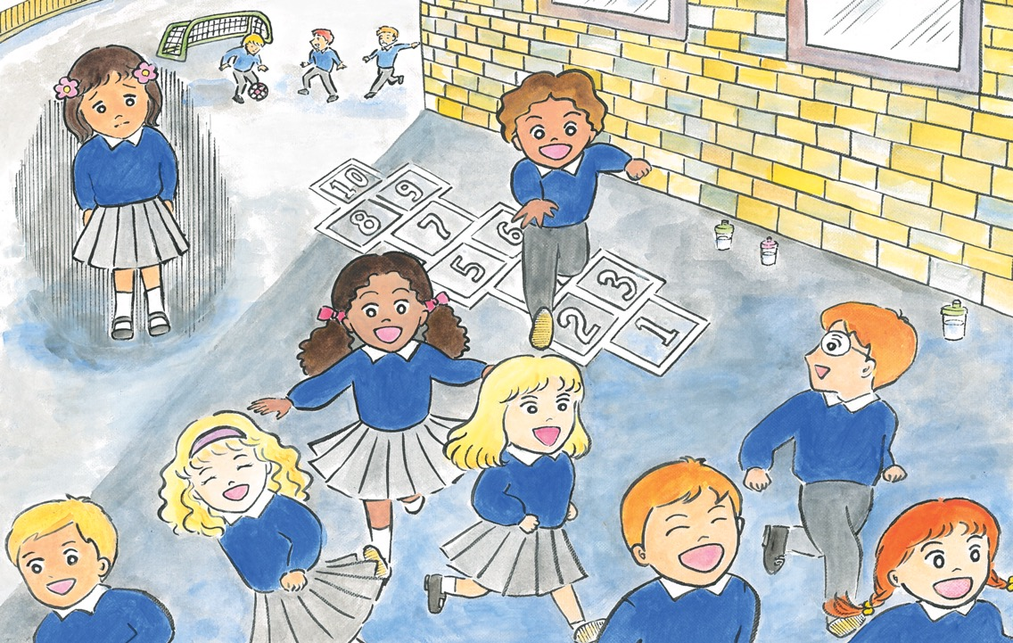
Notes:
3
She misses her old nursery in Japan where the nursery teachers were always smiling and kind. Here, she’s already going to school and she can’t understand what the teachers are saying – it sounds like a lot of instructions. The few words she knows aren’t much help to ask questions or talk to her classmates. On the first day she missed lunch as she didn’t understand what was going on - it was a very hungry day.
It’s not just the language, but there’s something else that Momoko isn’t used to. In her old nursery everyone was Japanese like her and had dark hair and olive skin. The children in her school here have so many different shades of skin and hair colour. Mum said some of her classmates moved to England from other countries too, but Momoko doesn’t feel like she fits in. She used to be very lively - sometimes too lively - but she has become very quiet. She misses her old teachers and her friends in Japan that she could talk to so much... She feels lost and alone.

Slide 4
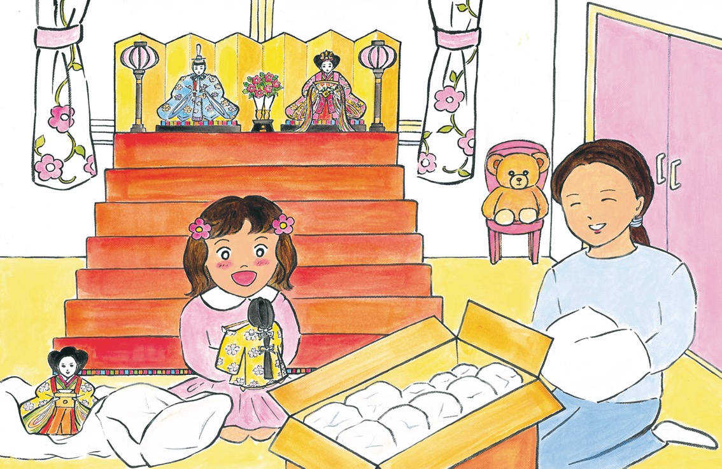
Notes:
4
Noticing Momoko’s distress, Mum suggested they put out her hina dolls earlier than usual this year. Momoko loves these dolls. They’re old - they used to be her mum’s, and before that they belonged to her grandma - but are well-made with beautiful details. Mum insisted on bringing them to England, saying it would be bad luck not to put them up for the Doll Festival.
So one Sunday, Mum and Momoko set to work. First, they set up the shelves where the dolls would sit, the hina dan. Then they took out the dolls one by one. They started from the top with the noble Emperor and the elegant Empress. Both of them are wearing luxurious outfits, with gold and silver woven into them. The Emperor has a sword and a hat with a long tail sticking up, which looks funny, but Momoko knows she shouldn’t laugh. The Empress’s long hair, which expands magnificently on both sides, is tied up at the back. Momoko and Mum take care unwrapping a small fan and golden hair accessory and placing them very carefully on the Empress so as not to break anything. Momoko adores her clothes, her hair and her graceful expression.

Slide 5
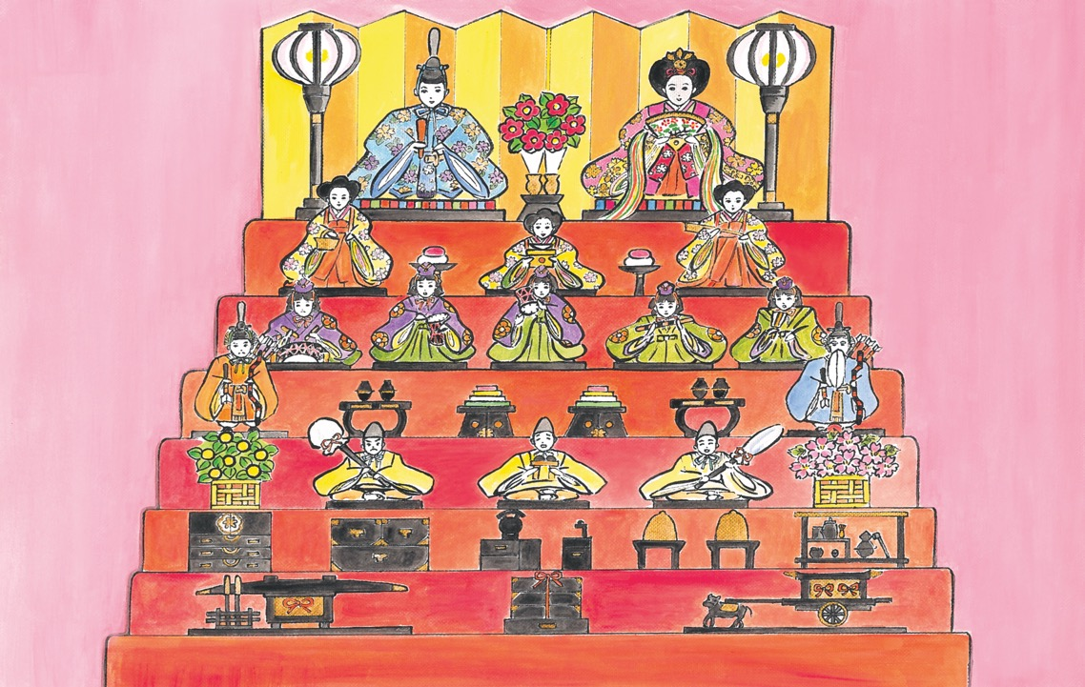
Notes:
5
Next they set up the dolls on all the other platforms. Sitting below the Emperor and Empress are the dignified Three Court Ladies. Each of them has a utensil to serve the royal couple and they all look very sincere, as if they’re working hard. Below them are the mischievous Five Musicians, all young boys. Three of them hold drums of all different sizes; one has a flute; and the final one, with a fan, is a singer. It was a fiddly job putting the tiny utensils and instruments into the small dolls’ hands, but as soon as they’re there the dolls look so alive.
The next step down is occupied by two solemn ministers, the protectors of the royal couple. They have stern faces and look invincible, with bows in their hands and arrows on their backs. The step below that belongs to the lively Three Servants, who sit between a cherry blossom tree and a mandarin orange tree. The one with a parasol looks angry, the middle one with a shoe rack looks like he’s about to cry, and the one with an umbrella is laughing. Momoko wonders why.
Finally they place all the extras: food trays, furniture, utensils, plants, lights and some carriages. There we are! A magnificent miniature palace has appeared in Momoko’s room.

Slide 6
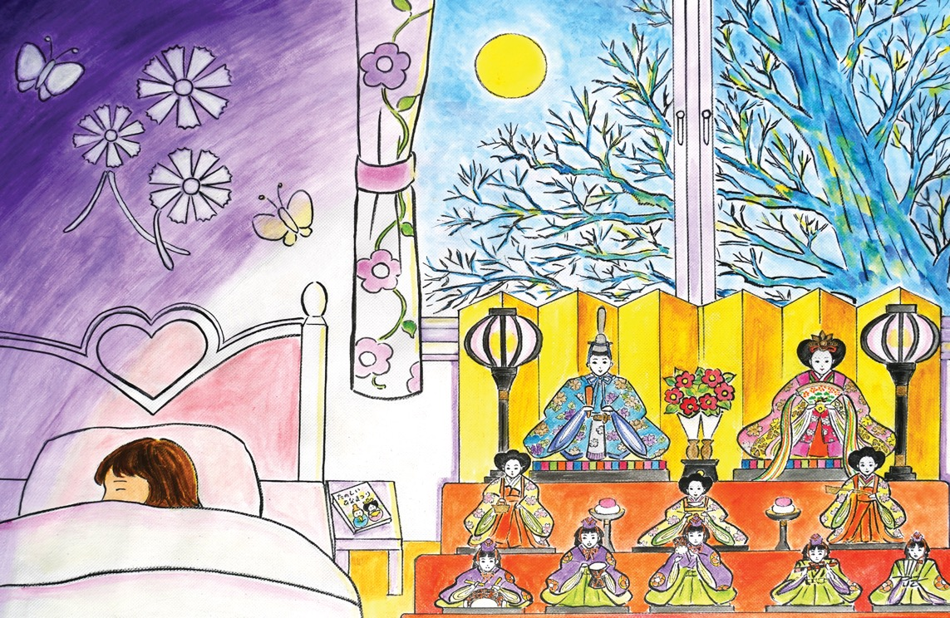
Notes:
6
It was wonderful to spend a day with just Mum, while Dad looked after Koji. They’d worked hard and Momoko felt very tired at bedtime. Sometimes she feels a bit lonely in her new room and asks Mum and Dad to leave the door slightly open, but tonight she has all the hina dolls to keep her company. So, after Dad finished her bedtime story and Mum said goodnight, she let them close the door.
Momoko snuggled up in bed. She could see the moon shining through the window, beyond the big tree. Usually the tree looks rather menacing with its bare branches extending out like bony arms, but tonight it made a nice background for the hina dolls. The two small bonbori lamps cast a soft light on the royal couple who looked calm and peaceful. The graceful smile on the Empress’ face was so enchanting and reassuring. Momoko fell asleep...
She was woken up by a strange sound – it sounded like someone murmuring in a very low voice, accompanied by a flute and some percussion. It reminded her of the music played at her local shrine in Japan during festivals. She turned her head towards the sound.

Slide 7
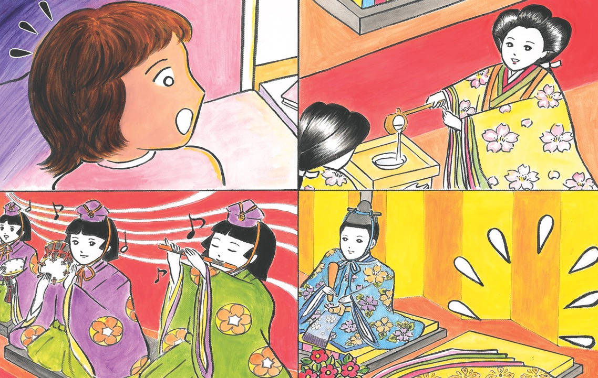
Notes:
7
It was coming from the hina dolls! There, Momoko saw the five musicians playing their instruments, moving their little arms and mouths. Momoko was fascinated. Above them, the three court ladies were busy preparing food and drink and the three male servants were passing them utensils from the steps below, standing on some of the furniture so they could reach.
Then Momoko’s eyes moved to the top tier. The Emperor was standing there in his usual noble manner and next to him was the elegant... wait, the Empress was missing! Her clothes were there, but the Empress herself was not! Momoko looked around, puzzled until she spotted the Empress on the floor in front of the display. She was wearing only a white garment which looked like old-fashioned underwear and moving very slowly with a serious face. Momoko thought she had seen masked performers doing a dance like that on Japanese TV before – was it called noh dance? Suddenly the Empress tripped and almost fell head over heels. She looked a bit shocked then burst out laughing.

Slide 8
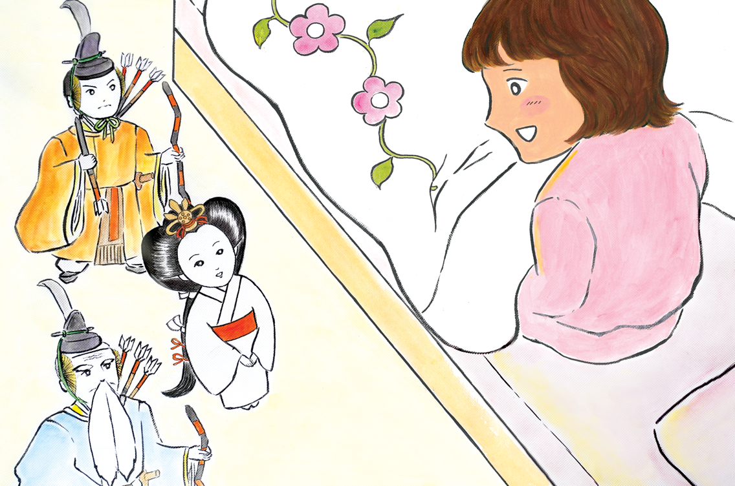
Notes:
8
Momoko was amazed and sat up so she could see better. The five musicians had joined in with the Empress’s laughter. The three court ladies looked very worried and crowded around the Empress but she waved them away saying, “I’m fine! I’m not used to this thing called carpet!”. The angry servant man said angrily, “Yes, what a stupid thing that is!” The crying servant said, almost crying, “Please be careful Empress, imagine if you hurt yourself!” And the laughing servant said, laughing, “The Empress is OK. She’s a tough lady.”
The Empress noticed Momoko and turned to her. Momoko was scared they might change back to lifeless dolls, but they didn’t. The ministers swiftly moved their hands to the arrows on their backs. The Empress stopped them with a wave of her hand and said in a very friendly manner, “Oh hello, Momoko-san! Thank you so much for bringing us out today.”
Momoko was thrilled the Empress was talking to her. She had a very warm, clear voice. Momoko had never talked to a doll before (or to an empress) so she wasn’t sure what to say for a while, but eventually she said, “You’re welcome.”

Slide 9
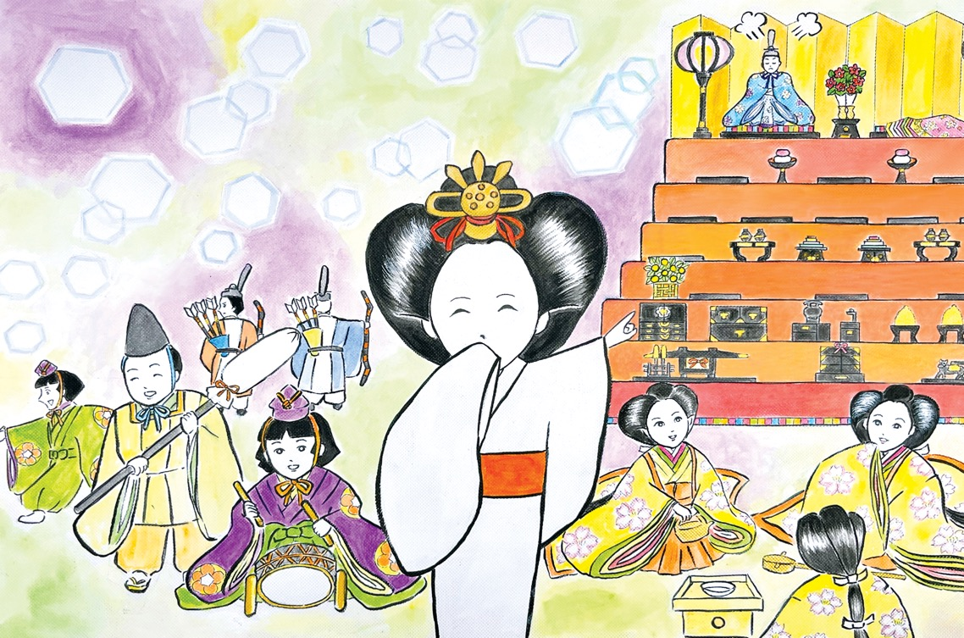
Notes:
9
The Empress looked around her and said, “I like this room, it’s big but cosy. Is this your new room?” When Momoko told her it was and that they had moved to England recently, the Empress’s face lit up with excitement. She turned around and called out, “We’re in England now! Can you believe it?”
Everyone started talking all at once. The Emperor was still on the shelf and looked like he was making a big effort to look calm in the midst of this chaos. The Empress shouted up to him, “Darling, did you hear? We’re in England, would you like to come down and have a look?”
The Emperor answered in rather quiet voice, “I can see much better from up here, thank you.” The Empress turned to Momoko and whispered, “He’s afraid of coming down as the steps are quite steep. He’s a bit of a scaredy cat!” and she winked. She continued, “Also he doesn’t want everyone to see him in his underwear. You can’t climb up and down in that ridiculous costume!” Then she laughed heartily.

Slide 10
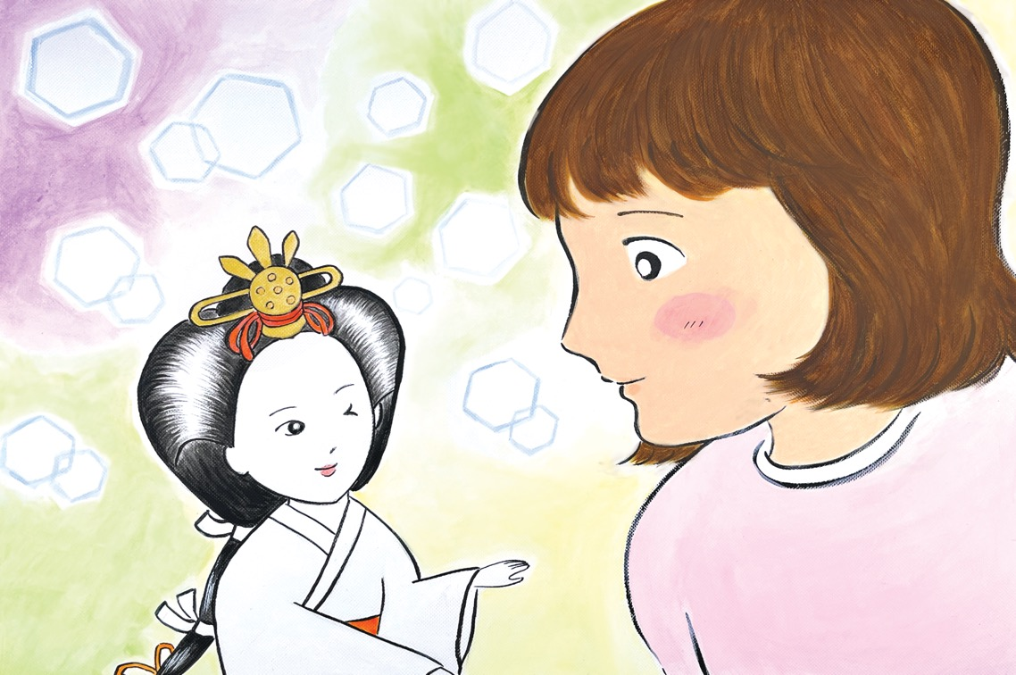
Notes:
10
That night, Momoko and the Empress talked and talked. The Empress wanted to know what it was like to live in England. She was most excited about Momoko’s school and she wanted to know everything about it. In the end, the three ladies called to inform her that it was terribly late, and she should let Momoko sleep. The Empress agreed and, as she hurried back to the shelves, she asked Momoko to remember everything that happened at school the following day and report back to her. Momoko asked if that meant she could see the Empress again tomorrow. The Empress turned round and smiled: “Of course! At bedtime. But keep it secret, please!”
She winked at Momoko again then she swiftly climbed the shelves using the furniture the three servants had set up as steps. At the top, she quickly put her elaborate costume back on and sat on her throne. As soon as she sat down, she became lifeless. Momoko got out of bed to check; all the hina dolls were exactly as she had set them up that afternoon, except there was a little bit of carpet fluff on the Empress’s hair. Momoko smiled and whispered, “See you tomorrow.”

Slide 11
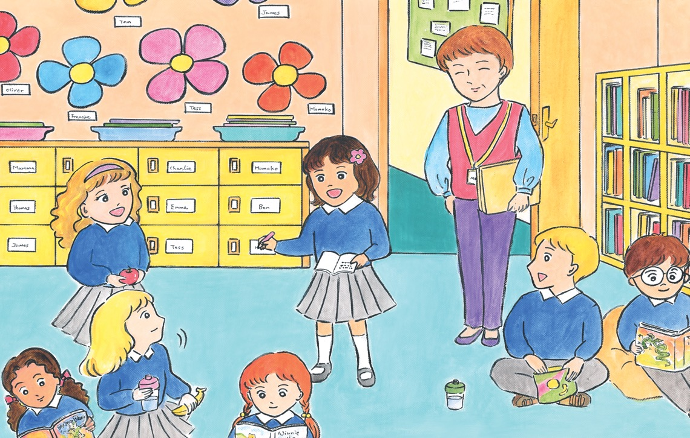
Notes:
11
When Momoko woke up the next morning, the sky looked different. It was still grey but it was lighter and more accommodating somehow. Over breakfast she thought Koji looked at her not meanly, but with respect, knowing that she was now a friend of an empress.
School felt different too. From morning assembly to the farewell greetings, Momoko was keen to know everything that was going on. She was on a very important mission for the Empress. She even tried asking a few questions to gather more information. That night, and then each night afterwards, Momoko met the Empress to tell her what had happened in school that day. She loved watching the Empress’s face light up with excitement. Momoko started to enjoy school more and more.
Noticing the change in her, one day the teacher asked Momoko to speak about Japan for Show & Tell. Momoko thought about it and then she had an idea - she could take the Empress to school! When Momoko mentioned her idea to the Empress that night, she was overcome with delight. The three ladies showed their concern, and the Emperor expressed some annoyance, but Momoko knew they couldn’t stop the Empress.

Slide 12
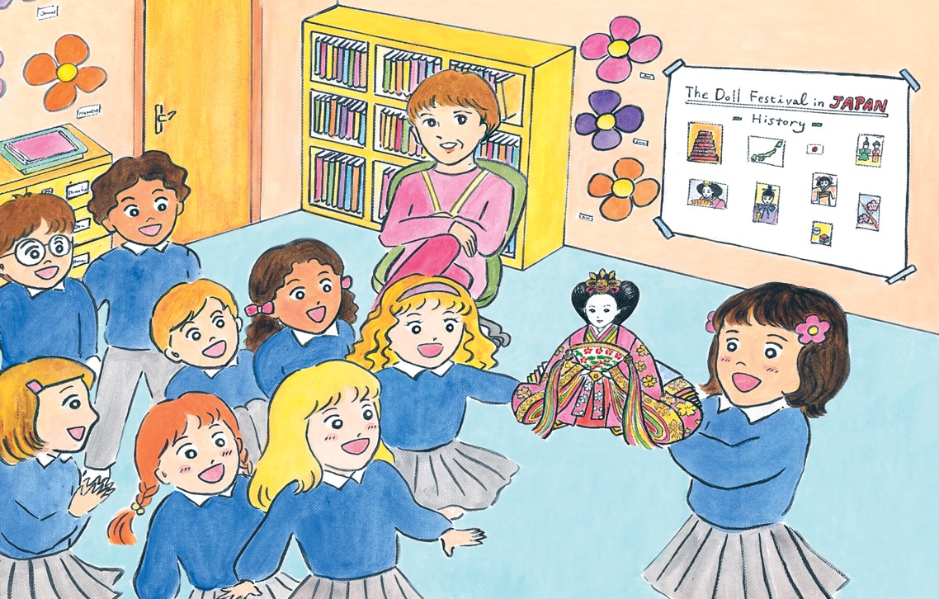
Notes:
12
Momoko gave her presentation on the third of March which was the day of Hina Matsuri, the Doll Festival! Momoko was well prepared; she had practiced her speech many times. She had a lot of pictures showing the Doll Festival in Japan and also a large picture of the hina dolls in her room – Dad took ages to take the photo. And she had a shoe box which contained the Empress, wrapped in very soft cloth and tissue paper.
The presentation went very well. When she produced the Empress, with the fan and golden hair ornament, the whole class gasped in amazement. As Momoko walked around showing everyone the Empress, she felt very proud and happy knowing the Empress would be thrilled to meet her classmates.
After school, some girls came up to Momoko and asked if they could come to see all her hina dolls. Mum was there to pick her up and agreed straight away - she was delighted that Momoko was making friends. A few other girls overheard and asked if they could come too. In the end, a large group of girls and their mums all followed Momoko and Mum home.

Slide 13
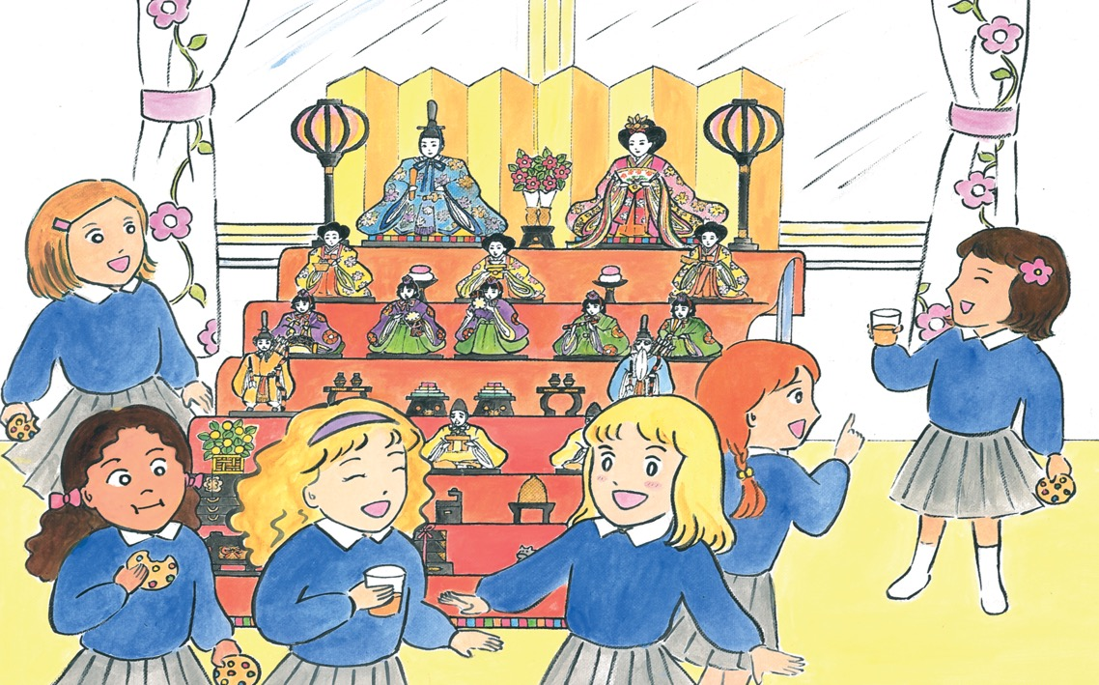
Notes:
13
While the mums chatted to each other in the front room, the girls all went to Momoko’s room to look at the hina dolls and the Empress back on her throne. They were very impressed by the scale and all the details. They sat around the hina dolls and drank some squash instead of amazake and ate cookies instead of hishimochi sweets. It was the most unusual Hina Matsuri Momoko had ever had. The most fun, too.
When no-one else was listening, the Empress whispered to Momoko – “Wow! Your school is so international, just like the Olympics. It must be amazing to have friends from all over the world!” Momoko looked around at her classmates. She realized the Empress was right; she wasn’t alone or lost in her new school in England, everyone was different and together they made something big and special – just like the Olympics! She felt happy to be a part of it.

Slide 14
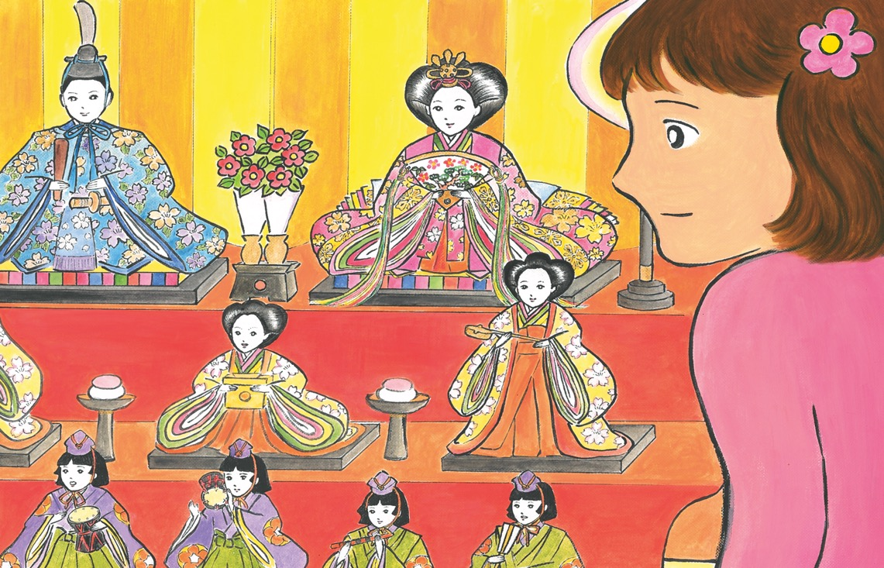
Notes:
14
That night, the Empress was the one who talked. She was so excited about the school visit and Momoko was happy to see her so happy. Then the Empress said: “Thank you so much, Momoko-san, I’m glad our last day ended like this. I had such a brilliant time this year. All thanks to you!”
Momoko couldn’t believe it. How could it be their last day together? The Empress explained that all the dolls had to go to sleep again after the festival - they had to be put away as soon as it was over. For a while Momoko was lost for words. Then she asked, “So we’ll meet again next year?”
“I would like that, but it all depends. You needed us this year, next year I hope you won’t,” said the Empress. “But don’t worry - we’ll always be here if you need us,” she added.
With that, she turned to the hina shelf and began to climb it most gracefully. Momoko wanted to call her back, but she knew she couldn’t stop her. After all, she was the empress! When she arrived at the top, she put on her costume slowly and smiled most warmly. Just before she turned back into a doll, Momoko could have sworn she saw her wink.

Slide 15

終わり
o-wa-ri
(The End)
Notes:
For more resources, visit www.japansociety.org.uk.

Slide 16

For more resources, visit www.japansociety.org.uk.
Notes:
For more resources, visit www.japansociety.org.uk.

