Slide 1
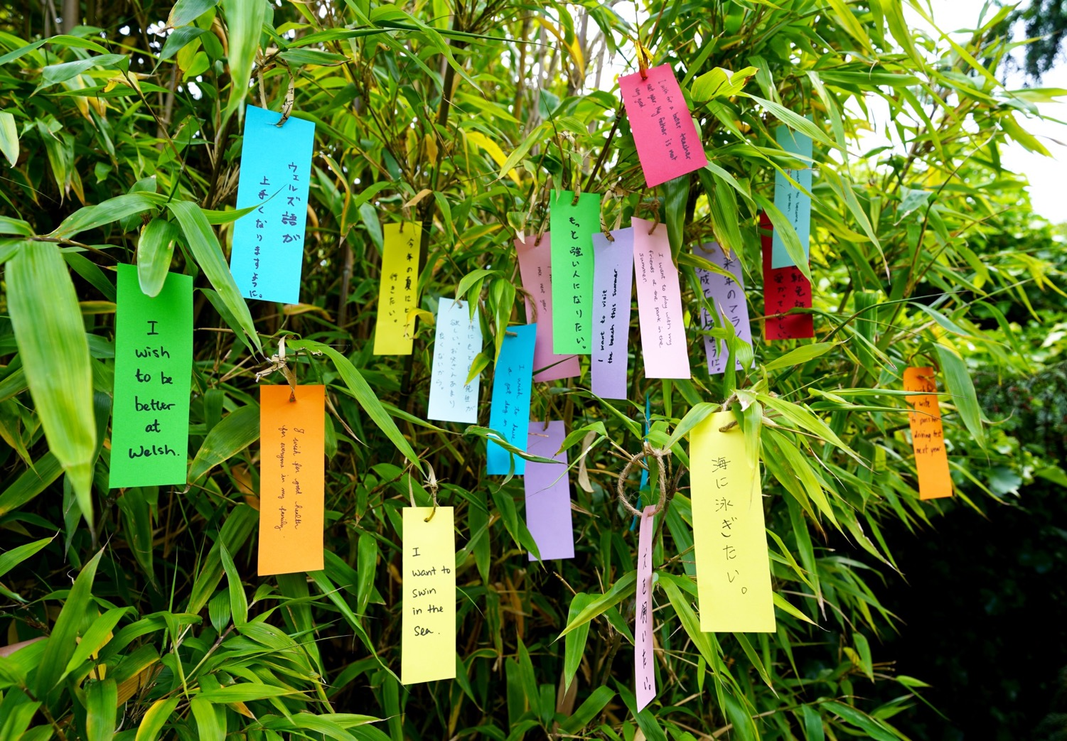

Tanabata:
The Star Festival

Slide 2




Tanabata Festival
Tanabata is a summer festival in Japan.
It is also called the Star Festival.
It is normally celebrated on July 7th.
In Japanese, July 7th is:
七月七日
(seventh month, seventh day)
Notes:
Tell Students
The summer months are a good time to look at the stars because of the clear skies.
The festival is not only celebrated on July 7th.
There are lots of Tanabata festivals all over Japan in July and August.

Slide 3
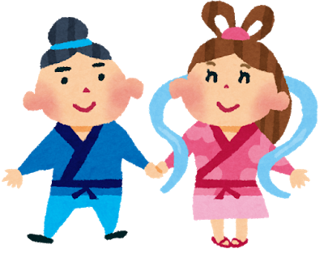
Tanabata Story
The Tanabata festival is based on an old love story about a weaver princess and a cow herder.
Let’s listen to the story together.
Notes:
Teacher’s Note
The story in the following slides is a condensed version of the story with fewer slides. Please see our digital kamishibai resources for the full version with animated effects or a printable version (https://www.japansociety.org.uk/resource?resource=38). The story is also available for physical loan (see https://www.japansociety.org.uk/kamishibaisetloan).
Pronunciation guide:
Tanabata: tah-nah-bah-tah
Orihime: awe-ree-he-may
Hikoboshi: he-co-bosh-ee
Tentei: tent-ay

Slide 4

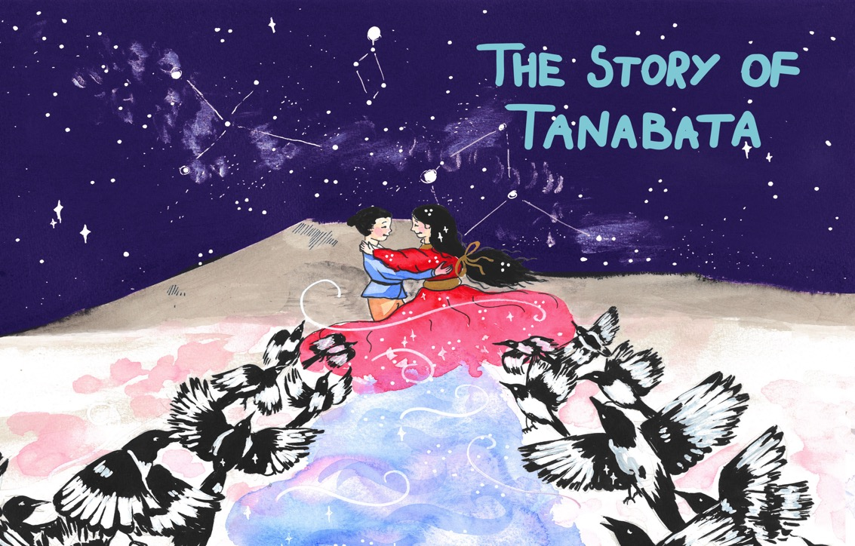
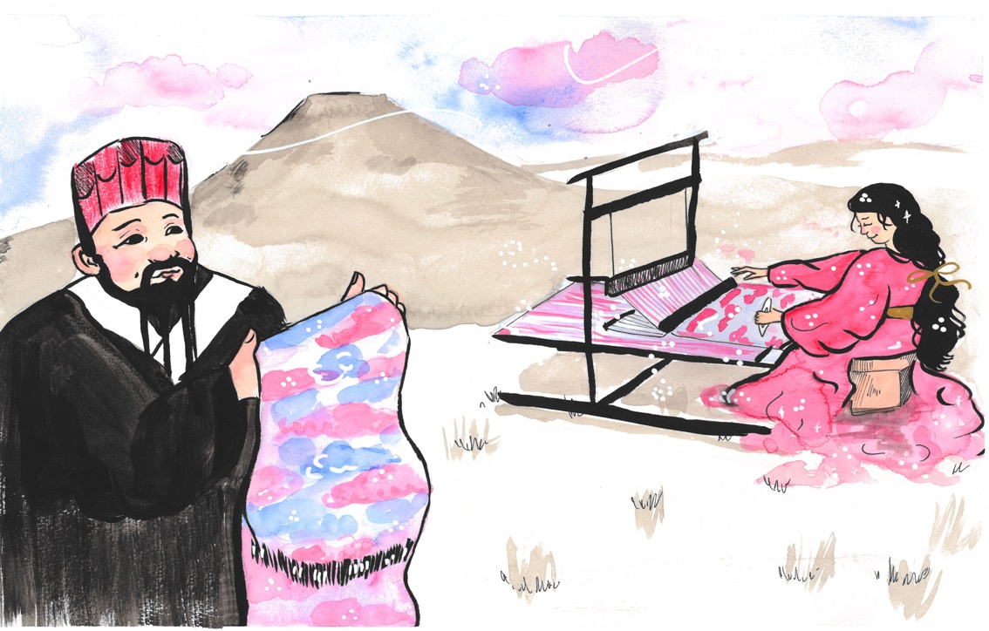
Notes:
Read to the students
This is a story which arrived in Japan long ago.
It originally came from China.
It explains the origins of the Tanabata Festival.
In Japanese, Tanabata means 'evening of the seventh’.
Listen to the story to find out why this date is special.

Slide 5
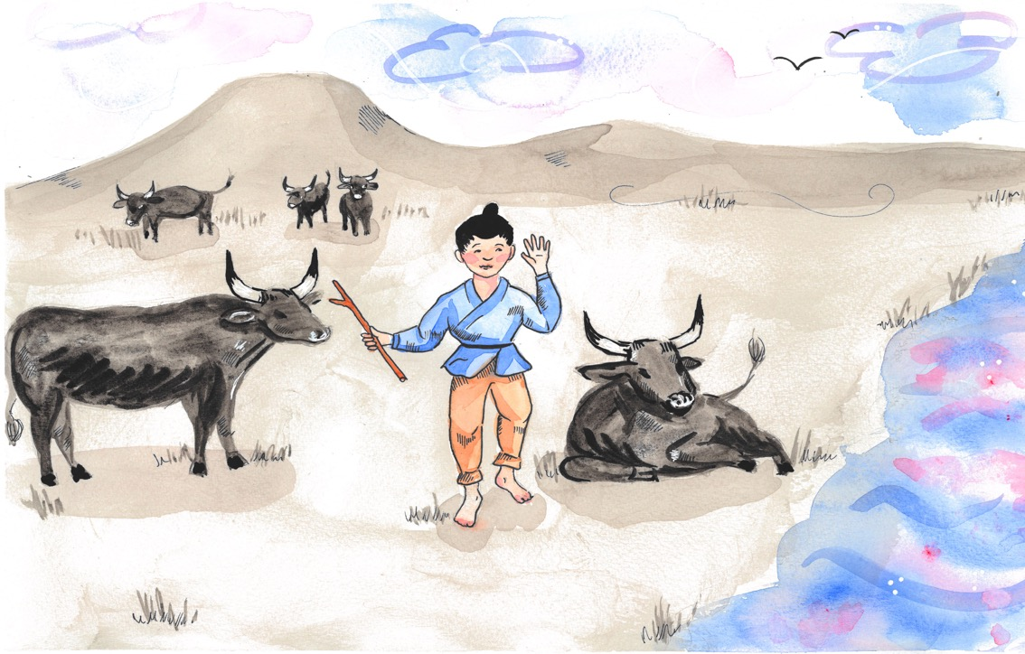
Notes:
Read to the students
Long, long ago, there was a beautiful young girl called Orihime who lived in the Milky Way with her father, Tentei, Emperor of the heavens. Orihime was a weaver and made beautiful clothes for her father to wear.

Slide 6
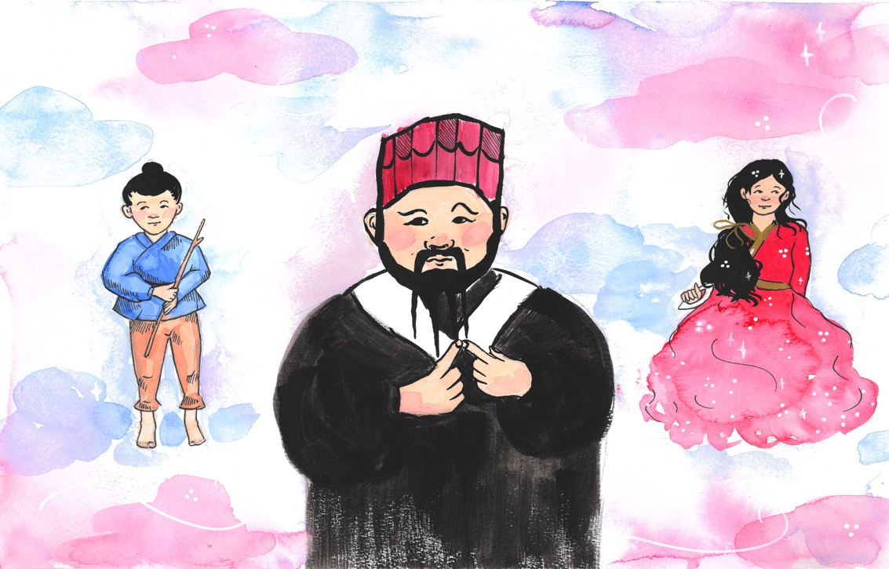
Notes:
Read to the students
There was also a young boy called Hikoboshi who lived in the Milky Way, on the other side of the Milky Way River. He was as a cattle herder and spend long hours outside each day looking after his cattle.

Slide 7
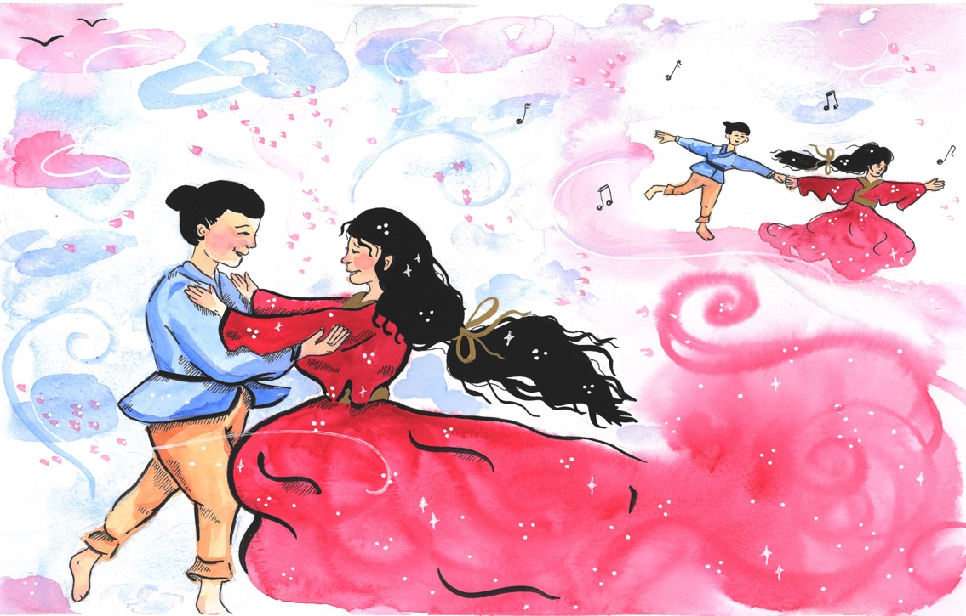
Notes:
Read to the students
Tentei began to worry that his daughter was working too hard and might be lonely. One day he had an idea that he thought would help. He decided to introduce Orihime to Hikoboshi. He thought they would get along well and could help each other with their work to become rich and prosperous.

Slide 8
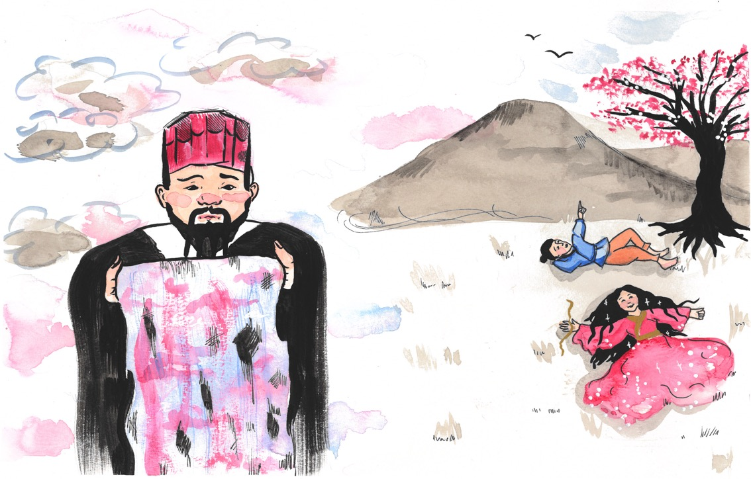
Notes:
Read to the students
Tentei was right; Orihime and Hikoboshi got on very well indeed. In fact, they fell deeply in love and Orihime crossed over to the other side of the Milky Way River to marry Hikoboshi. They spent all their time together, talking and laughing. From morning until evening they would sit in the shade as Orihime combed her long black hair and Hikoboshi made music by blowing through reeds.

Slide 9
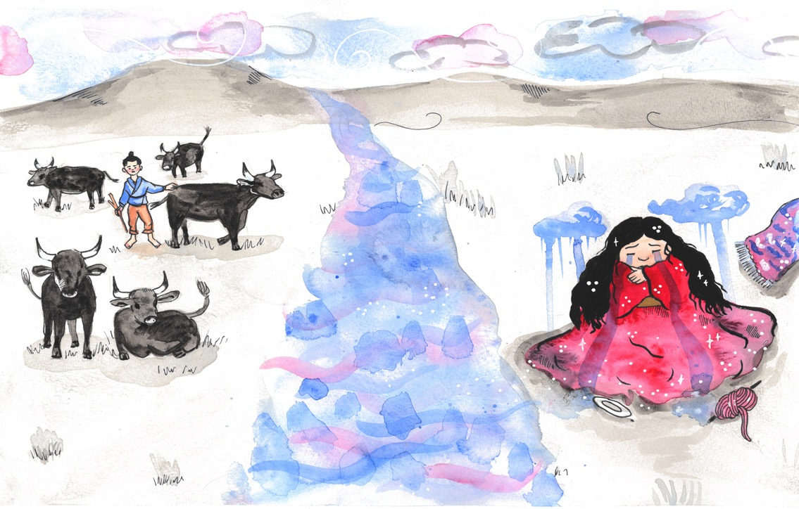
Notes:
Read to the students
After only a short while, Orihime’s fingers forgot how to weave and Hikoboshi’s skilled hands forgot how to control cattle. Tentei despaired. He said “If this continues then all our heavenly garments will be rags and all the cows will be left to roam freely and become sick.” Orihime and Hikoboshi showed no signs of getting back to work.

Slide 10
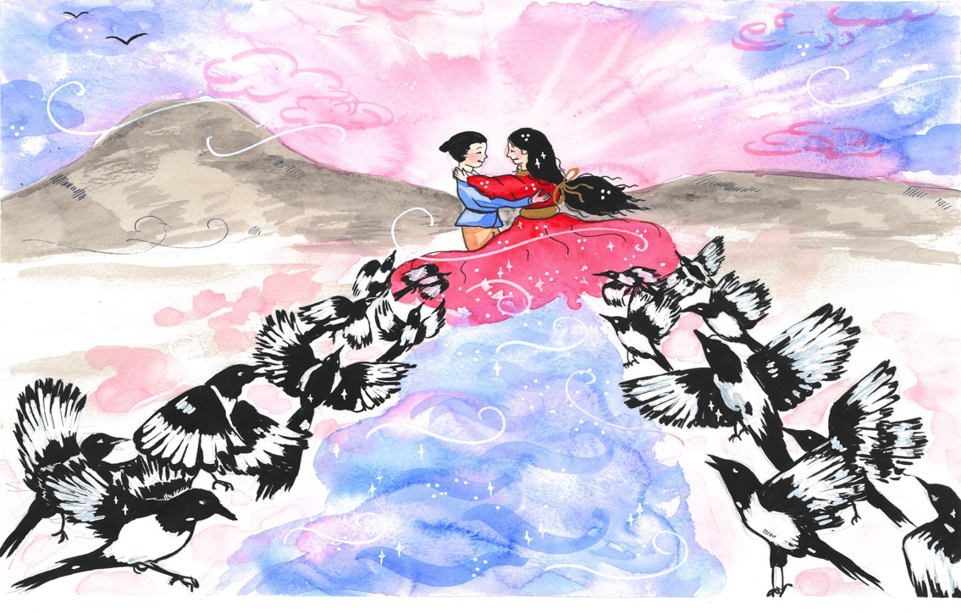
Notes:
Read to the students
So Tentei decided the couple had to be separated and he told Orihime that she must return to her original home, on the other side of the Milky Way river. Orihime had no choice but to do as he said, and so she crossed the river. Although Orihime began to weave again and Hikoboshi went back to tending to his cattle, they were both so upset by their separation that they weren’t able to do much work. They missed each other so much that they started to lose weight and look ill.

Slide 11
Notes:
Read to the students
When Tentei saw how upset they were and how ill they looked he felt sorry for them. He thought about what to do and announced, “Orihime and Hikoboshi, I will permit you to meet once a year.” He decided that the day would be the 7th July.
So on the evening of the 7th July, Orihime and Hikoboshi ran towards the banks of the Milky Way River. Suddenly a flock of magpies appeared from nowhere and spread out their wings to form a bridge.
It is said that this happens every year and Orihime crosses the bridge to join Hikoboshi. However, if it rains, the Magpies don’t come and Orihime is unable to cross the river to meet Hikoboshi. If this happens, the couple have to wait another year until they can be reunited.

Slide 12
The End

Slide 13


Now that you understand why
7th July is a special day,
let’s learn more about the festival!

Slide 14
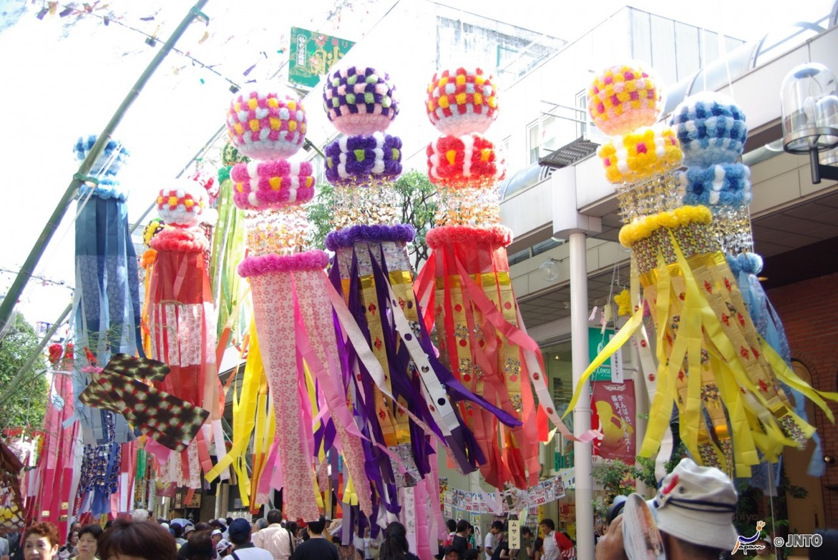
Decorations
Notes:
Tell Students
Many places in Japan have Tanabata Festivals
It’s common to see huge colourful decorations like these hanging in the streets and shopping areas
These streamers represent Orihime’s yarn

Slide 15
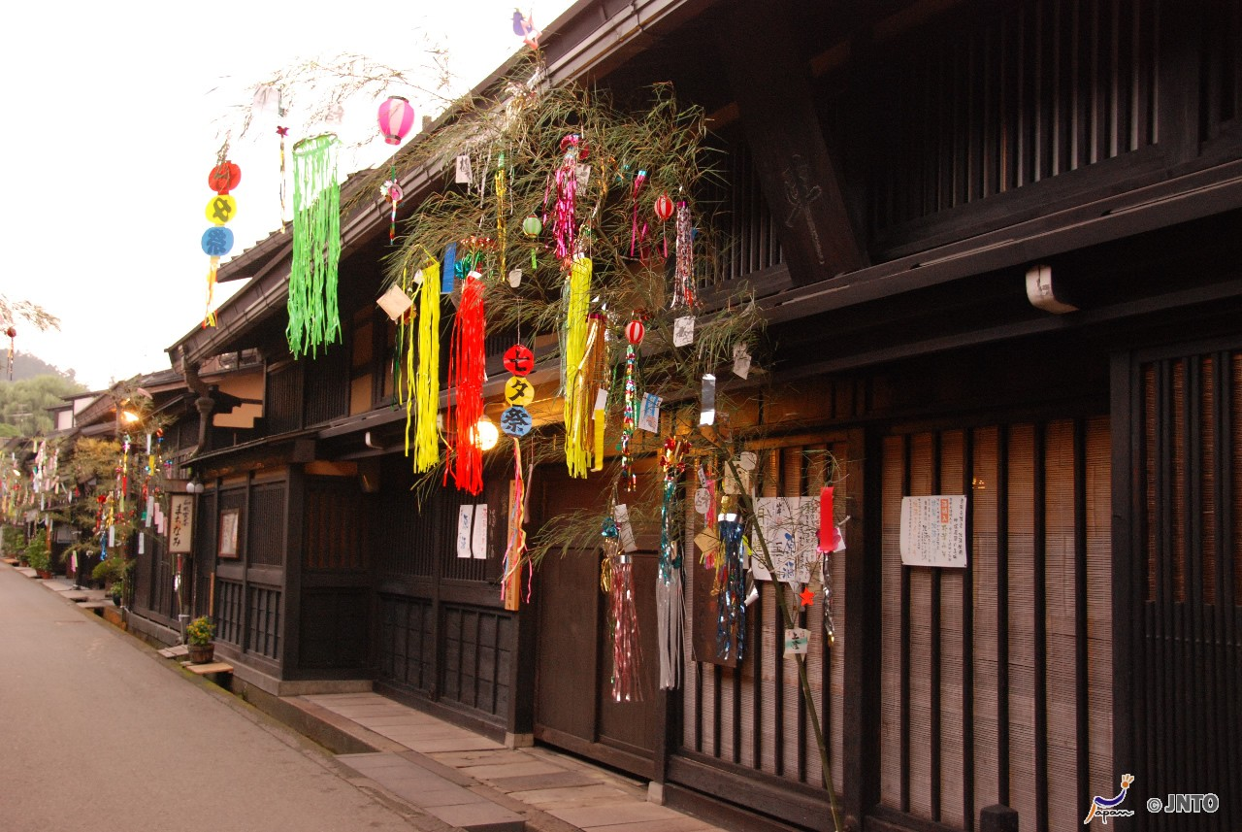
Notes:
Tell students
It is also common to see smaller decorations like this, outside homes and business.
Ask students
What plant are the decorations hung on? (Answer: Bamboo)

Slide 16
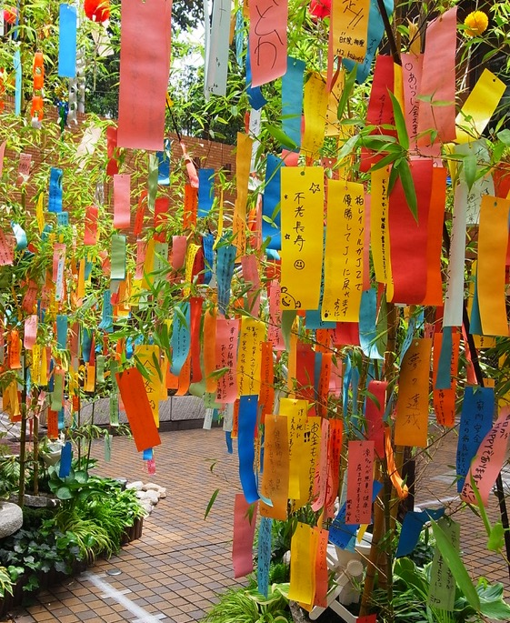
Customs
These are wishes, written on Tanzaku.
Traditionally, people wrote wishes to pray for the couple’s reunion.
Now many people write their own wishes as well.
They are hung up on bamboo plants outside shops, homes and shrines.
Notes:
Ask students
What do you think these are?
Tell students
Tanzaku are strips of paper normally used for writing poems on.
Early July is still the rainy season in Japan and people pray that July 7th will be fine so that the couple in the story can meet.
Traditionally people wrote wishes for the couple on strips of paper and hung them from bamboo branches.
Anyone, old or young, can write a wish on a tanzaku

Slide 17
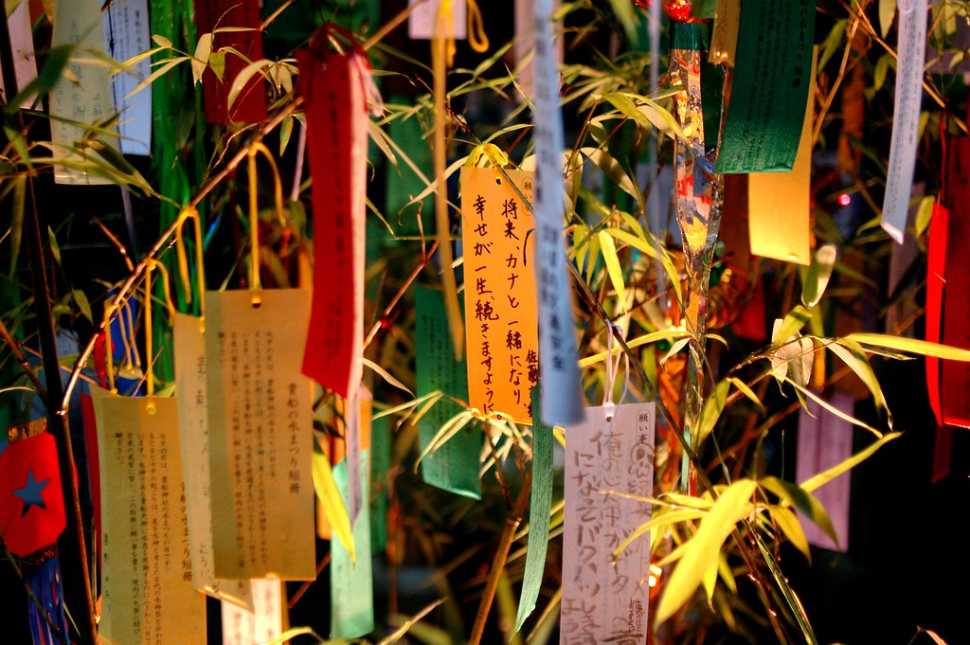

Slide 18

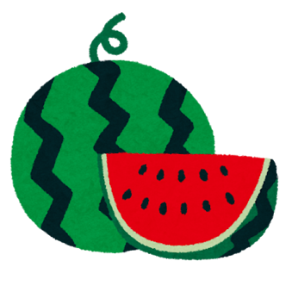
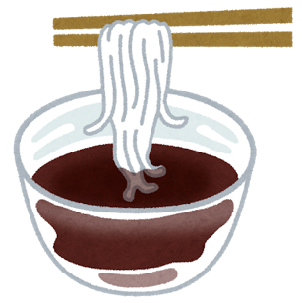
Summer Food
Tanabata takes place in summer when it is hot.
Some things eaten in summer in Japan are:
Shaved Ice
kakigori
Watermelon
suika
Noodles
somen
Notes:
Ask students
What are summer foods in the UK? What do you like to eat in summer?
Tell students
Kaki-gori (kakee-goh-ree) is a desert or sweet treat. It’s a bowl full of small ice flakes covered in a sweet syrup and sometimes fruit as well. There are lots of syrup flavours. It’s similar to a slushie.
Suika (sue-ee-kah) Watermelon is popular in summer in Japan. They are usually quite expensive (£10-15 for a whole watermelon) and can be given as a gift to friends and family.
Somen (So-men) In the winter, noodles are normally eaten in a hot broth or soup. In the summer, people can eat chilled somen noodles which are very thin and are served with a sauce to dip them into.

Slide 19
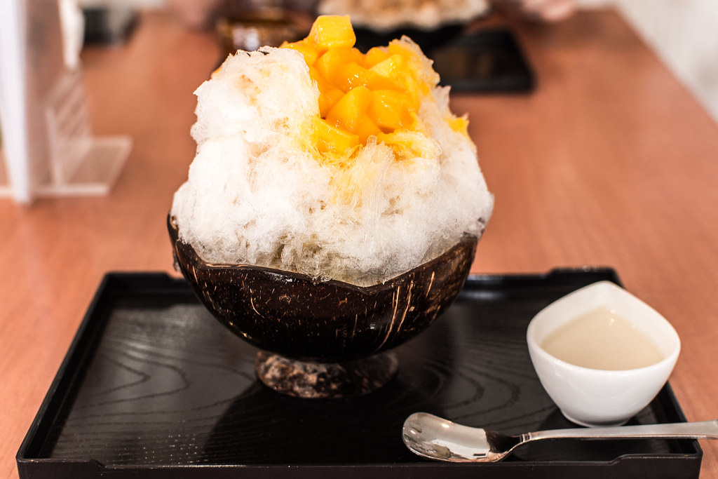
Notes:
Tell students
This is a picture of kakigori (shaved ice) with mango.

Slide 20
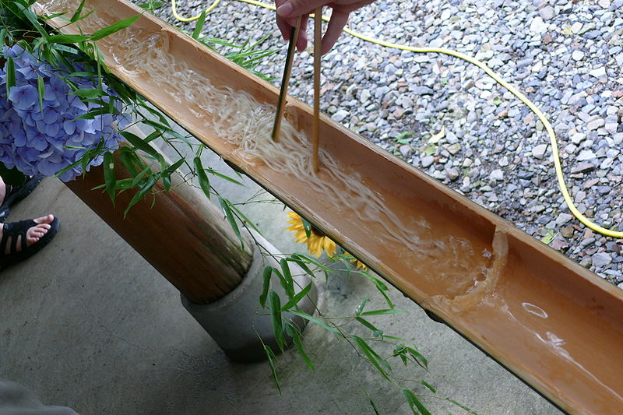
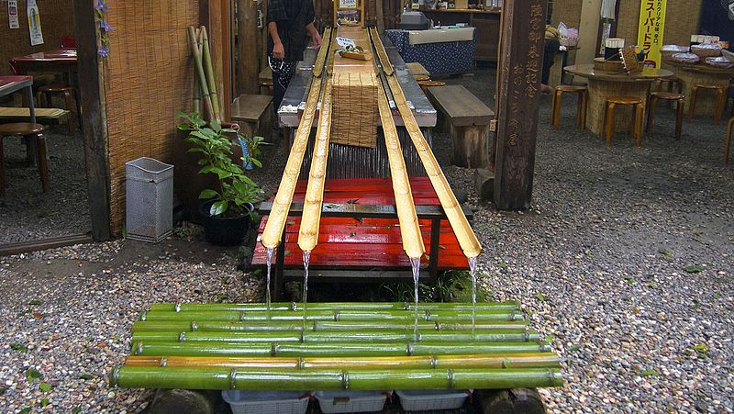
Notes:
Tell students
Sometimes somen noodles are eaten in a special way.
The noodles are in water and poured down shoots of bamboo.
As the noodles slide down the bamboo, people try to catch them with their chopsticks.
This is called ‘Nagashi Somen’ because Nagashi means “flowing”
• Here is a short clip of what Nagashi Somen looks like in action: https://www.youtube.com/watch?v=foZ_BllZayQ&feature=youtu.be

Slide 21


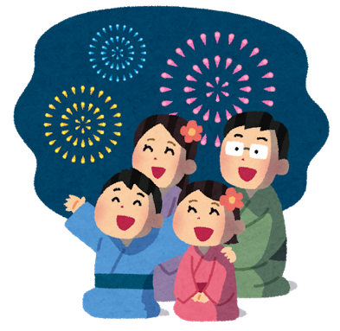
Sights +Sounds of Summer
Wind Chime
Furin
Cicada
semi
Fireworks
hanabi
Notes:
Ask students
What sounds remind them of summer? E.g. The music of an ice cream van
Play a short clip from the YouTube videos below so the students can hear the wind chimes and cicada.
Semi (cicada): https://www.youtube.com/watch?v=rs7Lr2d-INo (Note: There are 4 kinds of cicada in the video with distinct calls.)
Furin (wind chime): https://www.youtube.com/watch?v=qmKwTN0PIJ8

Slide 22

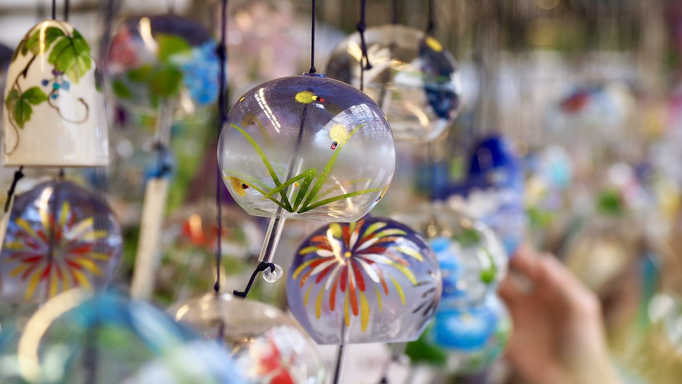
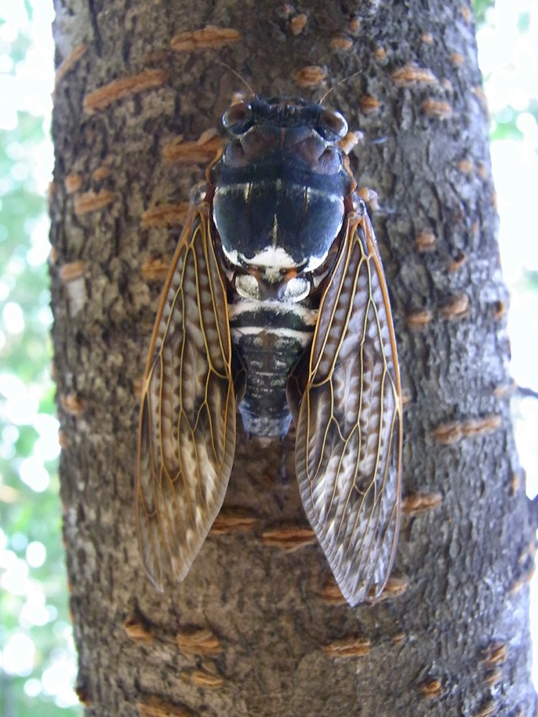
©Hiroshima Convention & Visitors Bureau

Slide 23
Tanabata Quiz
True
True
 | Tanabata takes place in Autumn
 | People celebrate on July 7th
 | Tanabata is also called the Moon Festival
 | People hang Tanzaku on cherry blossom trees
 | Tanabata is based on an old love story
Answer:
In summer
False
False
False
Answer:
The star festival
Answer:
On bamboo

Slide 24



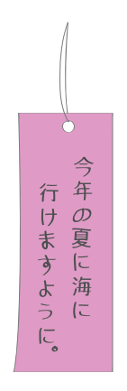
Task
Let’s write a wish on Tanzaku
Notes:
Teacher’s Note
Please visit our Tanzaku page for instructions on how to make one: https://www.japansociety.org.uk/resource?resource=39.
You can also watch a short clip with simple instructions here on our YouTube channel: https://www.youtube.com/watch?v=hq02pCYdE4c.

Slide 25

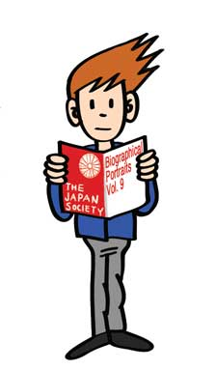


The Japan Society
13/14 Cornwall Terrace, London NW1 4QP
Tel: 020 7935 0475
Email: education@japansociety.org.uk
www.japansociety.org.uk
Follow us on:
@japansocietylon
@JapanSocietyLondon

