Slide 1
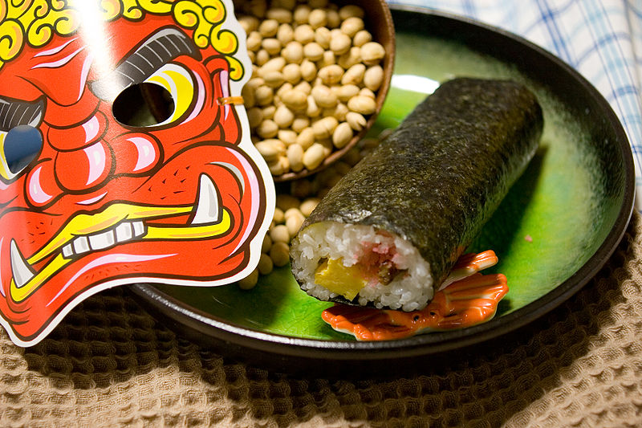

Setsubun
© sakura_chihaya+/CC BY-SA 2.0
Notes:
Image: sakura_chihaya+/ CC BY-SA 2.0 (no changes)

Slide 2

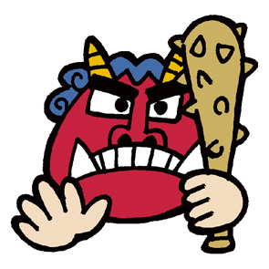
Setsubun
Setsubun is a traditional Japanese festival on February 3.
This celebration marks the end of winter
and the beginning of spring.
Seasonal
Division
節
分
setsu
bun
Notes:
Tell students
The Japanese word is made up of two characters which mean ‘seasonal’ and ‘division’.
(The pronunciation of the ‘bun’ is ‘boo-n’).

Slide 3
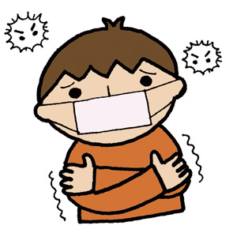
Setsubun
February is a cold month in Japan.
It is easy to get sick so it is a time when people wish for good health and fortune.
In the past, it was believed that bad luck and bad health was caused by demons (Oni).
Today, Japanese families take part in traditional ceremonies and games to celebrate Setsubun.

Slide 4
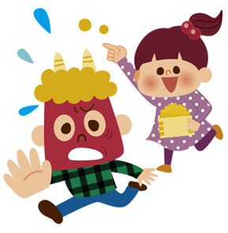
Bean Throwing
Mamemaki (Bean Throwing) is a ceremony where people throw roasted soy beans around the room to try and get rid of the demon.
This is lots of fun and usually someone pretends to be the Oni by wearing a mask.
The Oni gets chased by people throwing beans!
Notes:
Tell students
People shout:“oni wa soto, fuku wa uchi!”, which means ‘out with the demon, in with good luck’!

Slide 5
Ehō-maki
These large sushi rolls are supposed to be eaten without speaking or stopping!
They should bring good fortune and people make a wish as they eat.
Roasted Soy Beans
People also eat them. You should eat one for every year of your age to wish for health and happiness.
Oni Mask

Slide 6
Setsubun Quiz
True
True
 | Setsubun takes place at the end of spring
 | Some people dress up as a demon and have beans thrown at them!
 | ‘Oni’ means ‘beans’ in Japanese
 | When you eat a sushi roll during Setsubun, you have to stay silent
 | You should eat one sushi roll for every year of your age
Answer:
End of winter!
False
False
False
Answer:
Demons
Answer:
Eat one bean for every year!

Slide 7
Vocabulary Challenge
Fuku
Sushi rolls
 | Oni
 | Ehomaki
 | Mamemaki
 | Good luck
 | Festival marking beginning of Spring
Demons
Bean
throwing
Setsubun

Slide 8




This resource was developed by the Japan Society in collaboration with Katy Simpson
The Japan Society
13/14 Cornwall Terrace, London NW1 4QP
Tel: 020 7935 0475
Email: education@japansociety.org.uk
www.japansociety.org.uk
Follow us on:
@japansocietylon
@JapanSocietyLondon

