Slide 1


Draw what you see…
You have two minutes
Choose an image
Draw what you see without lifting your pencil from the paper
Don’t worry about the detail...
©Yasufumi Nishi/©JNTO
Notes:
Teacher’s Notes – Settler activity
The task should be a short, fun warm up of only 1 or 2 minutes
Include one, all or different images depending on your class
You can add an additional rule that students shouldn’t look down at what they draw
When the 2 minutes if up students should put their drawings to one side… we will come back to them later in the session.

Slide 2

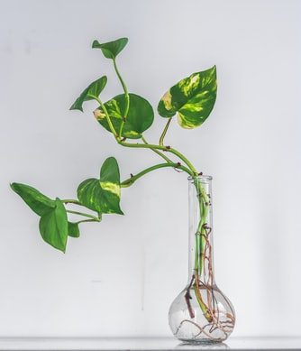
Photo by Galina N
Photo by Waseem Khan
Photographs sourced from Unsplash

Slide 3

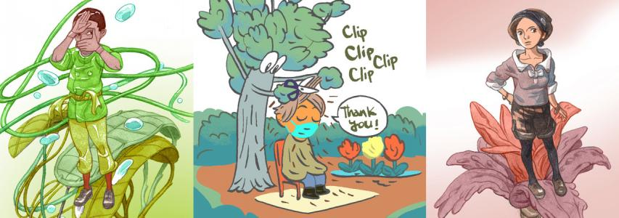
Magnificent Manga
© Fumio Obata
Notes:
Lesson Theme: Exploring the links between positive wellbeing and the development of new skills and knowledge through the Japanese art of manga

Slide 4

Learning Objectives
I can explain what manga is
I can explore emotions and create a manga character
I can consider why learning new skills improves wellbeing

Slide 5
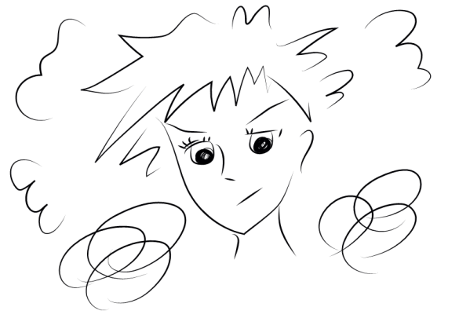
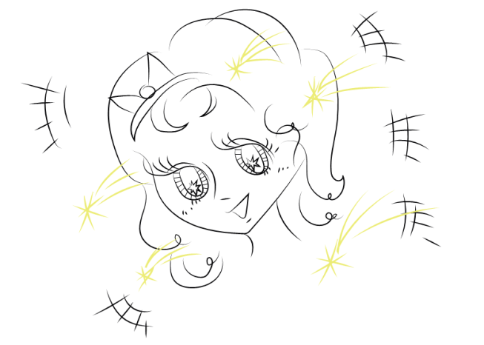
What is Manga?
Manga is a style of drawing that comes from Japan
Manga books look like comic books or cartoons
Manga is very popular in Japan with both children and adults
©Yasufumi Nishi/©JNTO
Click on the pictures to see them being drawn
Notes:
Ask students
What do they notice about the nose and mouth in the drawings? Are they simple or detailed?
What about the eyes?
Which character do you like best and why?

Slide 6
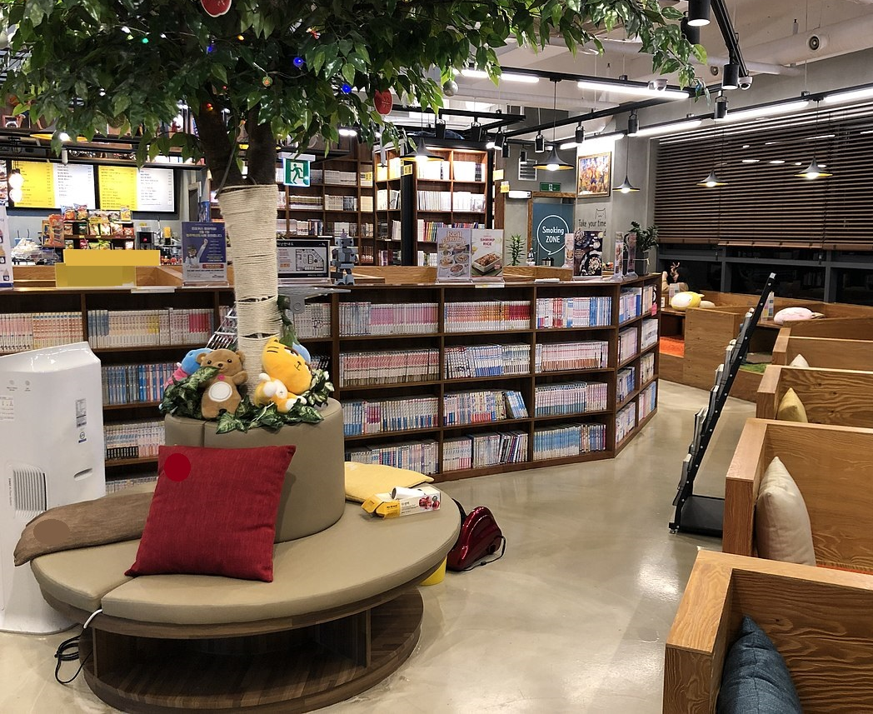
Manga Cafes
In Japan there are even ‘Manga Cafes’
They are like libraries, but they only have manga!
People pay so they can sit and read
They can also buy drinks and snacks
©Kimberley Evans in collaboration with The Japan Society
Notes:
Teacher’s notes
Popular manga series can go on for years and extend into hundreds of volumes.
Buying each volume can be expensive and take up a lot of space so manga cafes are a more economical way of enjoying manga.

Slide 7
Photo by Galina N
Photo by Waseem Khan
Go back to your pictures and add as much detail as possible! ( 5 minutes)
Notes:
Teacher’s Notes
Teacher to decide how long to spend on this. Minimum suggested time - 5 minutes.
Students should focus on the object and not the background.

Slide 8
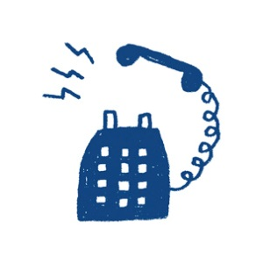
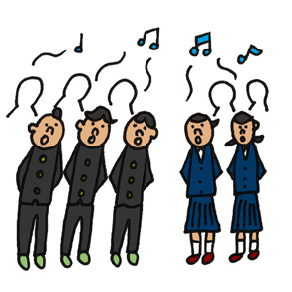


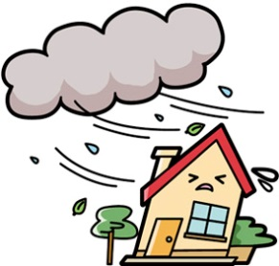
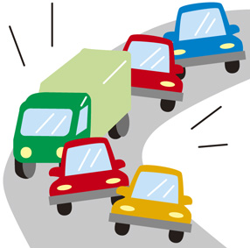
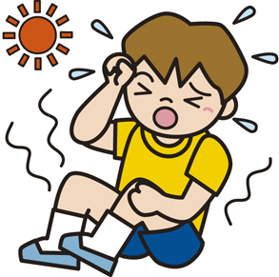

Think, pair, share…
Manga uses many types of speech bubbles and lines.
What do you think the different lines mean in these pictures?
1
2
3
4
5
6
7
8
Notes:
Teacher’s Notes
Think, pair, share activity then go through each picture asking the students what the lines mean in each one.
Following this, students should identify that the lines are used here to show detail, sound, movement or emotion.

Slide 9

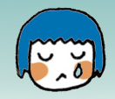

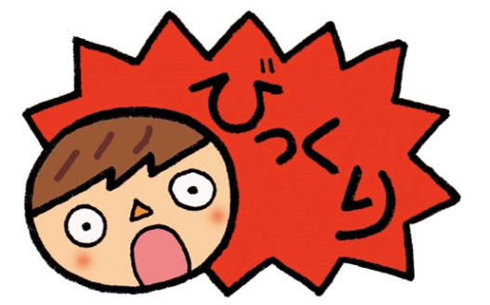
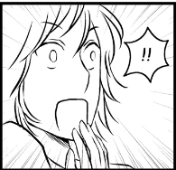
Identifying Emotions
Facial expressions are important. What do they tell us?
What do you think these characters are feeling?
1
2
3
4
5
©Chie Kutsuwada
Notes:
Teacher’s notes
Begin with a general conversation about why facial expressions are important in our lives. What do they tell us? Students should be able to explain that facial expressions tell us about how someone is feeling… they are linked to our emotions.
Can ask students to give an example of an emotion and a facial expression.
Therefore important to show our own feelings but also gives us a clue about the feelings of other people.
Then relate to Manga - the different speech bubbles and facial expressions are important so the reader can understand how the characters are feeling.
- Have a go with the example pictures i.e. what emotion is that?

Slide 10
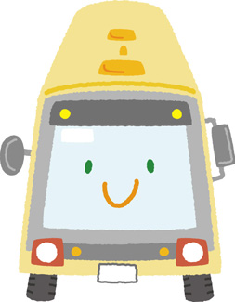
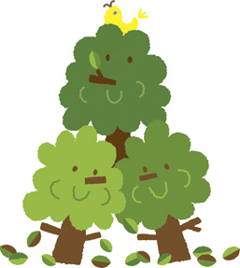
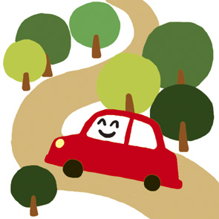





Faces and feelings
In manga, sometimes animals, plants and everyday objects have faces and feelings...
Notes:
Teacher’s notes
Students will be familiar with this concept from books and films. Draw out this comparison and ask for examples.
Today they will learn how to draw some manga facial expressions and make an everyday object into a character of their own.

Slide 11

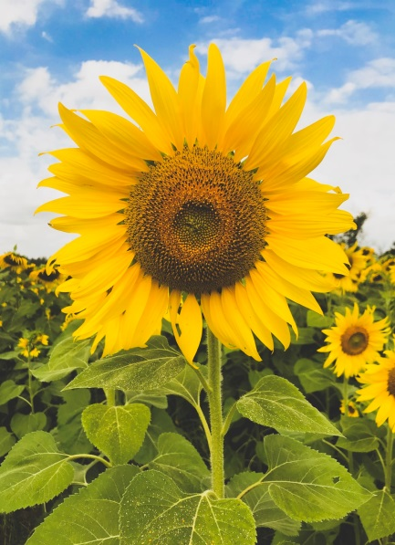


Creating characters
What kind of personalities could you give these plants?
Notes:
Teacher’s Notes
There is an extension activity where students can design their own characters. See additional resources.

Slide 12



Making a Character
Give your plant a name
Write down 3 adjectives to describe their personality (do not show anyone!)
Draw your plant a face
Notes:
Teacher’s Notes
Ask students to add a face to their drawing.
Slide of how to draw eyes and mouths showing different expressions can be handed out (as on next slide).

Slide 13
Example Expressions
Notes:
Teacher’s Notes
This slide can be shown if you wish or printed off and given to students to help them design their plant’s facial expression.
See resources for slide as a downloadable worksheet.

Slide 14
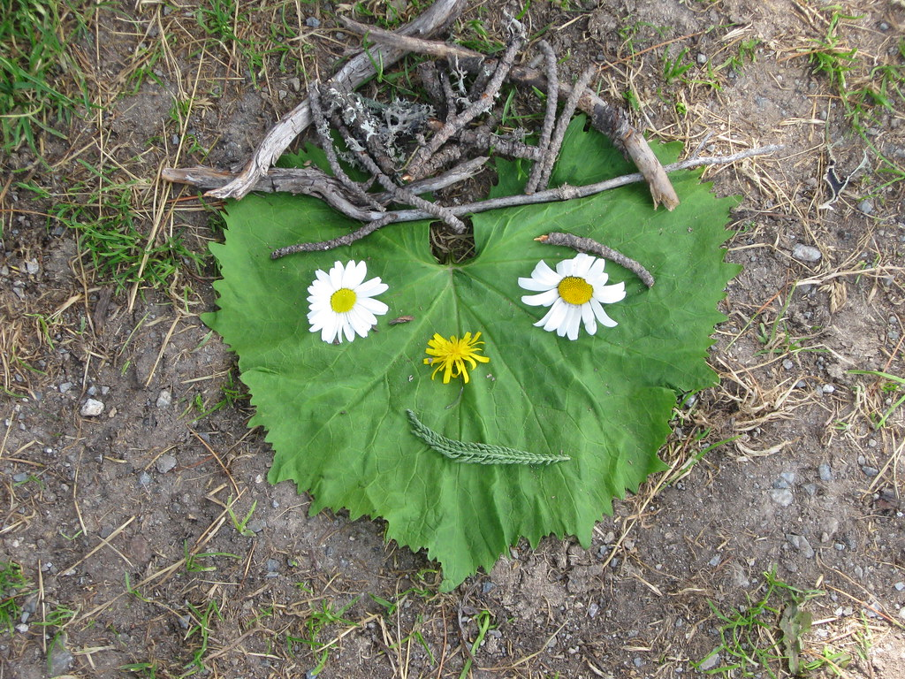
Share your
character
Introduce your character...
Can anyone guess their personality?
Can they guess your three adjectives?
"Nature Smiley Face" by greenoid is licensed under CC BY-SA 2.0
Notes:
Teacher’s Notes
Students can share in pairs, small groups, or volunteer to show to the whole class.

Slide 15

Reflection
Which one of the ‘5 Ways to Wellbeing’ have we been practising today?
Why do you think that learning new things is good for wellbeing?
Notes:
Teacher’s Notes
Facilitate a class discussion and reflection to end the lesson.
We have focussed on ‘Keep Learning’ Learning new things is good for wellbeing for a number of reasons. E.g.
1. It increases self-esteem showing us that nothing is fixed and that we can be in control of our own progress
2. It can encourage social interaction
3. It can give us hope for the future
4. It can help us handle stressful situations
5. We can find new passions or things we enjoy

Slide 16
Wellbeing in school
Teachers should use this slide to signpost to any provision they have in school i.e. school counsellor, worry box, teachers etc.
Whilst it is normal for us to have ups and down, if pupils are feeling sad and the feeling does not go away then they should talk to someone they trust.

Slide 17




This resource is based on a workshop designed by Fumio Obata and has been adapted by Kimberley Evans in collaboration with the Japan Society.
The Japan Society
13/14 Cornwall Terrace, London NW1 4QP
Tel: 020 7935 0475
Email: education@japansociety.org.uk
www.japansociety.org.uk
Follow us on:
@japansocietylon
@JapanSocietyLondon

