Slide 1
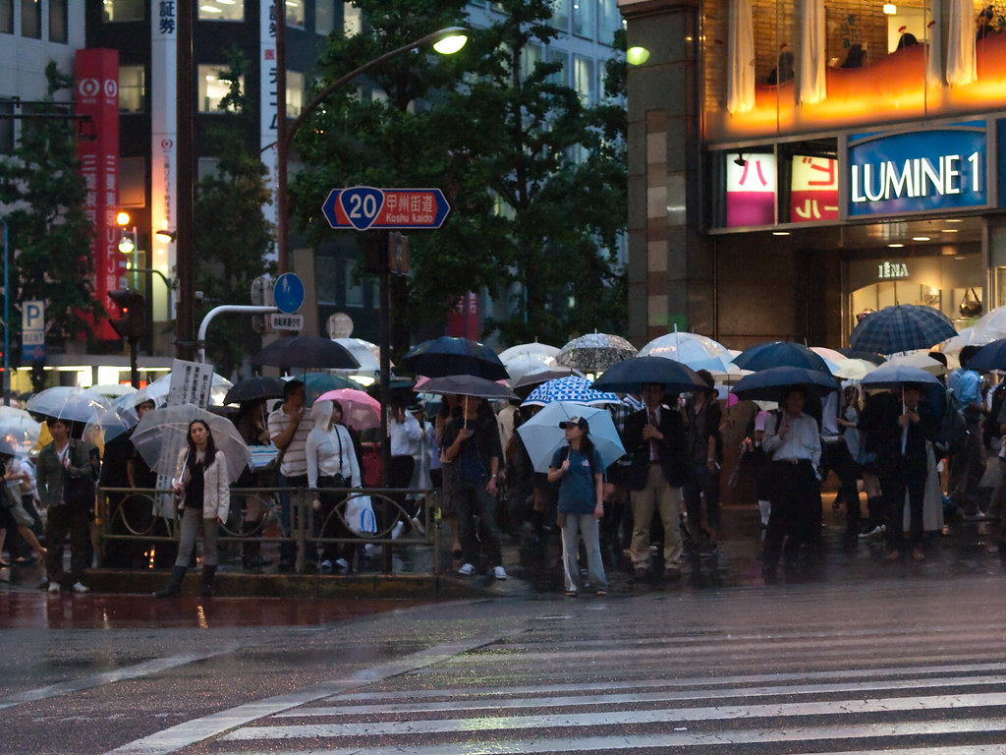

Rainy Season
Notes:
Prior to showing this presentation, ask students about seasons in their country.
How many seasons are there?
What is the weather like in each season?
Which months do we usually get the most rain?

Slide 2


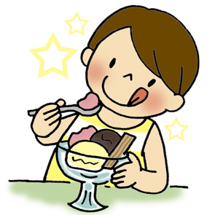

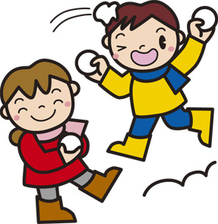
Seasons in Japan
How many seasons does Japan have?
Japan has 4 seasons.
Notes:
Ask students
Do they think seasons in Japan are the same, or different to the UK/their country?
How many seasons do they think Japan has?

Slide 3
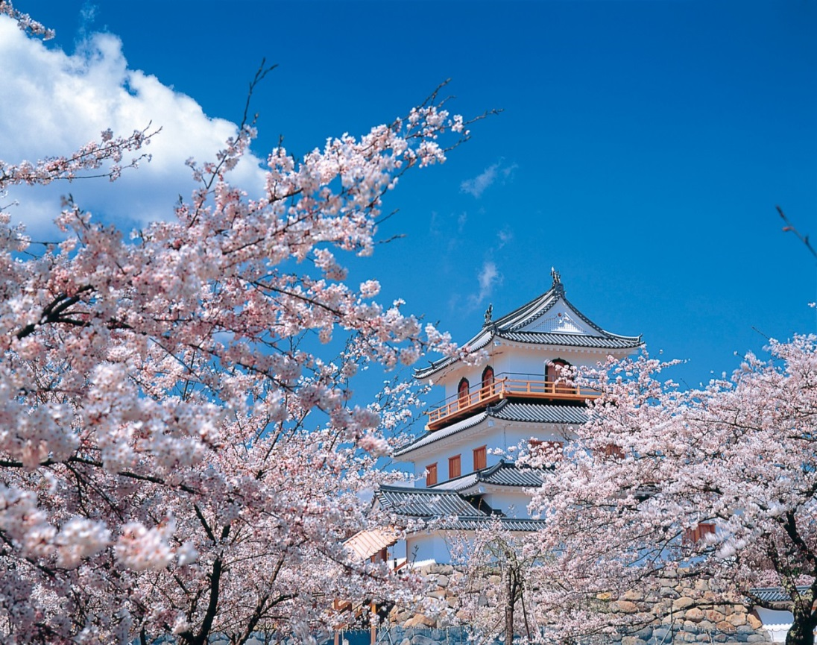
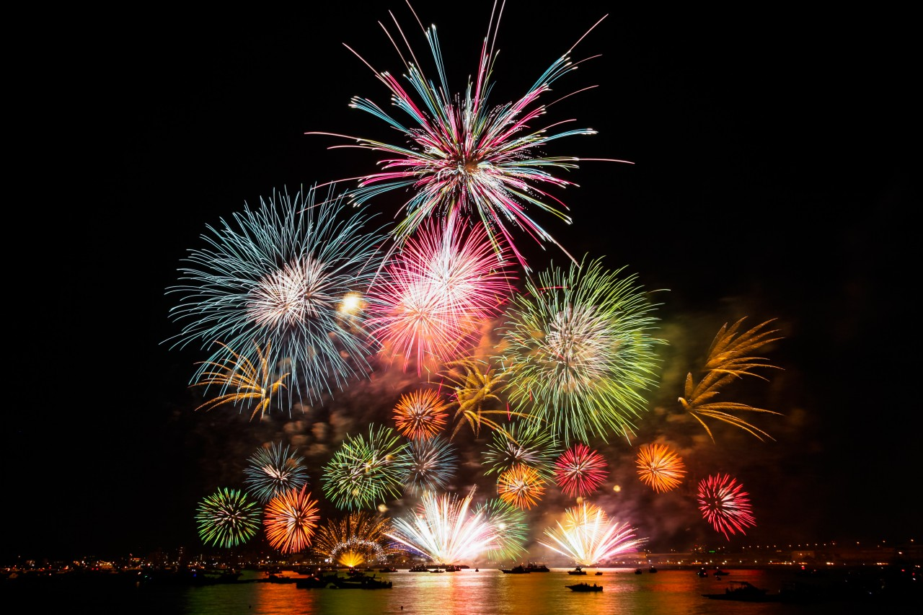
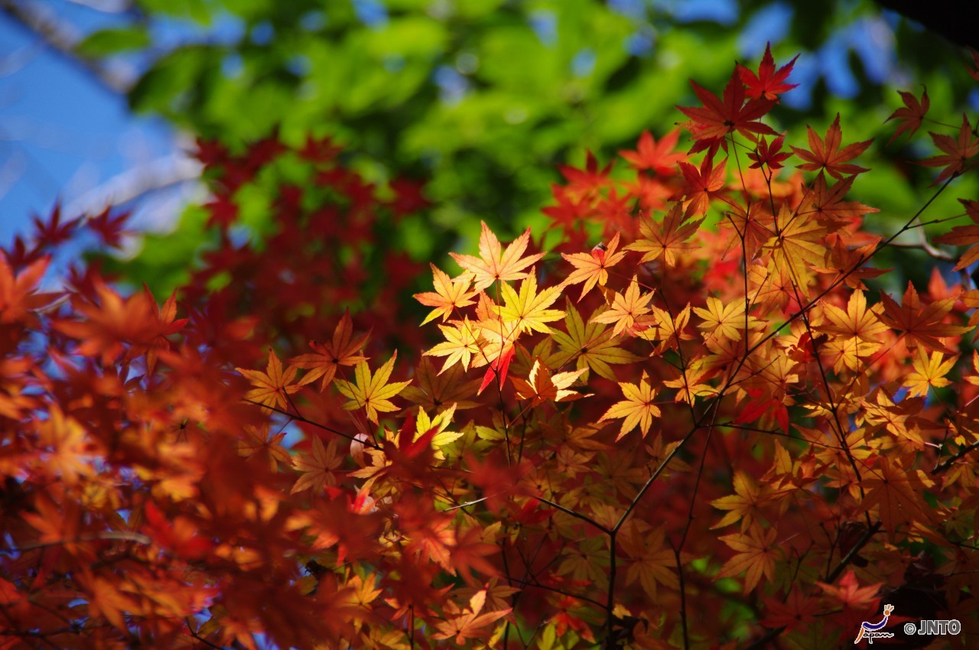
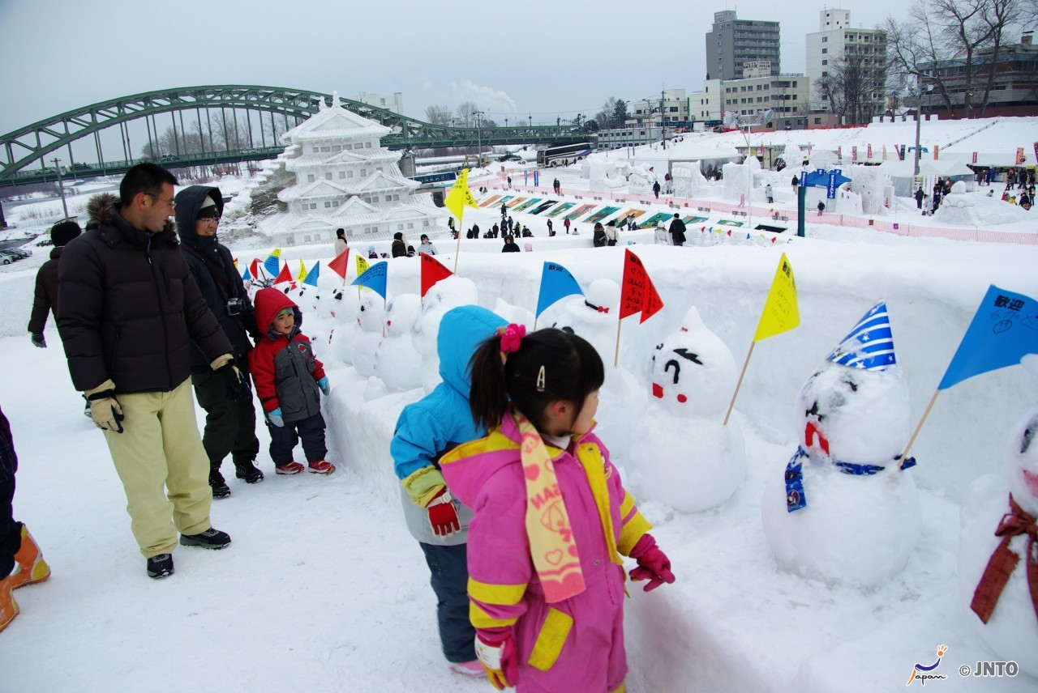
©Miyagi Prefecture/©JNTO
©Hiroshima convention & Visitors Bureau
Spring
Four Seasons in Japan
Summer
©Yasufumi Nishi/© JNTO
Autumn
Winter
©Yasufumi Nishi/©JNTO
Notes:
Tell Students
Spring: Cherry blossom trees are in bloom in spring. Many people have picnics underneath them.
Summer: Firework displays are usually held at summer festivals in Japan. It can be very hot and humid.
Autumn: People look forward to seeing the beautiful colours of the autumn leaves.
Winter: A snow festival in the north of Japan (Asashikawa City). The north of Japan is very cold in winter and has lots of snow.

Slide 4

Rainy Season
As spring turns into summer, Japan has a ‘rainy season’
It rains a lot and is very wet throughout June
June has more rainfall than any other month
The rainy season is called Tsuyu in Japanese.
Notes:
Pronunciation of Tsuyu is tsue-you
Tell students
As well as the 4 seasons, Japan has a ‘Rainy Season’ which lasts about 4-6 weeks.
The start of rainy season varies by region, but in most places it rains a lot throughout June and into early July.
In some places it rains almost every day.

Slide 5
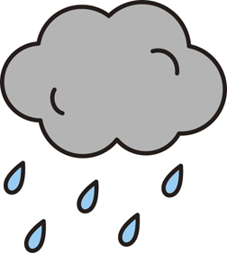
Temperature
It is hot even though it rains a lot
This means it feels humid outside
The average temperatures in June in Tokyo are:
Lowest
Highest
18ºC
26ºC
Notes:
Teacher notes:
Help students to understand how humidity might feel. Ask them to imagine they have just stepped out of a hot shower and that the air is full of moisture.
Find out the local average temperature in June and ask students if they think Japan is hotter or cooler than their area in June before revealing the answer.
Japan figures from JNTO (rounded up): https://www.jnto.go.jp/weather/eng/area_detail.php?area_id=4410

Slide 6
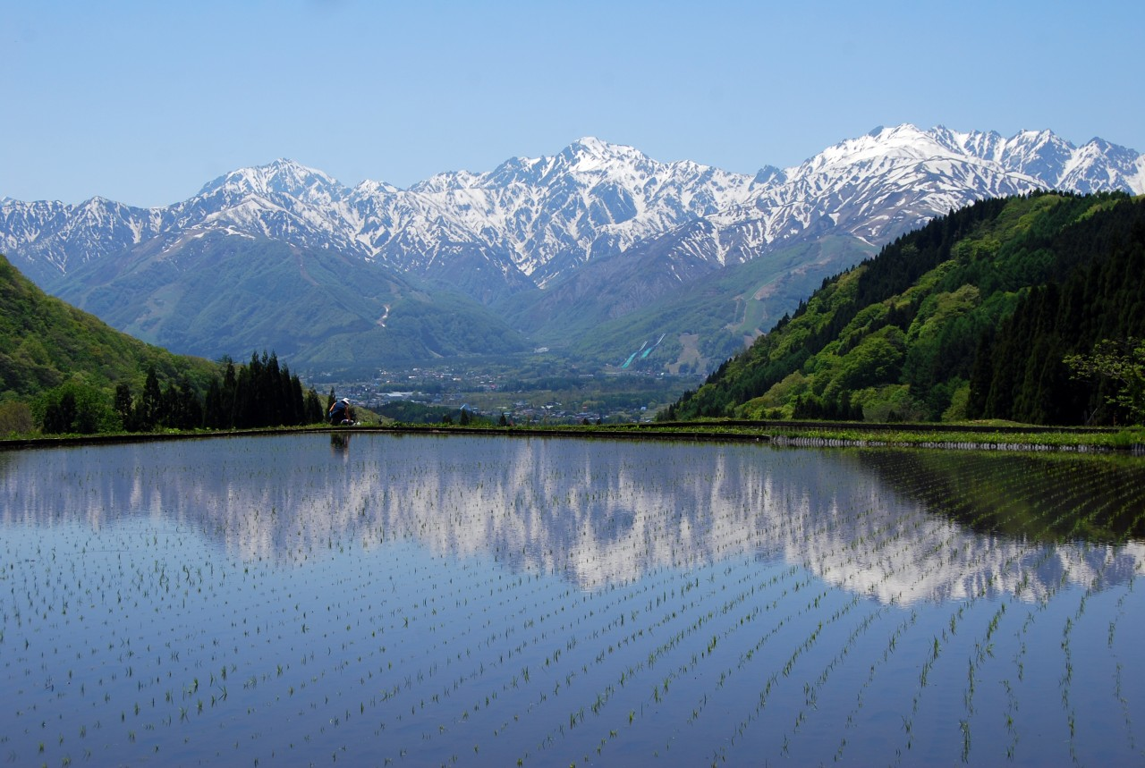
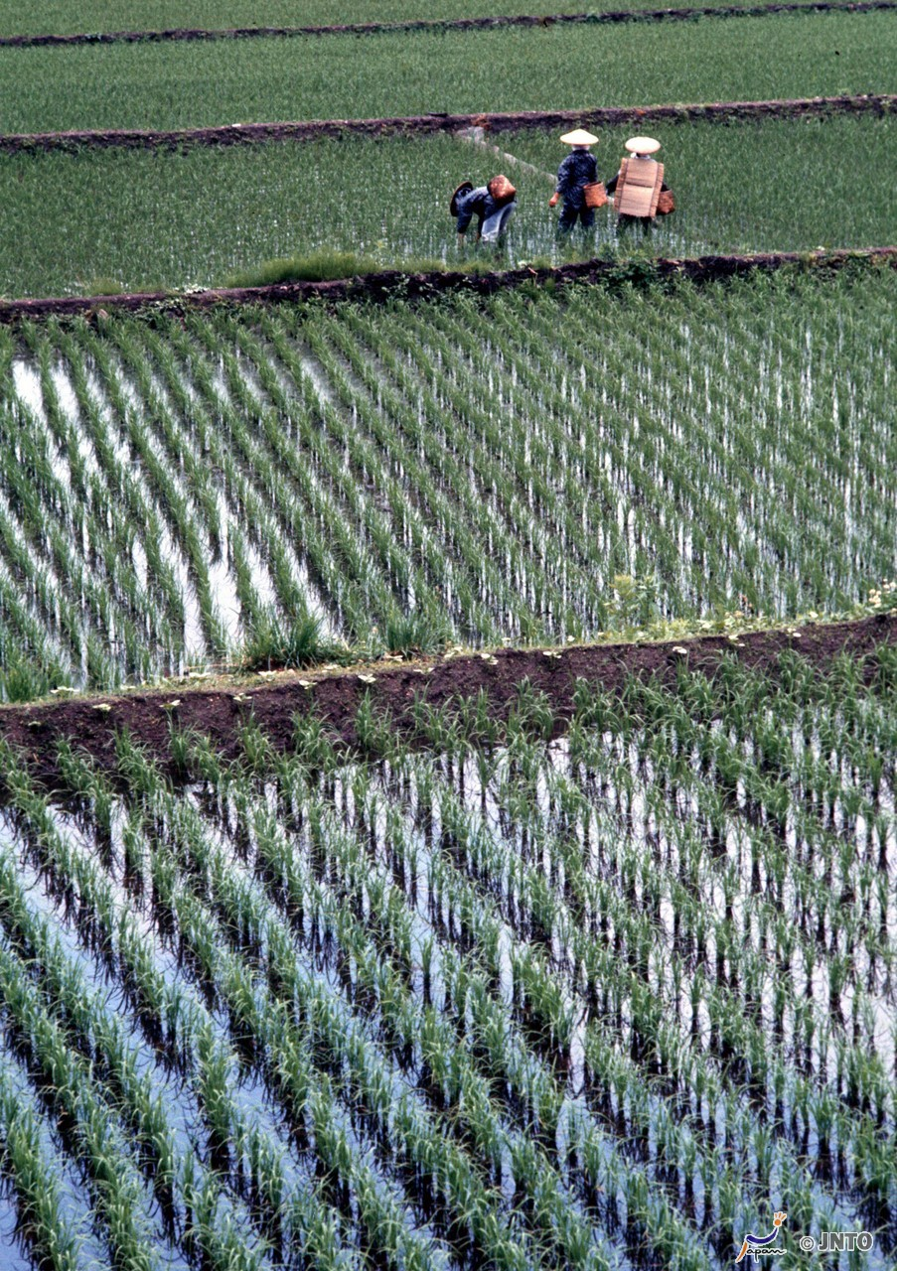
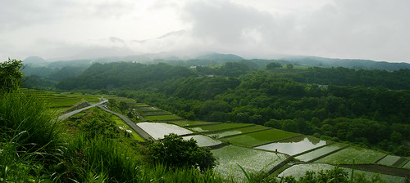
©Tourism Commission of Hakuba Village/©JNTO
Rainy Season
Rainy season is important
Can you guess why?
Notes:
Tell Students
Even though it may be gloomy and uncomfortable, rainy season is important. Rainy season is important for growing food, especially rice.
Farmers plant the rice from the end of April - June.
When it rains, the rice paddies in rural areas fill up with the water and the rice can grow. It is harvested later in the year.

Slide 7
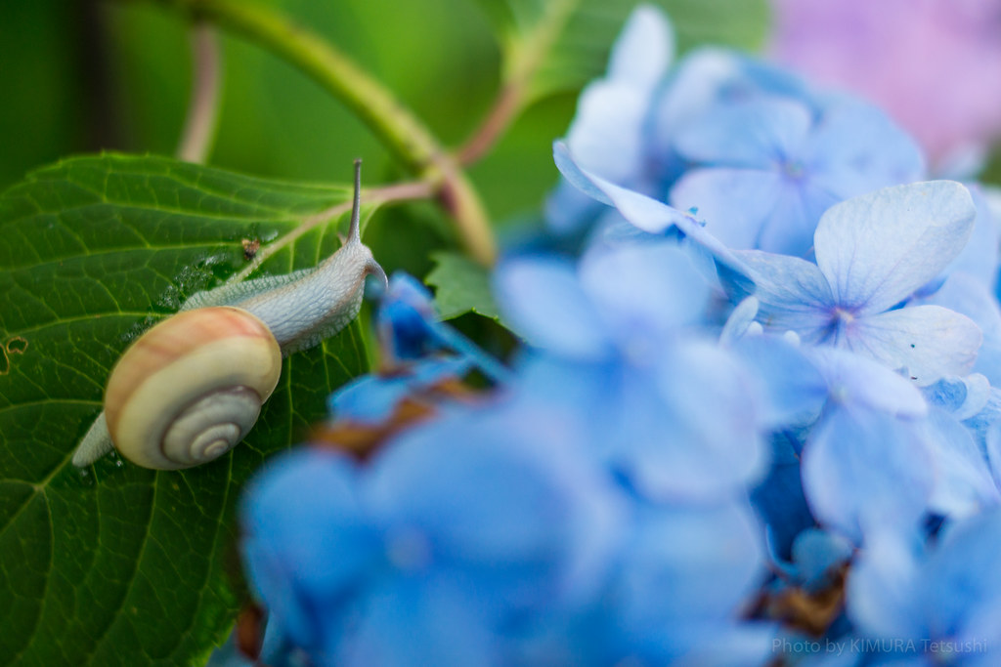
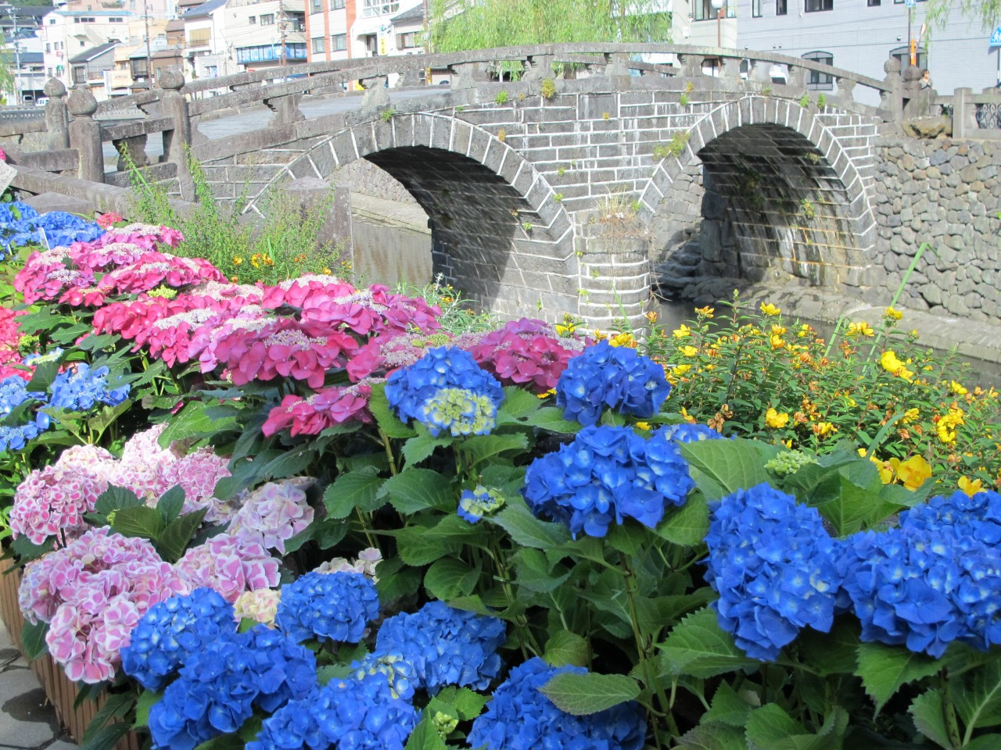


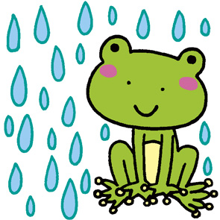
Common sights
During rainy season it is common to see:
Snails
katatsumuri
Frogs
kaeru
Hydrangeas
ajisai
© Nagasaki Prefecture Tourism Association
Notes:
Ask students
When do you think it rains the most in the UK? Are there any particular plants or animals that come to mind?
Tell students
As well as being important for growing food, animals and plants and flowers also appreciate the rain.

Slide 8

Rain Rhymes
Do you know any songs or rhymes about rain?

Slide 9

Words for Rain
How many different words
for rain can you think of?

Slide 10
Japanese Onomatopoeia
There are many descriptive words for the weather in Japanese
Try to guess what they mean from the sounds
sudden heavy rain | rumble of thunder | flash of lightning | drizzle | light sprinkle
go-ro go-ro | za za | shi-to shi-to | pi-ka pi-ka | pa-ra pa-ra
Notes:
Teachers note: Students can use the onomatopoeia cards to guess in pairs or small groups before going through the answers together.
Pronunciation
Goh-roh goh –oh
Pa-ra pa-ra
She-toh she-toh
Pee-kah pee-kah
Zah-zah

Slide 11
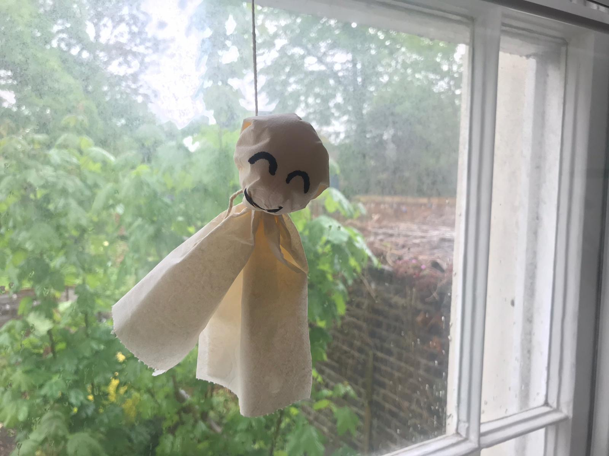
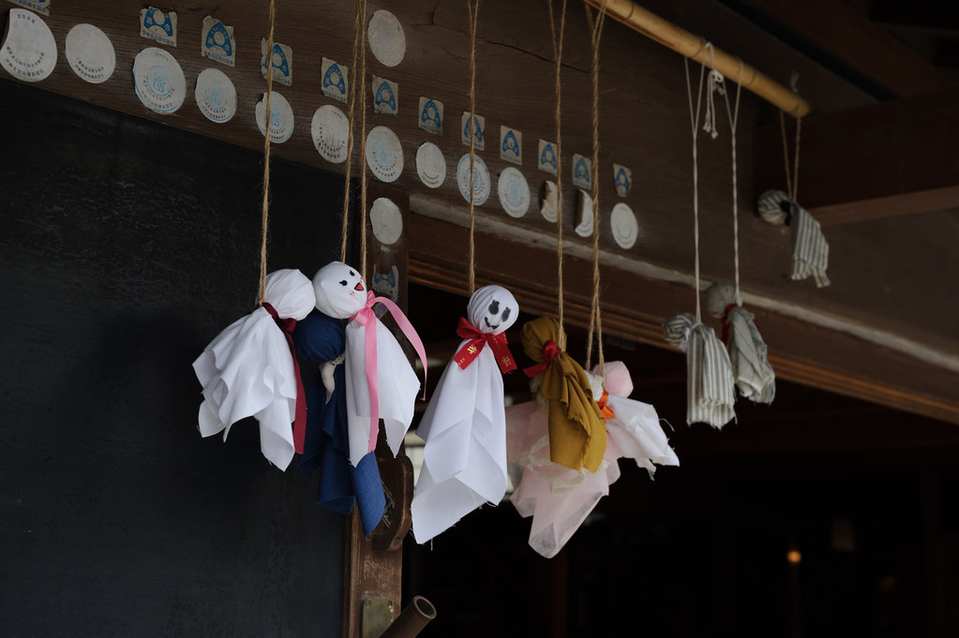


Customs
These dolls are called
Teru Teru Bozu
A Teru Teru Bozu is like a wish for the rain to stop and the sun to shine!
So people make them
during the rainy season
Notes:
Refer to the background notes for more information on Teru Teru Bozu

Slide 12




The Japan Society
13/14 Cornwall Terrace, London NW1 4QP
Tel: 020 7935 0475
Email: education@japansociety.org.uk
www.japansociety.org.uk
Follow us on:
@japansocietylon
@JapanSocietyLondon

