Slide 1

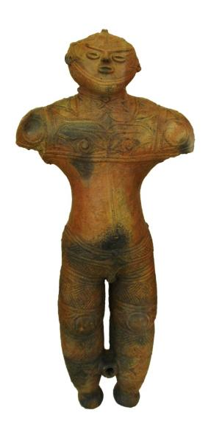
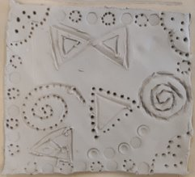
Starter
Think of a sentence about what you learnt and did during the last lesson.
Why do you think people kept these figures?
Why were they buried with people?
Notes:
Students should talk about key facts, features of Japan, the Dogu they learnt about, or the tile they made during the previous lesson.

Slide 2
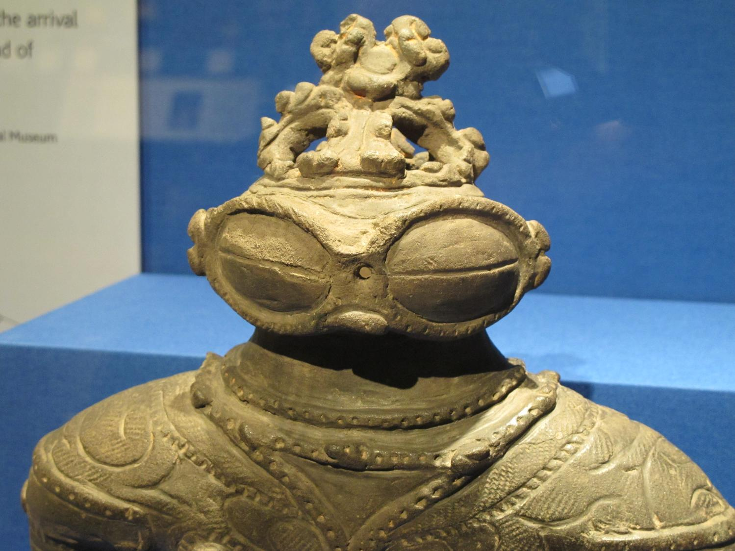

3: Design a Dogu
Notes:
Teacher’s Notes
Image of dogu from Wikimedia Commons: https://upload.wikimedia.org/wikipedia/commons/5/5e/Dogu_jomon_period_japan.jpg

Slide 3

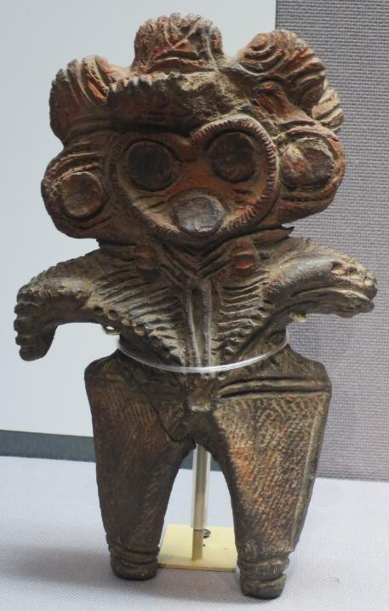
Dogu 土偶
Learning Objective:
Develop your own personal interpretation of dogu figurines by producing four draft designs.

Slide 4
Review your Tile
What went well?
What would you do differently on your figure?
Notes:
Encourage reflection on the use of clay and their success in creating patterns.
Teachers could show examples and get students to discuss these works before looking at their own.
Teachers could photograph or photocopy the tile design so that students have a copy to annotate in their books

Slide 5
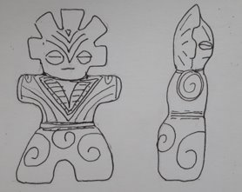
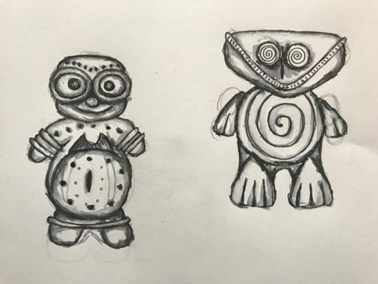
Design your Dogu
Things to think about in your design:
SCALE
ROUND TUMMY
PERSONALITY
PATTERNS
CURVY BODY SHAPE
3D FORM
SMALL LEGS AND ARMS
BIG EYES
SMALL 10-15CM
Side and back views are important too!
Activity: Create 4 different designs each with different characters
Notes:
Having gained an understanding of the pattern and form of the Dogu figures, students are now ready to design their own.
Less able students could be given templates to draw around and modify.
Encourage students to think about the sides and back of the design.
Creating 4 designs helps them learn to refine their work.

Slide 6
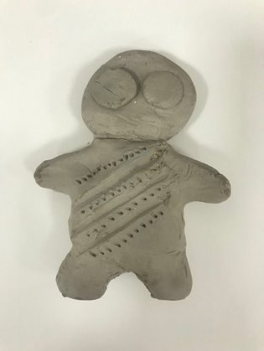
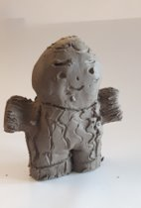
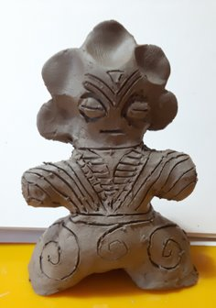
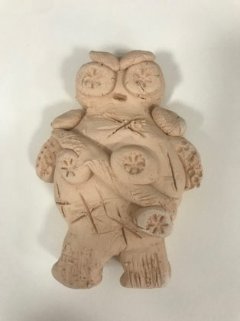
Making your Dogu
Watch a demonstration using clay or salt dough. This will show you how to create your figure next week.
Will your figure stand?
How will you make the patterns?
©J Buchanan and K Montague in collaboration with The Japan Society
© The Japan Society (2025)
Notes:
Demonstrate construction of the figure. If using clay ensure they are not solid or that they have bubbles of air inside – as they will explode!
Build techniques: thumb pot, slab building, coil building.
Discuss where clay comes from, why it was used.
Students should create a step by step of how they will achieve their design in the next lesson.
If clay is not available, salt dough is a good alternative, although it does tend to be softer and more difficult to create fine marks. This can be cured in the oven or microwave.

Slide 7




This resource was authored by J Buchanan and K Montague in collaboration with The Japan Society
The Japan Society
13/14 Cornwall Terrace, London NW1 4QP
Tel: 020 7935 0475
Email: education@japansociety.org.uk
www.japansociety.org.uk
Follow us on:
@TheJapanSociety
The Japan Society

