Slide 1


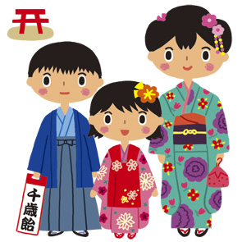

7-5-3 Festival
Notes:
Ask students
From looking at the middle picture and the name, do they have any guesses about what the festival might celebrate?

Slide 2

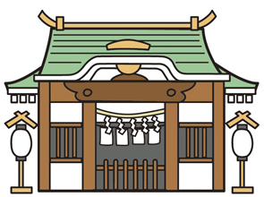
About 7-5-3
The 7-5-3 Festival celebrates the health of young children
It is celebrated on 15 November
Parents take their children to a shrine
to pray for their health and happiness
Notes:
Teacher’s note
Parents may take their children to a shrine (a place of worship) on the weekend nearest to 15th November.
The illustration is of a Japanese Shrine where Kami (Gods) live.

Slide 3
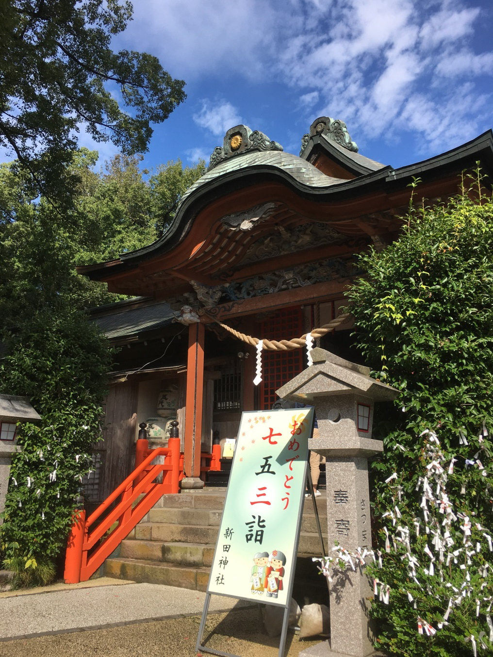
Notes:
Teacher’s note
The photograph is of a Japanese Shrine with a sign in Japanese for the 7-5-3 festival.

Slide 4
About 7-5-3
But not everyone celebrates the festival...
It is only for children who are 3, 5, or 7 years old!
So in Japanese the festival is called Shichi-Go-San
七
五
三
7
5
3
shichi
go
san
Notes:
Teacher’s note
Click to reveal the kanji characters at the bottom of the slide which show the numbers for 7, 5, 3 (L – R) in Japanese.
These numbers are thought to be lucky and were also seen as important milestones for children in the past.
Some say the event is celebrated in the 15th November because 15 is the total sum of 7-5-3.
Ask students if there are any special ages in their country/culture.

Slide 5
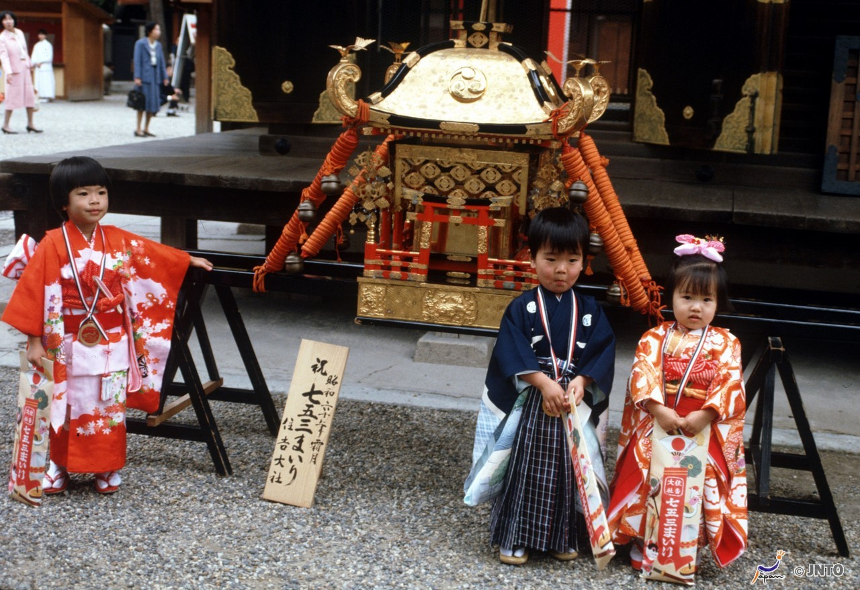
7-5-3 Festival
Notes:
Teacher’s Notes
Discuss what students can see in the picture and ask:
What kind of clothes are they wearing? (Do they look like everyday clothes? What about the shoes?)
Are there any ages that are special in their country/culture?
What occasions might they get dressed up for?
Tell Students
Children wear their best clothes for the festival.
However not everyone will wear traditional Japanese clothes for 7-5-3, some boys and girls will wear smart clothes like suits or dresses.
Special clothes like these can be very expensive, some people will rent them instead of buying them.

Slide 6
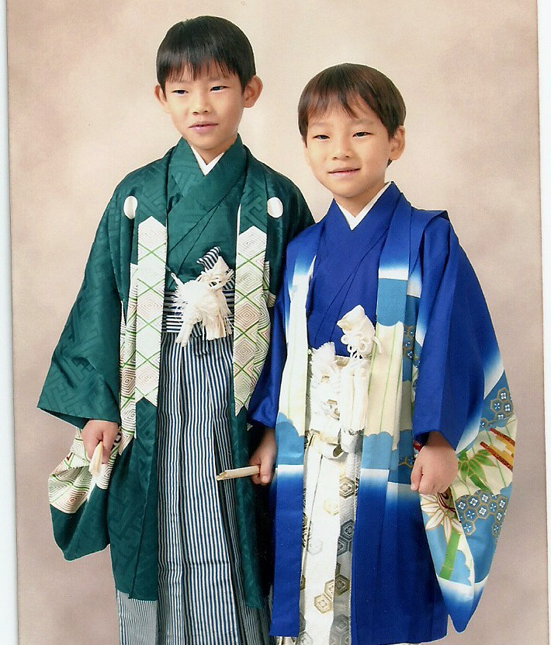
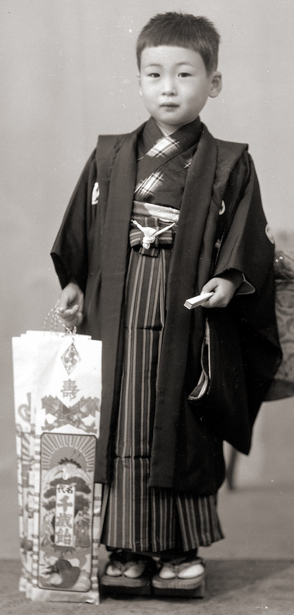
Festival Clothes
Boys who are 3 or 5 years old can celebrate the festival
In the past, boys wore these trousers, called hakama, from age 5
The jacket is called a haori
Notes:
Tell Students
The photos shows a boy wearing traditional Japanese clothing.
This is an old photograph, but boys today still wear these hakama trousers and haori jackets. They are worn over kimono.
Kimono are for everyone, both boys and girls.
In the past, boys would have started wearing hakama from age 5.

Slide 7
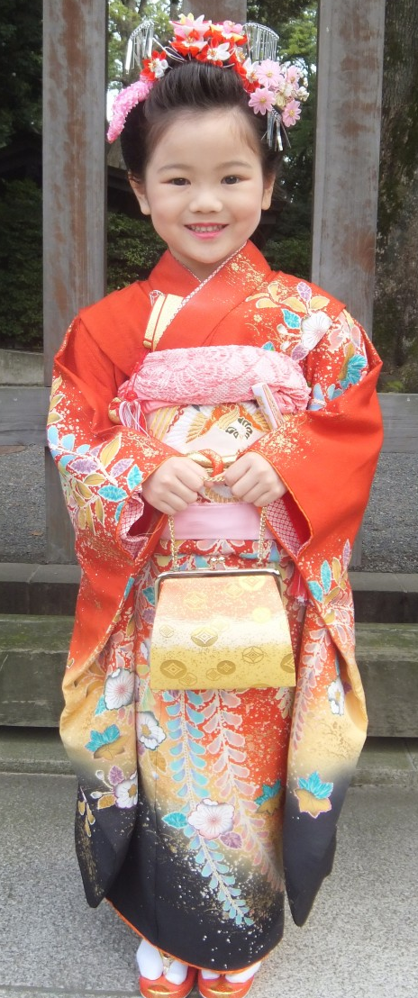
Festival Clothes
Girls who are 3 or 7 can celebrate the festival
This girl is also wearing a kimono
It is tied around the waist with an obi
In the past, girls would have started wearing obi from age 7
Notes:
Tell Students
The photo shows a girl wearing traditional Japanese clothing.
This is a modern photograph.
In the past, girls would have started wearing obi from age 7.
She is also wearing sandals called zori

Slide 8
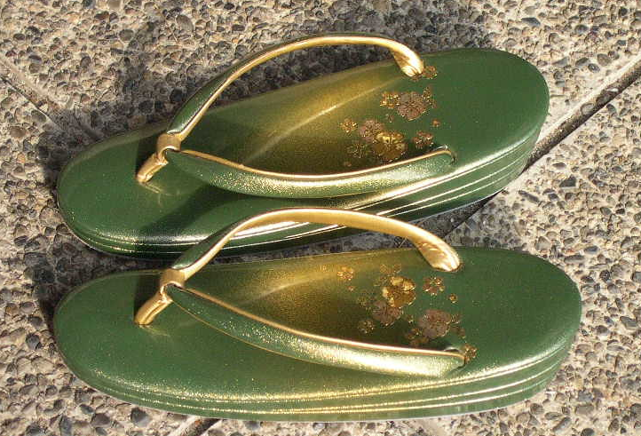
Festival Clothes
Festival Clothes
zori
Notes:
Tell Students
Zori look like sandals. These ones are for girls and are for special occasions.

Slide 9
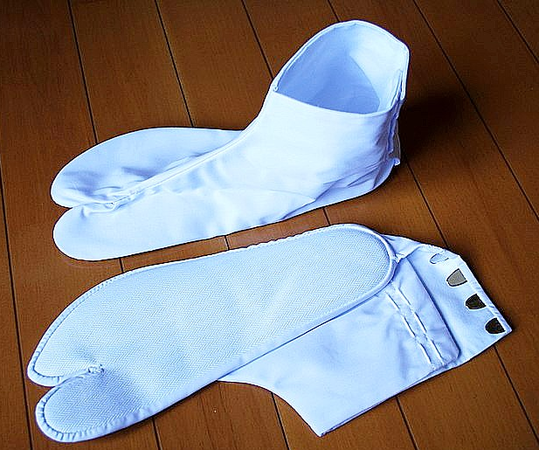
Festival Clothes
Festival Clothes
tabi
Notes:
Tell Students
Tabi are footwear too. They are sometimes described as similar to socks, but they are a little different. Can you see why?
Tabi separate the big toe from the other toes.

Slide 10
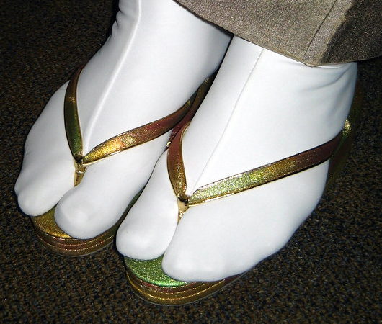
Festival Clothes
Festival Clothes
zori and tabi
Notes:
Tell Students
This is a photo of zori and tabi worn together

Slide 11
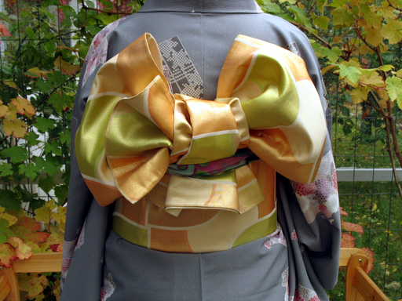
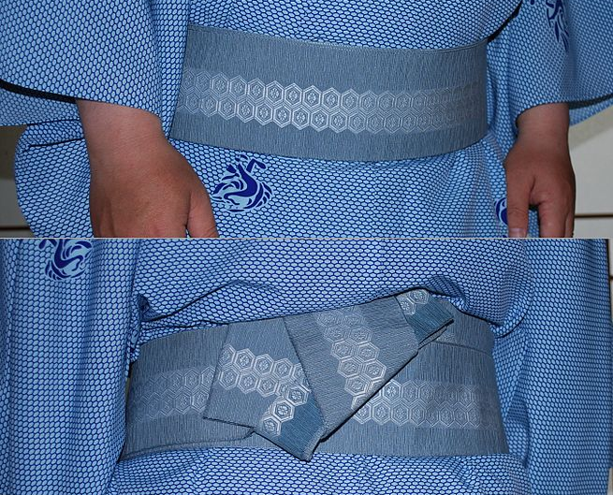
Festival Clothes
obi
Notes:
Tell Students
Obi are sometimes described as a belt because it is a piece of fabric which is tied around the waist.
Often women’s obi are very decorative and can be tied in many different ways, like this one in a bow.
Men’s obi are usually thinner and simpler.

Slide 12
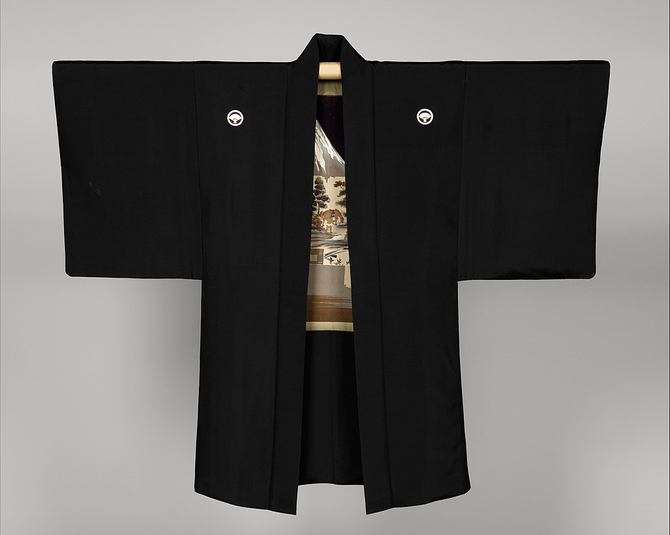
Festival Clothes
haori
Notes:
Tell Students
Haori is a like a jacket and is worn over a kimono.

Slide 13
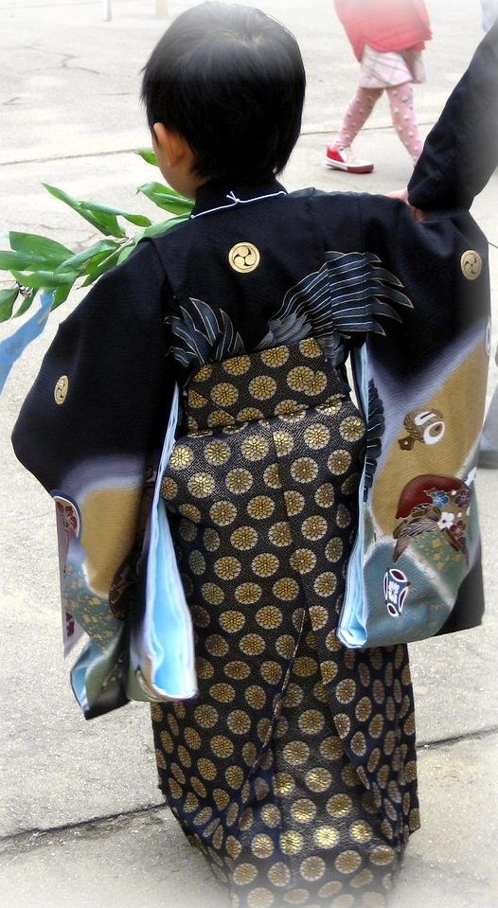
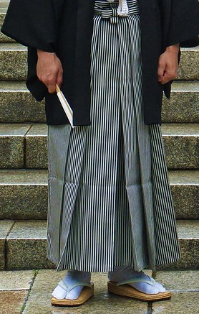
Festival Clothes
hakama
Notes:
Tell Students
Hakama are loose fitting trousers.

Slide 14
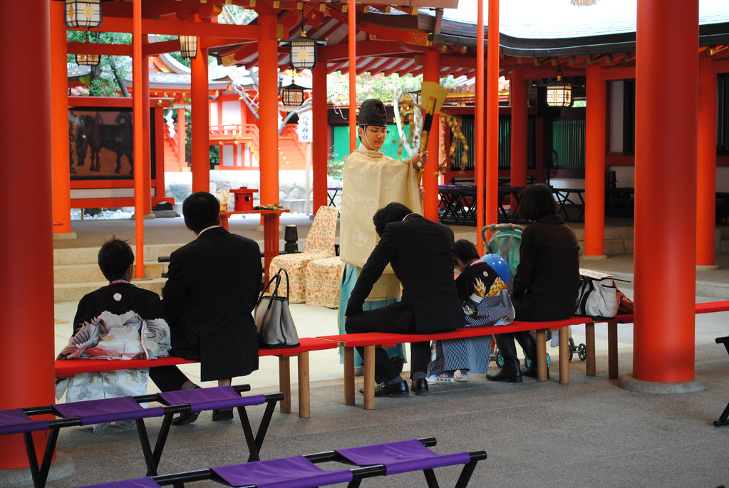
Receiving a blessing
Notes:
Ask students
What can you see in the picture?
Where do you think they are?
What do you think the man who is standing up is doing?
Tell students
The picture was taken in a shrine (a place of worship).
Some families will take part in a special ceremony with a Shinto priest. Shinto is the name of a religion in Japan.
The priest will read prayers and offer blessings.

Slide 15
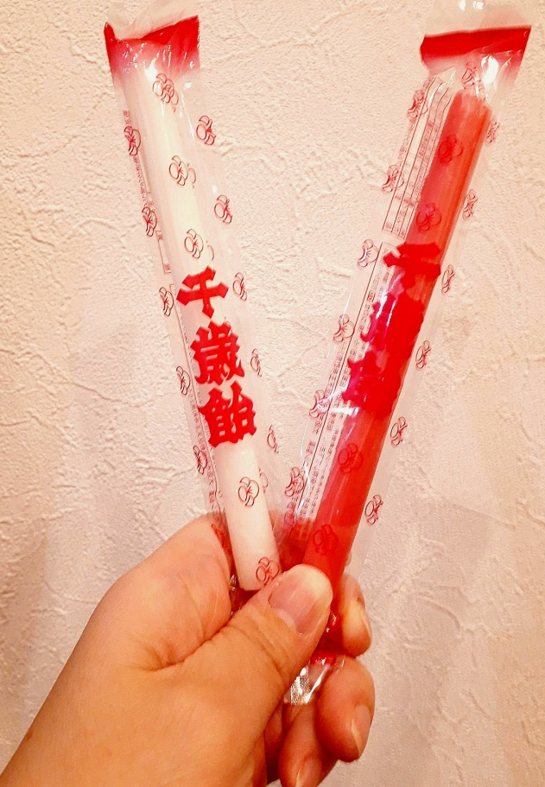
Sweets
Children receive sweets during the festival
They are red and white
which are lucky colours in Japan
The shape represents a wish for a long life
Notes:
Teacher’s Notes
Chitose ame (pronounced chee-toh-say ah-may) are like long sticks of rock.
Children can be seen holding the bags of chitose ame on slide 4.

Slide 16
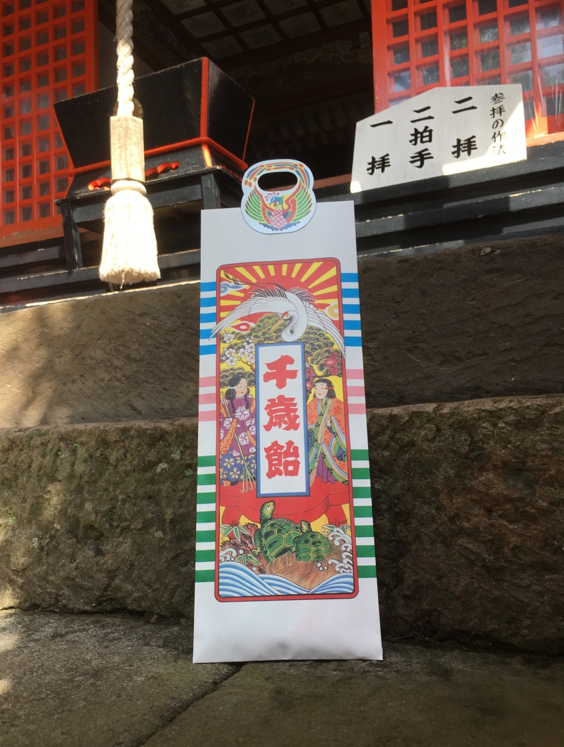
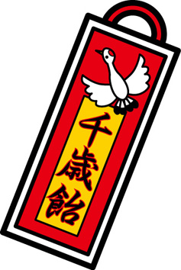
Sweets
The sweets are called
chitose ame
That means
“One Thousand Year Sweets”
They come in a long decorated bag
Notes:
Teacher’s Notes
Can students guess why they are called 1000 year sweets? It’s because they are a wish for a long and successful life.
They are also a wish for good fortune and good health.

Slide 17

Sweets
Take a closer look at the bag.
What animals
can you see?
Notes:
Teacher’s Notes
The three characters on the bag say ‘Chitose ame’ in Japanese.
Ask students what animals they can see on the bag. Answer and more information is on the next slide.

Slide 18
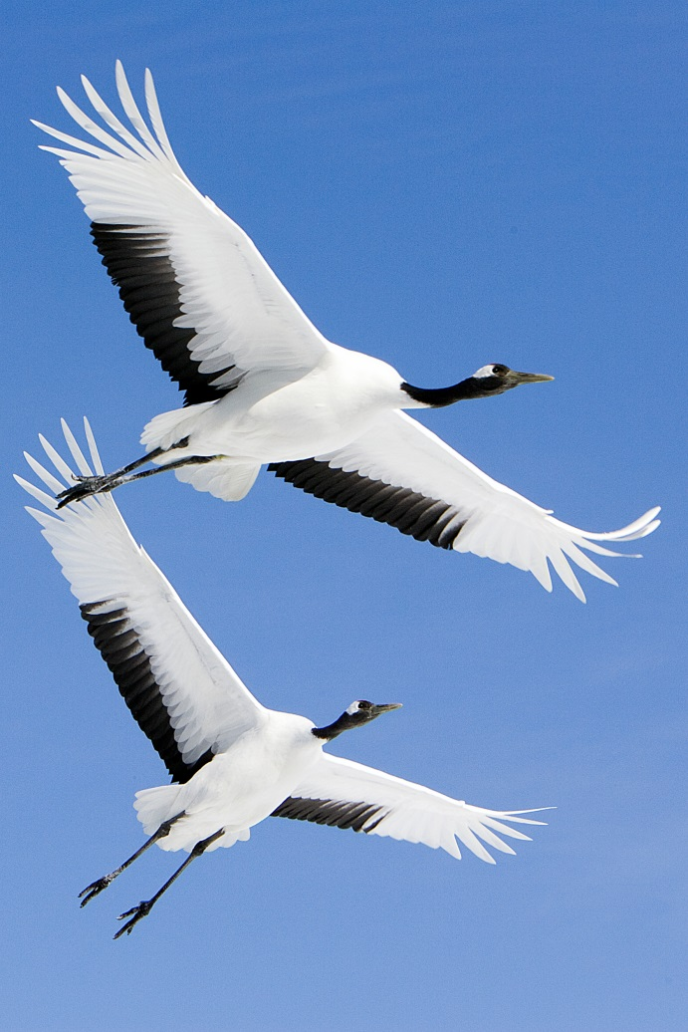

Animal Symbols
One is a type of bird called
a crane
Cranes are symbols of luck, happiness and long life in Japan
Turtles are also a symbol of long life in Japan
© Grus japonensis flight at Akan International Crane Center authored by Spaceaero2 is licensed under CC BY-SA 3.0
Notes:
Teacher’s Notes
Explain that a crane is a type of bird with a long neck.
There is usually has a design of a crane (tsuru) and/or a turtle (kame) on the packaging for chitose ame.
This is because, according to myth, cranes and turtles live for a really long time.
There is a saying in Japan that “cranes live for 1000 years, turtles live for 10,000 years”

Slide 19
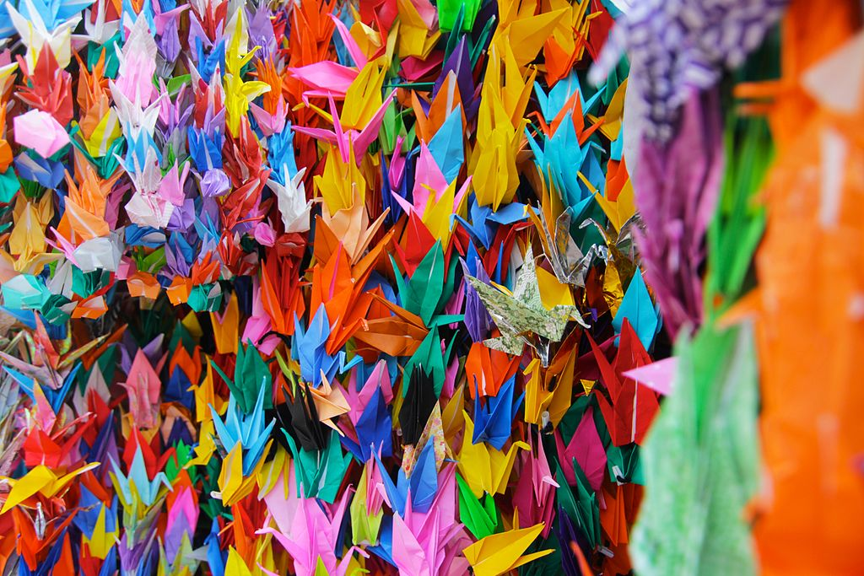
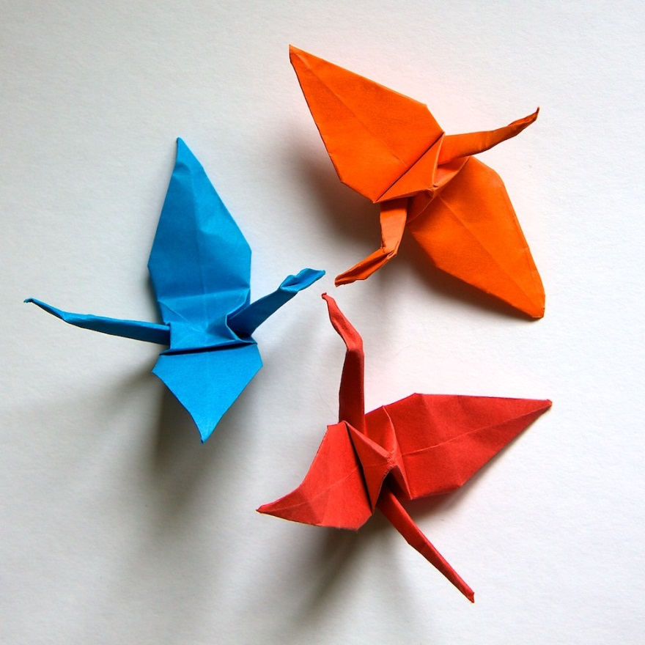
The crane
It’s possible to make an origami crane by folding paper
People sometimes make 1000 paper cranes as a wish for good luck
This is called senbazuru
Notes:
Teacher’s Notes
Senbazuru literally means ‘One Thousand Cranes’.
Sometimes people make them as a gift or a get well wish for loved ones who are ill.
It is also common for classes or clubs at schools to work together to make 1000 cranes to wish for good luck or victory in their next sports tournament for example.
Picture of crane: https://search.creativecommons.org/photos/5b8e215f-fb7d-45a2-8ef9-7ce09f0c829a (cropped image)

Slide 20
7-5-3 Quiz
True
True
 | The festival is for girls only
 | It is celebrated in November
 | The crane is a symbol of long life
 | Chitose ame means “one hundred year sweets”
 | Blue and white are lucky colours
Answer:
It’s for girls and boys
False
False
False
Answer:
It means ’1000 year sweets’
Answer:
Red and white

Slide 21




The Japan Society
13/14 Cornwall Terrace, London NW1 4QP
Tel: 020 7935 0475
Email: education@japansociety.org.uk
www.japansociety.org.uk
Follow us on:
@japansocietylon
@JapanSocietyLondon

