Slide 1

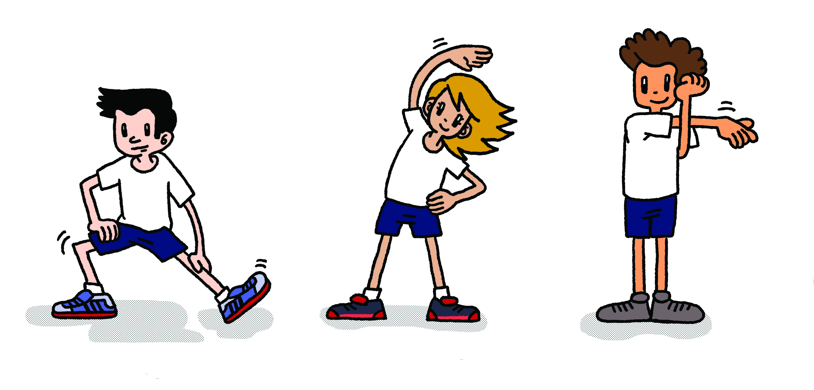
Radio Taiso

Slide 2

What is Radio Taiso?
A series of simple exercises
performed to music (on the Radio).
Each move is designed to warm up a different part of the body.
They use all of your muscles,
so help with flexibility and fitness.
Notes:
Tell students
It is so called because the music is traditionally played on Radio NHK (the national broadcaster, like the BBC) at 6am every day.
It was first introduced in Japan in 1928
Some people do the exercises every day.
The Japanese word for ‘radio’ is rajio – it comes from the English word.

Slide 3
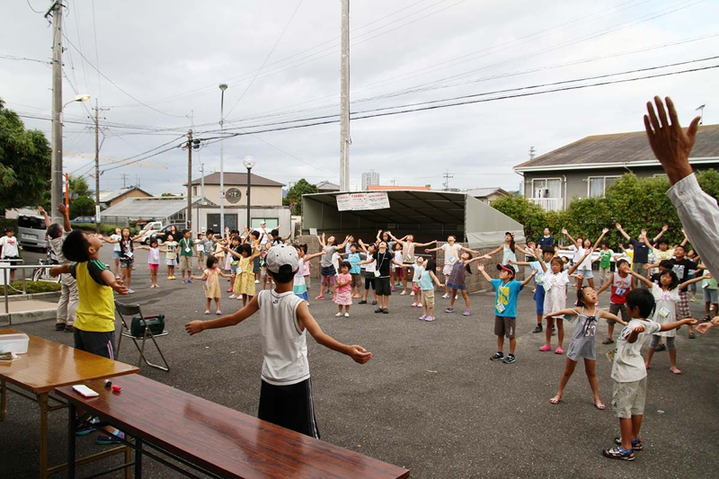
Notes:
Tell students
Practised by young generations.
People often perform the exercises in groups.

Slide 4
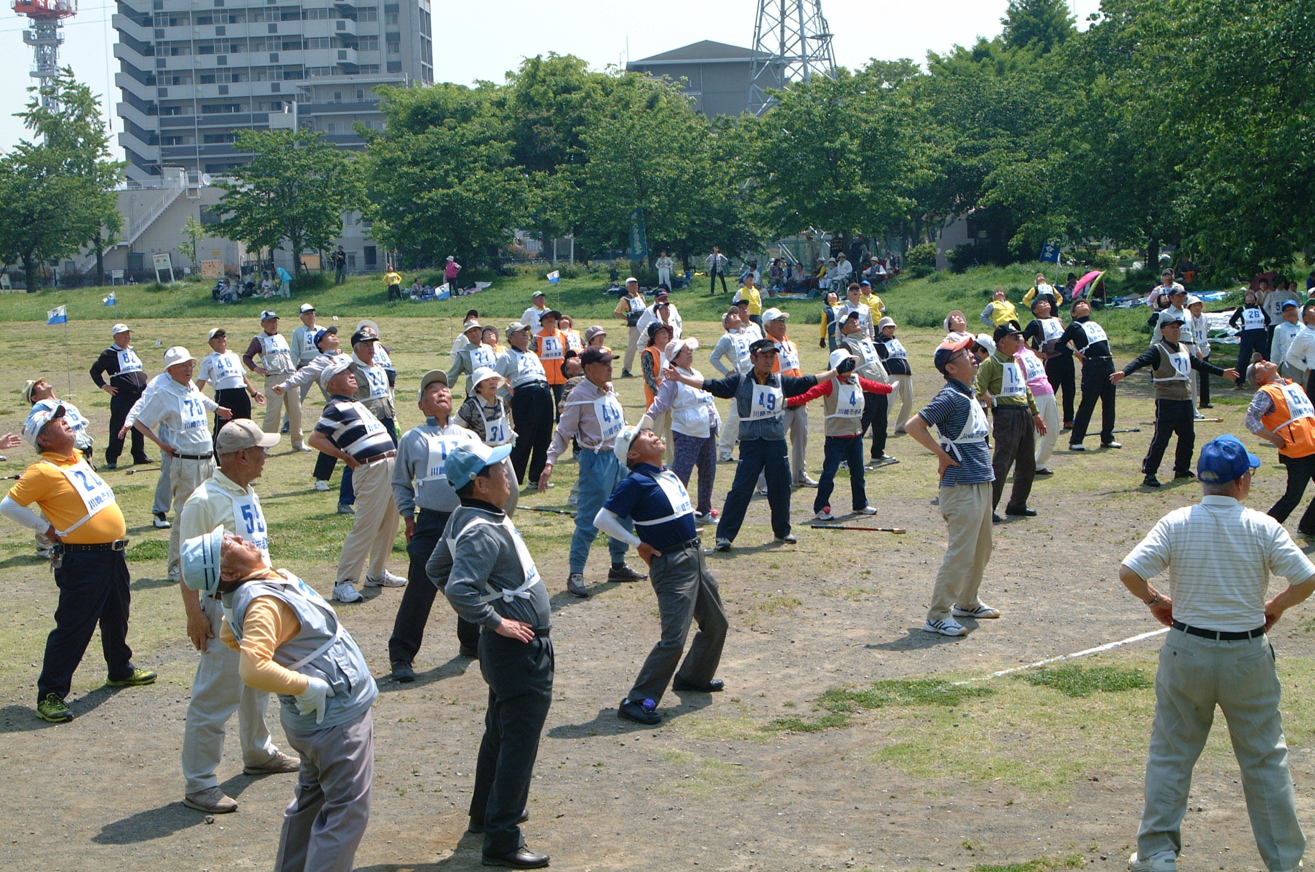
Notes:
Tell students
Practised by the older generations.
The exercises are designed to be suitable for all ages.

Slide 5
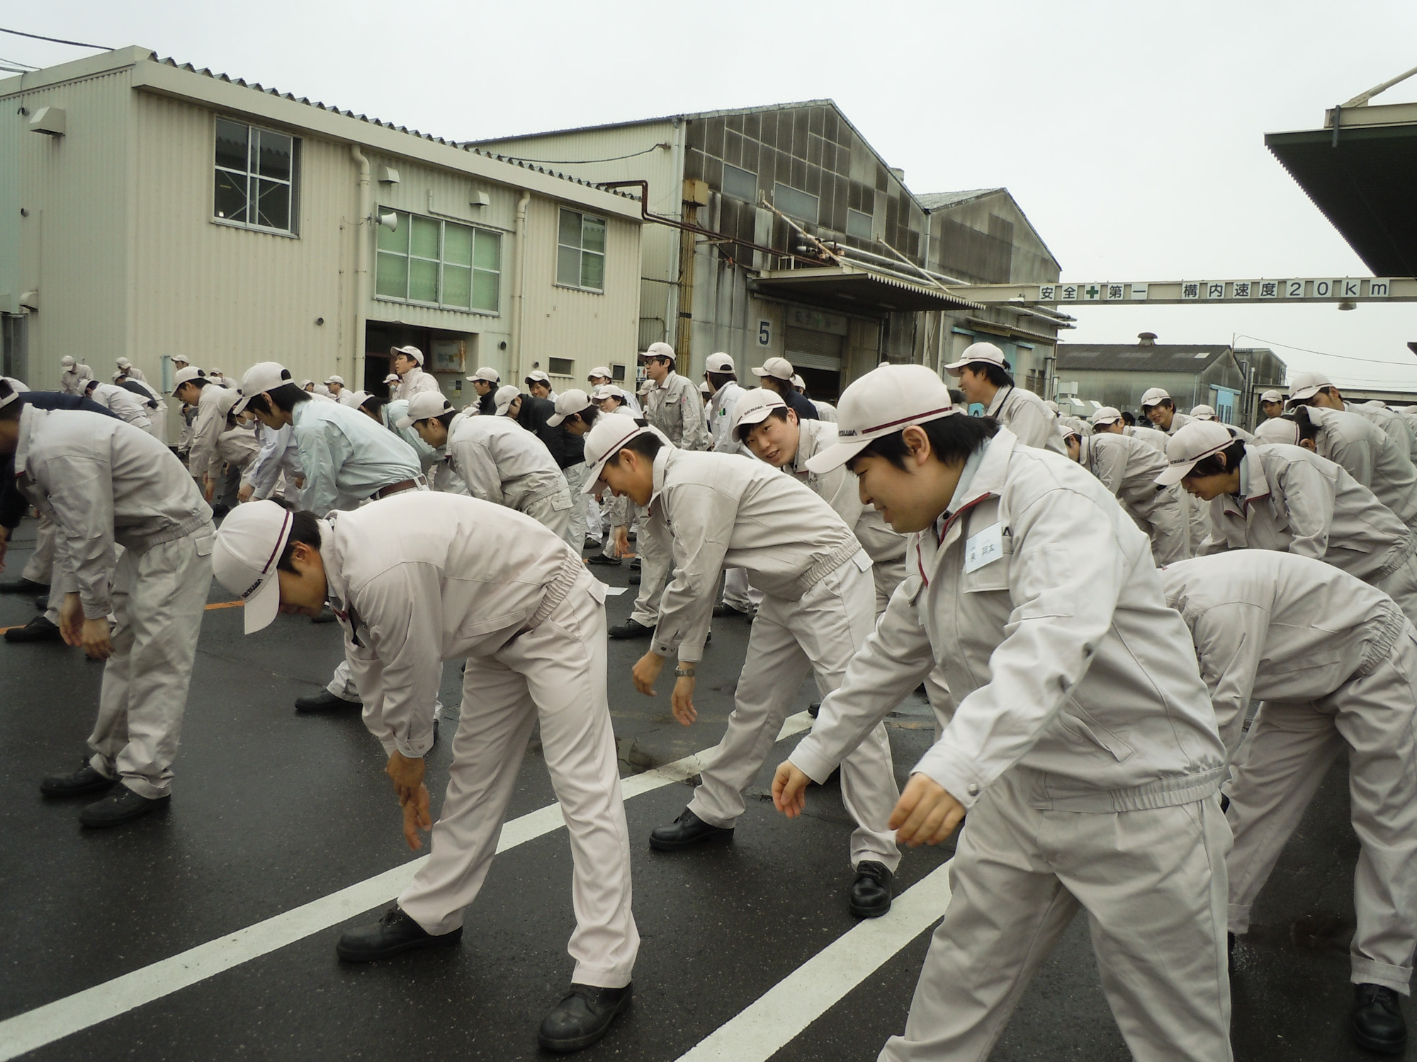
Notes:
Tell students
Practised by working age people.
It can be done at any time of day at home or at work.

Slide 6
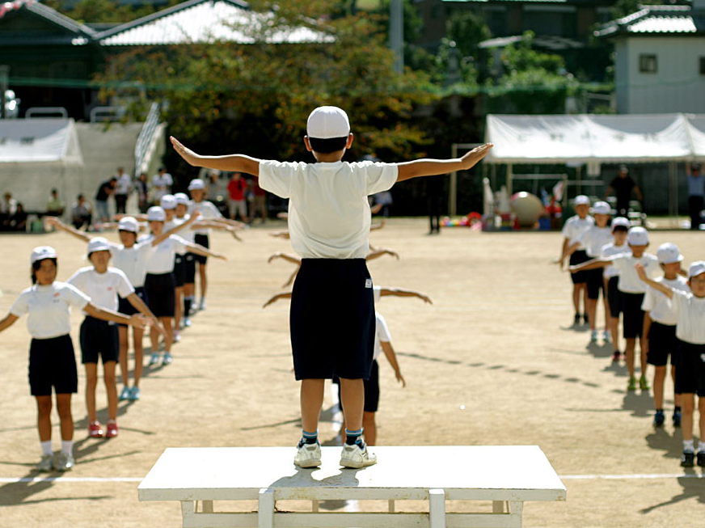
Notes:
Students may have already guessed that Radio Taiso is performed at Sports Events in the Think/Pair/Share activity.
They were right! This photo shows primary school students doing radio taiso at sports day, called undokai in Japanese.
Tell Students
Radio Taiso is most commonly performed at the beginning of Sports Day in Japan
Students of all ages (nursery, primary, secondary and high school) will do the exercises before the events
Before Sports Day students will practise to make sure that everyone is in time and knows all the moves
Sometimes students might do these exercises between classes to help improve their concentration

Slide 7



This resource was developed by The Japan Society.
The Japan Society
13/14 Cornwall Terrace, London NW1 4QP
Tel: 020 7935 0475
Email: education@japansociety.org.uk
www.japansociety.org.uk
Follow us on:
@japansocietylon
@JapanSocietyLondon

