Slide 1


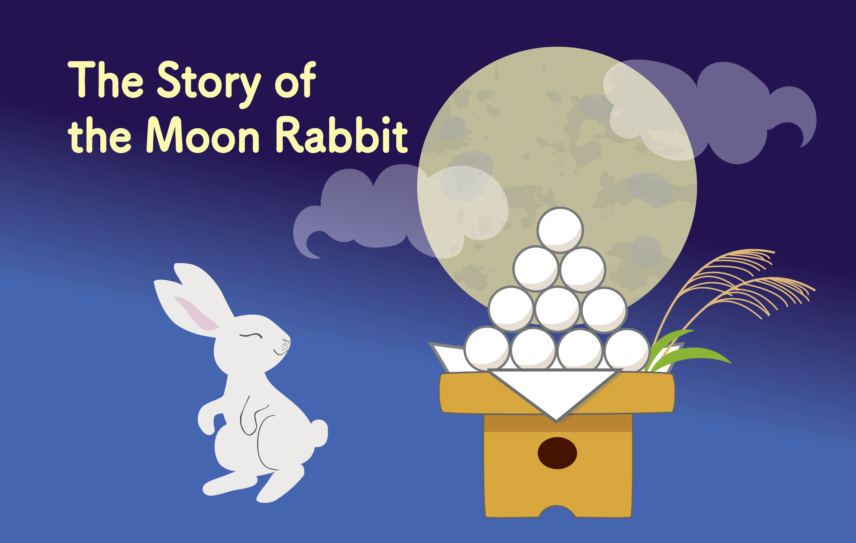

Kamishibai:
Japanese Storytelling
Notes:
Introduction
In Japan there is a popular myth that a rabbit lives on the moon
and this story explains how it came to be there.
The Japanese title of the story is Tsuki no Usagi which means
“The Moon Rabbit” (tsuki means moon and usagi means rabbit).

Slide 2
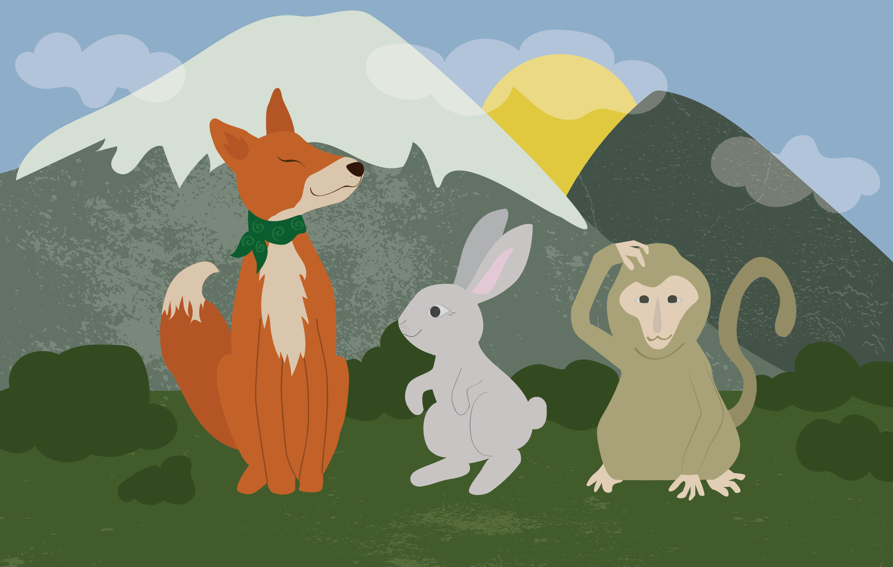

Notes:
1.
A long long time ago, there were three friends –
a monkey, a fox, and a rabbit.
They would often spend time playing together on the side of a mountain.

Slide 3
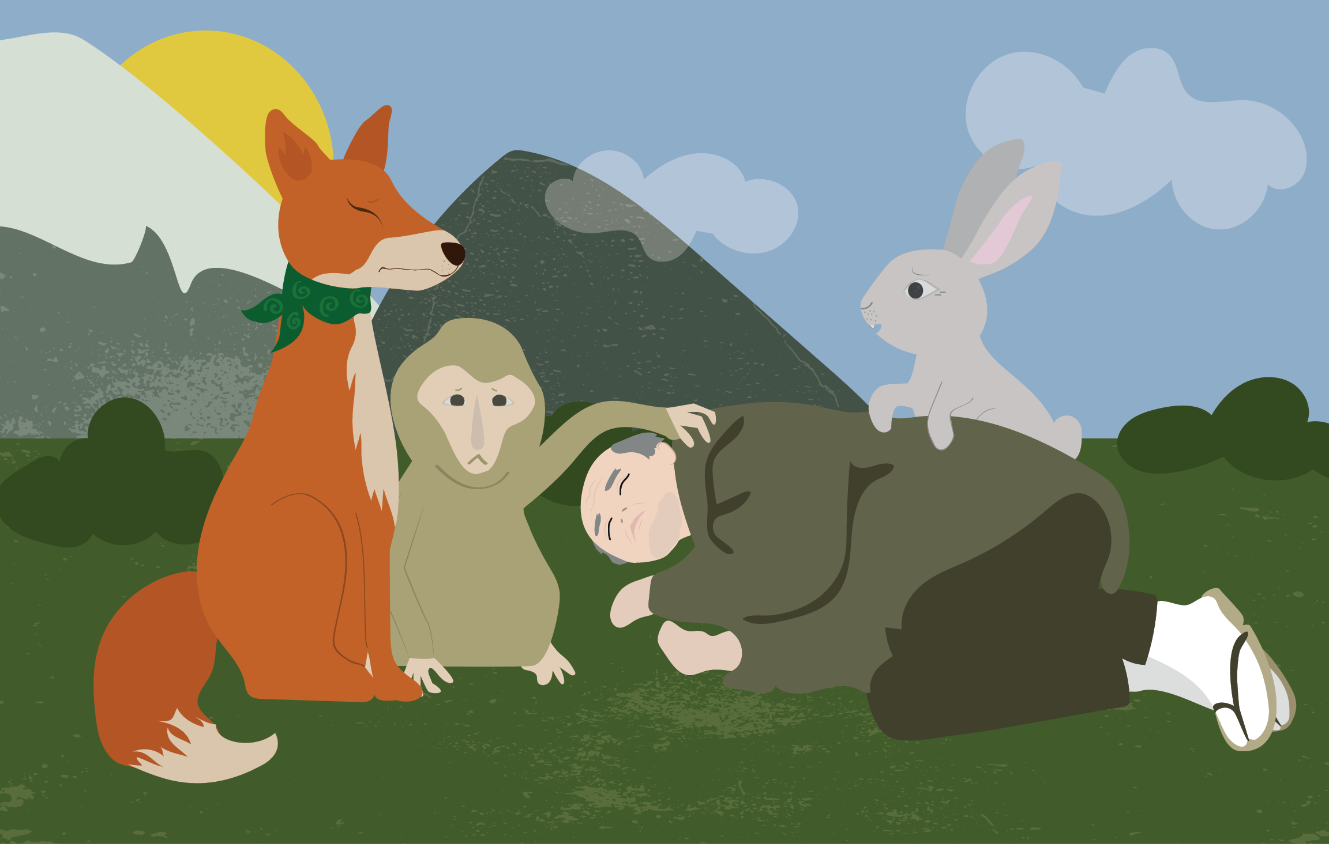
Notes:
2.
One day, they came across an old man who had fallen down, and was lying on the grass.
“Oh no, old man, are you ok?” said the fox.
“I’m so hungry and tired that I can’t move” replied the old man in a whisper.

Slide 4
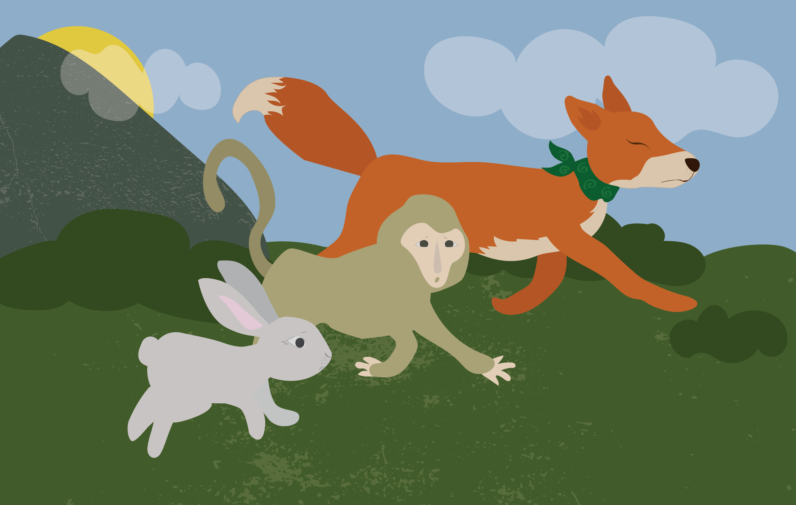
Notes:
3.
“Don’t worry, we will go and find you some food so you can be strong and healthy again” said the three friends.
So, the fox, monkey and rabbit ran off to find food for the
old man.

Slide 5
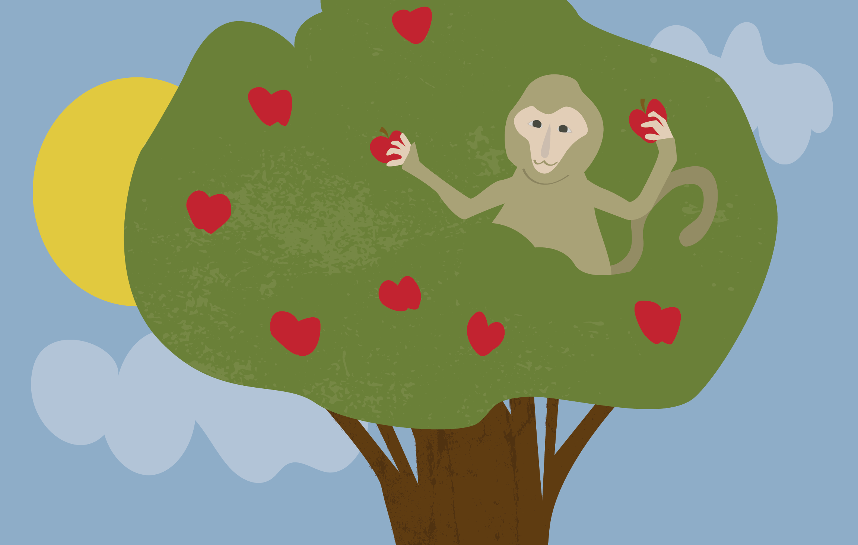
Notes:
4.
The monkey, who was good at climbing trees, easily swung up a tree and he picked lots of fruit.

Slide 6
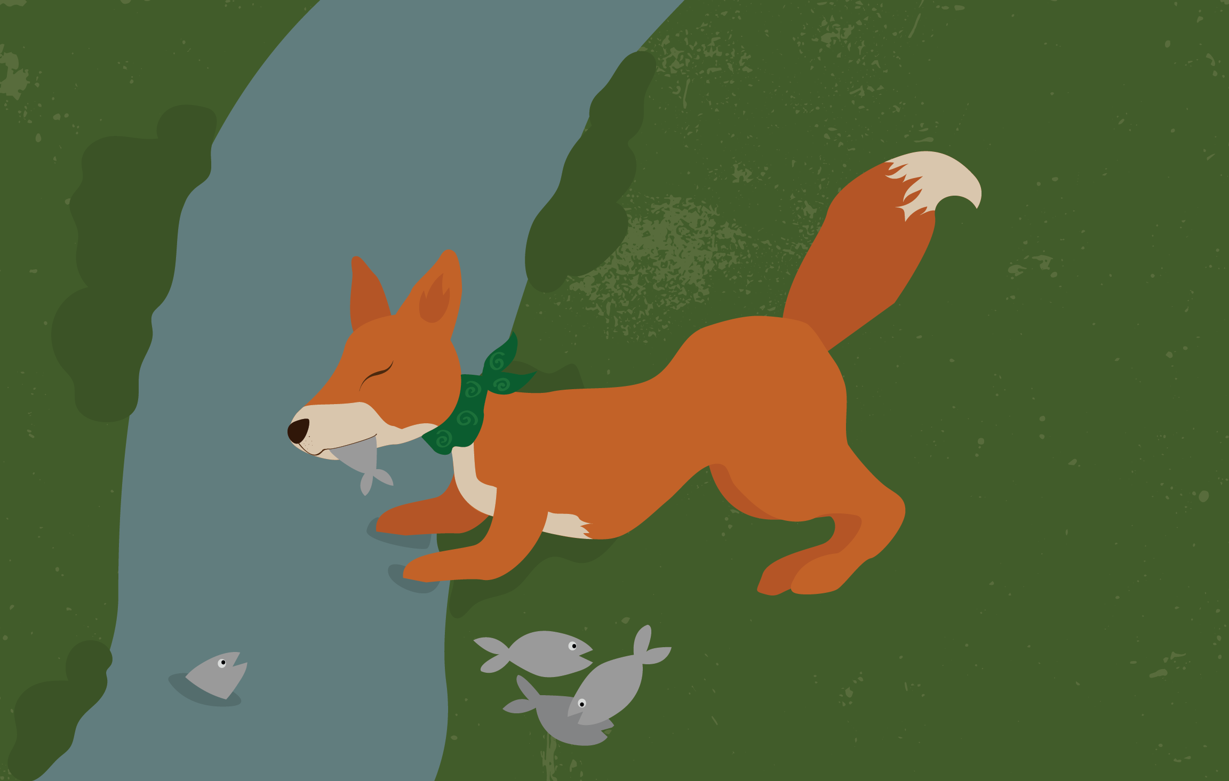
Notes:
5.
The fox was good at hunting and ran off to the river where he caught lots of fish.

Slide 7
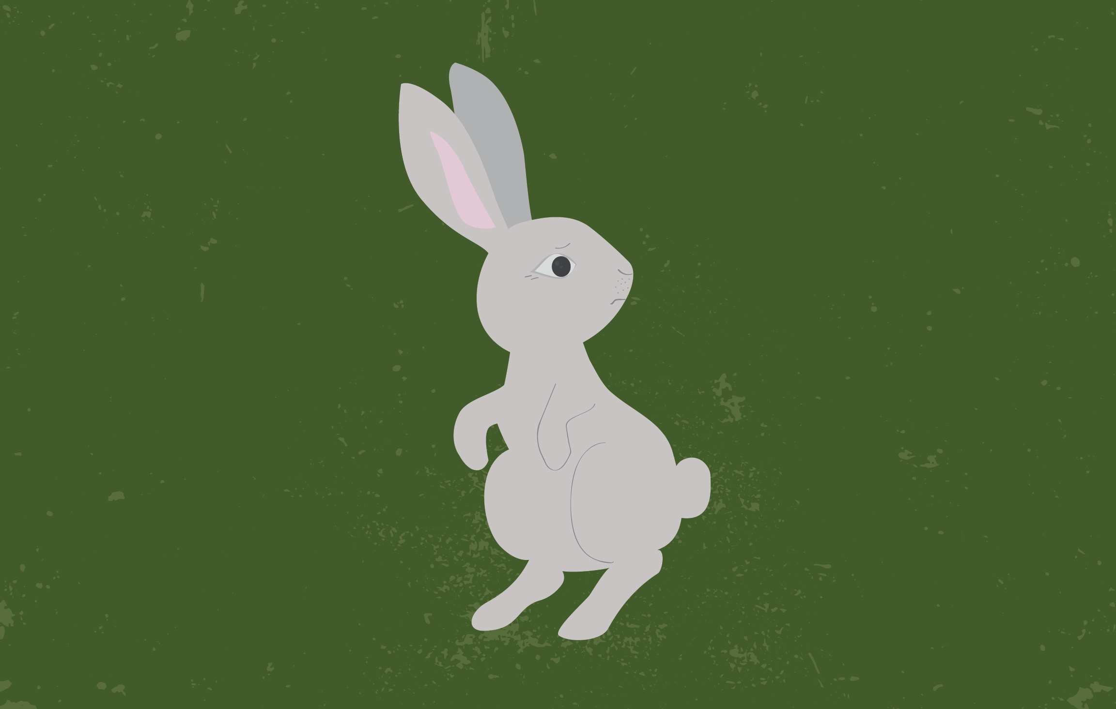
Notes:
6.
But, the rabbit could neither climb nor hunt.
He didn’t know what to do so he ran here and there around the woods.

Slide 8
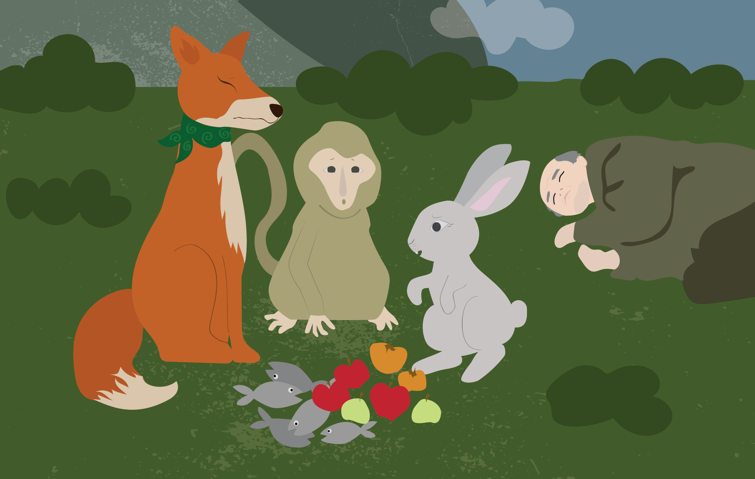
Notes:
7.
They all returned to see the old man.
The monkey had collected lots of fruit and the fox had collected lots of fish, but the rabbit had not been able to find anything!

Slide 9
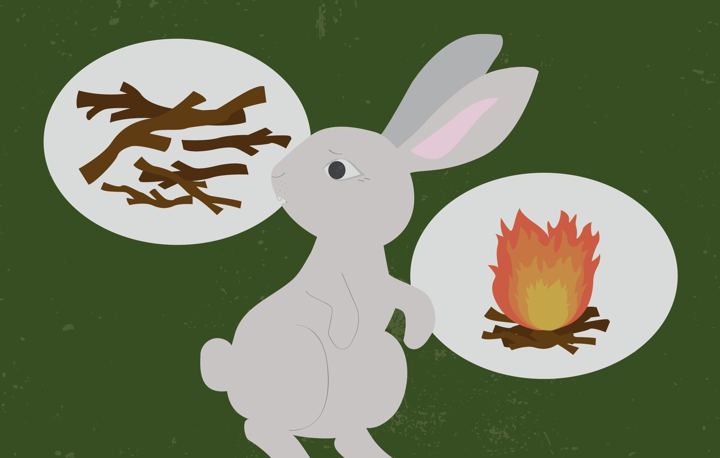
Notes:
8.
So the rabbit asked the monkey to collect lots of firewood.
And he asked the fox to build a big fire.

Slide 10
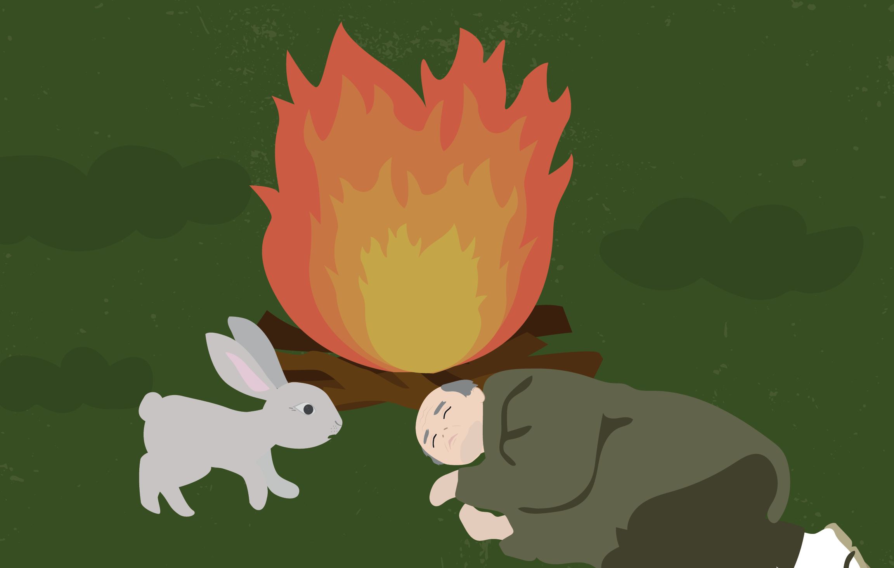
Notes:
9.
When the fire was burning brightly, the rabbit said to the old man:
‘I’m sorry, I could not find anything for you. So, instead, you can put me on the fire, cook, and eat me.”

Slide 11
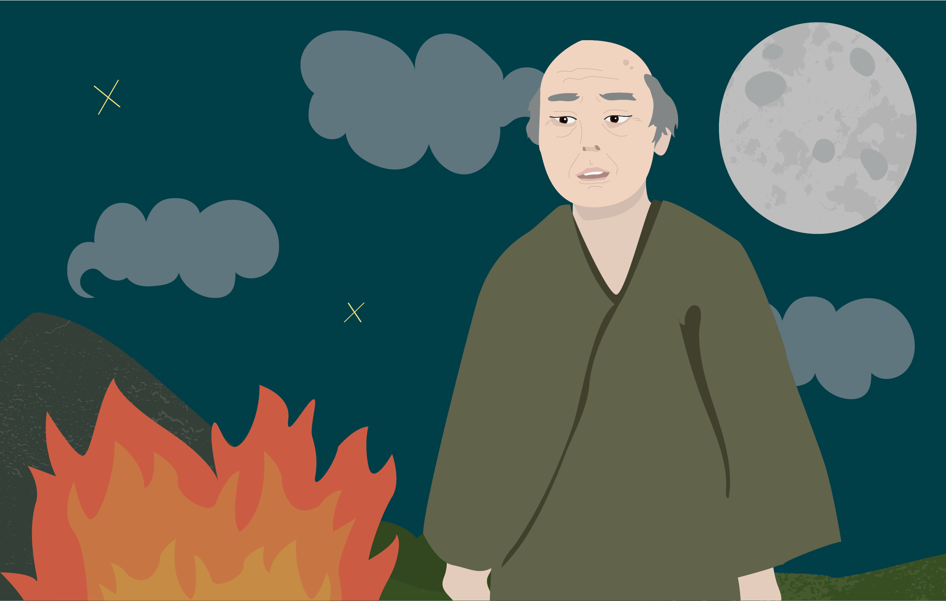
Notes:
10.
At that moment, the old man suddenly got up and said, “No, no rabbit, you must not do that! But, you are so kind that I wish to give you a reward.”

Slide 12
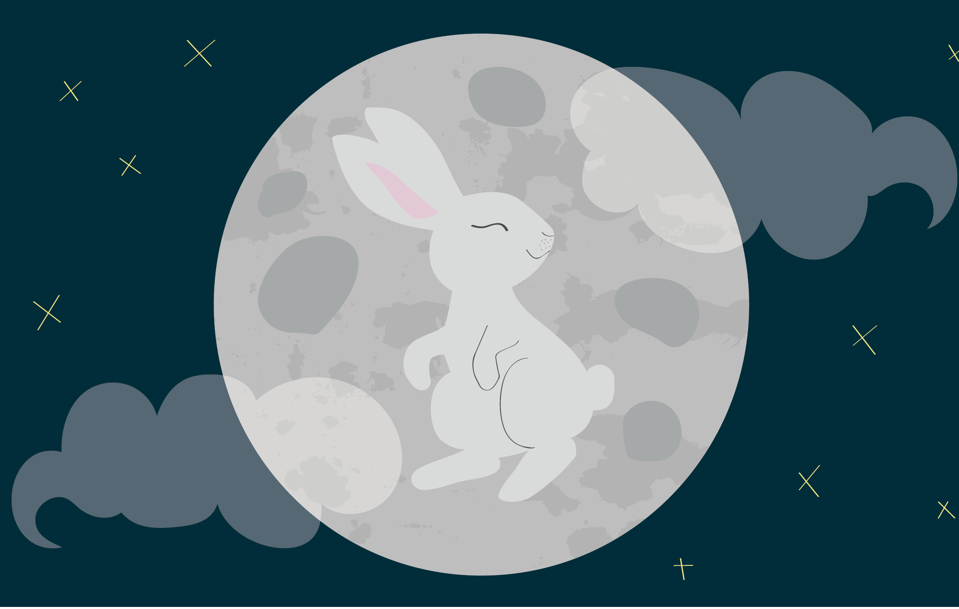
Notes:
11.
And with that, the old man magically transformed.
In fact, he was the Old Man of the Moon, and he took the rabbit to live with him there.
And to this day you can still see the rabbit on the moon.

Slide 13
終わり
o-wa-ri
(The End)
Notes:
For more resources, visit www.japansociety.org.uk.

Slide 14

For more resources, visit www.japansociety.org.uk.
Notes:
For more resources, visit www.japansociety.org.uk.

