Slide 1
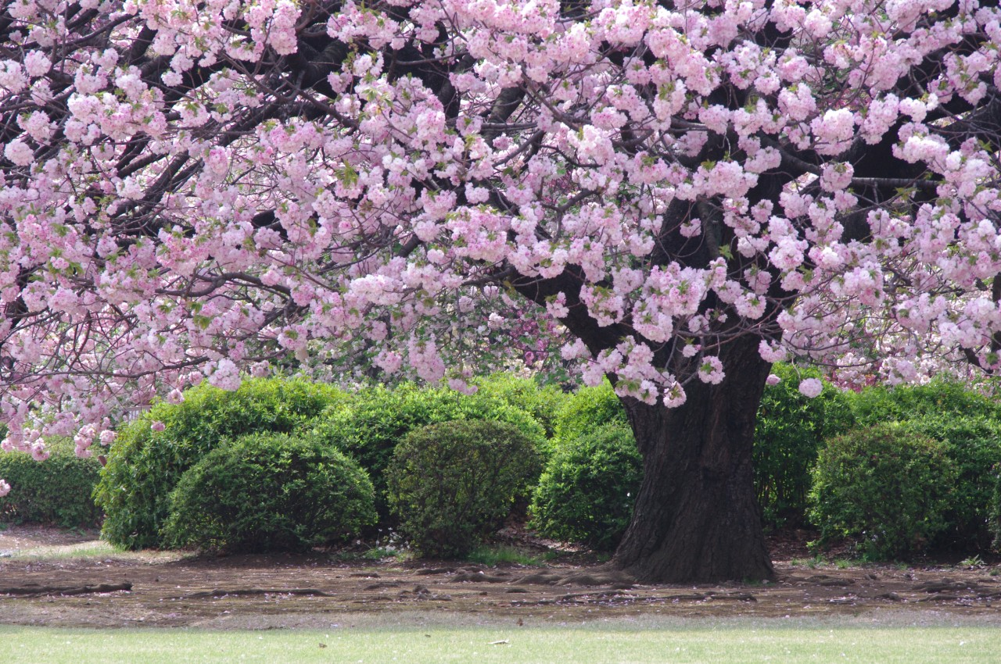

Being Mindful
©Yasufumi Nishi/© JNTO
Notes:
Theme: Exploring the idea of mindfulness by noticing the beauty of nature
Ask Students:
Does anyone know what this is?
Have you seen anything like this before?

Slide 2


Learning Objectives
I can describe cherry blossom using a range of adjectives.
I can explain why cherry blossom is so important in Japan.
I can create a Haiku and take notice of the world around me.

Slide 3
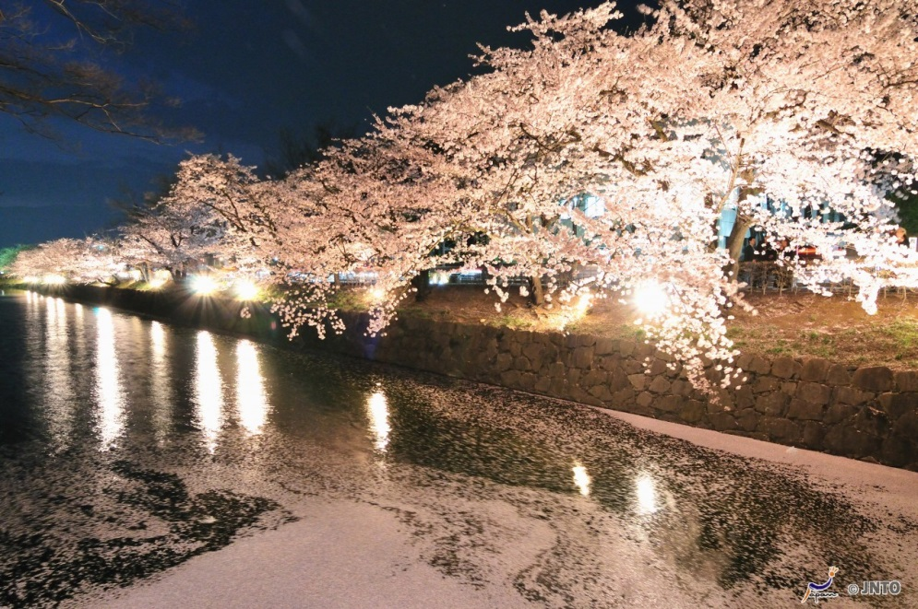
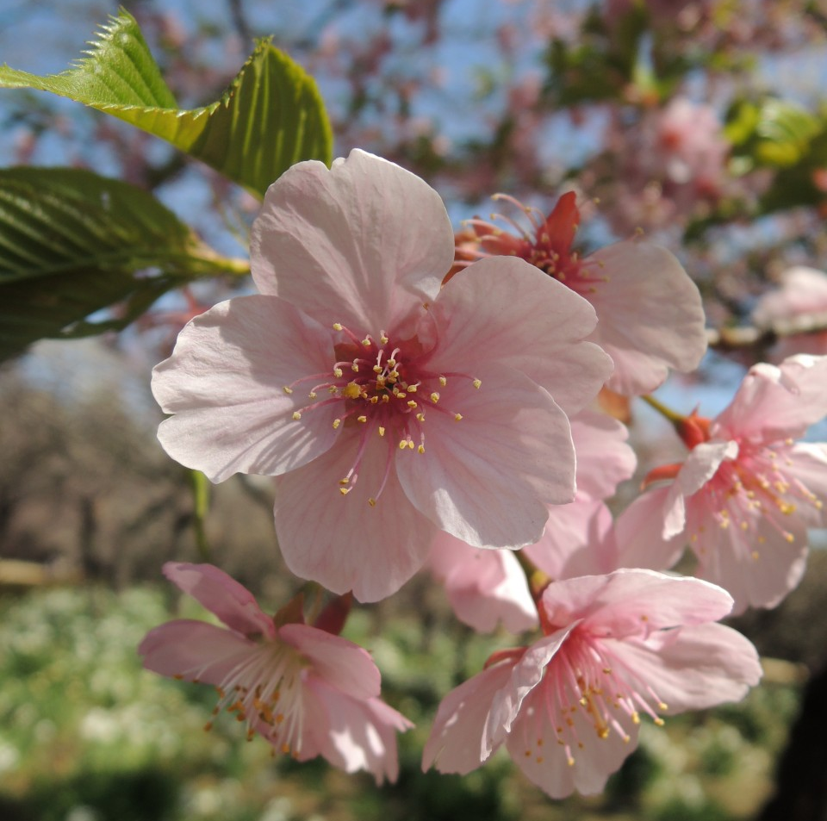
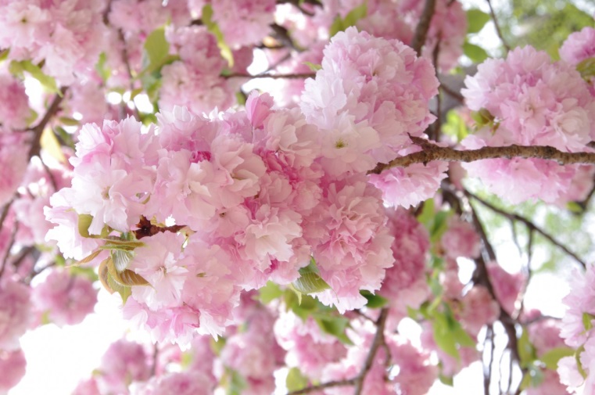
2 minutes of taking notice…
©Matsumoto city/©JNTO
©Yasufumi Nishi/©JNTO
©Yasufumi Nishi/©JNTO
Write down as many adjectives
as you can to describe the pictures.
Notes:
Take feedback from the class about the words they have chosen.

Slide 4
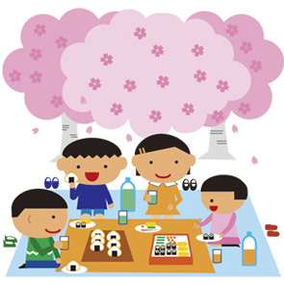
Cherry Blossom
An important national symbol in Japan
It does not last long so people hurry to enjoy it
Some people say this makes it even more beautiful
Notes:
Tell Students
Explain that the cherry blossom is a symbol of spring and Japanese people look forward to seeing it after winter.
Explain how Japanese people celebrate the cherry blossom in spring using the background notes or the video (click the image in the PPT): https://www.youtube.com/watch?v=pRVjUMFnE88&list=PLYZ-El4wKCobhBi7gzV9Fqsgd_Sw3edcg&index=29&t=0s

Slide 5

Discussion task
In pairs, discuss what lessons we can learn from the cherry blossom.
Appreciating the good things in each moment
Taking notice of what is happening in everyday life
Being thankful
Not worrying about the past, or the future... living in the present
Notes:
Take feedback from the class, hopefully draw out some ideas of mindfulness, being present and taking notice.
Emphasise that we need to appreciate the good things in each moment.

Slide 6
About Haiku
Haiku are Japanese poems with only three lines
They often describe the world around us
Haiku are seasonal poems which make us think about nature and a particular time of year
Notes:
For further information on Haiku, you can watch How to Haiku: https://www.youtube.com/watch?v=-HRmcKqVmqg&t=3s

Slide 7


Example Haiku
1.
cherry blossoms bloom
so beautifully but soon
they will disappear
2.
a bright breeze
dandelions just higher
than the grass
3.
in the weeds
one hundred and one
striped caterpillars
Notes:
Teacher’s Note
Haiku are normally read out loud twice
If time, you might like to clap out the rhythms and say them as a class

Slide 8





Haiku Activity
Choose one of the following:
Home/ Your city/ Your journey to school
2. What are the beautiful or good things about it?
3. Imagine you are there now.
What can you see, smell, hear, taste, feel?
Notes:
Ask the students to discuss this in pairs, or to write down their individual ideas on a post-it.
Remind students that haiku are seasonal poems – ask them to think about their chosen topic in the current season.
Time permitting, ask children to share their ideas with the class.

Slide 9

Writing Haiku
Write a Haiku about the world around you...
Choose one of the following tasks:
1. The cherry blossoms in the picture
2. Something you like or find beautiful
3. Something you think is ugly or boring
Notes:
Teacher’s Note
The tasks increase in difficulty. They can either be chosen by students or assigned as part of a differentiated task.
See lesson plan for tips on how to help students write their haiku.
Afterwards some students may wish to read their poems out. When sharing their poem, students should read it out twice.

Slide 10
Reflection
Take notice is one of the 5 ways to wellbeing.
How and why do you think this improves wellbeing?
Relaxation activity
Notes:
Teacher’s Note
Answers may focus on: appreciating the moment, not worrying about the past or future, being in the moment, enjoying what we have.
Emphasise the comparison with cherry blossom: that time goes quickly and we should appreciate the good things we have when we have them.
For the relaxation activity linked to the cherry blossom choose some music and have it playing softly whilst students close their eyes and relax. Allow heads to rest on desks and for students to make themselves comfortable, then read the relaxation script.

Slide 11




This resource was designed by Kimberley Evans with the Japan Society.
The Japan Society
13/14 Cornwall Terrace, London NW1 4QP
Tel: 020 7935 0475
Email: education@japansociety.org.uk
www.japansociety.org.uk
Follow us on:
@japansocietylon
@JapanSocietyLondon

