Slide 1


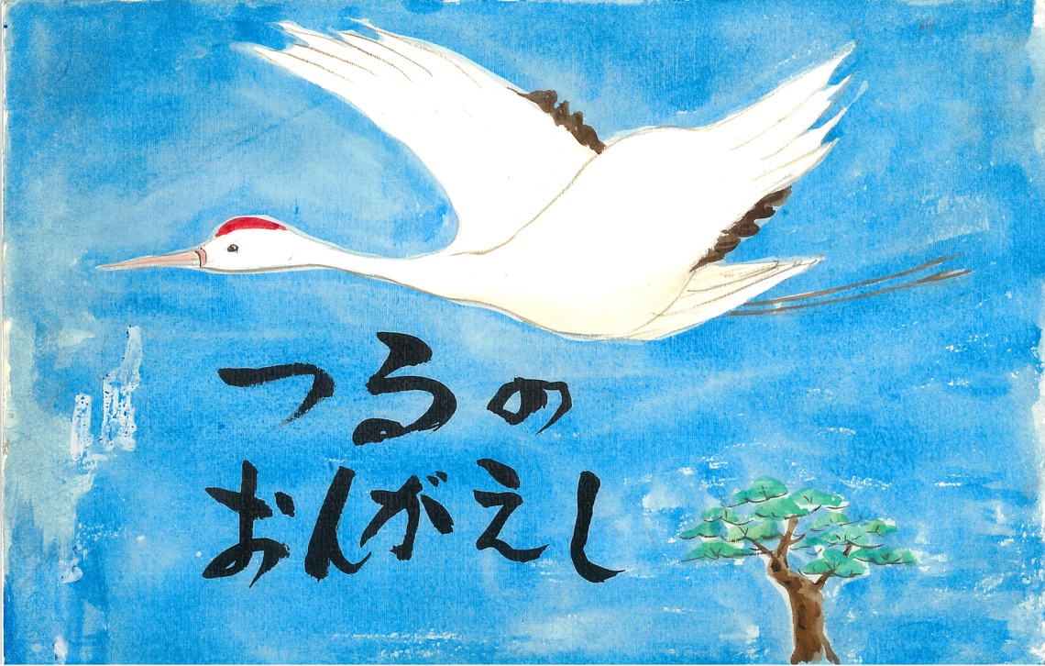

Kamishibai:
Japanese Storytelling
Notes:
Introduction
This is a story from Japan from long ago.
It is called Tsuru no Ongaeshi
(tsu-roo no on-guy-she)
In Japanese, “Tsuru” means “Crane”
And “Ongaeshi” means “to return a favour”
So Tsuru no Ongaeshi is known in English as
The Grateful Crane

Slide 2
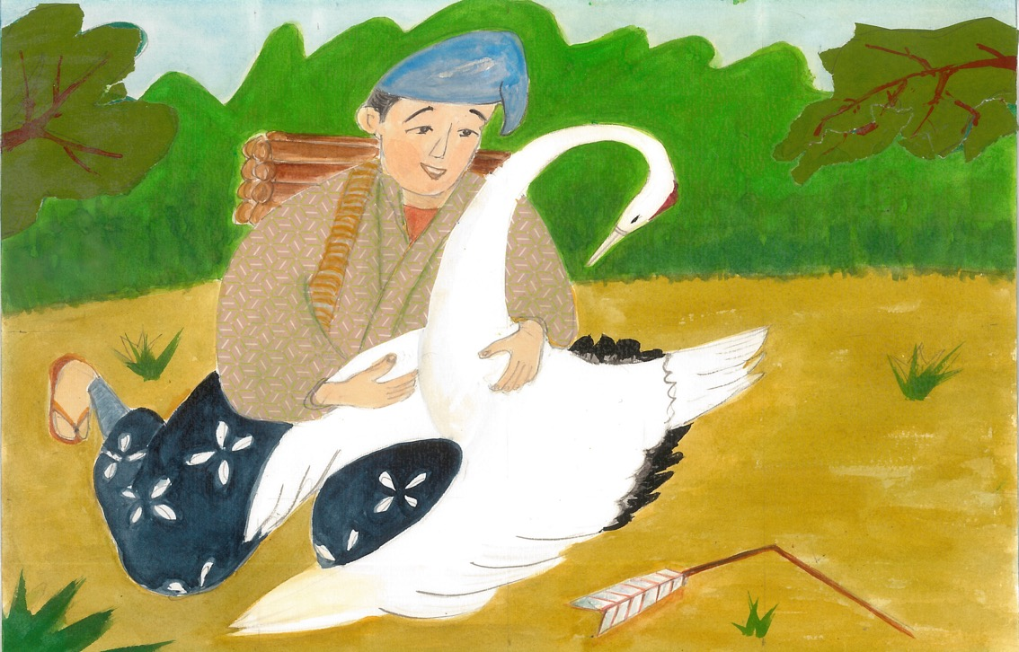

Notes:
1.
Mukashi mukashi* [Japanese]
Long, long ago in a far off land there lived a young man.
One day, while working on his farm, a brilliant white crane came swooping down and crashed to the ground at his feet. The man noticed an arrow pierced through one of its wings. Taking pity on the crane, he pulled out the arrow and cleaned the wound.
Thanks to his care the bird was soon able to fly again. The young man sent the crane back to the sky, saying, “Be careful to avoid hunters.” The crane circled three times over his head and let out a cry as if in thanks, before it flew away.
*Mukashi Mukashi means “Once upon a time” in Japanese.

Slide 3

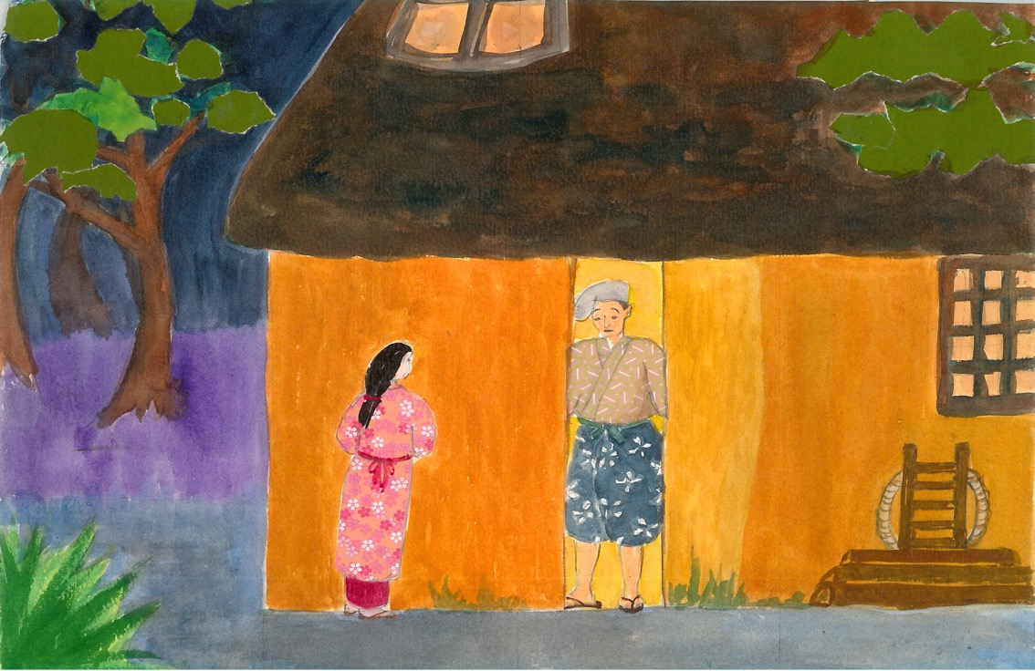
Notes:
2.
As the day grew dark the young man made his way home. When he arrived, he was surprised by the sight of a beautiful woman whom he had never seen before standing by the doorway.
“Welcome home. I am your wife,” said the woman. The young man was stunned and said, “I am very poor, and cannot support you.” The woman answered, pointing to a small sack, “Don’t worry, I have plenty of rice,” and she began preparing dinner.
The young man was puzzled, but he let her stay and the two began a happy life together. And the rice sack, mysteriously, always remained full.

Slide 4
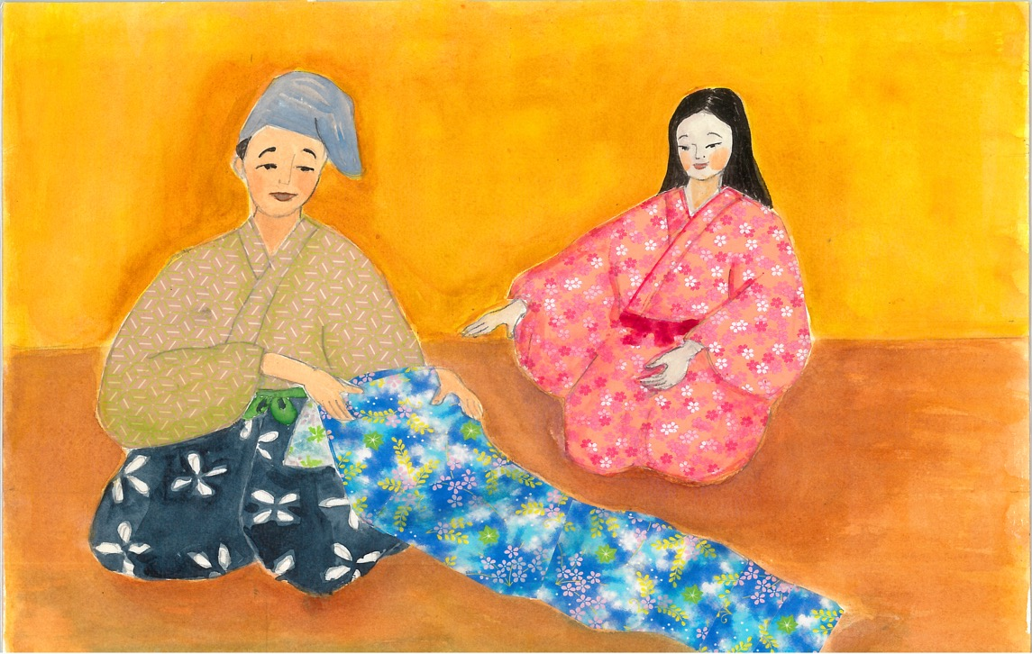

Notes:
3.
One day the wife asked the young man to build her a weaving room. When it was complete, she said, “You must promise never to look inside.” With that, she shut herself up in the room. The young man waited patiently for her to come out.
Finally, after seven days, the sound of the weaving machine stopped and his wife, who had become very thin, stepped out of the room holding the most beautiful cloth he had ever seen. “Take this cloth to the marketplace and it will sell for a high price,” said the wife.
The next day the young man took it to town and, just as she said, it sold for many coins. Happy, he returned home.

Slide 5
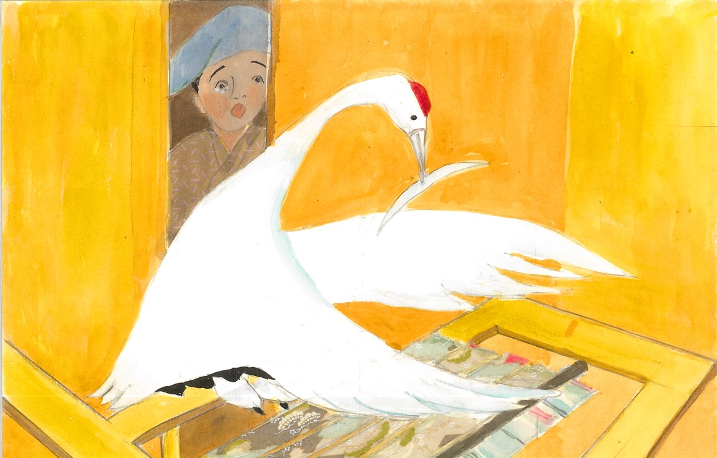

Notes:
4.
His wife returned to the room and resumed weaving. Curiosity began to overtake the man who wondered, “How can she weave such beautiful cloth without any thread?”
Soon he could stand it no longer and, desperate to know his wife’s secret, peeked into the room. To his great shock, his wife was nowhere to be seen. Instead, a crane sat at the loom weaving intently, plucking out its own feathers for thread.

Slide 6
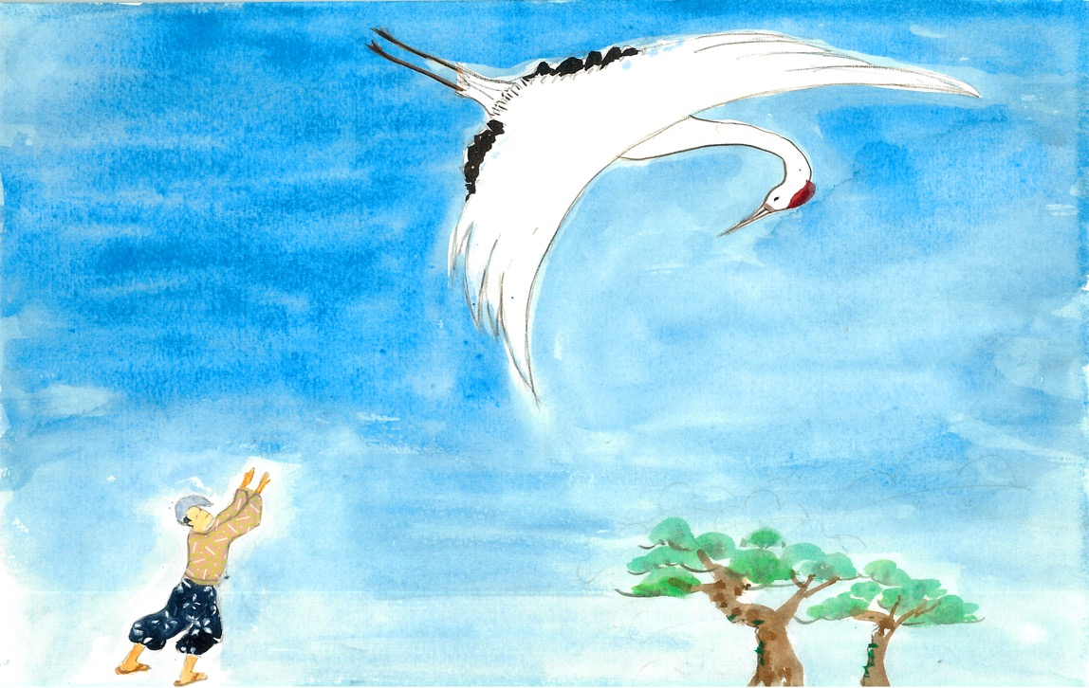

Notes:
5.
At that moment, the bird noticed the young man peeking in and said, “I am the crane that you saved. I wanted to repay you so I became your wife, but now that you have seen my true form I cannot stay here any longer.”
Then, handing the man the finished cloth, it said, “I leave you this to remember me by.” The crane then flew off into the sky and disappeared forever.

Slide 7

終わり
o-wa-ri
(The End)
Notes:
For more resources, visit www.japansociety.org.uk.

Slide 8

For more resources, visit www.japansociety.org.uk.
Notes:
For more resources, visit www.japansociety.org.uk.

