Slide 1
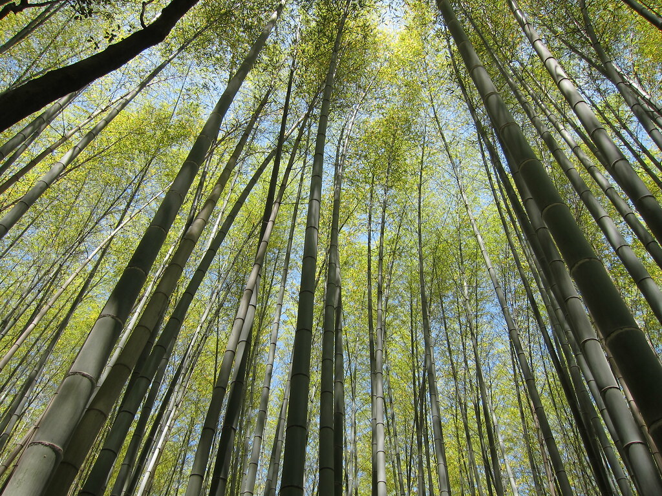

Health and Happiness in Japan
Notes:
Teacher’s Note
Lesson theme: An introduction to the concept of wellbeing and the country of Japan
Title image is "IMG_0549" by hslo: https://search.creativecommons.org/photos/54d331e1-89e2-4263-a941-aedcc3b936a4

Slide 2

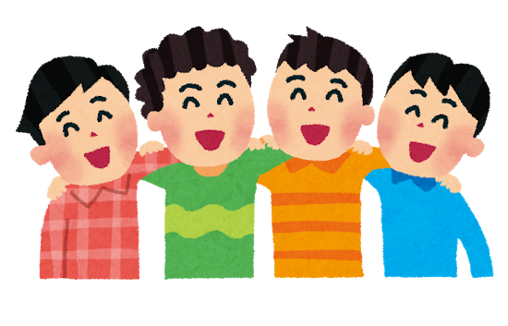
Learning Objectives
I can discuss how I feel
I can explain what wellbeing is
I can illustrate what makes me happy

Slide 3
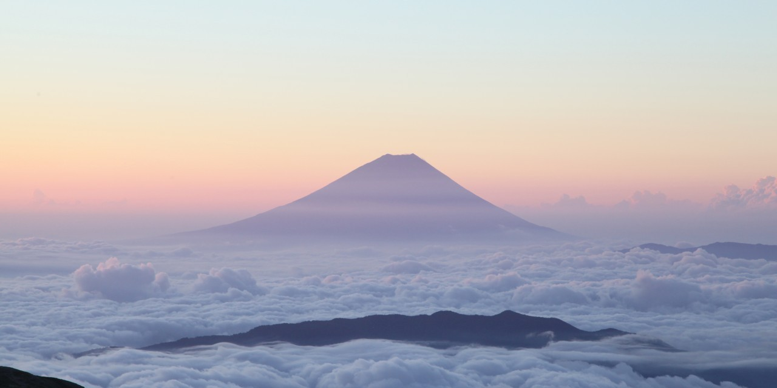
Discuss…
What is the picture showing?
Where do you think it is?
How would you feel watching this sunrise ?
©Yasufumi Nishi/©JNTO
Notes:
Teacher’s Note
Paired discussion. Third question appears on click.
May need to prompt students with different feelings i.e. relaxed, happy, excited etc.

Slide 4

Mount Fuji, Japan
Mount Fuji is an active volcano
3776.24 metres high (the highest in Japan!)
It last erupted more than 300 years ago
It is a very special and important symbol of Japan
What symbols do other
countries have?
Notes:
Tell Students
Mt. Fuji is the same height as: 824 double decker buses or 39 Big Bens
Ask Students
What symbols do other countries have? Answers fly in.
Brief class discussion around symbols of other countries i.e. Big Ben, Eiffel Tower, Empire State Building etc.

Slide 5

Dreaming of Mt. Fuji…
It is lucky to dream about Mount Fuji on 2nd January.
People believe it means they will be happy and healthy for the whole year.
They will have good wellbeing.
What does wellbeing mean?
Notes:
Ask students
What do you think it means to dream about Mt Fuji in Japan? Reveal answers
Teacher notes
The first dream of the year is called ‘Hatsu-yume’ (hat-sue you-may)
Hatsu means first and yume means dream.
Traditionally this is said to be on 2 January, but some people consider 1 January to be hatsu-yume night.

Slide 6
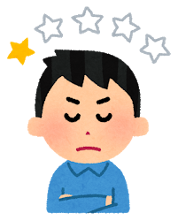
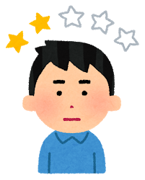
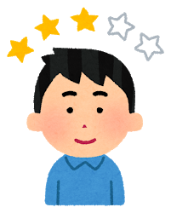
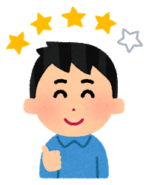
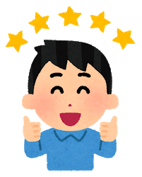
Wellbeing
How we feel inside.
How we feel about the world around us.
Important for mental and physical health.

Slide 7


Mini Quiz
Mount Fuji is the luckiest dream to have, but there are two more things that are considered lucky to dream about.
Can you guess what they are?
Hint: One is an animal and one is a vegetable
?
?
Hawk
taka
Aubergine
nasu
Notes:
Teacher’s Note
Give students the first hint. Time depending, you may want to give more hints or play a game of 20 questions.
Answers: A hawk and an aubergine! No one is quite sure why, there are many theories!

Slide 8
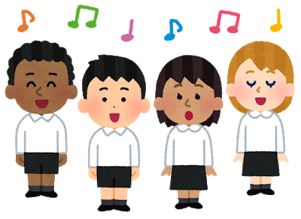
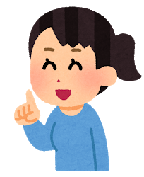
Mini Task
Discuss with a partner:
1. What makes you feel happy and healthy?
2. What would you like to dream of on January 2nd?
Notes:
If time, call on several students to talk about what they discussed.

Slide 9

Main Task
Draw your dream
of health and happiness
Notes:
Teacher’s Note
Give out dream templates or differentiated templates and refer to the teacher script if using.

Slide 10






Reflection
Wellbeing goes up and down and that’s ok.
Sometimes we feel happy and sometimes we feel sad.
Notes:
Tell Students
Today we have talked about lots of things that make you happy/give you good wellbeing.
Sometimes things happen that make us sad and that is ok.
Just as the sun comes up and down over Mt. Fuji, so does our mood and the way we feel.
Imagine wellbeing is a line and we are all at different points on the line every day depending what is happening for us.
It is normal to have happy and sad moments as well as to feel somewhere in the middle.

Slide 11
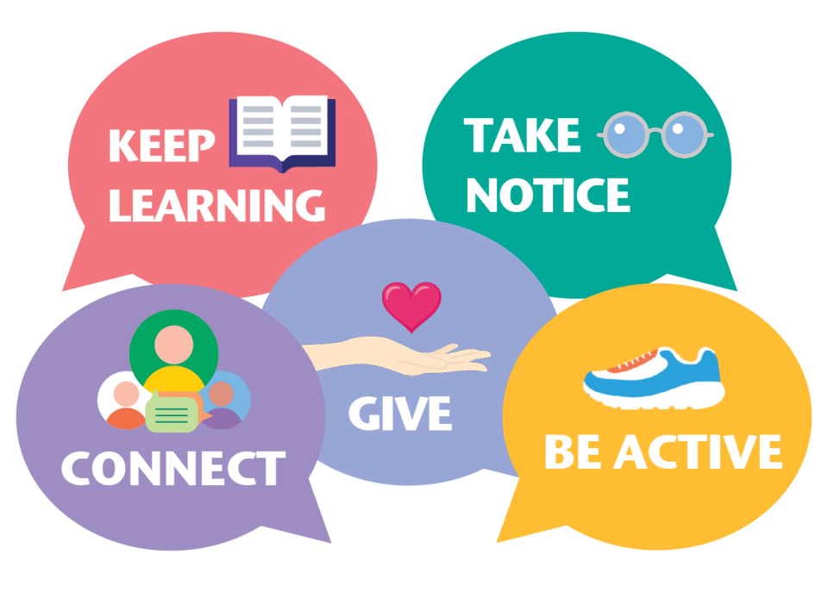
5 Ways to Wellbeing
If we look after our wellbeing it can make sad moments easier to cope with.
What do you do to look after your wellbeing?
https://www.youtube.com/watch?v=yF7Ou43Vj6c
Notes:
Tell Students
Over the next few lessons we will explore each one in more detail at the same time as learning more about Japan.
Watch the video produced by Rochdale Borough Council (‘1:21)
The 5 Ways to Wellbeing
Connect – this is about our positive relationships with other people
Be active – exercise produces endorphins which make us feel good
Keep learning- this is about challenging ourselves and feeling we can achieve i.e. new language, new hobby/skill
Give – feeling good about doing something for another person
Take notice – appreciating what we have and the world around us i.e. mindfulness, enjoying nature, observing changing seasons
https://www.nhs.uk/conditions/stress-anxiety-depression/improve-mental-wellbeing/ can give you more information.

Slide 12
Wellbeing in school
Teachers should use this slide to signpost to any provision they have in school i.e. school counsellor, worry box, teachers etc.
Whilst it is normal for us to have ups and down, if pupils are feeling sad and the feeling does not go away then they should talk to someone they trust.

Slide 13




This resource was designed by Kimberley Evans with the Japan Society.
The Japan Society
13/14 Cornwall Terrace, London NW1 4QP
Tel: 020 7935 0475
Email: education@japansociety.org.uk
www.japansociety.org.uk
Follow us on:
@japansocietylon
@JapanSocietyLondon

