Slide 1




Kamishibai:
Japanese Storytelling
Notes:
The Spider’s Thread
Based on the story by Ryunosuke Akutagawa
The Spider’s Thread is a well-known short story by the Japanese writer Ryunosuke Akutagawa, published in 1918. It is a moral fable about good, evil and redemption. Akutagawa was inspired by other stories and also Buddhist fables; according to some Buddhist beliefs, those who lead good, compassionate lives are reincarnated into a better life, and those who do not are sent to Hell.

Slide 2
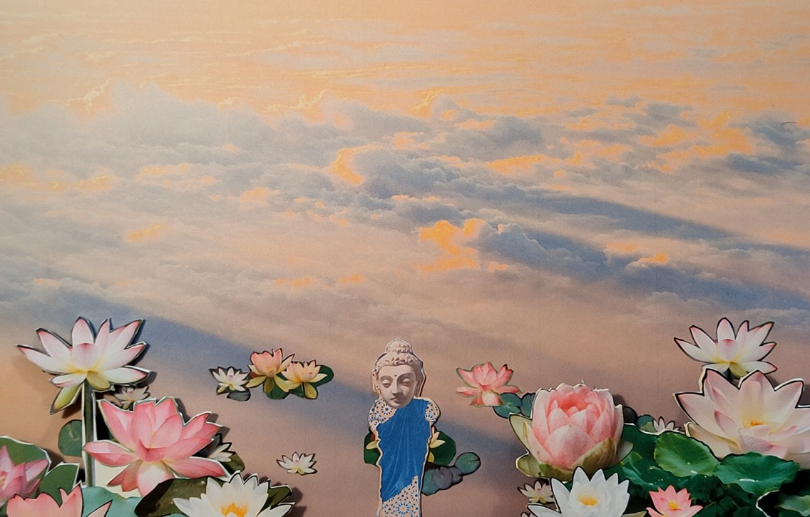
Notes:
1.
It was a beautiful morning in Paradise. The carpet of clouds had been turned shades of blue and apricot orange by the warm morning sun. From time to time, the fragrance of lotus flowers drifted through on the gentle breeze.
Our story starts on this very morning when Buddha was taking a walk over the Pond of Paradise.

Slide 3
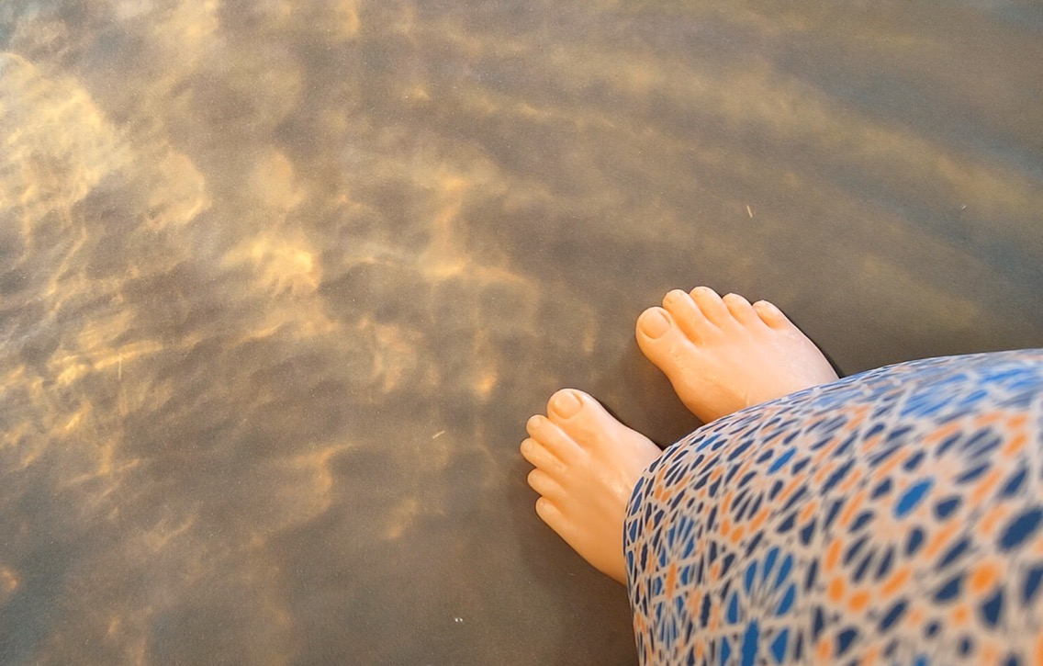
Notes:
2.
Buddha paused on his way and glanced down at the scenery through the water, between the flowers and leaves. The water in the pond was crystal clear, so clear that he could see all the way to the bottom - to the very depths of Hell.

Slide 4
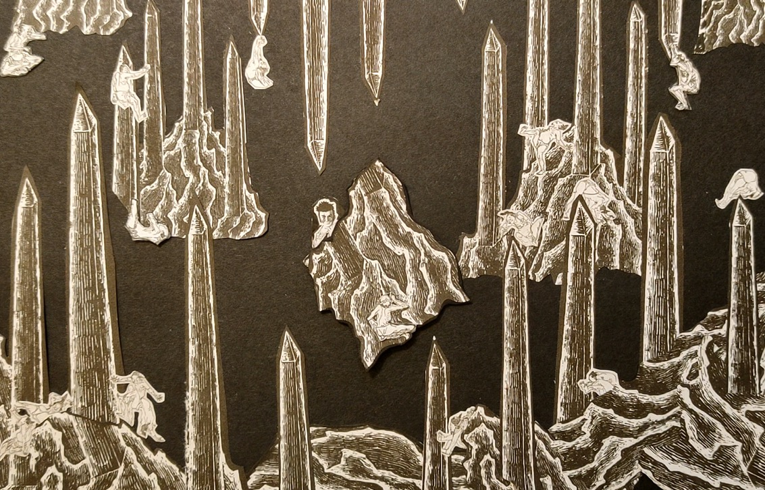
Notes:
3.
Hell was a silent darkness. But the Buddha could see the many sinners who were trapped there. Some were crawling and others were shaking in fear. But most lay motionless, exhausted by the relentless torture of the creatures in Hell.

Slide 5
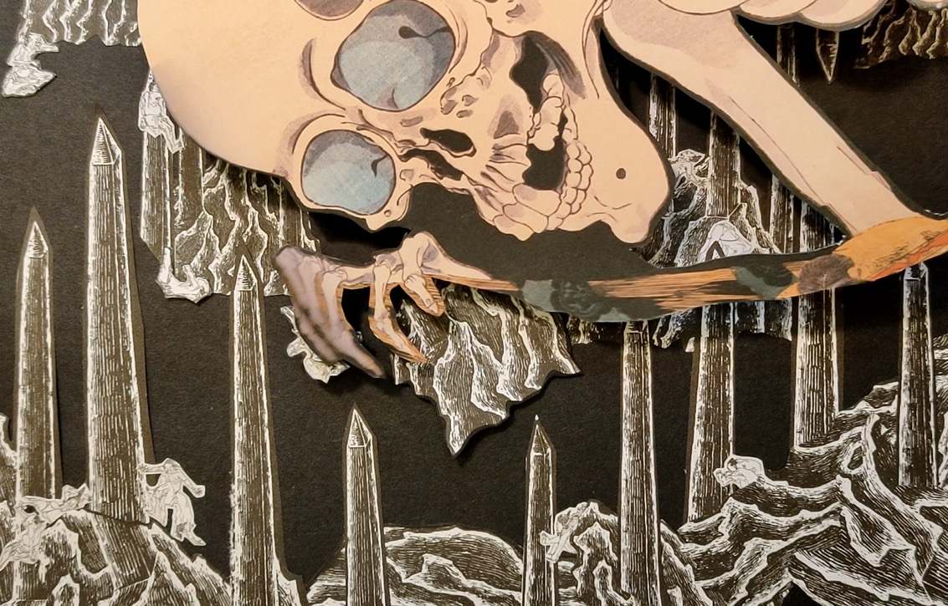
Notes:
4.
From time to time the silence of Hell was broken by agonised screams and pitiful calls for help. The sinners begged for mercy as monsters emerged from the shadows. In Hell, horrible things were happening, things that we cannot begin to imagine.

Slide 6
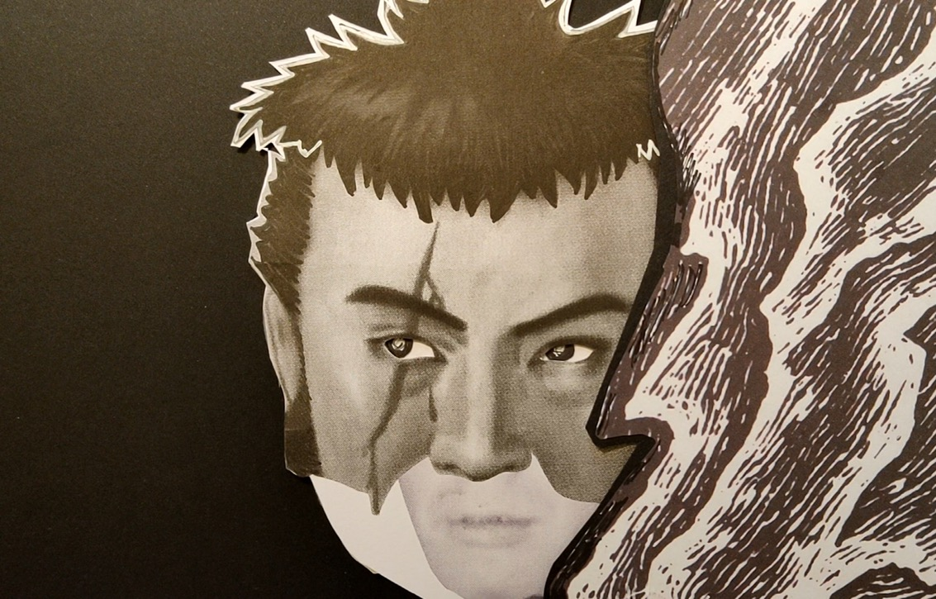
Notes:
5.
Among the many sinners, Buddha’s eye came to rest on an individual called Kandata, a man with a jagged scar running down one side of his face. He was hiding behind the large rocks, trying to escape the notice of the fearsome monsters of Hell.

Slide 7
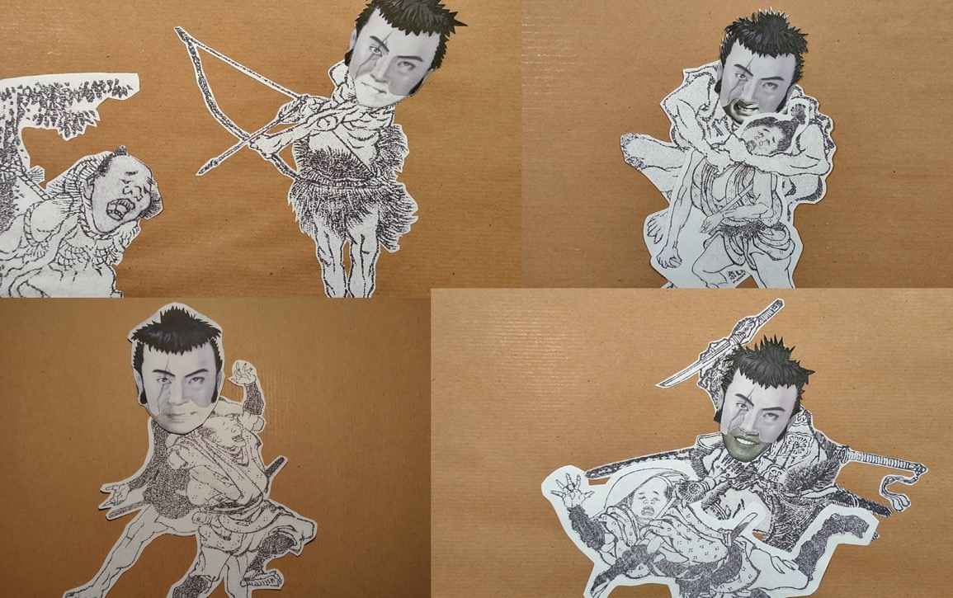
Notes:
6.
During his lifetime, this sinner, Kandata, had been an infamous thief. He was a ruthless killer too, taking the lives of many innocent souls and causing needless misery to countless ordinary people. However, wicked though he was, Kandata had performed one good deed in his past life of evil.

Slide 8
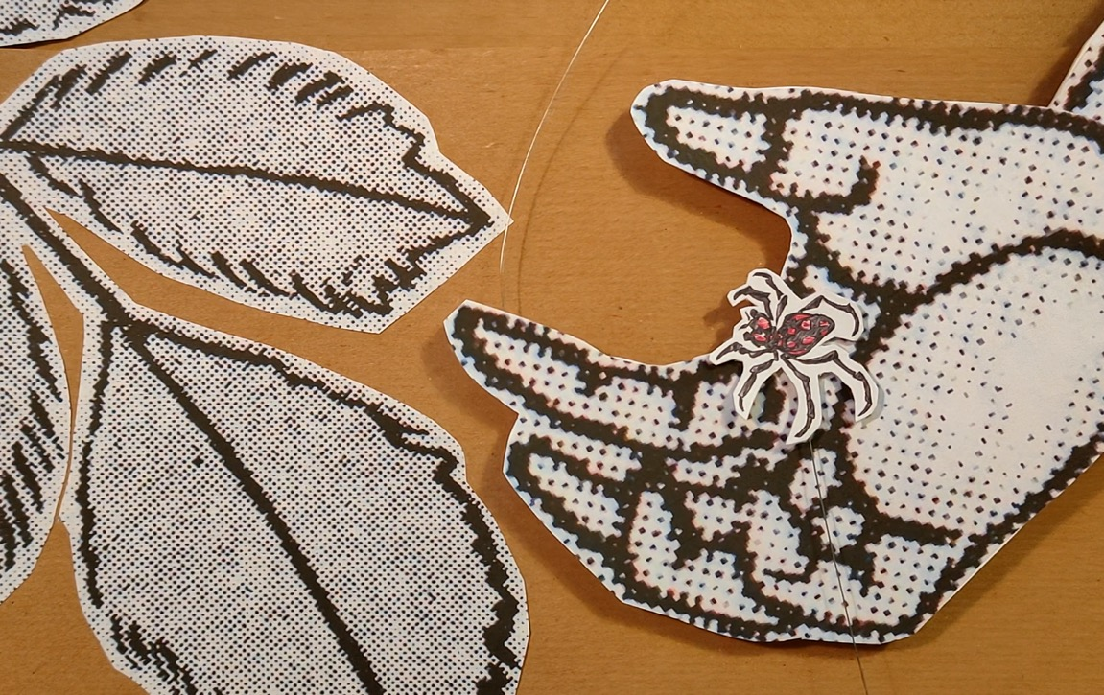
Notes:
7.
One day, as he was walking through the forest, he nearly stepped on a spider.
In a rare moment of compassion he had thought to himself
‘Even though it looks so tiny and weak, it is still a living being.
It is cruel to take a life for no reason’.
So he had taken the spider to a safe place, carrying it in the palm
of his hand.

Slide 9
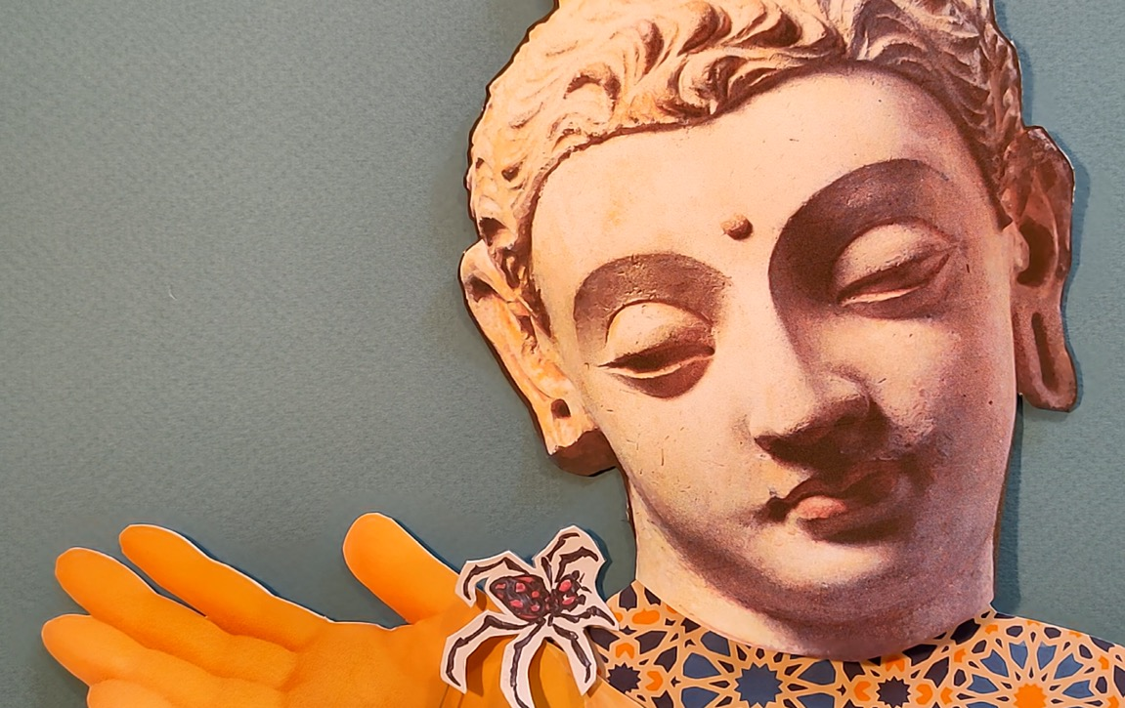
Notes:
8.
Buddha remembered this act of his kindness as he watched Kandata suffering in Hell. He decided to reward him for this one good deed and to save him from eternal torment.
Buddha found a spider on a nearby lotus leaf. He gently scooped up the small creature and asked it to find Kandata. He lowered the spider with its silver thread down to Hell.

Slide 10
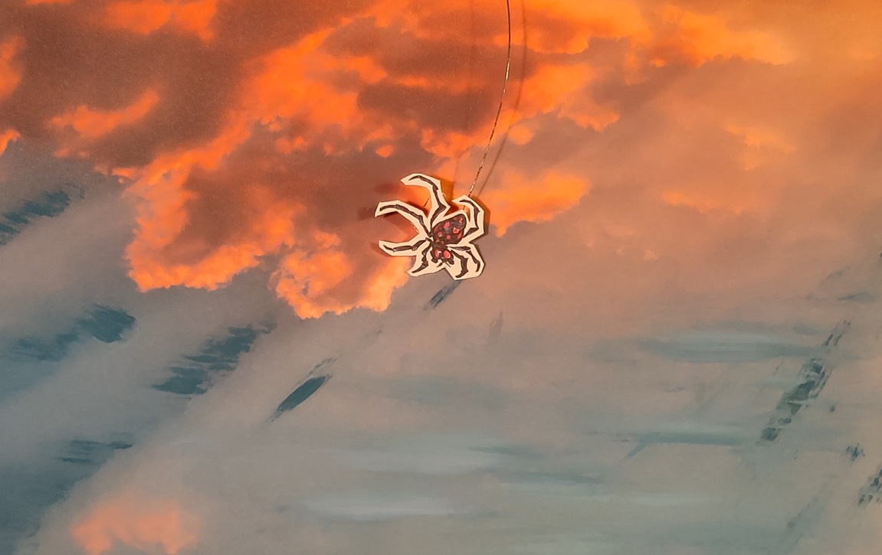
Notes:
9.
Hell was far from Paradise, so the spider’s descent was long and passed through many layers of sky and clouds. As it travelled further and further down, the colour drained from the landscape and everything became bleak and lifeless.

Slide 11
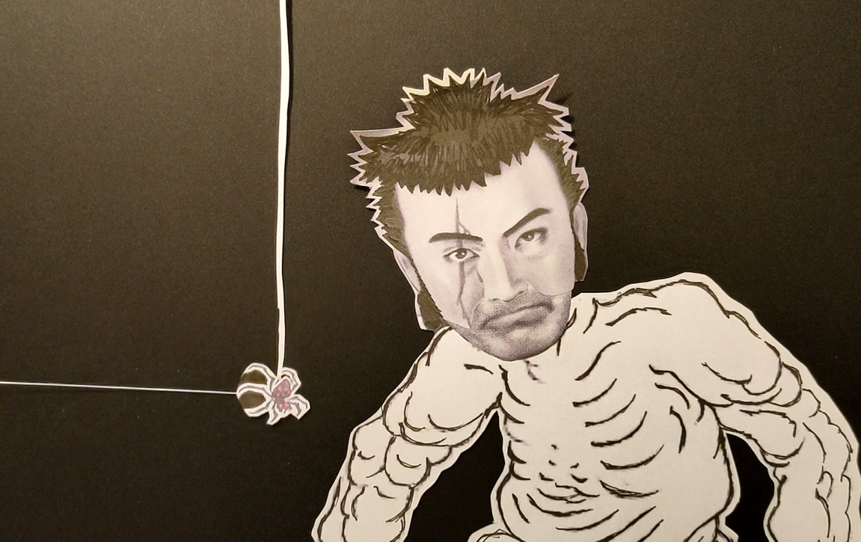
Notes:
10.
Kandata was exhausted from the perpetual torments of Hell. All he could do was stare into the gloom. Then, all of a sudden, something bright and shiny caught his eye. As he looked harder, he noticed the spider descending on its silvery thread.

Slide 12
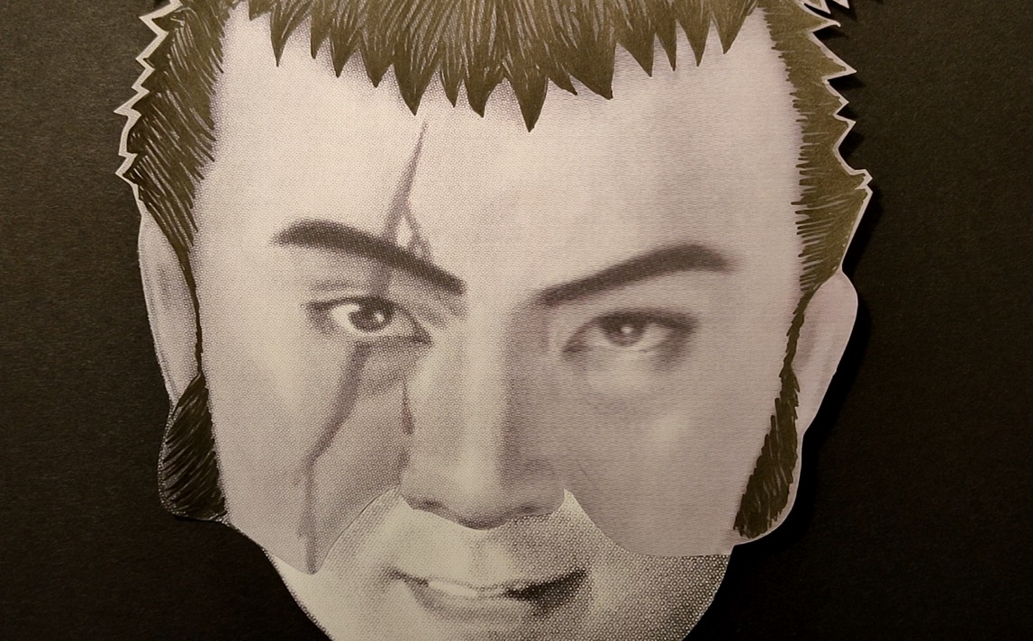
Notes:
11.
Kandata grabbed the thread and looked up to see where it was coming from. It seemed to lead all the way up to the roof of Hell. With a broad smile on his face, he told himself ‘If I could climb this thread all the way up to the top, I could get out of Hell. Maybe I could even escape into Paradise!’

Slide 13
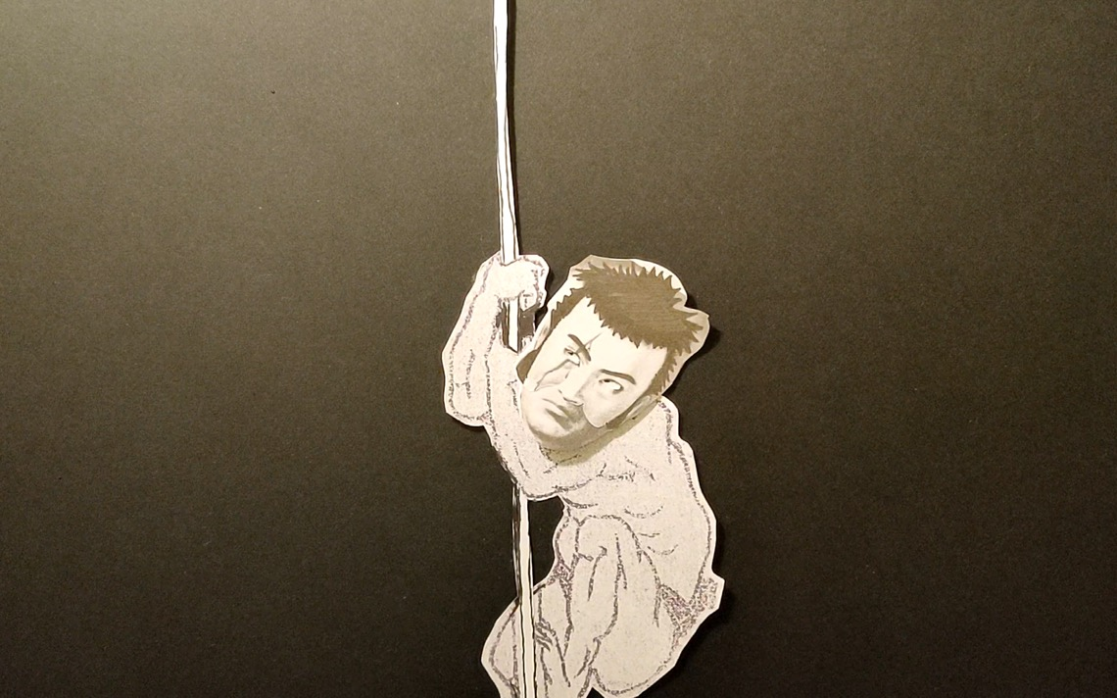
Notes:
12.
Kandata did not waste a moment. He grasped the spider’s thread with both hands
and pulled himself up with all his strength. As he was a great thief, this kind of climbing
came naturally to him.
He climbed up and up, higher and higher.
Yet it was not a quick and easy task; there was a vast distance between Hell and Paradise.
Who knows how many hours he spent climbing? Eventually, he paused as his arms and hands were burning from exhaustion.
As he was resting, he looked down to see how far he had come. But what Kandata saw filled his soul with rage.

Slide 14
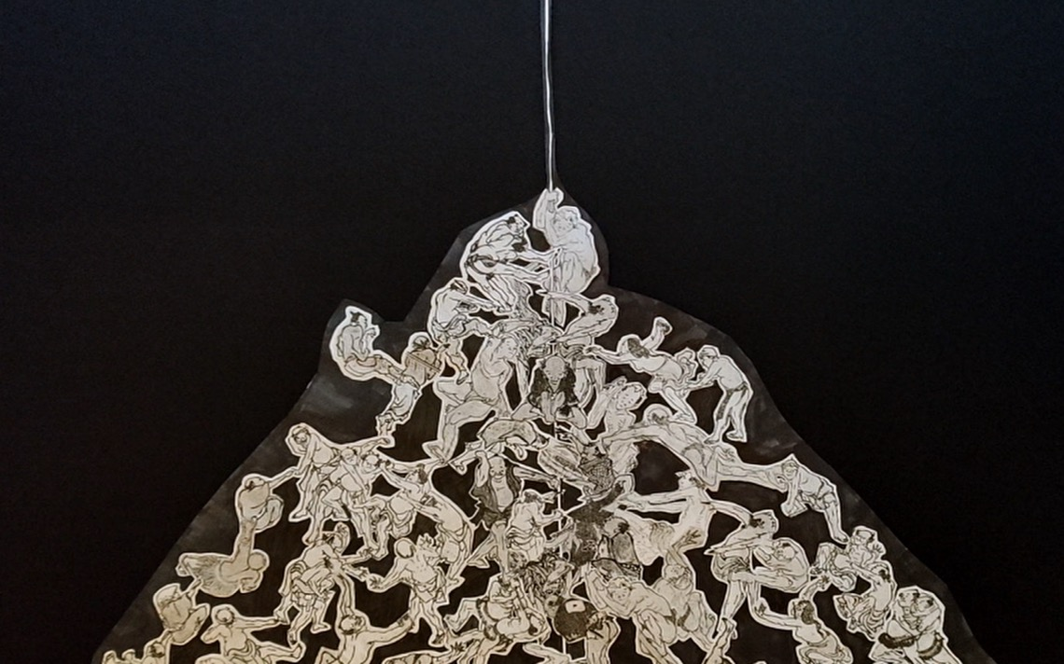
Notes:
13.
Far below him, there was a mountain of sinners clinging to the very same spider’s thread. The puny figures were wriggling and writhing, pulling and pushing as they climbed upwards like him.
How could such a thin and fragile thread possibly hold this enormous weight?
What if the spider’s thread should break because of these selfish sinners? Kandata would also fall back into Hell.

Slide 15
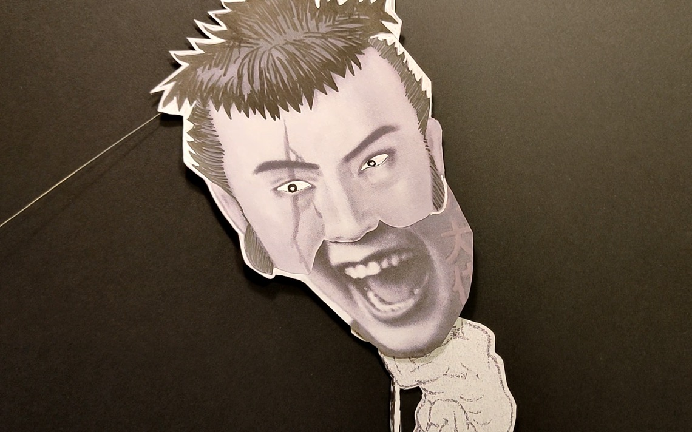
Notes:
14.
Kandata shouted down,
“Oi, sinners! This spider’s thread is mine alone. Who said you could climb with me? Get off, GET OFF!”
But the moment those words left his lips something happened.

Slide 16
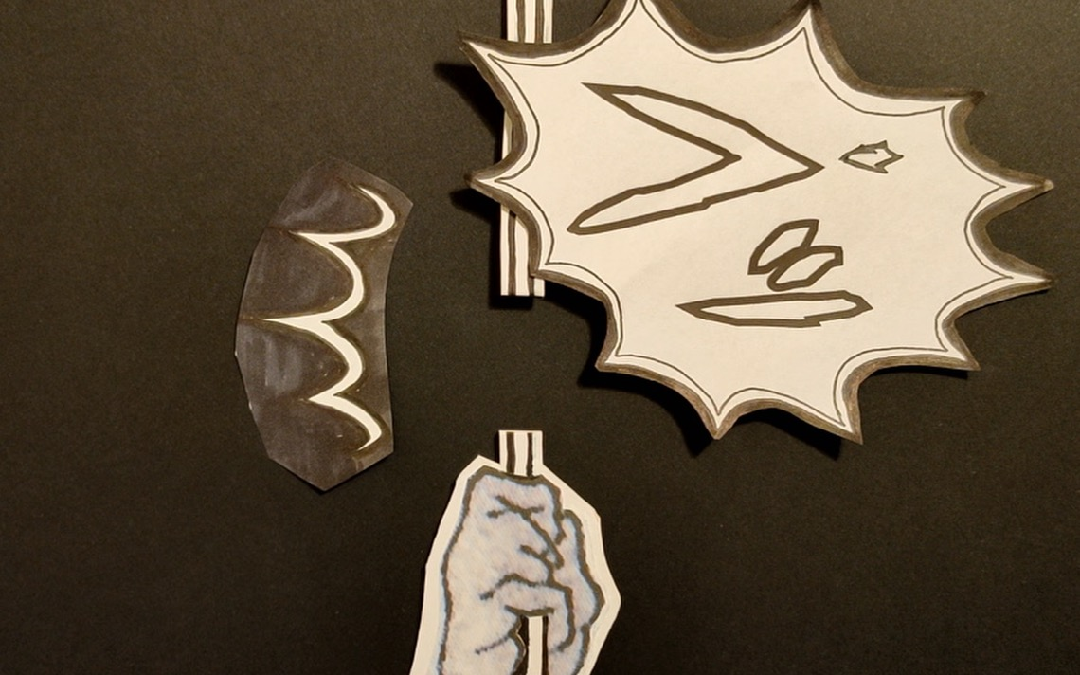
Notes:
15.
“SNAP!”
In that very instant, the spider’s thread broke, just above the point where Kandata was hanging on.

Slide 17
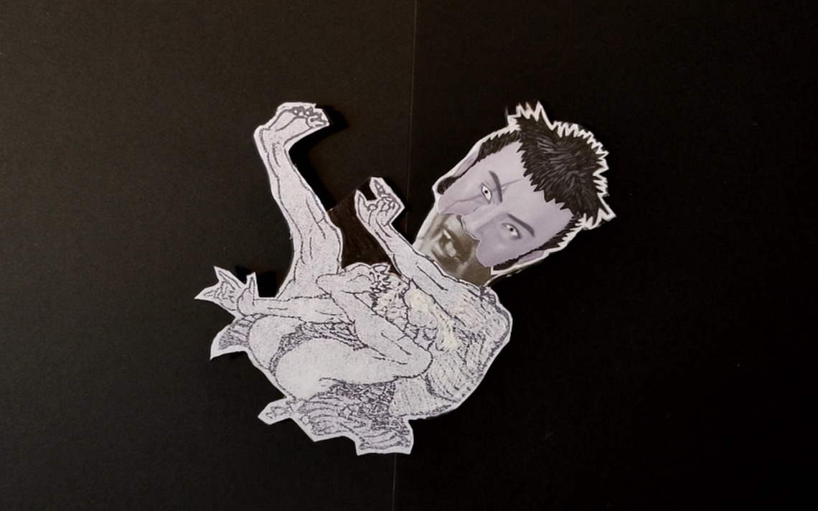
Notes:
16.
For a moment, Kandata sensed he was floating in the air, free as a bird. Then he was falling down as if being sucked into an endless abyss. He screamed and cried in agony and despair. He had been so close to Paradise, far away from all the suffering and pain that he had endured for a long time. But his screams were soon drowned out by the chorus of screams from the other sinners in Hell.

Slide 18
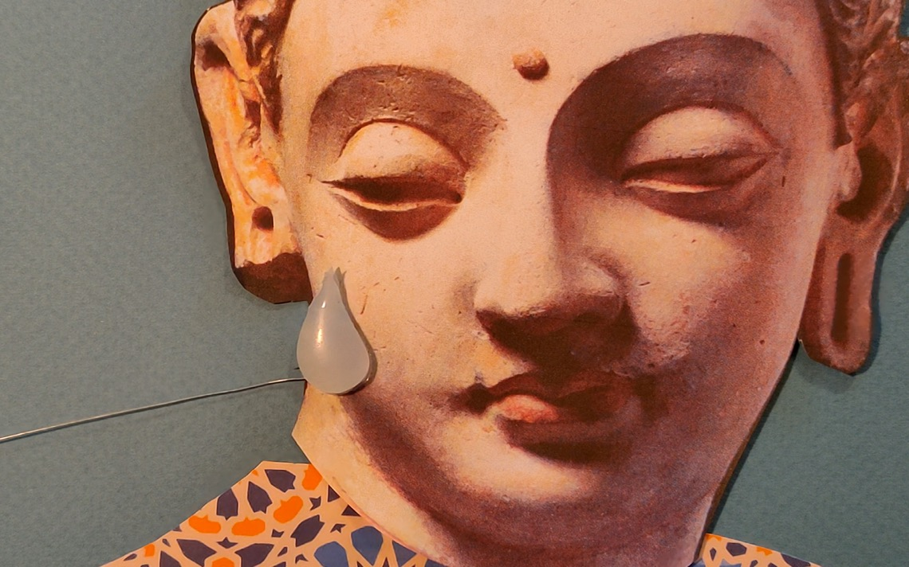
Notes:
17.
Buddha had seen everything happen through the crystal clear water. A single tear ran down his cheek as he watched Kandata being swallowed back into the darkness.
Yet, around Buddha’s feet, the petals of the lotus flowers were still dancing in the gentle breeze, carrying a wave of heavenly fragrance from the golden centre of the flower. The late morning sun turned the carpet of clouds a pearly white.

Slide 19

Notes:
18.
The End.

Slide 20

終わり
o-wa-ri
(The End)
Notes:
For more resources, visit www.japansociety.org.uk.

Slide 21

For more resources, visit www.japansociety.org.uk.
Notes:
For more resources, visit www.japansociety.org.uk.

