Slide 1
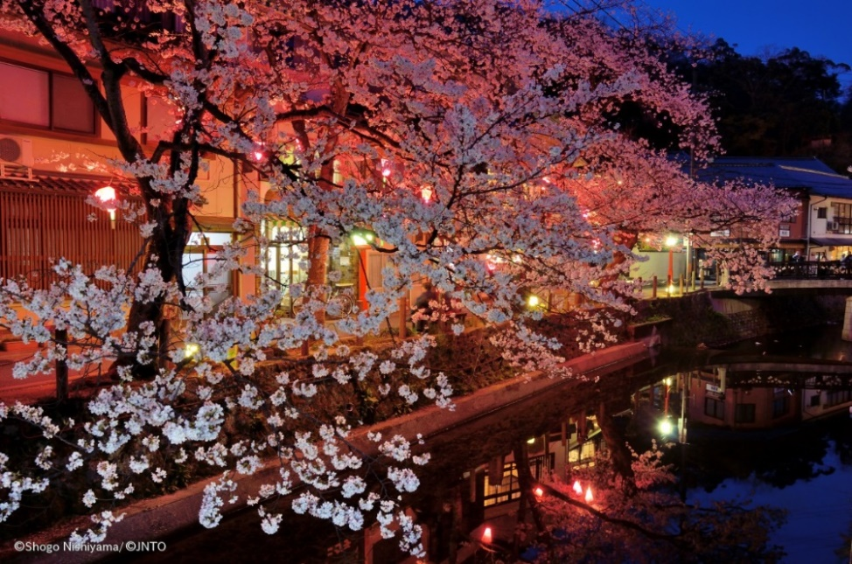
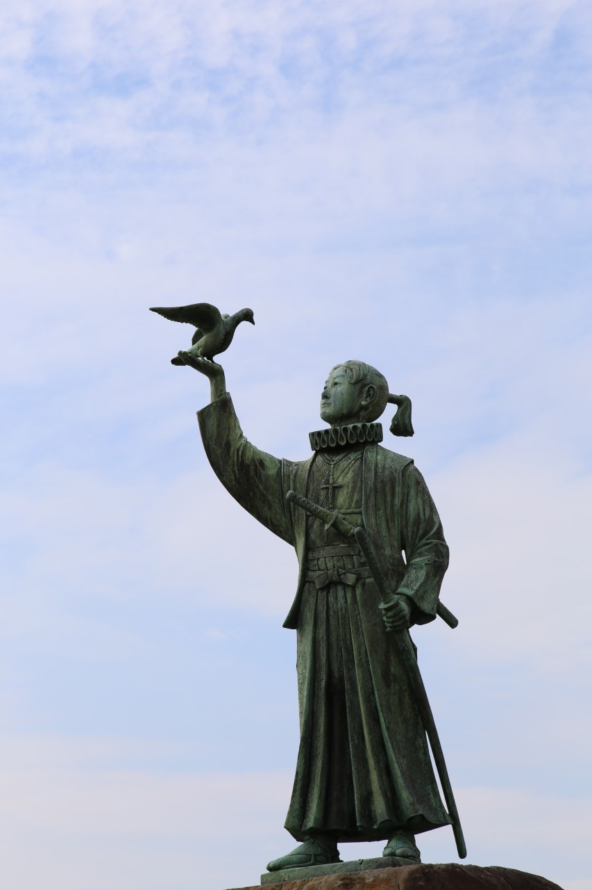
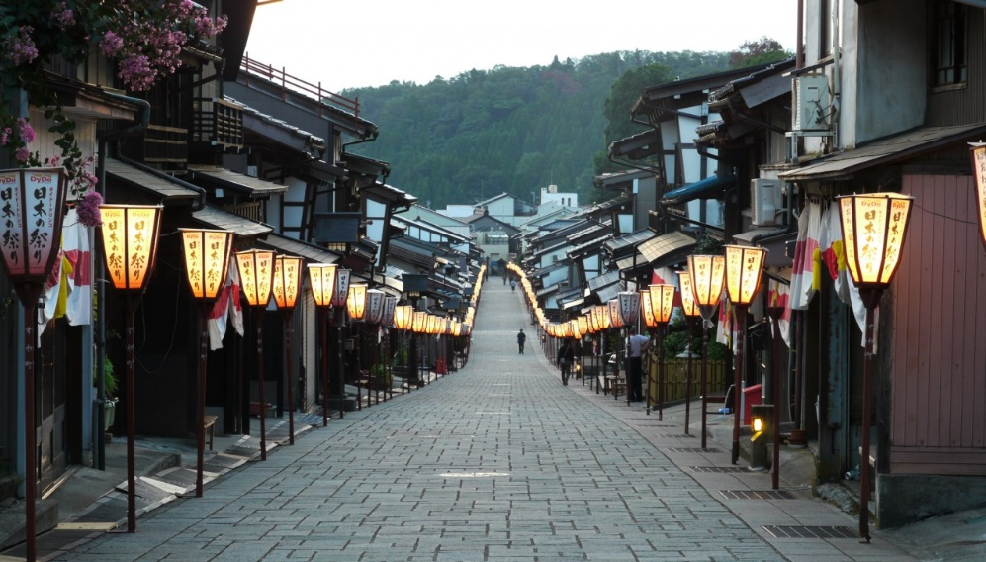
Warm Up
What country
are we
going to be learning about?
Japan!
©Toyama Prefectural Tourism Association/©JNTO
©Yasufumi Nishi/©JNTO
Notes:
Teacher’s Notes
Display this on the screen/board as students enter the classroom so that they can begin straight away, leaving space for the date and title if they are writing their answer in their books.

Slide 2

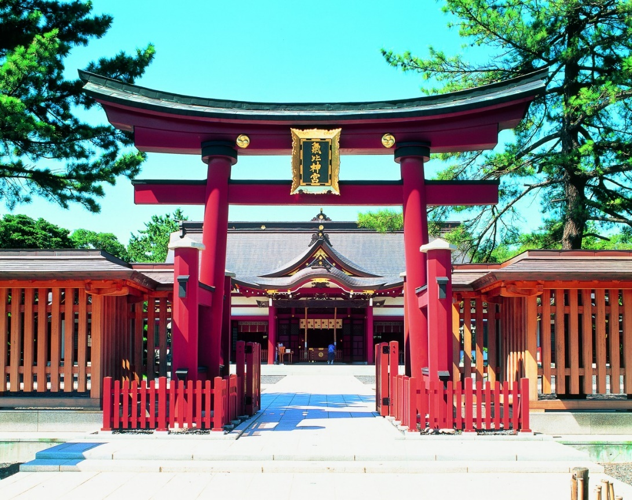
Introduction to Japan
Your Learning Objectives:
Describe the location of Japan.
Investigate the hazards and other challenges of living in Japan.
Analyse the opportunities of living in Japan.
©JNTO
Notes:
Teacher’s Notes
Image is Kehi Jingu Shrine in Fukui Prefecture

Slide 3
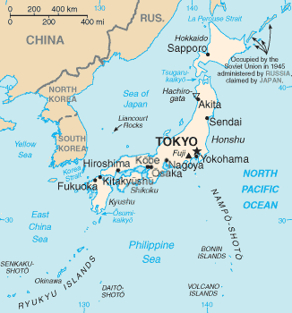
Starter
What can we learn about Japan, just from this map?
Come up with as many ideas as you can!
Did you notice that it’s a chain of islands?
Notes:
Teacher’s Notes
Students can discuss, write ideas in their book or use mini whiteboards to suggest ideas.
Ideas may include that it’s in Asia, off the coast of South Korea and Russia, in the North Pacific Ocean, it’s a group of islands.

Slide 4
Starter
Key term: Archipelago – a group of islands, often in a line known as a chain. The Japanese archipelago consists of 4 main islands and 6,847 smaller, more remote islands!
The British Isles is also an archipelago, with 2 main islands and around 5,000 small ones.
Notes:
Teacher’s Note
Students could add this to their list or write down the definition as a literacy focus for the lesson.

Slide 5

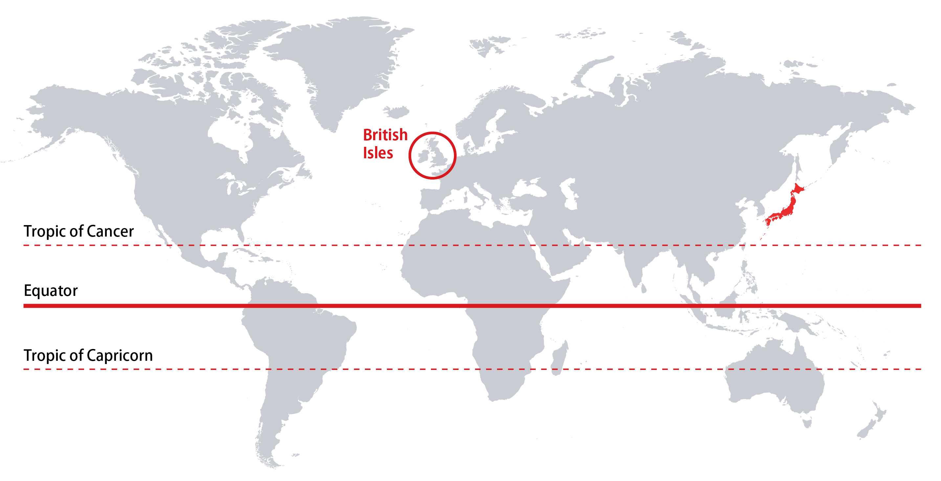
Task 1: Location
N
Task: Describe the location of Japan. Refer to compass directions and lines of latitude. Include the term ‘archipelago’ in your answer.
Challenge task: Compare the location of Japan with that of the British Isles.

Slide 6
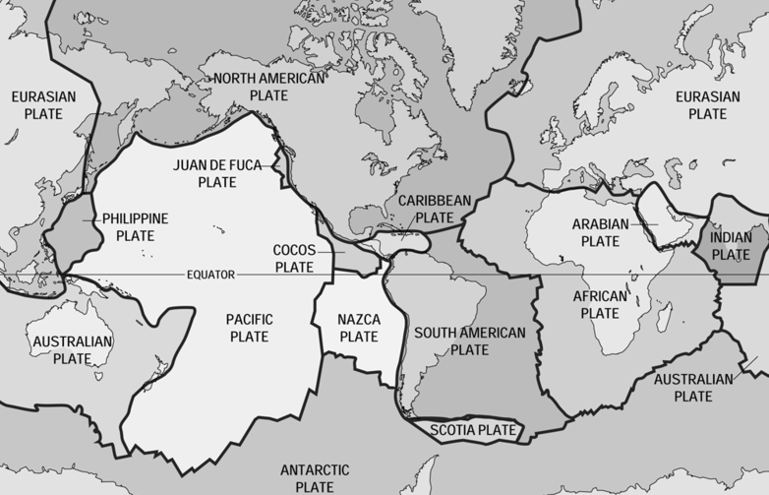
A Hazardous Place
The surface of the Earth is broken up into huge pieces called ‘plates’. Along the edges of these plate is where most earthquakes and volcanic eruptions occur.
Unfortunately, Japan is on the boundary between 4 different plates!

Slide 7
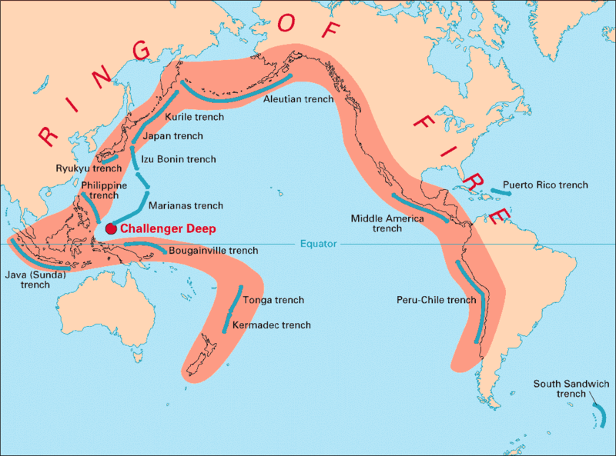
A Hazardous Place
It’s also located along the Pacific Ring of Fire, which is where the majority of the world’s earthquakes and volcanic eruptions occur.

Slide 8
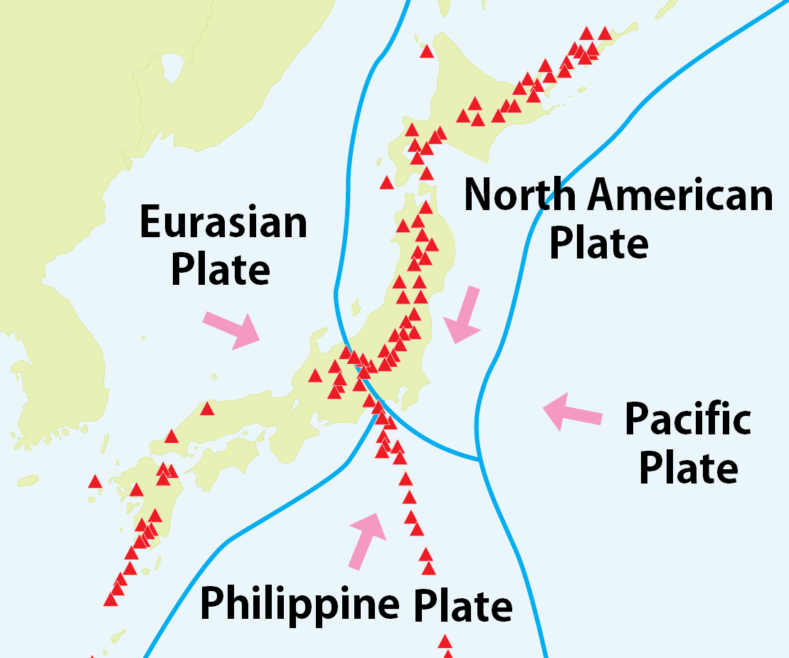
Task 2: A Hazardous Place
Task: What makes Japan a hazardous place to live?

Slide 9


Task 3: Opportunities & Challenges
Task: Complete the worksheet to identify a range of opportunities and challenges of living in Japan. Categorise the opportunities into energy, food, construction.
Challenge task: What are the economic opportunities?
Opportunities are advantages of living somewhere.
E.g., food, resources for energy or construction (building).
Challenges are disadvantages of living somewhere.
E.g., hazards or problems.

Slide 10
Task 3: Opportunities and Challenges
Key |  |  | Food
 | Opportunity |  | Energy
 | Challenge |  | Building
Japan is located in the Ring of Fire, split across four tectonic plates. | Typhoons hit Japan 2 or 3 times per year on average. | Almost ¾ of Japan is mountainous, making it difficult to build on. | Hot springs caused by the volcanic activity attract tourists.
Monsoons and rainy seasons can cause extreme flooding. | Forests cover 66% of the land, providing timber for construction. | Being an island makes it easy to have ports for fishing. | There are 108 active volcanoes which erupt frequently.
The climate is varied as it is tropical in the south and cool in the north. | Most of the rivers are fast flowing and so are able to be used to create electricity (HEP). | Earthquakes and volcanic eruptions under the sea can cause tsunamis. | Heat from under the ground can be used to make electricity (geothermal power).
Volcanic ash has made the soils very fertile and good for farming. | Small earthquakes happen daily, and several major ones happen every century. | Having a large coastline makes it easy to ship goods in and out of the country. | There are small amounts of minerals such as iron, coal and oil.

Slide 11



Task 3: Opportunities and Challenges
Key |  |  | Food
 | Opportunity |  | Energy
 | Challenge |  | Building
Japan is located in the Ring of Fire, split across four tectonic plates. | Typhoons hit Japan 2 or 3 times per year on average. | Almost ¾ of Japan is mountainous, making it difficult to build on. | Hot springs caused by the volcanic activity attract tourists.
Monsoons and rainy seasons can cause extreme flooding. | Forests cover 66% of the land, providing timber for construction. | Being an island makes it easy to have ports for fishing. | There are 108 active volcanoes which erupt frequently.
The climate is varied as it is tropical in the south and cool in the north. | Most of the rivers are fast flowing and so are able to be used to create electricity (HEP). | Earthquakes and volcanic eruptions under the sea can cause tsunamis. | Heat from under the ground can be used to make electricity (geothermal power).
Volcanic ash has made the soils very fertile and good for farming. | Small earthquakes happen daily, and several major ones happen every century. | Having a large coastline makes it easy to ship goods in and out of the country. | There are small amounts of minerals such as iron, coal and oil.
Notes:
Opportunity for self or peer assessment.

Slide 12
Plenary
Do the opportunities outweigh the risks?
If you lived in Japan, would you want to stay?
Yes
No
Be ready to give a reason for your opinion
Notes:
Teacher’s Notes
Students can move to one side of the room or the other to show which answer they agree with.
Alternatively, they can raise their left hand if they think ‘yes’, or their right hand if they think ‘no’. They can then discuss their ideas.

Slide 13




This resource was authored by Katie Holmberg in collaboration with the Japan Society
The Japan Society
13/14 Cornwall Terrace, London NW1 4QP
Tel: 020 7935 0475
Email: education@japansociety.org.uk
www.japansociety.org.uk
Follow us on:
@japansocietylon
@JapanSocietyLondon

