Slide 1
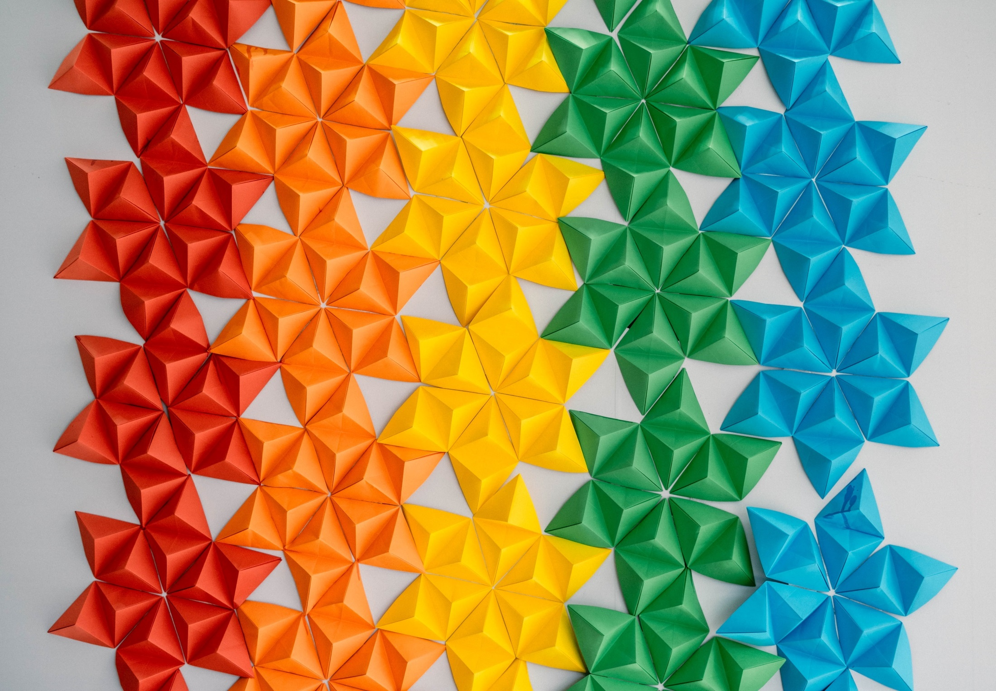

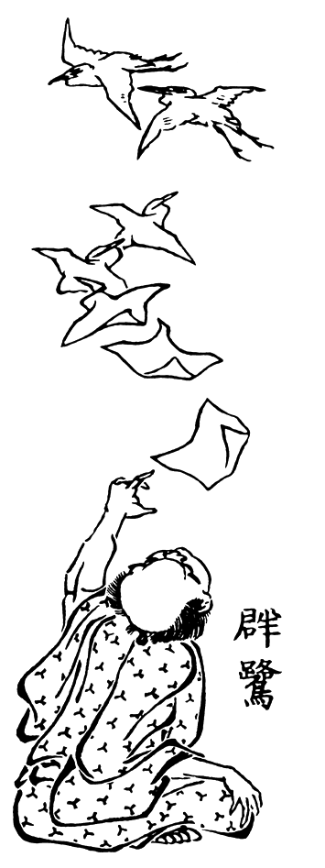
Origami and Mathematics
Background photo by Chinh Le Duc on Unsplash, edited by Japan Society
Resource designed by Tung Ken Lam in collaboration with The Japan Society
1
Notes:
A Magician Turns Sheets of Paper Into Birds” by Katsushika Hokusai, 1819
1

Slide 2

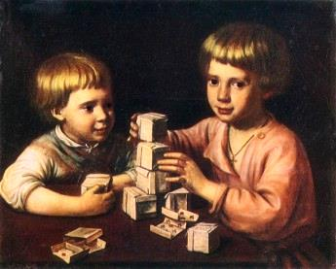
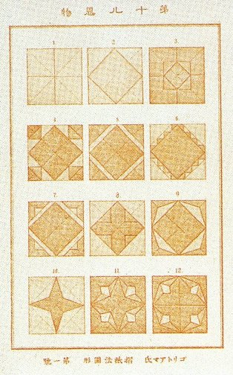
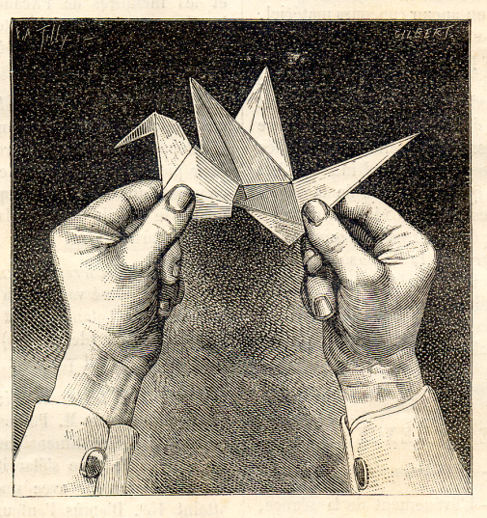
Paper and Paper Folding
Paper is a thin mat of plant fibres
Papermaking knowledge spread from China where it was invented
There are many traditions of paper folding around the world
Tung Ken Lam in collaboration with The Japan Society
Notes:
2

Slide 3
Around the World
  In France, it is known as faire les cocottes
  In Spain, it is papiroflexia or pajaritas
  In Japan, origami means “fold paper”
折り紙
‘ori’ means to fold
‘gami’ means paper
Tung Ken Lam in collaboration with The Japan Society
3
Notes:
3

Slide 4
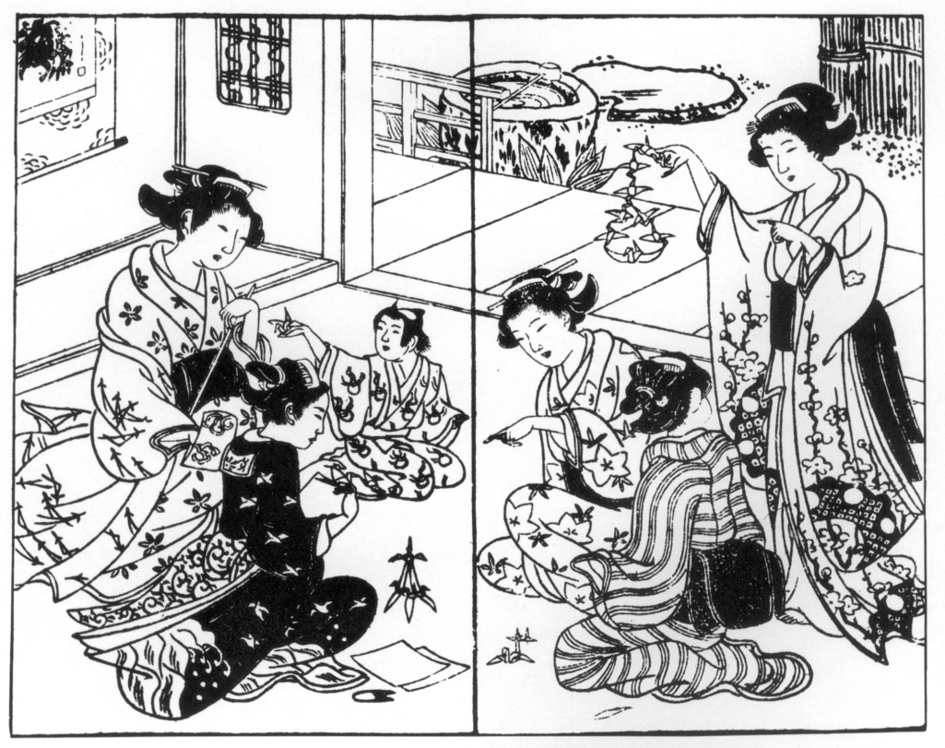
Four Kinds of Origami
Origami can be classified as:
Ceremonial - such as cut and folded paper streamers in temples and for use in rituals
Practical - for example envelopes and containers
Play – “chatterboxes” for example
Creative - origami as an artistic and educational activity
Tung Ken Lam in collaboration with The Japan Society
4
Notes:
4

Slide 5
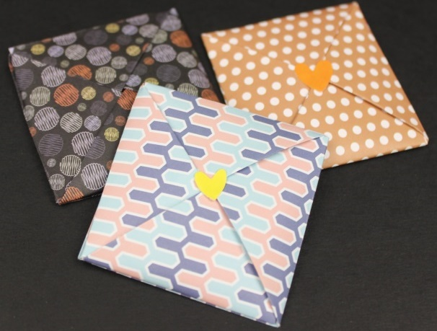

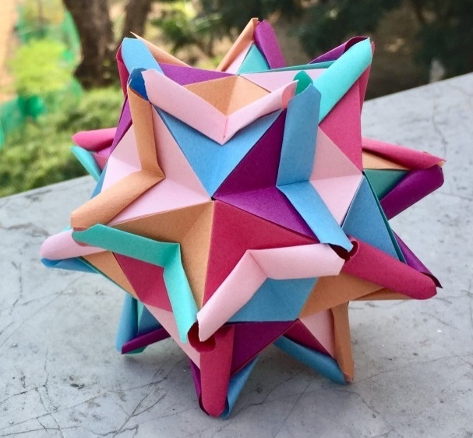
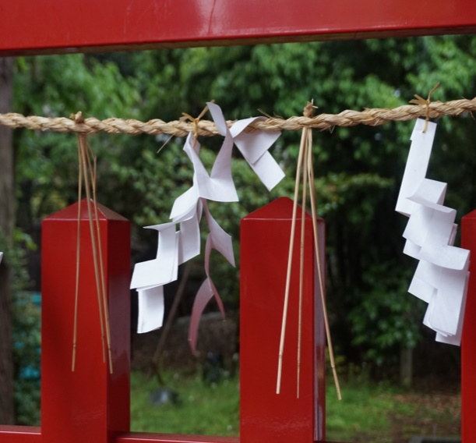
Which kind of origami are these?
Ceremonial
Creative
Play
Practical
Images, clockwise from top L: Umamanualidades, CC BY-SA 4.0; Papierflieger -- 2021 -- 7215 by Dietmar Rabich, CC BY-SA 4.0 ;
Tung Ken Lam; praaeew, public domain
Notes:
5

Slide 6
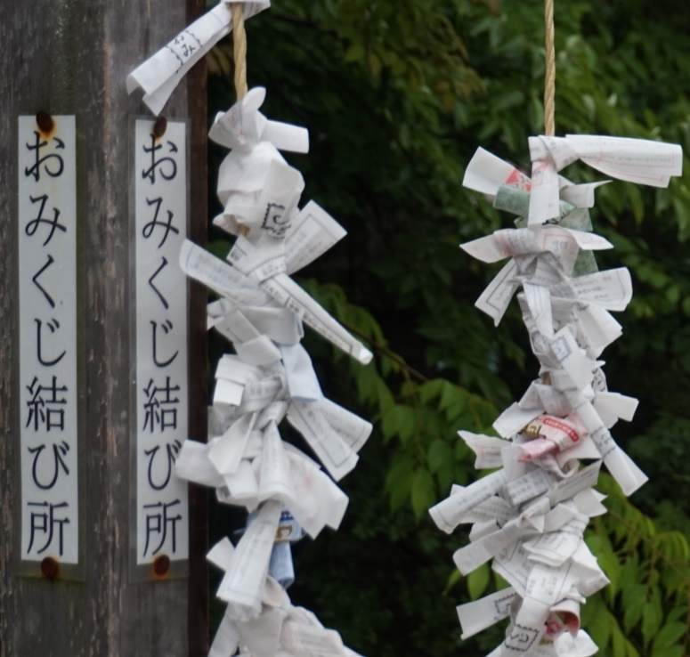
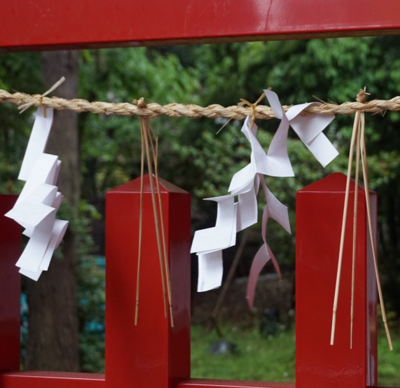
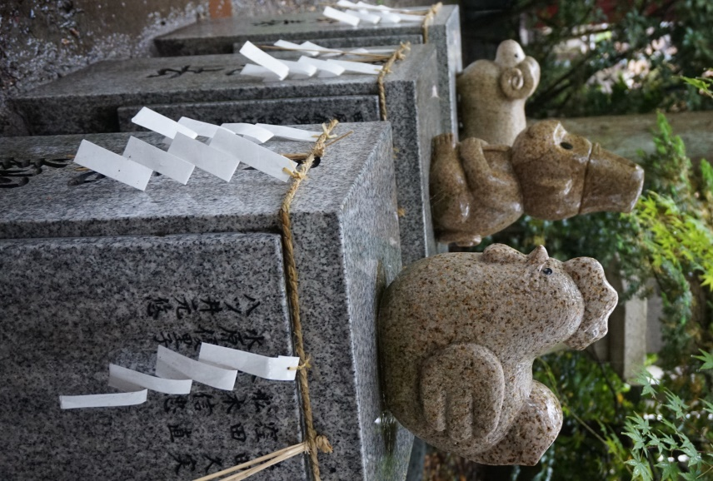
Origami in Japan
At shrines and temples in Japan you will see:
Zig-zag paper streamers attached to important objects
Paper fortunes which have been tied up and left behind
Tung Ken Lam in collaboration with The Japan Society
6
Notes:
6

Slide 7

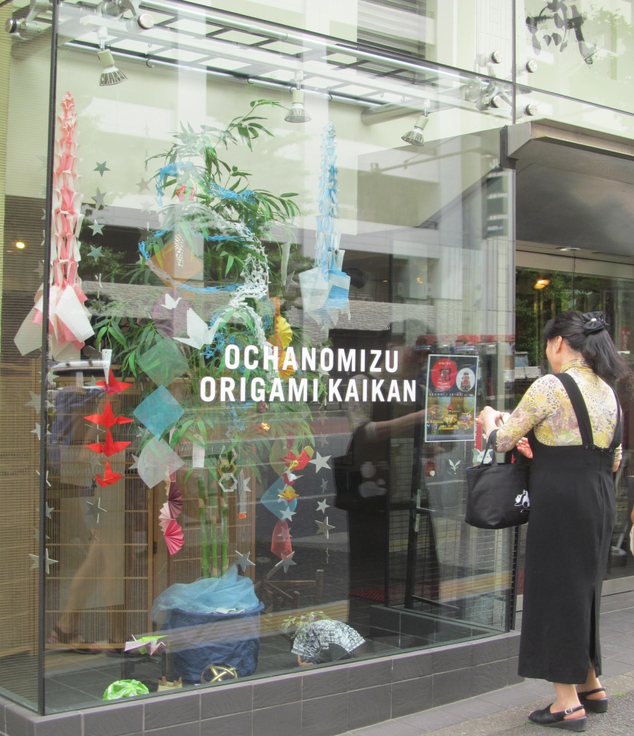
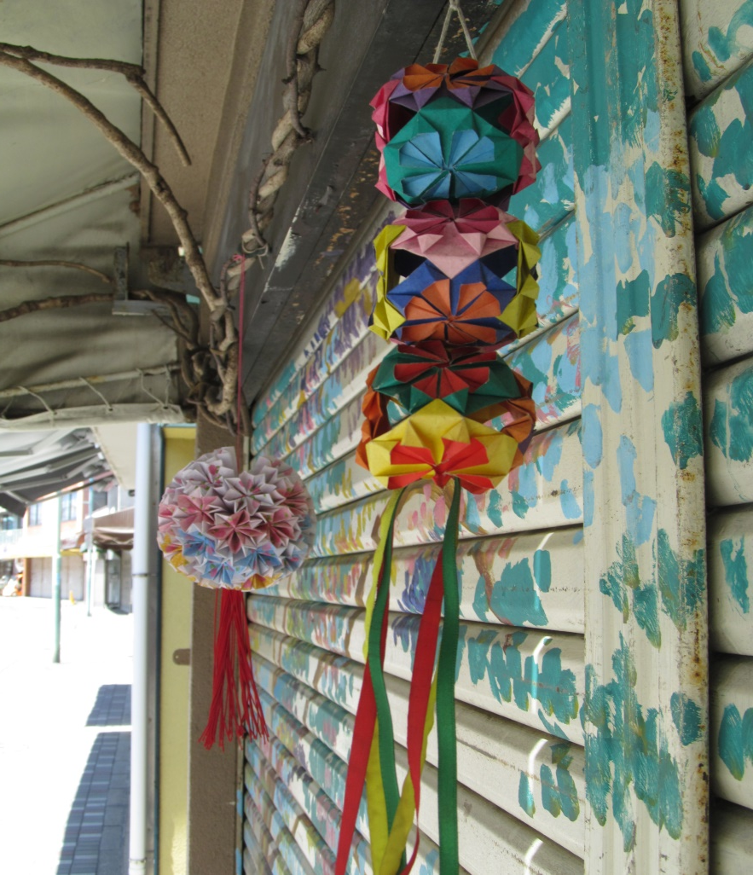
Origami in Japan
Elsewhere in Japan,
you might see:
Decorative kusudama
Shops specialising in paper and origami
Paper cranes which are a symbol of peace and good luck
Tung Ken Lam in collaboration with The Japan Society
Notes:
Teacher’s note:
Kusudama literally means ‘medicine ball’. In ancient Japan they were used for incense and potpourri. They are made by assembling many models together.
7

Slide 8
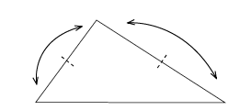
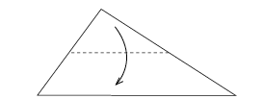


Origami & Mathematics
Mathematics arises naturally from origami
For example, folding one point onto another point makes a straight line crease
Folding a paper triangle can demonstrate that the angle sum is 180°and how to calculate the area of the original triangle
Tung Ken Lam in collaboration with The Japan Society
Notes:
8

Slide 9
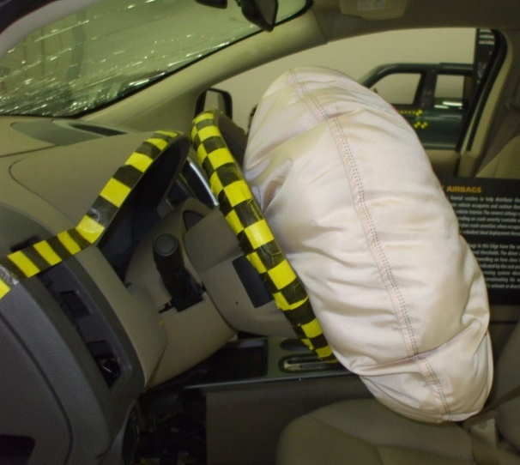

Origami and STEM
Scientists, engineers and mathematicians research origami
Origami has helped design useful items which can be folded up small when they are not being used
Two examples are airbags in cars and collapsible kayaks, but there are many more!
Airbag image by jimmyyyy is licensed under CC BY-NC 2.0;
Oru Kayak image by Lindblom is licensed under CC BY 2.0;
Notes:
9

Slide 10
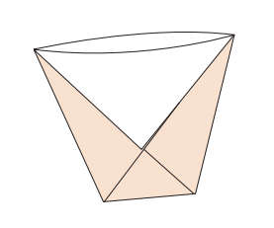
Task 1: Paper Cup
This simple origami model is fun and practical!
Made from small paper, it can be used for holding liquids
Made from larger paper, it can be worn as a hat
Tung Ken Lam in collaboration with The Japan Society
Notes:
10

Slide 11
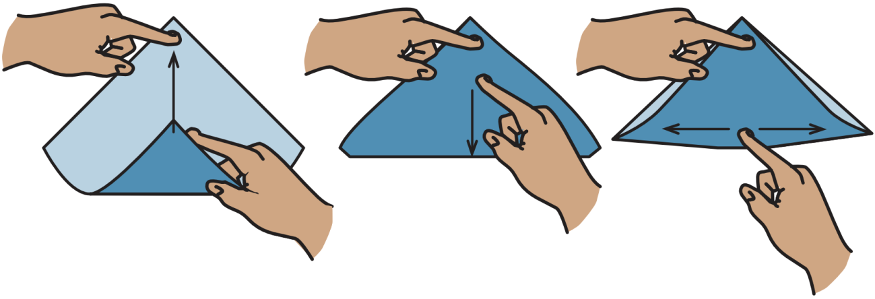
Tips for folding
Be accurate and make sharp creases
Use a clean and flat surface for support during folding
Fold the diagonal of a square by placing the bottom corner onto the top corner. Hold the corners together with one hand and sweep the paper flat with the other hand. Use a fingernail or thumbnail to make a firm crease.
Diagrams by Tung Ken Lam of folding the diagonal of a square:
extract from “Star Origami” by Tung Ken Lam, A K Peters/CRC Press, 2021
Notes:
Teacher’s Note
The fold shown is the first step to making paper cup. Demonstrate to students how to accurately and firmly fold the diagonal of a square.
11

Slide 12
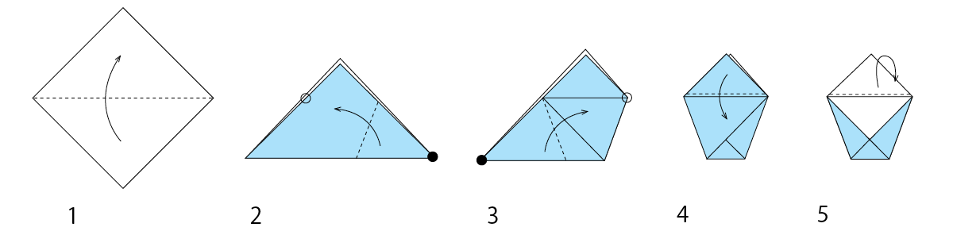
Task 1: Paper Cup
Fold the bottom corner to the top corner to fold the diagonal.
Move the right corner onto the left edge of the triangle. Adjust the position so that top edge of the flap is parallel to the hypotenuse of the original triangle.
Fold the left corner onto the right corner.
Fold the top upper flap downwards.
Turn over and repeat step 4. Then open the cup with your fingers.
Tung Ken Lam in collaboration with The Japan Society
Notes:
Teacher’s Note
Make sure students can identify the hypotenuse.
There are printable instructions with larger images of the diagrams.
If the second step is difficult – see the location point on Extension Activity 1
12

Slide 13
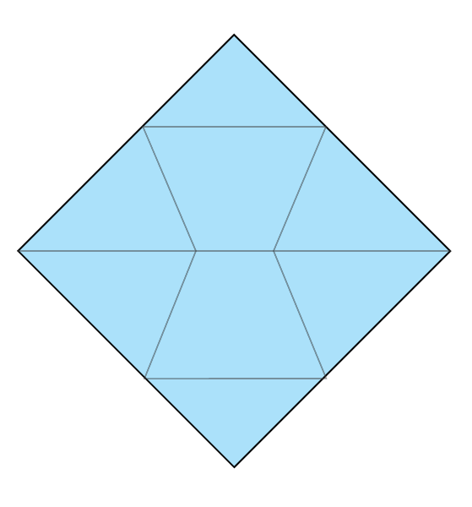
Task 1: Paper Cup
Now unfold the cup and observe the crease lines.
Which line segments are equal?
What angles can you identify?
Tung Ken Lam in collaboration with The Japan Society
Notes:
13

Slide 14
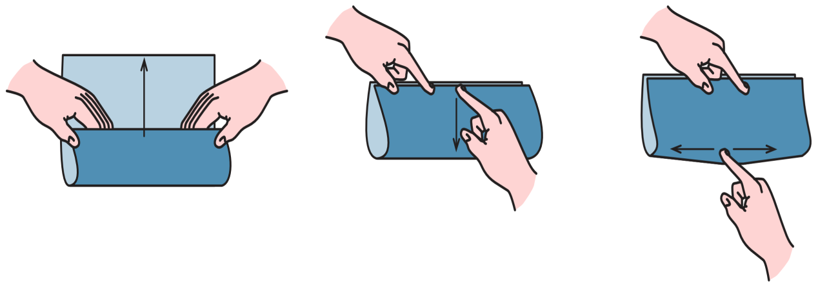
Task 2: Fractions
Now we’re going to use origami to look at fractions.
All you need is a rectangle of paper (not a square)!
Can you remember the tips for folding? This time, you will start by folding the bottom edge of your paper up to meet the top edge.
Diagrams by Tung Ken Lam of folding a square in half (book fold):
extract from “Modular Origami” by Tung Ken Lam, Schiffer Books, 2023
Notes:
Teacher’s Note
Before students fold, remind them of the tips. The fold shown is the first step for the next task. Demonstrate to students how to accurately and firmly make the first fold.
14

Slide 15
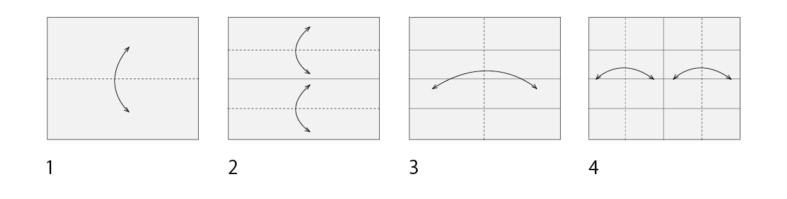
Task 2: Fractions
1. Fold the long edges together to fold the paper in half. Unfold.
2. Fold each of the long edges to the middle. Unfold.
3. Fold the short edges together to fold the paper in half. Unfold.
4. Fold the short edges to the middle. Unfold.
Tung Ken Lam in collaboration with The Japan Society
Notes:
15

Slide 16
Task 2: Fractions
With this 4 by 4 grid, what fractions can you make if the whole rectangle is one unit?
What are the equivalent fractions?
What operations can you perform on these fractions, e.g. add, subtract, multiply and divide?
Tung Ken Lam in collaboration with The Japan Society
16
Notes:
Teacher’s Note
Refer to the lesson plan and ask students further questions such as:
If the sheet is one unit, what fraction is one small rectangle? [one sixteenth]
Fold the paper to show one quarter. Show a different way to make one quarter. How many sixteenths are there in one quarter? [four]
Etc.
16

Slide 17
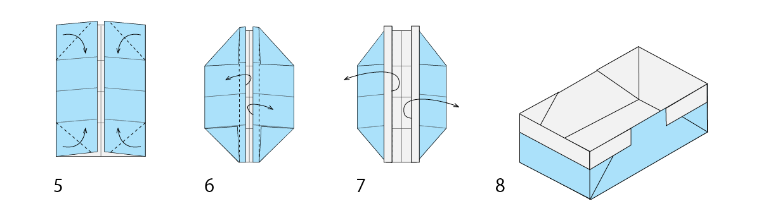
Task 2: Magazine Box
Now take your 4 by 4 grid and fold the short sides to the middle. Make the magazine box by following the steps below.
If you make two, you can fit them together as a box with a lid.
Tung Ken Lam in collaboration with The Japan Society
Notes:
Teacher’s Note
This pattern gets its name from the fact it can be made easily using rectangle of paper from a magazine.
If needed, instructions are:
- Fold the corners onto the crease lines that are one quarter along the longer edges.
- Fold the inner flaps of paper outwards and over the corners.
- Open the box and reinforce the creases of the edges to strengthen it.
If you have time, ask students what happens if they use a rectangle that has different proportions?
17

Slide 18
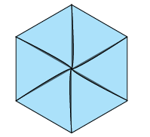
Task 3: Seed Packet
This origami is also practical
It can be used for storing seeds or other small items, or you could write a letter to a friend and fold it up!
You will need a rectangle of paper.
Tung Ken Lam in collaboration with The Japan Society
18
Notes:
18

Slide 19
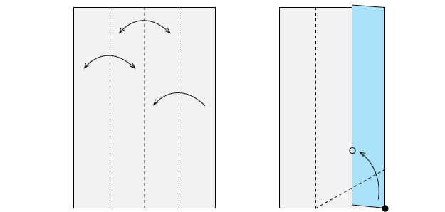


Task 3: Seed Packet
1.Fold the long edges together and unfold. Fold the sides into the centre and unfold the left flap (the right flap stays folded).
2. Lift the bottom right corner and fold it onto the middle line of the original rectangle. As you do so, make sure the fold starts at the point which is one quarter along the bottom of the original rectangle.
Tung Ken Lam in collaboration with The Japan Society
19
Notes:
Teacher’s Notes
The second step is tricky as the students have to do two things at once.
19

Slide 20
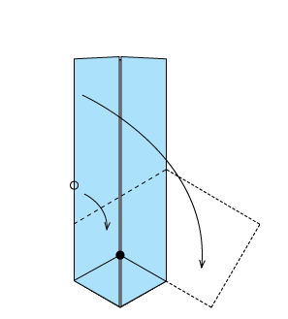
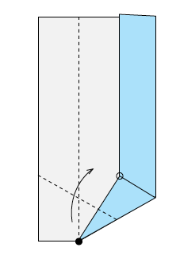
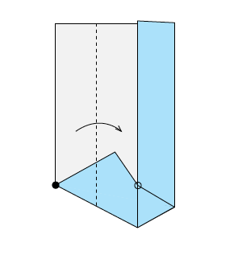



Task 3: Seed Packet
3. The red point indicated will be the centre of the hexagon. Fold the lowest right corner onto this point.
4. Fold the left flap into the middle so the two points indicated on the diagram touch.
5. Fold the top flap down so that one point on its left edge meets the centre of the hexagon and another point meets the lower right vertex.
Tung Ken Lam in collaboration with The Japan Society
20
Notes:
20

Slide 21
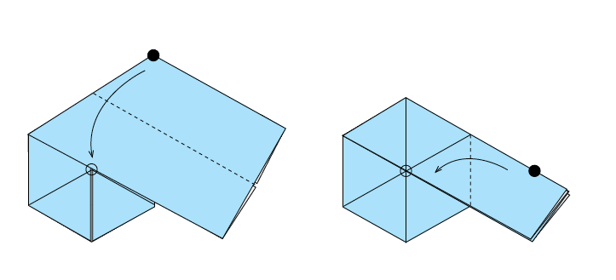
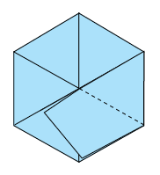
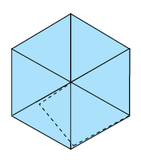



Task 3: Seed Packet
6. Fold the upper flap in half. (The crease line is the middle of the original rectangle).
7. Fold the flap to the left.
8. Tuck the flap into the pocket that is behind the flap.
Tung Ken Lam in collaboration with The Japan Society
21
Notes:
21

Slide 22

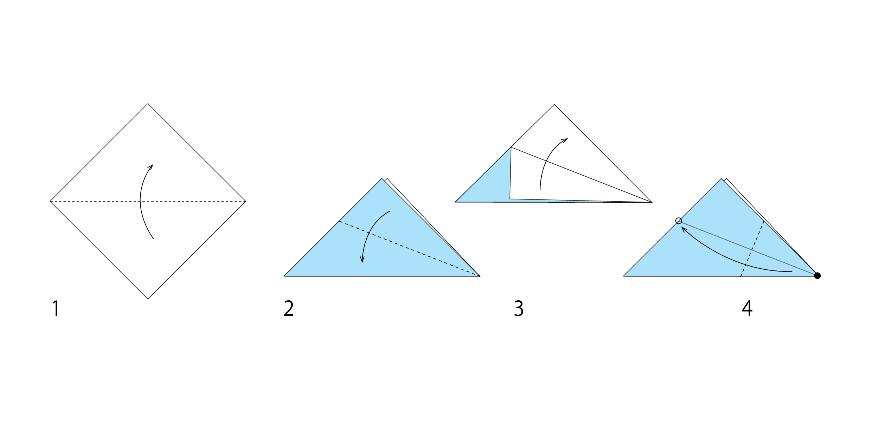
Extension Activity 1
The second fold of the paper cup has a precise location point: it is the intersection of the left edge of the triangle and the angle bisector of the right corner. Why?
Tung Ken Lam in collaboration with The Japan Society
22
Notes:
22

Slide 23
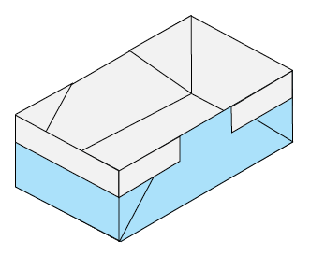
Extension Activity 2
For each model, make another one without looking at the instructions. Use the first model to help you remember the steps, or work out what is needed.
Tung Ken Lam in collaboration with The Japan Society
23
Notes:
23

Slide 24




This resource was designed by Tung Ken Lam in collaboration with the Japan Society
The Japan Society
13/14 Cornwall Terrace, London NW1 4QP
Tel: 020 7935 0475
Email: education@japansociety.org.uk
www.japansociety.org.uk
Follow us on:
@japansocietylon
@JapanSocietyLondon
Tung Ken Lam in collaboration with The Japan Society

