Slide 1
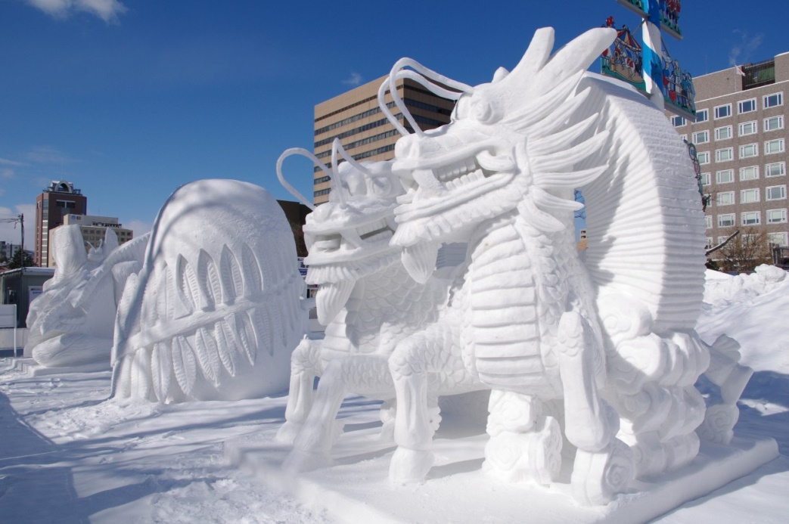
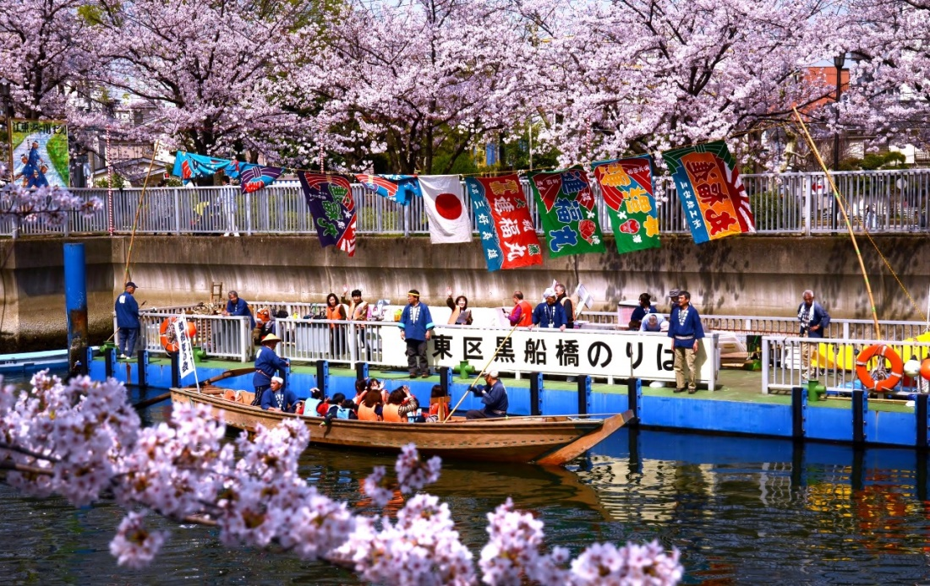
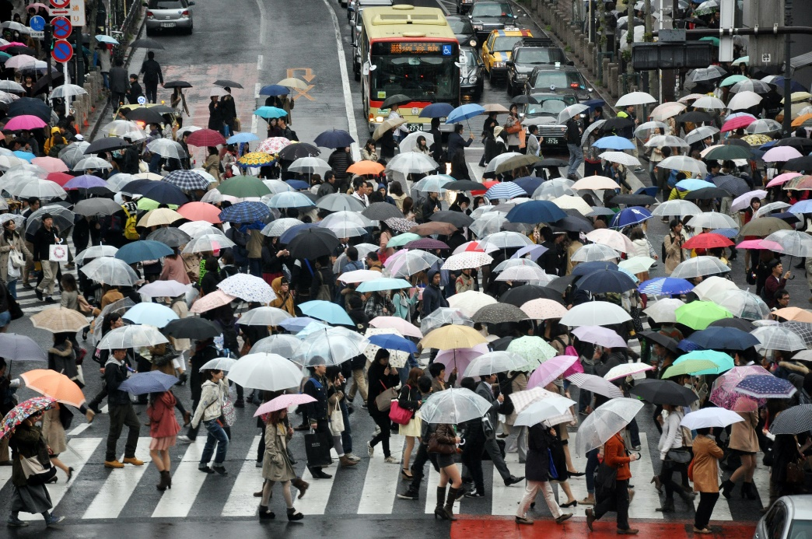
Warm Up
Study these images and answer the question:
What is Japan’s climate like?
©Yasufumi Nishi/©JNTO
©Koto City Tourism Association/©JNTO
Photo by Alex Block
Notes:
Teacher’s Note
Display this on the screen/board as students enter the classroom so that they can begin straight away, leaving space for the date and title if they are writing their answer in their books.

Slide 2

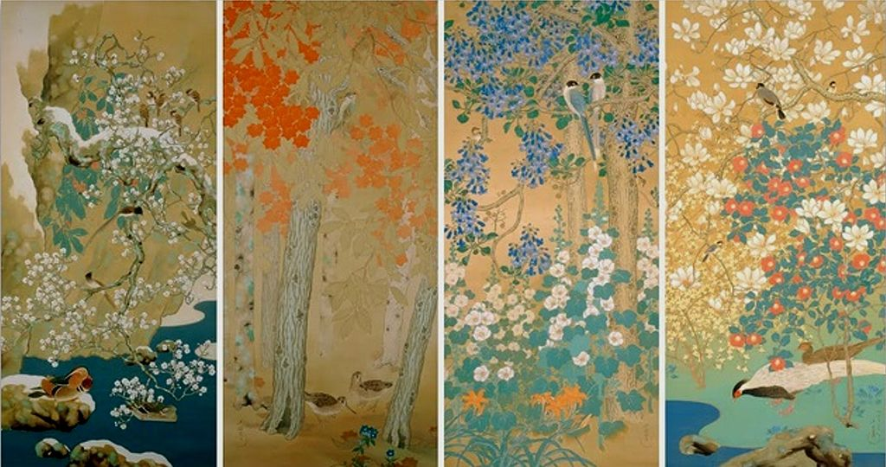
Japan’s Climate
Your Learning Objectives:
Describe the climate of Japan.
Investigate the climatic variations across the country and throughout the year.
Evaluate when would be the best time to visit Japan.
Notes:
Teacher’s Note
Image is Birds and Flowers of the Four Seasons by Araki Jippo. L-R shows Winter, Autumn, Summer and Spring.

Slide 3

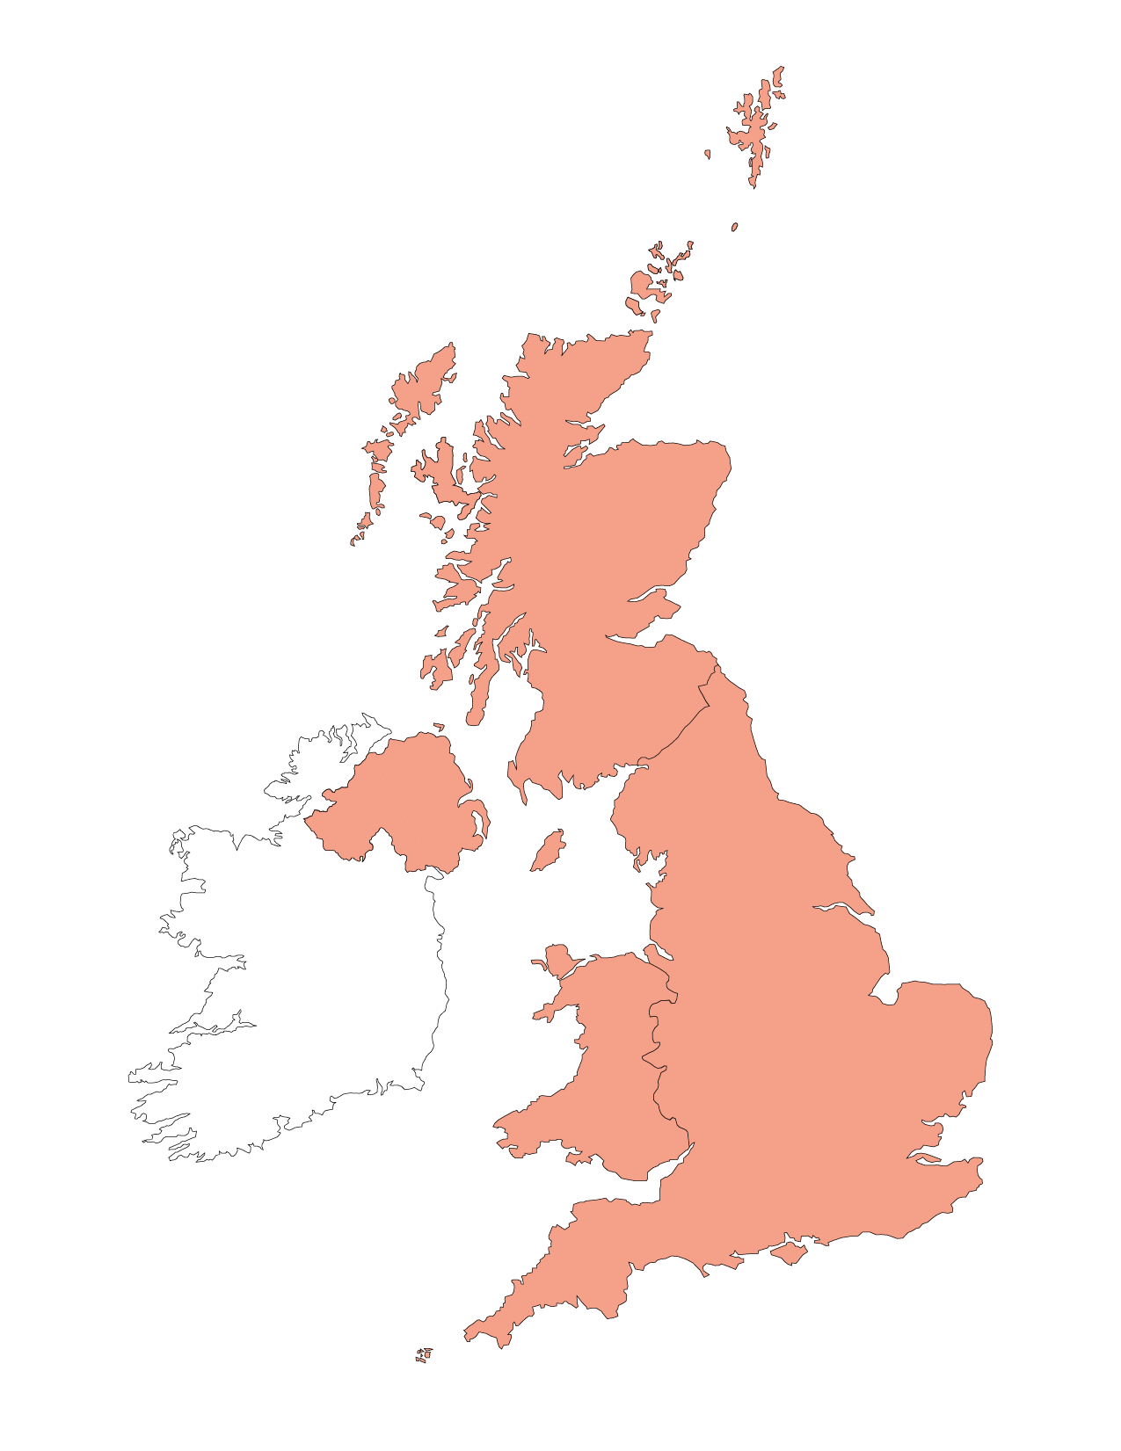




Climatic Variations
Countries like the UK and Japan, which are long and stretch out from north to south, have significant variations in climate from one end to the other.
In the UK, the south of the country, e.g., Cornwall and Kent, are warmer than it is at the other end, e.g., the north of Scotland.
Cooler and wetter

Slide 4
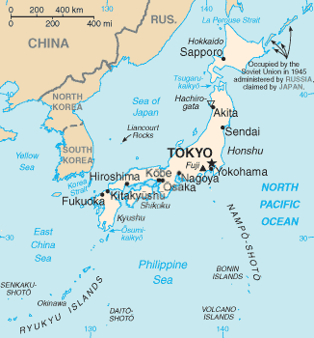
Starter: Japan’s Climate
How do you expect Japan’s climate (temperature and rainfall) will vary from north to south?
Notes:
Teacher’s Notes
HA classes can structure their own answers. LA classes may use the scaffolded version on the next slide.

Slide 5
Starter: Japan’s Climate
How do you expect Japan’s climate (temperature and rainfall) will vary from north to south? Copy and complete the sentences below:
Japan is a _ _ _ _ and thin country, stretching out from _ _ _ _ _ to south. The bottom of the country is closer to the tropic of _ _ _ _ _ _, where the temperature is _ _ _ _ _ _. The top of the country is further away from the tropics, so the
_ _ _ _ _ _ _ _ _ _ _ is _ _ _ _ _ _. There is also more _ _ _ _ to the
_ _ _ _ _.
temperature
snow
cancer
long
north
higher
lower
north
Notes:
Teacher’s Notes
Scaffolded version for LA students/to ensure sufficient detail. Also an opportunity for self/peer assessment.

Slide 6
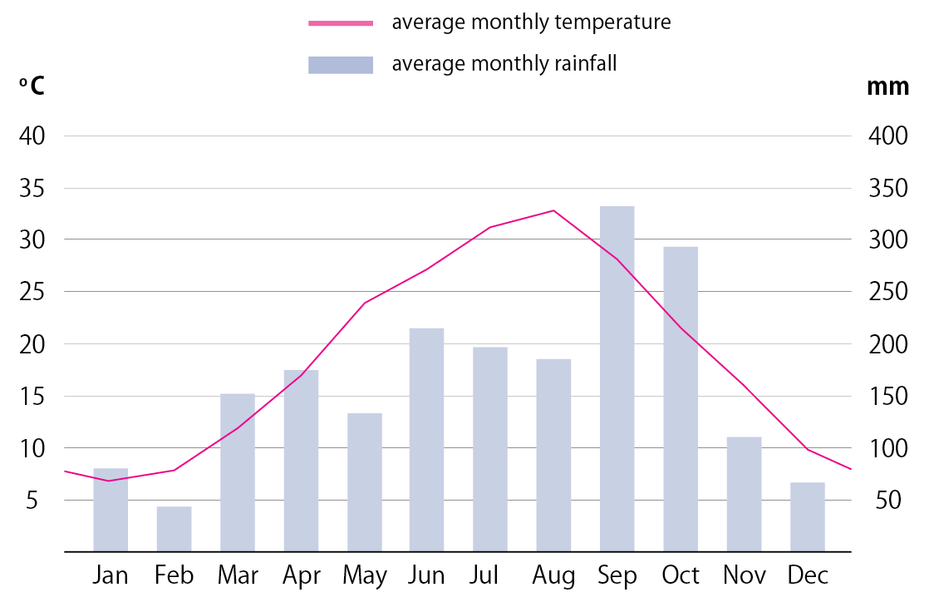
Task 1: Average Climate
Which month has the highest temperature?
Which month has the lowest temperature?
What is the temperature range? (Subtract the lowest temperature from the highest).
Which month has the lowest rainfall?
Which month has the highest rainfall?
When do you think their spring, summer, autumn and winter are?
Average Monthly Temperature and Rainfall in Tokyo
2015 - 2020
Notes:
This slide can be printed for students.
Answers: 1. August 2. January 3. 26 degrees (answers either side can be accepted) 4. February 5. September 6. Their seasons are the same as ours (Spring is March-May; Summer is Jun-Aug; Autumn is Sept-Nov; Winter is Dec-Feb)
Data sources
Temperature: https://www.data.jma.go.jp/obd/stats/etrn/view/monthly_s3_en.php?block_no=47662&view=1
Rainfall: https://www.data.jma.go.jp/obd/stats/etrn/view/monthly_s3_en.php?block_no=47662&view=13

Slide 7
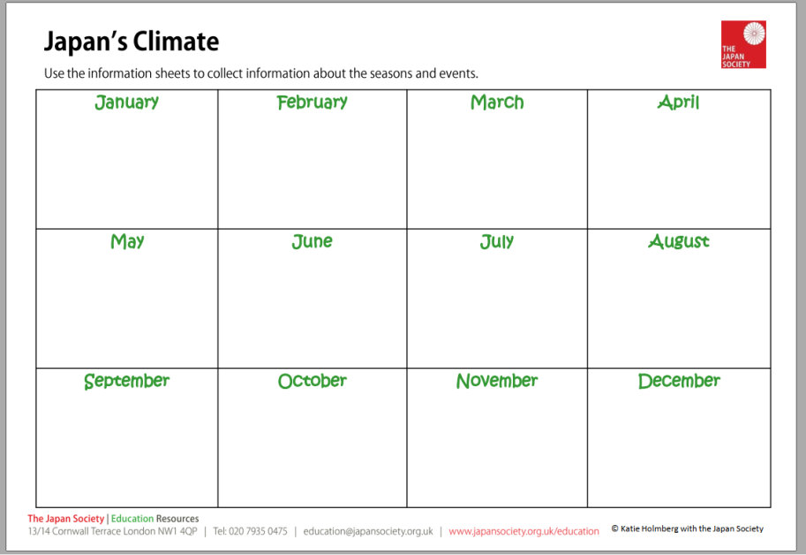
Climate Calendar
Read the information sheets about Japan’s climate.
Use the information to fill in details about:
1. The 4 main seasons
2. The rainy season and monsoons
3. Seasonal festivals
Write your notes onto the calendar worksheet.
Have a look at the example for the UK’s climate on the next slide to get some ideas of how you can fill yours in.

Slide 8
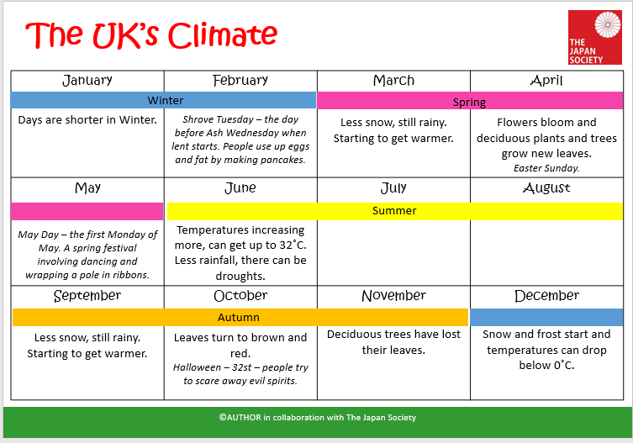
Climate Calendar
Here’s an example for the UK’s climate.
You could use colours and symbols to make your calendar of Japan’s climate more informative.

Slide 9
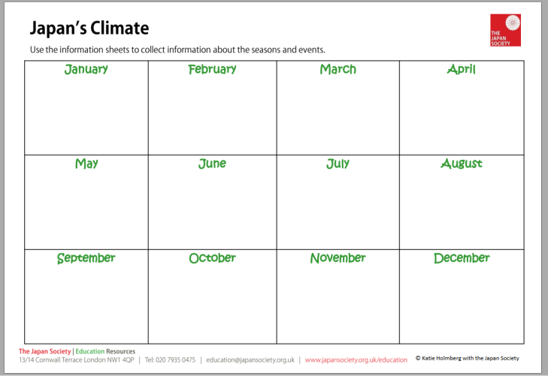
Climate Calendar
Read the information sheets about
Japan’s climate.
Use the information to fill in details about:
1. The 4 main seasons
2. The rainy season and monsoons
3. Seasonal festivals
Write your notes onto the calendar worksheet.
Challenge task: Using the information you have collected, decide when would be the best time to visit Japan. Give reasons for your answer. Try to consider both the north and south of Japan, as you may wish to visit them at different times of the year.

Slide 10
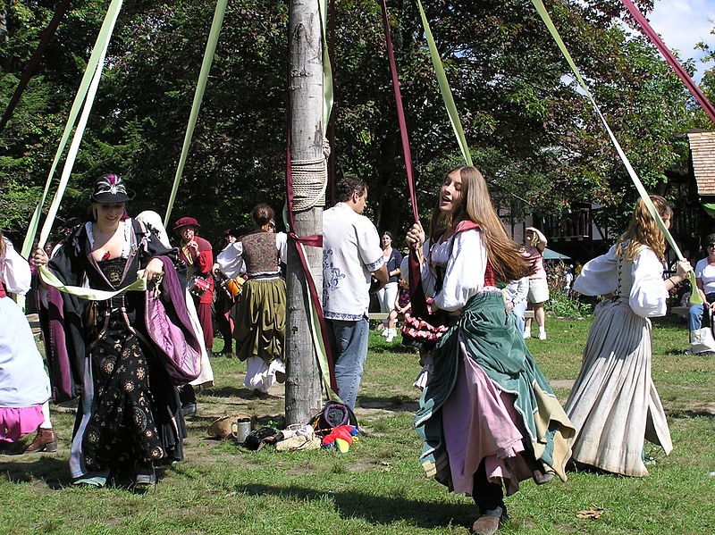
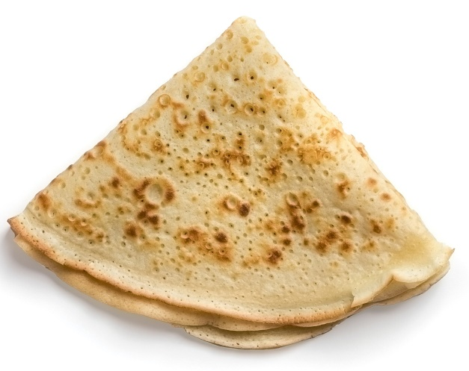
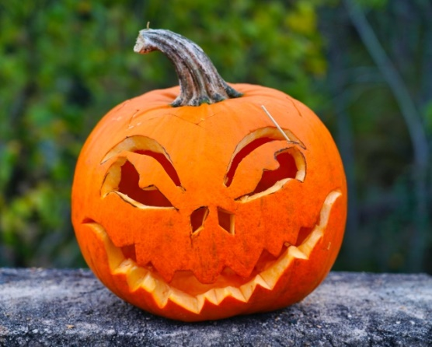
Plenary
Today we have learnt about some traditional Japanese festivals.
What seasonal festivals and celebrations do we have in the UK?
Photo
Mockup Graphics
Gene Gallin
Notes:
Teacher’s Notes
A few ideas to get students thinking, or if they struggle to think of any then it’s a good opportunity to discuss traditions such as Shrove Tuesday, Halloween and May Day. Other ideas could relate to Christmas, New Year, Easter, Valentine’s Day, Guy Fawkes night, Cheese Rolling, Harvest Festival, Christingle.

Slide 11




This resource was authored by Katie Holmberg in collaboration with the Japan Society
The Japan Society
13/14 Cornwall Terrace, London NW1 4QP
Tel: 020 7935 0475
Email: education@japansociety.org.uk
www.japansociety.org.uk
Follow us on:
@japansocietylon
@JapanSocietyLondon

