Slide 1
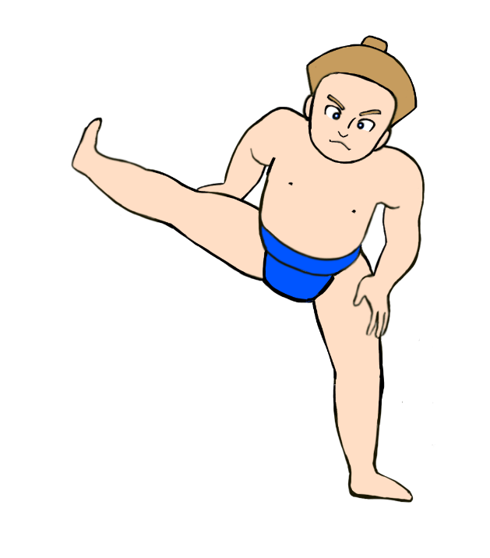

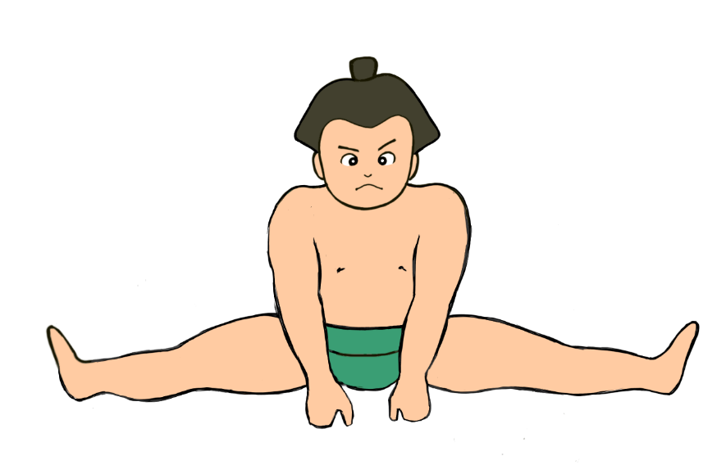

Sumo Training Moves
Let’s train like a sumo wrestler!
©The Japan Society (2025)
Illustrations by Aya Burbanks
Notes:
Teacher’s Notes
Make sure that pupils have done a 5 minute warm-up before beginning today’s lesson.

Slide 2
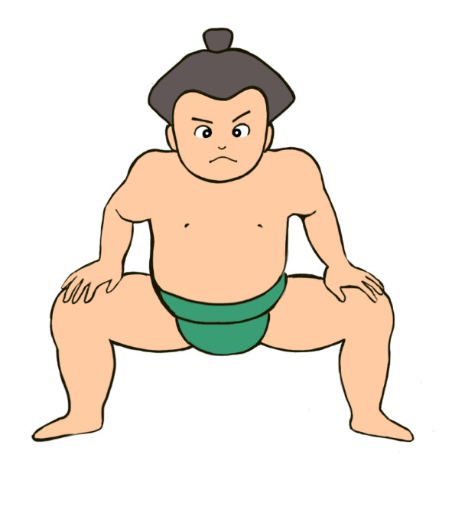
Learning Objectives
To learn about how sumo wrestlers train.
To practice some of the fundamental sumo training exercises.
©The Japan Society (2025)
Illustration by Aya Burbanks
Notes:
Teacher’s Notes
Introduce today’s Learning Objectives.

Slide 3
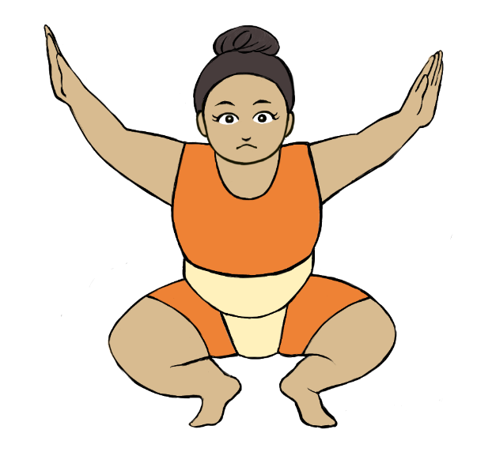
Key Words
Sumo
Rikishi (wrestler)
Training
Strength
Flexibility
Dohyo (ring)
©The Japan Society (2025)
Illustration by Aya Burbanks
Notes:
Teacher’s Notes
Introduce the key words of the lesson. Do pupils understand what the words mean?

Slide 4
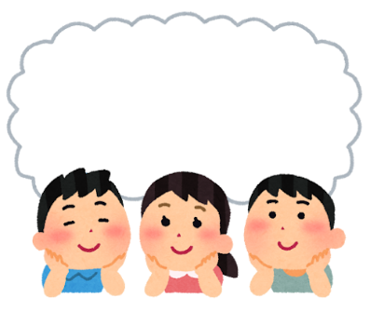
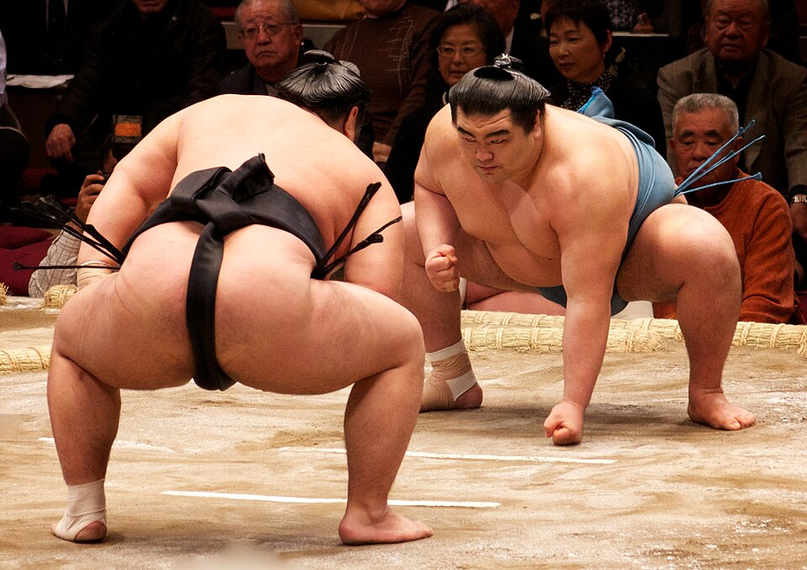
Discuss
What do you think the essential skills of a sumo wrestler are?
©The Japan Society (2025)
Notes:
Teacher’s Notes
Get pupils thinking about what the “essential skills” of a sumo wrestler are. What should they focus on training/improving to become a better wrestler? Encourage pupils to think about WHY these skills are so important.
You could list some examples using athletes who compete in other sports. For example, a runner would need to focus on improving their stamina if they are running a marathon.

Slide 5
Sumo Skills
To compete and be successful in tournaments, sumo wrestlers focus on training and improving their...
Strength
Flexibility
Balance
Speed
Agility
... and many other essential skills!
©The Japan Society (2025)
Notes:
Teacher’s Notes
These are just some of they key skills that sumo wrestlers focus on honing and improving before tournaments.
Strength is naturally very important, but flexibility, speed, balance, and agility are all areas in which a sumo wrestler should focus on improving when training.
For example, improving flexibility and core strength is important for a sumo wrestler. Bouts often only last a few seconds, so quickly being able to adapt to their opponent’s moves whilst in the ring is crucial. If a wrestler loses balance and falls or is pushed out of the ring, they lose the bout.

Slide 6
Let’s practice!
Today, we will try some of the exercises that sumo wrestlers do as part of their daily training!
Shiko
Suri-ashi
Koshi-wari
Matawari
Teppo
©The Japan Society (2025)
Illustration by Aya Burbanks
Notes:
Teacher’s Notes
Can pupils say the names of the exercises in Japanese?

Slide 7
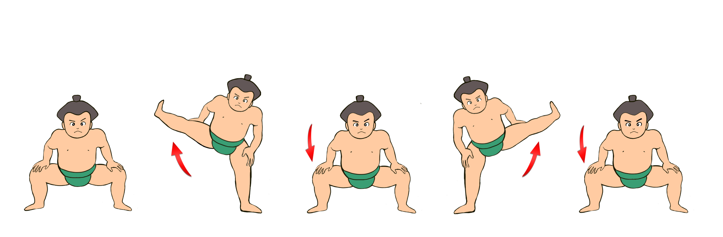

Shiko 四股
Remember: Slower is better – you don’t need to rush each step!
©The Japan Society (2025)
Illustrations by Aya Burbanks
Notes:
Teacher’s Notes
Shiko refers to the ceremonial leg raising and stomping in sumo. Professional sumo wrestlers practice shiko hundreds of times a day.
Squat with your legs apart, knees bent, and your hands resting on your thighs or knees.
Slowly raise your leg in the air, keeping your knee bent, and remaining in the same squat position as before. Hold your leg in this position for a short moment.
Lower your leg and return to the same starting squat position.
Now, do the same again, this time raising your opposite leg.

Slide 8
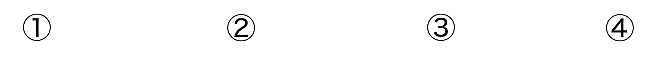

Suri-ashi すり足
Sliding feet
Remember:
Make sure your feet stay connected to the ground at all times.
Try to keep the low, squat position.
©The Japan Society (2025)
Illustrations by Aya Burbanks
Notes:
Teacher’s Notes
The starting position for suri-ashi is similar to shiko.
Squat with your legs apart, knees bent, feet positioned slightly outwards. Hold your arms out in front of you with your elbows tucked in, like you are ready to grapple your opponent.
Slide one foot forward, keeping your knees bent in the same squat position. Make sure your foot is still angled slightly outwards.
Slide your other foot forward, doing the same as above.
One of the most important aspects of suri-ashi is to ensure your feet remain connected to the floor at all times.

Slide 9
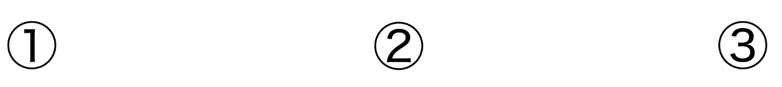

Koshi-wari 腰割り
Sumo squat
Remember:
Keep your knees pointed outwards when squatting
Keep your back straight.
©The Japan Society (2025)
Illustrations by Aya Burbanks
Notes:
Teacher’s Notes
Stand with your legs slightly further than hip distance apart. Your feet should be angled slightly outwards.
Slowly bend your knees and squat down. Lift your arms towards your chest whilst doing so, keeping your elbows tucked in. Remain in this position for a moment.
Slowly raise back to standing position. Lower your arms down to your sides again.

Slide 10
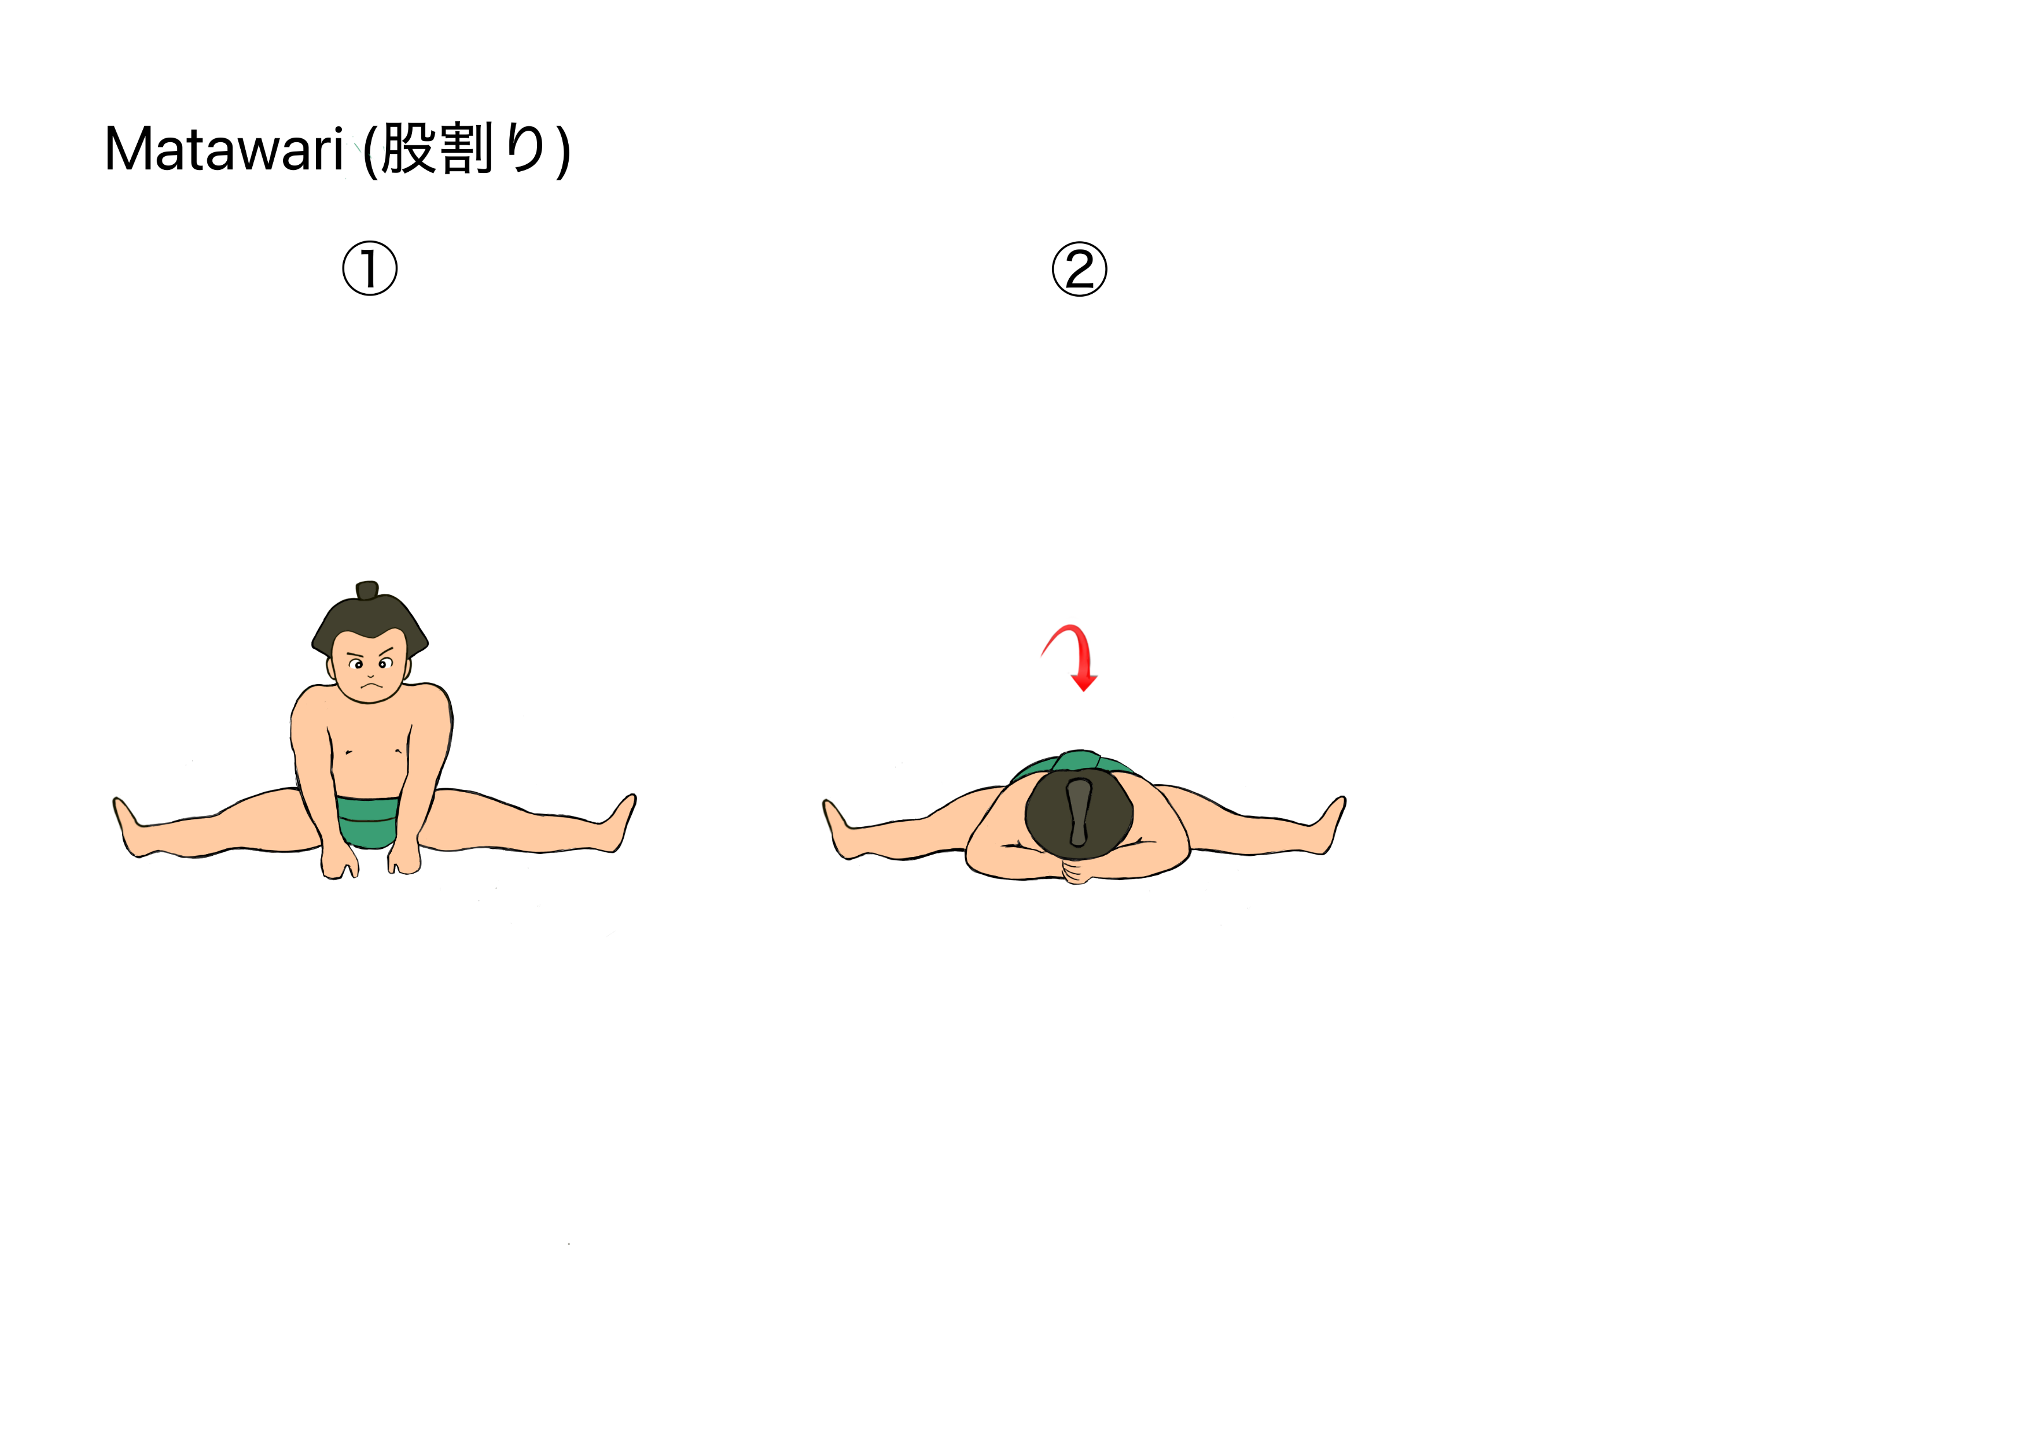
Matawari 股割り
Leg split and stretch
Remember:
Don’t overstretch! Only push yourself to stretch as far as you feel able to.
©The Japan Society (2025)
Illustrations by Aya Burbanks
Notes:
Teacher’s Notes
Sumo wrestlers are extremely flexible. Many are able to open their legs 180 degrees and lean forwards until their chest touches the ground!
Sit on the ground with your legs extended as far as you feel comfortable.
Walk your hands forward away from your body, keeping your arms stretched out ahead of you as you try to stretch as far forward as you can.
Walk your hands back towards you and sit upright with your legs extended.
Repeat this stretch again.

Slide 11
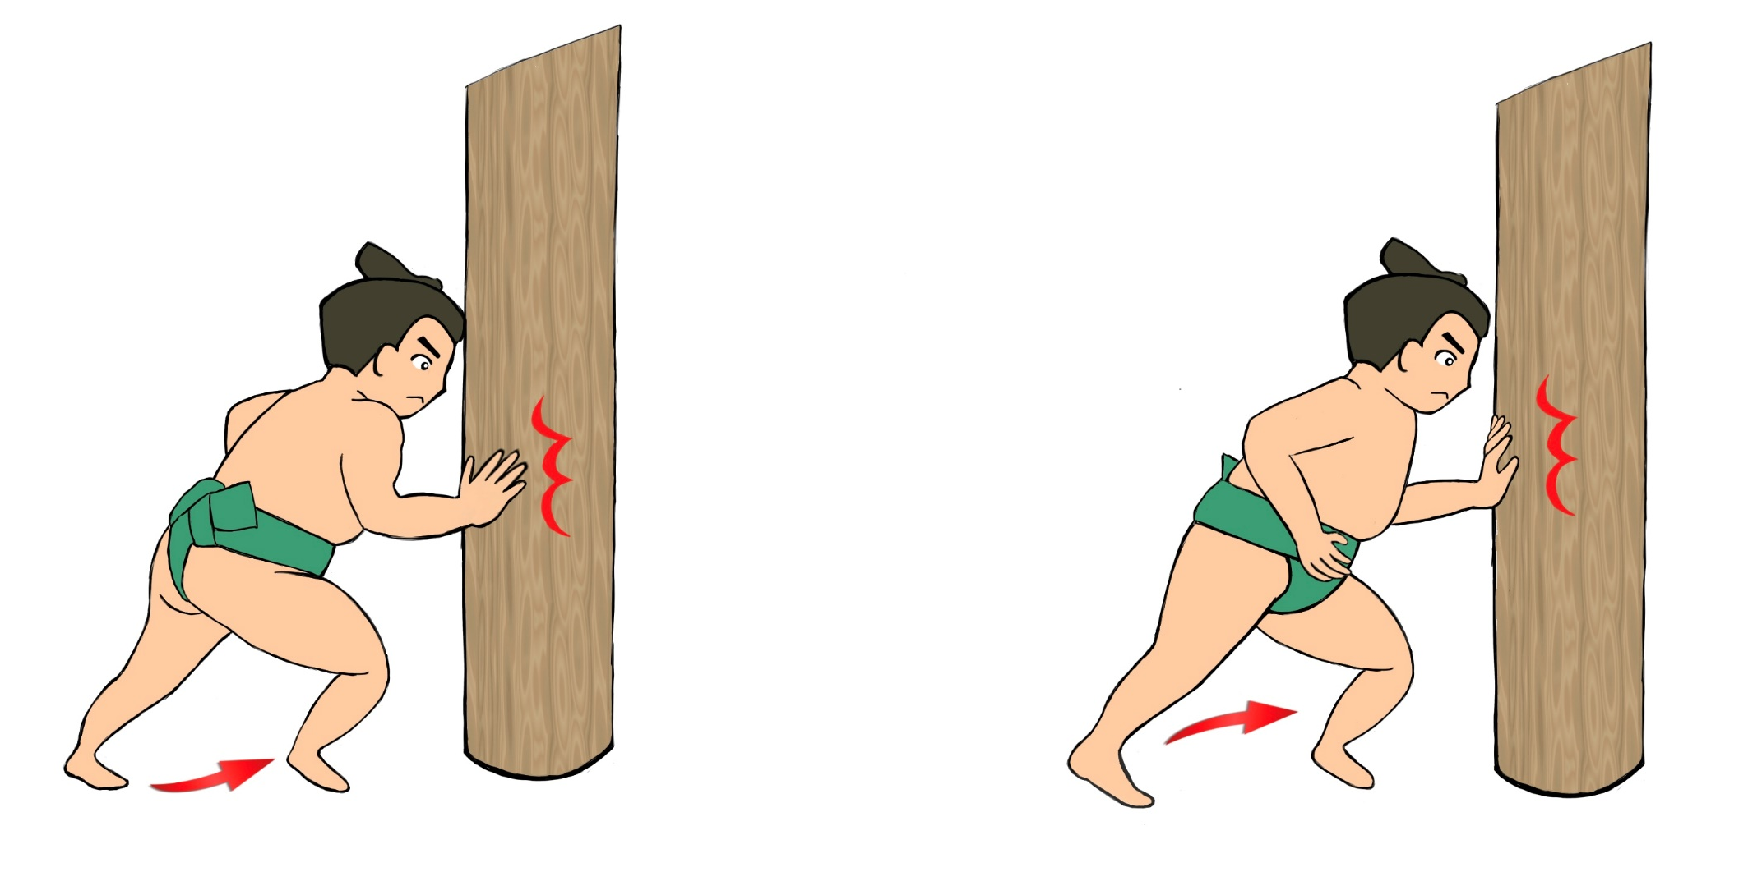
Teppo 鉄砲
Remember:
Keep your knees bent, feet angled slightly outwards.
Make sure your feet always remains connected to the ground.
©The Japan Society (2025)
Illustrations by Aya Burbanks
Notes:
Teacher’s Notes
Sumo wrestlers usually do this exercise using a teppo pole. You could do this exercise with something similar that is sturdy or against a wall. However, you can also practice the movement without this, too.
Stand with your legs apart, knees bent in a slight squat position, arms ready in front of you with elbows bent. Push one arm forward, whilst sliding your foot and leg on the same side forward. If doing this movement against a teppo pole or a wall, your hand should push against this slightly. Your foot and hip should also move towards the teppo pole and wall.
Return to your starting position to be ready to repeat the same movement. This time, push your opposite arm, hip, leg, and foot forwards instead.

Slide 12
Activity
Can you remember the names of all of the sumo exercises you practiced?
Time to test your knowledge!
©The Japan Society (2025)
Illustrations by Aya Burbanks
Notes:
Teacher’s Notes
Pupils walk or jog around the room. Call out the name of one of the previously learned training exercises and see if pupils can remember and do the correct movement. The purpose of this first activity is to get pupils to be able to confidently recall each of the names of the exercises and do them correctly.

Slide 13

Game
Time for a sumo tournament!
Stand in the dohyo facing your partner.
Listen to the name of the sumo exercise that is called out.
Whoever does the correct exercise first, wins the bout and gains a point.
©The Japan Society (2025)
Illustrations by Aya Burbanks
Notes:
Teacher’s Notes
Get pupils to change partners after a couple of rounds.

Slide 14
Recap
What are the names of the exercises you learned today?
What are the essential skills of a sumo wrestler?
Which exercise did you find the most challenging?
©The Japan Society (2025)
Illustration by Aya Burbanks
Notes:
Teacher’s Notes
Make sure pupils do a proper cool-down exercise after the lesson’s activities

Slide 15


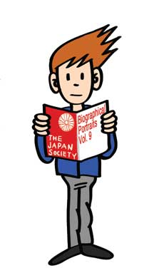


This resource was created by The Japan Society.
Sumo Training Moves illustrations by Aya Burbanks.
The Japan Society
13/14 Cornwall Terrace, London NW1 4QP
Tel: 020 7935 0475
Email: education@japansociety.org.uk
www.japansociety.org.uk
Follow us on:
@TheJapanSociety
The Japan Society

