Slide 1


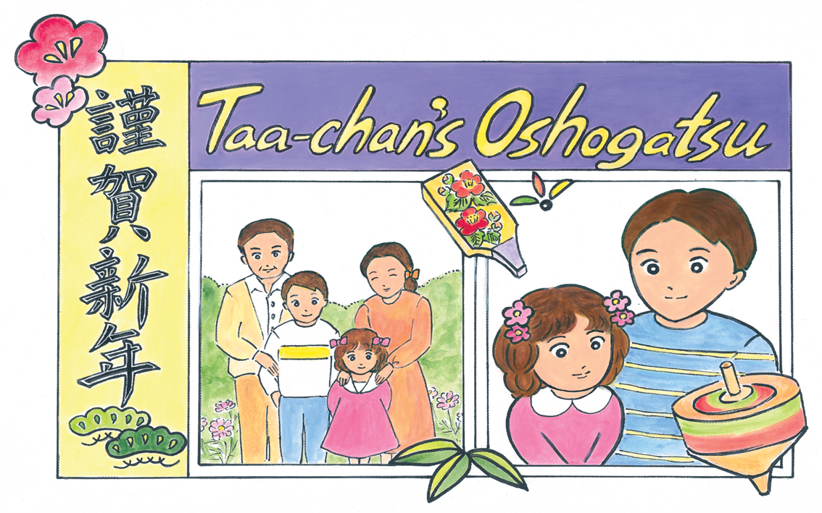

Kamishibai:
Japanese Storytelling
Notes:
Taa-chan’s Oshogatsu
1
Pre-text
New Year, or Oshogatsu, is the most important holiday of the year in Japan. In the run-up to New Year’s Day, people spend time cleaning their homes, putting up decorations, and writing cards to friends and family. New year cards are called nengajo and are actually postcards. They feature a New Year greeting and short message, as well as seasonal designs and sometimes a family picture on the front, with the back reserved for the recipient’s address only.
On New Year’s Day, people spend time with family and eat traditional dishes called osechi ryori which each have a special meaning. Many people will also visit a shrine or temple: the first visit of the year is called hatsumode.
The Japanese words in this story are:
Oshogatsu: New Year’s Day
Omisoka: New Year’s Eve
Chan: a suffix added to names as a term of endearment or familiarity. It is often used for children, especially girls. In the story, Takako is known as ‘Taa-chan’
Toshikoshi soba: Noodles traditionally eaten on New Year’s Eve
Osechi ryori: Traditional dishes eaten during the New Year holidays
Joya no kane: Tradition in which bells at Buddhist temples are rung 108 times at midnight on New Year’s Eve to drive away negativity
Ozoni: A soup eaten along with osechi ryori on New Year’s Day, the recipe varies according to region and household
Mochi: Rice cakes made from pounding rice until it is soft and chewy and can be moulded into shape
Otoshidama: Envelopes containing money which are gifted to children on New Year’s Day
Omikuji: A small paper fortune, sold at shrines and temples

Slide 2
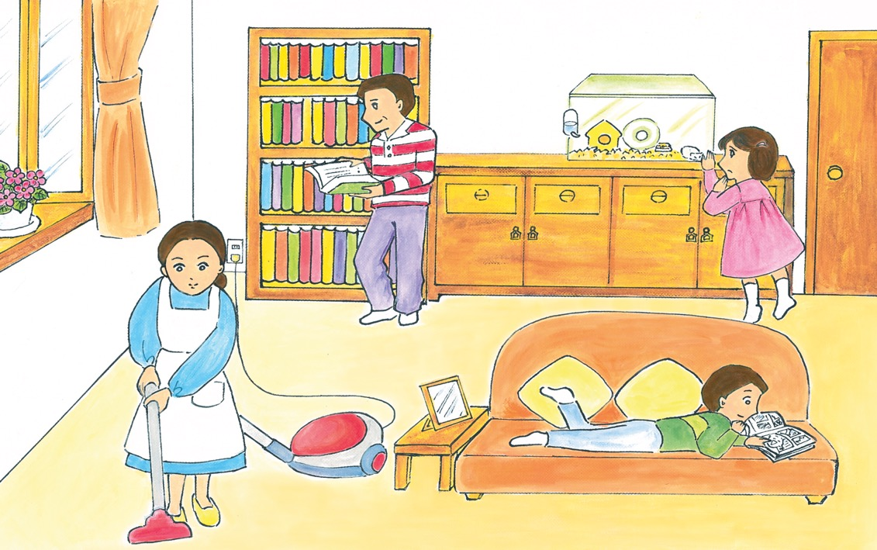
Notes:
2
It’s Omisoka today, New Year’s Eve. Taa-chan’s mummy has been very busy since early morning. As well as cooking special dishes called osechi ryori for tomorrow, she’s also been vacuuming and tidying their home from top to bottom to welcome the God of New Year. Taa-chan’s elder brother Hiroki was kicked out of bed early to clean their room and Daddy is tidying up his bookshelves. However, Daddy seems to be spending more time reading than organising; he closes the books very quickly whenever Mummy is nearby.
Taa-chan loves to help Mummy because she gets to taste the osechi ryori. Her favourite is kinton, mashed sweet potato cooked in sweet syrup. But today Taa-chan doesn’t feel like it. She is too worried about her hamster, Ham.

Slide 3
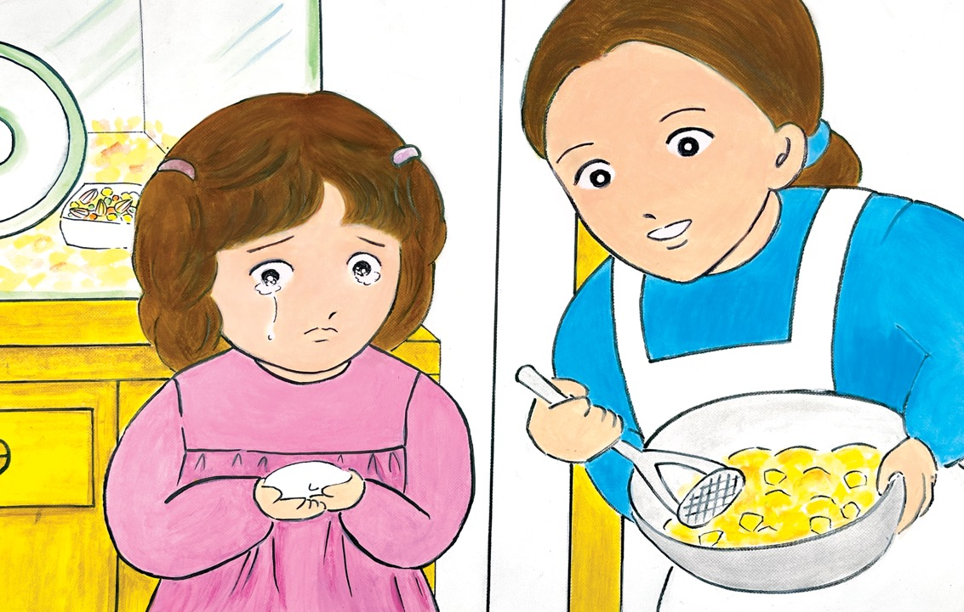
Notes:
3
He hasn’t been moving much for the last couple of days, and he hasn’t been eating anything either. Today Ham has barely moved at all. When Taa-chan told Hiroki, he came to have a look and said, “Hmmm. They told us hamsters only live for a couple of years, maybe he’s dying!”
This made Taa-chan cry. Mummy told Hiroki off for being so insensitive, so he apologised and buried himself in a comic book. Mummy told Taa-chan to let Ham rest and help her taste the kinton, which was almost ready. It was delicious, but Taa-chan didn’t cheer up. She wasn’t her usual lively self after dinner either; they always had noodles called toshikoshi soba on New Year’s Eve. Eating them was a tradition to say farewell to the past year before flowing into the next one.
Hiroki said, “Don’t be so sad, maybe we’ll get a tarantula next time. They live for 20 years!” This almost made Taa-chan cry again, but Daddy and Mummy both scolded him, so she felt slightly better.

Slide 4
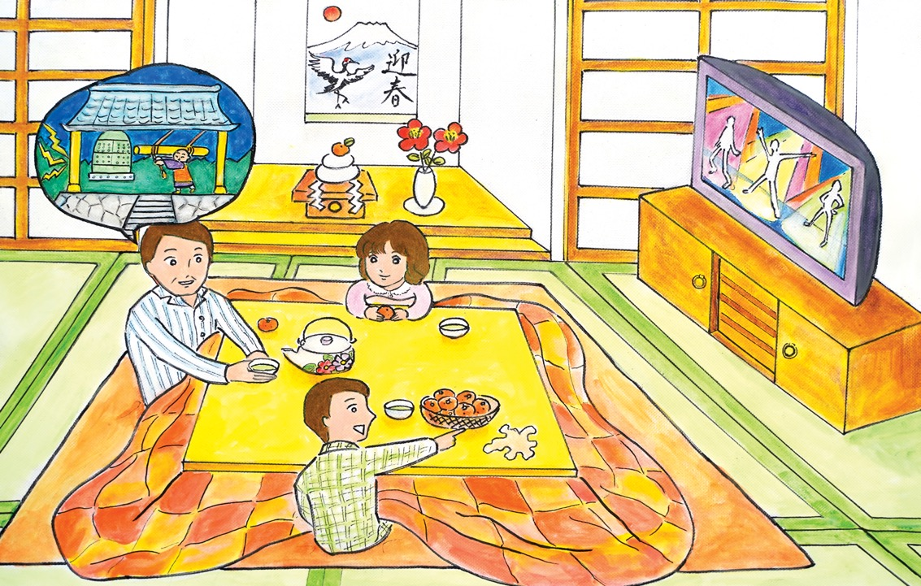
Notes:
4
After eating, Mummy carried on preparing for New Year’s Day. Daddy did the washing up and then settled down in front of the TV. Taa-chan had a bath and changed into her pyjamas, but didn’t go to bed. She wanted to stay up till midnight
to hear the temple bells ringing all over Japan to mark the arrival of the New Year. It was called Joya No Kane and the bells rang 108 times! She went to check on Ham in his cage one last time and then sat down to watch TV. She was determined to stay up till Joya No Kane. Yes, she was going to make it...
She woke up in her bunk bed. Bright sunlight was coming through the gap in the curtains. Hiroki was still asleep in the top bunk. She got up and went to the kitchen. Mummy was there. As soon as she saw Taa-chan, she wished her a Happy New Year and said, “The ozoni soup will be ready soon. Then we’ll wake up your brother.”

Slide 5
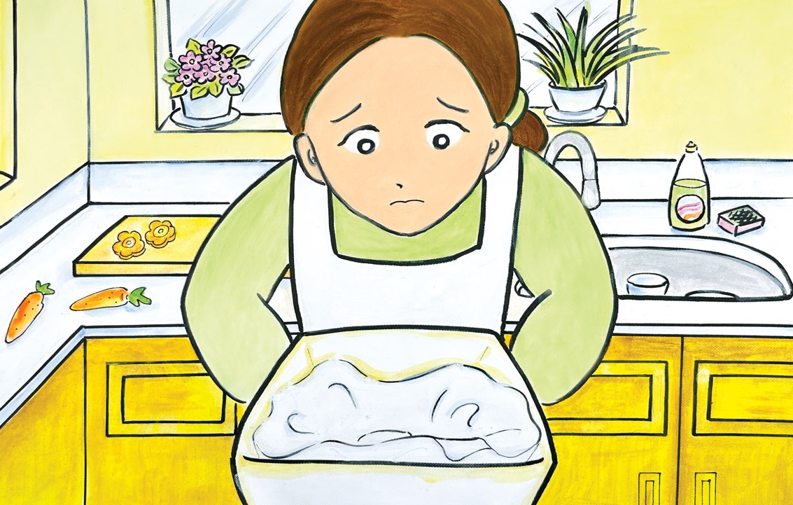
Notes:
5
Then Mummy came and bent down in front of her and with a rather serious face she said, “Taa-chan, I have sad news.” Taa-chan’s heart sank. Mummy explained that when she went to check on Ham this morning, he wasn’t breathing anymore: he was dead. She produced an ice cream box filled with white tissues. Then Taa-chan noticed Ham’s pink nose and closed eyes, his white body was half buried in the tissue. She started to cry. Mummy switched the cooker off and lifted her up.
“It’s ok to feel sad, but Ham had a very happy life being looked after by you. To us he was only two years old, but that’s very old for a hamster.” Taa-chan couldn’t stop crying. Mummy carried her to the sofa in the living room and cuddled her for a while. When Taa-chan was a bit calmer, Mummy asked, “Do you know why you’re called Takako?” Taa-chan didn’t know. She wondered why Mummy was talking about her name at a time like this.

Slide 6
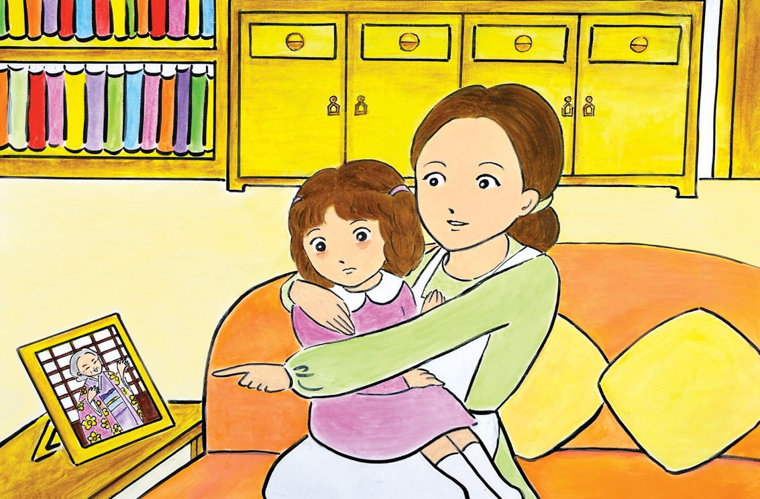
Notes:
6
Mummy explained that the name came from her own grandma: Taa-chan’s great grandma. She pointed at a small photo of an old lady who looked like she was dancing. Taa-chan had often wondered who she was and what she was doing.
Mummy said, “She loved making me laugh by showing me her funny dance, like in the picture. We were very close. But she became very ill when I was pregnant with you and I couldn’t go to see her much because you were so heavy.” Then Mummy made a huge belly with her hands and started breathing heavily and groaning. Her face was so funny it made Taa-chan laugh a bit.
Mummy continued, “Then one morning, my mum phoned to tell me my grandma had died.” Mummy paused and looked like she was remembering that moment and feeling very sad. “But then you started to come! Daddy had to take me to
the hospital straight away and in just a few hours you were born. That’s you, my precious Taa-chan!”. Mummy pressed her face up against Taa-chan’s and Taa-chan felt Mummy’s skin, all warm and soft.

Slide 7
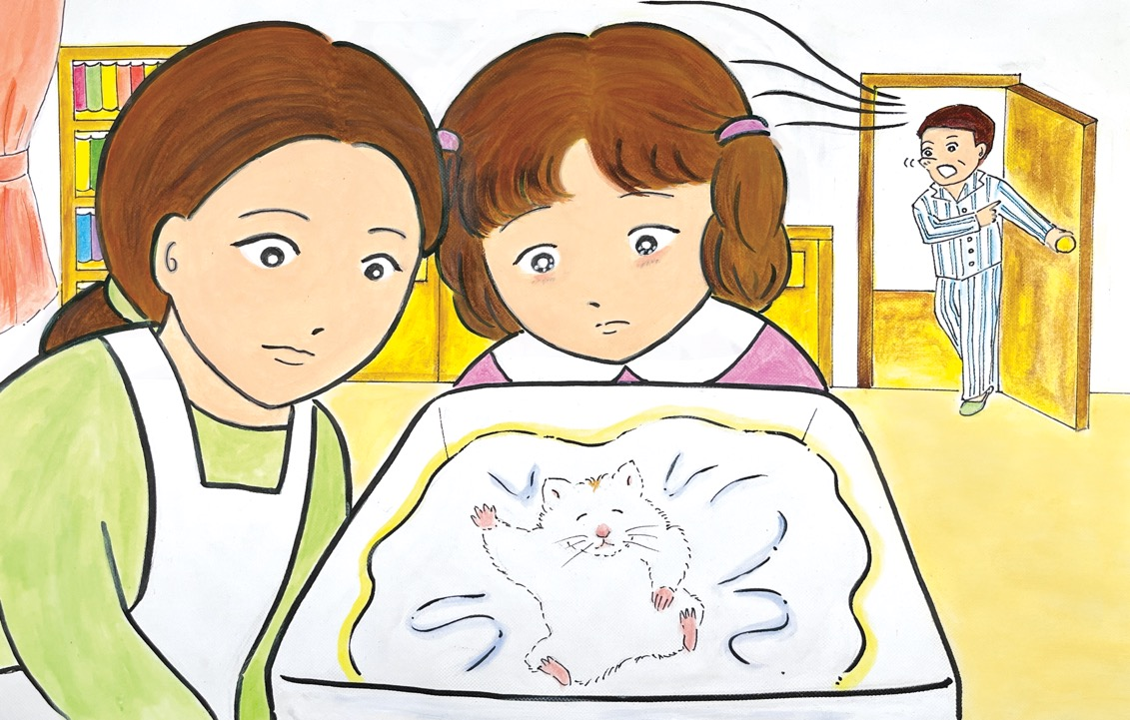
Notes:
7
Then Mummy said she thought Taa-chan must be her grandma’s umare kawari. Taa-chan didn’t know what that meant. Mummy explained it was like reincarnation: after someone dies their spirit returns in somebody else and is re-born. The new person is called umare kawari.
Taa-chan was still a bit puzzled. She looked again at the photo of the old lady. Did that mean her great grandma was inside her? Mummy said, “Don’t worry. It just means my grandma is always with us, protecting you and our family. That’s why
we gave you her name. That’s also why you’re so good at dancing!”
She said Ham’s spirit might be looking for something to be reincarnated into now. They both wondered what he would become... Suddenly, Daddy, who was still in his pyjamas, came in and said, “Do you smell something burning?” Mummy jumped up and ran to the kitchen – she had left mochi in the toaster!

Slide 8
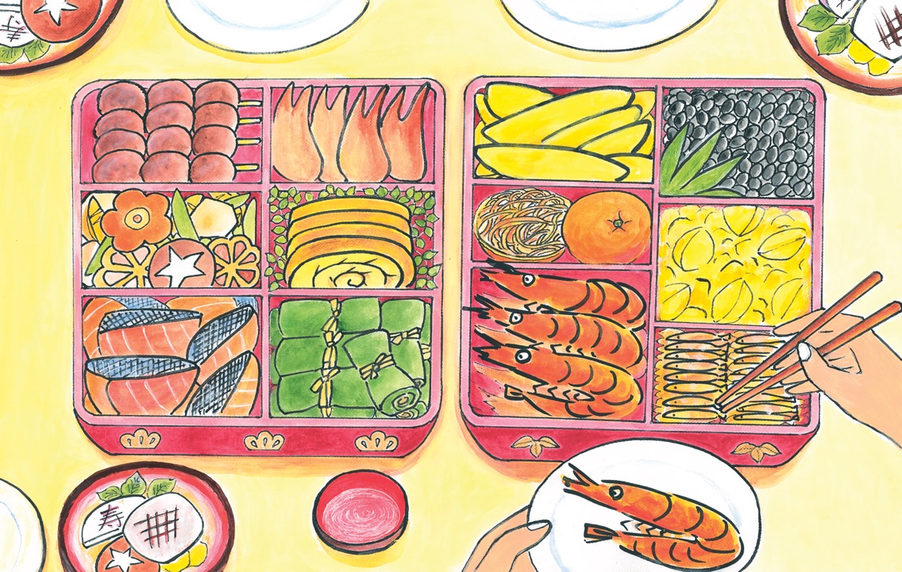
Notes:
8
The New Year breakfast was fantastic. There was ozoni soup with mochi rice cakes in it (mind you, some were a bit burnt!) and all the osechi ryori which had special meanings. Taa-chan remembered them all: the grilled prawns with their bent bodies represented a long life; the sweet stew of shining black beans was for getting rid of evil spirits; the salad made of grated carrot and daikon radish in sweet vinegar was red and white because they were celebration colours; the dish of lots of small fish cooked in sticky juice symbolised hope for a great harvest; the yellow herring roe represented a wish for many children; and of course Taa-chan’s favourite, kinton, which was a golden colour, was a wish for wealth, great success, and happiness.
After breakfast they decided to visit their local shrine. Taa-chan knew lots of other families would be there too, doing hatsumode, the first visit of the year to a temple or shrine.

Slide 9
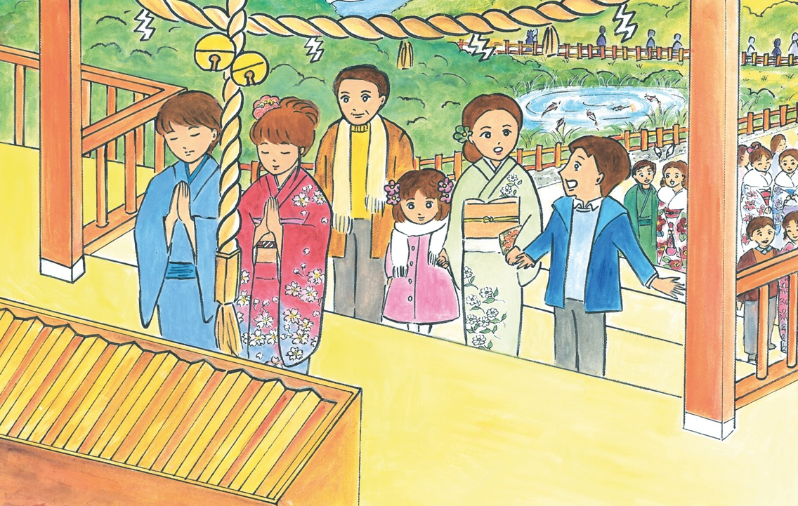
Notes:
9
The shrine was very busy and they had to join a long queue to pray at the main hall. Lots of women were dressed in colourful kimonos. Taa-chan still felt a bit sad, but the colour, sounds and joyful atmosphere started to lift her spirits.
As they neared the front, they discussed what they should wish for this year. Mummy and Daddy both said the health and happiness of the whole family, but Hiroki said that was very boring. He declared he was going to ask for a really
big otoshidama – the money that children receive as a new year present. But Mummy said, “You’re going to be 12 this year Hiroki, that’s too old for otoshidama. Didn’t you know you won’t get anything this year?”
“What?” Hiroki shouted. He looked very distressed.
Then it was their turn, so they all prayed and threw coins as an offering into the big wooden box. Hiroki looked very serious when praying. Taa-chan prayed for her hamster’s spirit to be happy and to find a great umare kawari.

Slide 10
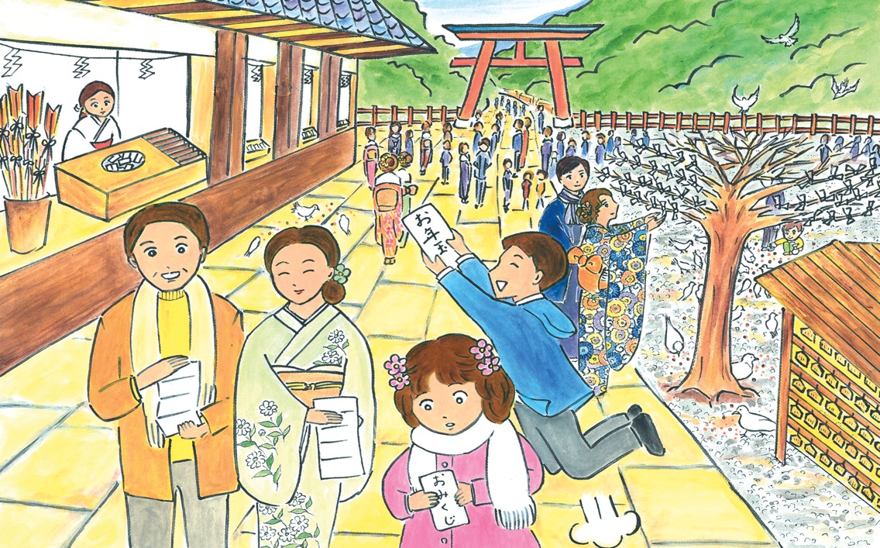
Notes:
10
After praying, Mummy suggested they buy an omikuji fortune telling strip from the shrine. Daddy went first and unfolded the small piece of white paper. It predicted ‘a little luck’. He said it sounded just right for his life and laughed heartily. Mummy’s said ‘some luck’ and they debated whether that was better or worse than Daddy’s, but couldn’t decide.
Hiroki opened his omikuji very seriously - it said medium happiness. He instantly became more cheerful and said loudly, ”It’s lucky! I must be getting the otoshidama I prayed for. Mummy you must have been wrong.” Mummy laughed and said, “Ooh, I can feel the shrine God is bending the rules, and also my arm...” as she pretended somebody was forcing her arm into her bag. She produced a small envelope and gave it to Hiroki. He hopped about with excitement.

Slide 11
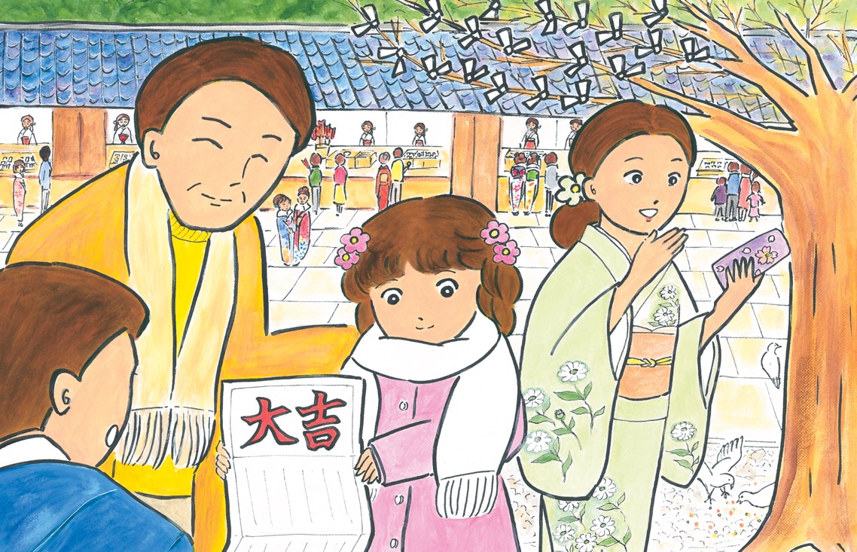
Notes:
11
Taa-chan was a bit apprehensive about opening her fortune. Mummy said not to worry if it was a bad one; in that case they could tie it onto one of the trees nearby, which were full of omikuji, and it would change to a good one. Taa-chan opened it. It said ‘greatest luck’ which was the best fortune of all. Mummy was excited - much more than Taa-chan was.
“Woah, Taa-chan, I wonder what this means...” Then her phone rang, “It’s your Uncle Masaki!” she said, “I must get this.”
She went to a quiet corner and answered her phone. Taa-chan could see Mummy smiling and looking excited during the call. After a while, she waved her hand to invite over the rest of the family. “Your Aunt Sanae just had a baby boy!” Mummy said excitedly, “Hiroki and Taa-chan, you have a new little cousin. Come and have a look!”

Slide 12
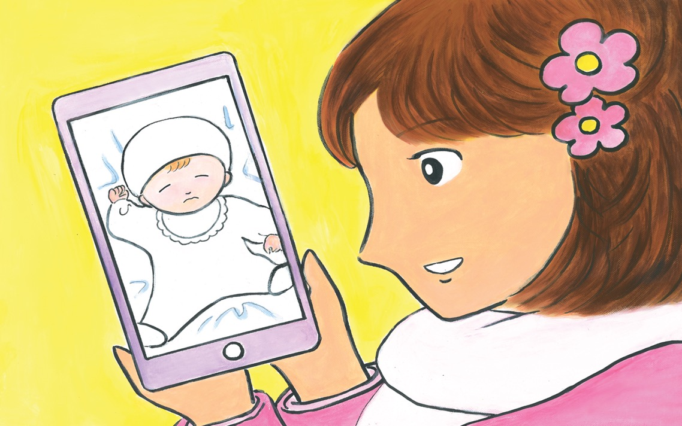
Notes:
12
Mummy lowered her phone and Daddy, Hiroki and Taa-chan all gathered around to peer at the screen. Taa-chan had to stretch, but she wanted to join in. First they saw Uncle Masaki’s beaming face on the screen. Then the camera moved to a baby in a cot. Mummy said with a sigh of appreciation,“What a beautiful baby!”
Taa-chan took the phone from Mummy and looked at it more carefully. She didn’t think the baby looked particularly beautiful, with his scrunched-up face. In fact, she though he looked more like a gigantic dried plum, with reddish skin and wrinkles. He was all wrapped up in white. The camera zoomed in to the baby. His eyes were tightly closed but his mouth moved slightly as if he was munching something. Taa-chan stared at him hard. He reminded her of something...
Daddy congratulated her aunt and uncle. Taa-chan couldn’t look away from the baby. Yes, he must be...but was it possible? Taa-chan thought she could almost see whiskers growing on his face...

Slide 13
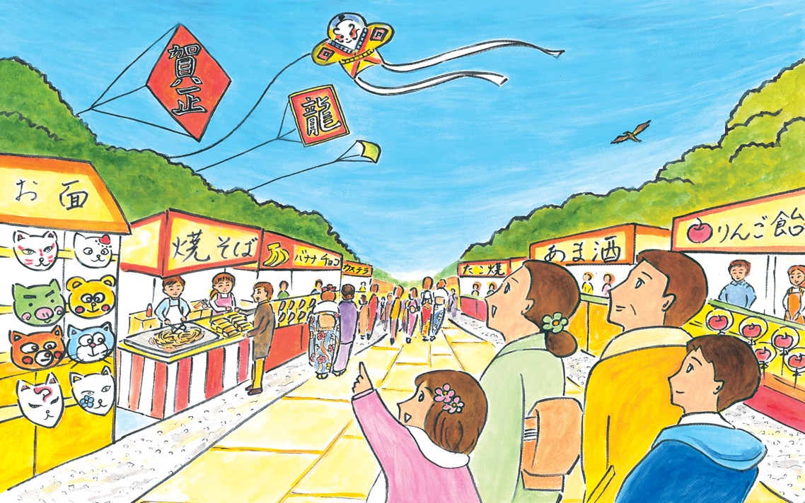
Notes:
13
On the way back, Taa-chan was very quiet and deep in thought as she walked beside Mummy. After a while she asked, very seriously, “Mummy, do you think a hamster can get reincarnated as a baby?”
Mummy looked surprised and almost burst out laughing, but didn’t. She just said she was sure that was possible. Then she smiled and pointed up at the sky, “Look, Taa-chan!”
Taa-chan looked up and saw colourful kites flying in the distance. As they moved and fluttered in the wind, Taa-chan thought they looked like they were dancing to celebrate Oshogatsu. Happy New Year!

Slide 14

終わり
o-wa-ri
(The End)
Notes:
For more resources, visit www.japansociety.org.uk.

Slide 15

For more resources, visit www.japansociety.org.uk.
Notes:
For more resources, visit www.japansociety.org.uk.

