Slide 1

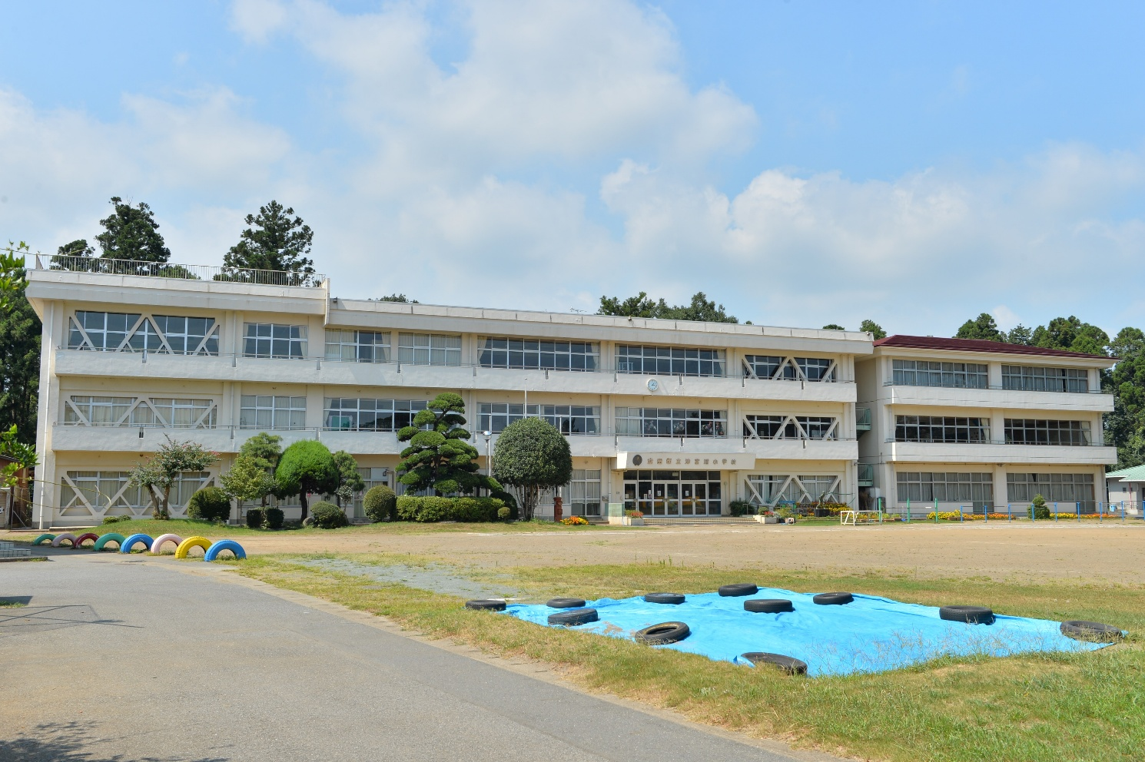
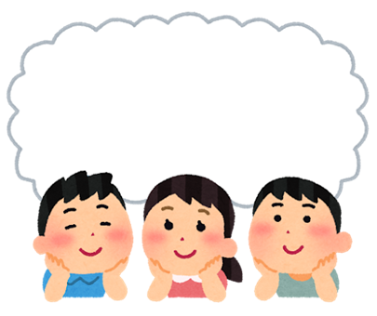
Starter Discussion
What do you think this building is?
Notes:
Teacher’s Notes
Starter activity – ask pupils to have a look and think about this picture. Ask them to think about:
What do they think this building is?
Why are you showing them this picture?
What do they think this lesson will be about?
You could offer some hints to help them narrow down their ideas.
Picture of Tsubuura Elementary School from Wikimedia Commons: https://commons.wikimedia.org/wiki/File:Narita_City_Tsubuura_Elementary_School_01.jpg
Picture from Irasutoya: https://www.irasutoya.com/2017/10/blog-post_992.html

Slide 2
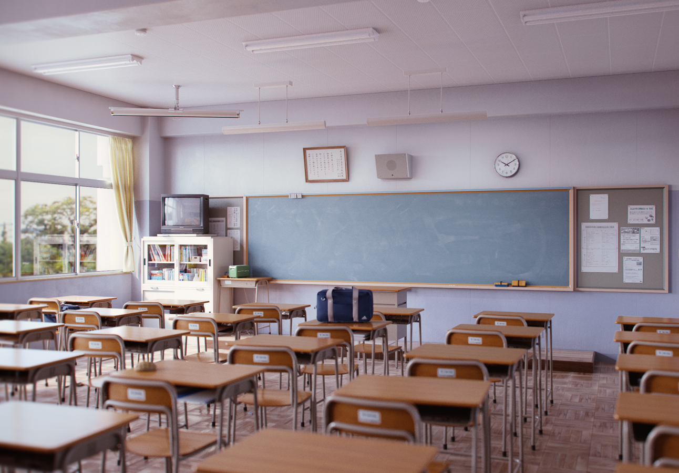

School Life
in Japan
Notes:
Teacher’s Note
Image of classroom: https://www.deviantart.com/icephei/art/Classroom-Day-588151746

Slide 3

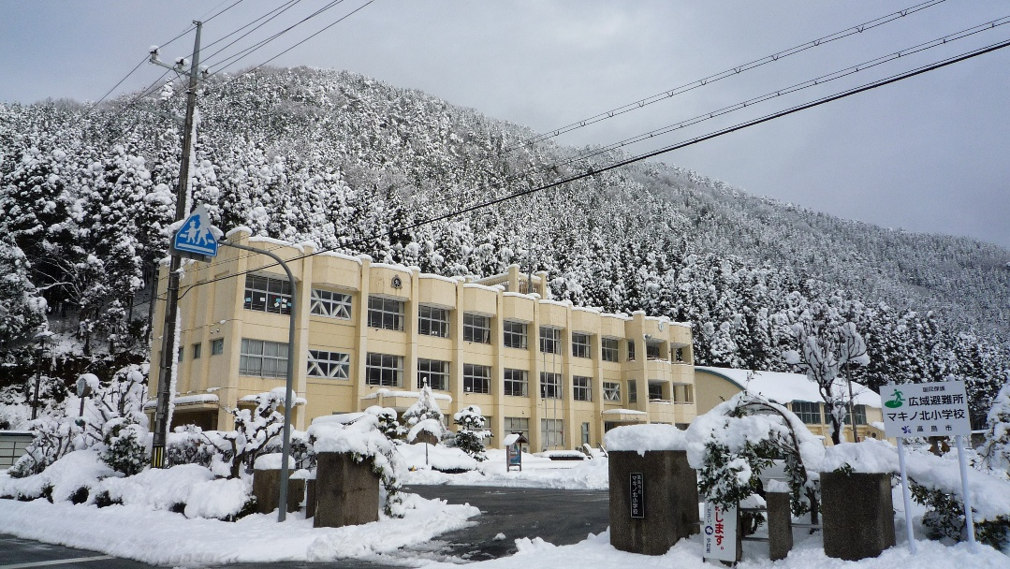
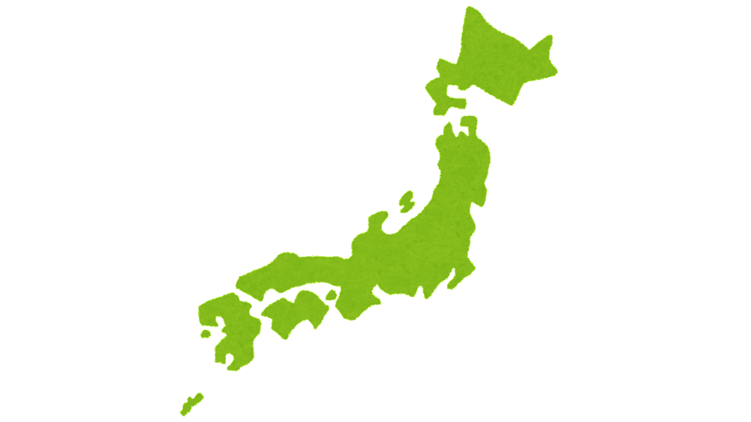
School Life
Learning Objective:
To compare and contrast Japanese schools to British schools.
Notes:
Teacher’s Notes
Introduce today’s learning objective.
This lesson will focus on elementary school life in Japan (ages 6 – 12).
Pictures from Wikimedia Commons and Canva
https://commons.wikimedia.org/wiki/File:%E3%83%9E%E3%82%AD%E3%83%8E%E5%8C%97%E5%B0%8F%E5%AD%A6%E6%A0%A1_-_panoramio.jpg

Slide 4
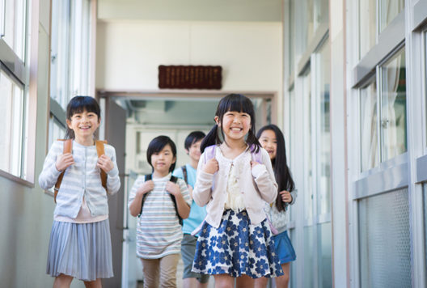
Japanese Schools
Discuss: What do you predict a Japanese school might be like?
Start and end time
Lessons
Uniform
Lunch time
Classrooms
School rules
Afterschool clubs
Notes:
Teacher’s Notes
Pupils will discuss these ideas together with a partner or in a small group initially, before feeding back to the rest of the class.
You could also note down your main predictions on the board, so at the end of the lesson, you could reflect whether your predictions were correct or incorrect together as a class.
Picture from Canva

Slide 5
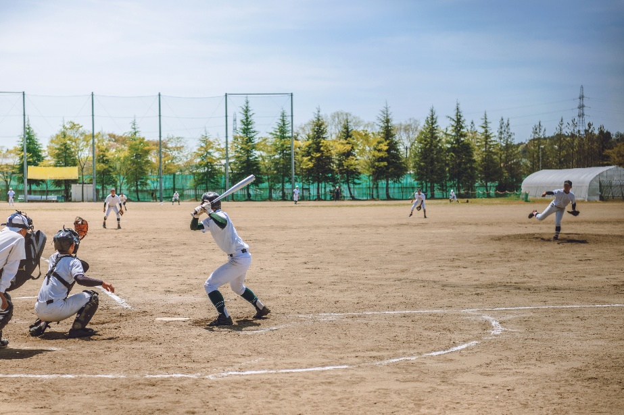
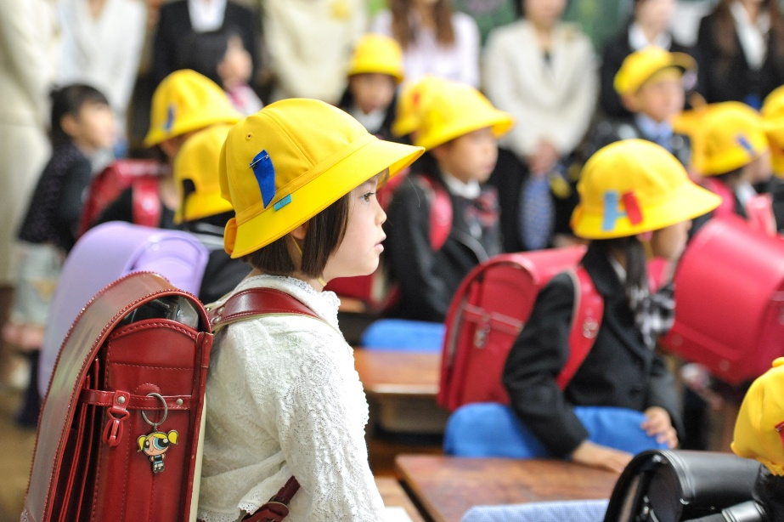
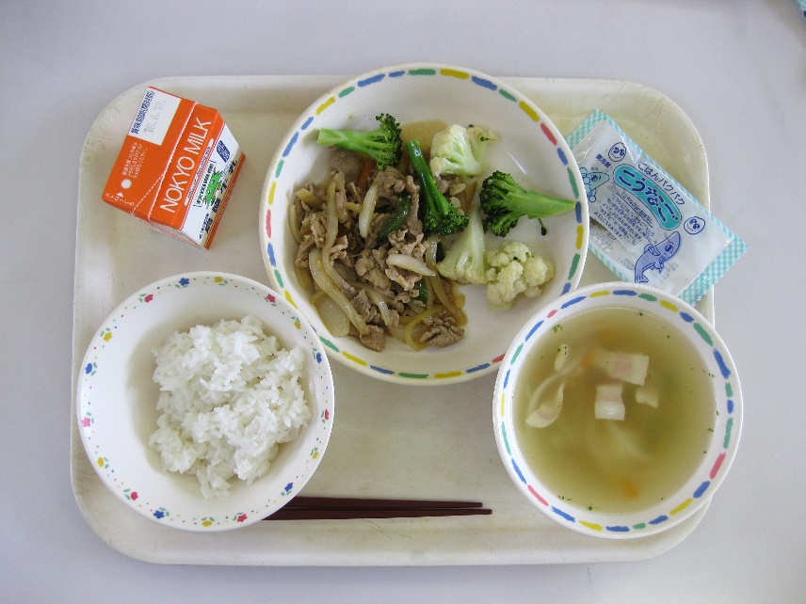
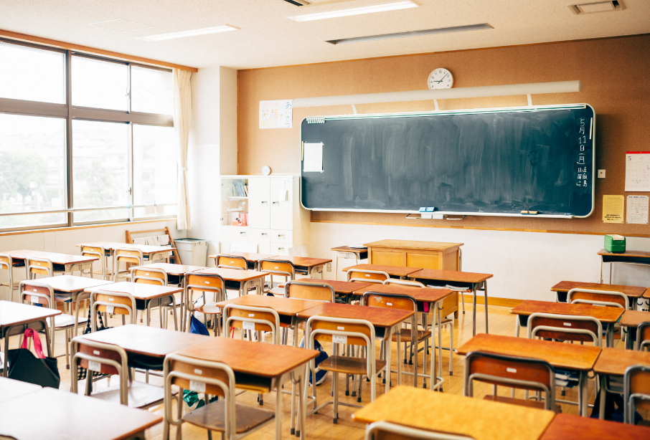
Notes:
Teacher’s Notes
You can use these photos to prompt discussion. Ask children to look at the pictures and share what they notice. Some of these points will be elaborated on further in the presentation.
Top left: Baseball is a popular sport for elementary school boys in Japan, and many attend afterschool baseball clubs.
Top right: Elementary school children do not wear a uniform, but often use these large backpacks known as randoseru, and wear brightly coloured hats to school. As children travel to school without an adult, the bright randoseru and hat make them easier to notice - cars can stop and allow the children to cross the road safely.
Bottom left: A typical school meal (known as kyuushoku). Kyuushoku is designed to be healthy and nutritious. Children also have a carton of milk as part of their school meal too.
Bottom right: A typical classroom. Children have their own individual desks, and teachers use chalk boards to write on. Smart boards are not as commonplace in Japan as they are in the UK.
Pictures:
https://stock.adobe.com/images/%E9%AB%98%E6%A0%A1%E9%87%8E%E7%90%83%E8%A9%A6%E5%90%88%E9%A2%A8%E6%99%AF/193543274
https://stock.adobe.com/images/First-day-of-a-beautiful-little-girl-in-Japanese-Elementary-School.-In-class-wit/204690079
https://commons.wikimedia.org/wiki/File:Japanese_school_lunch.jpg
Bottom right image is from Canva

Slide 6
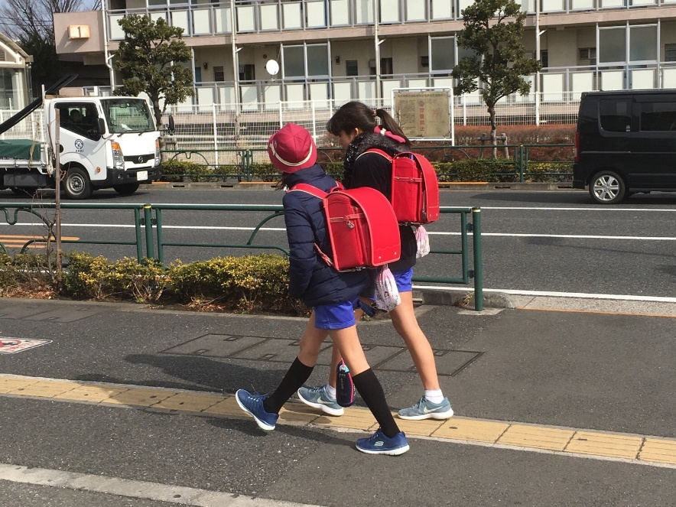
Getting to School
Children in Japan walk to school with friends – not with an adult!
Usually, the year 5 and 6 children walk together with the year 1 and 2 children.
Sometimes they will even travel to school by bus or train!
Do children usually walk to school without an adult in Britain?
Notes:
Teacher’s Notes
An aspect of Japanese school life that many people find unique or surprising, is that children walk to school with their friends and / or siblings – without a parent or an adult!
The year 5 and 6 children will often meet children in younger classes, and walk together with them on the way to school – they look out for them.
As you may notice, elementary school children wear large, rounded, colourful backpacks – known as randoseru (more on this in the Background Notes for Teachers PDF). Some schools may require children to wear a colourful hat as well. This is so that others walking in the morning can identify the elementary school children, and look out for them / help them if needed!
Picture from Wikimedia Commons: https://commons.wikimedia.org/wiki/File:Randoseru-red-walkinggirls-feb14-2019.jpg

Slide 7
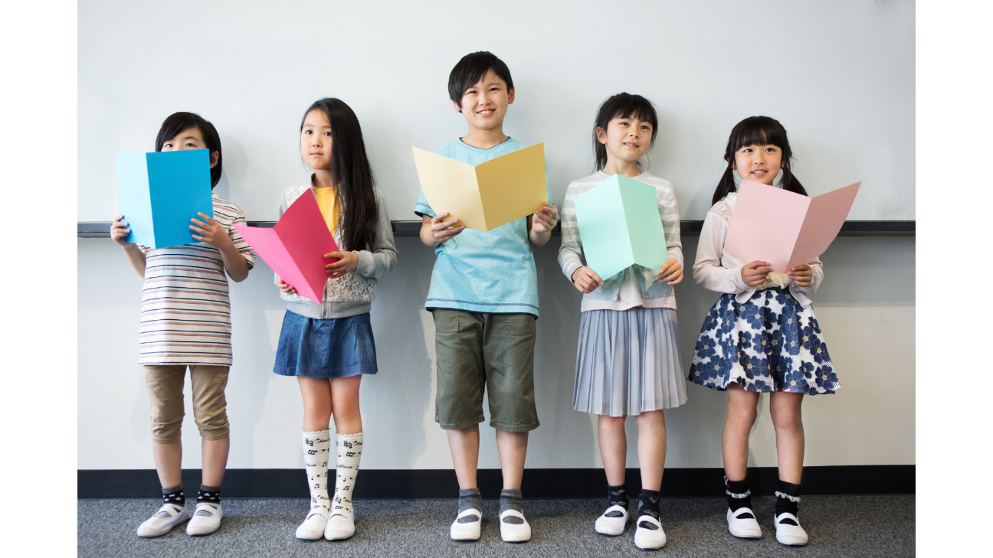
School Uniform
In elementary school, children don’t have to wear a school uniform!
But they have to wear clothes that will be comfortable for them when doing PE lessons.
Would you prefer being able to wear your own clothes to school? Why or why not?
Notes:
Teacher’s Notes
There are no school uniform rules for children in elementary school. They just need to wear clothes that will be comfortable for them whilst doing sports / PE.
Some private elementary schools may require pupils to wear a uniform.
Picture from Canva

Slide 8
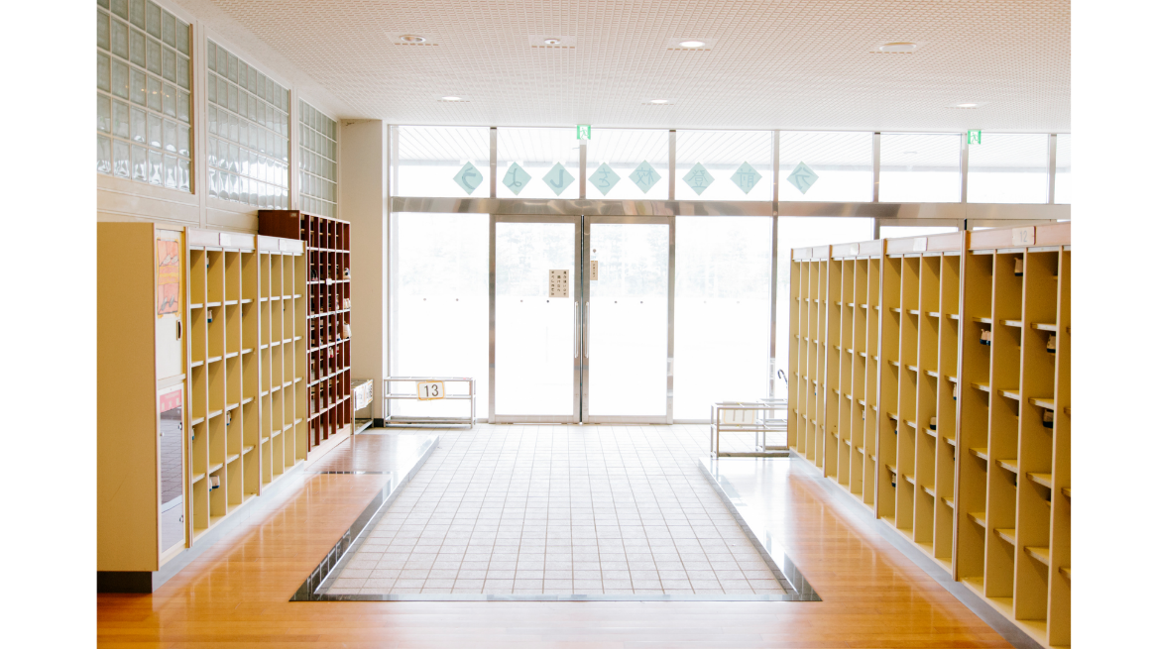
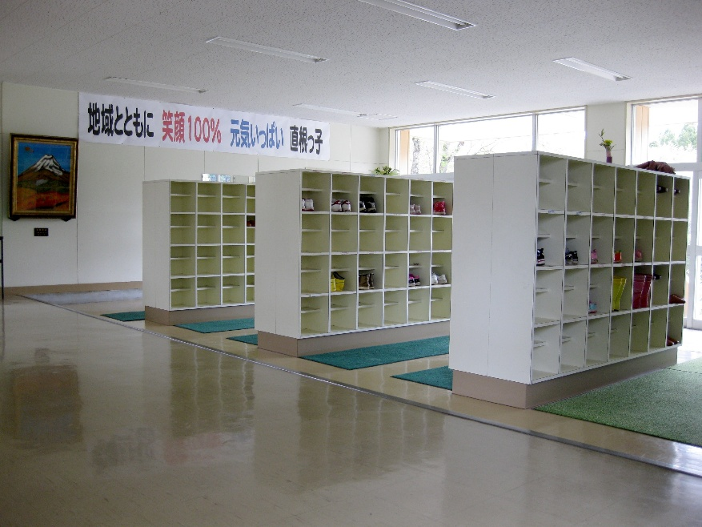
Arriving at School
When pupils arrive at school in the mornings, they enter the building through the genkan 玄関
What do you think genkan means?
Notes:
Teacher’s Notes
Genkan 玄関 means “entrance”.
Pupils might notice that the entrance to a Japanese school looks different to theirs. They might notice the large cupboards / shelves by the doors. You could ask them why they think they are there.
(This is where pupils take their outdoor shoes off and change into indoor shoes – this will be elaborated on in the next slide)
Pictures from Canva and Wikimedia Commons
https://commons.wikimedia.org/wiki/File:Hitane_es.entryway.jpg

Slide 9
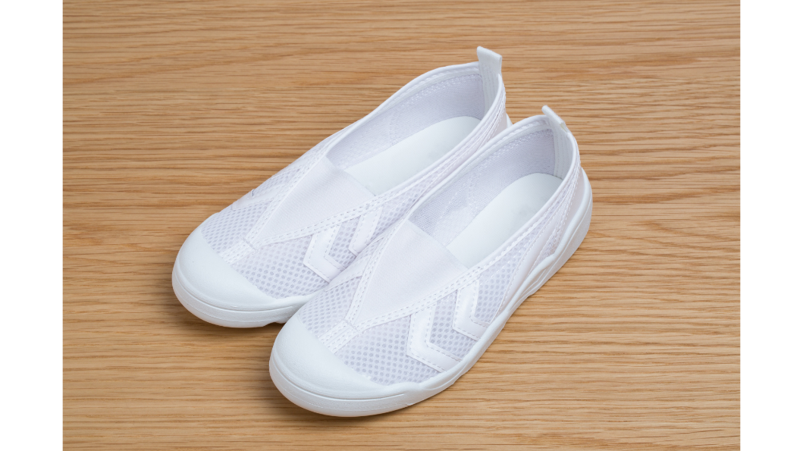
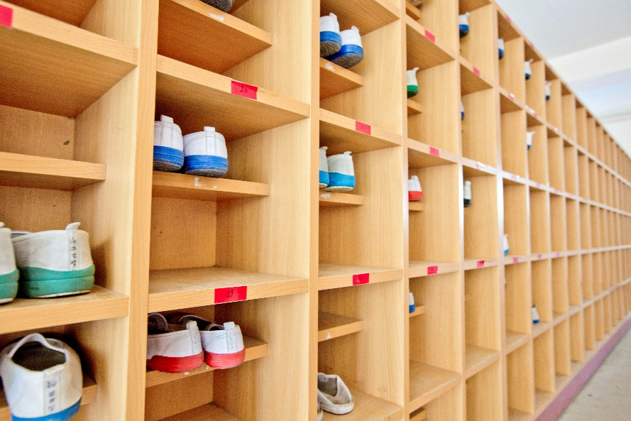
Arriving at School
The pupils take off their shoes, and put on special indoor slippers they wear in school.
Why do you think the children change their shoes when arriving at school?
Notes:
Teacher’s Notes
Ask pupils to discuss why they think children change into indoor shoes before explaining why.
In Japanese schools, children change into indoor shoes and place their outdoor shoes onto their own personal shelf at the entrance (genkan), as seen in the image above. People do this for hygiene reasons, so that they can keep the floors clean. In Japanese households, people remove their shoes at the genkan (entrance) before entering their house – so this is not an aspect unique to schools.
Pictures from Canva and Wikimedia Commons
https://commons.wikimedia.org/wiki/File:Japanese_Elementary_School_(47977321511).jpg

Slide 10
School Day
Here is what a typical school day might look like for an elementary school pupil in Japan...
8:20am – 8:35am | Registration and morning assembly
8:40am – 9:20am | Japanese
9:25am – 10:05am | Maths
10:05am – 10:25am | Break
10:30am – 11:10am | English
11:15am – 11:55am | Moral Education
12:00pm – 12:50pm | Lunch
12:50pm – 1:10pm | Break
1:10pm – 1:30pm | Cleaning
1:35pm – 2:15pm | Arts and Crafts
2:25pm – 2:35pm | End of day
Notes:
Teacher’s Notes
Challenge questions to think about: Does this timetable look similar to your school day? Do you have similar or different subjects?
Have a look at the school timetable and see what subjects you can notice. Most of the subjects children study are similar to British schools.
In Japanese elementary schools, children stay in their classrooms with the same teacher all day, similar to British primary schools. They don’t move to different classrooms for different lessons with different teachers.
Note - Moral Education is similar to PSHE in British schools. Children usually learn English as MFL. On some days of the week, children will only have 5 lessons so they will finish school early. But there may be some school days where children have 6 lessons, and they will finish school around the same time British primary schools finish (3:00pm – 3:25pm).

Slide 11
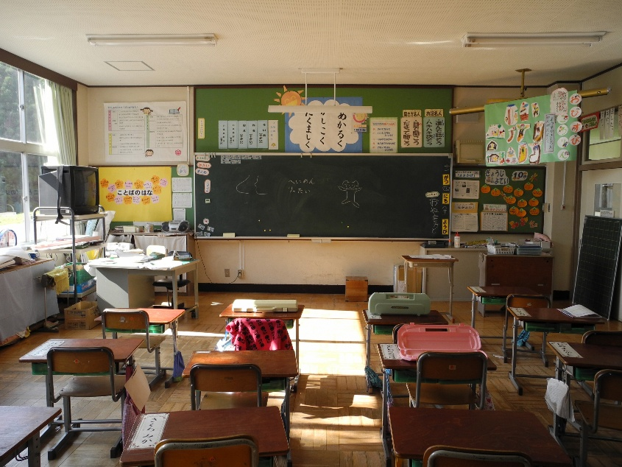
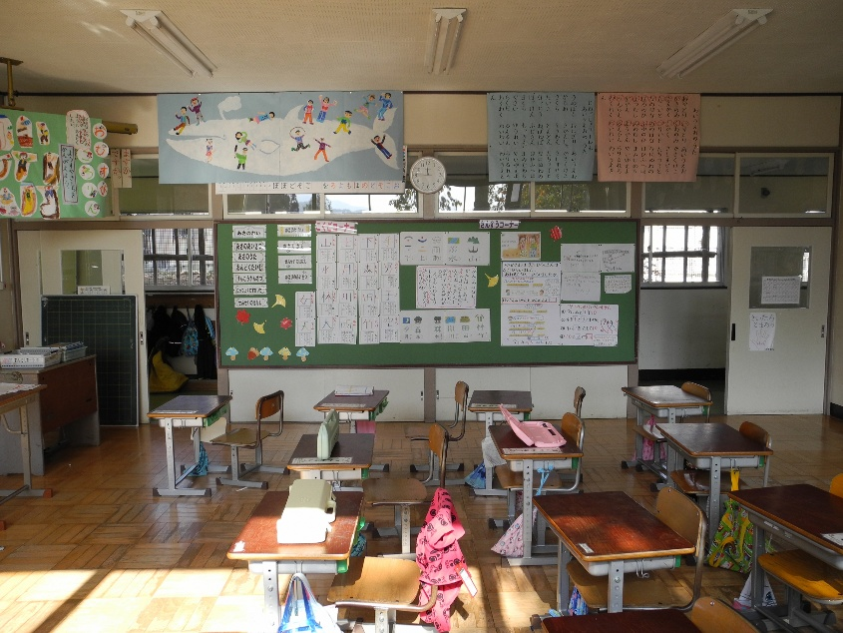
Classroom
Pupils head to their classroom to start the school day.
Does this classroom look similar or different to yours?
Notes:
Teacher’s Notes
Discuss and compare the lay-out of a typical Japanese elementary school classroom to your own classroom. Is it similar or different? What can pupils see in the pictures?
These photos are of a year 1 classroom (ages 6-7).
Children often have their own individual desks. They are set out in rows facing a chalk board at the front of the classroom. Usually at the back of the classroom, there will be space for pupils to store their coats / bags / belongings.
Interactive whiteboards / smart boards are not so commonplace in Japanese schools.
Pictures of Jinego Elementary School from Wikimedia Commons
https://commons.wikimedia.org/wiki/File:Jinego_Elementary_School_1st_grade_classroom_front.jpg
https://commons.wikimedia.org/wiki/File:Jinego_Elementary_School_1st_grade_classroom_side.jpg

Slide 12
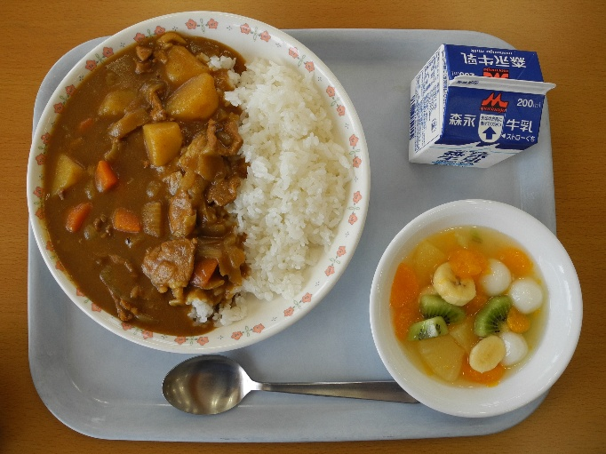
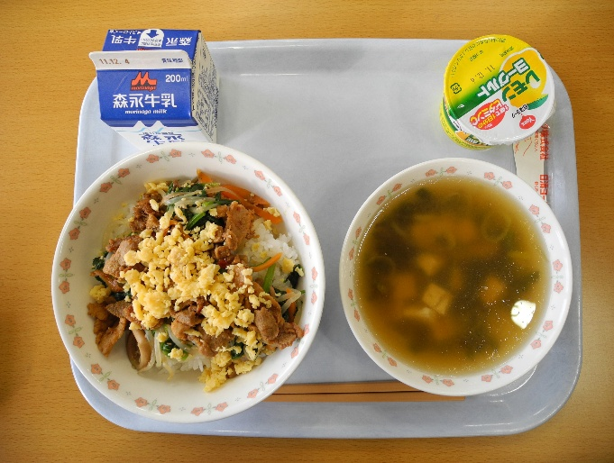

Lunch Time
In Japanese elementary school, every child eats school dinners – known as kyuushoku 給食 in Japanese!
Look at the pictures above – do you know what any of these meals are? Would you like to try them?
Notes:
Teacher’s Notes
Every child in elementary school eats school dinners, known as kyuushoku in Japanese.
The kyuushoku menu is often decided by a nutritionist, and children are taught the importance of eating a well-balanced diet. Every kyuushoku meal will also come with a carton of milk, as you can see in the above pictures.
Note – in rare cases, some children may take a packed lunch (known as obento) for allergy or dietary reasons, but the vast majority of children eat school dinners.
Pictures from Wikimedia Commons
https://commons.wikimedia.org/wiki/File:Jinego_ES_lunch.jpg
https://commons.wikimedia.org/wiki/File:Yashima_JHS_lunch_1.jpg
https://commons.wikimedia.org/wiki/File:Japanese_school_lunch.jpg

Slide 13
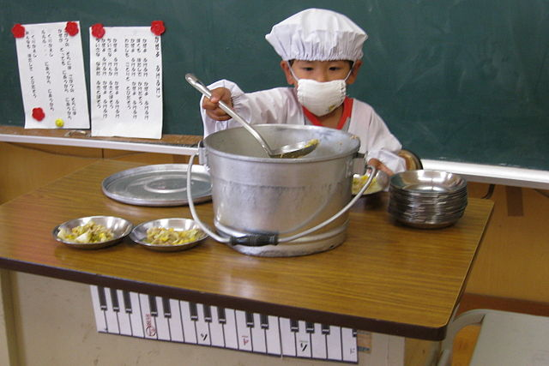
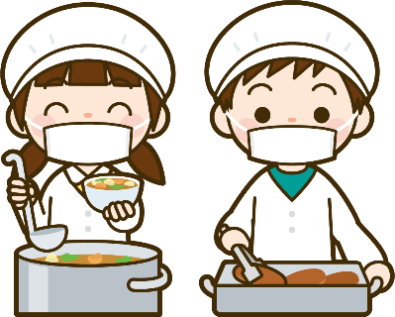
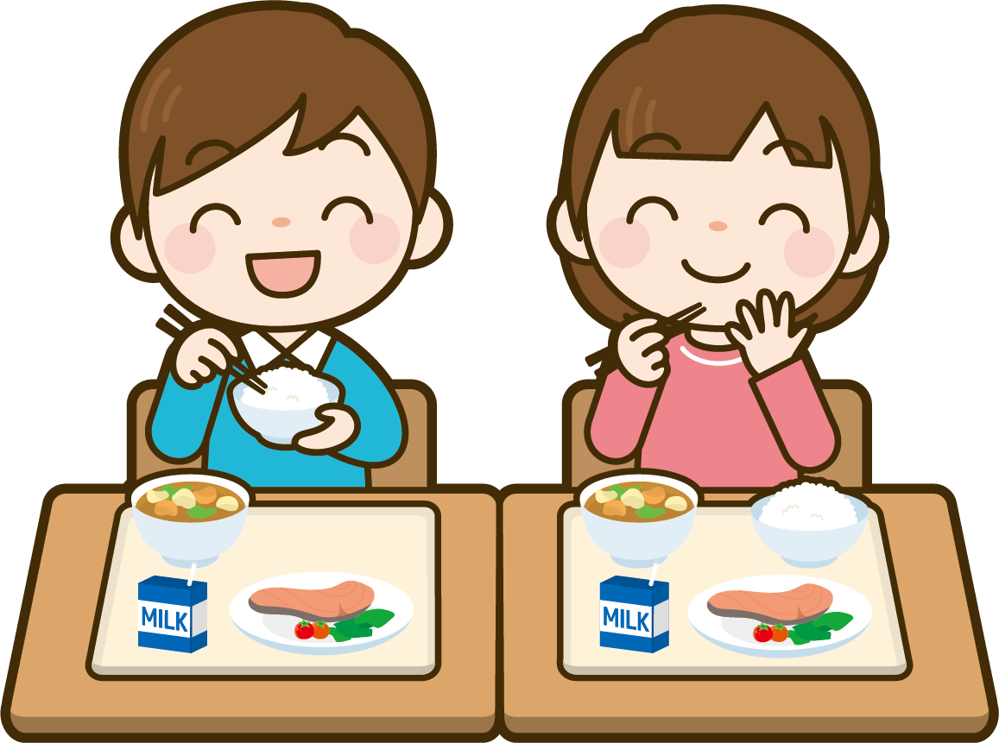
Lunch Time
Pupils take turns serving each other food at lunch time. They wear a special hat and apron.
Everyone eats kyuushoku together in the classroom with their teacher!
Why do you think children in Japanese schools serve each other lunch and eat together in the classroom?
Notes:
Teacher’s Notes
Another perhaps surprising and unique aspect of Japanese school life, is that children actually take it in turns to serve each other food at lunch time. They sit and eat together in the classroom with their teacher.
When discussing the question on the board, think about your own school values too. The idea is that serving each other food and eating together promotes the importance and value of teamwork; responsibility to one another; and community. They also gain skills that will help prepare them later on in life when they become adults, becoming more confident and more independent.
What ways do you show teamwork in your classroom? How do your pupils show they are confident, independent learners at school?
Picture from Wikimedia Commons https://commons.wikimedia.org/wiki/File:%E7%B5%A6%E9%A3%9F%E5%BD%93%E7%95%AA_(3585013233).jpg

Slide 14
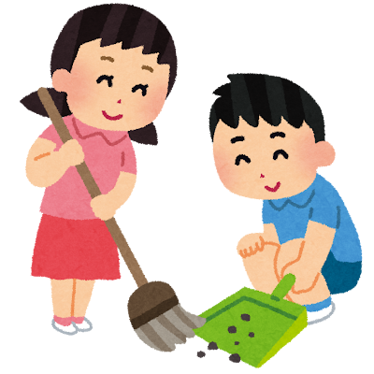
Cleaning
After lunch or at the end of the school day, the children have to clean and tidy up the classrooms and hallways.
At the end of the school year, there is also usually a deep clean of the entire school!
Do you help clean and tidy up your classroom everyday too?
Notes:
Teacher’s Notes
Everyday, usually after lunch or at the end of the school day, children must clean and tidy their classrooms, corridors, and around the school. They often have designated jobs or responsibilities during this cleaning time.
At the end of the school year or term, there is also usually a deep clean of the entire school.
Picture from Irasutoya
https://www.irasutoya.com/2015/01/blog-post_711.html

Slide 15
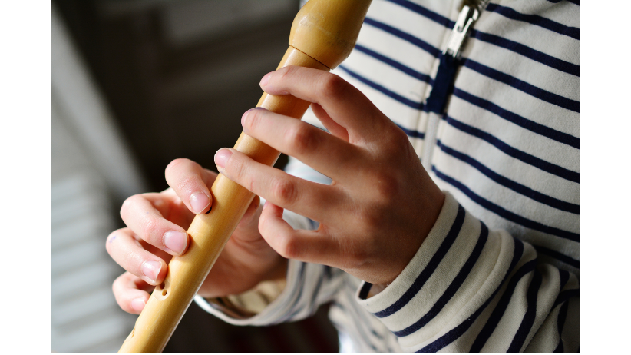

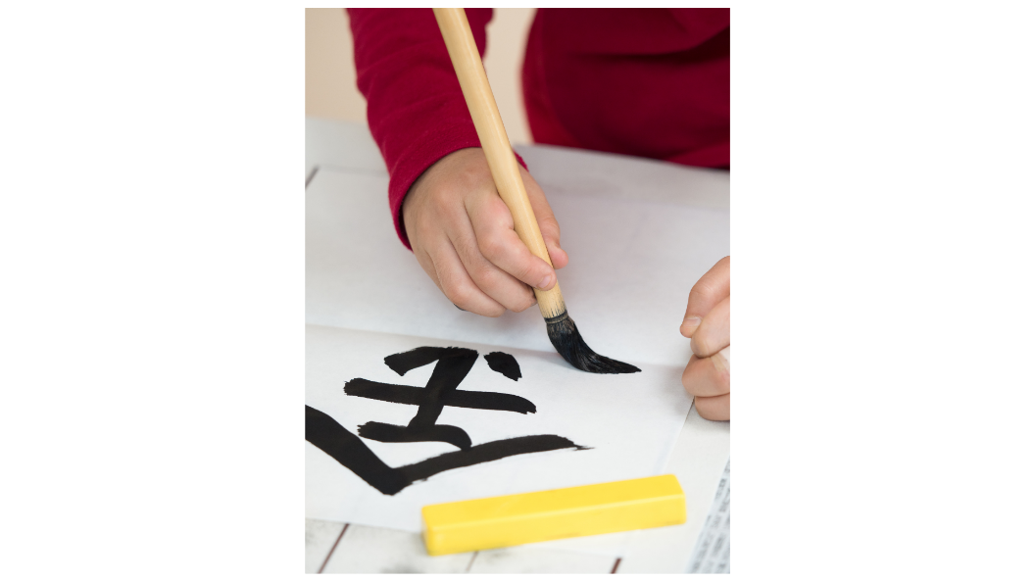
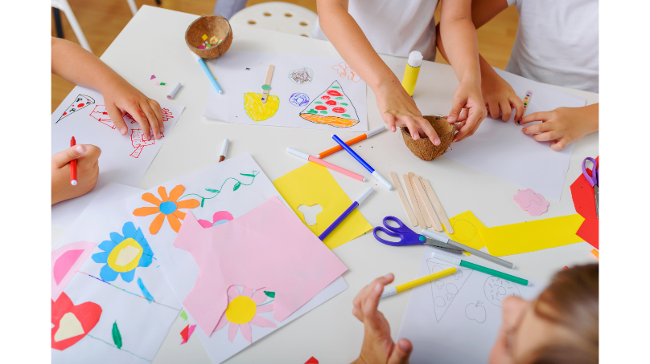
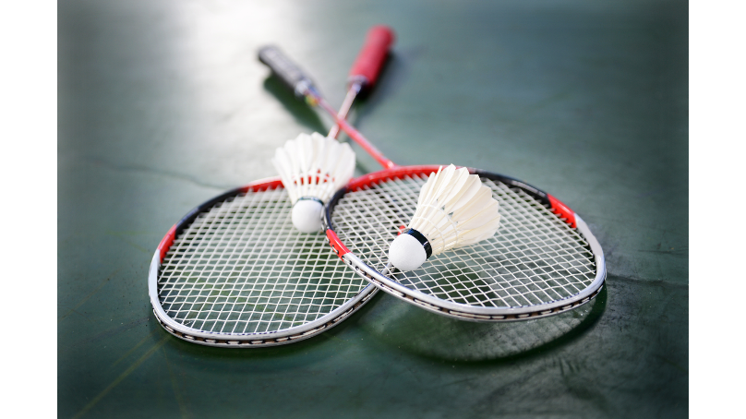
Afterschool Clubs
Does your school offer these kinds of afterschool clubs too?
Notes:
Teacher’s Notes
Some children stay at school for afterschool clubs and other extracurricular activities.
Have a look at the pictures on this slide of the different club activities the children are participating in. Ask children if they can guess what each club activity is.
Are there any club activities on these slides that they would like at their school too?
Images from left to right: recorder, baseball, calligraphy, arts and crafts, and badminton.
Images from Canva.

Slide 16

Task
Discuss and write down the similarities and differences between Japanese and British primary schools.
Also think about... What aspects of Japanese school life do you like? What do you dislike? Why?
Notes:
Teacher’s Notes
Children can work together in pairs or small groups, or as a whole class with the teacher writing down key points. You can use the Similarities and Differences worksheet to complete this task.
Feedback as a class and share ideas. At this point, reflect together – are Japanese schools that different to British schools? Why or why not?
Pupils could also think about and share their reasons why they do or do not like these aspects of Japanese school life.
Picture from Canva

Slide 17

Challenge:
Your headteacher wants to make some changes, and introduce new rules to your school based off of Japanese elementary schools. Think and discuss:
What rules would be good?
What rules would be not so good?
How would you feel?
Notes:
Teacher’s Notes
In pairs, small groups, or as a whole class, discuss the questions on the board. You might like to guide pupils by suggesting some ideas of school rules your headteacher might like to introduce!
You could talk about… No school uniform / wearing indoor shoes / cleaning the whole school everyday / serving each other lunch and eating together in the classroom.
Picture from Irasutoya
https://www.irasutoya.com/2017/10/blog-post_992.html

Slide 18

Extension Task:
Write a short letter to your headteacher to share your thoughts and feelings about the new school rules.
Make sure to include...
Features of a typical letter
Which rules you think would be good
Which rules you think wouldn’t be so good
Anything else you liked about Japanese schools!
Notes:
Teacher’s Notes
This task could be done independently, or as pair work / group work, or together as a whole class letter.
You could show pupils the sample letter and read it together beforehand to help them understand the task.
Lower ability pupils could also use the letter template handout to help them write the letter.
Picture from Irasutoya
https://www.irasutoya.com/2013/04/blog-post_823.html

Slide 19

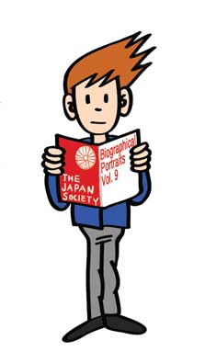


This resource was created by The Japan Society.
The Japan Society
13/14 Cornwall Terrace, London NW1 4QP
Tel: 020 7935 0475
Email: education@japansociety.org.uk
www.japansociety.org.uk
Follow us on:
@TheJapanSociety
@TheJapanSociety

