Slide 1
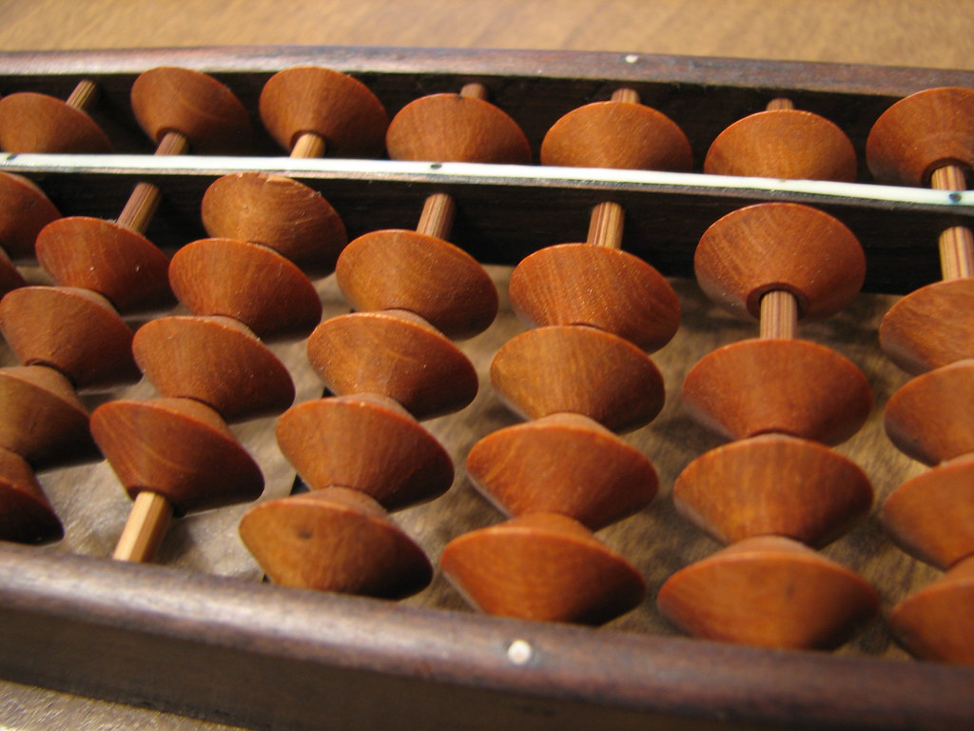

Title image is “soroban macro” © John Vela/CC BY-NC-SA 2.0
Soroban: Lesson 1
Notes:
Title image:: John Vela is licensed under CC BY-NC-SA 2.0 (no changes)

Slide 2

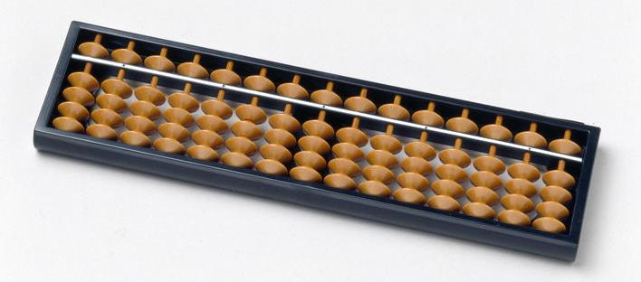
What is Soroban?
A soroban is a Japanese abacus.
Japanese children learn how to use a soroban
at primary school.
© Science Museum Group Collection/ CC-BY-NC-SA
©Lee Blowers, Tomoko Hoult & Kimie Markarian in collaboration with The Japan Society.
Notes:
Tell students:
• It is a counting tray with parallel rods, each containing 5 beads.
• They are used for calculations –like a modern day calculator.
• You can add, subtract, multiply and divide.
• The soroban is more efficient than using pen and paper to solve problems. Some people can even solve problems on a soroban faster than on a calculator!
Image: “Soroban Japanese abacus, 2001” © Science Museum Group Collection/ CC-BY-NC-SA https://search.creativecommons.org/photos/d208c0db-5f53-4b36-b9bd-42420b407c3a

Slide 3
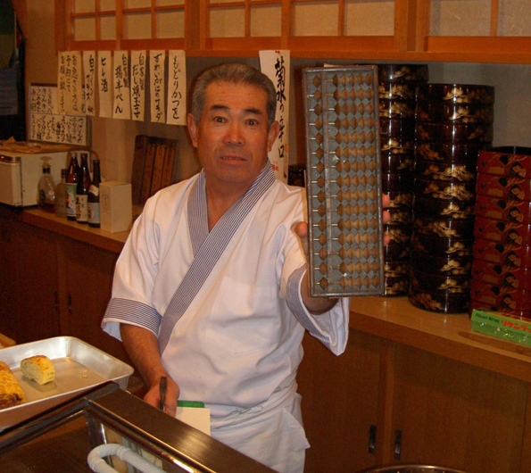
History of Soroban
Soroban has been used for over 450 years!
It originally came from the Chinese abacus.
In Japan today, you might see soroban still being used in some places.
Notes:
Tell students
• All shops and offices will use calculators and computers, but you might see soroban too.

Slide 4
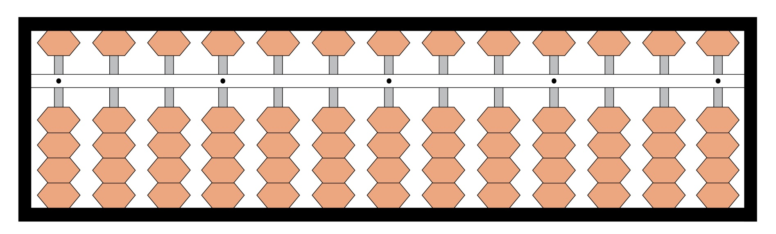
Parts of the soroban
Position Marker
Digit Rod
Frame
Beam
1 Bead
5 Bead
Notes:
Ask students:
• Can you see the frame? It is the outside rectangle which contains all the other parts of the soroban.
• Can you see the beam? It is the bar that runs across the middle soroban. There are 4 beads on each rod below the beam, and one bead on each rod above the beam.
• Can you see the 5 beads? The beads above the beam are called 5 beads. Can you guess why? It’s because they represent 5.
• Can you see the 1 beads? The beads below the beam are called 1 beads. Can you guess why? It’s because they represent 1.
• Can you see the position marker? They are the little dots that you can see on the beam. (When we make numbers on the soroban, the position marker shows where the ones will be) It’s best to use the dot in the middle.
• Can you see the digit rods? They hold all the 5 beads and the 1 beads.

Slide 5
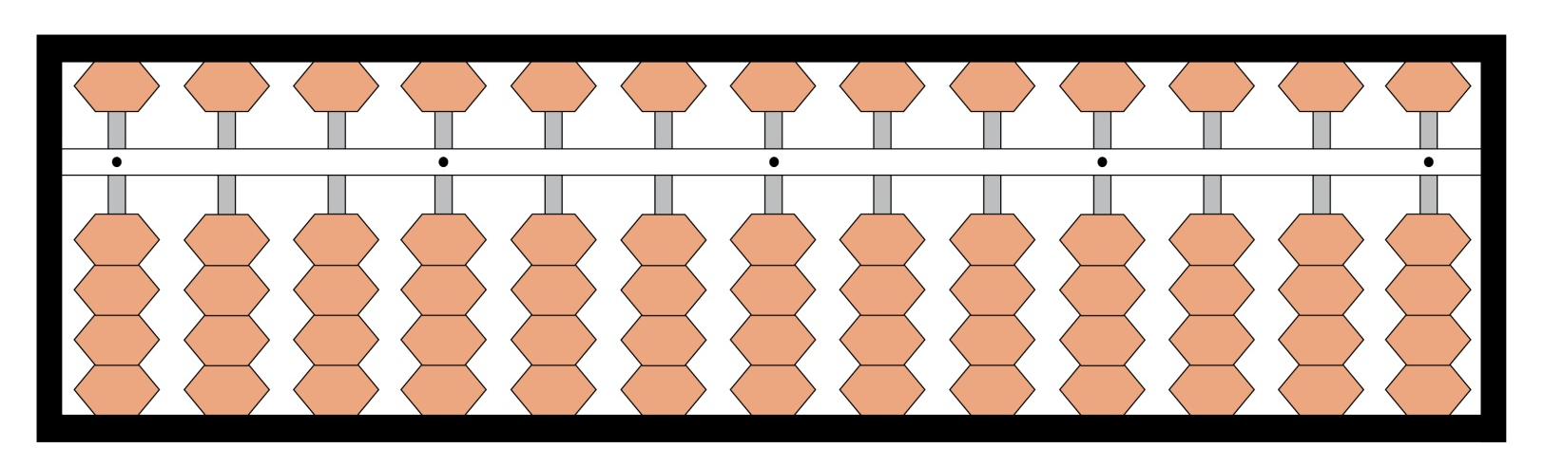
Reading soroban
0
If there are no beads touching the beam,
the soroban is at zero.
Notes:
• Tell the students that we only count the value of beads that are touching the beam.
• That means the soroban in this picture is empty or showing zero.
• Before you do anything on your soroban you always need to make sure it shows zero and there are no beads touching the beam.

Slide 6
Clearing the soroban
As easy as 1-2-3!
1. Using your left hand tilt the abacus towards you.
2. Place the abacus down again.
3. Using your right index finger, gently brush the top of the beam, pushing the top beads upwards.
Watch how to clear your soroban!
Notes:
Tell students: Each time you use your soroban, you should start at zero. To get to zero, you have to ‘clear’ the soroban.
• Watch the video to show how to clear your soroban and then practice ‘messing up’ and clearing it.
• In the video the person using the soroban says “ichi, ni, san” Can you guess what that means? Tell the students it means 1,2,3 in Japanese.

Slide 7
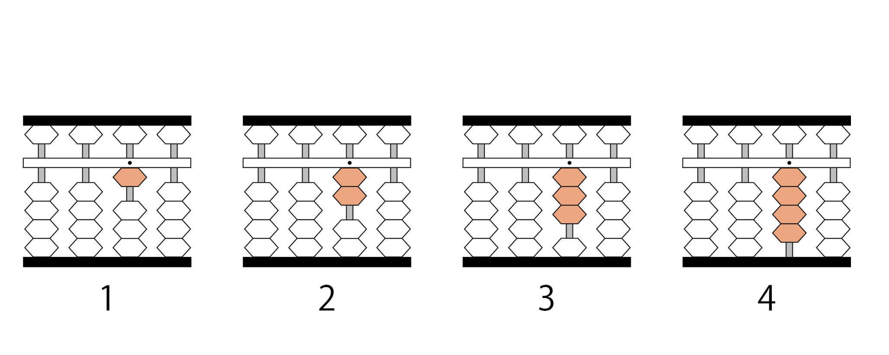
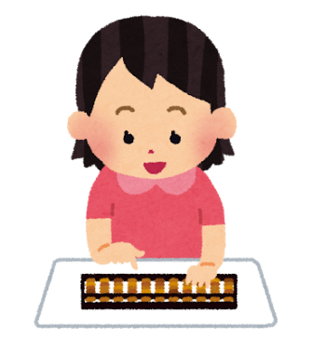
Numbers 1 - 4
O
O
O
O
Notes:
Tell students that each bead below the beam represent 1. Practice making 1 – 4.
Point out the letter above the digit rods. Explain that O is for Ones and make it clear that the ones are on the same digit rod as the position marker.
Image: https://www.irasutoya.com/2014/04/blog-post_8758.html

Slide 8
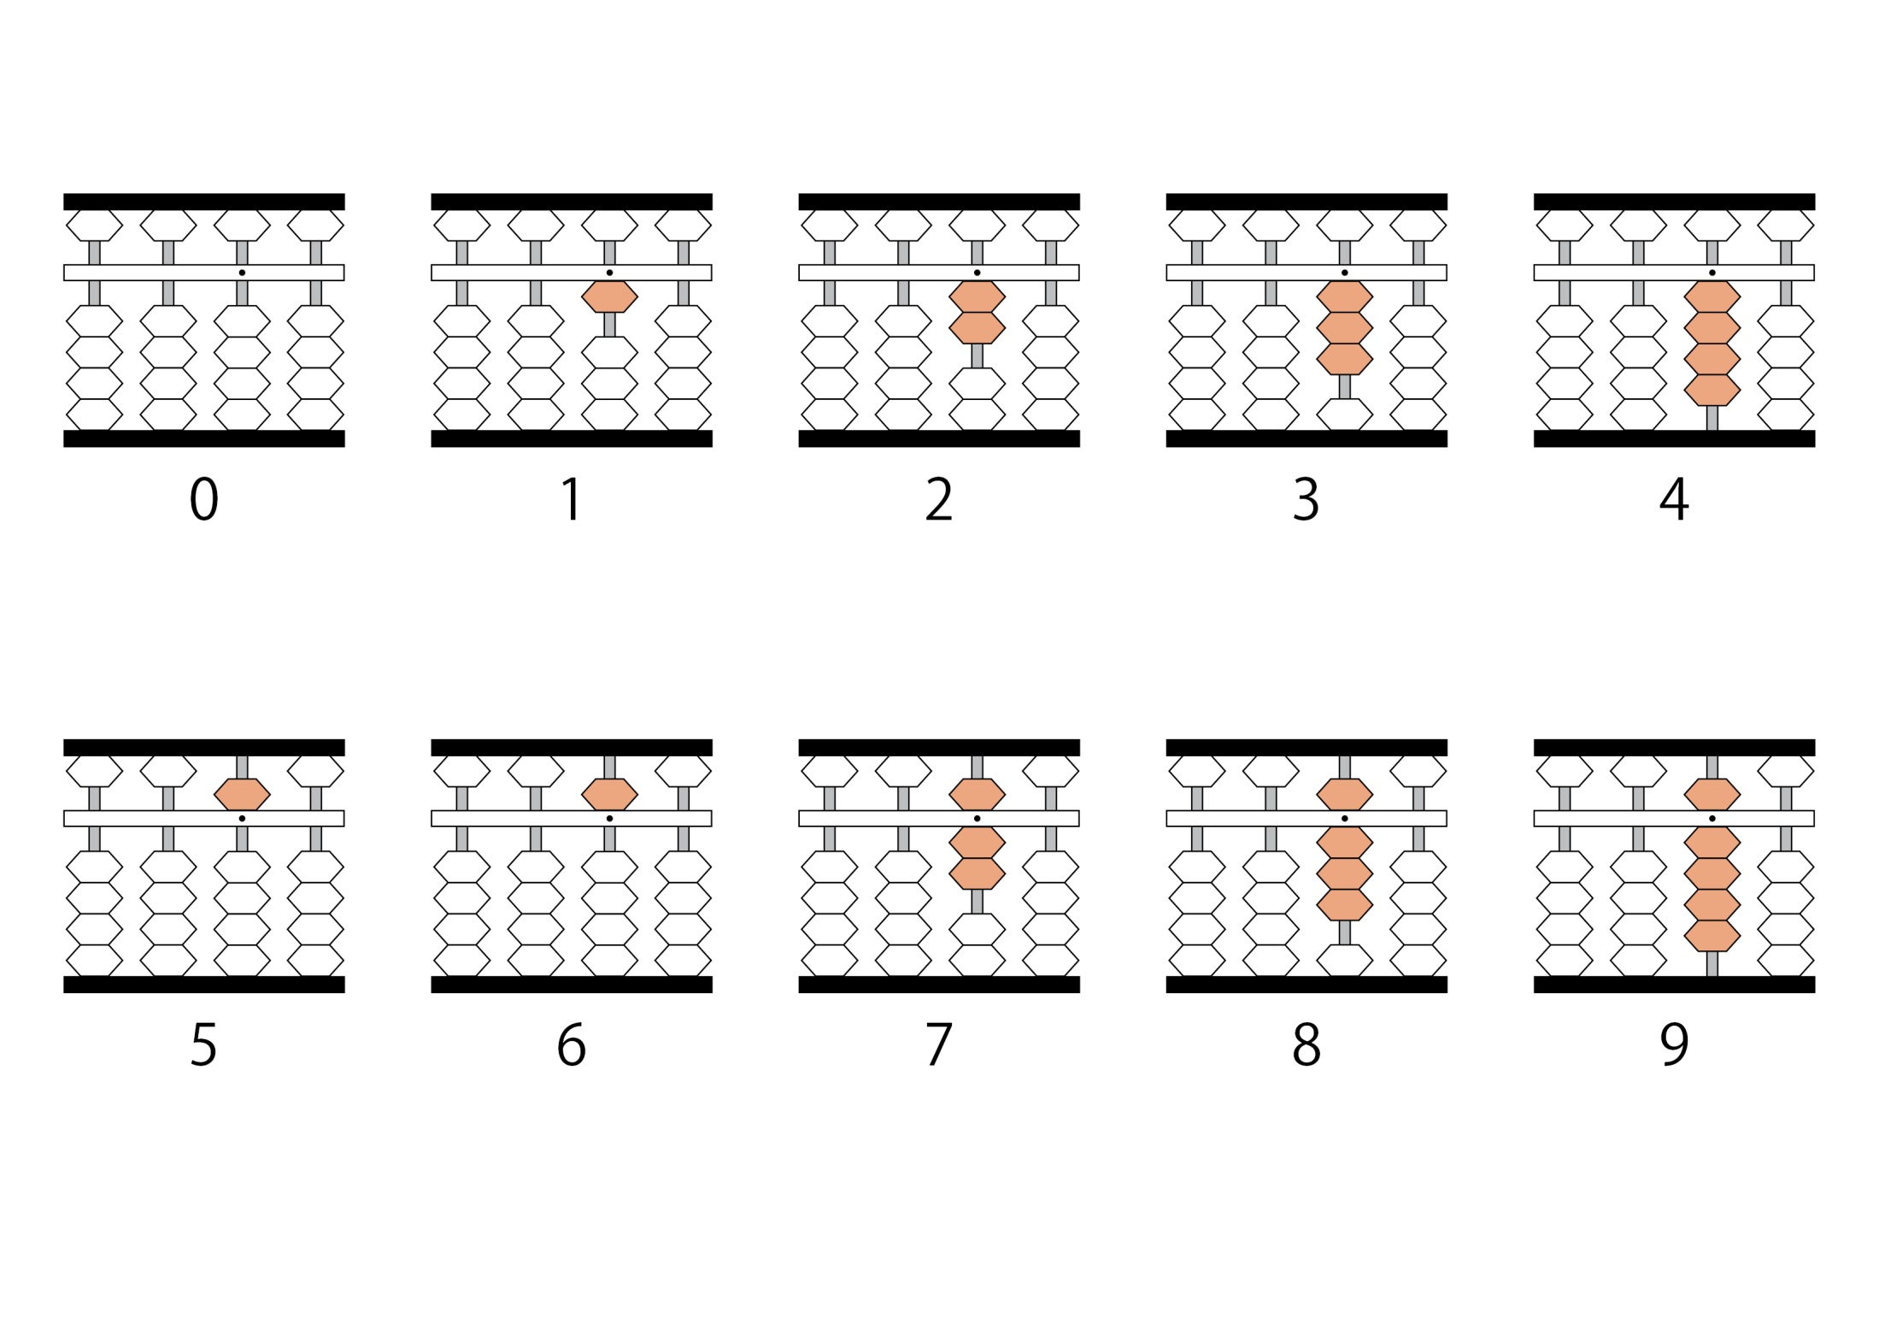
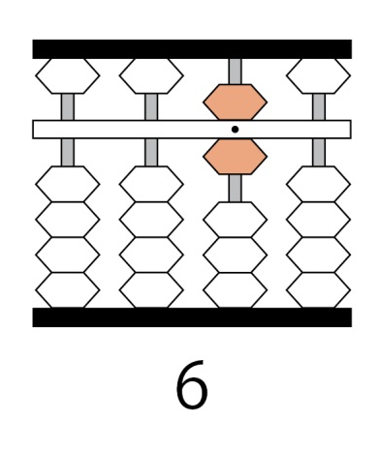
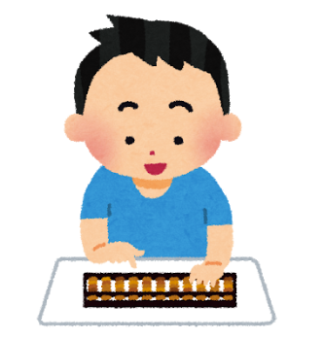
Numbers 5 - 9
O
O
O
O
O
5 + 1
5 + 2
5 + 3
5 + 4
Notes:
• Tell students that beads above the beam represent 5. Practice making numbers 1-9 on the soroban.
**You can leave this slide up as a reference or hide it if you think the students have mastered it.
Image: https://www.irasutoya.com/2013/09/blog-post_2557.html

Slide 9
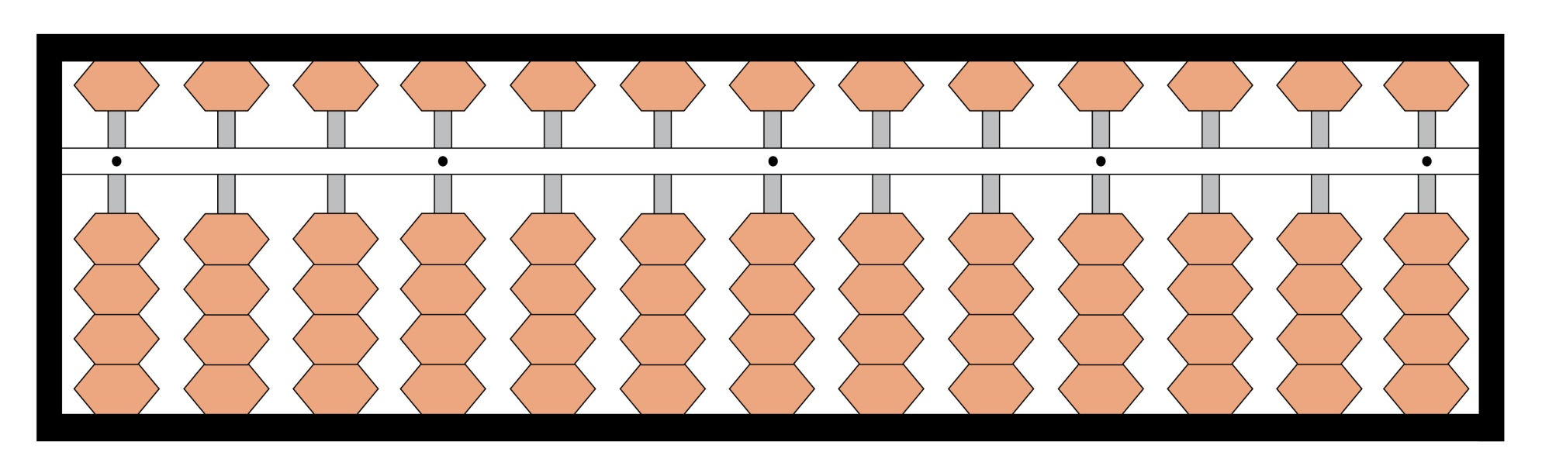
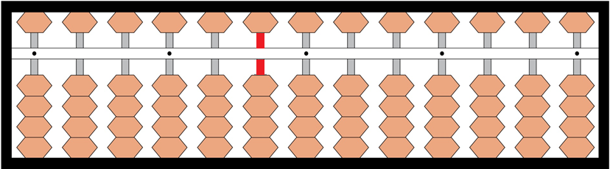
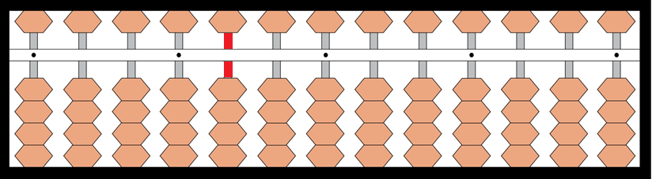
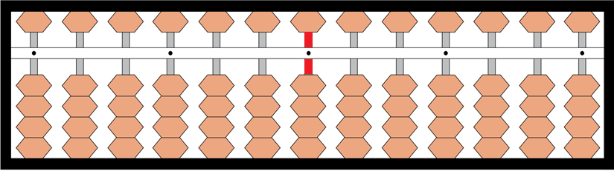
Larger numbers
H
T
O
Notes:
• Check understanding of place value on the soroban.
• Point to the digit rod showing the position marker in the middle of the soroban and see if they can correctly identify the rods for ones, tens and hundreds.
Image: https://www.irasutoya.com/2013/09/blog-post_2557.html

Slide 10




This resource was made by Lee Blowers, Tomoko Hoult, Kimie Markarian in collaboration with The Japan Society
The Japan Society
13/14 Cornwall Terrace, London NW1 4QP
Tel: 020 7935 0475
Email: education@japansociety.org.uk
www.japansociety.org.uk
Follow us on:
@japansocietylon
@JapanSocietyLondon

