Slide 1

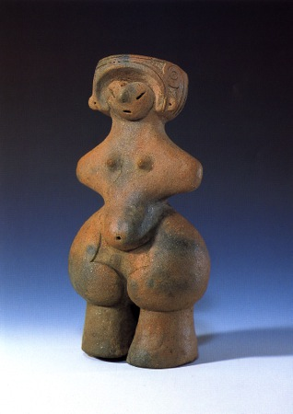
Starter
Today, you are going to make your dogu figure.
Be ready to answer the following starter questions:
Where does clay come from?
Have you ever used clay or salt dough before?
What tips do you have for success?
Notes:
Ask pupils the following questions and get them to discuss in pairs or small groups.

Slide 2
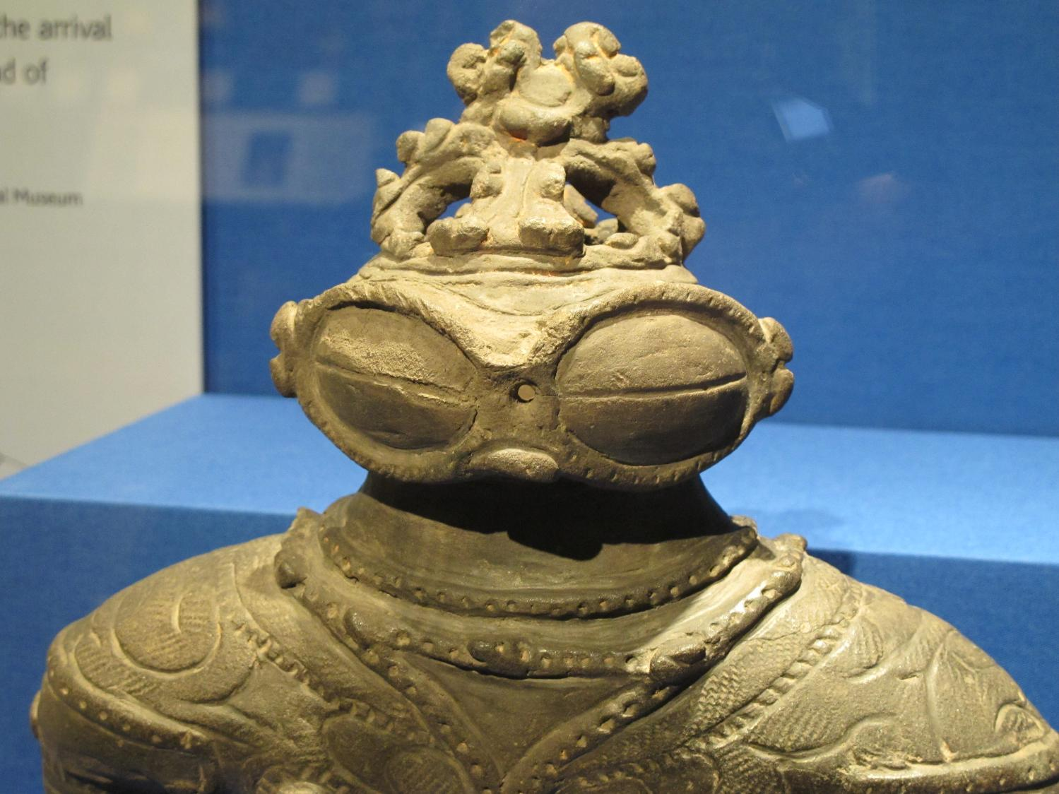

4: Create a Dogu
Notes:
Teacher’s Notes
Image of dogu from Wikimedia Commons: https://upload.wikimedia.org/wikipedia/commons/5/5e/Dogu_jomon_period_japan.jpg

Slide 3

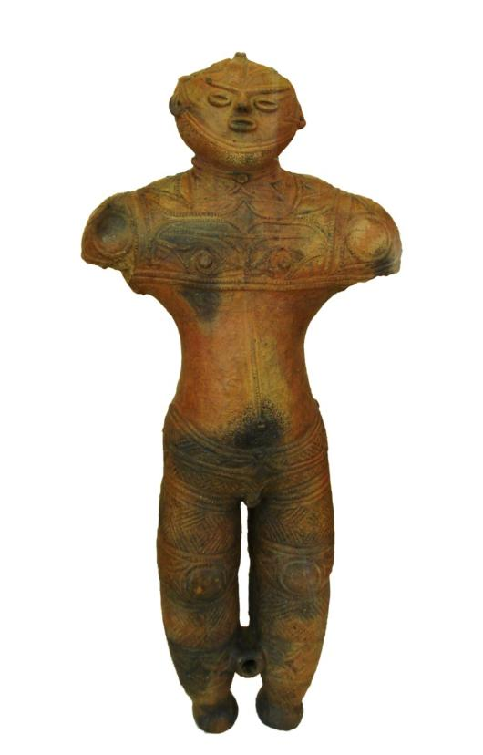
Dogu 土偶
Learning Objective:
Construct a 3D figurine and apply the pattern according to your design, inspired by your research.

Slide 4
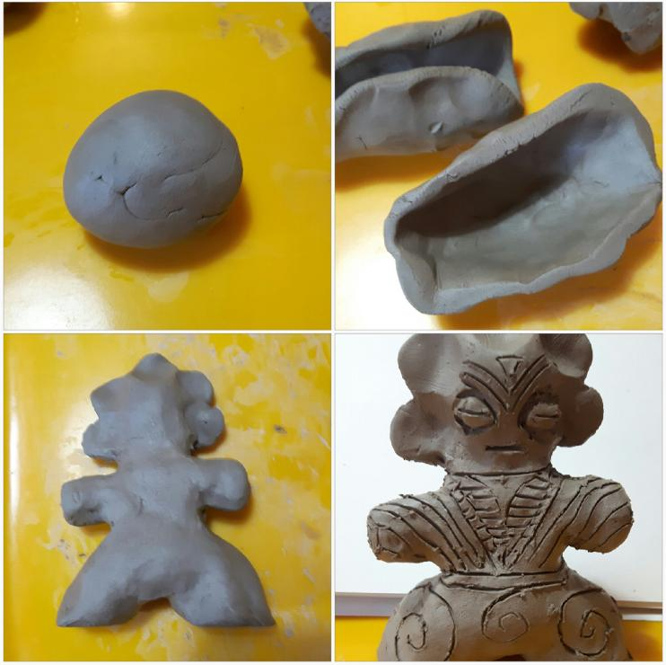
Making your Dogu
©J Buchanan and K Montague in collaboration with The Japan Society
© The Japan Society (2025)
Notes:
You may need to revisit demonstrations from the previous lesson and go over how to construct a figure.
If using clay, remind students they shouldn’t be solid/need to have bubbles of air inside or they will explode!
Build techniques: thumb pot, slab building, coil building
Discuss where clay comes from, why it was used
If clay is not available salt dough is a good alternative, although it does tend to be softer and more difficult to create fine marks. This can be cured in the oven or microwave.

Slide 5

Extension Activity 1
Imagine you are living in ancient Japan during the time dogu were originally made.
Activity: Write a short story about receiving your dogu and illustrate it with drawings.
Who gave you the dogu?
Why was it given to you?
How did it make you feel?
Emoji designed by OpenMoji, License: CC BY-SA 4.0
© The Japan Society (2025)

Slide 6

Extension Activity 2
The Dogu figure continues to influence Japanese artists even today.
In fact, the modern Pokémon characters, Baltoy and Claydol, were created and inspired by Dogu.
Activity: Redesign your character as a Pokémon using bright colours.
What powers or characteristics will it have?
Write a story about finding your character.
Emoji designed by OpenMoji, License: CC BY-SA 4.0
© The Japan Society (2025)
Notes:
Search for images of the Pokemon characters Baltoy and Claydol to show students
News article about the Pokemon-Dogu links: https://japantoday.com/category/features/lifestyle/first-ever-pokemon-manhole-covers-installed-in-downtown-tokyo

Slide 7




This resource was authored by J Buchanan and K Montague in collaboration with The Japan Society
The Japan Society
13/14 Cornwall Terrace, London NW1 4QP
Tel: 020 7935 0475
Email: education@japansociety.org.uk
www.japansociety.org.uk
Follow us on:
@TheJapanSociety
The Japan Society
©J Buchanan and K Montague in collaboration with The Japan Society
© The Japan Society (2025)

