Slide 1
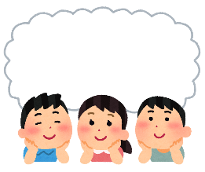

Starter
Think about the questions below and discuss them with a partner or in a group...
What food do people like to eat during winter in the UK?
What is your favourite meal to eat in winter, and why?
What holidays do we celebrate during winter?
© The Japan Society 2025
Notes:
Teacher’s Notes
Ask pupils to discuss the questions on the slide with a partner or in a group. Ask pupils if they can think about what today’s lesson might be about based on these questions.
Illustration from Irasutoya.

Slide 2
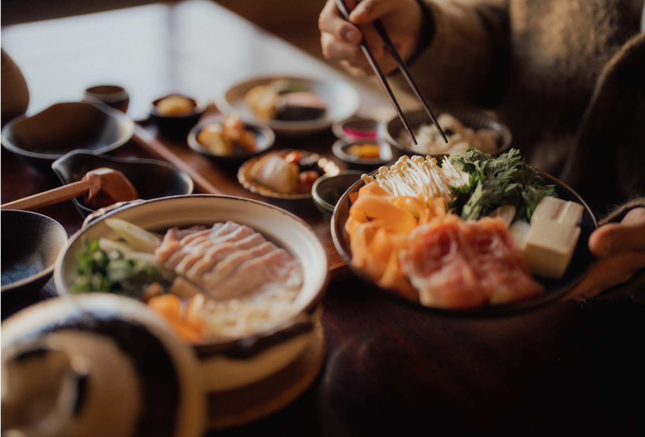

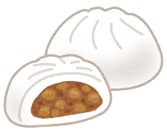
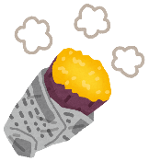
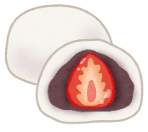
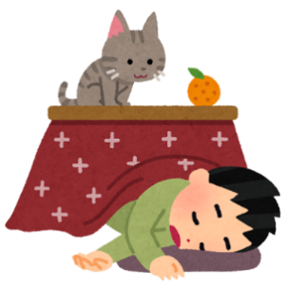
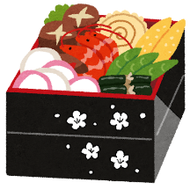

Winter Food
in Japan
© The Japan Society 2025
Notes:
Teacher’s Notes
Introduce today’s topic – Winter Food in Japan.
Title slide image- ©Matsu via Canva.com
Illustrations from Irasutoya.

Slide 3
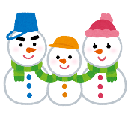
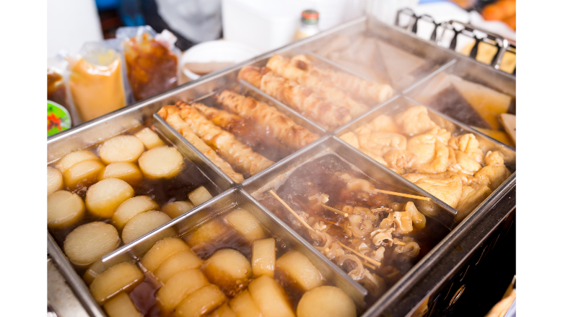
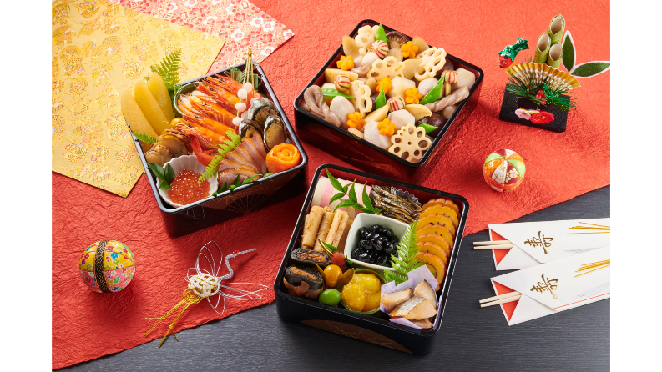
Learning Objective
To learn about popular foods and seasonal dishes associated with winter and winter celebrations in Japan.
© The Japan Society 2025
Notes:
Teacher’s Notes
Introduce the Learning Objectives.
Images: Oden - ©Leung Cho Pan via Canva.com and Osechi - ©Aflo Images via Canva.com
Illustration from Irasutoya.

Slide 4
Key Words
Fuyu (winter)
Seasonal
Celebration
Christmas
Oshogatsu (New Year)
Hemisphere
© The Japan Society 2025
Notes:
Teacher’s Notes
Introduce this lesson’s key words – do pupils know what these words mean?
Illustration from Irasutoya.

Slide 5
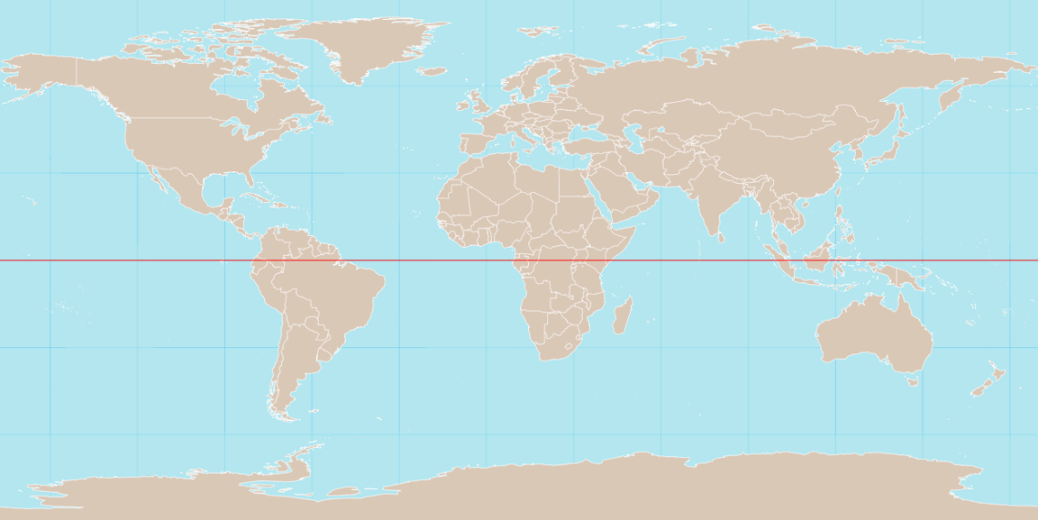
Winter
In the UK, we consider the winter months to be from December to February. The weather tends to be colder at this time in the northern hemisphere.
northern hemisphere
UK
southern hemisphere
© The Japan Society 2025
Notes:
Teacher’s Notes
Challenge: Ask pupils if they can point out on this map where Japan is. What are Japan’s neighbouring countries?
If it is winter in the northern hemisphere from December to February, what season would it be in the southern hemisphere?
Image from Wikimedia Commons: https://commons.wikimedia.org/wiki/File:World_map_with_equator.svg

Slide 6
Winter
Japan is also in the northern hemisphere, so it can also be cold from December to February...
northern hemisphere
UK
Japan
southern hemisphere
© The Japan Society 2025
© The Japan Society 2025
6
Notes:
Teacher’s Notes
Challenge: Ask pupils whether they think Japan’s climate/weather similar to the UK? Why do they think that? They can use the map of the world to help justify their reasoning.
Image from Wikimedia Commons: https://commons.wikimedia.org/wiki/File:World_map_with_equator.svg

Slide 7
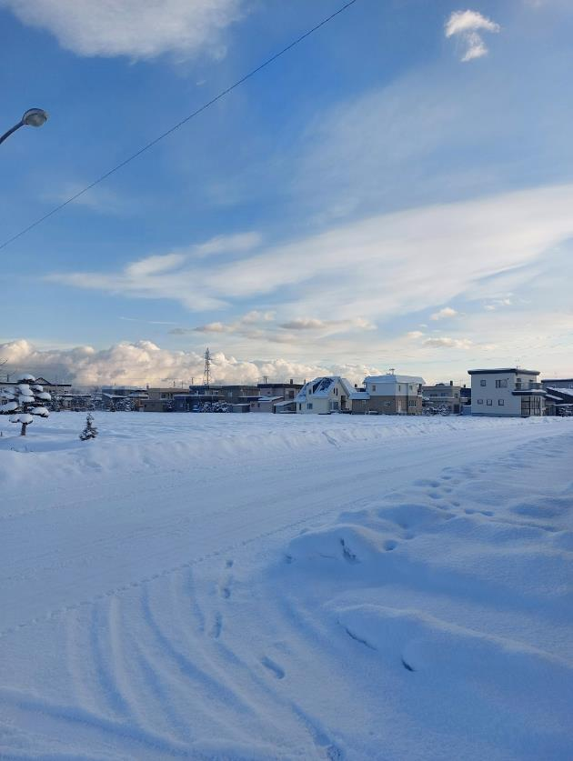
Winter
In some northern parts of Japan, it can especially get very snowy and very cold.
The temperatures here will regularly drop below 0 degrees Celsius during winter!
© The Japan Society 2025
Notes:
Teacher’s Notes
Show pupils the images on the slide. Remind pupils that it is only in certain areas of Japan (mainly in the north; such as Hokkaido) that experience snowfall like this – not everywhere in Japan experiences this much snow or this level of cold!
Hokkaido is the most northern island in Japan.
Photo taken in Yoichi, Hokakido.

Slide 8
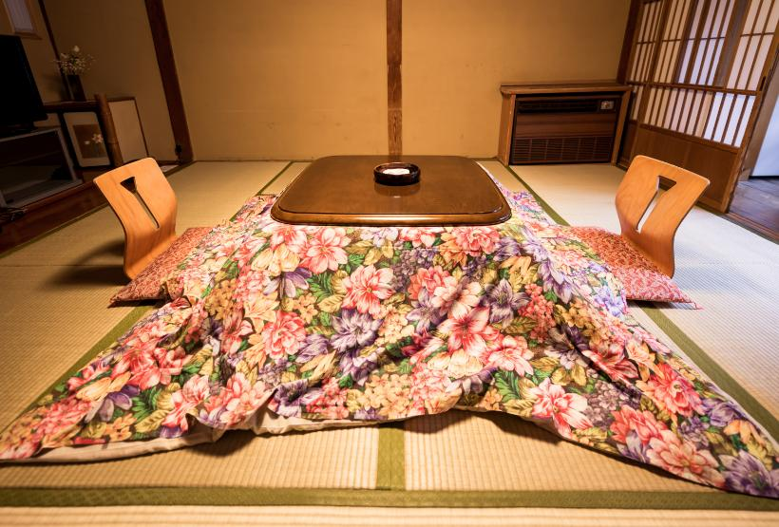

Staying warm
Because winter can be so cold, people stay warm by enjoying hot, warming meals at home - especially whilst sitting under a kotatsu!
The blankets help to trap the heat
Underneath the table is a small heater
How do you keep warm during winter?
© The Japan Society 2025
Notes:
Teacher’s Notes
Click on the slide to reveal the arrows and information about the kotatsu. Before doing so, ask pupils if they know what a kotatsu is/if they have seen one before? Do we have or use anything similar to this in the UK in order to keep warm during the winter?
Kotatsu/Japanese room - ©SmokedSalmon from Getty Images via Canva.com

Slide 9
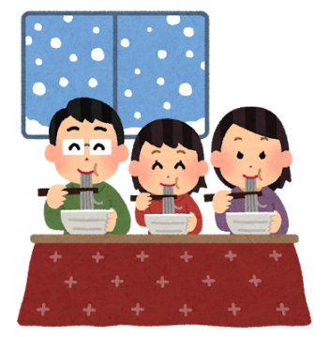
Winter Food
Discuss with a partner or in a group:
What types of meals and dishes do you think would be popular to eat during winter time in Japan?
© The Japan Society 2025
Notes:
Teacher’s Notes
Before starting the discussion, you could ask pupils if they know of any popular Japanese dishes already? What kinds of food do people eat in Japan?
Then, ask pupils to discuss in pairs or groups the question on the slide.
Illustrations from Irasutoya.

Slide 10
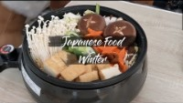
Video
Watch the video all about popular food people like to eat in Japan during winter time.
© The Japan Society 2025
Notes:
Teacher’s Notes
If the above link and video are not working, you can find access the video from the resource page - https://www.japansociety.org.uk/resource?resource=115

Slide 11
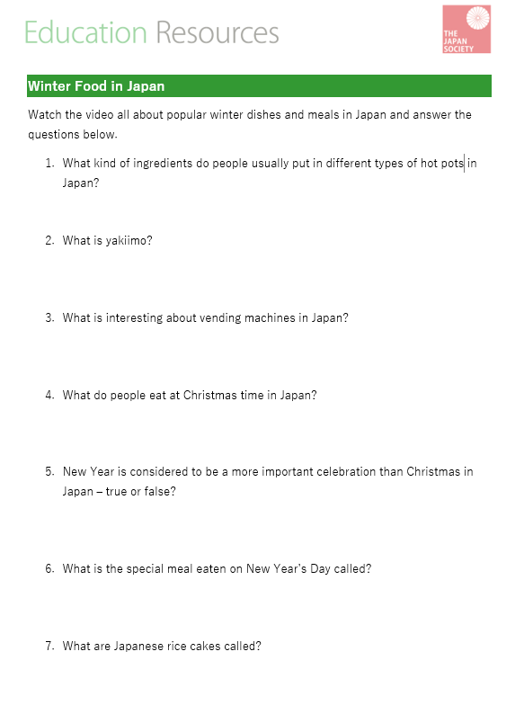
Activity 1
Watch the video again.
This time, make notes on the worksheet and answer the questions.
© The Japan Society 2025
Notes:
Teacher’s Notes
Hand out the activity worksheet. You may need to rewatch the video once or twice to allow pupils to make notes and then write down their answers properly.
See slides 11-19 for more images and explanations of each of the dishes discussed in this video.

Slide 12
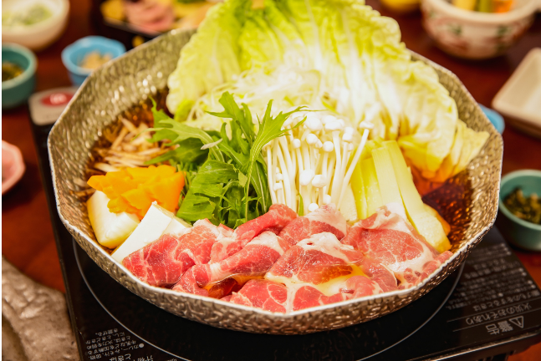
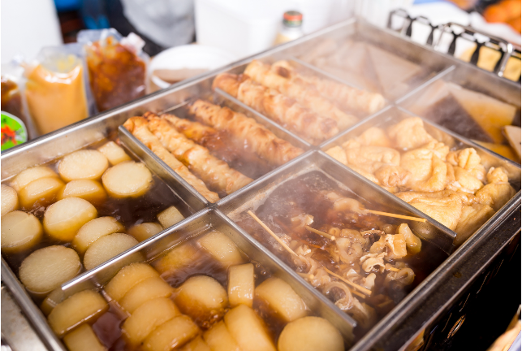
Nabe 鍋 - hotpot
A variety of hotpot dishes. People cook various ingredients, including meat and vegetables, in a boiling pot to share and eat together.
shabu shabu
oden
© The Japan Society 2025
Notes:
Teacher’s Notes
There are different varieties of nabe – shabu shabu (left) and oden (right). Have pupils tried any similar types of hotpot dishes at home before too?
Images: Shabu shabu - ©Aflo Images via Canva.com and Oden - ©Leung Cho Pan via Canva.com

Slide 13
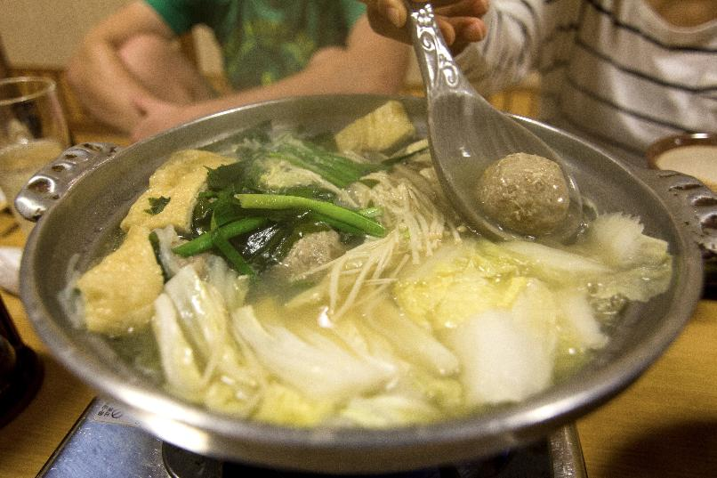
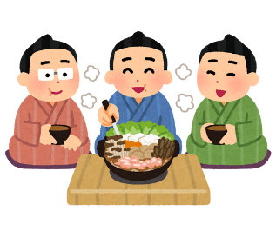
Chankonabe ちゃんこ鍋
Chankonabe is a popular hotpot dish that is most commonly eaten by sumo wrestlers all year round – not just during the winter time!
© The Japan Society 2025
Notes:
Teacher’s Notes
Chankonabe contains meat and vegetables, such as chicken, seafood, tofu, bok choy, and mushrooms. The wrestlers eat it in large quantities to help them gain weight and grow strong.
Image from Wikimedia Commons: https://commons.wikimedia.org/wiki/File:Chankonabe.jpg
Illustration from Irasutoya.

Slide 14
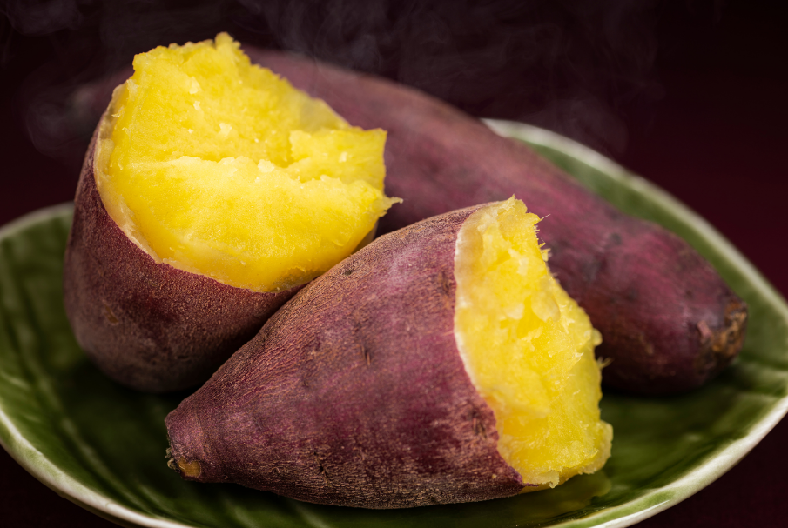
Yakiimo 焼き芋
Baked sweet potatoes are popular snacks during the autumn and winter months in Japan.
© The Japan Society 2025
Notes:
Teacher’s Notes
Ask pupils to look at the image on the slide – do these sweet potatoes look similar to the ones we would usually see in supermarkets in the UK?
Image: ©kuppa_rock via Canva.com

Slide 15
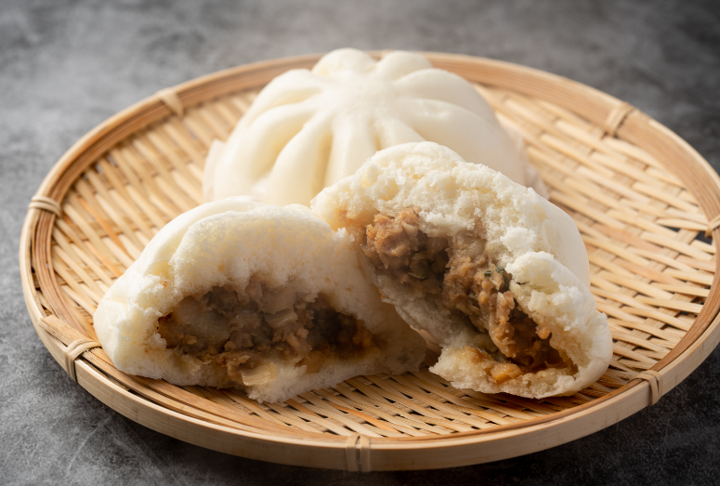
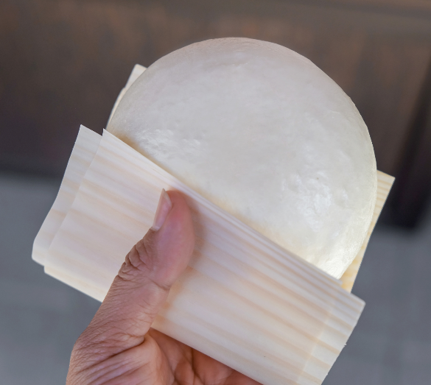
Nikuman 肉まん
Nikuman are steamed buns filled with pork, vegetables, and other ingredients. You can often buy these in konbini (convenience stores).
© The Japan Society 2025
Notes:
Teacher’s Notes
There are many different types of steamed buns you can purchase at konbini. Pizaman are similar to nikuman – but they are filled with tomato sauce and cheese, similar to a pizza!
Images: ©Hanasaki via Canva.com and ©Kanawa_Studio via Canva.com

Slide 16
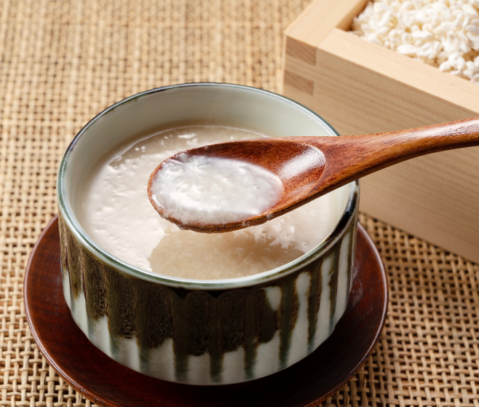
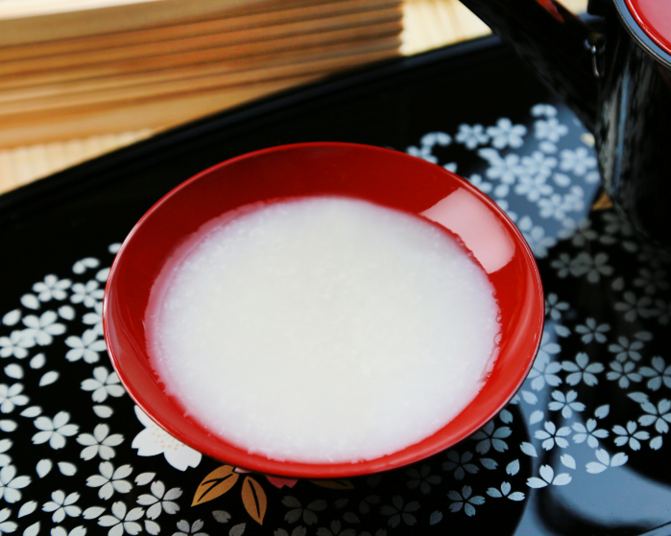
Amazake 甘酒
A sweet traditional Japanese drink that is made from fermented rice, often served hot.
© The Japan Society 2025
Notes:
Teacher’s Notes
If necessary, explain what the word “fermented” means.
Images: ©masa44 via Canva.com and ©yasuhiroamano via Canva.com

Slide 17
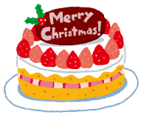

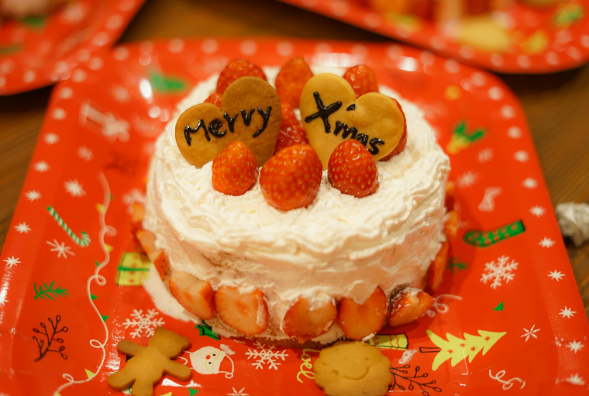
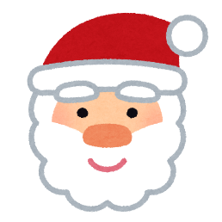
Christmas cake
In Japan, people celebrate Christmas with delicious Christmas cakes – sponge cakes topped with whipped cream frosting and decorated with strawberries!
© The Japan Society 2025
Notes:
Teacher’s Notes
In the video, the narrator calls these cakes shotokeki (shortcake) – Ask pupils if they can guess what this word sounds similar to in English.
What kinds of Christmas desserts do we have in the UK? Is this similar to any of our desserts?
Image: ©Aflo Images via Canva.com
Illustrations from Irasutoya.

Slide 18
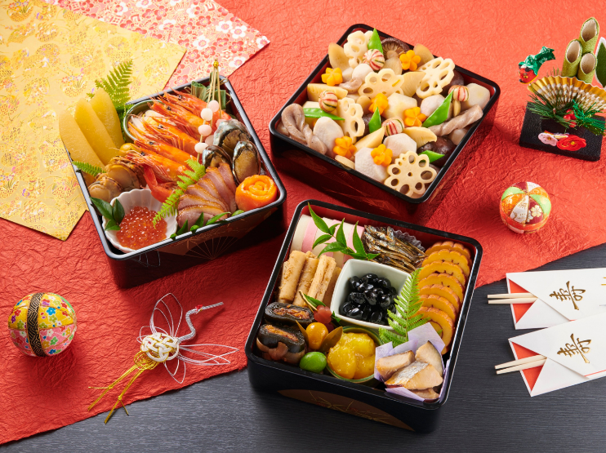
Osechi おせち料理
New Year is the most important holiday of the year in Japan, and people eat special dishes to celebrate it. These are called osechi.
© The Japan Society 2025
Notes:
Teacher’s Notes
Osechi dishes vary from region to region, and are typically served in multi-tiered boxes. The different dishes within the boxes symbolise different meanings thought to bring good and luck and fortune for the coming year!
See our New Year resources to learn more about some of the deeper meanings associated with osechi dishes and to learn more about Japanese New Year –
https://www.japansociety.org.uk/resource?resource=11 New Year’s Celebrations
https://www.japansociety.org.uk/resource?resource=107 New Year and Osechi Food
Image: ©Aflo Images via Canva.com

Slide 19
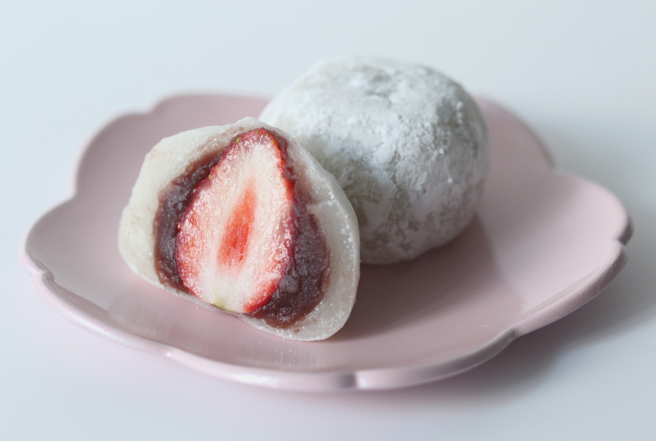
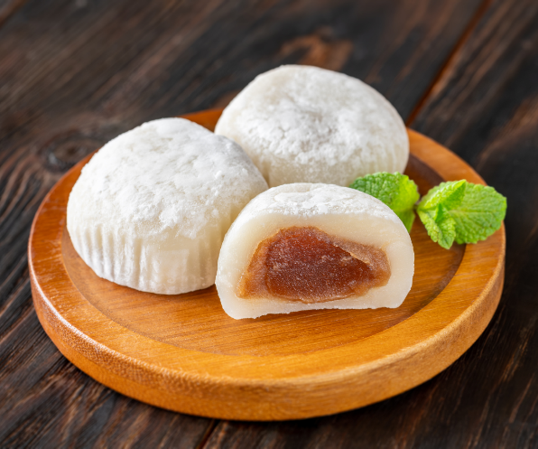
Mochi もち
Mochi are Japanese rice cakes. The rice used to make mochi is pounded into a paste before being moulded into a rounded shape.
© The Japan Society 2025
Notes:
Teacher’s Notes
There are many different types of mochi. For example, the mochi on the left is referred to as daifuku, and contains a strawberry in the middle. Mochi sometimes contains fillings, such as red bean paste.
Ask pupils if they have tried mochi before – it has become a popular snack outside of Japan, too! If they have, you could ask them to describe what it tasted like/what the texture was like – it can be quite unusual to those who have not tried it before!
Images: ©Aflo Images via Canva.com and ©Oleksandr Prokopenko via Canva.com

Slide 20
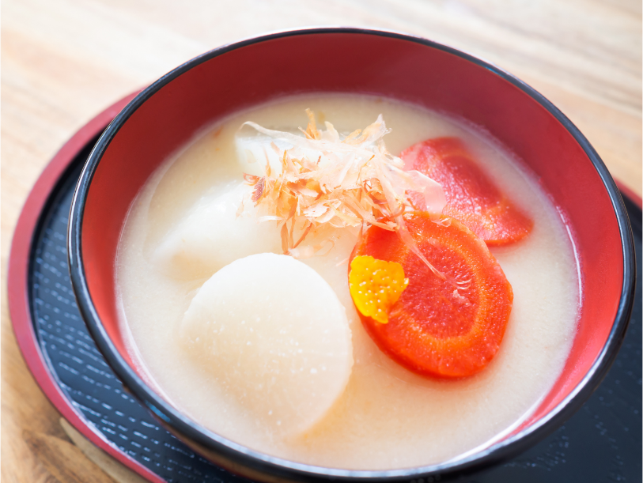
Ozoni お雑煮
A traditional Japanese soup containing mochi that is typically eaten during the New Year celebration period.
© The Japan Society 2025
Notes:
Teacher’s Notes
Ozoni often contains both mochi and vegetables. Pupils may have tried mochi before and expect that it is usually sweet, but it can also be used in savoury dishes, too.
Image: ©kaorinne via Canva.com

Slide 21
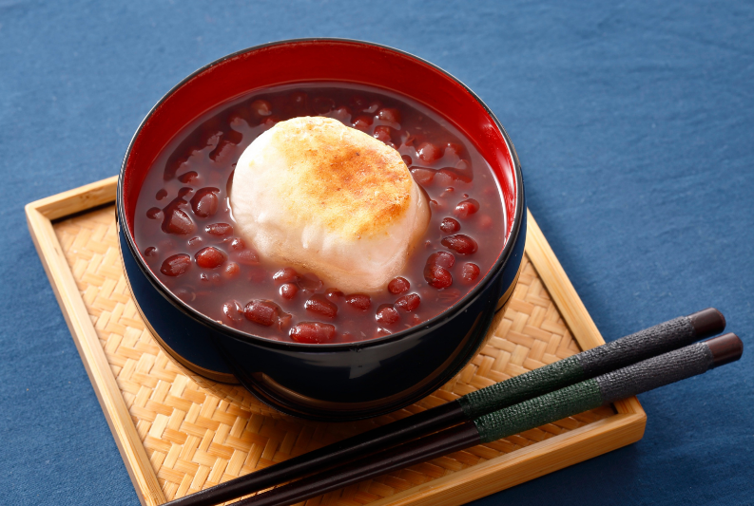
Zenzai ぜんざい
This is a traditional Japanese soup, made with sweet red beans and mochi. Zenzai is also usually eaten during the New Year’s celebrations.
© The Japan Society 2025
Notes:
Teacher’s Notes
Mochi is used in a lot of New Year’s dishes.
Red beans are known as adzuki beans in Japanese.
Image: ©Aflo Images via Canva.com

Slide 22
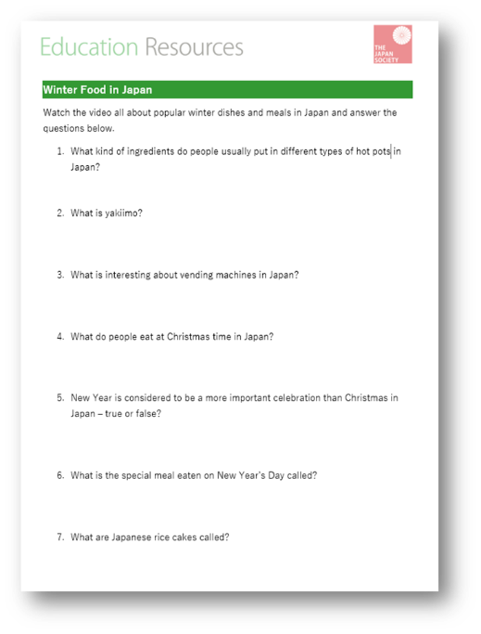

Answers
Now it’s time to check your answers!
© The Japan Society 2025
Notes:
Teacher’s Notes
Use the answer sheet to check the answers for the worksheet.
Illustration from Irasutoya.

Slide 23
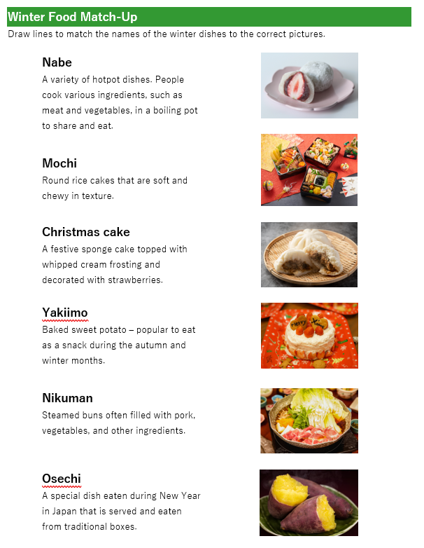

Activity 2
How much can you remember from today’s lesson?
Match up the words on the activity sheet to the correct picture.
© The Japan Society 2025
Notes:
Teacher’s Notes
If you want to challenge pupils, use the alternative version of the worksheet, where pupils must match up the word to the definition.

Slide 24
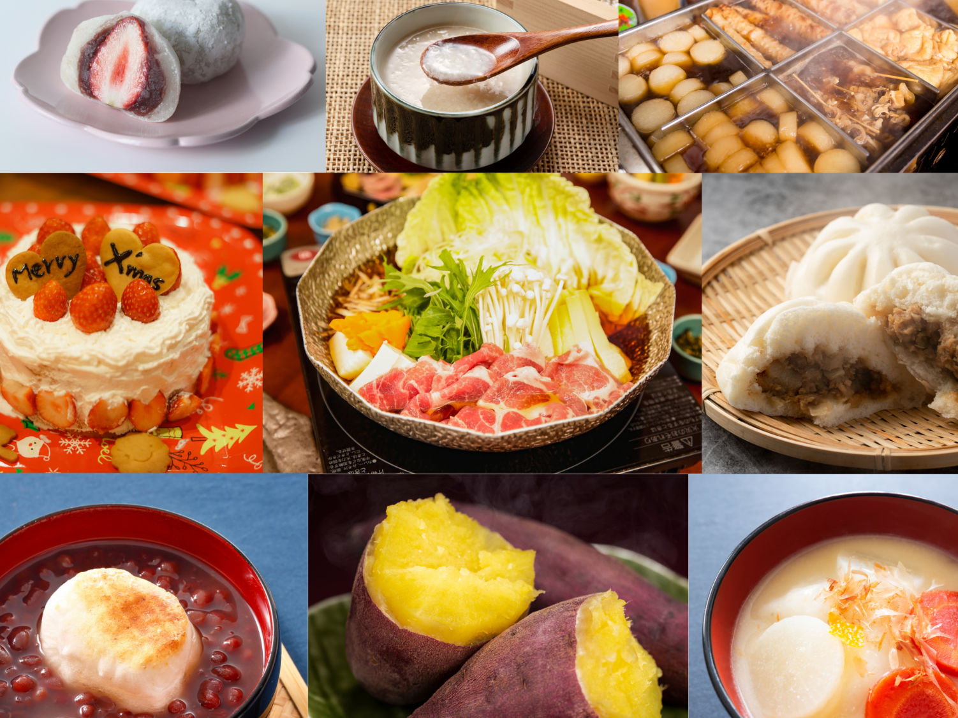
What food would you like to try?
© The Japan Society 2025
Notes:
Teacher’s Notes
What food would you like to try?
Collage of images- left to right, top to bottom:
©Aflo Images, ©masa44, ©Leung Cho Pan, ©Aflo Images, ©Aflo Images, ©Hanasaki, ©Aflo Images, ©kuppa_rock, ©kaorinne – all images via Canva.com

Slide 25
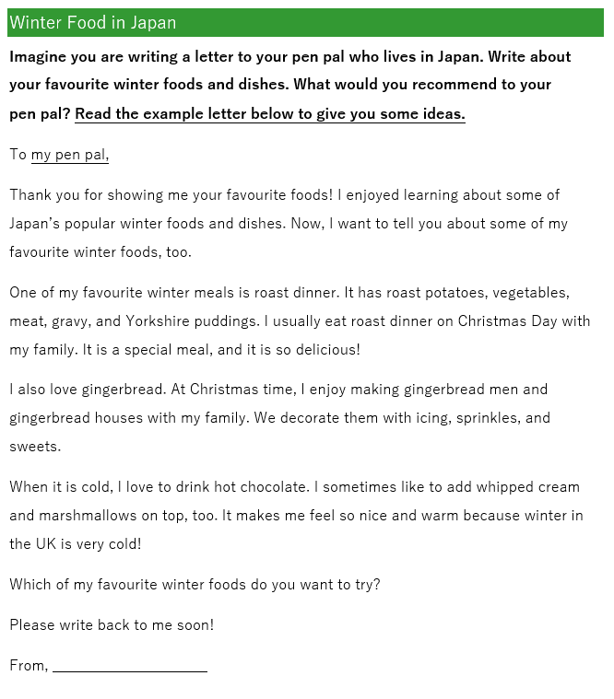

Extension
Imagine you are writing a letter to your pen pal who lives in Japan.
Write about your favourite winter food and meals.
What would you recommend to your pen pal?
© The Japan Society 2025
Notes:
Teacher’s Notes
The example letter as seen on this slide can be downloaded from the resource page on our website. You can feel free to share this with pupils beforehand so they know what sort of content their letter should cover/to give them some ideas.
Illustration from Irasutoya.

Slide 26


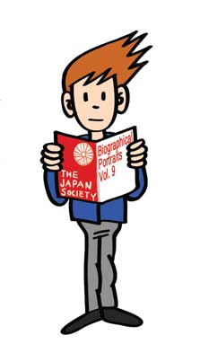




This resource was developed and created by
The Japan Society.
The Japan Society
13/14 Cornwall Terrace, London NW1 4QP
Tel: 020 7935 0475
Email: education@japansociety.org.uk
www.japansociety.org.uk
Follow us on social media:
@TheJapanSociety

