Slide 1
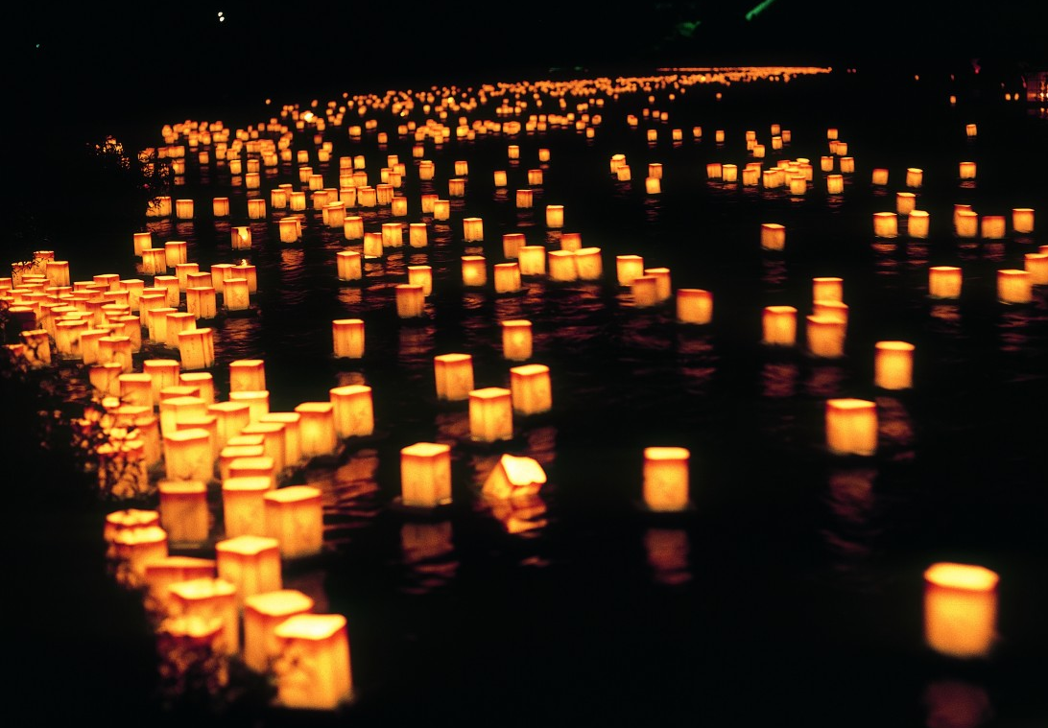

Obon
Notes:
Teacher’s Note
Pronunciation is Oh-Bon
Ask students
What can they see in the picture? Answer: Lanterns floating on water. We will learn about this soon.

Slide 2


About Obon
Obon is one of the most important Japanese festivals
It takes place in August and lasts 3 days
It is a time to celebrate your ancestors
お盆
Notes:
Tell students
Another important time in Japan is New Year’s.
The writing in the green box says ‘Obon’ in Japanese

Slide 3

The meaning of Obon
Obon is a Buddhist festival
It is said that the spirits of peoples’ ancestors
visit their families during Obon
People pray their loved ones who have passed away
are happy and at peace
Notes:
Tell students
For Japanese people this is a time to think about their loved ones and family members who have passed away.
Obon might seem like it should be a sad time, or that people may be afraid of the spirits but emphasise this isn’t the case.
It is a time to celebrate that spirits can be reunited with their families.

Slide 4
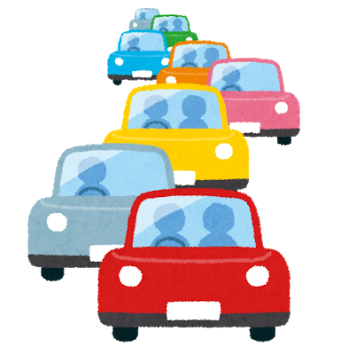
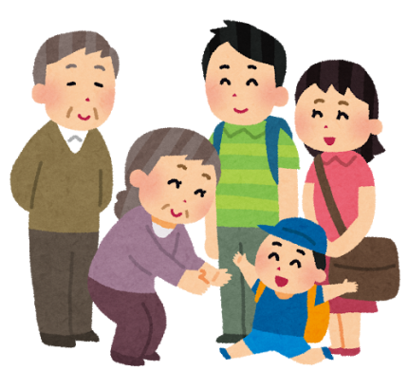
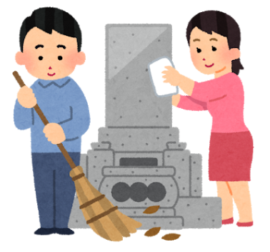
Getting Ready
There is lots to do before Obon, such as:
Travelling to see family
Cleaning the house and family graves
Preparing offerings to welcome the spirits
Notes:
Ask students
How would you get ready for a big festival? (Give prompts such as: How do you get ready for Christmas day?
Tell students
There are lots of things get ready before Obon.
Many people return to their home towns so public transport and roads are very busy.
Some will set up special altars/shelves at home where they display nice things as a symbolic offering to their loved ones who have died.

Slide 5
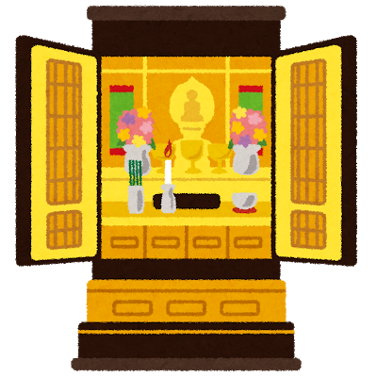
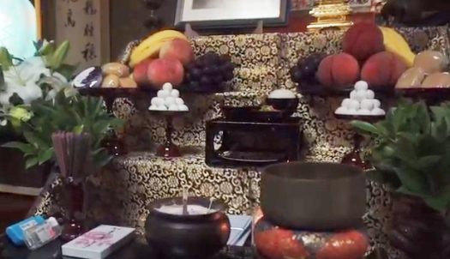
Offerings
Fruit, flowers and other food items
can be used as offerings
Notes:
Tell students
The picture shows a shelf set up for Obon.
At the top there might be a picture of family members.
This is a place where living family can pray for their loved ones, light incense for them, and leave nice things such as fruit and flowers.

Slide 6
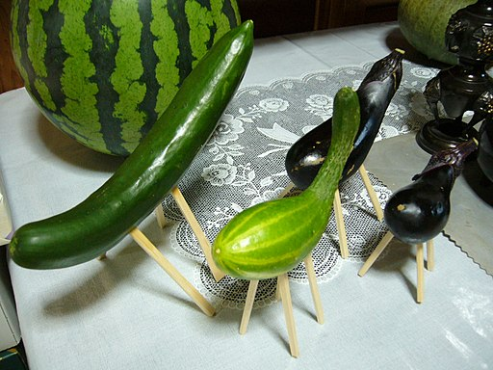

Offerings
These are called shoryo-uma
What do they look like?
They represent a horse and a cow
They are a symbol to help the spirits on their journeys
Notes:
Teacher’s note
Not everyone in Japan will make this kind of offering, or even have heard of it. There are always regional differences.
The pronunciation is show-rio-oo-ma
Tell students
Shoryo means ‘spirit’ and uma means ‘horse’. So this means “spirit horse”.
They are vegetables with cocktail sticks for legs, sometimes put as an offering on the altar/shelf during Obon.
The idea behind these are so ancestors can use the animals to make their journeys and maximise the time they have in this world with their relatives.
The cucumber ‘horse’ brings sprits back quickly and the aubergine ‘cow’ takes them away at a leisurely pace.
They should not be eaten after Obon.
Image is: https://commons.wikimedia.org/wiki/File:Syoryou-uma,obon,katori-city,japan.JPG

Slide 7
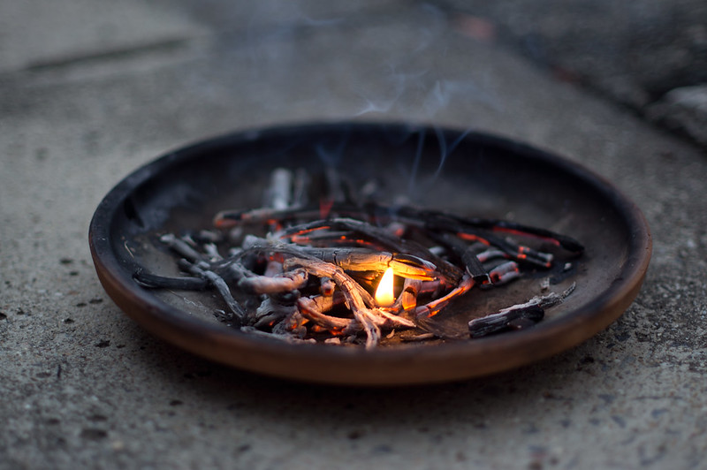

Welcoming Spirits
It is important that the spirits can find their way home
So people light small fires called mukaebi to welcome their ancestors
Notes:
Tell students
Mukae means “welcome” and bi means “fire” or “flame”

Slide 8
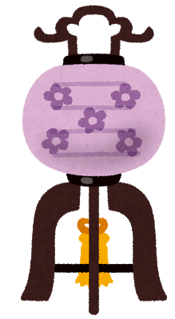
Welcoming Spirits
People might also light lanterns called chochin to guide them
Notes:
Tell students

Slide 9
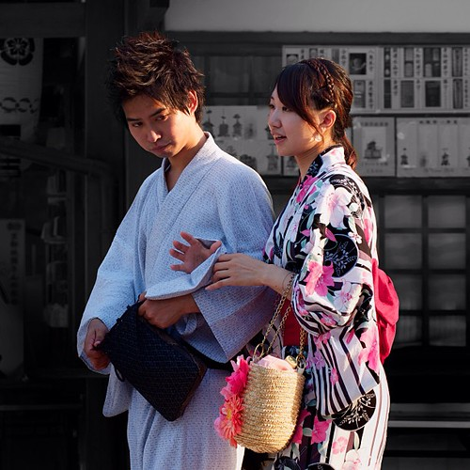
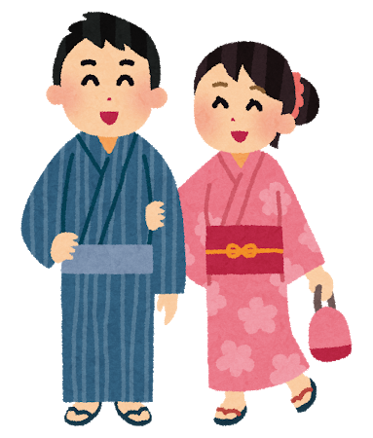
Celebrations
Many people attend outdoor celebrations during Obon
Lots of people will dress up in summer kimono called yukata
There might be fireworks at the festival too
Notes:
Tell students
Anyone can wear yukata.
We might associate fireworks with cold weather, but in Japan most firework displays are held in summer

Slide 10
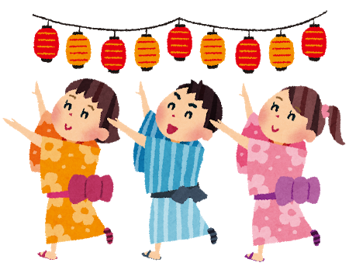
Celebrations
There is a special dance for Obon called Bon Odori
Each area may have its own dance, music and costumes
The dance is performed outside so people can watch or join in
Notes:
Teacher’s Notes
Odori means “dance”
Show students the dance in the Obon video after finishing the PPT

Slide 11
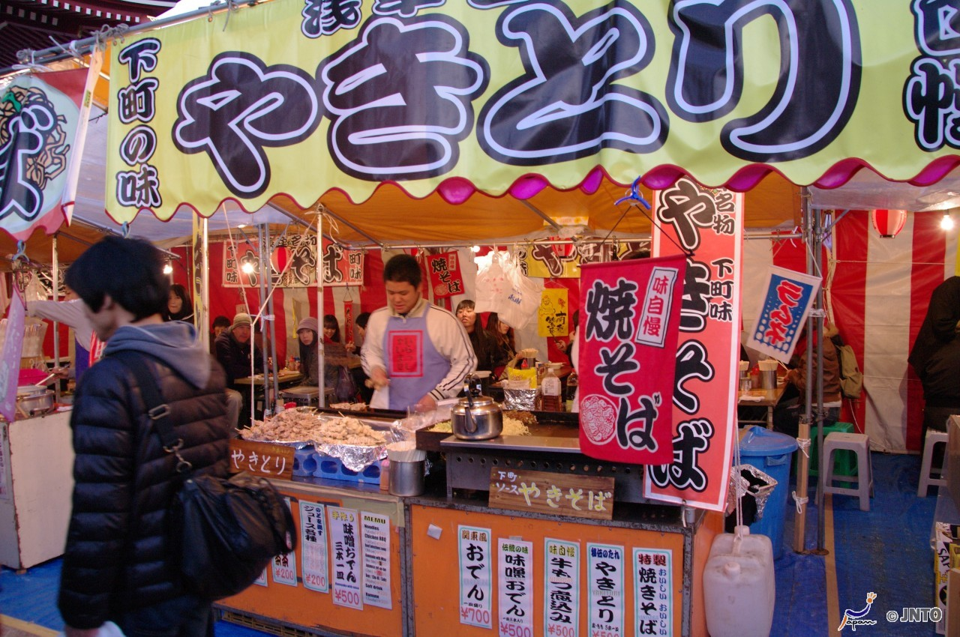
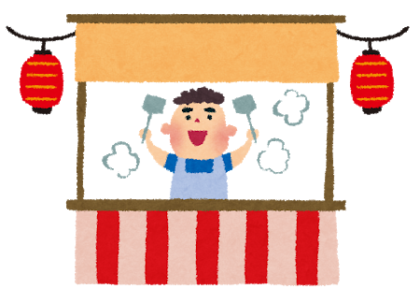
Festival Food
Food stalls are set up in the streets for festivals in Japan
They are called yatai
Notes:
Ask students
What are summer foods in the UK? What do you like to eat in summer?

Slide 12

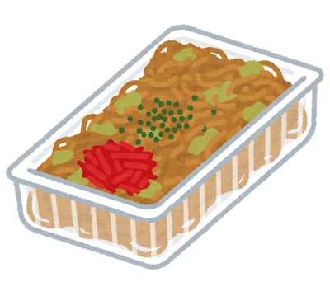
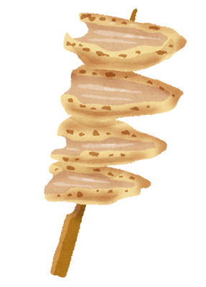
Festival Food
Some foods sold at yatai are:
Chicken Skewers
yaki-tori
Sweetcorn
tomoro-koshi
Fried noodles
yaki-soba
Notes:
Ask students
What are summer foods in the UK? What do you like to eat in summer?
Tell students
These are just some of the foods you can buy at a summer festival
Chicken skewers (Yacky-tory) is usually grilled chicken or meat, but can mean any skewered food.
Sweetcorn (tomoro-koshy) Sweetcorn brushed with sauce and barbequed.
Fried noodles (Yacky-so-bah) Noodles fried on a big hot plate with meat and vegetables and covered in a sweet sticky sauce

Slide 13
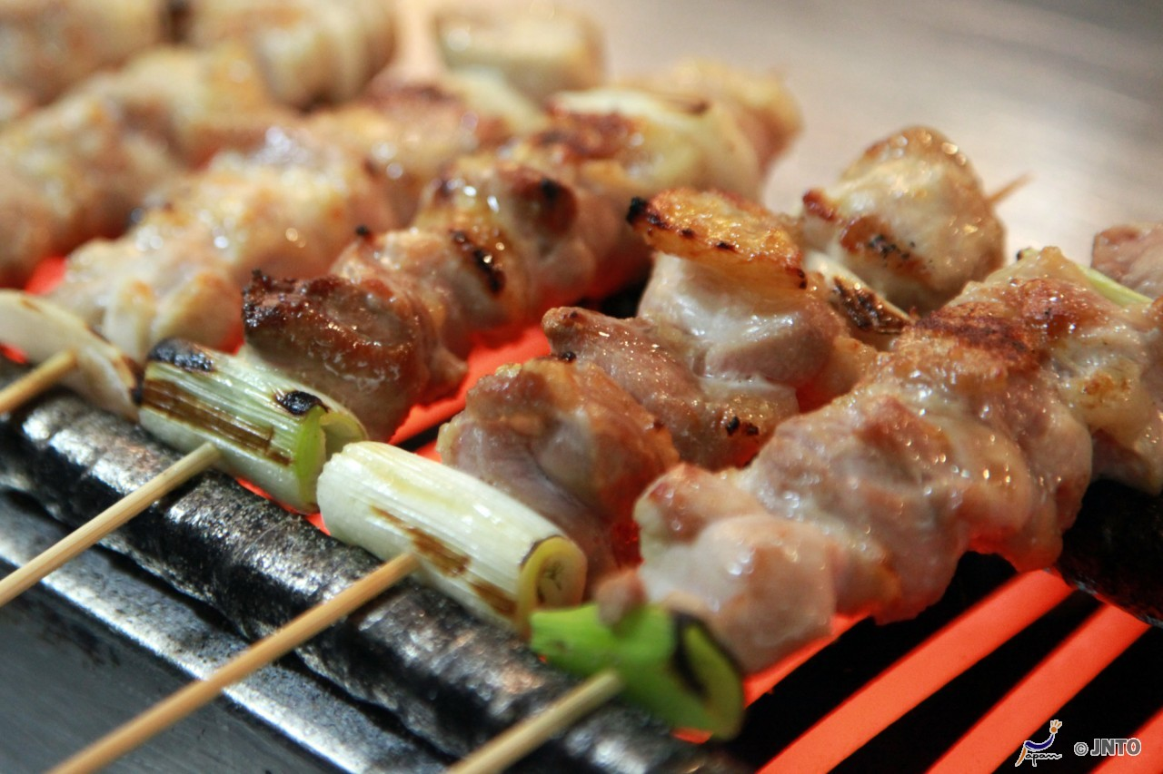

Slide 14
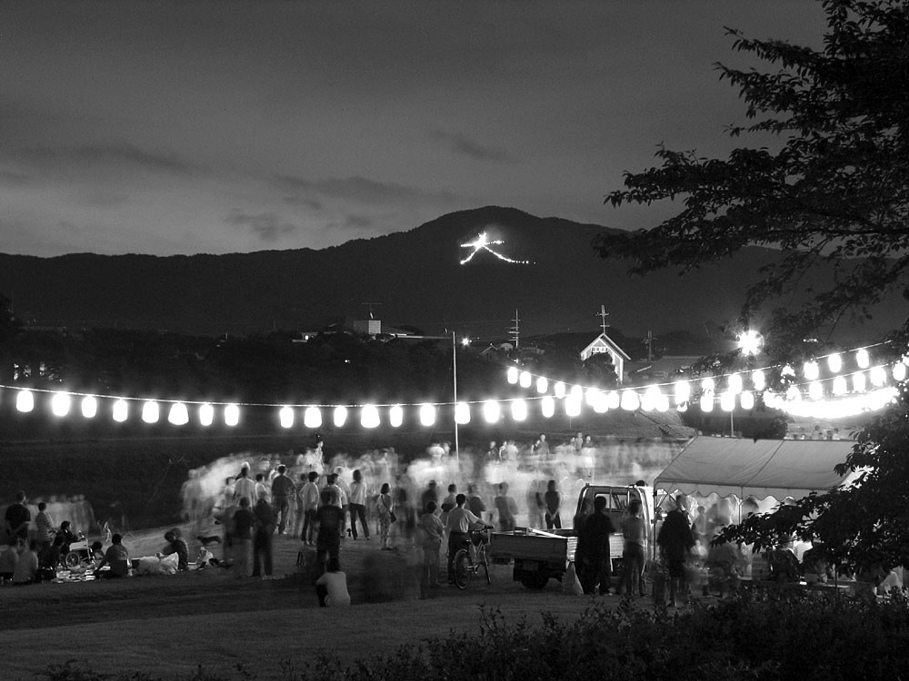
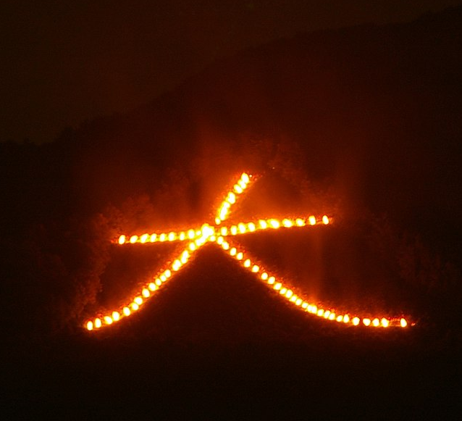
Saying Goodbye
At the end of Obon
people light fires again to see the spirits off
These fires are called Okuribi
Some areas have large bonfires which are famous
Notes:
Teacher’s Notes
Okuri means “to send off” and bi means “fire” or “flame”
The shape of this fire is a Japanese character. It means “big”.
Image 1 link: https://commons.wikimedia.org/w/index.php?curid=277172

Slide 15
Saying Goodbye
Some places have a special ceremony called Toro Nagashi
Lanterns are placed on water to guide the spirits home
Notes:
Teacher’s Notes
Toro is another word for lantern and nagashi means “to float”. So the ceremony means “floating lanterns”.
Again, not everywhere in Japan will hold this kind of ceremony.

Slide 16
Learn more
Let’s watch a video
about Obon
https://www.youtube.com/watch?v=kcNnWgeFJvo&t=7s

Slide 17
Obon Quiz
True
True
 | Obon takes place in the summer
 | Many people spend Obon with family
 | Obon is a time to mourn and feel sad
 | People use lanterns to guide the spirits
 | Obon lasts for one day only
False
True
False
Answer:
It’s a time to celebrate
Answer:
Obon takes place over 3 days

Slide 18

Bonus Question
What are lanterns used for during Obon?
Notes:
Ask Students
Can you remember why people use lanterns at Obon?
Prompt: Do you remember why people light chochin lanterns during Obon?
Answer: People light lanterns to guide the spirits and make sure they can find their way.

Slide 19
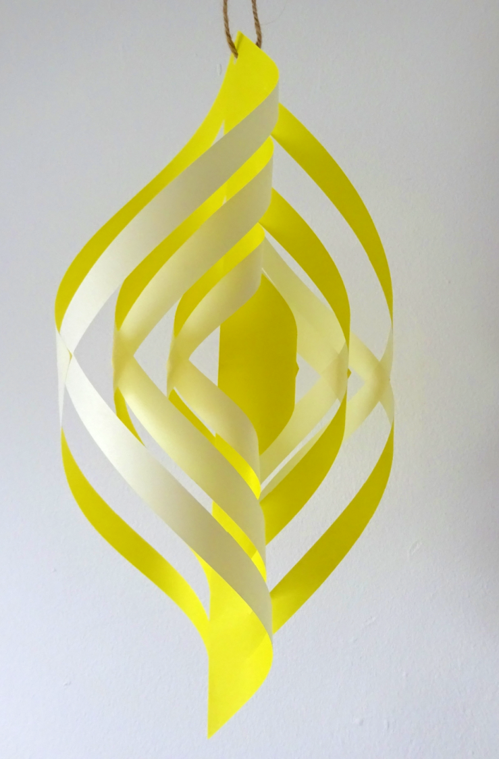
Let’s make a lantern decoration
Watch the video: https://www.youtube.com/watch?v=miB-NOnqa6M

Slide 20




The Japan Society
13/14 Cornwall Terrace, London NW1 4QP
Tel: 020 7935 0475
Email: education@japansociety.org.uk
www.japansociety.org.uk
Follow us on:
@japansocietylon
@JapanSocietyLondon

