Slide 1
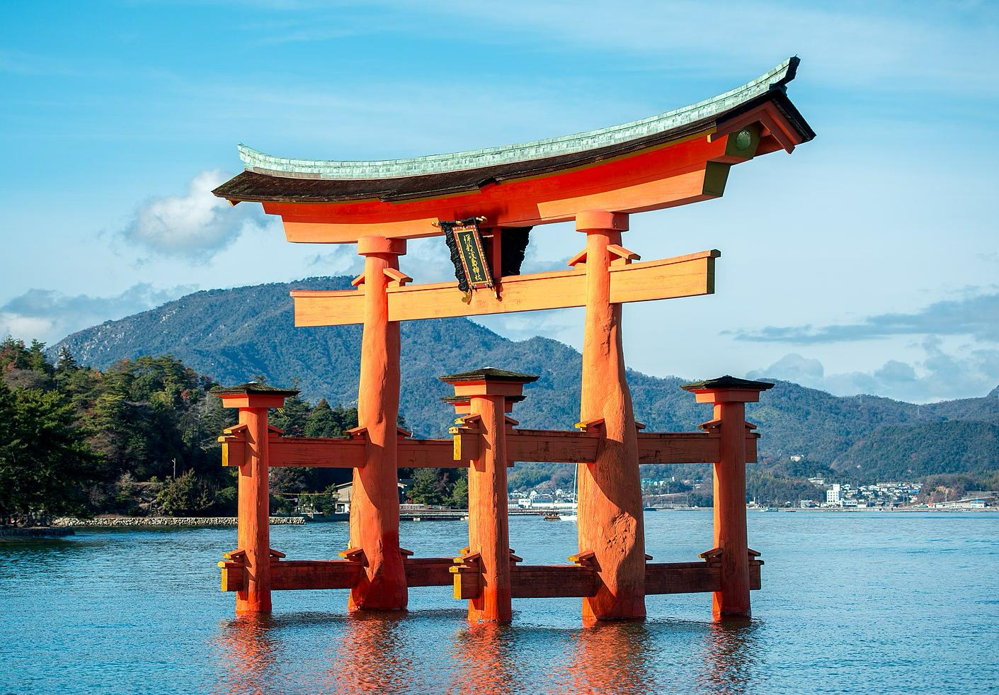

Japan Essentials
for Schools
© The Japan Society
Notes:
Teacher’s Notes
This presentation can be used as a supplement to the Information Pack provided as a part of this resource. We recommend you use this presentation to brief pupils about aspects of Japanese culture and life they should know about before they go on their trip.
Image from Wikimedia Commons (https://commons.wikimedia.org/wiki/File:Itsukushima_Gate.jpg)

Slide 2

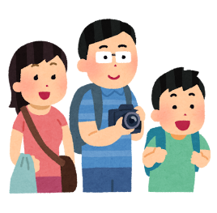
Your trip to Japan
This presentation covers key aspects of daily life in Japan that you may experience as a visitor.
If it’s your first time in Japan, you might find societal and cultural norms quite different from your own. Feeling some culture shock is completely normal.
To ease the transition, learning about Japan in advance can help you know what to expect and navigate the experience more smoothly.
© The Japan Society
Notes:
Teacher’s Notes

Slide 3
Contents
This presentation will be split into 5 sections.
Introduction to Japan
Daily life
Public transport/travel
Food and restaurants
Shopping
Learning about these different aspects of life will also help you be a better, more respectful visitor.
Your information pack will also contain more information on each of these sections as well as useful vocabulary and phrases!
© The Japan Society
Notes:
Teacher’s Notes
Please note that more information regarding each of these topics is available in the Information Pack PDF. We recommend that you provide pupils with this pack before your trip.

Slide 4
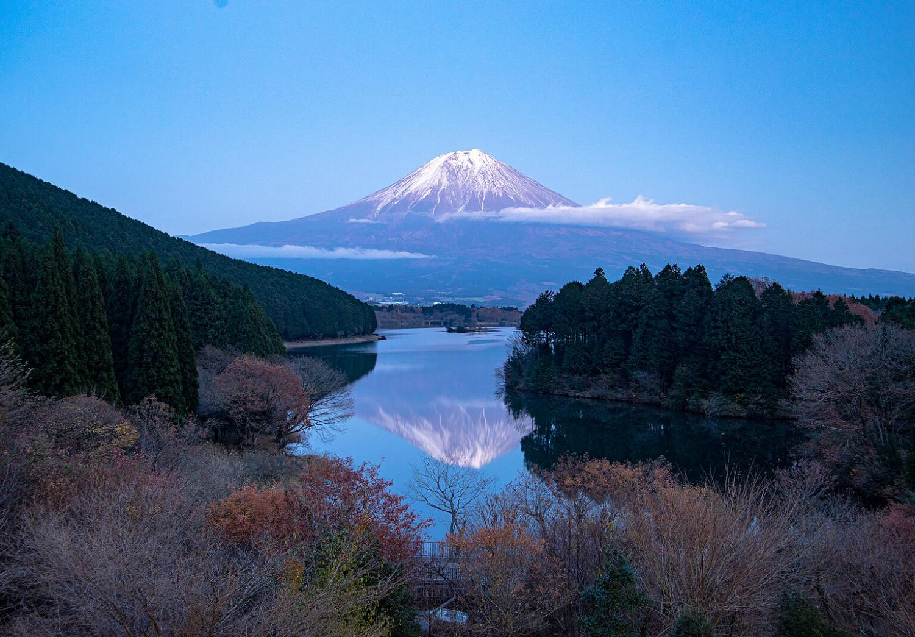
Introduction to Japan
© The Japan Society
Notes:
Teacher’s Notes
This section will cover key information about Japan as a country as well as some activities you can enjoy during the seasons.
Image from Wikimedia Commons (https://commons.wikimedia.org/wiki/File:Tanuki_ko_no_Fuji_san_20181130.jpg)

Slide 5
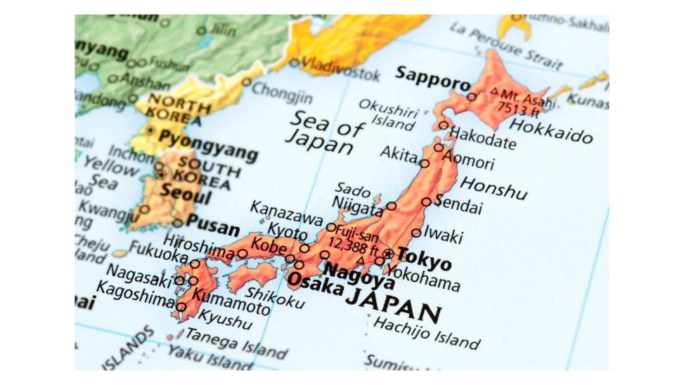
Japan Facts
Time difference: 8 – 9 hours (depending on daylight savings)
Flight time: non-stop from London to Tokyo – approximately 13.5 hours
Capital city: Tokyo
Currency: Yen ¥
© The Japan Society
Notes:
Teacher’s Notes
You can mention here length of the journey you will be taking to Japan, as well as any stop-overs you may make.
From March, there is an 8 hour time difference. From October, there is a 9 hour time difference.

Slide 6
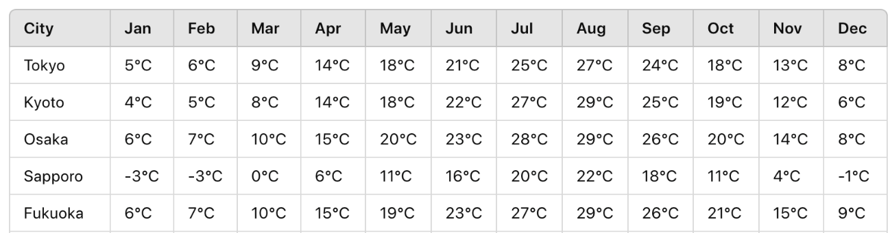
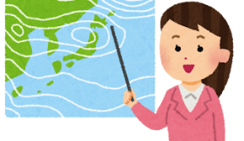
Weather and Climate
Depending on where and when you go, the weather and climate
in Japan can vary greatly.
Make sure to check the weather before you travel so you know what to pack!
© The Japan Society
Notes:
Teacher’s Notes
Be sure to provide information about what the weather and temperature will be like in the region(s) you will be visiting.
Image from Irasutoya

Slide 7

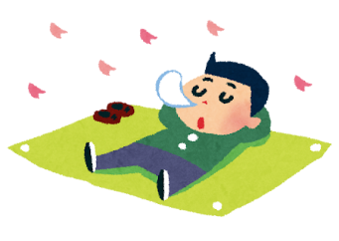
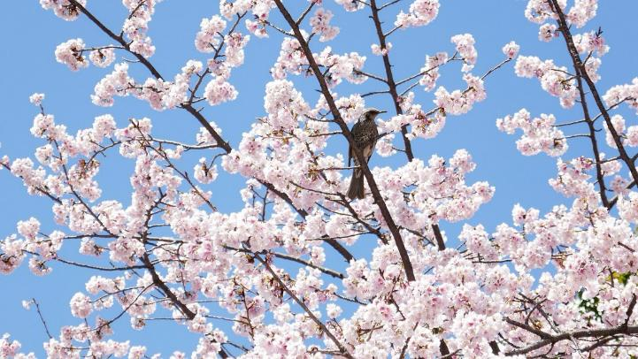
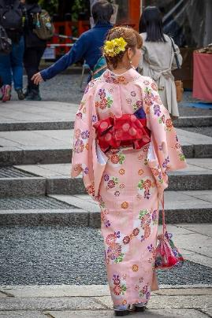
Spring in Japan
Experience the beauty of spring with...
Hanami (cherry blossom viewing)
Exploring parks and nature
Renting and wearing a kimono
Savouring seasonal food like sanshoku dango or sakura mochi
© The Japan Society
Notes:
Teacher’s Notes
Images from Irasutoya and Wikimedia Commons (Cherry blossom - https://commons.wikimedia.org/wiki/File:Kimono,_Kyoto_(45588193025).jpg and Kimono - https://commons.wikimedia.org/wiki/File:Cherry_blossom_P1000452.jpg)

Slide 8


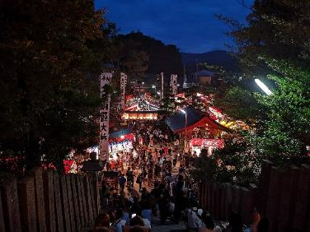
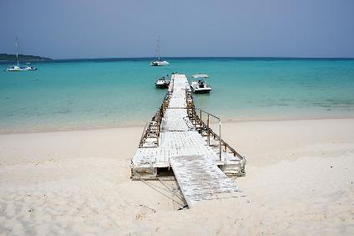
Summer in Japan
Enjoy the summer festive vibes with...
Matsuri (festivals)
Fireworks
Visiting the beach
Savouring shaved ice and festival food
Renting a yukata
© The Japan Society
Notes:
Teacher’s Notes
Images from Irasutoya and Wikimedia Commons
(Summer matsuri - https://commons.wikimedia.org/wiki/File:Kyotango,mineyama_Kotohira-jinja_%E5%A4%8F%E7%A5%AD%E3%82%8A%EF%BC%92.jpg
Okinawa beach - https://commons.wikimedia.org/wiki/File:Yonahamaehama_Miyakojima_Okinawa_Japan05bs3s4592.jpg
Fireworks - https://commons.wikimedia.org/wiki/File:Itabashi_Hanabi_Taikai_Zenkei_1.jpg)

Slide 9



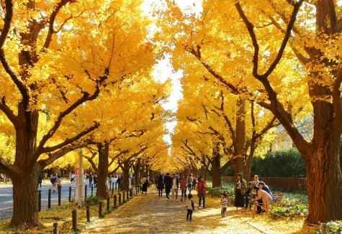
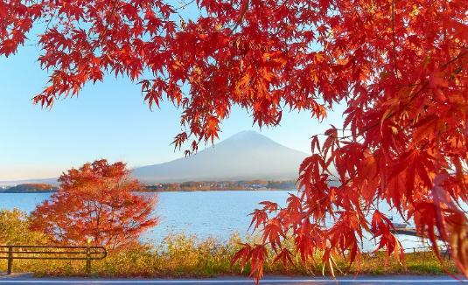
Autumn in Japan
Discover the charm of autumn with...
Koyo (autumn leaves)
Hiking
Visiting parks and getting out into nature
Savouring seasonal treats like yakiimo (baked sweet potato) and kuri (chestnuts)
© The Japan Society
Notes:
Teacher’s Notes
Images from Irasutoya and Wikimedia Commons
(Ginkgo -
https://commons.wikimedia.org/wiki/File:Jingu_Gaien_Ginkgo_Street_in_Autumn_5.jpg
Momiji - https://commons.wikimedia.org/wiki/File:Lake_Kawaguchiko_and_Mount_Fuji_at_sunset_during_the_Momijigari_period.jpg)

Slide 10

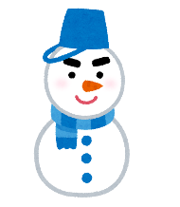
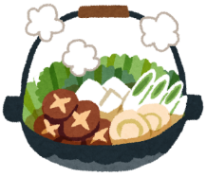
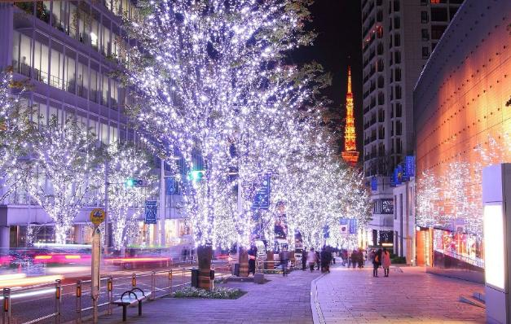
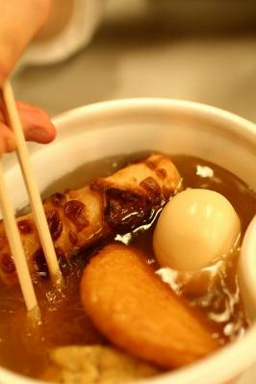
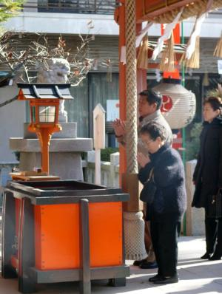
Winter in Japan
Enjoy the magic of winter with...
Winter sports such as skiing and snowboarding
Winter illuminations
Warming up with seasonal foods like oden and nabe
New Year’s celebrations
© The Japan Society
Notes:
Teacher’s Notes
Images from Irasutoya and Wikimedia Commons
(Hatsumode - https://commons.wikimedia.org/wiki/File:%E5%88%9D%E8%A9%A3%EF%BC%92.JPG
Winter illuminations - https://commons.wikimedia.org/wiki/File:Roppngi_Hills_at_night_3.JPG
Oden - https://commons.wikimedia.org/wiki/File:Oden_by_Mori_Chan.jpg)

Slide 11
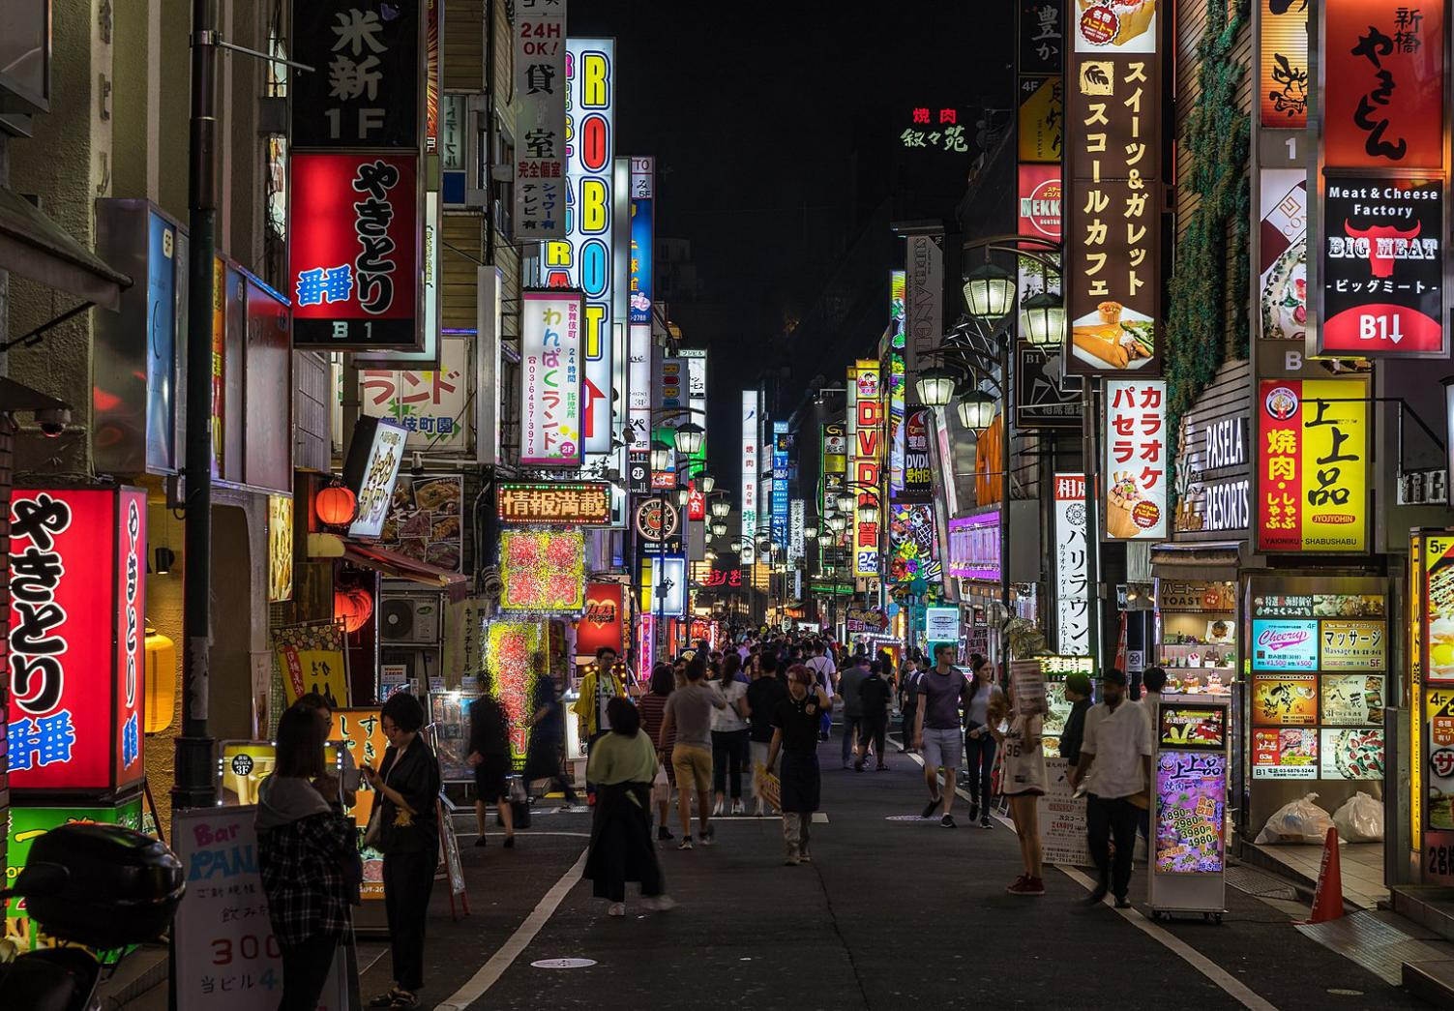
Daily Life
© The Japan Society
Notes:
Teacher’s Notes
Image from Wikimedia Commons (https://commons.wikimedia.org/wiki/File:Colorful_neon_street_signs_in_Kabukich%C5%8D,_Shinjuku,_Tokyo.jpg)

Slide 12
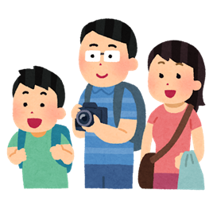
Daily Life
There are different societal rules and expectations you are likely to encounter during your stay in Japan.
No matter where you are staying and what you are doing, it’s a good idea to familiarise yourself with these rules before you go.
Be a respectful visitor and follow these rules to have an enjoyable trip!
© The Japan Society
Notes:
Teacher’s Notes
Image from Irasutoya

Slide 13
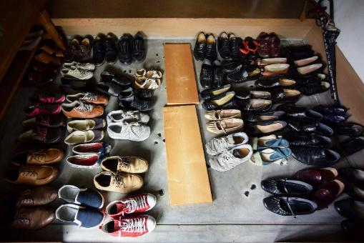
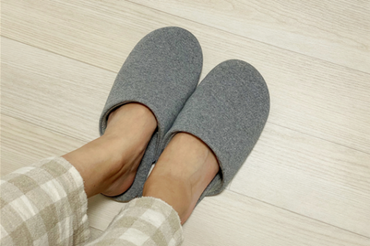
Shoes
When entering some buildings in Japan, you might be expected to take off your shoes at the genkan (entrance) for hygiene reasons.
Be mindful not to step inside these places with your shoes still on!
If you are staying with a host family, it might be a good idea to pack a pair of slippers to bring with you!
© The Japan Society
Notes:
Teacher’s Notes
Mention that when entering someone’s home in Japan, you should definitely make sure to take your shoes off. Other buildings that may require you to take your shoes off include hospitals, shrines, temples, and even some traditional restaurants if you are sitting on tatami flooring. A good pair of comfortable shoes you can easily slip on or off might be ideal to bring with you to Japan.
Images from Canva and Wikimedia Commons
https://commons.wikimedia.org/wiki/File:%E3%81%AA%E3%81%8C%E3%82%89%E3%81%AE%E7%8E%84%E9%96%A2_2016_(28795677960).jpg

Slide 14
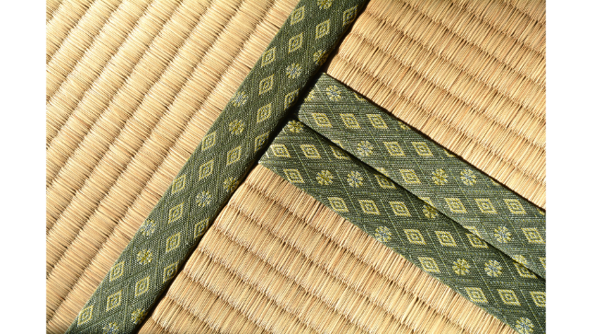

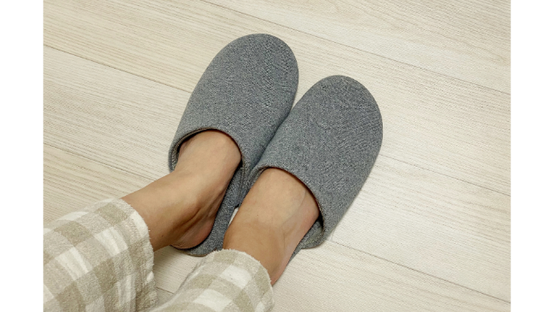
Tatami
Some houses and buildings may have traditional Japanese rooms with tatami flooring.
It is considered to be poor manners to wear shoes or slippers when stepping on tatami, so make sure you take them off.
© The Japan Society
Notes:
Teacher’s Notes
The right picture is an example of what tatami flooring looks like. Not all Japanese households will have rooms with tatami but it’s still important to mention to pupils, especially if they are staying with a host family.
Images from Canva and Irasutoya

Slide 15
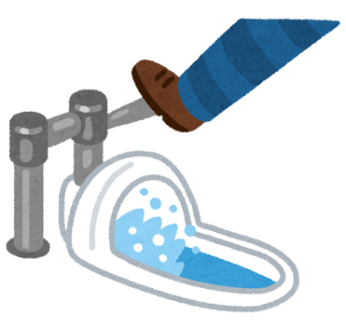
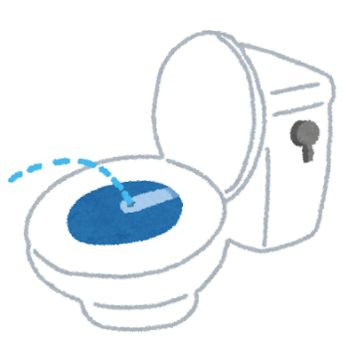
Toilets
Most public bathrooms will have both modern Western-style toilets and older Japanese-style squat toilets.
Western-style toilets come equipped with a bidet and sometimes even heated seats.
Sometimes, older buildings may only have the Japanese-style squat toilets.
© The Japan Society
Notes:
Teacher’s Notes
Images from Irasutoya

Slide 16
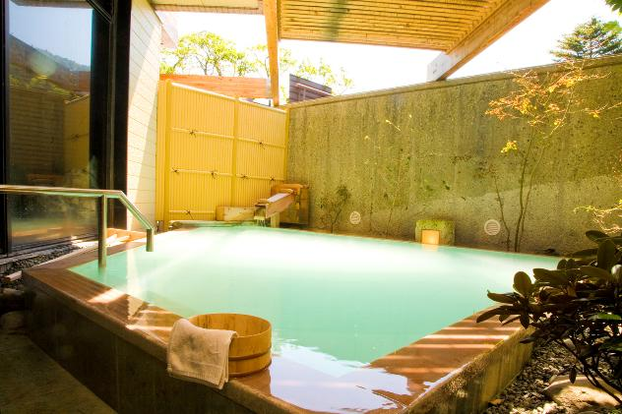
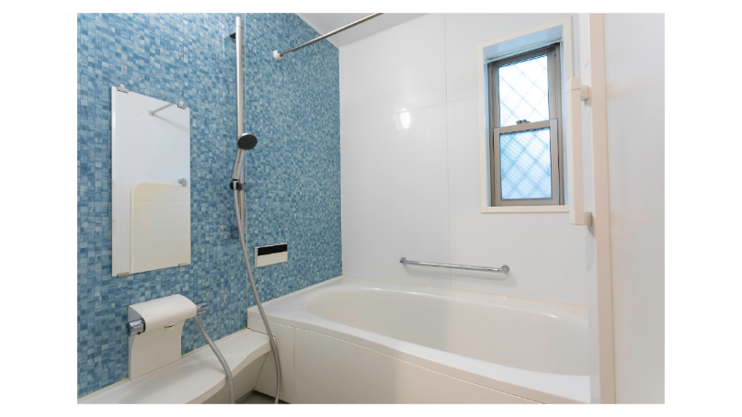
Bathrooms
Taking a bath in Japan, whether at an onsen or at home, is slightly different to how many people take baths in the UK.
Be mindful of bathing etiquette in Japan, especially if you are using public baths or going to an onsen.
© The Japan Society
Notes:
Teacher’s Notes
There are many public baths and onsen across Japan, which is why bathing etiquette is so important. If pupils are staying with a host family and wish to take a bath, they should try to follow this etiquette.
Japanese bathrooms tend to be like wet rooms, with a separate space for bathing and showering. You should rinse your body using the shower hose first before entering the bathtub.
Images from Wikimedia Commons and Canva
https://commons.wikimedia.org/wiki/File:%E3%81%AB%E3%81%94%E3%82%8A%E6%B9%AF%E6%BA%90%E6%B3%89%E3%81%8B%E3%81%91%E6%B5%81%E3%81%97%E7%A1%AB%E9%BB%84%E6%B3%89.jpg

Slide 17
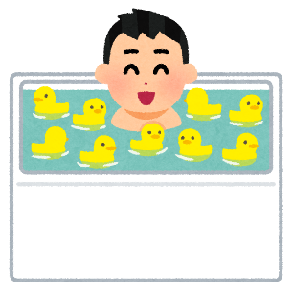
Bathrooms
Before taking a bath, you should first wash your body and hair in the shower area to make sure everything is clean.
After rinsing off the soap, you can enter the bathtub to soak and relax.
The bath is for soaking only and not further cleansing, so avoid adding soap or dipping towels into the bath water.
Once finished in the bath, step out into the shower area to rinse your rinse and dry off.
© The Japan Society
Notes:
Teacher’s Notes
There are many public baths and onsen across Japan, which is why bathing etiquette is so important. If pupils are staying with a host family and wish to take a bath, they should try to follow this etiquette.
Image from Irasutoya

Slide 18
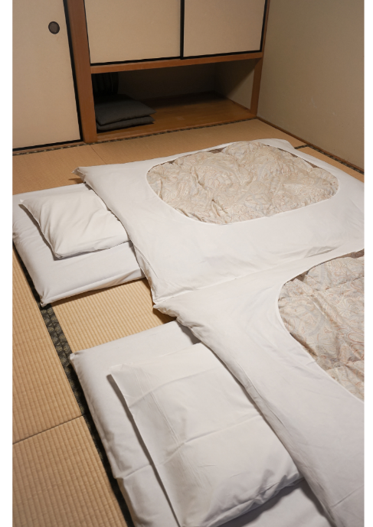
Bedrooms
Most Japanese hotels and households have beds with proper mattresses and bedframes.
However, you might also stay in a Japanese-style room where you will sleep on a futon on the floor.
Make sure to fold up and put your futon and bedsheets away in the morning, so the tatami flooring can be aired out.
© The Japan Society
Notes:
Teacher’s Notes
This may not be applicable to all pupils, but it is still good for them to know in advance just in case.
Image from Canva

Slide 19
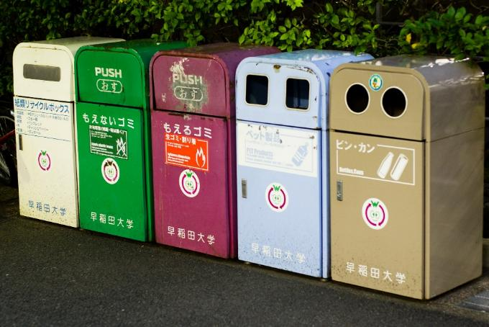
Recycling
It may be hard to find bins on the street. If you do have rubbish, you should keep hold of it until you find a bin.
Convenience stores usually have recycling bins you can use, but try to avoid dumping too much in them all at once!
Make sure you sort and dispose of your rubbish correctly.
© The Japan Society
Notes:
Teacher’s Notes
More information on how to correctly sort and dispose of your rubbish can be found in the information pack.
Image from Wikimedia Commons
https://commons.wikimedia.org/wiki/File:Waseda_University_recycling_bins_20080625.jpg

Slide 20
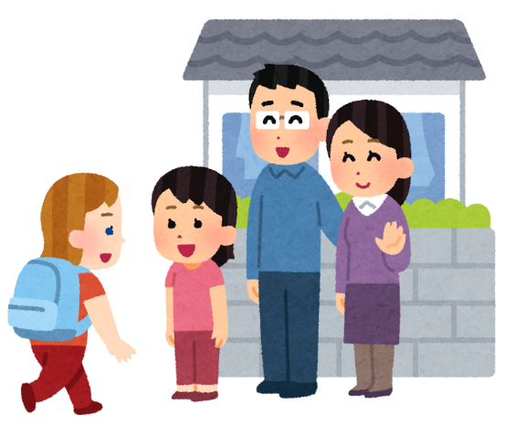
Host Families
If you are staying with a host family, make sure to ask them what their house rules and expectations are if they do not already tell you.
Help your host family with any daily chores such as cleaning, washing dishes, and helping to prepare food for dinner.
© The Japan Society
Notes:
Teacher’s Notes
If your pupils are not staying with host families, you can skip slides 19-21.
Image from Irasutoya

Slide 21


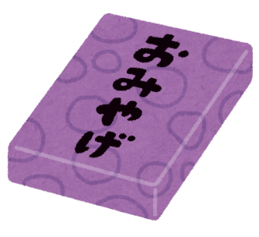

Omiyage お土産
You should bring a souvenir (omiyage お土産) for your
host family/host school – it doesn’t have to be big or expensive!
It might be nice to bring omiyage that is representative of your hometown, city, or country.
For example: tea, sweets, biscuits, etc.
© The Japan Society
Notes:
Teacher’s Notes
Images from Irasutoya and Canva

Slide 22
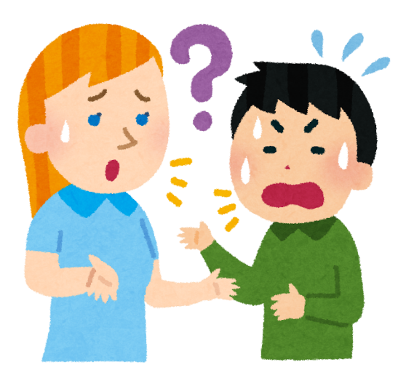
Communication
Try your best to communicate with your host in Japanese as much as possible. If you are having trouble with communicating with one another, remember...
Be patient
Speak clearly
Try to use simpler words
Use alternative forms of communication (body language, drawing, translation apps, etc.)
© The Japan Society
Notes:
Teacher’s Notes
Key phrases are available in the information pack, if pupils wish to learn some useful Japanese vocab before their trip.
Image from Irasutoya

Slide 23
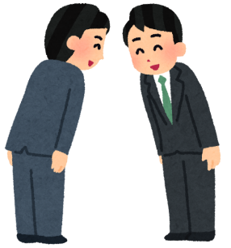
Bowing and body contact
Bowing is an important part of greeting and communication for Japanese people.
A casual bow can be as simple as a small nod of the head - about 15-30°
Deeper bows are used more in formal situations when you want to convey respect to someone.
Body contact in general, such as shaking hands
or hugging, is not so common in Japan.
© The Japan Society
Notes:
Teacher’s Notes
People bow to greet each other, to apologise, to thank someone, or to even ask someone for a favour.
Pupils will most likely not need to do any deep, formal bows during their trip. You could show them an example of how they should bow in common situations, i.e., when thanking someone.
Image from Irasutoya

Slide 24
Key Phrases
おはようございます。Ohayou gozaimasu.
- Good morning.
こんにちは。Konnichiwa.
- Hello/good afternoon.
こんばんは。Konbanwa.
- Good evening.
ありがとうございます。Arigatou gozaimasu.
- Thank you.
すみません。Sumimasen.
- Excuse me.
More key phrases available in the Your Trip to Japan information pack!
© The Japan Society
Notes:
Teacher’s Notes
More key phrases are available in the Information Pack PDF!

Slide 25
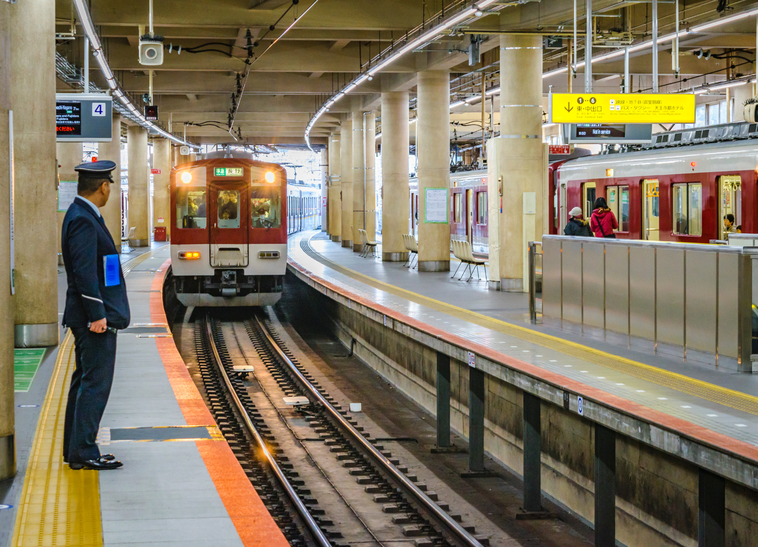
Public Transport and Travel
© The Japan Society
Notes:
Teacher’s Notes
We recommend that you check information regarding the buses, trains, and subway lines you will be using during your trip in Japan, as these can vary from region to region.
Image from Wikimedia Commons

Slide 26

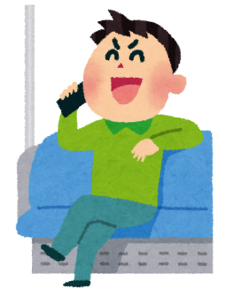

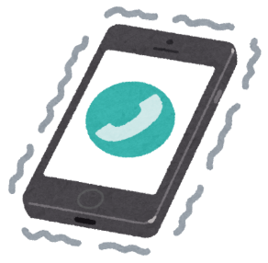
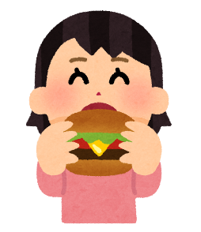
Etiquette
When using any form of public transportation in Japan...
Be quiet so you do not disturb other passengers.
Set your phone to silent mode and do not take phone calls.
Do not eat or drink.
© The Japan Society
Notes:
Teacher’s Notes
Note – if a pupil starts to feel unwell whilst using public transport, drinking water is of course okay.
Images from Irasutoya

Slide 27
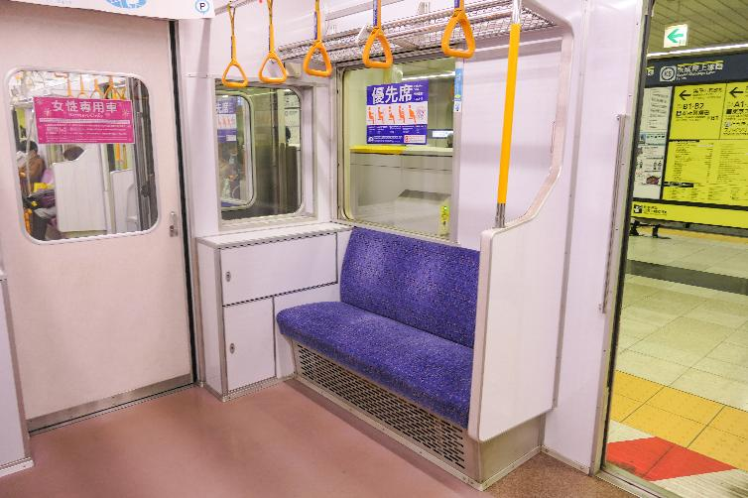
Etiquette
Board in order of the queue and do not push in front of others.
Be mindful of where priority seats are and avoid using them unless you are entitled to one.
© The Japan Society
Notes:
Teacher’s Notes
Priority seats are for the elderly, disabled people, pregnant women, or young children.
The image on the slide is an example of what priority seats look like on a subway train.
Image from Wikimedia Commons
https://commons.wikimedia.org/wiki/File:Tokyo-Metro_Series8000-8109_3-Priority-seat.jpg

Slide 28
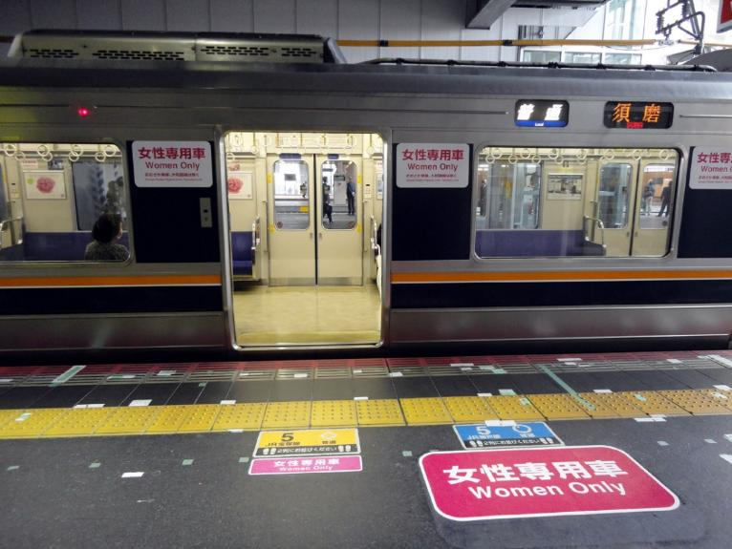
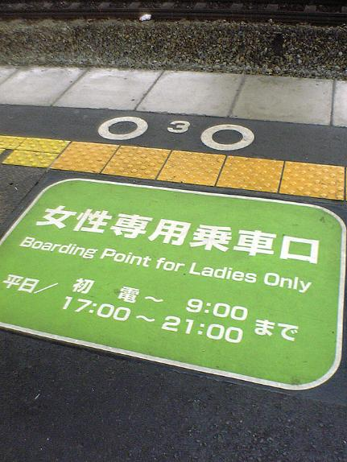
Women Only Carriage
Sometimes there will be women only carriages on the train. These will be clearly signposted in both Japanese and English.
© The Japan Society
Notes:
Teacher’s Notes
Women-only carriages are sometimes only in effect during certain hours of the day, such as peak travel times.
Images from Wikimedia Commons
https://commons.wikimedia.org/wiki/File:Broading_point_for_womanonly.jpg
https://commons.wikimedia.org/wiki/File:Ladies_Only_Train.jpg

Slide 29
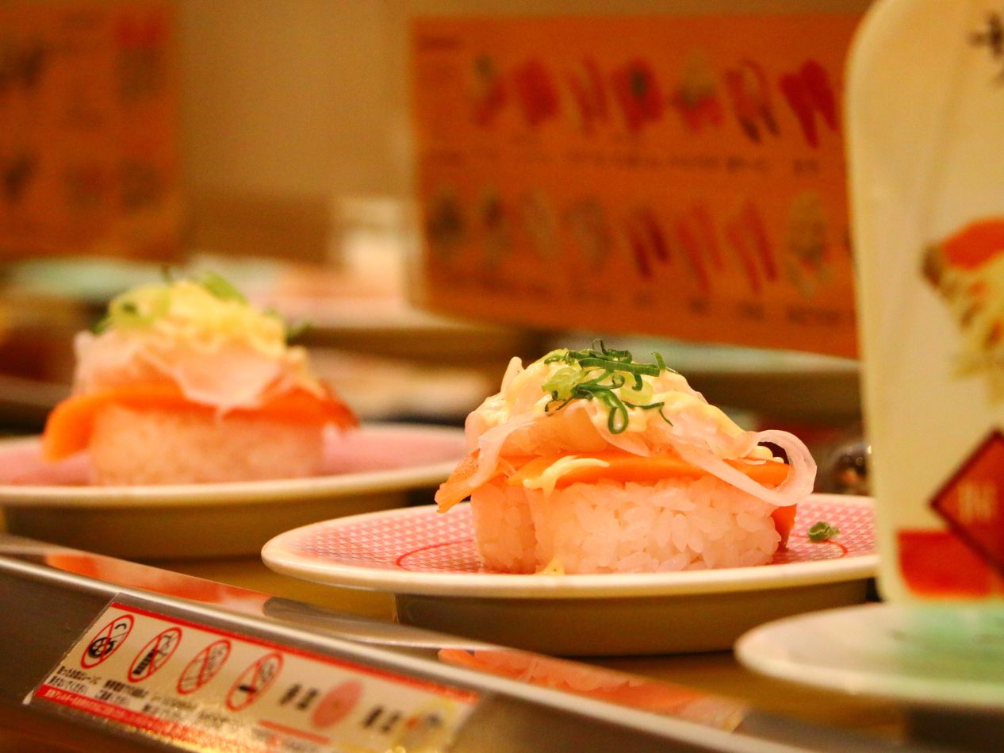
Food and Restaurants
© The Japan Society
Notes:
Teacher’s Notes
More information regarding food and restaurant etiquette is available in the Information Pack PDF!
Image from Canva

Slide 30
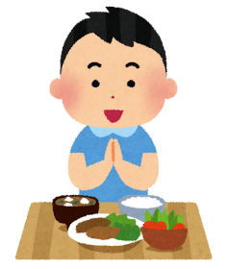
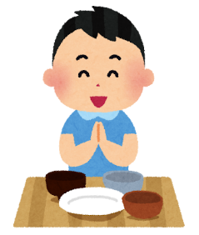
Table Manners
If you’re staying with a host family, make sure everyone is seated with their meal before you start eating.
Japanese people say itadakimasu いただきます before eating – this literally means “I humbly receive”. It’s a way of showing respect and gratitude for the food.
When finished eating, make sure to say gochisousama deshita
ごちそうさまでした (“thank you for the meal”) as well.
© The Japan Society
Notes:
Teacher’s Notes
Images from Irasutoya

Slide 31
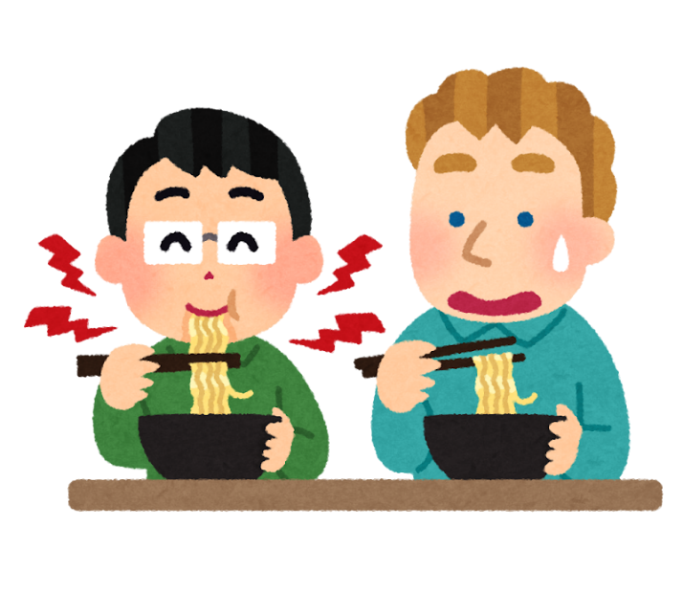
Eating at restaurants
You might notice when eating soba (noodles), Japanese people tend to slurp quite loudly. This is a sign of appreciation for the food and that you find it to be delicious!
© The Japan Society
Notes:
Teacher’s Notes
Images from Irasutoya

Slide 32
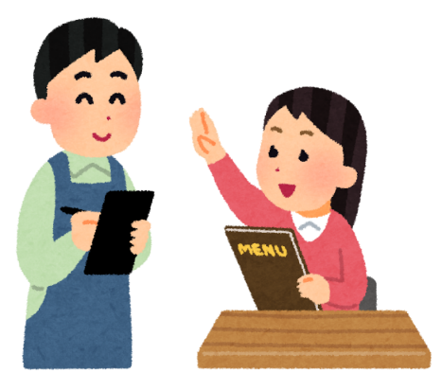
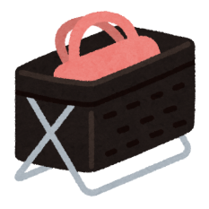
At restaurants
When seated at a restaurant, you may notice a box underneath your table – this is for you to place your bag and belongings in.
There is no tipping culture in Japan, so you do not need to leave a tip when paying at a restaurant (or anywhere!)
© The Japan Society
Notes:
Teacher’s Notes
Images from Irasutoya

Slide 33

Chopsticks
Most of the time, restaurants will give you chopsticks to eat with. Restaurants that serve Western food may give you a knife, fork, and spoon instead.
However if you struggle to use chopsticks, you can always ask a member of staff for a knife and fork.
© The Japan Society
Notes:
Teacher’s Notes
Encourage pupils to try practice using chopsticks before they travel, if possible.
Image from Irasutoya

Slide 34
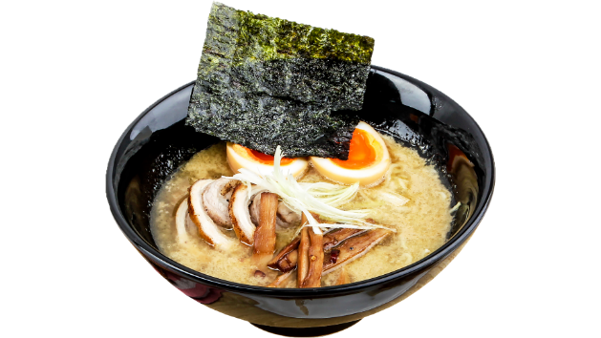








Allergies + Dietary Requirements
Restaurants will not always be accommodating of your needs and finding vegetarian, vegan, or halal options can be challenging.
For example: ramen broth contains fish stock and/or meat products.
Make sure to inform a member of staff beforehand of your allergies/dietary requirements.
Some restaurants may use pictograms to indicate the ingredients contained in a dish.
© The Japan Society
Notes:
Teacher’s Notes
If a pupil has allergies or dietary requirements, be sure to research beforehand what foods and restaurants will be accessible for them before going to Japan.
As stated on the slide, many foods and meals that are often safe to eat in the UK may not often be suitable for some people in Japan. For example, ramen broth often contains fish stock known as dashi, which would make it unsuitable for those who cannot eat meat.
In the Information Pack, there are also some key phrases and vocabulary that people with dietary requirements or allergies should learn before they travel to Japan.
Images from Irasutoya and Canva

Slide 35
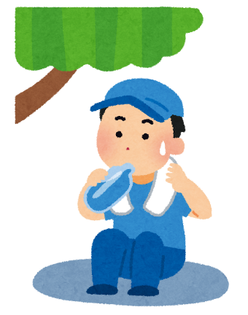
Eating outside
Avoid eating and drinking whilst walking – it’s not something that you will see other people do in Japan!
You can stand somewhere out of the way of other people, and drink and eat whilst standing.
© The Japan Society
Notes:
Teacher’s Notes
Image from Irasutoya

Slide 36

Shopping
© The Japan Society
Notes:
Teacher’s Notes
Image from Canva

Slide 37

Cash
Japan is still, relatively speaking, a cash-based society.
It is advisable to bring and use cash – some places may not accept card payments.
You may notice 2 prices on a label. One price will be without tax, the other will be with tax included.
Look for the slightly higher number as that will be the tax included price you pay at the till.
© The Japan Society
Notes:
Teacher’s Notes
Emphasise to pupils to bring cash over cards, as it will be generally be much easier for them to pay for things using cash.
Image from Canva

Slide 38


Paying
When paying for an item at the till, place your cash into one of the cash trays on the counter.
Do not directly hand your cash to the cashier, and do not place it onto the counter.
The cashier will also return your change to you on the cash tray.
© The Japan Society
Notes:
Teacher’s Notes
Images from Irasutoya and Wikimedia Commons
https://commons.wikimedia.org/wiki/File:Protective_plastic_sheets_in_a_convenience_store_in_Tokyo_Apr_15_2020_01-52AM.jpg

Slide 39



Important information:
Save these numbers to your mobile phone before you travel, so you know which numbers to call in case of emergency.
Ambulance – Dial 119
Fire – Dial 119
Police – Dial 110
© The Japan Society
Notes:
Teacher’s Notes
Remind pupils of what your school’s rules and procedures are if there is an emergency of any kind whilst on the trip.
Images from Irasutoya

Slide 40



Enjoy your trip to Japan!
© The Japan Society
Notes:
Teacher’s Notes
Images from Canva

Slide 41





This resource was created by The Japan Society.
The Japan Society
13/14 Cornwall Terrace, London NW1 4QP
Tel: 020 7935 0475
Email: education@japansociety.org.uk
www.japansociety.org.uk
Follow us on:
@TheJapanSociety
@TheJapanSociety
© The Japan Society

