Slide 1
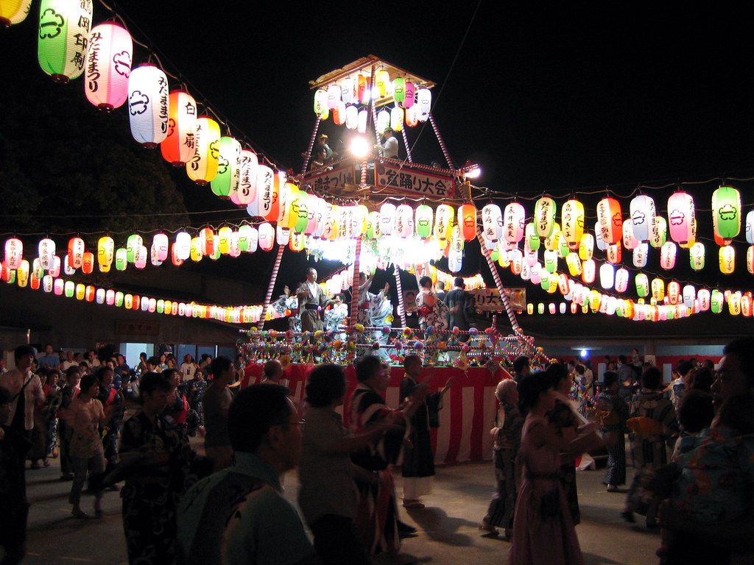

Friends, Family
and Festivals
Notes:
Teacher’s Note
The theme of this lesson is: exploring the importance of connecting with other people using the Japanese festival of Obon
Title image is: https://search.creativecommons.org/photos/f0392595-813a-4365-b1a2-db59fece8fcc (no changes made)

Slide 2

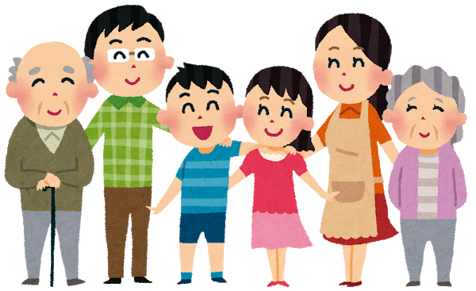
Learning Objectives
I can describe what home means to me
I can create a symbol of my home and/or family
I can explain why connecting with others improves wellbeing

Slide 3
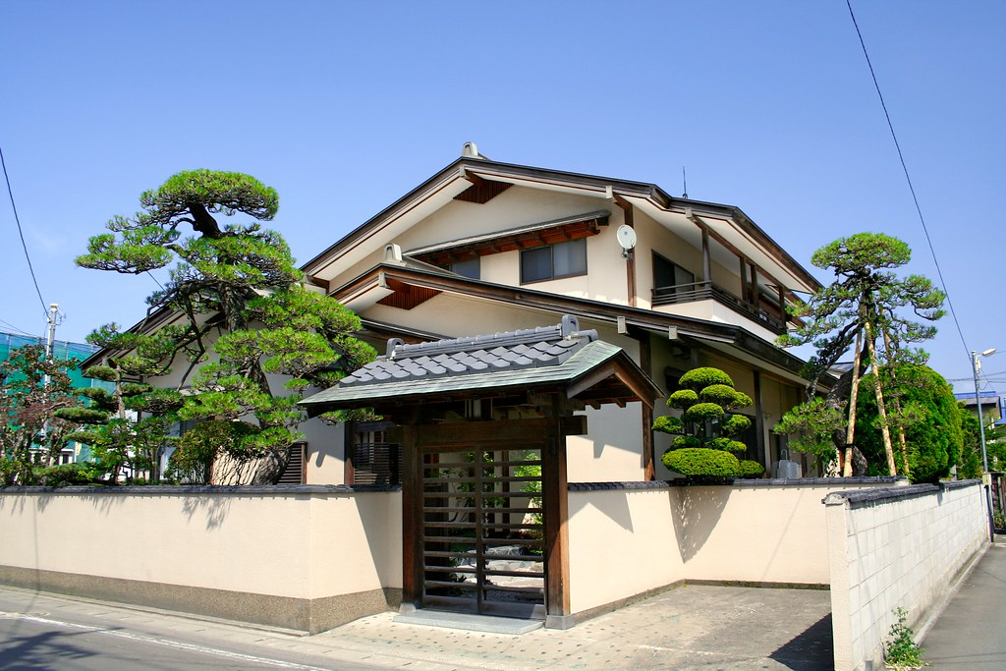
Discuss…
What is the picture showing?
Where do you think it is?
Notes:
Tell students
Reveal it is in Japan, but emphasise that not all Japanese people live in homes like this.
Many Japanese people in cities will live in flats or apartments or modern-looking buildings.
Image is from Creative Commons: https://search.creativecommons.org/photos/8dddf42d-5dab-4419-97a0-56c5452174a2

Slide 4

Activity
The picture showed a traditional-style Japanese house.
Write down 3 things you think of when you think of home.
Share them with a partner.
1.
2.
3.

Slide 5

Home in Japan…
家
There are two meanings of home in Japan:
1. A house
2. Family and people who are close to you, or a place you feel happy and comfortable
Which did you write about?
Notes:
Teacher’s Note
The character in the green circle is Japanese character for ‘home’.
Discuss as a class how this compares to what they wrote on their post-its and/or discussed with their partners.
Are relationships important when we think of home and happiness or is it more the physical building?

Slide 6
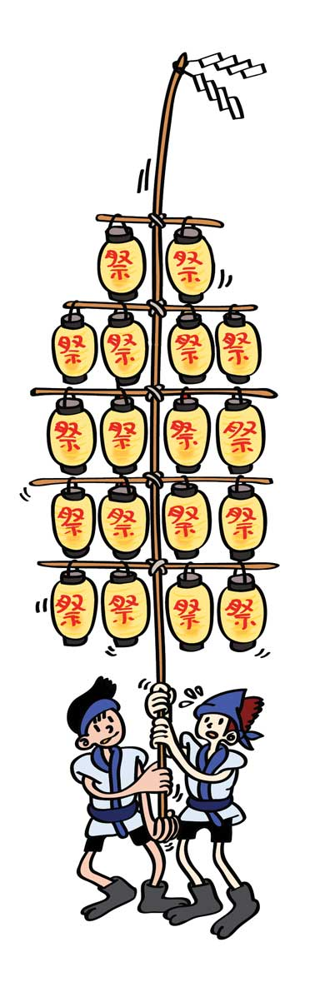
Festivals in Japan
In Japan, festivals are called matsuri.
There are lots of different types of matsuri that take place throughout the year.
They are a way to celebrate with family and friends.
What festivals do you celebrate?
Notes:
Teacher’s Note
Matsuri is pronounced mat-sue-ree
Tell students
The picture shows two people performing at a festival in Japan.
They are holding a long bamboo poles with lanterns on it.

Slide 7
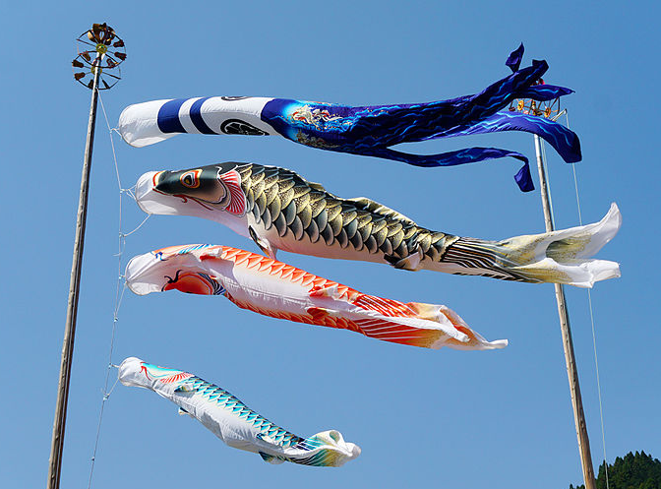
Festivals in Japan
© 663highland / CC BY-SA 3.0
Children’s Day
Notes:
Teacher’s Note
Children’s Day was traditionally a celebration of Boys, but now it is normal to celebrate the health of children regardless of gender. The koi carp fish represents strength and these streamers are hung up for the celebrations. Each koi represents a different member of the family.
Link to short Youtube video explaining children’s day: https://www.youtube.com/watch?v=BVivjZdIhaI
Children’s Day image: https://commons.wikimedia.org/wiki/File:150425_Koinobori_Chizu_Tottori_pref_Japan01bs.jpg

Slide 8
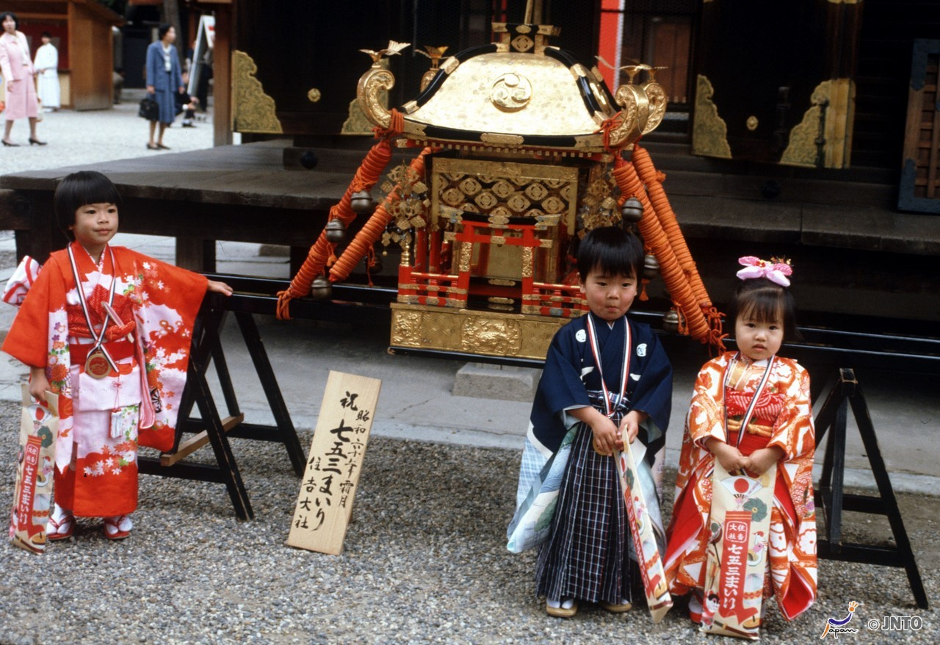
Festivals in Japan
© 663highland / CC BY-SA 3.0
7-5-3 Festival
Notes:
Teacher’s Note
Shichi-go-san means 7,5, 3 and celebrates children who are these ages. These ages were important milestones for children in the past.

Slide 9
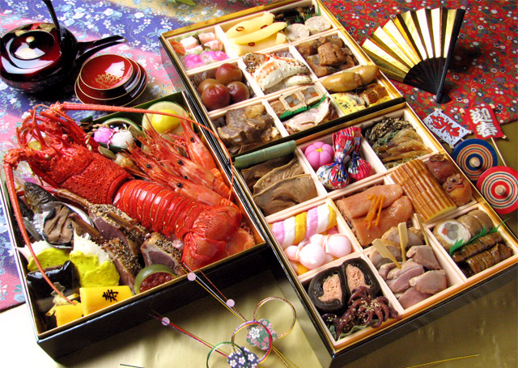
Festivals in Japan
© 663highland / CC BY-SA 3.0
New Year’s
Notes:
Teacher’s Note
New Year’s is the most important celebration in Japan. It’s a time for families to get together, relax and eat a meal together. This is called Osechi Ryori (oh-sech-ee ree-or-ree) and eaqch food has a special meaning.
Image: https://commons.wikimedia.org/wiki/File:Oseti.jpg

Slide 10
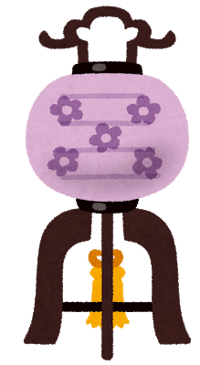
Obon Festival
Obon is one of the most important Japanese festivals
It is said that spirits return to their homes during Obon
So Japanese people often travel to see their families for Obon and welcome the spirits of their ancestors
Watch a video about Obon
Notes:
Tell students
Obon (oh-bon) is a celebration of family and ancestors. People hope their loved ones who have died are happy and at peace.
It might seem like it should be a sad time, or that people may be afraid of the spirits but this isn’t the case.
Students may be familiar with All Hallows’ Eve (Halloween), Day of the Dead (Mexico), Pitru Paksha (Hinduism)

Slide 11
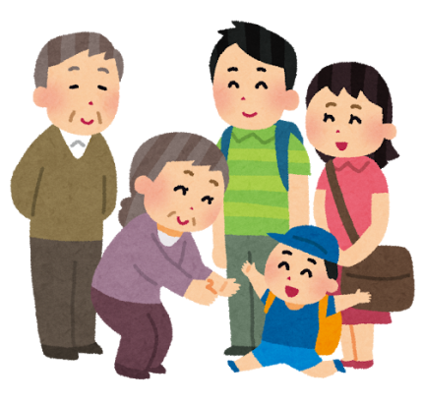
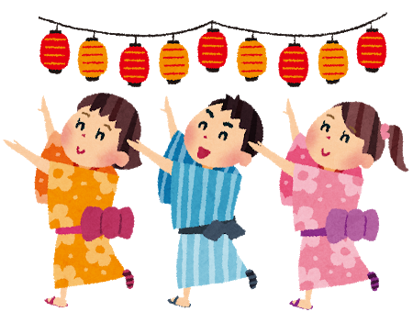
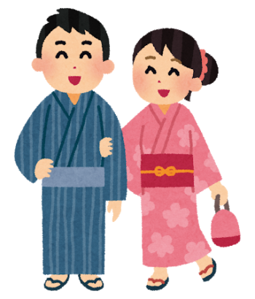
How do people
celebrate?
See family
Light lanterns
Dance with others
Attend a festival
outdoors
Notes:
Teacher’s Note
Ask students what they remember from the video – how do people celebrate Obon?
Make sure students understand the main point about connection, it’s okay if they can’t remember other details.

Slide 12
Obon Quiz
False
Test your knowledge – answer true or false!
False
True
 | Many people spend Obon alone
 | Obon is a time to mourn and feel sad
 | People use lanterns to guide the spirits
Answer:
Obon is spent with family
Answer:
It’s a time to celebrate
Notes:
Use the short quiz to recap the main points.

Slide 13
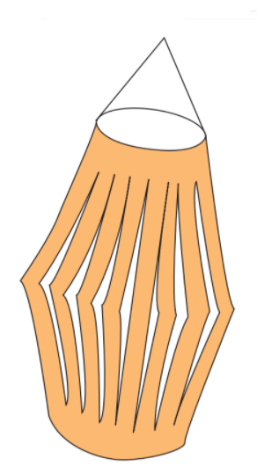
Main Task
You will now experience the festival of Obon by making your very own chochin lantern.
If you would like, choose a friend or family member to dedicate your lantern to.
You will then present your lantern to a partner/the class.
Notes:
See resources for the instruction worksheet to print out and give to students.
There is also an alternative lantern activity which is more challenging: https://www.youtube.com/watch?v=miB-NOnqa6M&t=1s

Slide 14

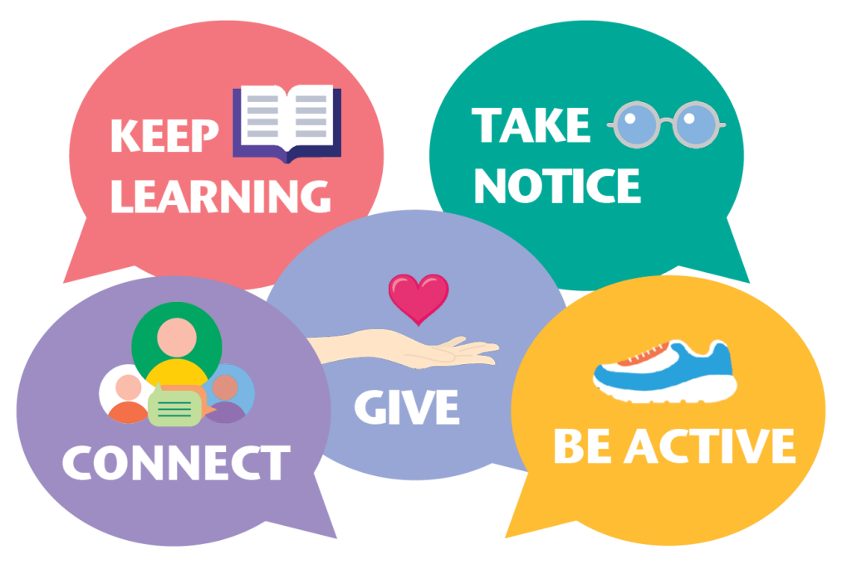
Reflection
Which of the ‘5 Ways to Wellbeing’ do you think is important for Obon?
Why do you think that connecting with others is important for our wellbeing?
Notes:
Tell Students
Connect is about our relationships. Feeling close to and valued by other people improves our wellbeing.
We can share our problems with others but also feel loved, respected and know that we matter.
There are many different ways to connect i.e. on the phone, social media but this festival is about coming together and connecting in person as well as remembering the connections we have with those who have died or gone before us.
This is an important part of appreciating life, those around us and our place in the world.

Slide 15
Wellbeing in school
Teachers should use this slide to signpost to any provision they have in school i.e. school counsellor, worry box, teachers etc.
Whilst it is normal for us to have ups and down, if pupils are feeling sad and the feeling does not go away then they should talk to someone they trust.

Slide 16




This resource was designed by Kimberley Evans with the Japan Society.
The Japan Society
13/14 Cornwall Terrace, London NW1 4QP
Tel: 020 7935 0475
Email: education@japansociety.org.uk
www.japansociety.org.uk
Follow us on:
@japansocietylon
@JapanSocietyLondon

