Slide 1


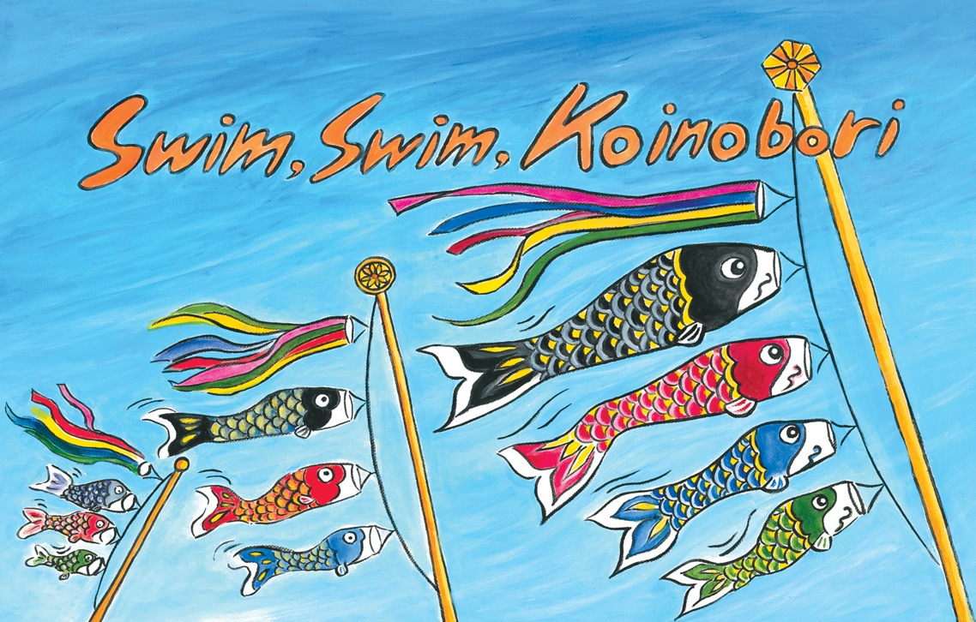

Kamishibai:
Japanese Storytelling
Notes:
Swim, Swim, Koinobori
* * * * * * * * * * * *
Pre-text
Children’s Day (kodomo no hi in Japanese) is a festival celebrated on May 5 in Japan. In the past, the day celebrated the health and happiness of boys, but nowadays it is for all children.
There is a legend in Japan about a carp which swam upstream and became so strong it turned into a dragon and flew to heaven. For this reason, koi carp are seen as a symbol of strength and perseverance in Japan; koinobori flags are hung up for the festival in the hope that all children will grow up to be strong and healthy.
The Japanese words in this story are:
Koinobori: flags of koi carp
Satsuki bare: Sunny spells or fine weather in May
Kun: a suffix added to names, generally used for boys. In the story, it is used as a term of familiarity
Kashiwa mochi: a popular Children’s Day snack made from pounded rice with a sweet red bean paste filling, wrapped in an oak leaf.
End of pre-text
* * * * * * * * * * * * * * * * * *
1
It’s May the 5th, the Children’s Day Festival. Flags shaped like koi carp, called koinobori, are everywhere. On one tall pole,
there are three carp. The big black one is Daddy Carp, the smaller red one is Mummy Carp and the smallest one of all is Koisuke, the blue child carp. On this day, the sky becomes an enormous pond. It also happens to be satsuki bare – the time in May when the sun shines most brightly. There are no clouds and the wind is blowing through the carp, making them look strong as they swim gracefully through the sky. Pata Pata Pata.*
* Pata Pata is an onomatopoeic word for the sound of something flapping or fluttering in the wind.

Slide 2
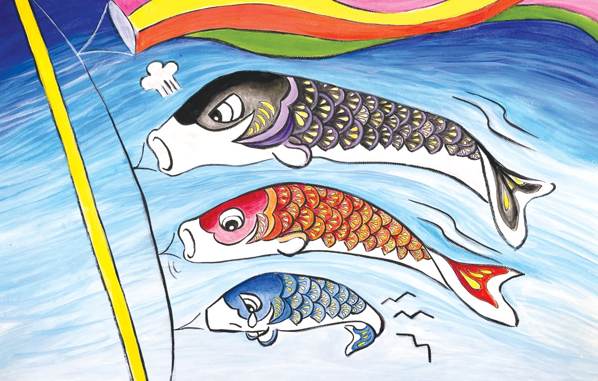
Notes:
2
But Koisuke, the little child carp, had been dreading the festival. Daddy Carp wants their pole to look the best; he has demanded Koisuke swim in exactly the same way as him, but Koisuke’s small tail just doesn’t respond to the wind like Daddy and Mummy’s big tails. After trying all morning, he was exhausted. He had had enough.
“I don’t want to be with you anymore. I’m old enough to swim on my own,” he shouted.
“Watch your mouth!” Daddy Carp snapped back. Mummy Carp just shook her head in disappointment.
Koisuke continued, “Why do you always get to go at the top? Why can’t I have a go?”
“Be quiet!” Daddy roared. “How dare you say that? You can’t swim on your own. You should be grateful to be a part
of this family.”

Slide 3
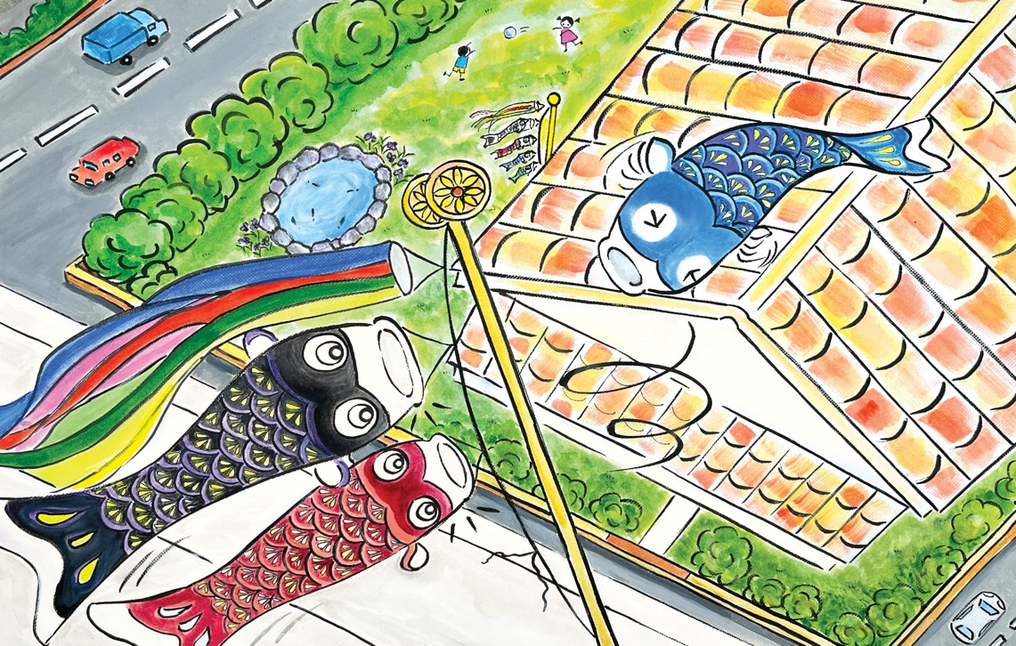
Notes:
3
Koisuke twisted his body in anger and his blue scales became almost purple with rage. The wind was so strong now that his small body shook vigorously from side to side. As Koisuke moved, the knot anchoring him to the pole was
getting looser and looser. Shu shu!* The wind blew again and before he knew it, Koisuke was swept away into the sky.
He swam freely into the wind, leaving Daddy and Mummy astonished with their mouths wide open (actually, it’s quite difficult for them to close their mouths!).
* Shu Shu is an onomatopoeic word meaning woosh or swish.

Slide 4
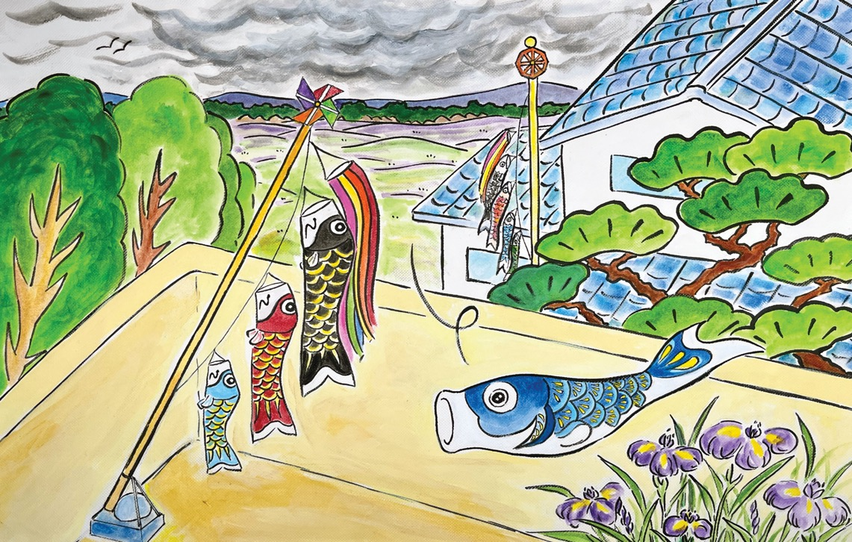
Notes:
4
It was a great feeling to be swimming in the sky without anything holding him down. He felt so grown up. But this feeling didn’t last long as the sky suddenly changed colour and it started to rain. Koisuke tried to continue swimming but there was no wind any more. He tumbled down onto the balcony of a flat below. As he landed, he noticed a small set of koinobori flags attached to the balcony wall.

Slide 5
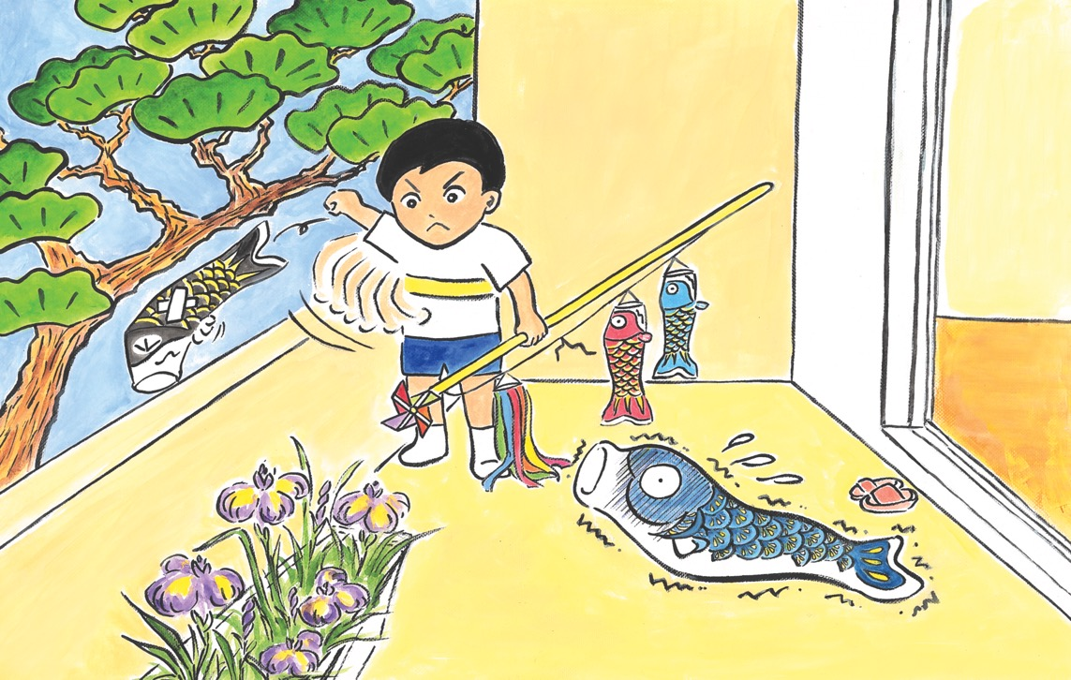
Notes:
5
The flat belonged to Makoto’s family. He only has a mummy. As far back as he can remember he has never had a daddy. Because of that Makoto hates Children’s Day. He hates seeing all the koinobori sets with daddy carp. Just as Koisuke landed on the balcony, Makoto came rushing out and tore down the koinobori flags. In his rage, he pulled the daddy carp off and threw it off the balcony. Then Makoto went back inside, still raging. He didn’t notice Koisuke, who lay there horrified, wondering whether he might encounter the same fate as that daddy carp.

Slide 6
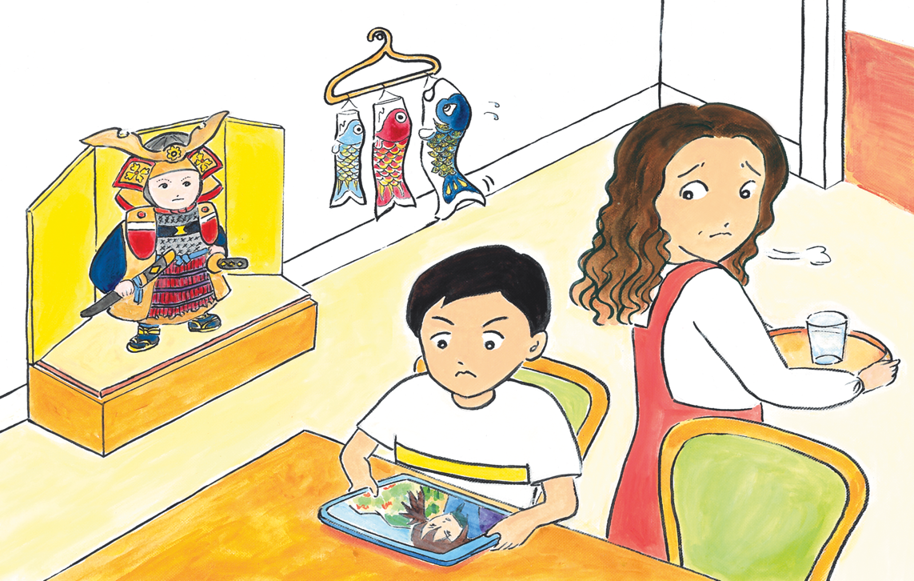
Notes:
6
Makoto’s mummy went outside and picked up the remaining koinobori flags. She looked over the balcony wall to see where the daddy carp had landed but she couldn’t see it. Instead she saw Koisuke on the balcony floor; she was puzzled, but picked him up too and brought them all inside. Koisuke was relieved.
Mummy looked at Makoto sulking but didn’t say anything. She untied the two carp from the pole and hung them up with Koisuke on an empty coat hanger. Koisuke felt a bit undignified being upside down. He missed his own pole. Mummy disappeared into the next room. Koisuke heard her talking on the phone for a while. Makoto picked up his tablet and started watching a cartoon. After a while, the doorbell rang.
“That must be your Auntie,” Mummy said as she went to open the door.

Slide 7
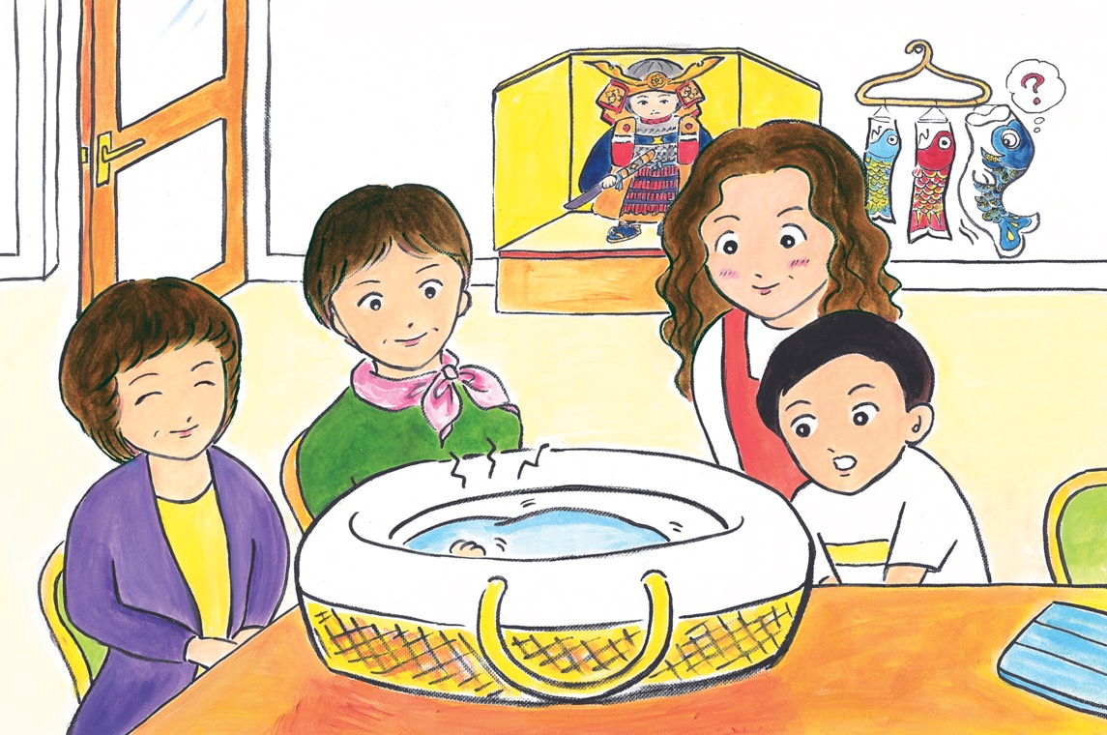
Notes:
7
Two women came in with a huge basket. All three grown-ups looked very happy to see each other and Makoto’s mummy was delighted to see what was inside it. Koisuke wondered if it was a big present. Then he heard a noise
coming from the basket. It sounded like a strange animal with a breathing problem. Koisuke felt a bit worried. Makoto, who had been ignoring them, looked up. Makoto’s mummy said to him, “They brought their new baby! It’s his first outing!”
Auntie put both hands in the basket, lifted up a tiny baby and said, “Makoto-kun, this is your cousin, Hiroki-kun. Come and say hello.”
The bell rang again. Auntie said, “I invited my friends, too. I hope you don’t mind. I wanted us to all celebrate Children’s Day together.”

Slide 8
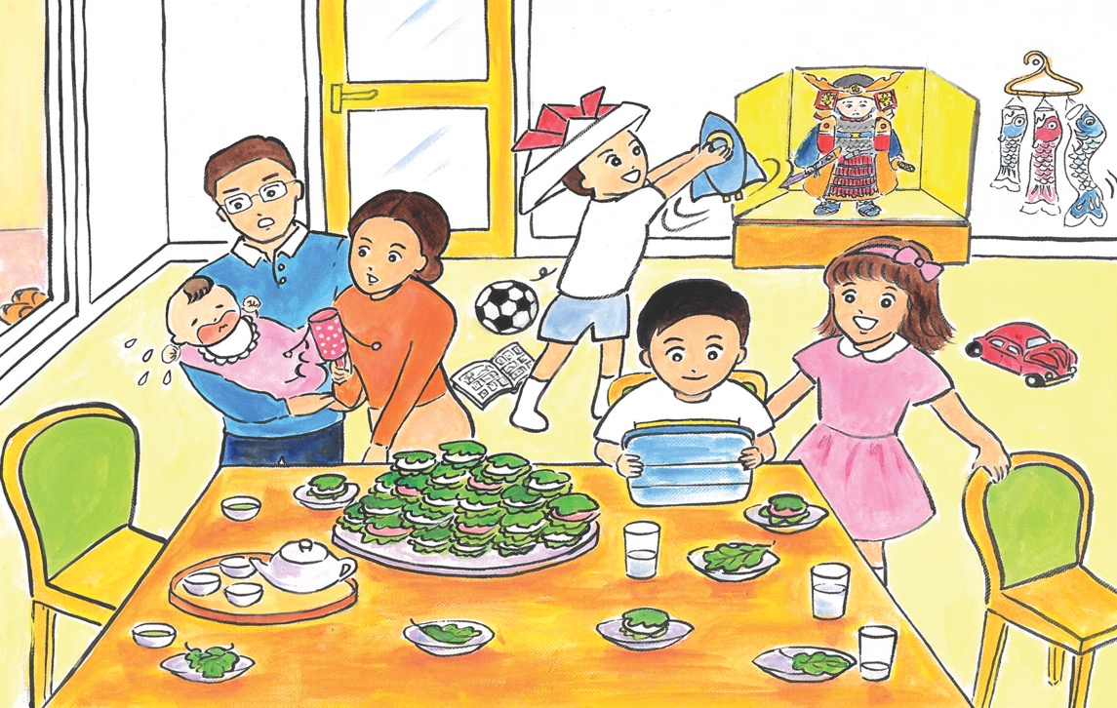
Notes:
8
Mummy went to open the door and there was a burst of noise. When she came back into the room, she was followed by a couple and two children - a boy and a girl, both a similar age to Makoto. Their daddy was holding yet another small baby. Everyone was very excited to see each other.
Makoto’s mummy brought a mountain of kashiwa mochi with tea and juice. Makoto was still glued to his tablet but he enjoyed some juice and a couple of kashiwa mochi. He felt his mood beginning to change. The boy and the girl
were so impressed by his tablet and joined him to watch the cartoon. Then they asked him if they could all play together. The children started to run around and almost knocked over the table, and then the babies started to cry. It was chaos! Makoto was starting to feel much better.

Slide 9
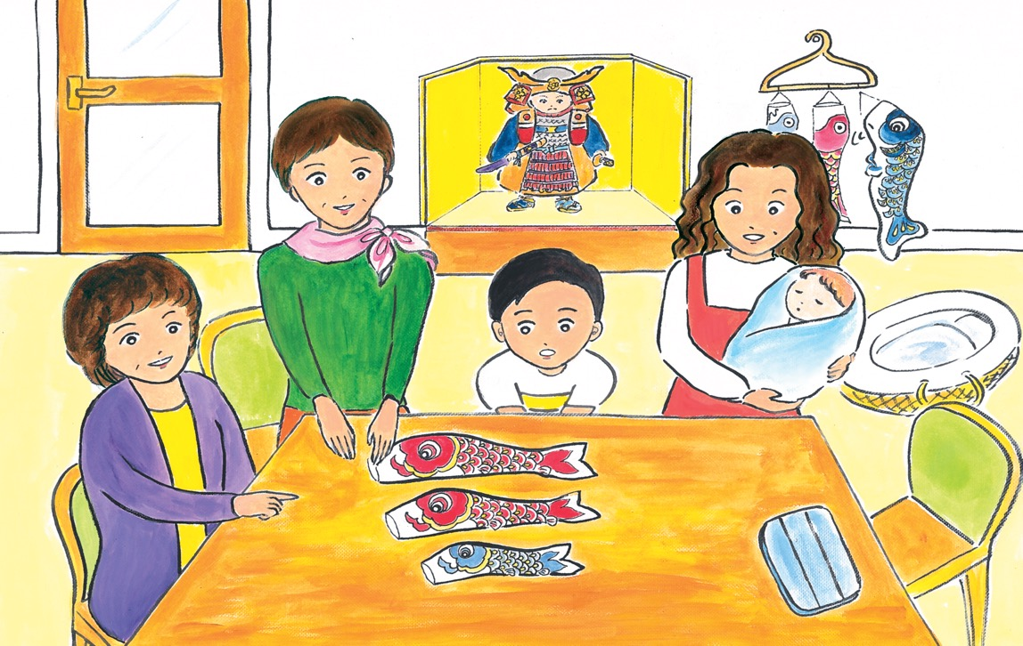
Notes:
9
Later on, Auntie said to Makoto, “I brought something to show you,” and she took out a koinobori set from her big bag. The set was even smaller than Makoto’s one. When she unfolded the flags, Koisuke saw that there were two mummy carp and a child carp.
“This is a bit different from the usual ones, but we wanted it to reflect our family,” said Auntie, and she and her partner smiled at each other. Then Auntie said, “We couldn’t find a set like this, so we had to buy two sets. That’s why
it’s so small – it was too expensive to buy two large sets!” and she laughed.
Her partner said, “With the spare daddy and child flags we will make a pillow for Hiroki and a nappy bag for us!” They laughed some more and everybody joined in.

Slide 10
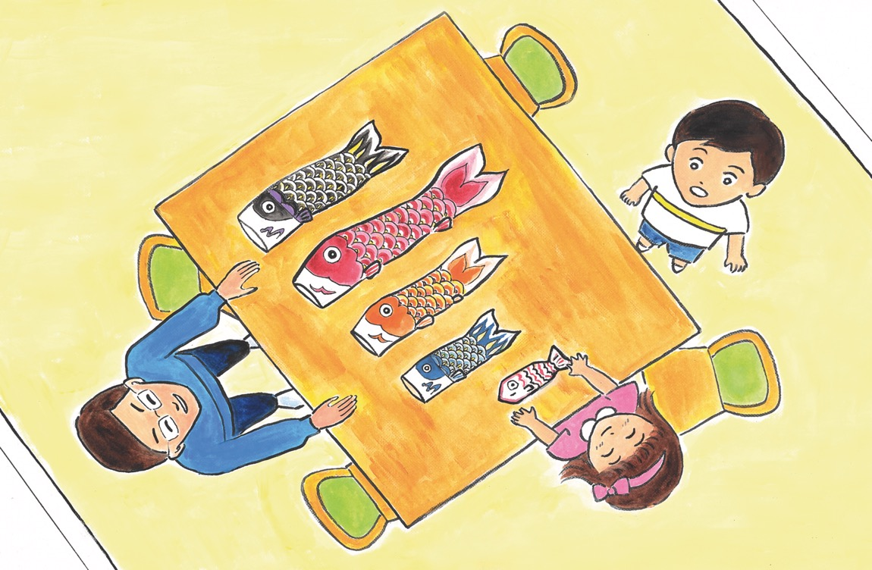
Notes:
10
The dad from the couple said proudly, “We brought ours with us, too” as he took out a very odd looking set of koinobori flags. In this one, the mummy carp was bigger than the daddy carp, and the three child carp were all different sizes. The smallest one was obviously homemade.
The mum in the couple said, smiling, “When we met, we each already had a child, so we’ve combined our sets. My set was quite large and that’s why the mummy carp is bigger than the daddy carp. No offence!”
There was more happy laughter. “Now we have a new baby sister, so we made a baby fish, too!” explained the girl as she pointed at the smallest carp, which attracted much admiration.

Slide 11
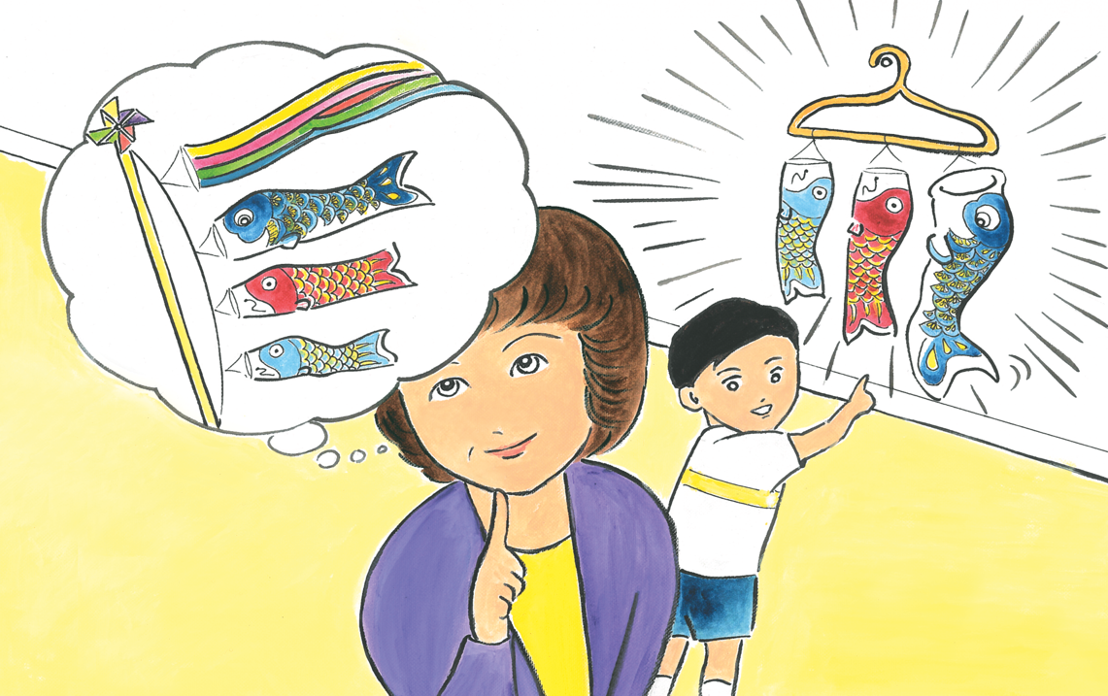
Notes:
11
Then the boy and girl asked Makoto where his koinobori set was. Makoto reluctantly pointed at the hanger on the wall, where Koisuke was hung up with the two other carp. Auntie said, “They look good there, but aren’t they a bit upside down? Shall we tie them together? Do you still have a pole?”
Makoto’s mummy went to get the carp and the pole, explaining that Koisuke was an accidental addition. Looking at them, Auntie said, “This is an interesting set too. It has two Makoto-kuns! A small one who is being looked after by mummy and a big one who is in charge of looking after Mummy!”
She put the three together in a row on the pole with Koisuke at the top. Koisuke felt a little embarrassed, but the other two carp looked happy so he started to feel rather proud. Now he had a family to look after and it felt so good not to be hanging upside down from the hanger, but attached to the pole the right way up.

Slide 12
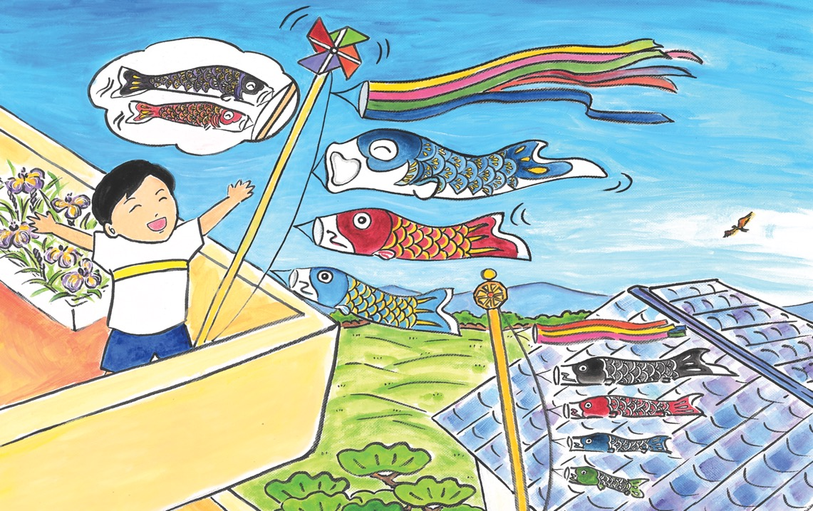
Notes:
12
Everyone went out onto the balcony with the three koinobori sets. The weather had improved and the satsuki bare was back. The wind was blowing strongly again. Hyuu Hyuu.* The three different koinobori sets were all swimming
strong and gracefully. Makoto’s set had pride of place in the corner of the balcony, looking out over the enormous pond of sky full of swimming carp. Each family was proud of their koinobori and even Makoto enjoyed looking at
his set. Koisuke didn’t want to leave the pole anymore. He was sure his parents would be proud if they saw him now. Hata Hata Hata.**
* Hyuu Hyuu is an onomatopoeic word for the sound of whistling or the wind.
** Similar to pata pata, with the impression of something moving more gently.

Slide 13

終わり
o-wa-ri
(The End)
Notes:
For more resources, visit www.japansociety.org.uk.

Slide 14

For more resources, visit www.japansociety.org.uk.
Notes:
For more resources, visit www.japansociety.org.uk.

