Slide 1
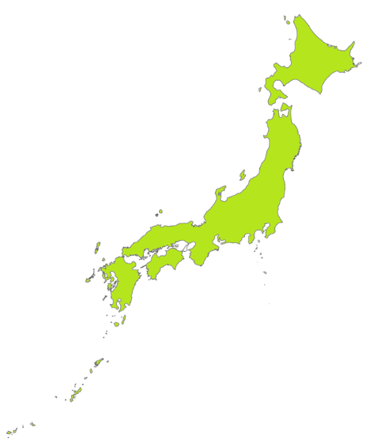
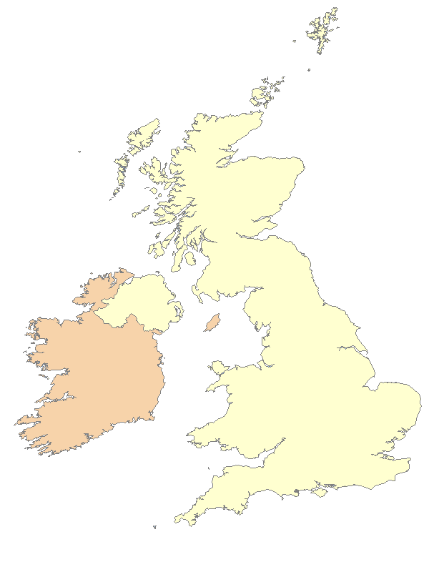

Starter
Discuss the following questions and decide whether you think the answer is...
or
Japan
the UK
Notes:
Teacher’s Note
You can format this starter activity however you like.
Pupils could “vote with their feet”. One side of the classroom is Japan, and the other side is the UK. Pupils stand on the side of the classroom they think the answer is.
Pupils could work in teams/pairs and write down their answers on mini whiteboards and hold up their answers.
Allow pupils time to discuss each question before revealing the answers.

Slide 2
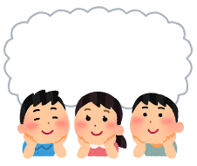
Which country…
... Has the highest mountain?
... Is smaller?
... Has the most populous city?
(largest population)
or
Notes:
Teacher’s Notes
Ask pupils to discuss the questions on the slide.
Click the slide to reveal each question.
Explain what the word “populous” means if necessary.

Slide 3


1. Which has the highest mountain…
The Japan Society
Notes:
Teacher’s Notes
Reveal the answer by clicking on the slide again for the animation.

Slide 4
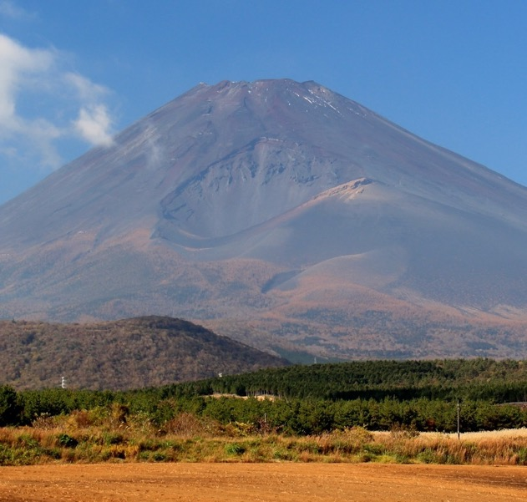
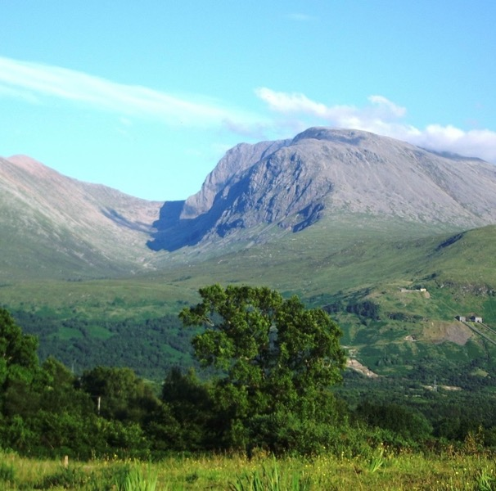
Japan has the highest mountain!
Mount Fuji
Ben Nevis
Mount Fuji by Alpsdake, CC BY-SA 4.0
Image of Ben Nevis, public domain
Notes:
Teacher’s Note
Ask pupils if they know the names of either mountain.
Mount Fuji (L) is 3,776 m and it is also an active volcano. The last time it erupted was 1707!
Ben Nevis (R) is 1,345 m. Ask pupils if they know where it is: England, Scotland, Wales or N. Ireland?
You could tell pupils that a long time ago it used to be an active volcano.

Slide 5
2. Which is smaller …
The Japan Society
Notes:
Teacher’s Notes
Reveal the answer by clicking on the slide again for the animation.

Slide 6
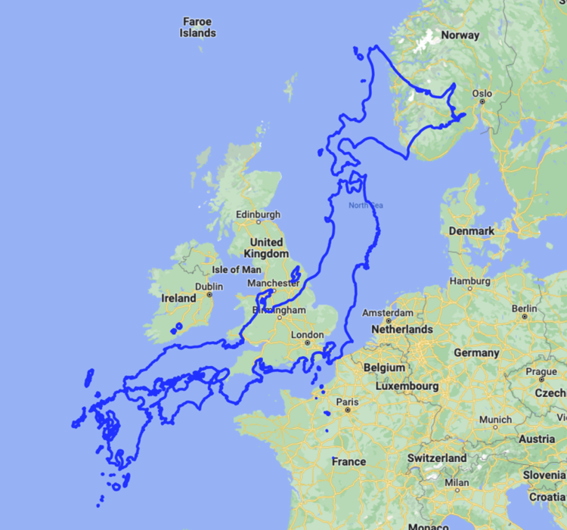
The UK is smaller than Japan!
Map Data © Google 2022, edited by the Japan Society
Notes:
Teacher’s Note
Tell pupils they might think the UK is bigger because of the size of the images on the previous slides and/or maps which are not to scale.
Explain that Japan is actually bigger – the image above shows how big Japan is in comparison to the UK!

Slide 7
3. Which has the most populous city…
Notes:
Teacher’s Notes
Reveal the answer by clicking on the slide again for the animation.

Slide 8
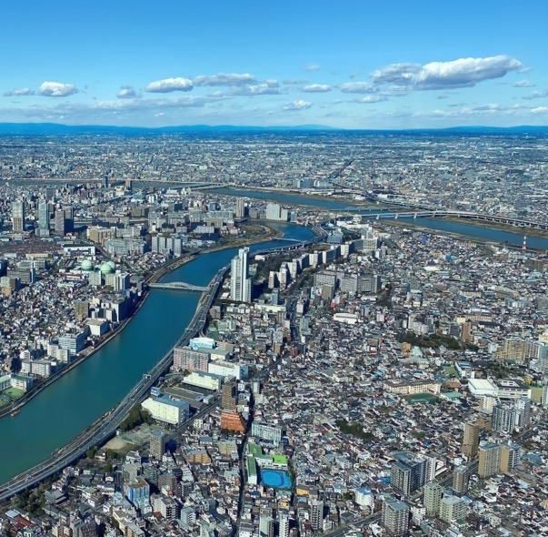
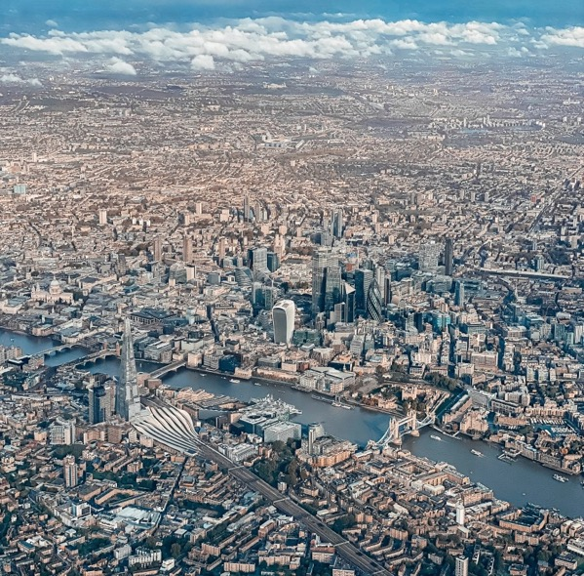
Japan has the most populous city.
Tokyo
London
Notes:
Teacher’s Note
Check pupils know the capital cities of Japan and the UK.
Here Tokyo (approx. 14 million people) is compared to London (approx. 9 million people).
You could compare Tokyo to Cardiff, Edinburgh, or Belfast (all under 1 million) as well.
Greater Tokyo is considered the world’s largest city.

Slide 9
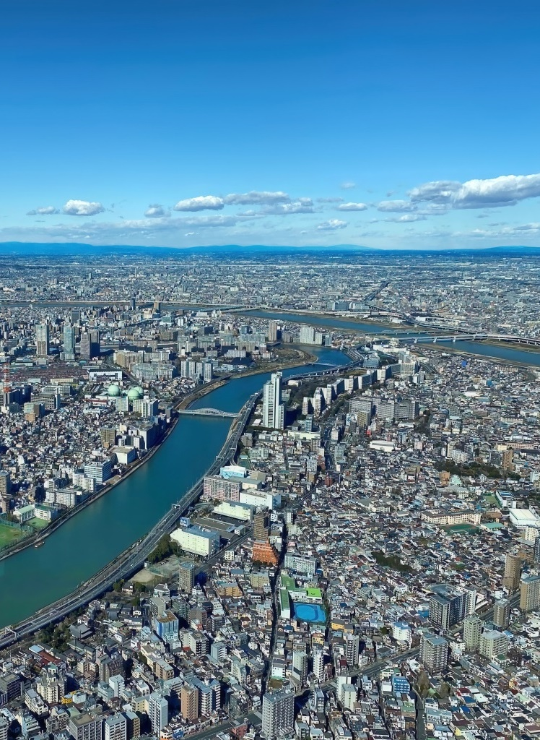
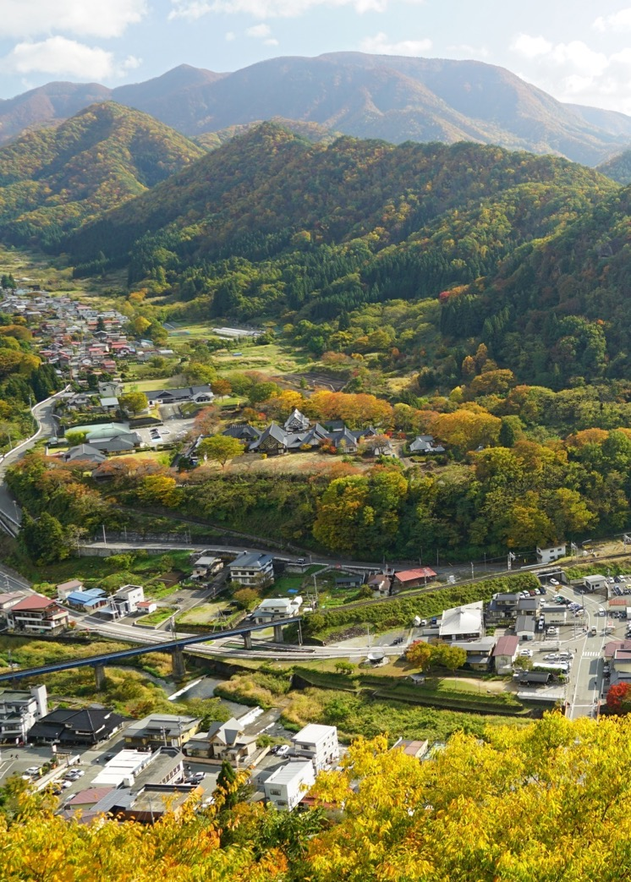
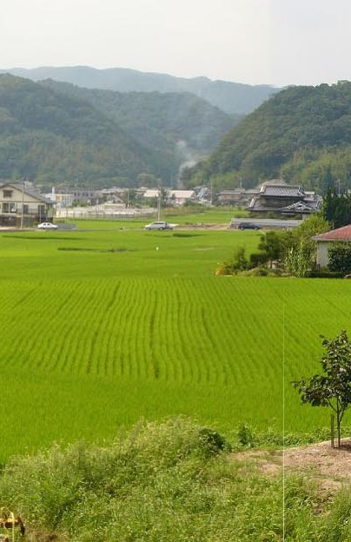


Rural and Urban Japan
Notes:
Teacher’s Notes
Introduce the topic of today’s lesson.

Slide 10
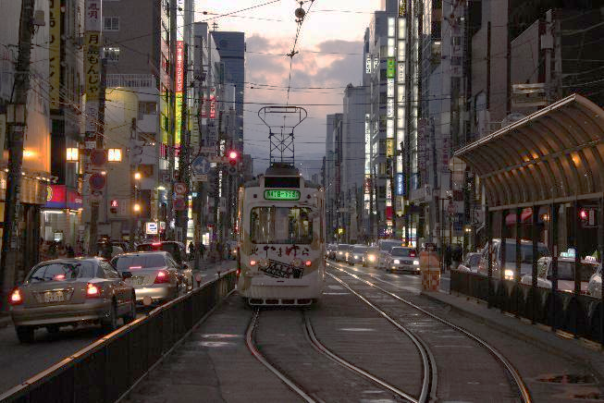
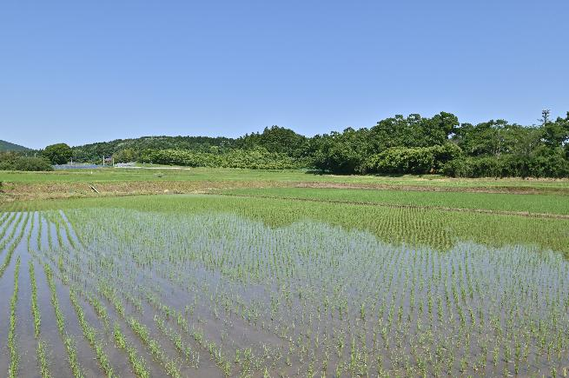
Learning Objectives
To recognise the similarities and differences between rural and urban areas in Japan.
To consider and evaluate the advantages and disadvantages of these areas.
Notes:
Teacher’s Notes
Introduce today’s Learning Objectives.
Images from Wikimedia Commons:
https://commons.wikimedia.org/wiki/File:Sapporo_electrical_tramway;_2009.jpg
https://commons.wikimedia.org/wiki/File:Rural_scenery_(Ishioka_City,_Ibaraki_Prefecture,_JAPAN).jpg

Slide 11

Key Words
Rural
Urban
Population
City
Countryside
Similarities
Differences
Facilities
Notes:
Teacher’s Notes
Introduce this lesson’s key words.
Ask pupils if they know what these words mean/how they would define them.
Illustration from Irasutoya.

Slide 12
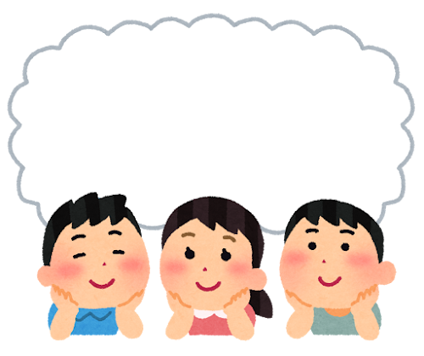
Discussion
What words would you use to describe Japan?
noisy
fast trains
peaceful
green
busy
mountains
tall
buildings
farmland
Notes:
Teacher’s Notes
Before diving into the main learning of today’s lesson, ask pupils to discuss either in partners or in groups what words they would use to describe Japan, based on what they have learned so far. Pupils can also do this task individually at first, noting down words independently before sharing with a partner/group.
Use the words on the slide to help prompt discussion. You could share some photos of Japan to give pupils ideas.
Illustration from Irasutoya.

Slide 13
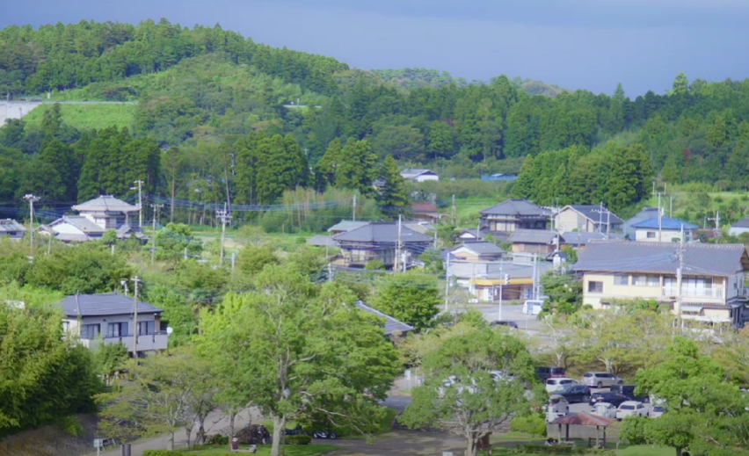
Watch the video to find out more!
Notes:
Teacher’s Note
Copy and paste address into your browser if the hyperlink doesn’t work: https://youtu.be/_01Eat0Zo_Q

Slide 14
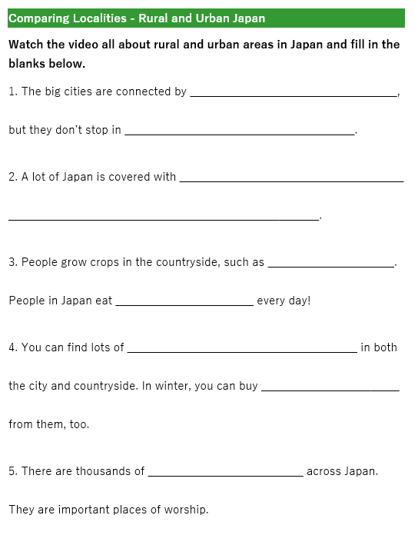
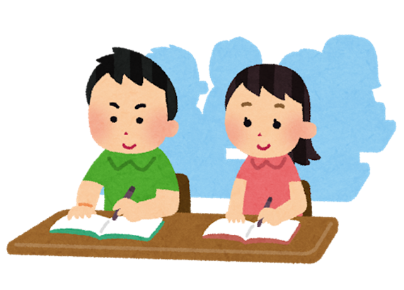
Task 1:
Watch the video again, and fill in the blanks on your worksheet.
Notes:
Teacher’s Notes
Hand out the worksheet. Pupils should fill in the blanks based on what they hear in the video.
If pupils are struggling, you could provide a word box with the answers, so that all pupils need to do is match the word from the box to the correct sentence.
Answers:
Bullet trains (shinkansen), small towns
Forests and mountains
Rice, rice
Vending machines, hot drinks
Shrines
Illustration from Irasutoya.

Slide 15
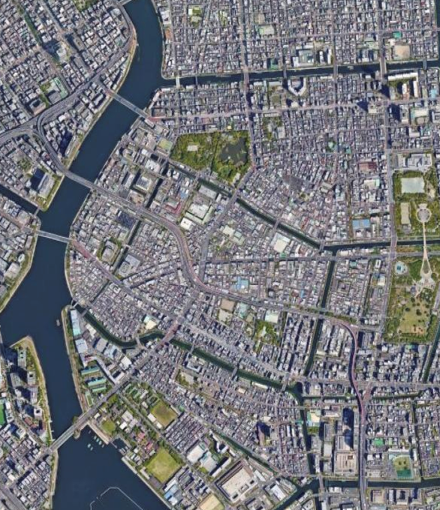
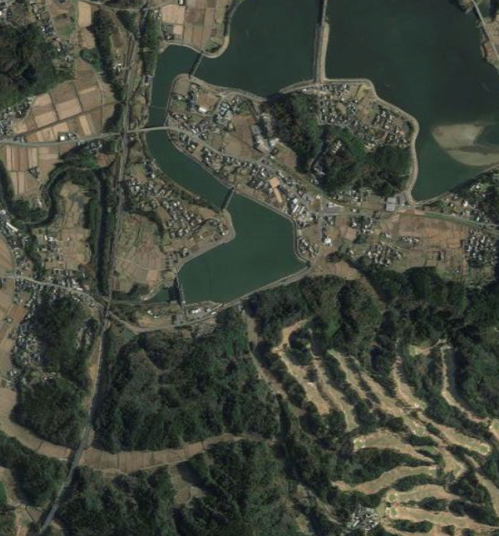
Challenge: Find one difference and one similarity between the pictures below.
Notes:
Teacher’s Note
After watching the video, ask pupils to look at the screen and think of at least one similarity and one difference between these images.

Slide 16

Let’s take a
closer look!
Notes:
Teacher’s Notes:
Slides 19-28 offer a closer look at life in rural and urban Japan.
Illustration from Irasutoya.

Slide 17
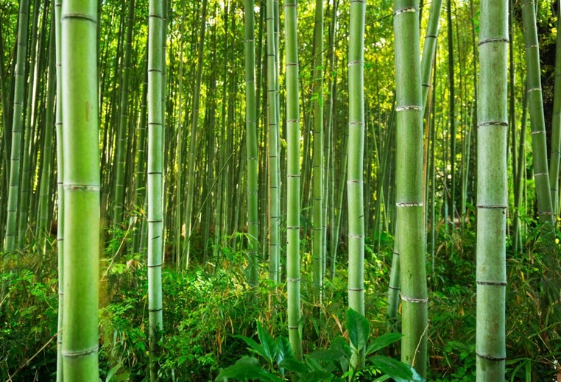
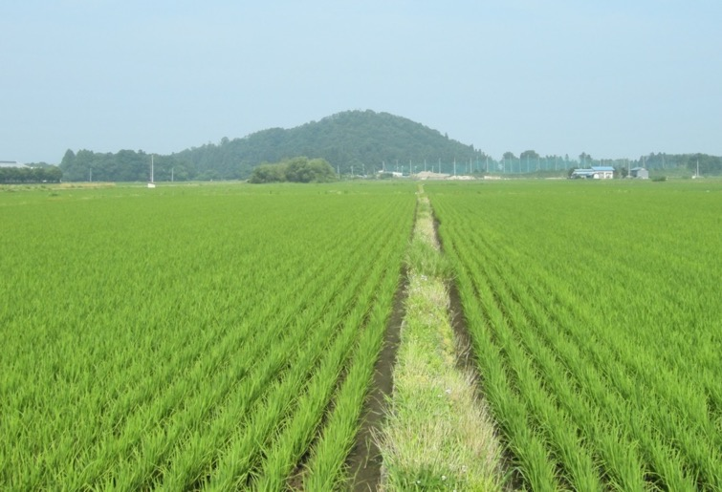
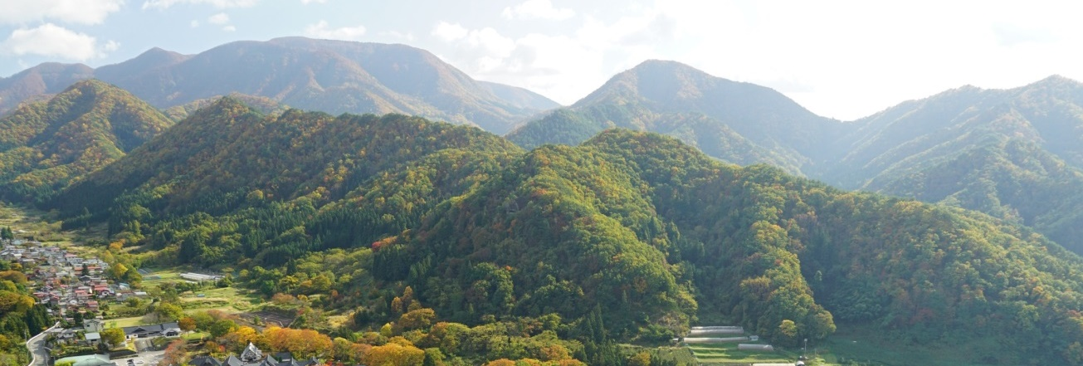
Bamboo 竹
Rice Paddies 田んぼ
Rural Japan
Mountains and Forests 山と森
Notes:
Teacher’s Note
This slide is intended as a quick look at some features seen in rural Japan – pupils may have more ideas.
More details are given in the following slides.

Slide 18
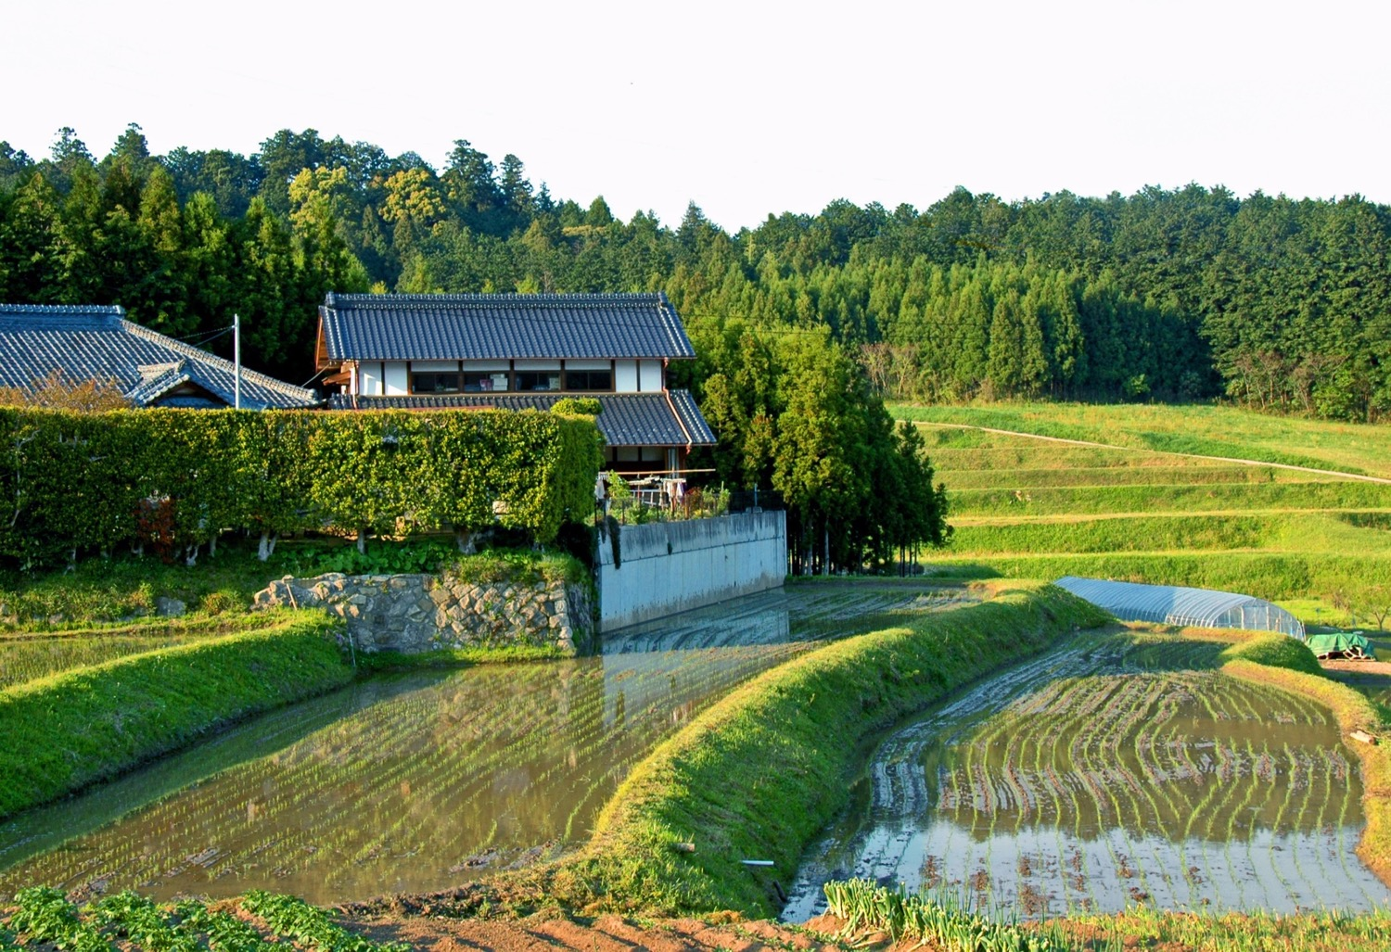
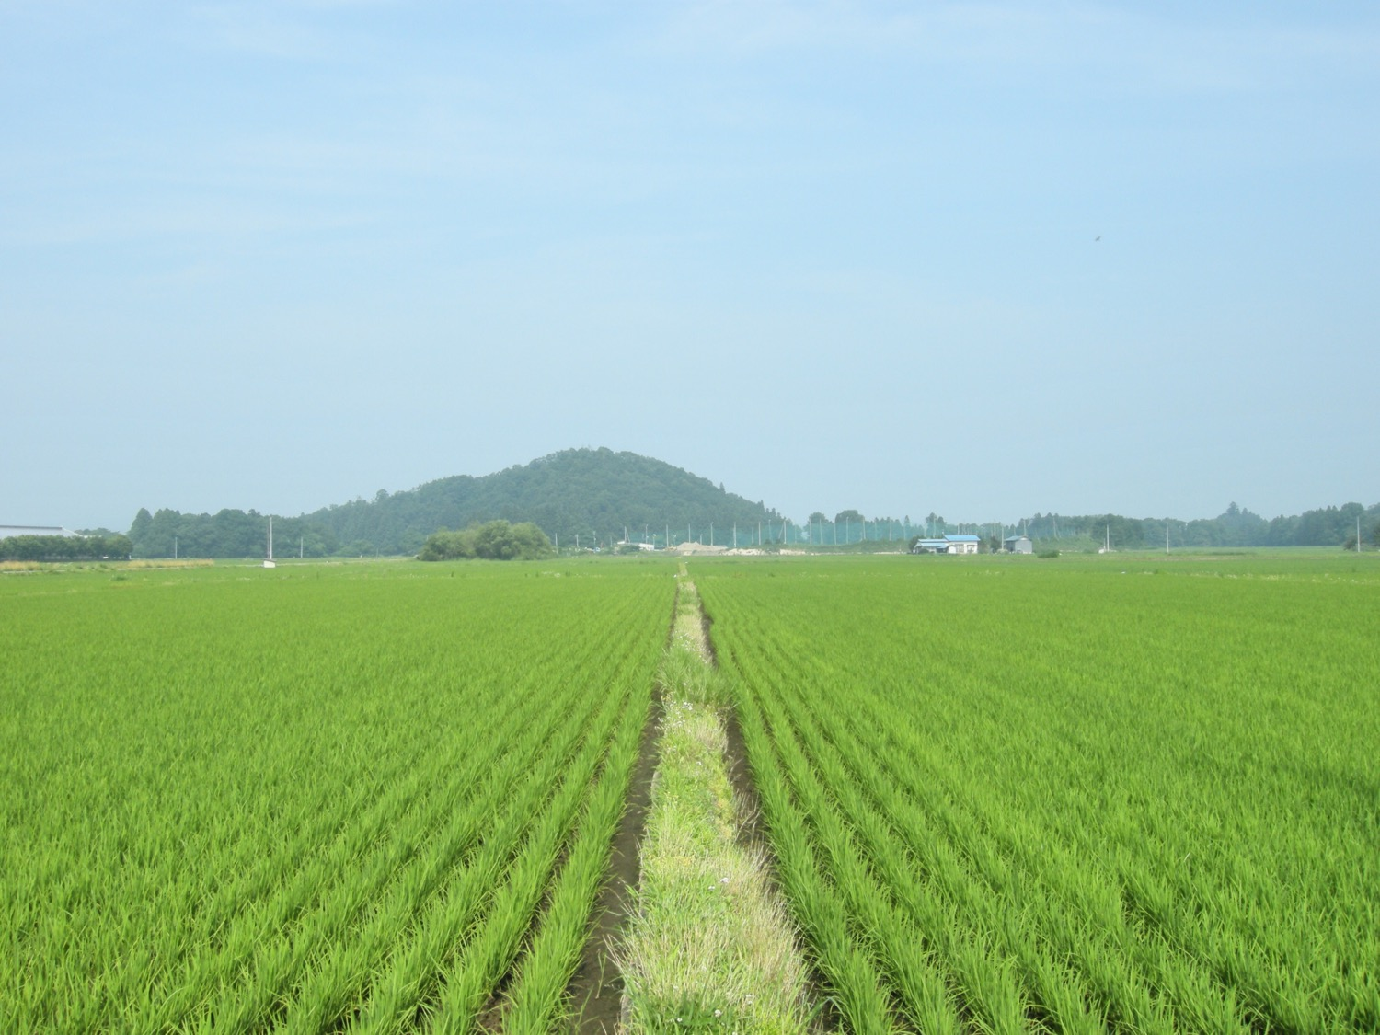
Notes:
Teacher’s Note
Recap the video explanation that rice is eaten everyday in Japan so land is needed to grow the rice.
Explain that the paddies need to fill with water (see second image) to grow rice so the land has to be flat.

Slide 19
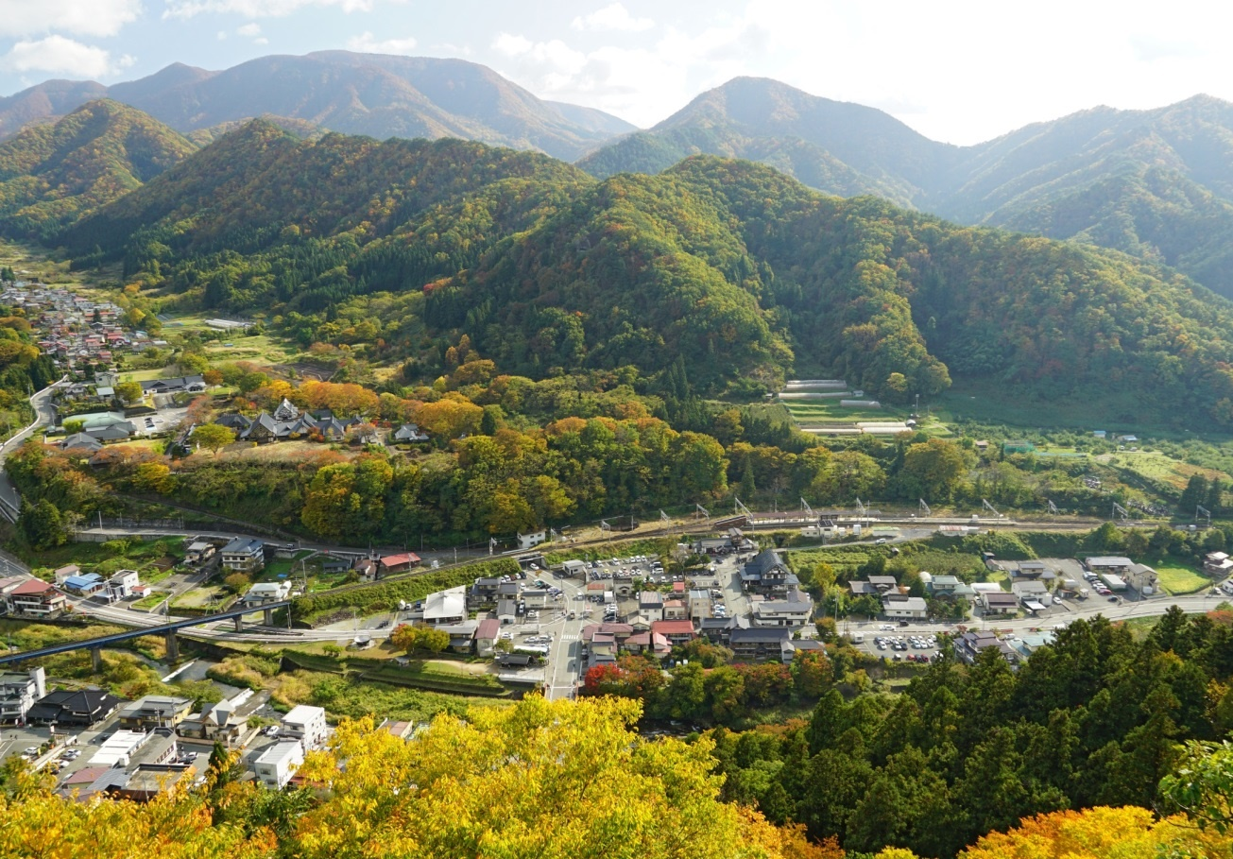
Notes:
Teacher’s Note
Tell pupils that a lot of Japan is covered in mountains and forests.
Approximately 70% of Japan’s land is mountainous.
And 68.5% of the land is forested areas (according to CIA world factbook, 2018).
Draw their attention to the roads and buildings – where are they? (Elicit the answer: flat land – because Japan is so mountainous, cities, towns, and villages are built in the more limited areas of flat land)

Slide 20
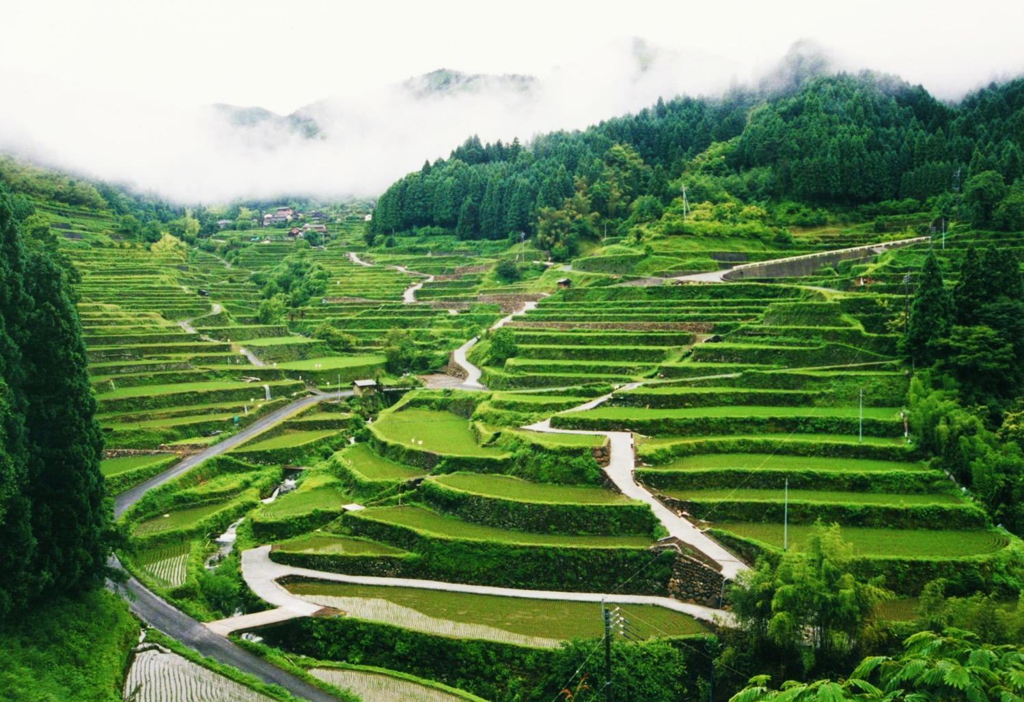
Notes:
Teacher’s Note
Here there are terrace rice paddies in the mountains and some buildings in the distance.
However, the mountains and forests mean that a lot of the land in Japan isn’t suitable for farming or for building places like homes, shops and schools.
There is a limited amount of suitable space for building on which is one reason why Japanese cities are so populous.

Slide 21
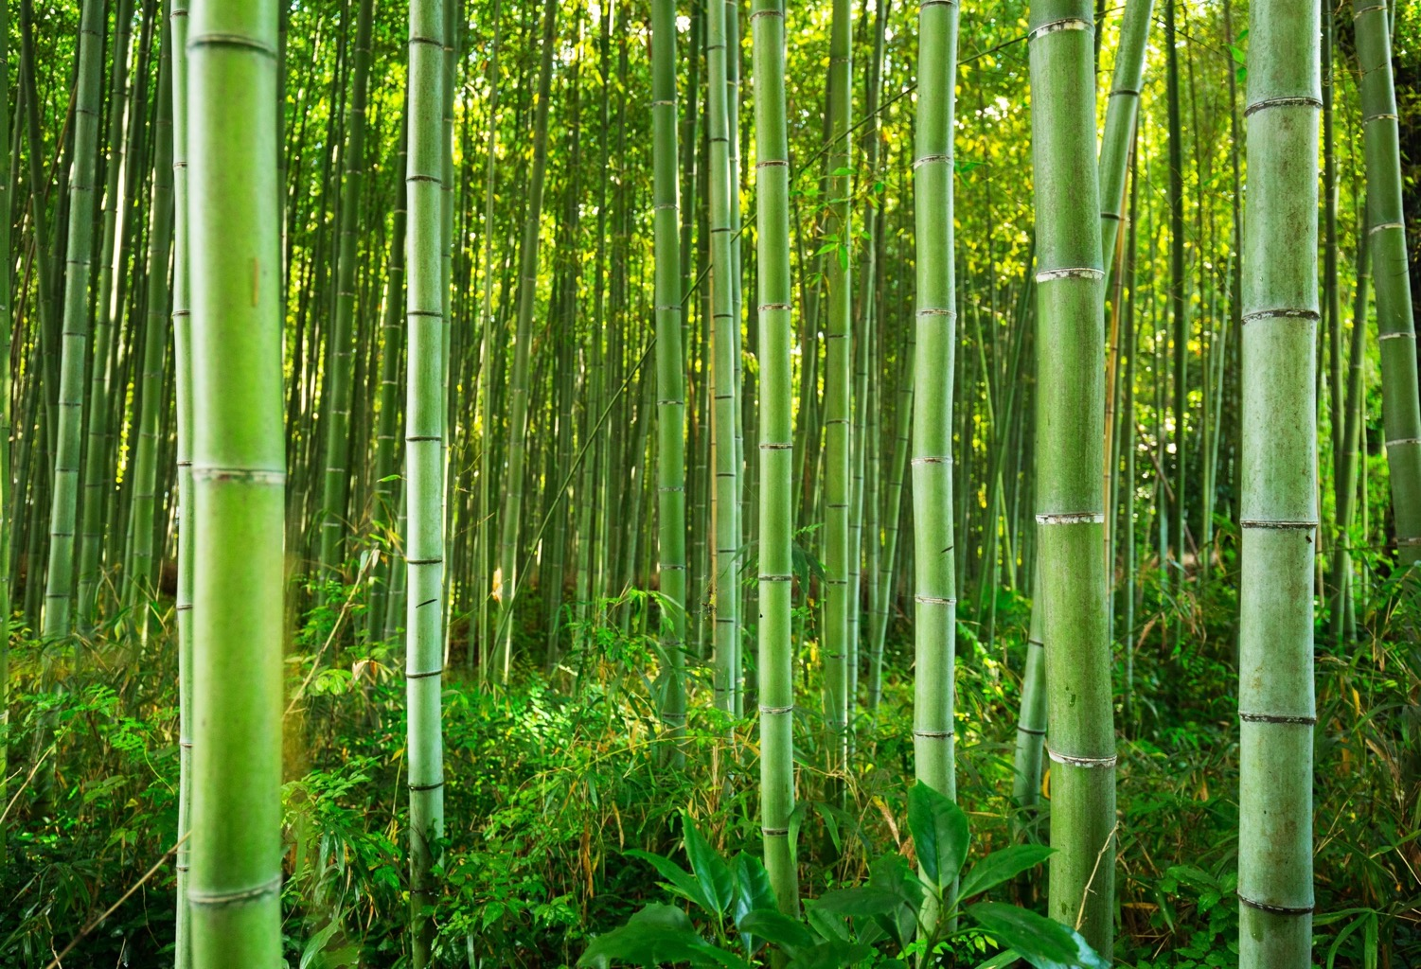
Notes:
Teacher’s Note
Bamboo is well suited to the Japanese climate (warm and humid) so bamboo groves are a common sight in rural Japan.
It grows quickly and is a strong and flexible material.
Objects such as toys, musical instruments, chopsticks and furniture can all be made from bamboo.

Slide 22
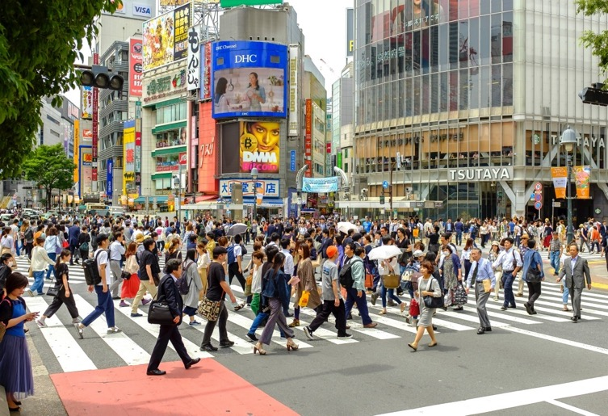
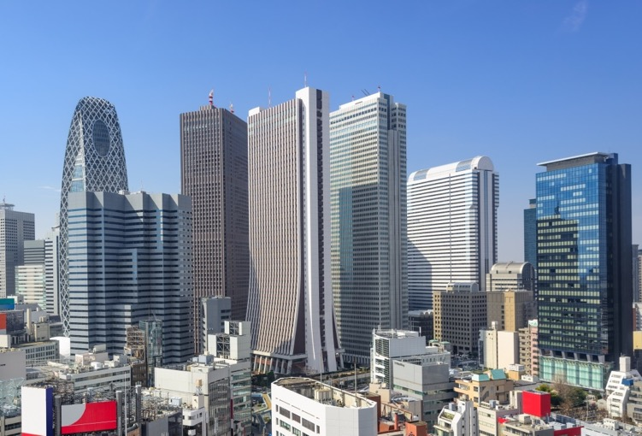
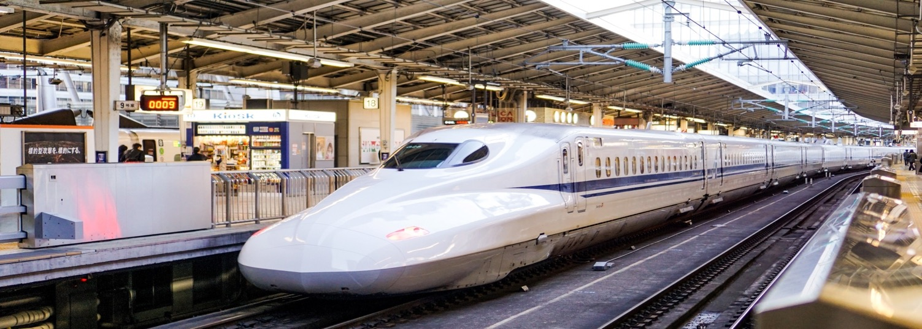
Busy streets にぎやかな道
Tall Buildings 高いビル
Urban Japan
Bullet Trains 新幹線
Notes:
Teacher’s Note
This slide is intended as a quick look at some features in urban areas – pupils may have more ideas.
More details are given in the following slides.

Slide 23
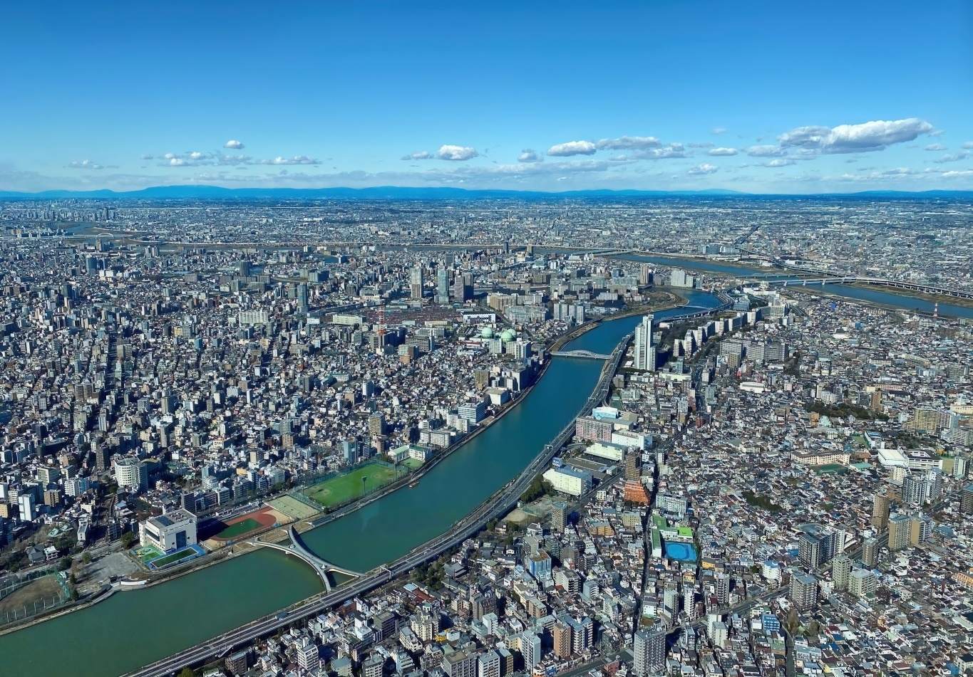
Landscape
Notes:
Teacher’s Note
This is Tokyo. Can they see any mountains? (They might be able to make out the mountains in the far distance).
Why might this area have developed into a city? (As appropriate for your class – flat land, proximity to a river, etc.)

Slide 24
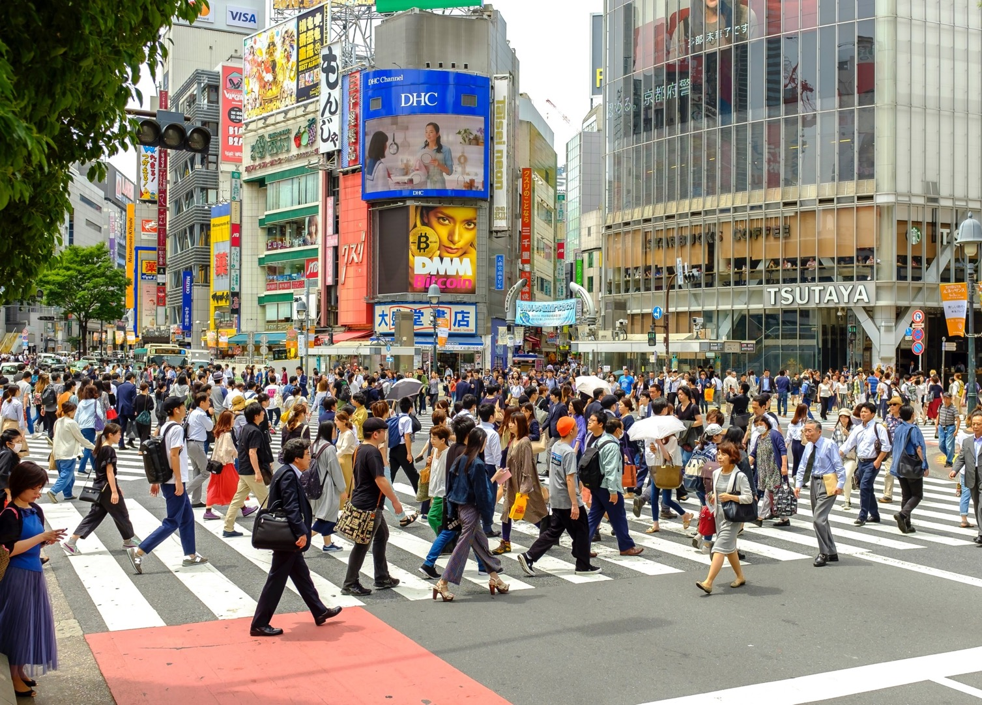
Notes:
Teacher’s Notes
The majority of the population in Japan lives in cities (92% according to the CIA World Factbook, 2022), making them very busy.
There are lots of people, places to work, and leisure and entertainment options.

Slide 25
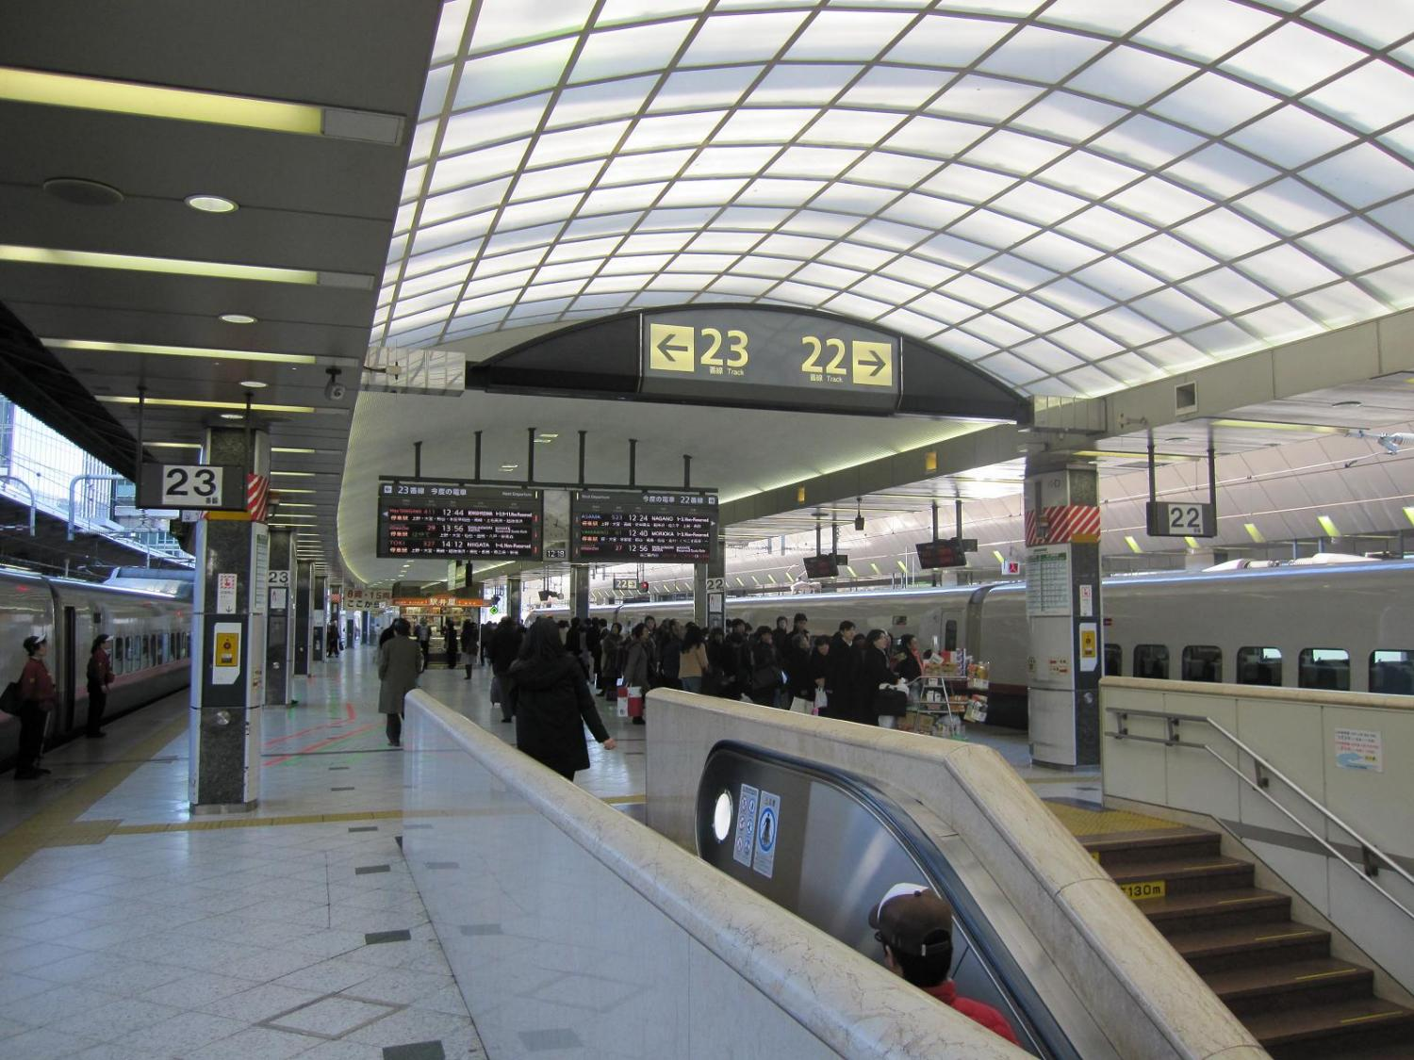
Notes:
Teacher’s Notes
Japanese cities are well-connected. People travelling in cities in Japan will have a lot of options to get to their destination using public transport, possibly including: planes, high-speed trains called shinkansen (bullet train), local trains, the metro system, buses, taxi, tram, and monorail.
Point out that the station in this image has over 20 platforms!

Slide 26
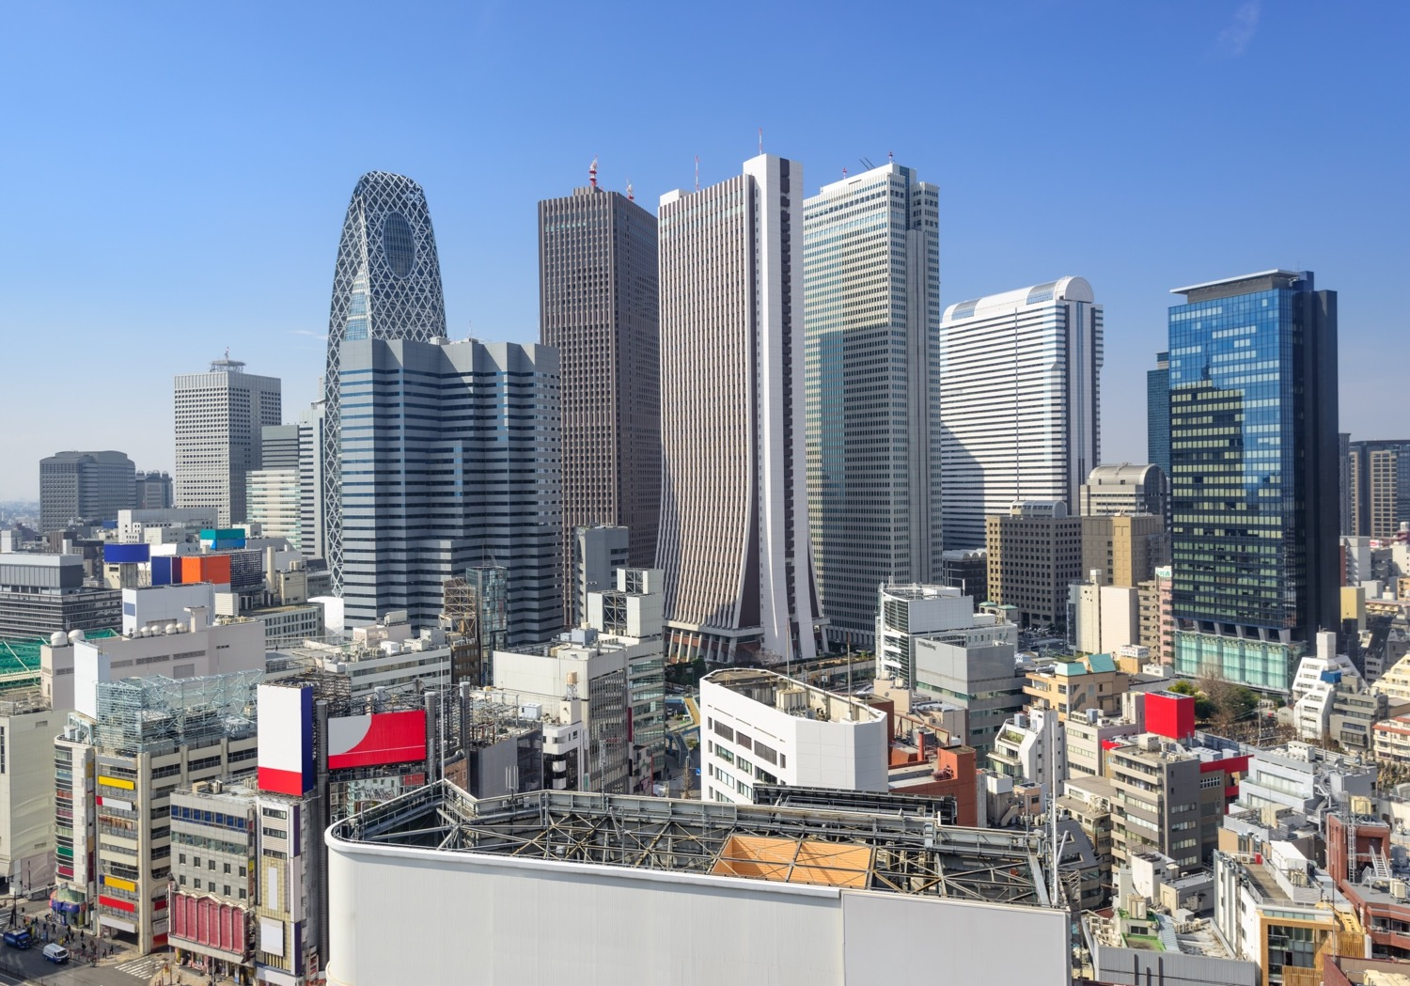
Notes:
Teacher’s Note
These tall buildings are offices in central Tokyo.

Slide 27


Urban and rural areas have differences, but they also have things in common.
Wherever people live, they need access to basic facilities, such as homes, shops and schools.
Facilities may be different, depending on the area.
Let’s look at some examples…
Notes:
Teacher’s Notes
Remind pupils that, even though rural and urban areas may look very different, they still share many similarities!
Slides 30-37 offer a closer look at common amenities and facilities that you can find in both rural and urban areas.

Slide 28
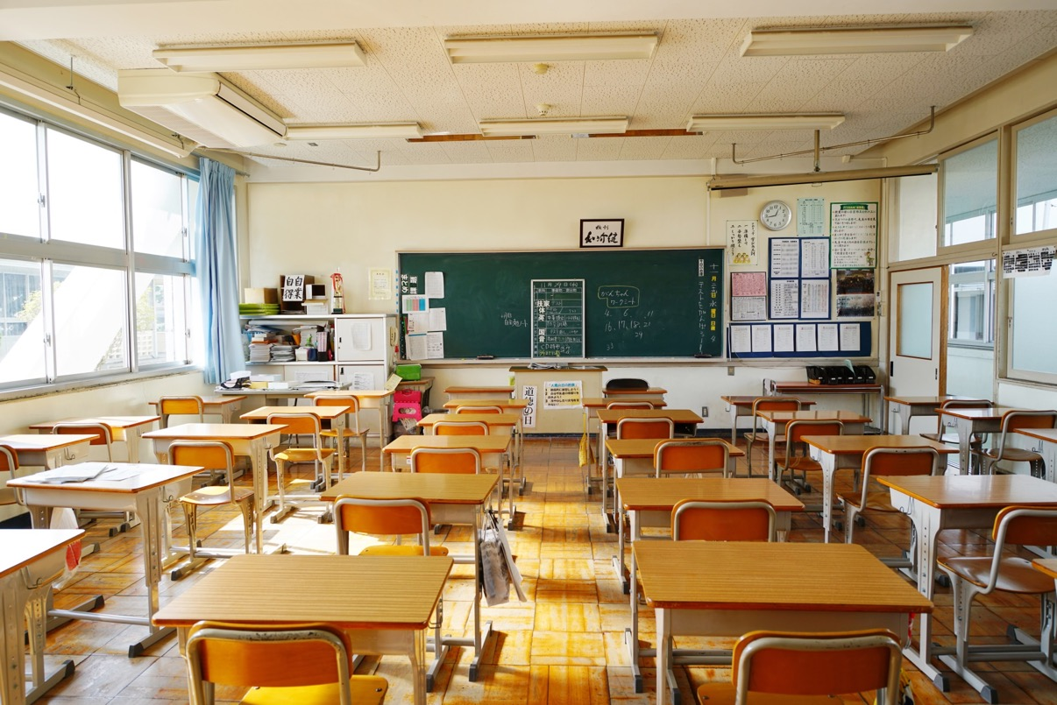
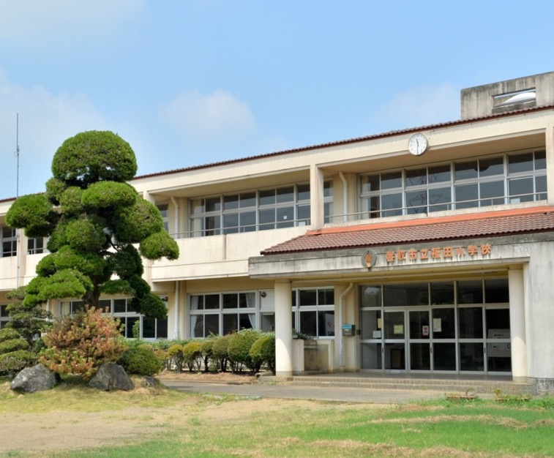
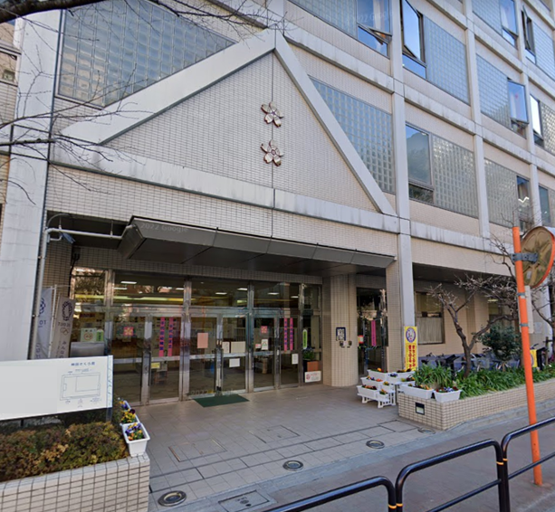
Schools
Notes:
Teacher’s Note
Left: a typical school in rural or suburban Japan (2 or 3 stories high with a large open playground for sports)
Right: a city school on a road and attached to neighbouring buildings.
Additional image: Classrooms in both rural and city areas look similar – each student has a desk which can be easily moved for group work or lunch times (lunch is eaten in the classroom).

Slide 29
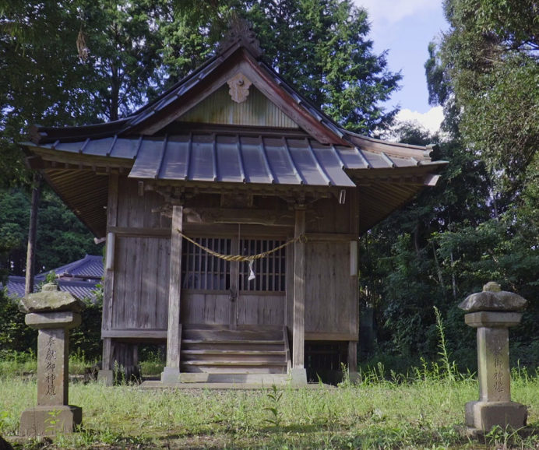
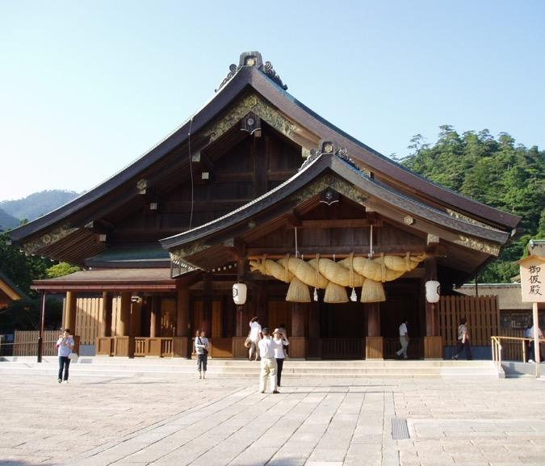
Places of Worship
Notes:
Teacher’s Notes
Left: Students see this building in the video – do they remember what it is? It’s a shrine, which is a Shinto place of worship. This is a small local one.
Right: This shrine (Izumo Taisha in the city of Izumo) is one of the oldest and most important shrines in Japan. It is a popular tourist sightseeing spot.
The two main religions in Japan are called Shinto and Buddhism. Shinto is Japan's own religion, Buddhism came to Japan from other countries.
There are both Shinto shrines (and Buddhist temples), large and small, all across Japan in rural areas and city centres.
There are some churches, mosques, and other religious places of worship, but they are not as common.

Slide 30
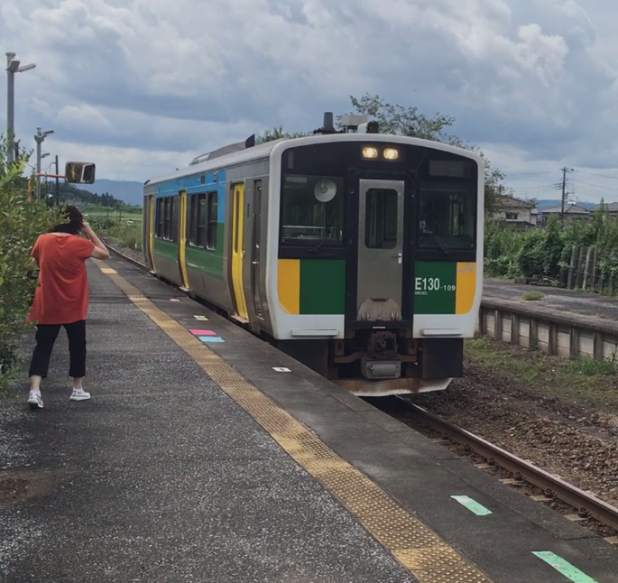
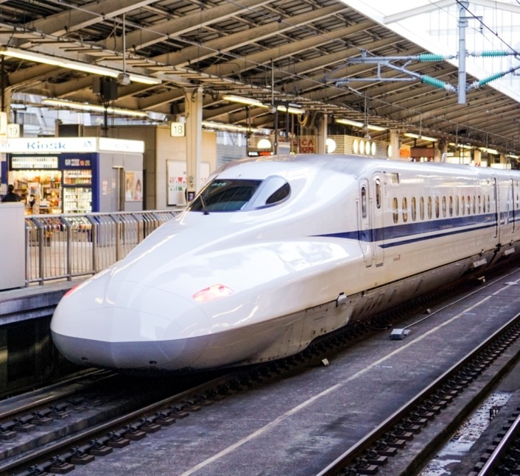
Transport
Notes:
Teacher’s Note
Left: A local train with only 1 carriage – it will make lots of stops in towns and rural areas.
Right: The shinkansen or ‘bullet train’ travels a long distance and is very fast. It only stops at major cities.
Ask students: Does this look similar or different to trains you have travelled on? How so?
What other modes of transport did you hear about or see in the video?

Slide 31
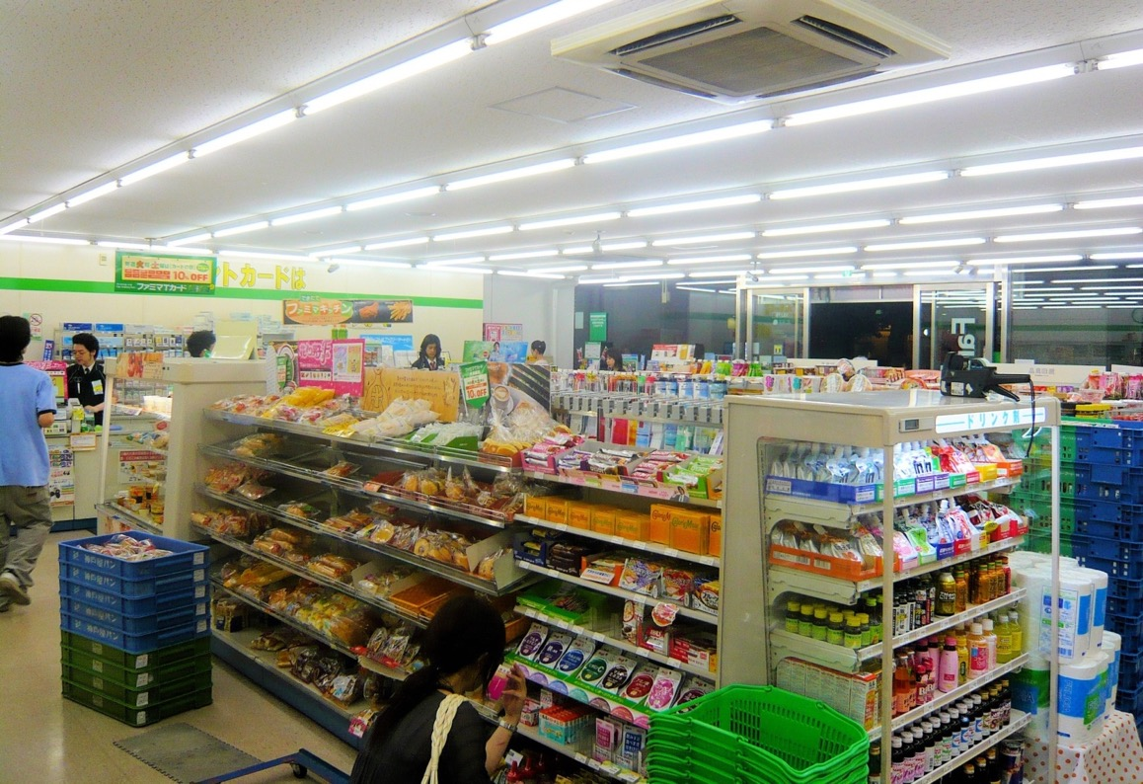
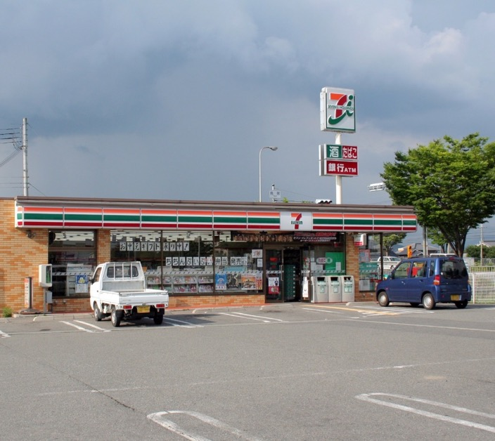
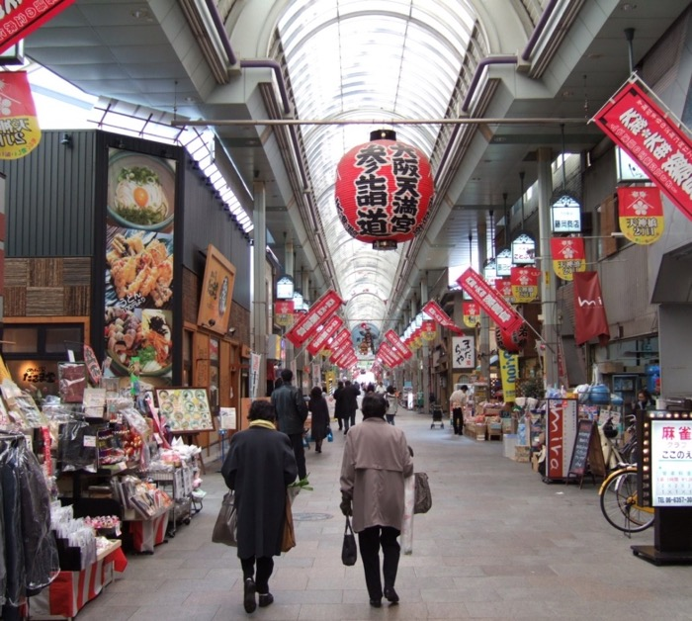
Shops
Notes:
Teacher’s Note
Left: Rural areas may only have a few shops and people may have to drive there. This is a convenience store, called conbini, open 7 days a week, 24 hours a day.
Right: Shows a covered shopping street/arcade – these are common in Japanese cities.
Nowadays many rural areas have a conbini, but in cities they are on practically every street corner. Like a small supermarket, they are well-stocked with things that people might need on the go (see additional image).

Slide 32
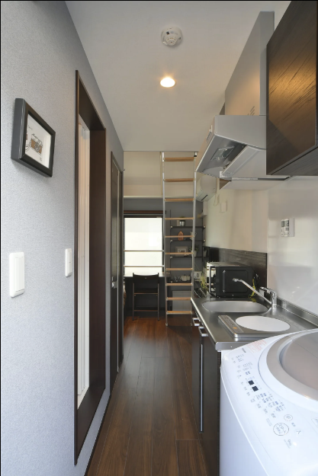
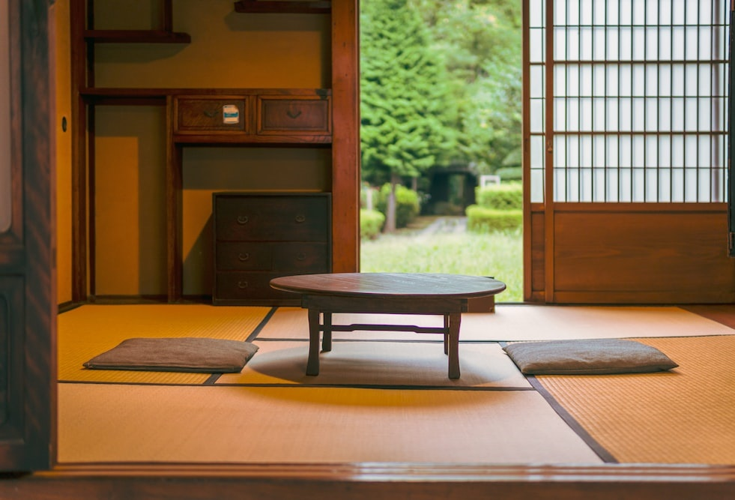
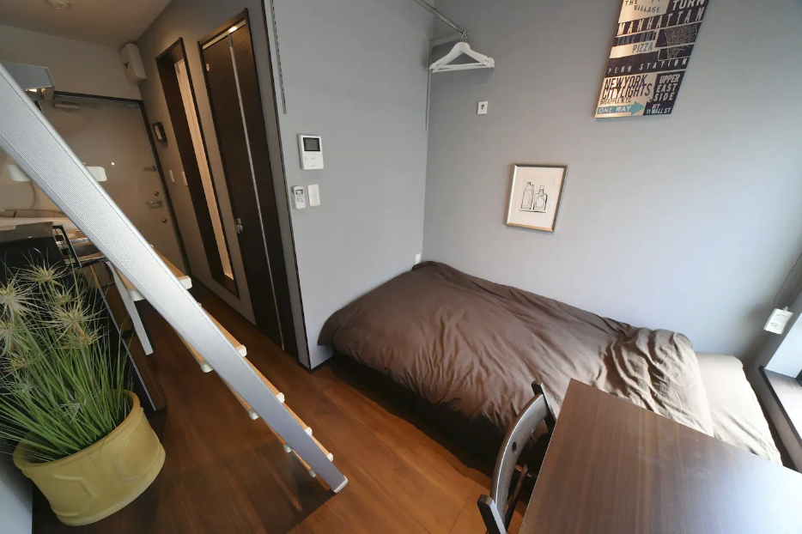
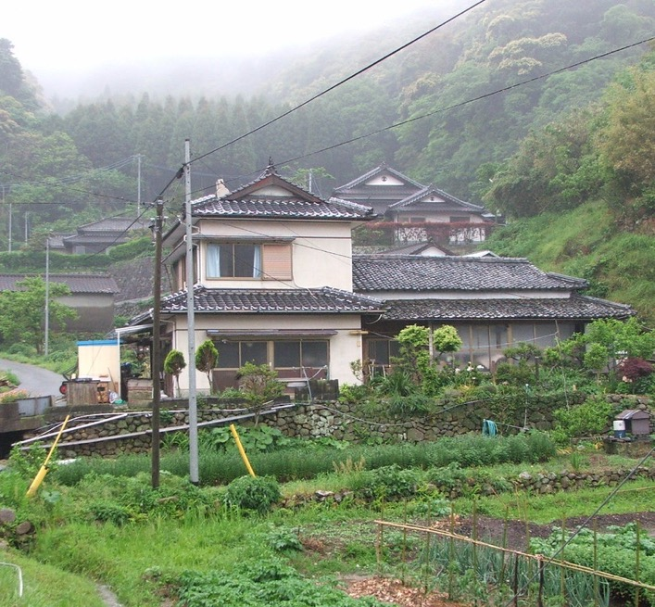
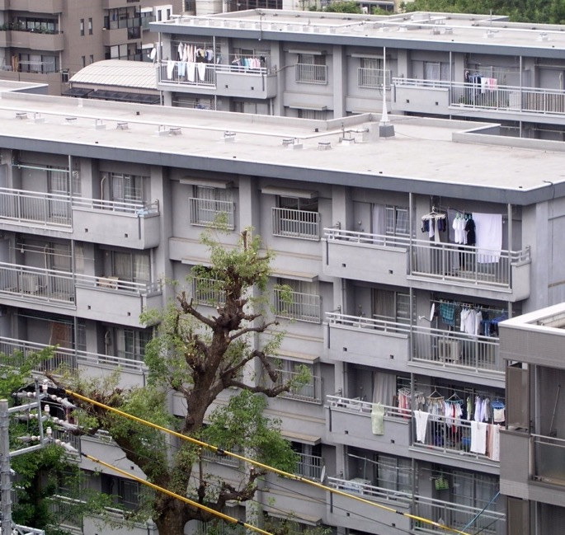
Homes
Notes:
Teacher’s Note
Left: A large detached home in a rural area. Traditional-style homes featuring paper sliding doors (shoji) and tatami mats are more common there.(See additional image)
Right: Apartment buildings in cities. Many people in cities live in apartments. Some are very small (see additional image)
Additional images: Traditional tatami flooring and paper sliding doors; a “micro” apartment which has a washing machine and kitchen in the corridor by the front door. There is a small bathroom to the left and a bed at the back.

Slide 33
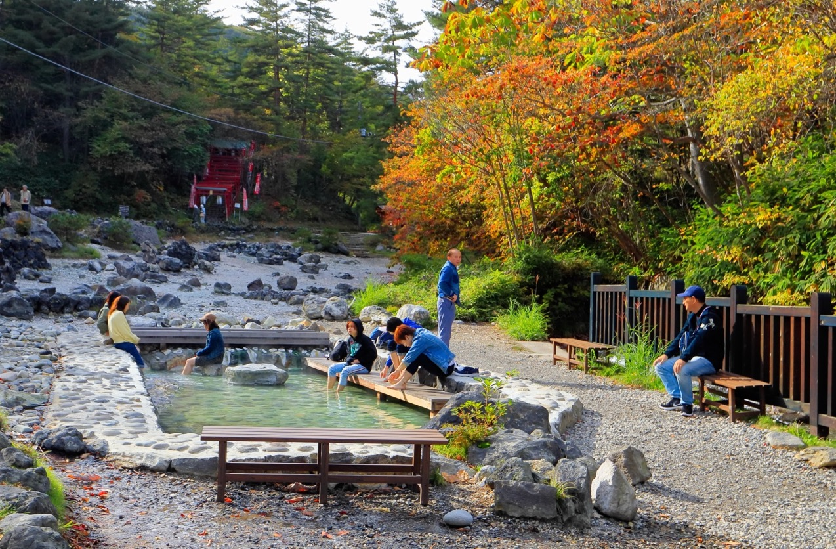


Leisure & entertainment
Notes:
Teacher’s Notes
Left: a hot spring, called onsen in Japanese. Explain that it’s naturally hot water from the ground which people can bathe in.
Right: a games arcade which are a common and popular source of entertainment in Japanese cities.
There are onsen in cities and even ‘onsen towns’ (where there are many hot springs) but many Japanese people also travel to rural areas for relaxing onsen or ‘foot onsen’ in natural settings (see additional image).
Ask students what other forms of leisure or entertainment they would expect to find in cities/rural areas.

Slide 34




Restaurants
Notes:
Teacher’s Notes
Left: A restaurant in a rural area which serves noodles.
Right:A fast-food burger chain in Japan. As well as usual options it has Japanese-style items such as a “Teriyaki Burger”.
Restaurants in cities tend to be brightly lit and in main shopping areas. There are many choices and some streets have lots of very small restaurants clustered together. (See additional image). Rural areas may only have 1 or 2 restaurants.
Some restaurants (in both rural areas and cities) have traditional seating - tatami mats (made from woven straw), with low tables and cushions for the customers to sit on. (See additional image).

Slide 35


Workplaces
Notes:
Teacher’s Note
Left: A local town hall office in a rural area.
Right: Offices and high-rise buildings in central Tokyo.
Ask students for their ideas about other workplaces or jobs people might do in cities or rural areas.

Slide 36


Task 2:
Sort the photos into two groups: rural and urban.
Look at the photos. Using the venn diagram worksheet, write down any similarities and differences you notice.
Notes:
Teacher’s Notes
There are different versions of this activity (see next slide for a more challenging version). You can do both activities or just this one.
In this activity, pupils will be given a set of photos, sorting them two groups “rural” and “urban”. Using the venn diagram worksheet, pupils should note down the similarities and differences between the images.
Draw a venn diagram on the board and do a few examples together as a class.
See additional resources for a venn diagram worksheet or ask students to draw their own.

Slide 37
Task 3:
Look and compare the set of images of Japan to your local area.
Using the venn diagram worksheet, write down any similarities and differences you notice.
Notes:
Teacher’s Notes
This activity is a more challenging version of the previous task. This will encourage pupils to consider and evaluate the similarities and differences between Japan and their local area.
You could also choose photos from somewhere else, like a country you may have studied about previously.

Slide 38

Task 4:
Imagine you meet a genie on your way to school. They offer to move you to Japan!
You can live in the countryside or the city. Discuss with your group:
The advantages of living in this area. ☺
The disadvantages of living in this area. ☹
Notes:
Teacher’s Notes
Assign each group either “countryside/rural” or “city/urban”, and get them to discuss the advantages and disadvantages of their chosen area. They could note down their ideas on a mini whiteboard or in their notebooks. Then, ask each group to feedback their ideas with the rest of the class.
Illustration from Irasutoya.

Slide 39


Extension:
Design and create a tourism poster that promotes visiting either the city or the countryside in Japan.
Think about the advantages of your chosen area, and how you would use these to encourage someone to visit!
Notes:
Teacher’s Notes
To extend your learning on this topic, get pupils to design and create their own poster (or leaflet) that promotes either rural or urban Japan to tourists who may be interested in visiting! This will encourage pupils to further think about what are the advantages of rural/urban areas in Japan, and how these could be used to attract tourists to come and visit.
Pupils should include some examples of things they could see and/or do in this area.
To extend this learning, pupils could research a specific city or rural town in Japan and design their poster/leaflet to promote it.
Illustrations from Irasutoya.

Slide 40


Reflection
Based on what you have learned and discussed today... Where would you prefer to live?
Rural Japan
Urban Japan
Why?
Notes:
Teacher’s Notes
To end the lesson, ask pupils to consider whether they would prefer to live in rural or urban Japan? Ask pupils to share their ideas as well as their reasons why!

Slide 41







This resource was developed and created by
The Japan Society.
The Japan Society
13/14 Cornwall Terrace, London NW1 4QP
Tel: 020 7935 0475
Email: education@japansociety.org.uk
www.japansociety.org.uk
Follow us on social media:
@TheJapanSociety

