Slide 1

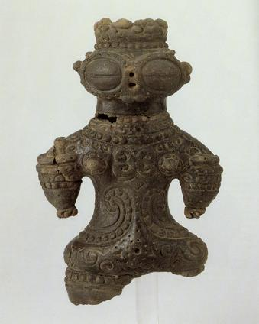
Starter
What different shapes can you see on this dogu?
What tools could you use to make these shapes?
Notes:
You may like to show a selection of images for this starter task to prompt more ideas.

Slide 2
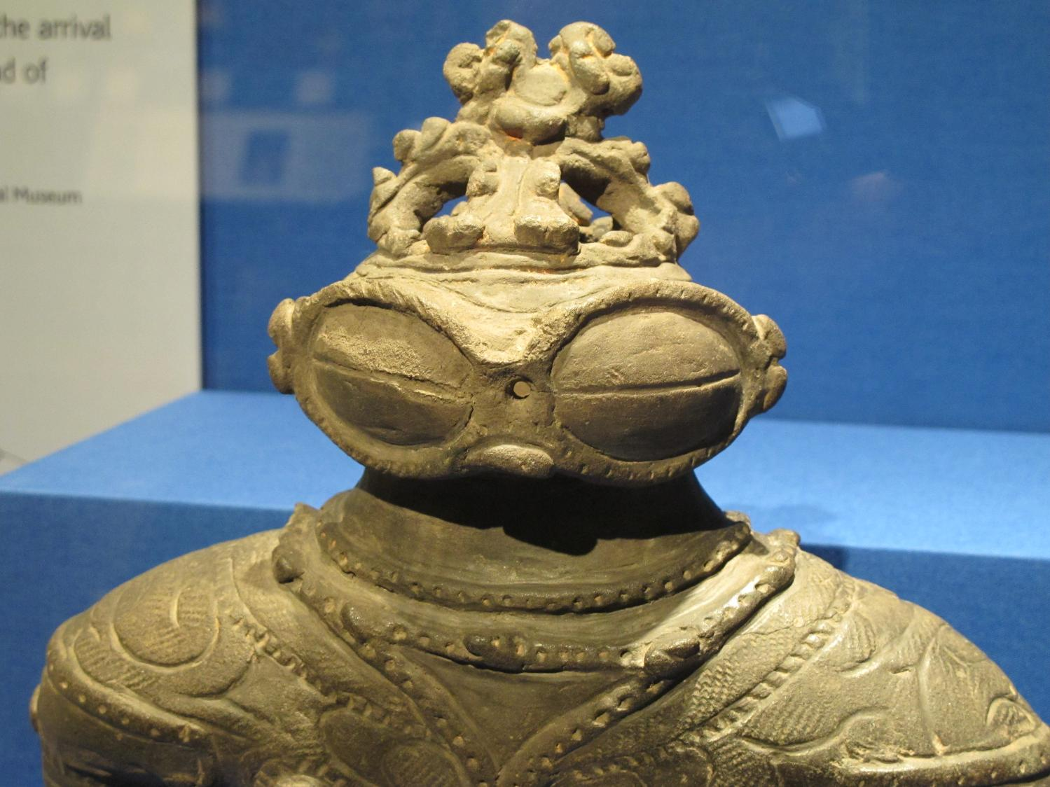

2: Dogu Patterns
Notes:
Teacher’s Notes
Image of dogu from Wikimedia Commons: https://upload.wikimedia.org/wikipedia/commons/5/5e/Dogu_jomon_period_japan.jpg

Slide 3

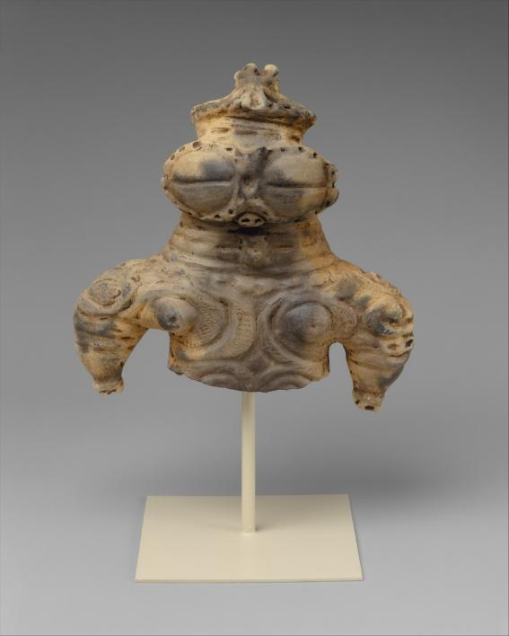
Dogu 土偶
Learning Objective:
Recognise the key features of a dogu figurine.
Create your own design on a clay tile inspired by the patterns on dogu figurines.

Slide 4
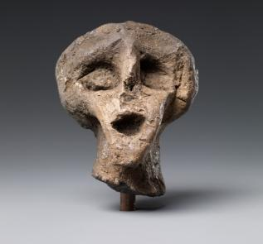
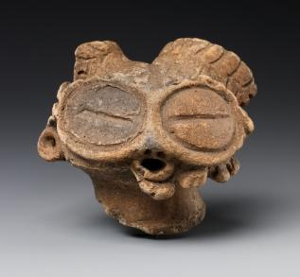
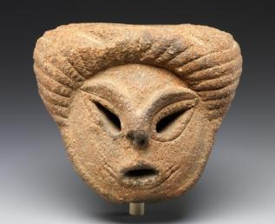
Dogu Patterns
Activity 1:
Annotate the image of the dogu in your book:
What are the key features?
What sort of character is it?
What patterns can you see?
Activity 2:
Create a draft version of your tile in your book.
Notes:
Teacher’s Notes
Having learnt some of the facts about the Dogu, students can use descriptive language to annotate an image of a dogu figure.
They should be encouraged to think about emotions related to the character as well as describing the physical qualities.
See slide 1 of Teachers Background PPT for dogu with an array of different facial expressions.
Activity 2: Students will now create a draft version of their tile (10cmx10cm) on paper. This gives them the chance to look closely at the mark-making and patterns that have been used, and think about what they want to make on their clay tile.

Slide 5
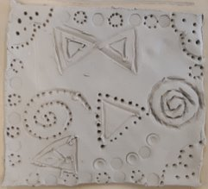
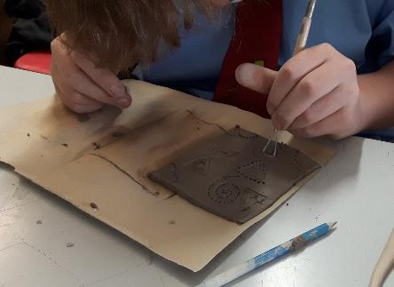
Dogu Patterns
Activity 3: Create your tile design in clay
Roll the clay to an equal thickness
Use tools to make the marks and patterns
Try... experimenting with string, rope, or twisted tissue to make marks like the Jomon potters.
Notes:
Students use the design and close investigation of the mark making to create their own clay tile
They will learn to roll a square of clay or salt dough.
A template could be used to ensure a square or students could measure.
Jomon potters made marks using cord or string and pressing it into the clay
Encourage students to use different tools to create what they see on the figures, e.g. fork, pencil, twisted paper or string.

Slide 6




This resource was authored by J Buchanan and K Montague in collaboration with The Japan Society
The Japan Society
13/14 Cornwall Terrace, London NW1 4QP
Tel: 020 7935 0475
Email: education@japansociety.org.uk
www.japansociety.org.uk
Follow us on:
@TheJapanSociety
The Japan Society

