Slide 1

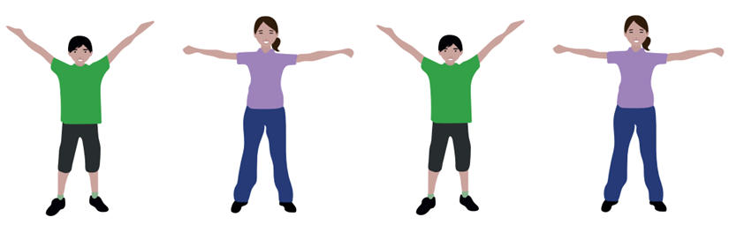
Let’s Learn Radio Taiso

Slide 2
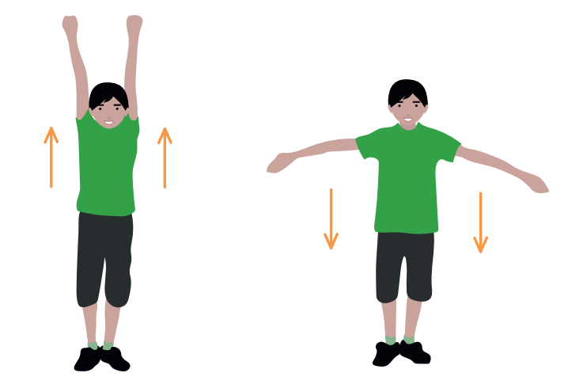
Stretch Up High
Raise arms up in front of the body
Lower arms to the sides
x2

Slide 3
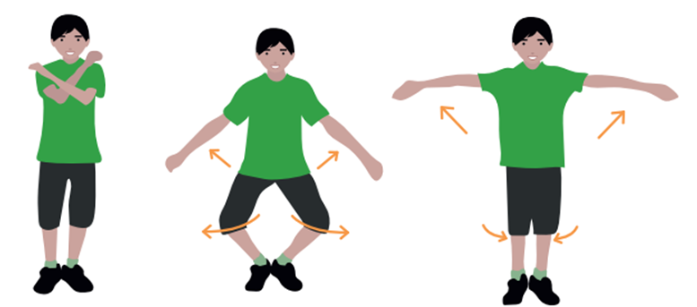
Arms and Legs
x8
Lightly squat
whilst swinging arms out to the sides

Slide 4
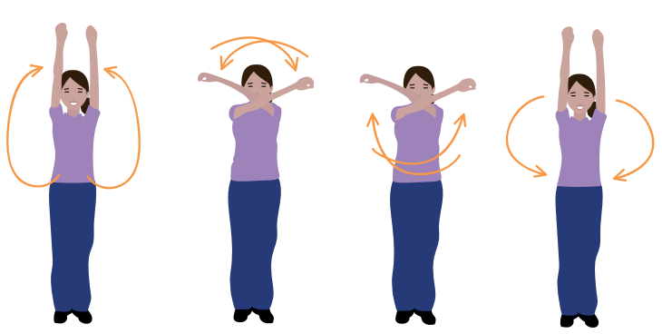
Arm Circles
x4
Swing arms in full circles
Alternate the direction: first out, then in

Slide 5
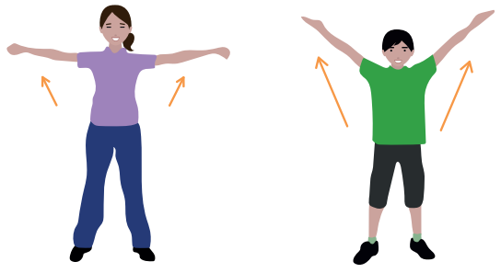
Chest Stretches
Feet apart. Swing arms out to shoulder level
Cross arms then swing out again, above shoulders
x4

Slide 6
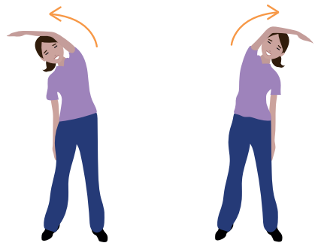
Side Stretches
x2
Stretch to one side twice
Repeat on the other side

Slide 7
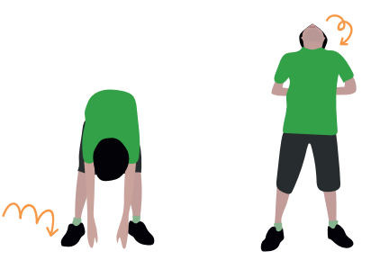
Forward and Backward
Bends
Bend forward and bounce lightly three times
Bend backwards slightly and look up
x2

Slide 8
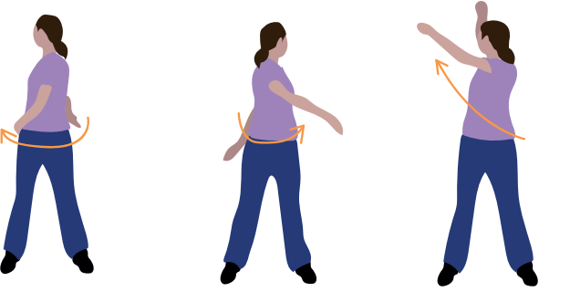
Body Twists
Twist four times from side to side
Two big twists on the same side
x2
Once each side

Slide 9
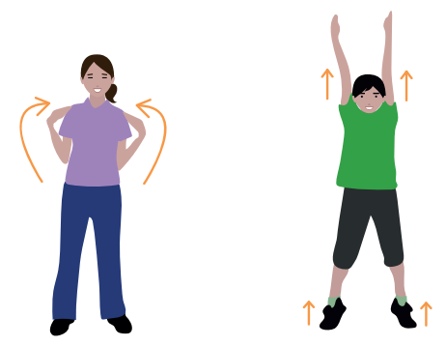
Arm Stretches
Feet apart with hands on shoulders. Reach up on tiptoe Return arms to shoulders, then lower arms
x4

Slide 10
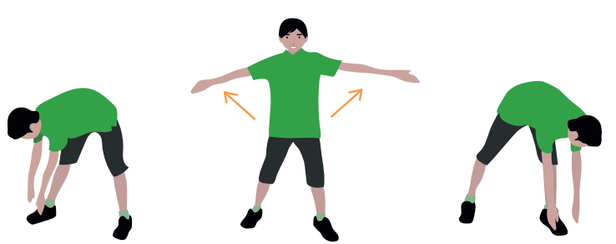
Forward Bends
Bend down to one side
Return to standing and open the arms out
Repeat on the other side
x2

Slide 11
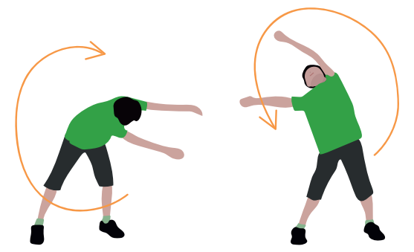
Circle the Body
Rotate your body and arms in a large circle
Repeat on the opposite side
x2

Slide 12
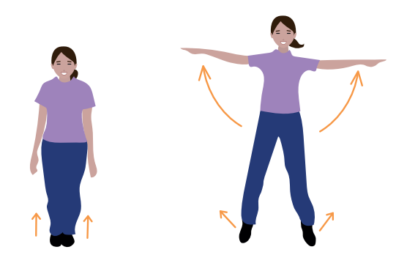
Jumps
Jump four times with legs together and loose arms
Then do two star jumps
x2

Slide 13
Arms and Legs
x8
Lightly squat
whilst swinging arms out to the sides

Slide 14
Deep Breaths
Breath in and raise arms up in front of the body Breath out and lower arms to the sides
x2

Slide 15





The Japan Society
13/14 Cornwall Terrace, London NW1 4QP
Tel: 020 7935 0475
Email: education@japansociety.org.uk
www.japansociety.org.uk
Follow us on:
@japansocietylon
@JapanSocietyLondon

