Slide 1

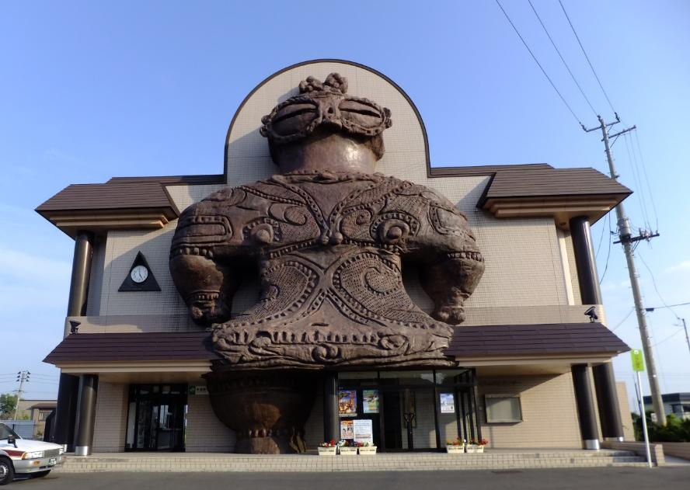
Starter
Think of a sentence to describe this picture.
Where could it be?
What could the building be used for?
Notes:
Teacher’s Notes
This shows Kizukuri Station, Japan. This train line (the Gono Line) is known for its series of stunning seascapes.
When visiting Kizukuri station you’ll find that this station is guarded by a huge statue of a Shakoki-Dogu. This big, peculiar stone statue built on a façade of the station is 17m (55.77 ft) long and made based on an image of Dogu.
A Dogu is a clay figurine mainly made during Jomon period, which is what we are going to learn about over the next lessons. (Note: they are usually much smaller!)

Slide 2
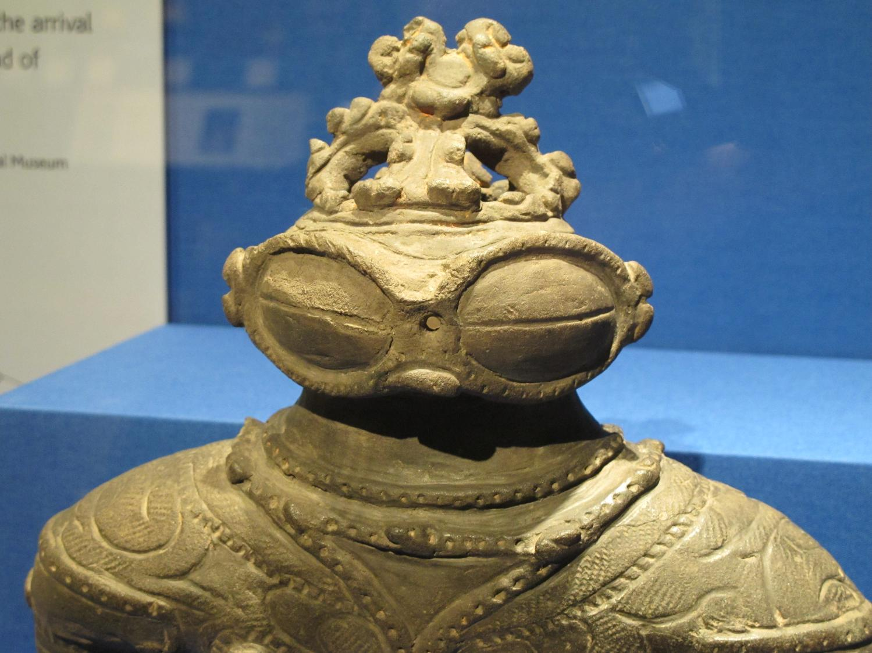

1: Introduction to Dogu
© The Japan Society (2025)
Notes:
Teacher’s Notes
Image of dogu from Wikimedia Commons: https://upload.wikimedia.org/wikipedia/commons/5/5e/Dogu_jomon_period_japan.jpg

Slide 3

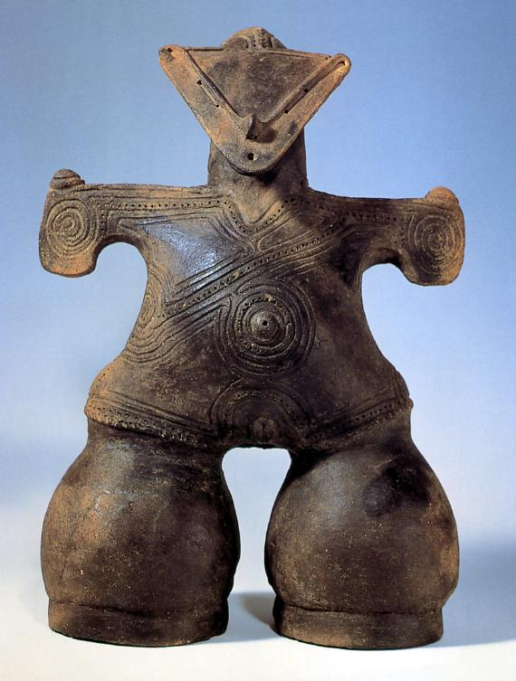
Dogu 土偶
Learning Objectives:
Learn about dogu and its significance in Japanese culture and history.
Compare dogu to other ancient artefacts from around the world.
Notes:
Teacher’s Notes
Dogu is pronounced ‘Doh-goo’ with the final vowel elongated.
This image is a reconstruction of a figurine.

Slide 4

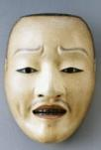
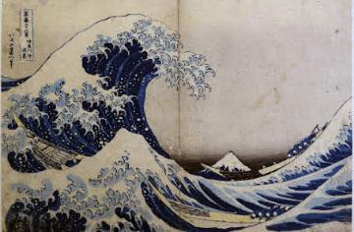
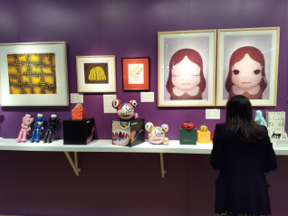
History of Japan
Have a look at the timeline below.
Discuss what you know about Japan and Japanese art already.
10,000-300 BC
Jomon Period
Dogu
1333-1500
Muromachi Period
Noh Theatre
1600-1890
Edo Period
The Great Wave - Hokusai
Present
Contemporary Japanese art
What was happening elsewhere in the world during the times on this timeline?
Notes:
Teacher’s Notes
Facilitate a general discussion on Japan, focusing on Japanese culture, art, and history.
The next slide (5) has a timeline that looks at other major events that occurred around the same time as these historical periods in Japan.
Explain to pupils that the following slides (4-7) will look more closely at each time period on the timeline.

Slide 5
Historical timelines
10,000-300 BC
Jomon Period
Dogu
1333-1500
Muromachi Period
Noh Theatre
1600-1890
Edo Period
The Great Wave - Hokusai
Present
Contemporary Japanese art
Other major world events include...
2500 BC
Stonehenge was built
1440
Gutenberg invents the printing press
1879
Edison invents the lightbulb
1999
The first emoji was created
Notes:
Teacher’s Notes
Discuss and compare these major world events to events that happened in Japan using the timelines.

Slide 6
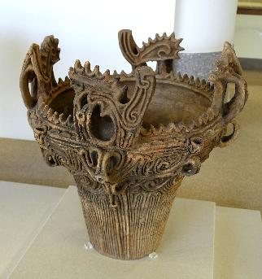
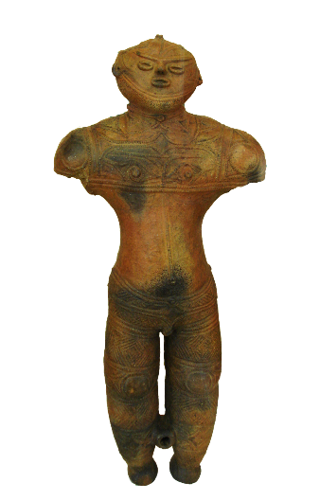

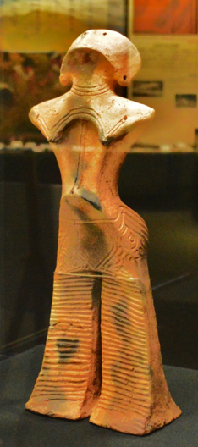
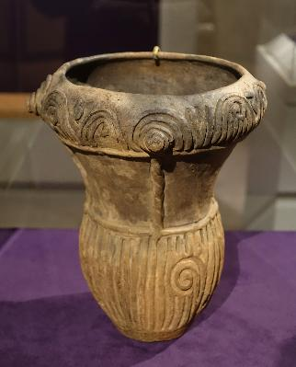
Jomon Period art
Jomon pottery - earliest discovered art in Japan (prehistoric period).
Jomon potters would fire their creations on open bonfires.
Notes:
Teacher’s Notes
You could discuss briefly here what are pupils’ initial thoughts on dogu and Jomon pottery in general.
Images of Jomon Pottery
https://commons.wikimedia.org/wiki/File:Clevelandart_1984.68.jpg
https://commons.wikimedia.org/wiki/File:Jar,_excavated_at_Niigata_prefecture,_Japan,_Middle_Jomon_period,_3500-2500_BC,_ceramic_-_Hakone_Museum_of_Art_-_Hakone,_Kanagawa,_Japan_-_DSC08128.jpg

Slide 7
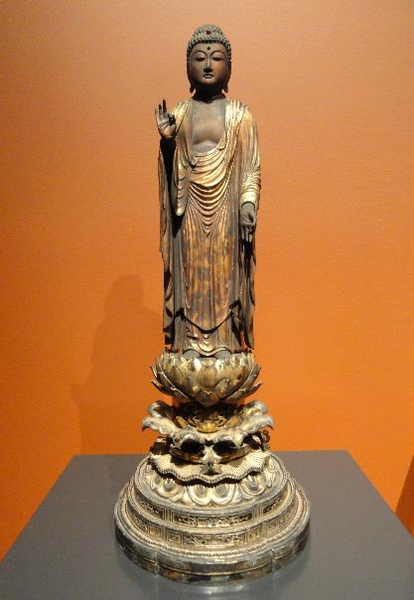
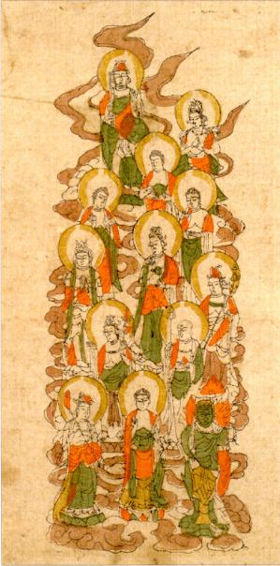
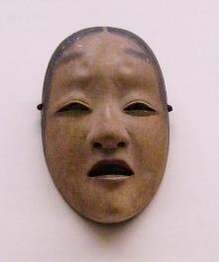
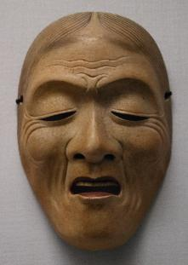
Muromachi Period art
Rise and popularisation of Chinese Zen Buddhism in Japan.
Popularisation of Noh theatre as a form of entertainment.
What do you notice about art from the Muromachi Period of Japan?
How has art developed from the Jomon Period to the Muromachi Period?
Notes:
Teacher’s Notes
Noh theatre – a form of classical Japanese theatre that originated from the 14th century. Noh theatre is centred heavily around music and dance, and performers wear masks (often with expressive faces) to help the audience understand the character that is being portrayed.
Images found on Wikimedia Commons:
https://commons.wikimedia.org/wiki/File:Amida_Raigo,_Japan,_Muromachi_period,_c._1500,_wood_with_lacquer_and_gold-leaf_-_San_Diego_Museum_of_Art_-_DSC06500.JPG
https://commons.wikimedia.org/wiki/File:%27J%C3%BBsambutsu-Mandala%27_(Mandala_of_the_Thirteen_Buddhas),_Muromachi_period_Japan,_hand_colored_woodblock_print,_Honolulu_Academy_of_Arts.jpg
https://commons.wikimedia.org/wiki/File:Masugami_Lady_Noh_mask.jpg
https://commons.wikimedia.org/wiki/File:N%C5%8D_mask_-_Uba_Type.JPG

Slide 8
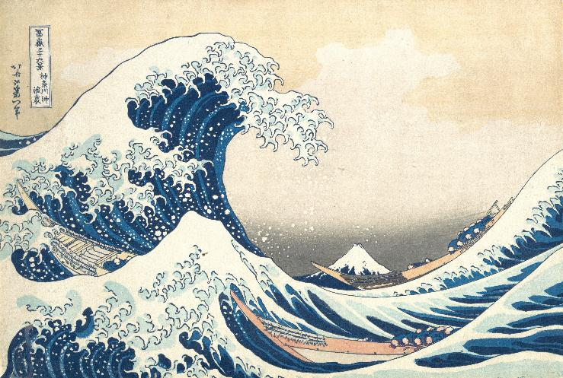
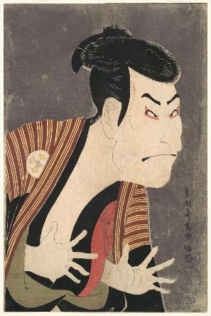
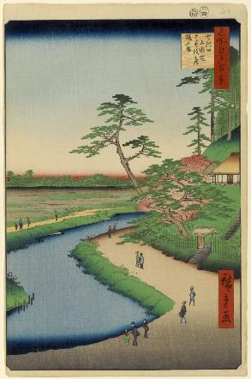
Edo Period art
Some of Japan’s most famous and recognisable art was made during this time.
The Edo period saw the popularisation of ukiyo-e (woodblock printing).
What do you notice about art from the Edo Period of Japan?
Do you recognise any of these pieces of art?
Notes:
Teacher’s Notes
Pupils may recognise some Edo Period art – arguably some of Japan’s most iconic art was made during this time. Many state that Hokusai was the “inventor” of manga, as in 1814, the first volume of his Hokusai Manga (北斎漫画) was published, which included a series of sketches of various subjects.
Left to right: The Great Wave off Kanagawa by Katsushika Hokusai, 1831
Ontani Oniji by Toshusai Sharaku, 1794 (famous for his portraits of kabuki actors)
Basho’s Hermitage and Camellia Hill on the Kanda Aqueduct at Sekiguchi, no. 40 by Utagawa Hiroshige, 1857

Slide 9
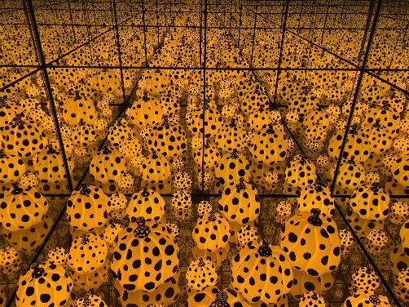
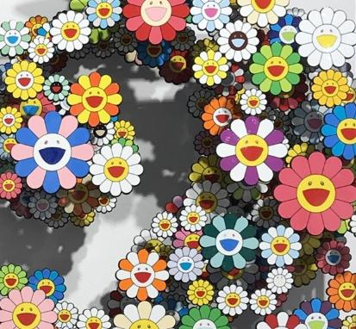
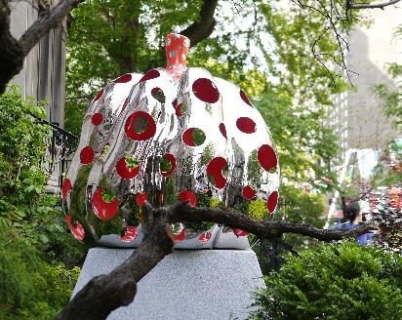
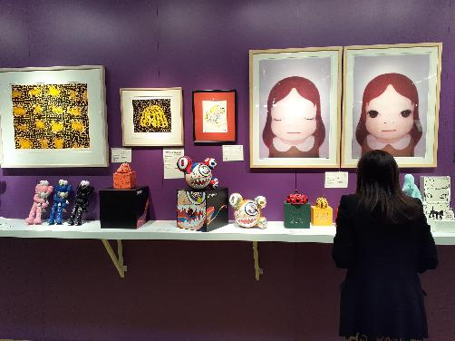
Contemporary Japanese art
Some famous contemporary Japanese artists include Yayoi Kusama, Murakami Takashi, and Yoshitomo Nara.
What do you notice about the art you see here?
How do you think contemporary Japanese art has been influenced by art from previous time periods?
Notes:
Teacher’s Notes
Challenge pupils to think about how the art they have seen from the previous slides may have influenced contemporary Japanese art. Thinking about patterns, techniques, materials used, subject matter, and so on.
Left to right, top to bottom:
The Spirits of the Pumpkins Descended into the Heavens by Yayoi Kusama, 2015. Exhibited at the National Gallery of Australia.
Flowers by Takahashi Murakami, exhibited in London.
Pumpkin by Yayoi Kusama, 2015.
Modern Japanese art featuring various artists in Hong Kong. (from Wikimedia Commons: https://commons.wikimedia.org/wiki/File:HK_WCN_Wan_Chai_North_auction_preview_exhibition_item_April_2021_SS2_02.jpg)

Slide 10
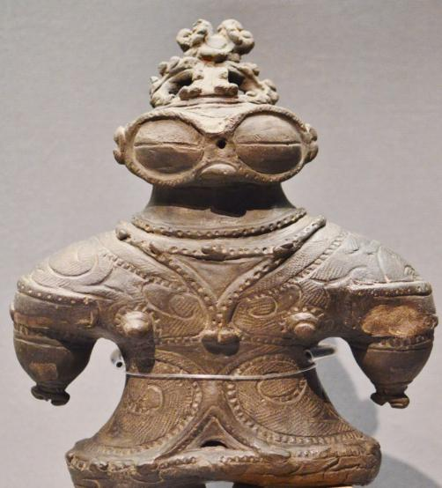
The Dogu Figure
Dogu literally means "earthen figure".
They are small humanoid and animal figurines.
Made during the latter part of the Jomon period (14,000–400 BC) of prehistoric Japan.
Most of the Dogu have been found in eastern Japan and it is rare to find one in western Japan.
The shakoki dogu (遮光器土偶),
or "goggle-eyed dogu"
Notes:
Teacher’s Notes
In the UK, we tend to talk about the north and south, whereas Japan is generally divided into east and west.
The Shakōkidogū (遮光器土偶), or "goggle-eyed dogū", is so called because of the eyes - it has been discussed that these might be covers used to block out bright light. Glasses such have these have been used in other cultures, e.g. Inuit.
See here for wooden snow goggles in a UK collection: https://wellcomecollection.org/works/evzd5vc3
Other example of such a figure here: https://www.metmuseum.org/art/collection/search/45532

Slide 11
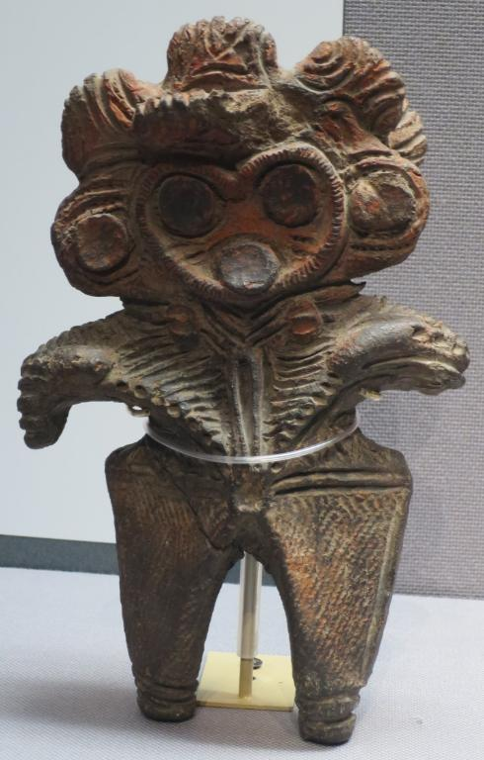
The Dogu Figure
Dogu are made of clay and are small, typically 10 to 30 cm high.
They have been found by archaeologists near where people were buried.
Most have marks on the face, chest and shoulders, made from twisted cord.
Photo by Hiart, CC0
Notes:
Teacher’s Notes
It could be suggested that the dogu were buried with people as they were considered objects of significance to them. You could also ask students what other reasons do they think the dogu were buried near people?
Pupils could also discuss objects of significance to them – what in modern times would be as important as these little figures were to the people in prehistoric Japan? Mobile phone? PlayStation? a favourite toy?

Slide 12
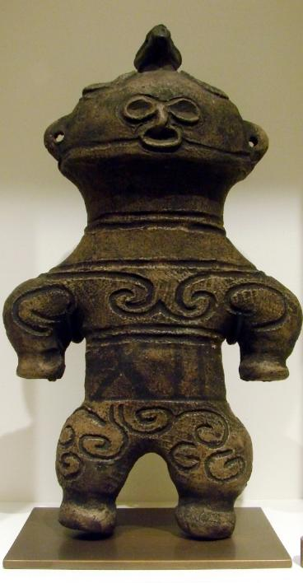

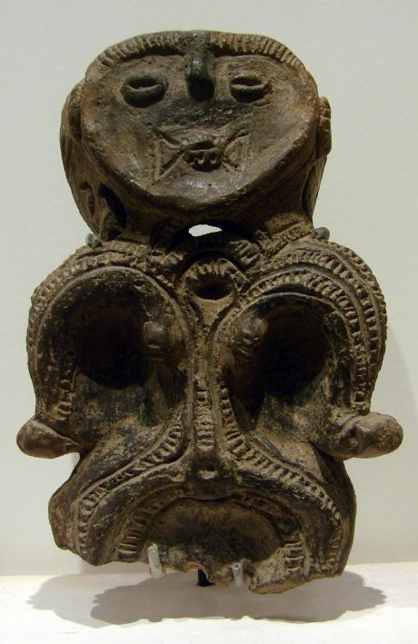
Examples of Dogu
Notes:
Teacher’s Notes
The Introduction to Dogu Figurines PPT also has more examples.
Images of dogu from Wikimedia Commons

Slide 13
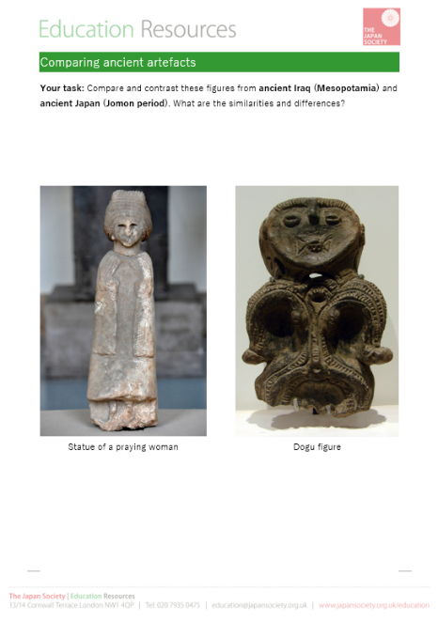
Task:
Compare dogu to figures and statues made in other countries and civilisations during the prehistoric period.
Using the worksheet, look closely at the different figures and statues, and annotate what you notice.
What makes dogu similar or different to these other artefacts?
Notes:
Teacher’s Notes
Pupils will now annotate the images on the sheet, considering the similarities and differences. They should look closely at and think about…
The materials that have been used
The sizes of the different artefacts
What were their purposes
When were the artefacts create
The patterns they can see

Slide 14
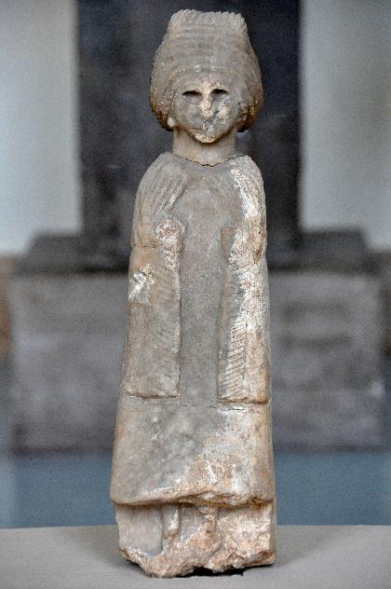
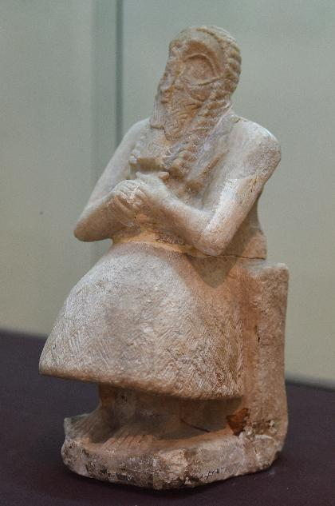
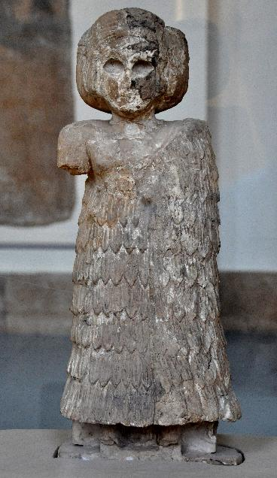
Mesopotamia (Iraq)
Statues of praying women and seated man, 2600 - 2400 BC
Notes:
Images of statues from Wikimedia Commons
Statues of praying women from the Archaic Ishtar Temple of Assur, Iraq. 2400 BC https://commons.wikimedia.org/wiki/File:Statue_of_a_praying_woman_from_the_Archaic_Ishtar_Temple_of_Assur,_Iraq._2400_BCE._Pergamon_Museum.jpg
https://commons.wikimedia.org/wiki/File:Statue_of_a_praying_woman_from_the_Archaic_Ishtar_Temple_of_Assur,_Iraq._2400_BCE._Pergamon_Museum,_Berlin.jpg
Seated male statue from the Temple of Sin at Khafajah, 2600-2400 BC
https://commons.wikimedia.org/wiki/File:Seated_male_statue_from_the_Temple_of_Sin_at_Khafajah.jpg

Slide 15
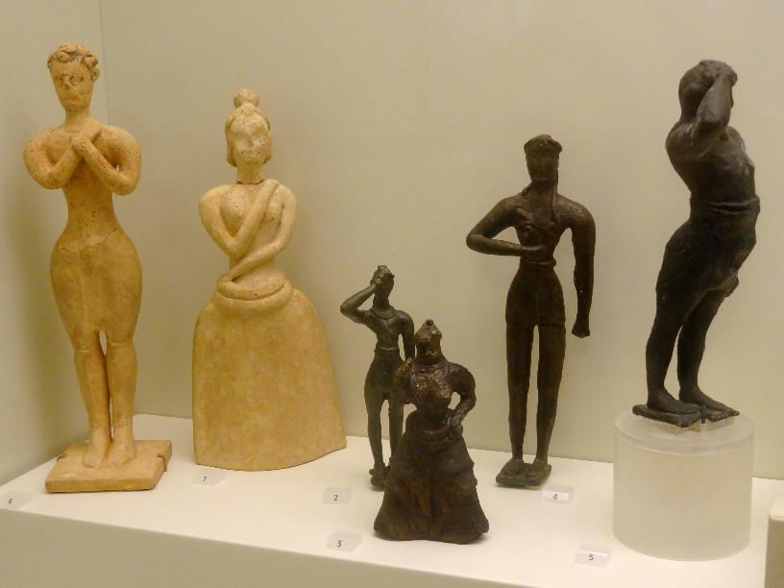
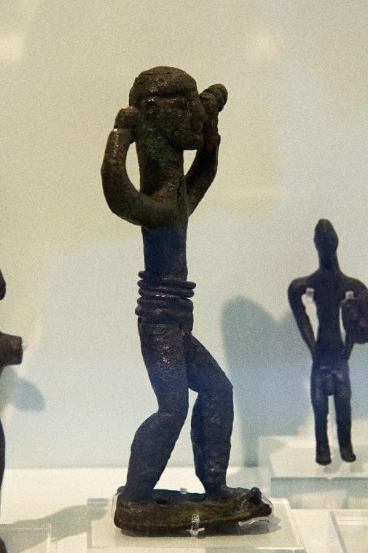
Minoan art (Greece)
Figures from post-palatial period, 1450 - 1100 BC
Notes:
Images of statues from Wikimedia Commons
Assorted Minoan statues from post-palatial period
https://commons.wikimedia.org/wiki/File:Minoische_Adoranten_01.jpg
Bronze figurine of warrior from post-palatial period
https://commons.wikimedia.org/wiki/File:Bronze_figurines_of_warrior,_Crete,_Postpalatial,_AMH,_145301.jpg

Slide 16
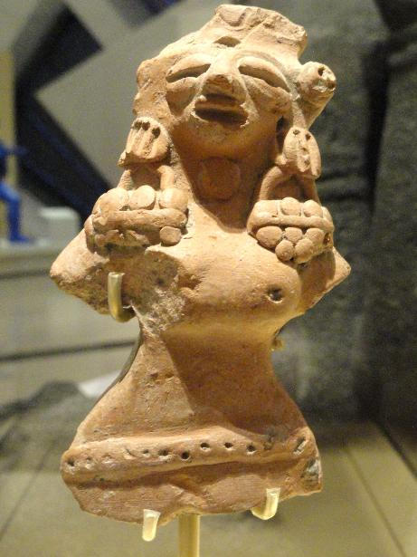
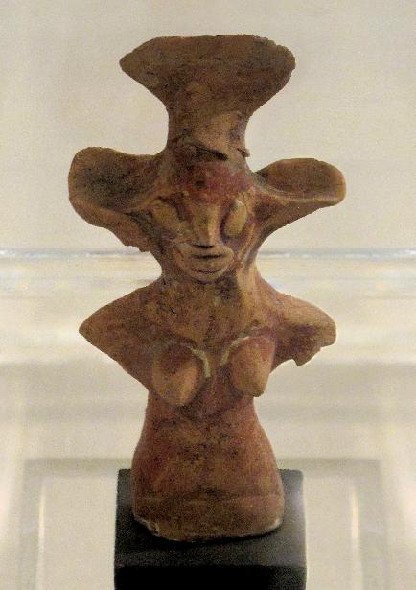
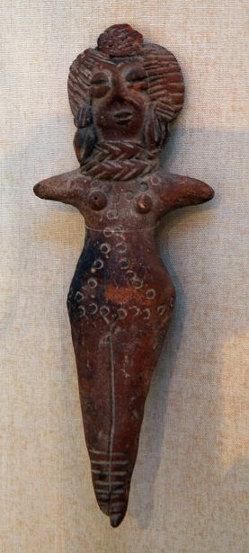
Indus Valley (Pakistan and India)
Figures of women, 2700 - 1800 BC
Notes:
Images of figures from Wikimedia Commons, from left to right
Female figure, from Mature Harappan Phase
https://commons.wikimedia.org/wiki/File:Female_figure,_possibly_a_fertility_goddess,_Indus_Valley_Tradition,_Harappan_Phase,_c._2500-1900_BC_-_Royal_Ontario_Museum_-_DSC09701.JPG
Female figurine, made from terracotta, 2700-2000 BC, Mature Harappan Phase.
https://commons.wikimedia.org/wiki/File:Female_figurine_3._Mature_Harappan_period._Indus_civilization_(detail).jpg
Figurine of woman, from Mature Harappan Phase
https://commons.wikimedia.org/wiki/File:Figurine_Indus_Bruxelles_02_10_2011.jpg

Slide 17




This resource was authored by J Buchanan and K Montague in collaboration with The Japan Society
The Japan Society
13/14 Cornwall Terrace, London NW1 4QP
Tel: 020 7935 0475
Email: education@japansociety.org.uk
www.japansociety.org.uk
Follow us on:
@TheJapanSociety
The Japan Society

