Slide 1
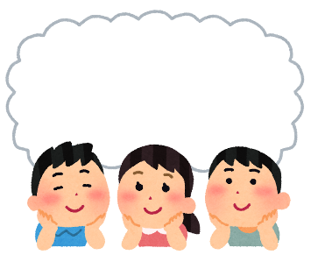

Starter
Think about the questions below and discuss them with a partner or in a group...
What do you think winter in Japan is like?
What kind of food or dishes do you think people eat in Japan during winter?
© The Japan Society 2025
Notes:
Teacher’s Notes
Ask pupils to discuss the questions on the slide with a partner or in a group. Share and feedback ideas as a class.
Illustration from Irasutoya.

Slide 2
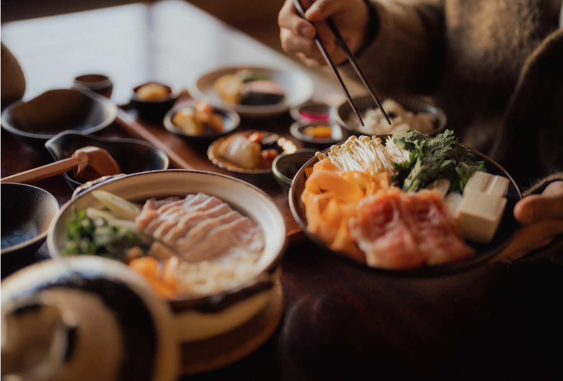

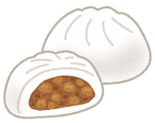

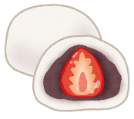
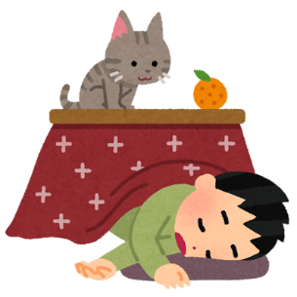
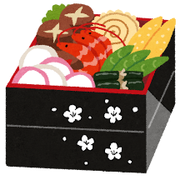

Winter Food
in Japan
© The Japan Society 2025
Notes:
Teacher’s Notes
Introduce today’s topic – Winter Food in Japan.
Title slide image- ©Matsu via Canva.com
Illustrations from Irasutoya.

Slide 3
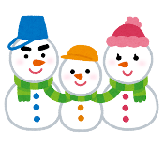
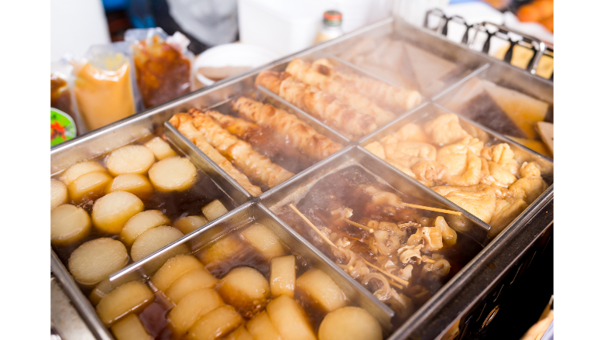
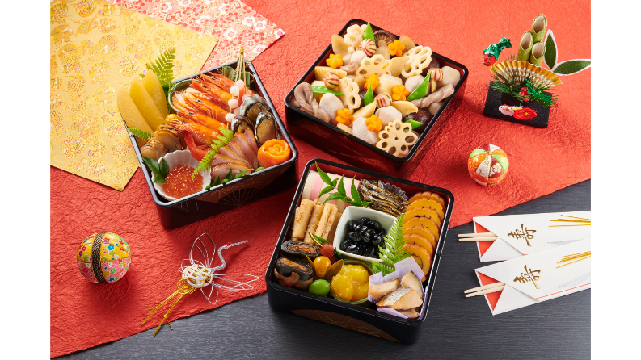
Learning Objectives
To learn about popular foods and seasonal dishes associated with winter and winter celebrations in Japan.
To learn about the significance of New Year in Japan and the foods eaten at this time.
© The Japan Society 2025
Notes:
Teacher’s Notes
Introduce the Learning Objectives.
Images: Oden - ©Leung Cho Pan via Canva.com and Osechi - ©Aflo Images via Canva.com
Illustration from Irasutoya.

Slide 4

Key Words
Winter - 冬 (fuyu)
Dish/cuisine - 料理 (ryori)
New Year - お正月 (oshogatsu)
Osechi – おせち/おせち料理 (osechi / osechi ryori)
Christmas - クリスマス (kurisumasu)
Season - 季節 (kisetsu)
© The Japan Society 2025
Notes:
Teacher’s Notes
Introduce this lesson’s key words – do pupils know what these words mean?
Illustration from Irasutoya.

Slide 5
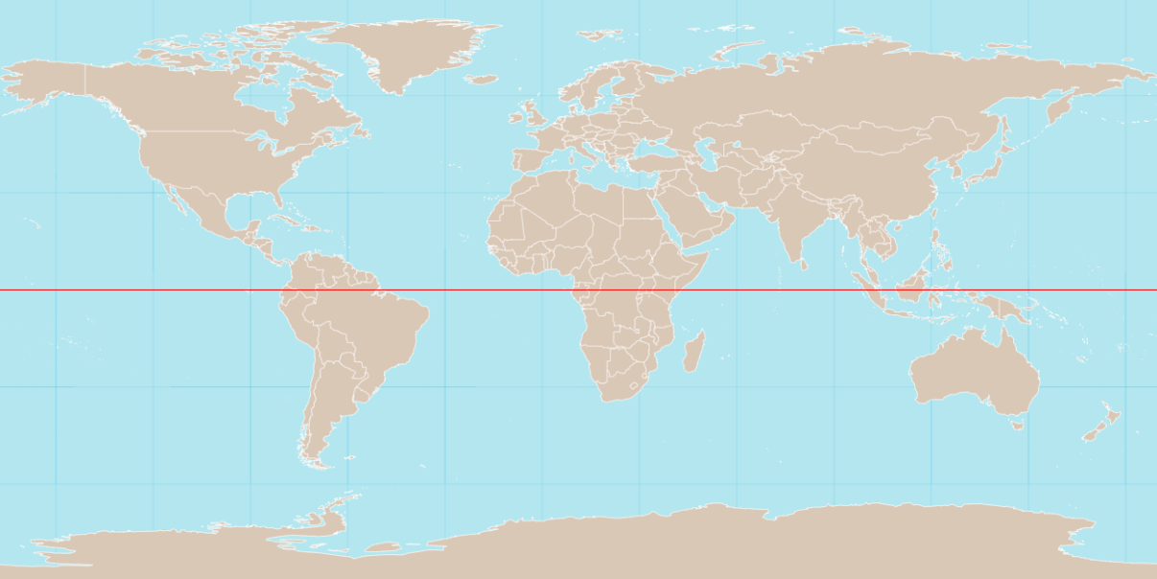
Winter
Japan and the UK have a relatively similar climate.
UK
Japan
Mini-task: Find out what the temperature and weather is like in Tokyo right now; is it similar or different to where you live?
© The Japan Society 2025
Notes:
Teacher’s Notes
Search up together as a class the weather forecast for Tokyo right now and compare to your town/city. Is it similar or different to where you live?
Mention that, similar to the UK, there are climatic variations in the north and south of Japan. Northern Japan can experience very cold and snowy winters, whereas in contrast, in southern Japan (such as in Okinawa), winters can be very mild and warm, even!
Image from Wikimedia Commons: https://commons.wikimedia.org/wiki/File:World_map_with_equator.svg

Slide 6
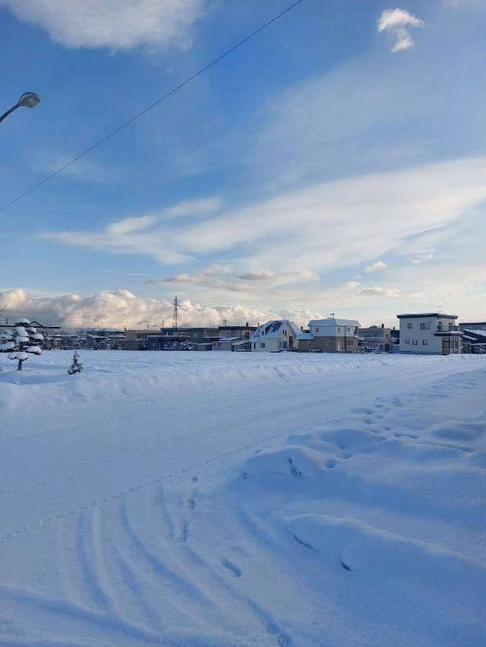

Winter
In northern parts of Japan, it can especially get very cold and snowy.
In Hokkaido, the temperatures regularly drop below 0 degrees Celsius during winter!
As such, winter sports such as skiing and snowboarding are particularly popular.
© The Japan Society 2025
Notes:
Teacher’s Notes
Show pupils the images on the slide. Remind pupils that it is only in certain areas of Japan (mainly in the north) that experience snowfall like this – not everywhere in Japan experiences this much snow or this level of cold!
Hokkaido is the most northern island in Japan.
Photo taken in Yoichi, Hokakido.

Slide 7
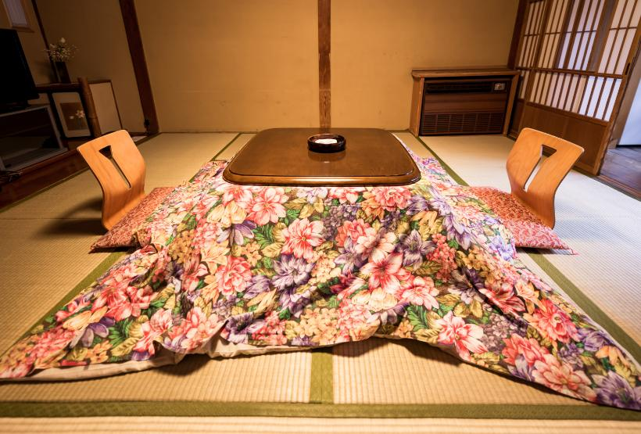
Staying warm
Because winter can be so cold, people stay warm by enjoying hot, warming meals at home - especially whilst sitting under a kotatsu!
The blankets help to trap the heat
Underneath the table is a small heater
© The Japan Society 2025
Notes:
Teacher’s Notes
Click on the slide to reveal the arrows and information about the kotatsu. Before doing so, ask pupils if they know what a kotatsu is/if they have seen one before? Do we have or use anything similar to this in the UK in order to keep warm during the winter?
Kotatsu/Japanese room - ©SmokedSalmon from Getty Images via Canva.com

Slide 8
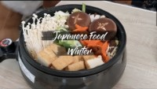
Video
Watch the video all about popular food people like to eat in Japan during winter time.
© The Japan Society 2025
Notes:
Teacher’s Notes
If the above link and video are not working, you can find access the video from the resource page - https://www.japansociety.org.uk/resource?resource=115

Slide 9
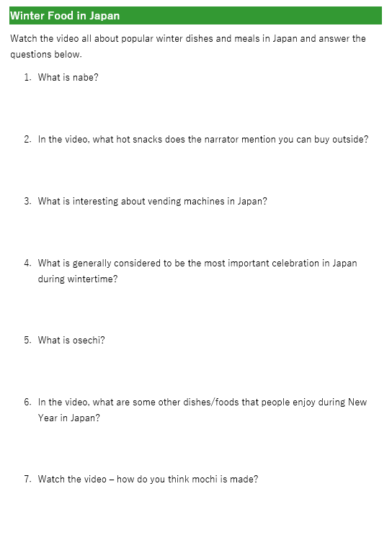

Activity 1
Watch the video again.
This time, make notes on the worksheet and answer the questions.
© The Japan Society 2025
Notes:
Teacher’s Notes
Hand out the activity worksheet. You may need to rewatch the video once or twice to allow pupils to make notes and then write down their answers properly.
See slides 10-21 for more images and explanations of each of the dishes (and more) discussed in this video.

Slide 10
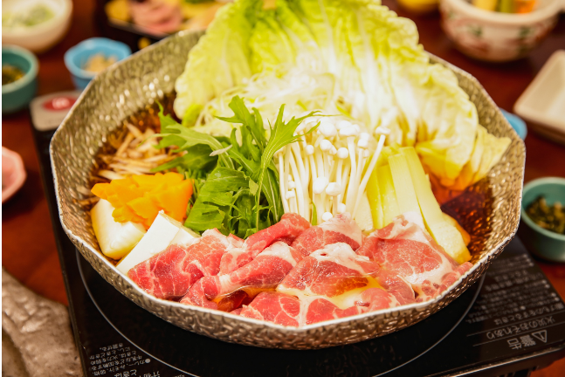
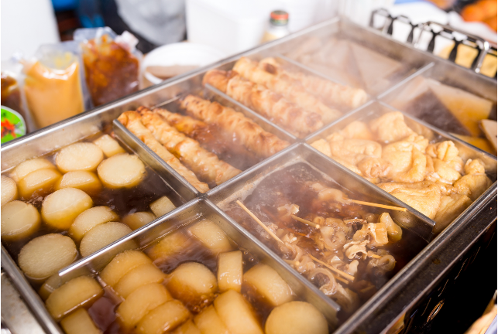
Nabe 鍋 - hotpot
A variety of hotpot dishes. People cook various ingredients, including meat and vegetables, in a boiling pot to share and eat together.
shabu shabu
oden
© The Japan Society 2025
Notes:
Teacher’s Notes
There are different varieties of nabe – shabu shabu (left) and oden (right). Have pupils tried any similar types of hotpot dishes at home before too?
Images: Shabu shabu - ©Aflo Images via Canva.com and Oden - ©Leung Cho Pan via Canva.com

Slide 11
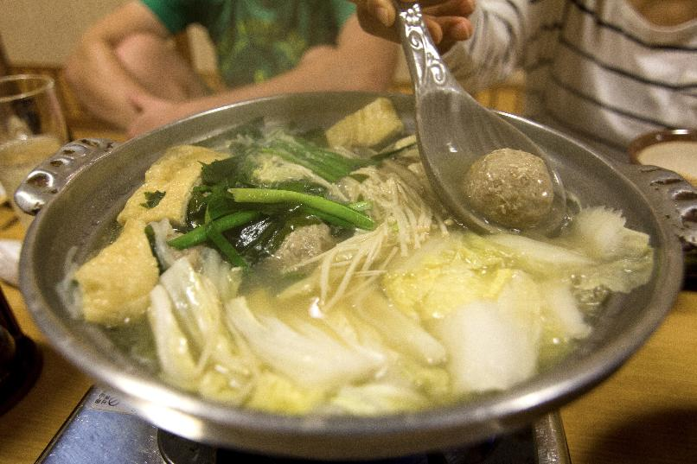
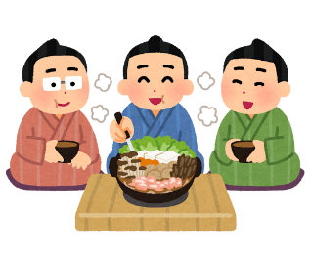

Chankonabe ちゃんこ鍋
Chankonabe is a popular hotpot dish that is most commonly eaten by sumo wrestlers all year round – not just during the winter time!
© The Japan Society 2025
Notes:
Teacher’s Notes
Chankonabe contains meat and vegetables, such as chicken, seafood, tofu, bok choy, and mushrooms. The wrestlers eat it in large quantities to help them gain weight and grow strong.
Image from Wikimedia Commons: https://commons.wikimedia.org/wiki/File:Chankonabe.jpg
Illustration from Irasutoya.

Slide 12
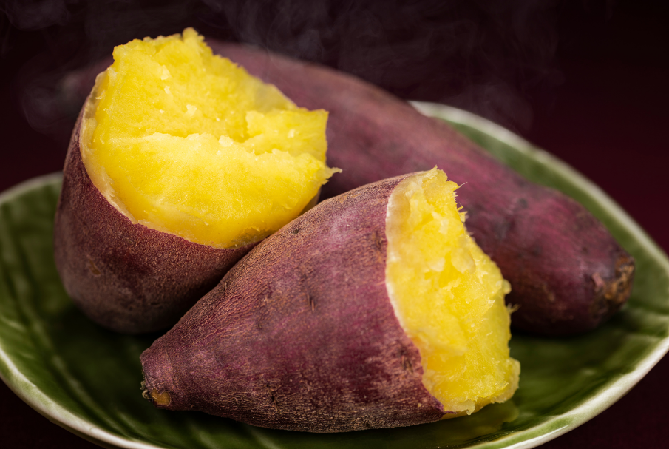
Yakiimo 焼き芋
Baked sweet potatoes are popular snacks during the autumn and winter months in Japan.
© The Japan Society 2025
Notes:
Teacher’s Notes
Ask pupils to look at the image on the slide – do these sweet potatoes look similar to the ones we would usually see in supermarkets in the UK?
Image: ©kuppa_rock via Canva.com

Slide 13
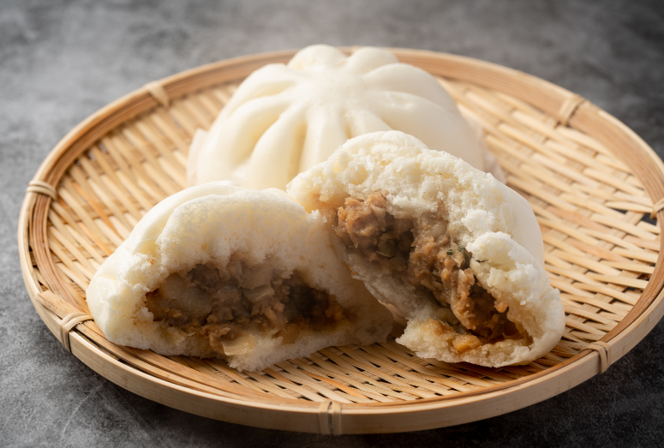
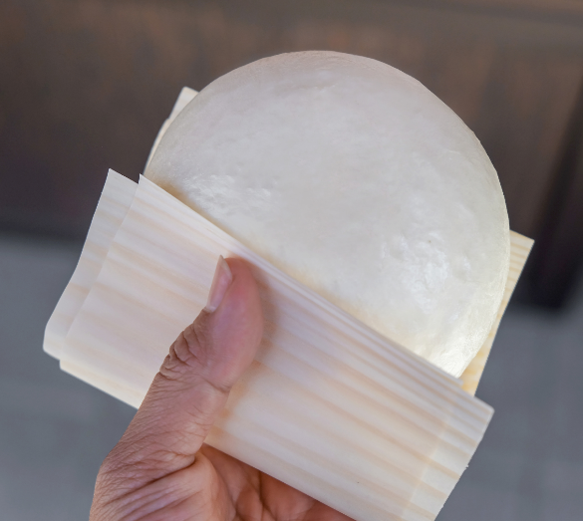
Nikuman 肉まん
Nikuman are steamed buns filled with pork, vegetables, and other ingredients. You can often buy these in konbini (convenience stores).
© The Japan Society 2025
Notes:
Teacher’s Notes
There are many different types of steamed buns you can purchase at konbini. Pizaman are similar to nikuman – but they are filled with tomato sauce and cheese, similar to a pizza!
Images: ©Hanasaki via Canva.com and ©Kanawa_Studio via Canva.com

Slide 14
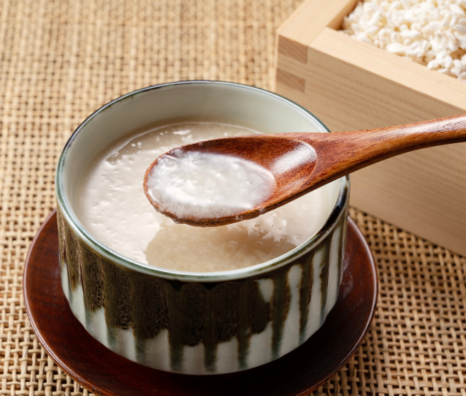
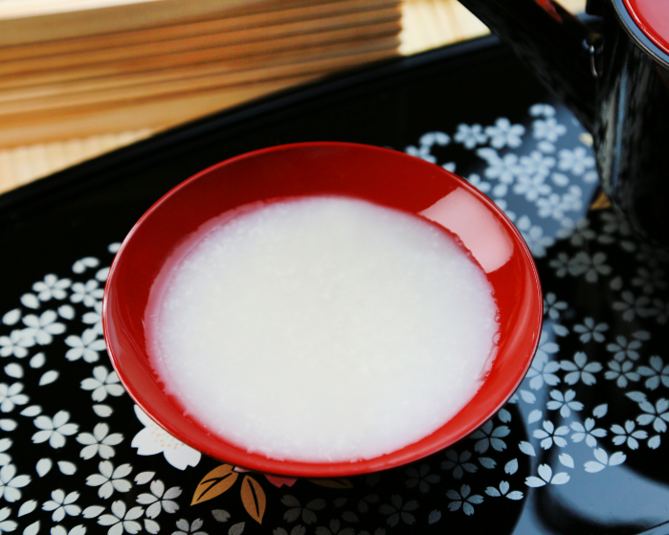
Amazake 甘酒
A sweet traditional Japanese drink that is made from fermented rice, often served hot.
© The Japan Society 2025
Notes:
Teacher’s Notes
If necessary, explain what the word “fermented” means.
Images: ©masa44 via Canva.com and ©yasuhiroamano via Canva.com

Slide 15


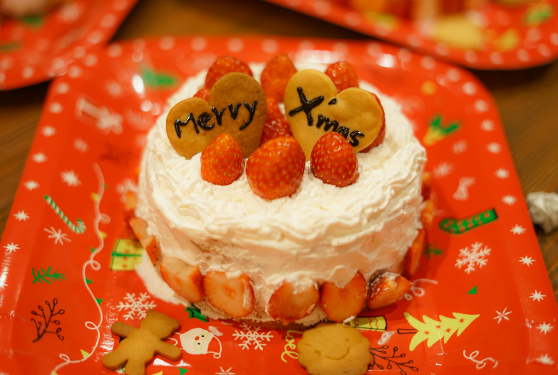

Christmas cake
In Japan, people celebrate Christmas with delicious Christmas cakes – sponge cakes topped with whipped cream frosting and decorated with strawberries!
© The Japan Society 2025
Notes:
Teacher’s Notes
In the video, the narrator calls these cakes shotokeki (shortcake) – Ask pupils if they can guess what this word sounds similar to in English.
These cakes are also often called kurisumasu keki クリスマスケーキ – Christmas cake.
What kinds of Christmas desserts do we have in the UK? Is this similar to any of our desserts?
Image: ©Aflo Images via Canva.com
Illustrations from Irasutoya.

Slide 16
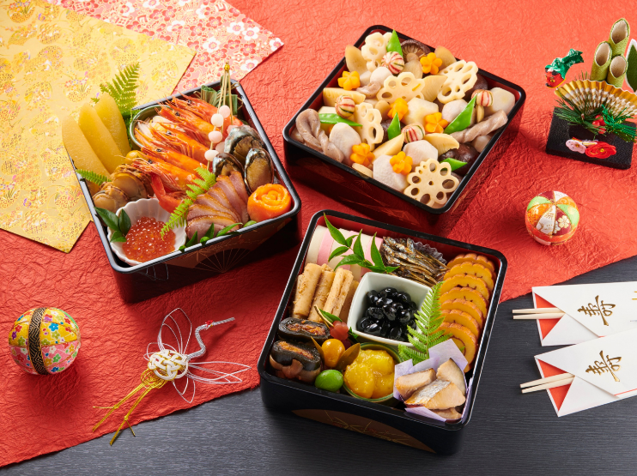
Osechi おせち料理
New Year is the most significant holiday of the year in Japan, and people eat special dishes to celebrate it. These are called osechi.
The dishes vary from region to region, and are typically served in multi-tiered boxes (see picture), known as jubako 重箱.
Every osechi item symbolises different meanings thought to bring good luck and fortune for the coming year.
© The Japan Society 2025
Notes:
Teacher’s Notes
Osechi dishes are prepared in advance, and are eaten over the first few days of the New Year. Osechi ryori is symbolic of Japan’s New Year’s celebrations and traditions. The following slides will include just a couple of examples of common foods/dishes that are eaten during the New Year.
See our New Year resources to learn more about some of the deeper meanings associated with osechi dishes and to learn more about Japanese New Year –
https://www.japansociety.org.uk/resource?resource=11 New Year’s Celebrations
https://www.japansociety.org.uk/resource?resource=107 New Year and Osechi Food
Image: ©Aflo Images via Canva.com

Slide 17
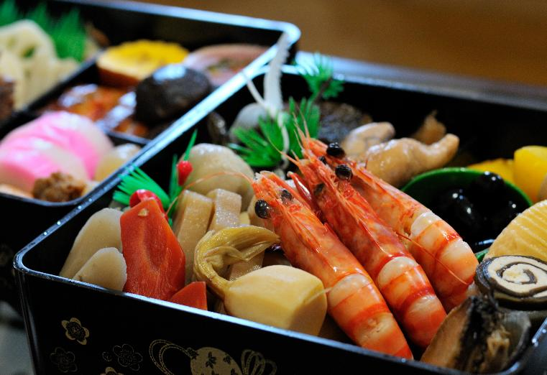
Osechi おせち料理
For example, prawns (ebi えび 海老) are commonly eaten at New Year in Japan. They have curved backs and whiskers which make them look elderly, so they symbolise a wish for a long and healthy life.
© The Japan Society 2025
Notes:
Teacher’s Notes
Mention also that in Japan, red and white are considered to be lucky colours, so eating ebi is also believed to bring good luck in the New Year, due to its colour.
Image from Wikimedia Commons: https://commons.wikimedia.org/wiki/File:Japanese_traditional_dishes_for_new_year.jpg

Slide 18
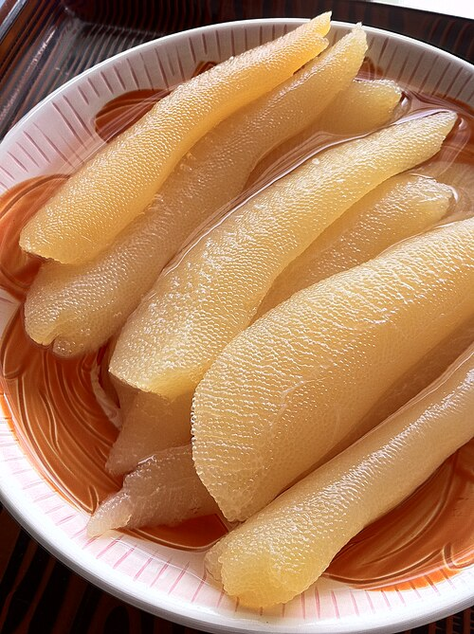
Osechi おせち料理
Another example is kazunoko 数の子 – herring roe.
Its bright yellow colour reminds people of gold, thus symbolising wealth.
It is also believed to symbolise a wish to bear many children.
© The Japan Society 2025
Notes:
Teacher’s Notes
Image from Wikimedia Commons: https://commons.wikimedia.org/wiki/File:Kazunoko_(5310618428).jpg

Slide 19
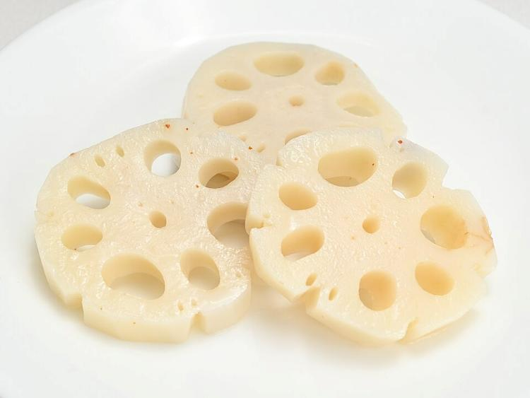
Osechi おせち料理
Lotus root – known as renkon レンコン – is also a staple of osechi.
There is a belief that looking through the holes of a lotus root will allow you to see into the future and check that everything is fine.
© The Japan Society 2025
Notes:
Teacher’s Notes
Image from Wikimedia Commons: https://commons.wikimedia.org/wiki/File:Su-basu_001.jpg

Slide 20
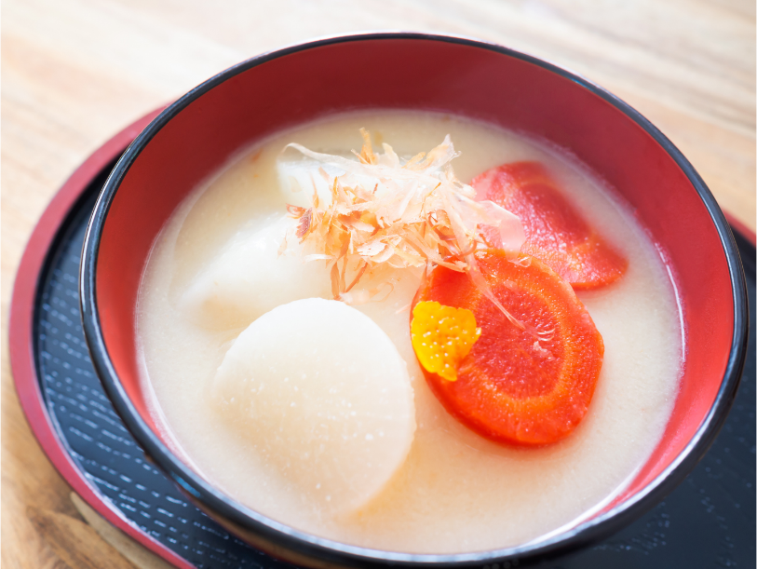
Ozoni お雑煮
A traditional Japanese soup containing mochi that is typically eaten during the New Year celebration period.
© The Japan Society 2025
Notes:
Teacher’s Notes
Ozoni often contains both mochi and vegetables. Pupils may have tried mochi before and expect that it is usually sweet, but it can also be used in savoury dishes, too.
Image: ©kaorinne via Canva.com

Slide 21
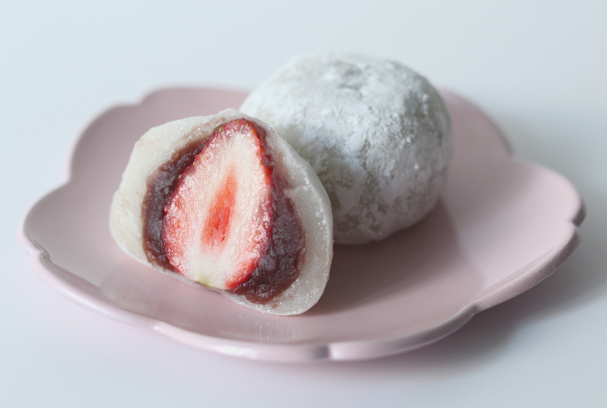
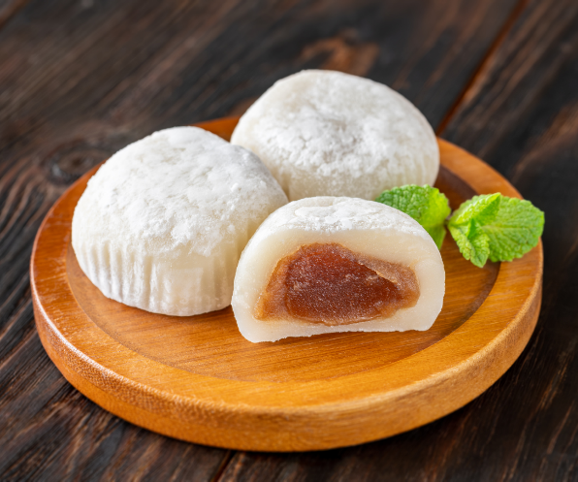
Mochi もち
Mochi are Japanese rice cakes. The rice used to make mochi is pounded into a paste before being moulded into a rounded shape.
© The Japan Society 2025
Notes:
Teacher’s Notes
There are many different types of mochi. For example, the mochi on the left is referred to as daifuku, and contains a strawberry in the middle. Mochi sometimes contains fillings, such as red bean paste.
Ask pupils if they have tried mochi before – it has become a popular snack outside of Japan, too! If they have, you could ask them to describe what it tasted like/what the texture was like – it can be quite unusual to those who have not tried it before!
Images: ©Aflo Images via Canva.com and ©Oleksandr Prokopenko via Canva.com

Slide 22
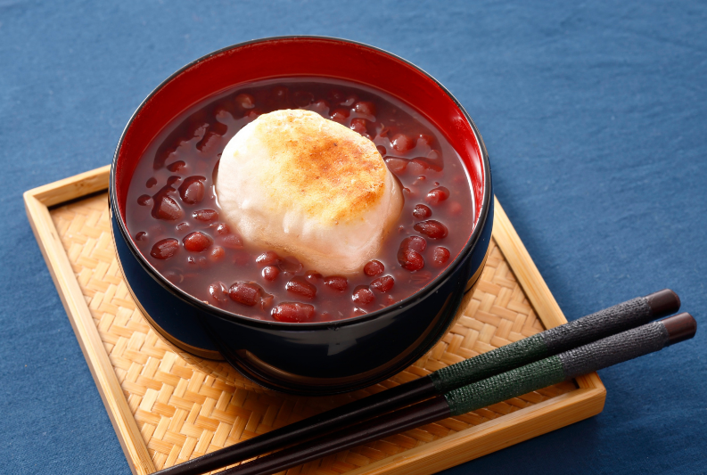
Zenzai ぜんざい
This is a traditional Japanese soup, made with sweet red beans and mochi. Zenzai is also usually eaten during the New Year’s celebrations.
© The Japan Society 2025
Notes:
Teacher’s Notes
Mochi is used in a lot of New Year’s dishes.
Red beans are known as azuki beans in Japanese.
Image: ©Aflo Images via Canva.com

Slide 23
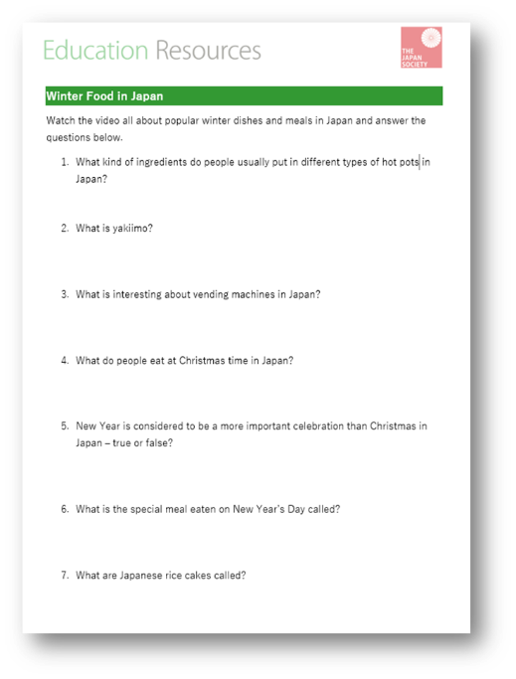

Answers
Now it’s time to check your answers!
© The Japan Society 2025
Notes:
Teacher’s Notes
Illustration from Irasutoya.

Slide 24
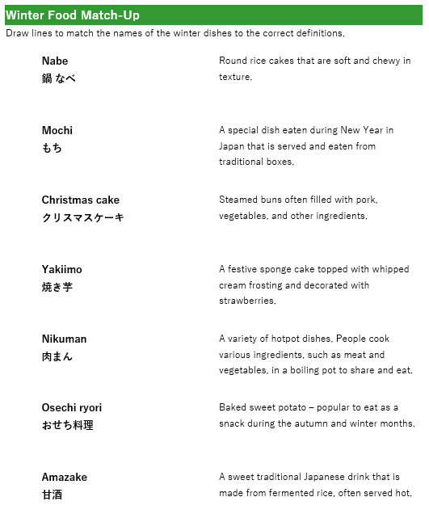

Activity 2
How much do you remember from today’s lesson?
Match the words on the activity sheet to the correct definition.
© The Japan Society 2025
Notes:
Teacher’s Notes
Ask pupils to draw lines to match the definition to the correct word.
Download the worksheet from the resource page on The Japan Society website – answers are included.
Illustration from Irasutoya.

Slide 25
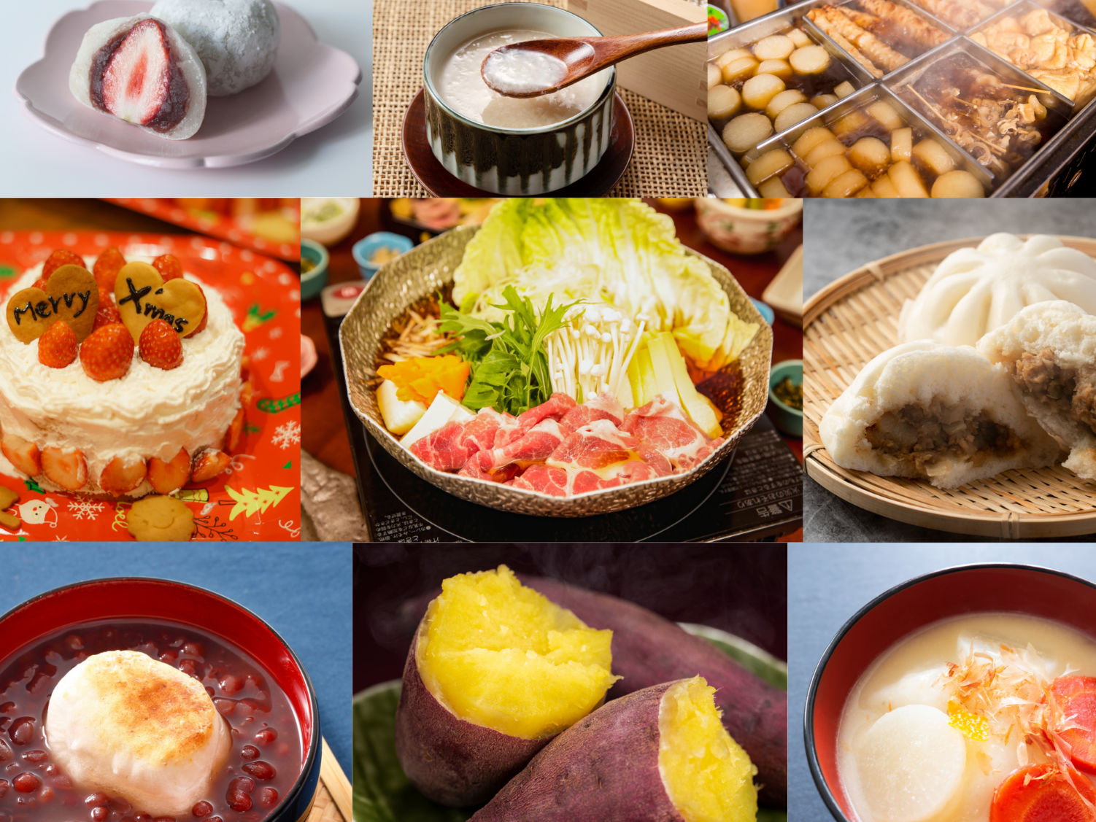
What food would you like to try?
© The Japan Society 2025
Notes:
Teacher’s Notes
What food would you like to try?
Collage of images- left to right, top to bottom:
©Aflo Images, ©masa44, ©Leung Cho Pan, ©Aflo Images, ©Aflo Images, ©Hanasaki, ©Aflo Images, ©kuppa_rock, ©kaorinne – all images via Canva.com

Slide 26


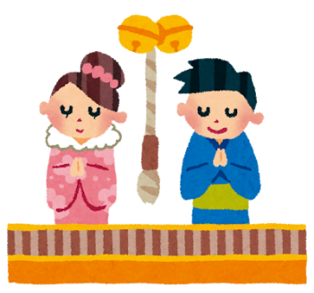
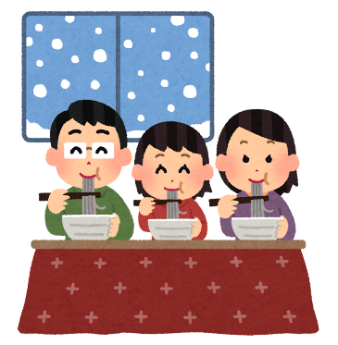


Extension Activity
Design and create a tourism poster to promote winter and winter food in Japan. Think about what kind of things a tourist might enjoy in Japan during the winter season.
© The Japan Society 2025
Notes:
Teacher’s Notes
This extension activity could be perfect to link up with other learning you may have done about winter time in Japan – i.e., New Year’s celebrations in Japan; popular activities such as winter sports, visiting winter illuminations; and so on.
Use some of the illustrations on this slide to inspire pupils with ideas for their poster.
Illustrations from Irasutoya.

Slide 27
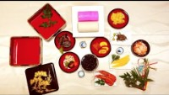
Learn more about New Year and Osechi Foods!
Visit the resource page to discover more!
© The Japan Society 2025
Notes:
Teacher’s Notes
If the above video and link are not working, you can access them both by visiting pasting this link into your browser search bar- https://www.japansociety.org.uk/resource?resource=107

Slide 28


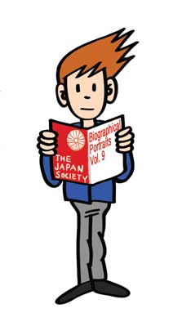




This resource was developed and created by
The Japan Society.
The Japan Society
13/14 Cornwall Terrace, London NW1 4QP
Tel: 020 7935 0475
Email: education@japansociety.org.uk
www.japansociety.org.uk
Follow us on social media:
@TheJapanSociety

