Slide 1
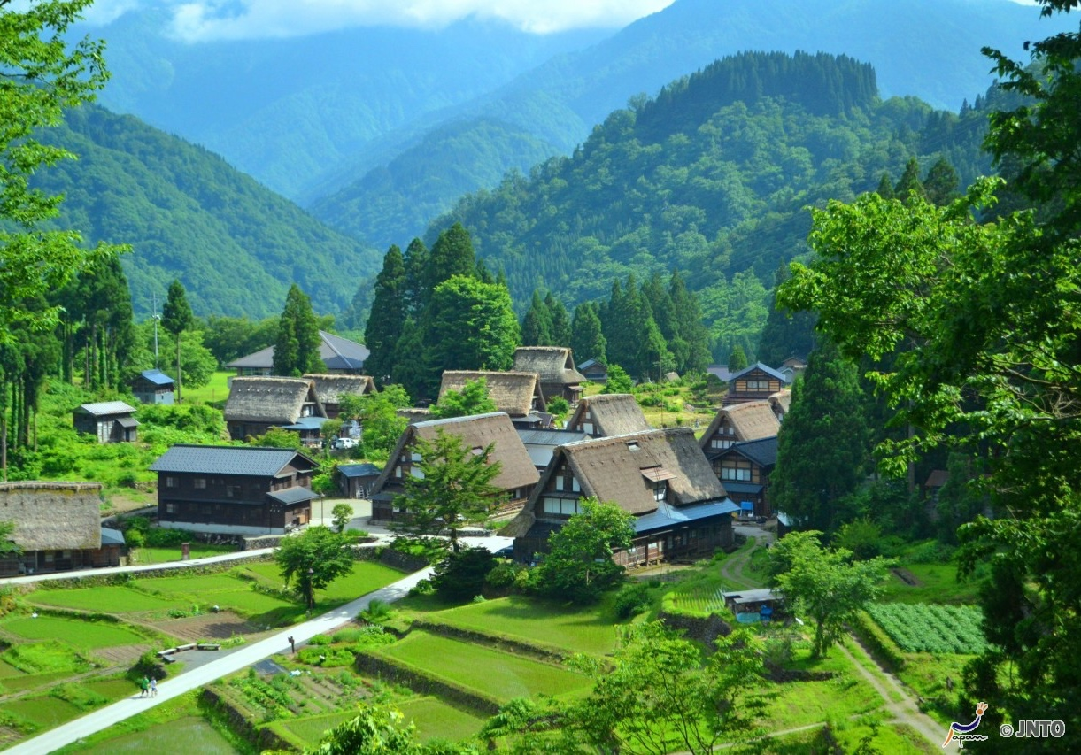
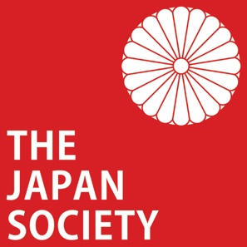
Explore the Peach Boy’s World
Notes:
Teacher’s Note
Momotaro is one of the most famous Japanese folk stories. Like many other tales, it started as an oral tradition (passed down through storytellers).
It was not until the Edo period (1603-1867) that it was written down.
It is important when teaching Kamishibai and folk stories to emphasise that the stories contain places, objects and themes from the past. You can use this as an interesting talking point to look at how lifestyles and customs change over time.

Slide 2
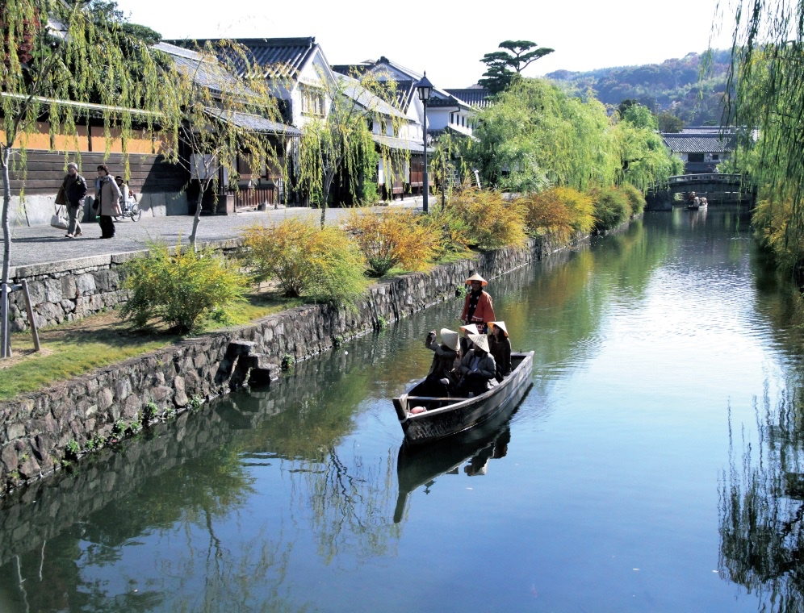
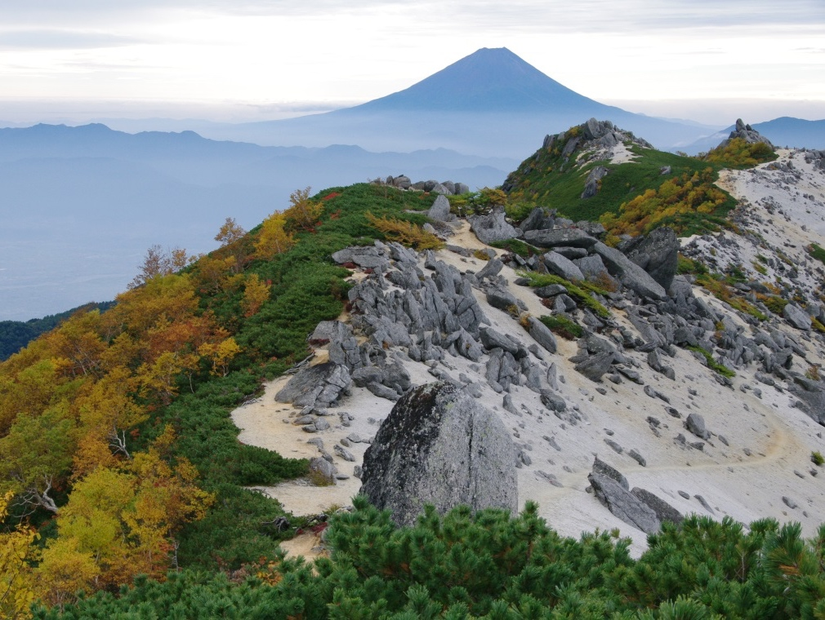
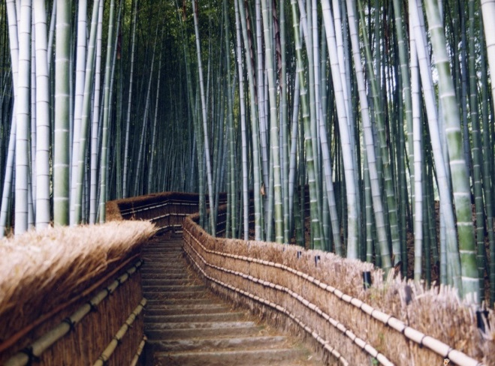
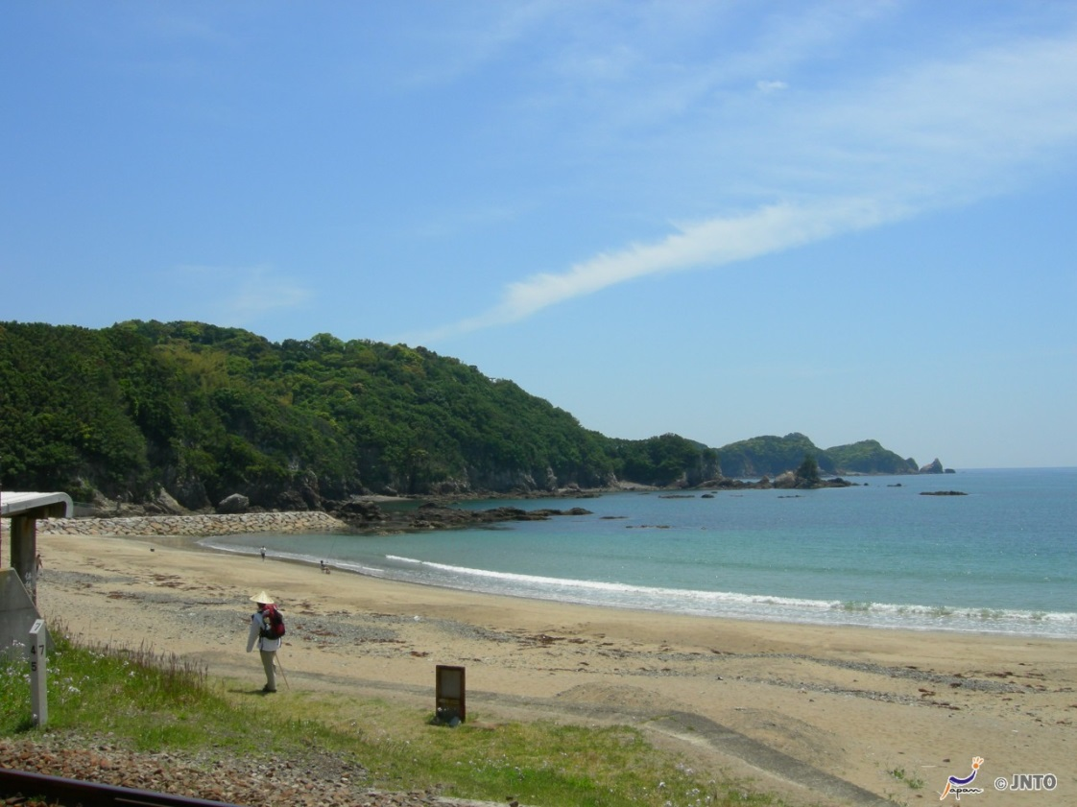
Rivers
Mountains
©JTA/ ©JNTO
Landscape
©Yasufumi Nishi/©JNTO
©JTA/ ©JNTO
Forests
©Akira Okada/©JNTO
Sea
©Yasufumi Nishi/© JNTO
Notes:
Tell students a little about each image, as much as you feel is appropriate.
Image top left [Kurashiki River Boat Riding] was taken in Kurashiki City, Okayama prefecture. In Kurashiki ,today you can still enjoy a traditional boat ride while enjoying the sites of the historical district. You can watch a video on this link (http://www.mustlovejapan.com/subject/kurashiki_river_boat_riding/)
Image top right [Mt. Fuji] is a view of Japan’s famous iconic mountain/active volcano, and UNESCO World Heritage Site, Mt. Fuji. This image was taken from the top of Mt. Yakushi-dake in Yamanashi prefecture. You can check into Mt. Fuji’s live web camera: http://www.fujisan-climb.jp/en/todays/livecamera.html
Image bottom left [Sagano] is of the famous bamboo forest in Kyoto. Bamboo is an important and iconic traditional plant in Japan. But, forests of bamboo are rarely now seen close to urban areas. However, in Kyoto there is an historical district called Arashiyama which is a popular tourist destination where people can experience the Sagano Bamboo forest.
Image bottom right [Seashore] was taken in Tainohama Minami town in Tokushima prefecture. This is located on Shikoku island, the smallest and least populated of Japan’s 4 islands where you can experience a rich, traditional culture. One of the most famous things on Shikoku is the 88 Temple Pilgrimage – a 1200km loop of the island. On this image, you can see a pilgrim (henro) dressed in traditional clothing.

Slide 3
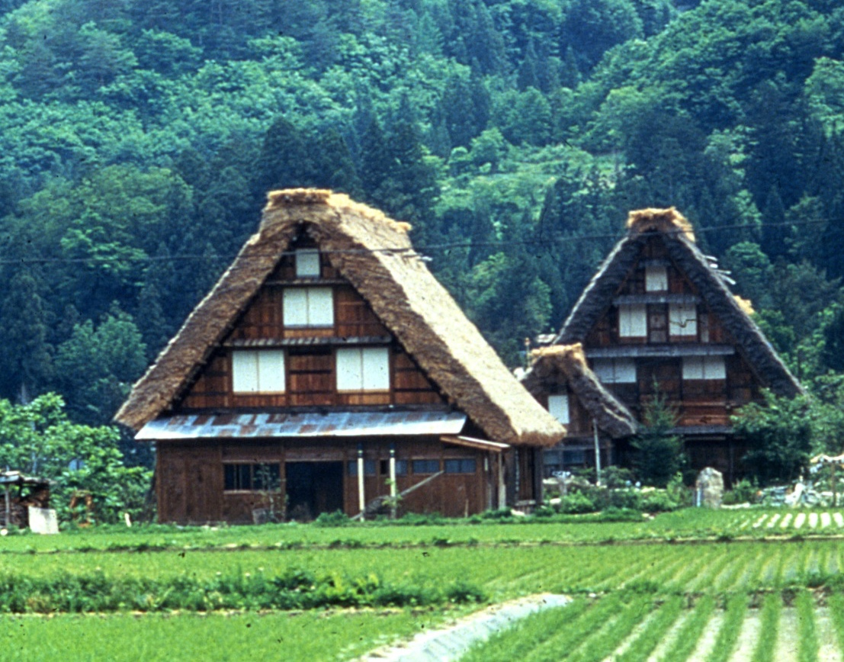
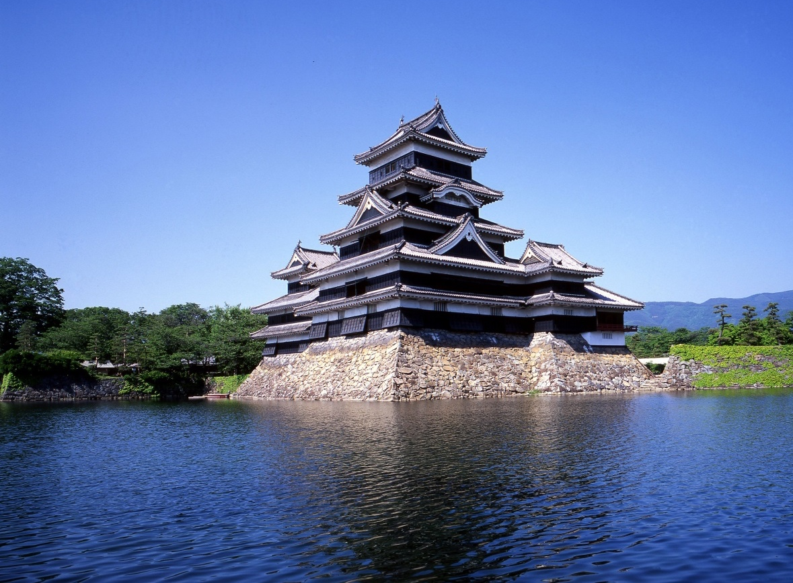
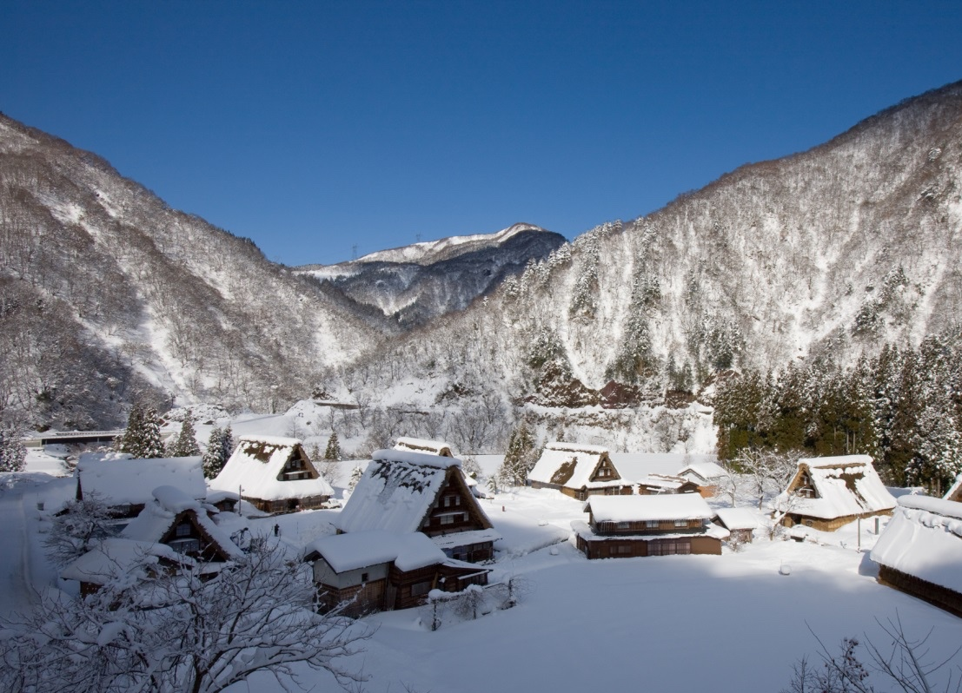
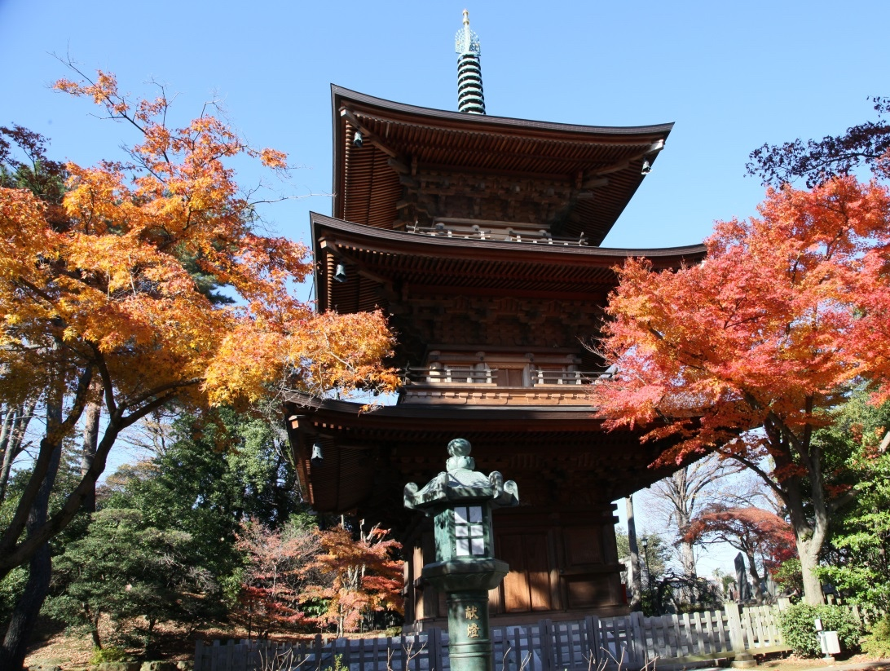
©JNTO
©Matsumoto city/©JNTO
Farmhouses
Traditional Buildings
Castles
©Toyama Prefectural Tourism Association/©JNTO
©Yasufumi Nishi/©JNTO
Villages
Temples
Notes:
Tell students a little about each image, as much as you feel is appropriate.
Top Left: A pair of traditional Gassho-Zukuri farmhouses located in the Shirakawa-go region. Along with its neighbour Gokayama (shown image bottom left) this region is a popular tourist destination.
Top Right: Matsumoto Castle is known as Crow Castle because of its black walls and spread out roofs that look like wings. The original building was completed around 1595 during the Sengoku period. Many castles in Japan rarely survive in their original form because of damage by earthquakes and fires; so Matsumoto is one of the few castles that maintains its original wooden interior and stonework.
Bottom Left: Gokayama village is the neighbouring village to Shirakawa-go, with the traditional farmhouses having a very similar appearance.
Bottom Right: Gotokuji Temple is said to be the birthplace of the Maneki-neko (‘Beckoning Cat’), which are today popular figurines that are used as good luck charms. The legend states that the cat was owned by a priest and it led the lord of the land to safety during a thunderstorm by using its trademark beckoning wave, and as thanks, the lord rewarded the cat’s master, the priest, with rice, land and Gotokuji Temple.

Slide 4
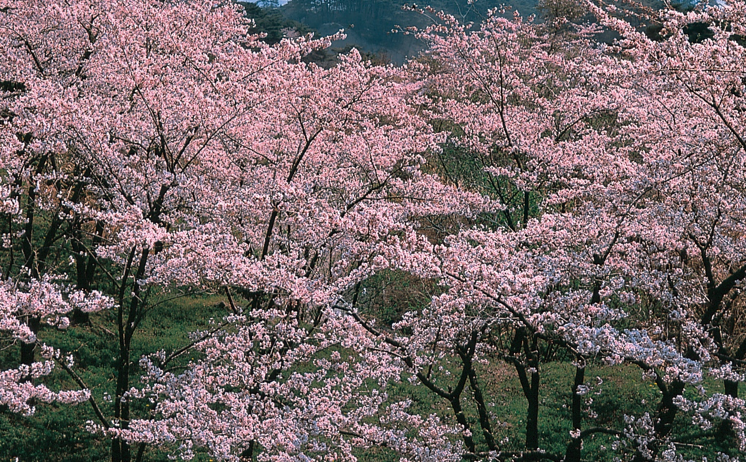
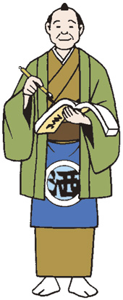
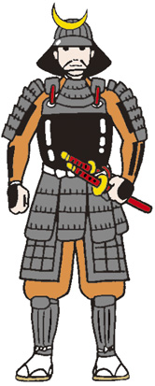
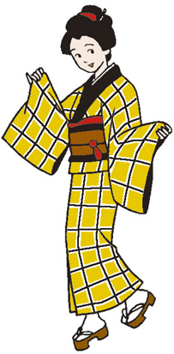
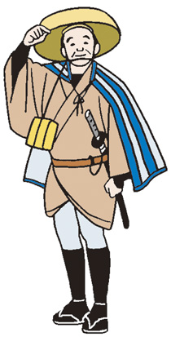
Men’s
Clothes
Samurai
warrior
Traditional
Clothing
Traveller
Women’s
Clothes
Miyagi Prefecture/©JNTO
Notes:
Tell students a little about each image, as much as you feel is appropriate.
Top Left: Men’s traditional kimono. These usually have colours such as black, grey, brown and dark blue. Traditionally men would wear Tabi (split toe socks, Zori (straw sandals) or Geta (wooden clogs) on their feet and a half-coat called a haori or montsuki. This often had the family crest on it.
Bottom Left: Women’s traditional kimono. These are different to men’s as they usually have bright colours and elegant designs. Women’s kimono were traditionally made of cotton or silk, and they wore the same footwear as men. While kimono for men and women used to be the every day dress for Japanese people in the past, men and women today in Japan only wear kimono on formal occasions, such as weddings; but it is more common for women to wear kimono for other special celebrations.
Top Right: Samurai armour is highly intricate with many parts:
Kabuto – helmet; Dou – the chest plate, often adorned with pendants and symbols; Kusazuri – steel and leather plates hanging from the Dou to protect the upper legs and lower body; Sode – shoulder plates; Kote – armoured sleeves from the shoulder to the Kote gauntlets; Mengu – face mask/armour made of leather that attaches the Kabuto to the rest of the armour to secure it in place and provide facial protection; Yodare-kake – throat guards; Haidate – thin waistguard; Suneate – shin guards made of iron splints.
This is all held together by the kusari which is iron chain armour sewn into cloth worn underneath.
Bottom Right: Someone going on a journey might wear: a sugegasa - a type of traditional hat or made from weaving bamboo peel (take no kawa) or another type of plant to provide shade from the sun (and protection from the rain); waraji – straw sandals worn by everyday people and also samurai when making long journeys on foot; kyahan – leggings to protect the lower legs from the cold, insects or bushes; furiwake nimotsu – luggage divided it into 2 parcels and carried over the shoulder – one at the front of the body and one resting on the back; kogatana – a small sword.

Slide 5
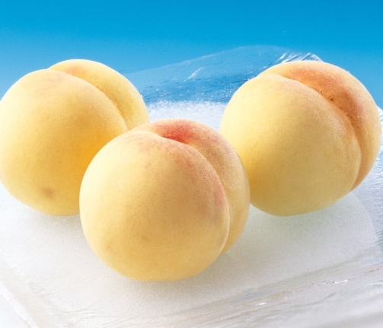
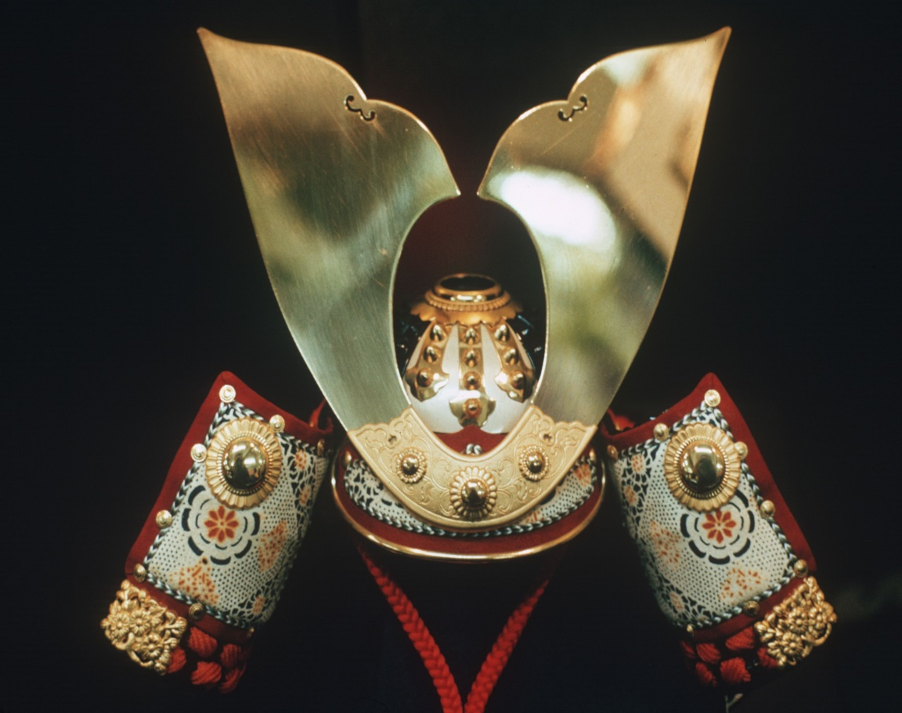
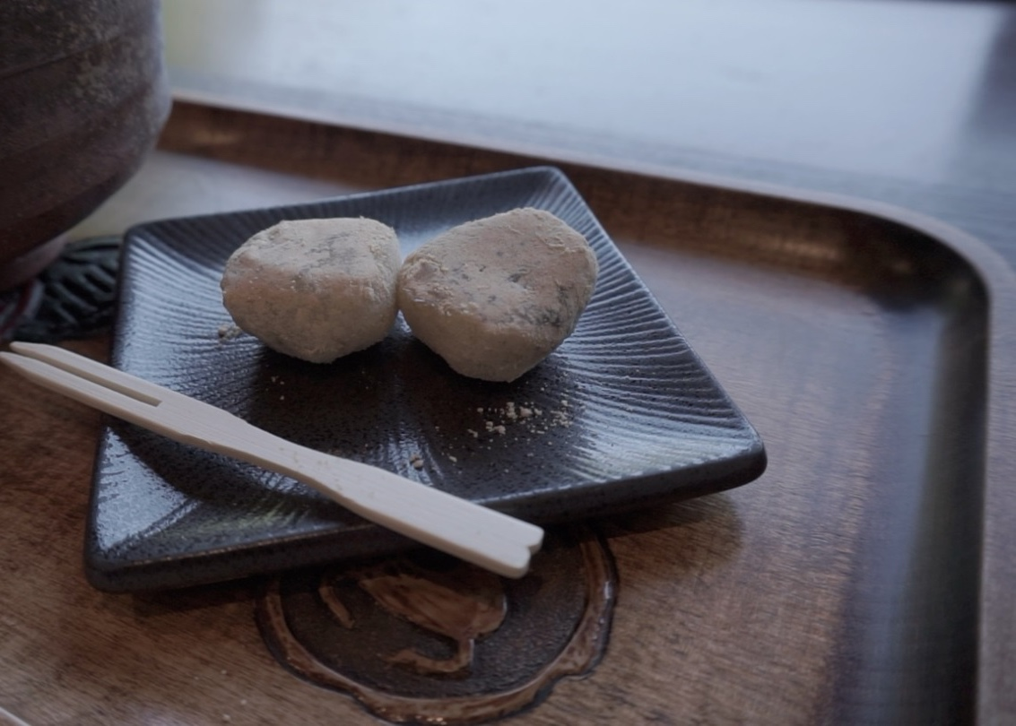

©Okayama-ken Kanko Renmei/©JNTO
© JNTO
Peach
Armour
Objects
© Victoria and Albert Museum, London
©Japan Society
Sword
Kibi Dango
Notes:
Tell students a little about each image, as much as you feel is appropriate.
Top Left: The Japanese peach “Momo” is where “Momotaro” (The Peach Boy) gets his name. They are a popular summer fruit in Japan, have a whiteish colour, and are much larger than peaches in the UK.
Top Right: A highly decorative samurai Kabuto (helmet). These date back to the 5th century and were worn by samurai warriors both for combat and tradition.
Bottom Right: Modern Kibi Dango are a little different from the Kibi Dango eaten by Momotaro, but they are still popular in Japan as a sweet snack. They are made mainly from rice flour and sugar and are available in many different flavours, especially in Okayama where the story of Momotaro originates. They have a soft, chewy texture similar to a marshmallow.
Bottom Left: A Samurai (Japanese warrior) would have carried two swords: a katana and a wakizashi, which was shorter. The pair was called daishō which means ‘large-small’. As well as being a weapon, they were symbols of authority and were also appreciated as beautiful objects. Japanese swords are said to be ‘the soul of the Samurai’.

Slide 6




This resource was developed by the Japan Society in collaboration with Fergus McNicol.
The Japan Society
13/14 Cornwall Terrace, London NW1 4QP
Tel: 020 7935 0475
Email: education@japansociety.org.uk
www.japansociety.org.uk
Follow us on:
@japansocietylon
@JapanSocietyLondon

