Slide 1


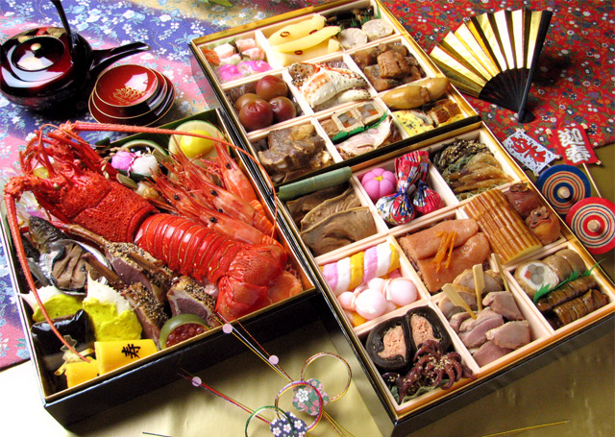
Japanese
New Year
Notes:
Ask the students what they can see in the picture.
What do they think this might be?

Slide 2
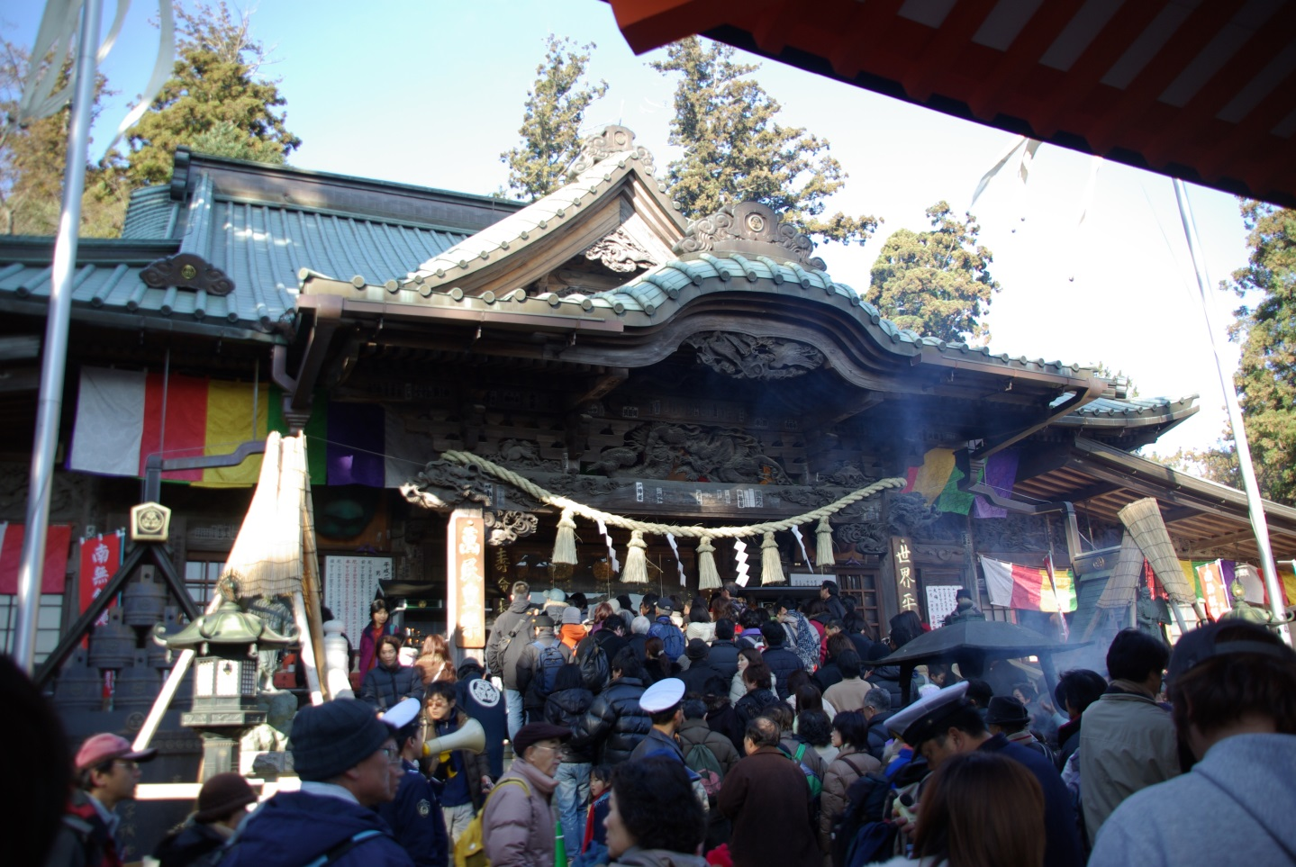
©Yasufumi Nishi/JNTO
New Year is the biggest celebration in Japan.
The celebration is called Oshogatsu.
Notes:
Teacher’s Note
Tell students that Oshogatsu happens between the 1st to the 5th of January.

Slide 3
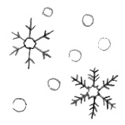


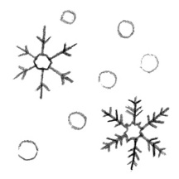


Task 1
Your teacher will introduce different aspects of Japanese New Year.
As you hear about Japanese New Year Celebrations, match the picture cards to the word cards.
Extra Challenge: Match the hiragana words too by using a hiragana chart to help.

Slide 4
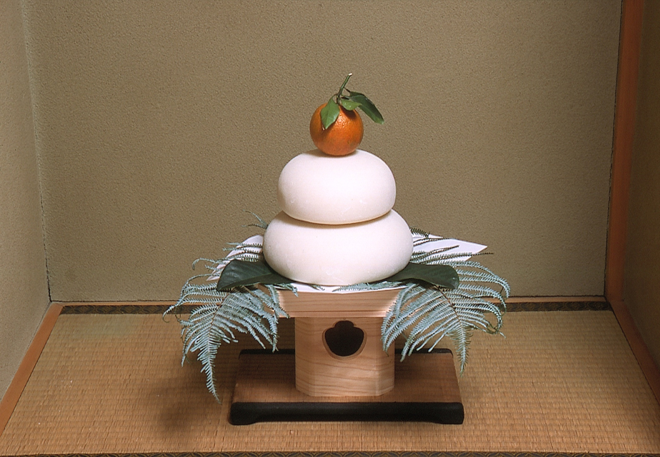
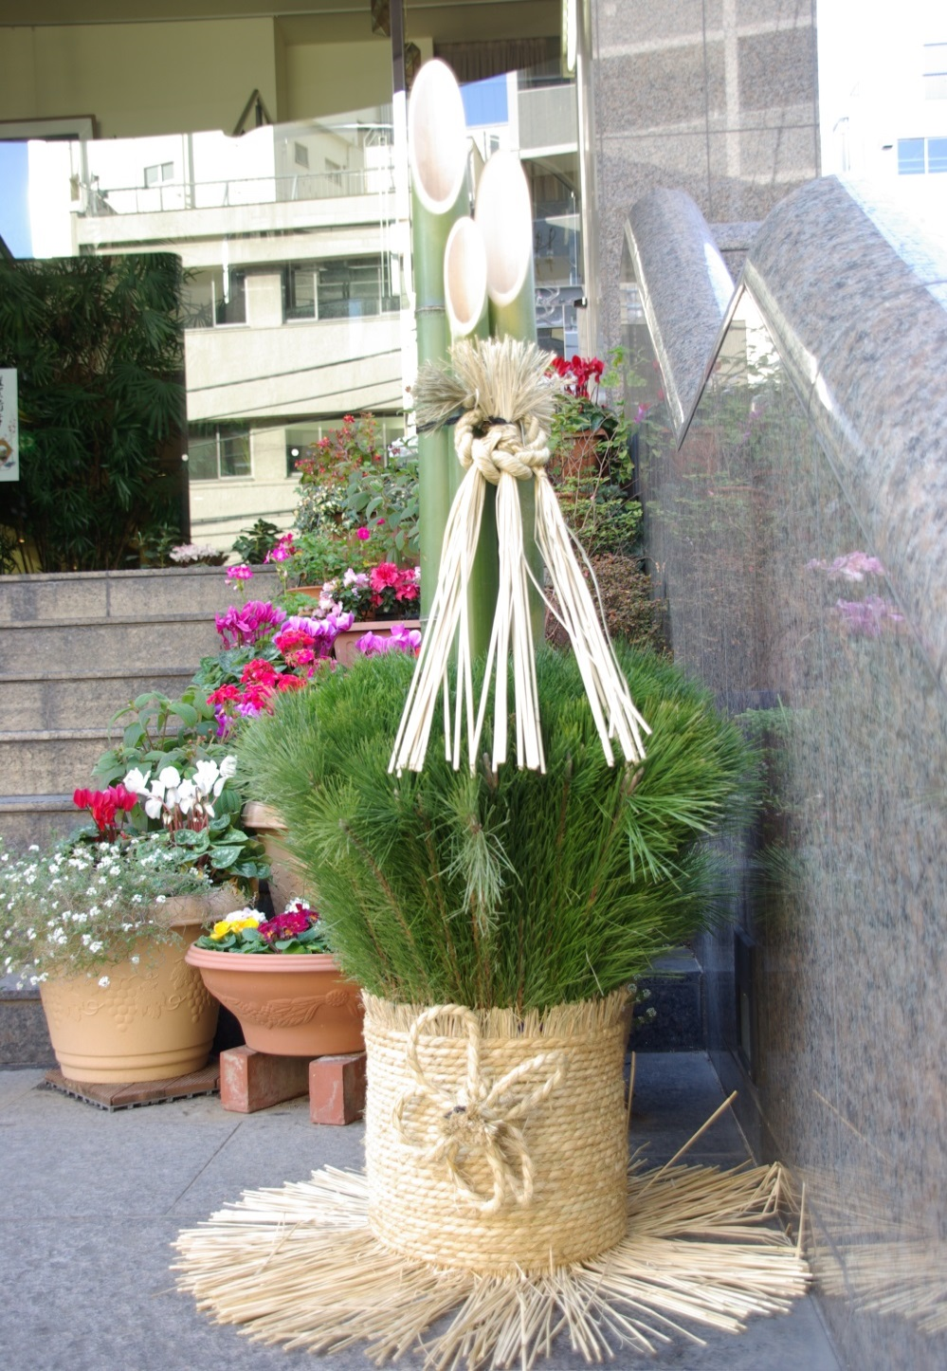
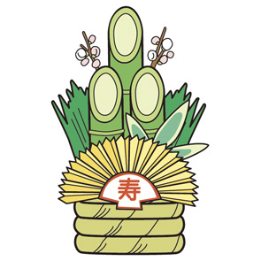

Decorations
Japanese people decorate their homes with traditional decorations called kazari
Kadomatsu
かどまつ
kagamimochi
かがみもち
©JNTO
©Yasufumi Nishi/JNTO
Notes:
Kadomatsu is made of bamboo and pine
Kagamimochi is made of rice cake with an orange on top
Refer to Teacher’s background notes for information on Kadomatsu and Kagamimochi

Slide 5
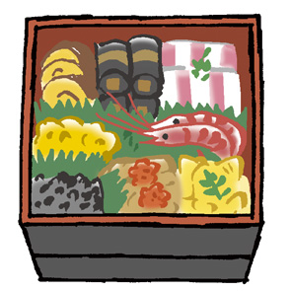
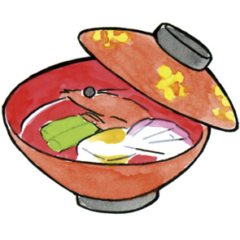
Food
Japanese families eat special food together at New Year.
Osechi ryori
おせちりょうり
Ozoni
おぞうに
Notes:
Tell Students
Osechi is colourful food presented in boxes. Each food has a special meaning.
Ozoni is a special soup eaten in the morning, which includes mochi – Japanese rice cake, which is very gloopy!
Japanese Food at New Year’s - http://a2-2.marugotoweb.jp/ja/life-and-culture/

Slide 6
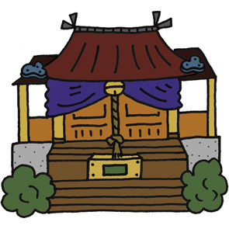
Rituals
Shinto and Buddhism are the two main religions of Japan.
As many Japanese people are Buddhist or Shinto, people may visit a temple or a shrine around New Year’s.
This is called
hatsumode
はつもうで
Notes:
Shinto is a religion originating from Japan, and has existed for as long as Japan has itself. Shinto literally means “the way of the gods”.
‘Hatsu’ means first, so Hatsumode is ‘the first visit’ of the year.
See this Japan Foundation Marugoto website for video on how Japanese people spend New Years Day
Topic 5: Oshogatsu: http://a2-2.marugotoweb.jp/ja/life-and-culture/

Slide 7
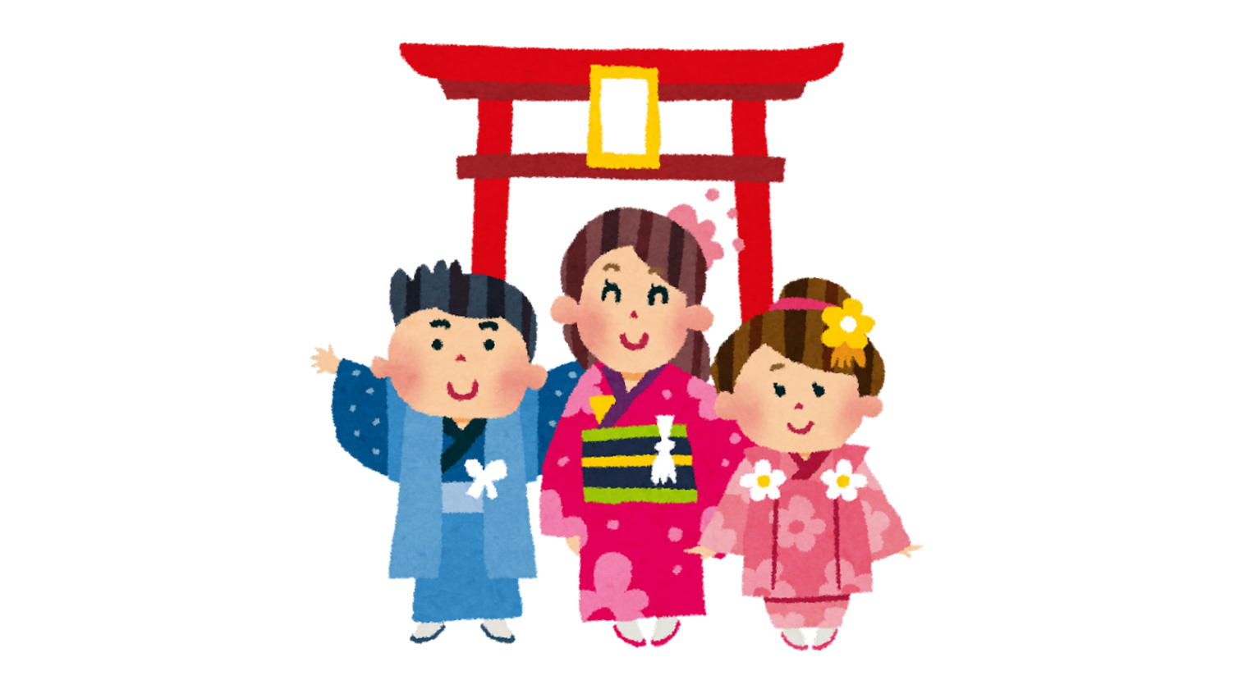
Rituals
Some people wear traditional Japanese clothing when they visit the temple or shrine.
This is called a
kimono きもの
Notes:
Kimono is the national dress of Japan.
Both men and women wear kimono!
Image from Canva.

Slide 8
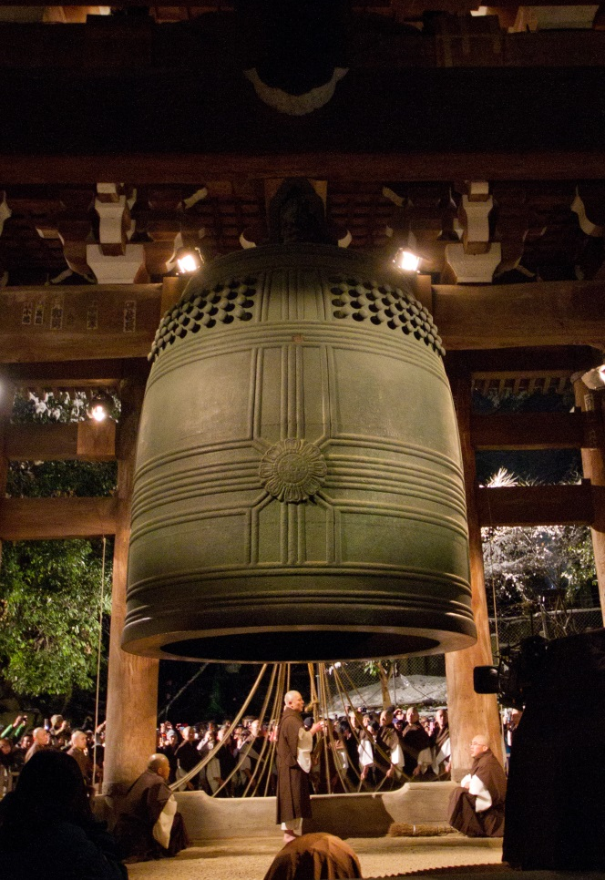
Rituals
© Fumihiko Ueno /CC BY 3.0
There is a bell-ringing ceremony at temples on New Years Eve.
It’s called
Joya no Kane
じょやのかね
The bells are rung 108 times to represent the worries of the past year being forgotten. The final chime is at midnight.
Notes:
The Joya no Kane takes place in Buddhist temples.
There is a Buddhist belief that humans are plagued by 108 desires which cause human suffering – each bell ring purifies one of the desires.
Some bells are so large that it takes a team of monks to ring them.
The bell ringing is normally performed Buddhist monks at the temple, but some places allow the public to take part.
You can try a virtual bell ringing from: https://plicy.net/GamePlay/87786

Slide 9

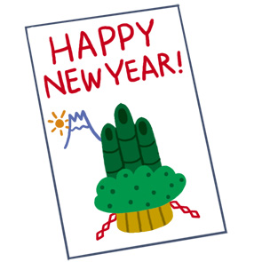
Customs
Japanese people send
special postcards at New Year.
They are called nengajo
ねんがじょう
Adults give money to the children in the family at New Year. The money is put into pretty envelopes.
This is called otoshidama
おとしだま
Notes:
Otoshidama image: https://www.irasutoya.com/2012/04/blog-post_05.html

Slide 10
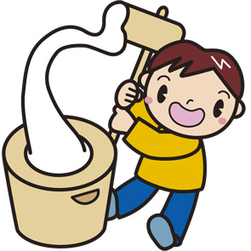
Activities
A popular traditional activity at New Years
is called mochitsuki もちつき
This is the traditional way of making the sticky rice cakes, called ‘mochi’.
It involves pounding steamed rice with a wooden hammer in a special mortar (bowl) until it has a firm, sticky and creamy texture.
Notes:
Show students a short clip of mochi being made:
https://www.youtube.com/watch?v=5AZ-R3VondI

Slide 11
Task 2
In your speech bubble, write things you remember about Japanese New Year. Stick it on the board for your teacher to discuss with the class,
or use them to decorate your classroom.
What do Japanese people do at
New Year?
What do Japanese people eat at
New Year?
What do Japanese people write at
New Year?
Where do Japanese people go at
New Year?

Slide 12
Extension Activity
Food | Decorations | Rituals | Customs | Activities
mochitsuki
hatsumode
kadomatsu
nengajo
otoshidama
kagamimochi
ozoni
osechiryori
joya no kane
Notes:
Pupils should match each word to the corresponding category. Get them to discuss either in pairs or small groups at first, and feedback as a whole class. Ask pupils if they remember what each word means too!
Use the animations on the PowerPoint slides to check your answers.

Slide 13

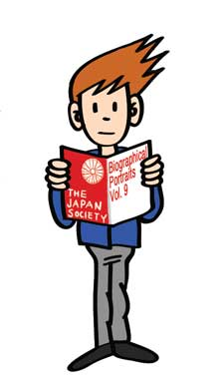


This resource was developed by the Japan Society in collaboration with Katy Simpson.
The Japan Society
13/14 Cornwall Terrace, London NW1 4QP
Tel: 020 7935 0475
Email: education@japansociety.org.uk
www.japansociety.org.uk
Follow us on:
@japansocietylon
@JapanSocietyLondon
©The Japan Society with Katy Simpson

